Slide 1
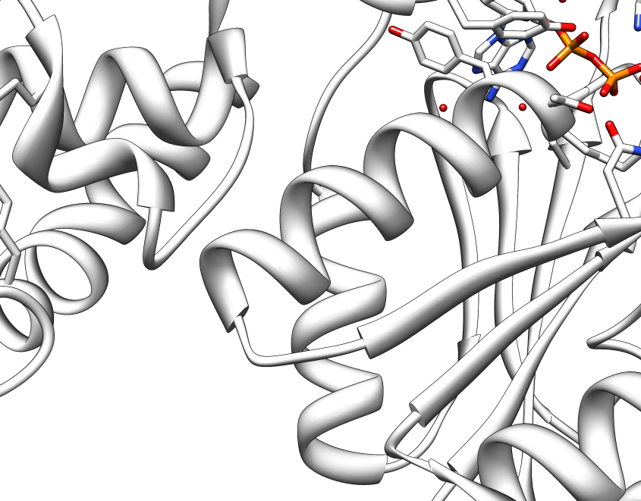
Epidrug development targeting human G9a H3K9
Yong-Hwan Lee
Louisiana State University & NuPotential
Shinkai and Tachibana, Genes&Dev. 2011

Slide 2
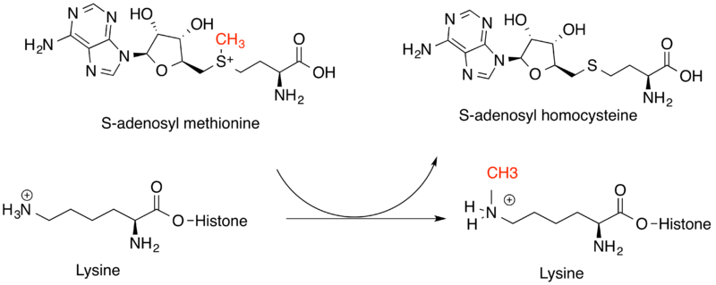
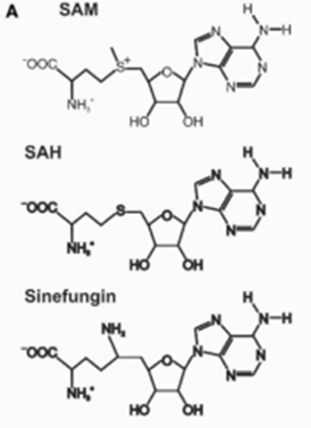
G9a H3K9: Histone3 Lys9 Methyltransferase

Slide 3
Relevance of G9a to tumorigenesis
Tumorigenesis
H3K9me2
K9
G9a activation
G9a activation
H3K9me1
H3K9me3
Normal
Activation of Serine-Glycine
Synthesis Pathway
Repression of Tumor
Suppressor gene
H3K9 me1-
G9a inhibitors
H3K9 me2/3-
G9a inhibitors
Autophage
Tumor suppressor gene
Activation & Apoptosis
Inhibition of Cancer cell Proliferation
&
Survival

Slide 4
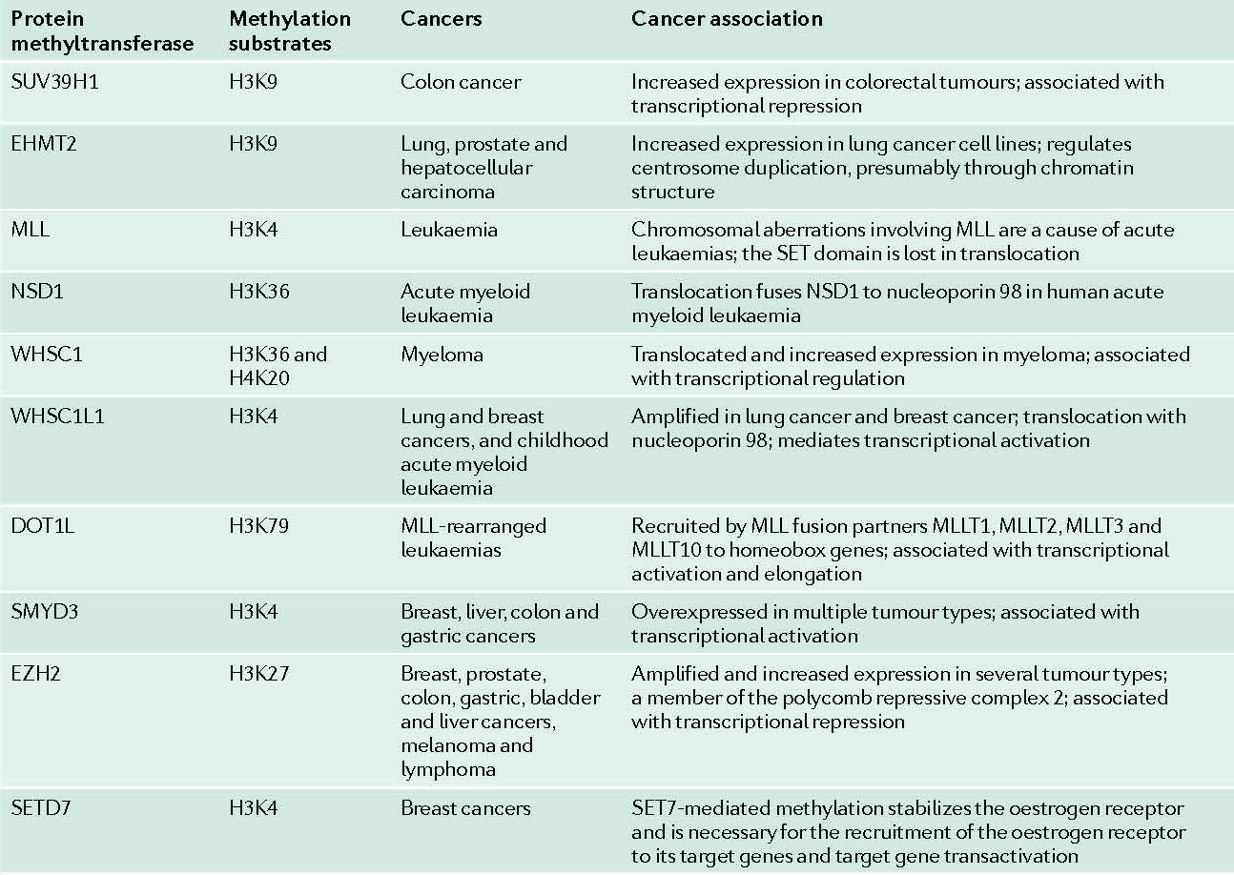
Selected PKMT showing an association with human cancers
/G9a
/G9a
Copeland et al. Nat. Rev. Drug Discovery, 2009

Slide 5
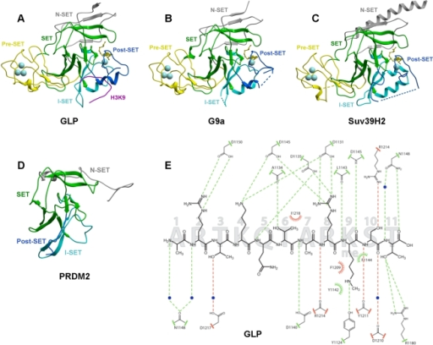
Isoforms of G9a
Wu H, Min J, Lunin VV, Antoshenko T, Dombrovski L, Zeng H, Allali-Hassani A, Campagna-Slater V, Vedadi M, Arrowsmith CH, Plotnikov AN, Schapira M - PLoS ONE (2010)

Slide 6

Scheme of Virtual screening
~ 18 Million 2D library
~ 1.6 Million 3D library
1
2
3
4
Commercially
Available Compounds
Standard-ization
3D Structure Generation
Tautomer Enumeration
Conformer Enumeration
Leadlike Compound Subset
Database Preparation
2D Similarity Search
Top 200 Hits
Structure Based Docking
Top 17,000 Hits
3D Similarity Search
Query = SAM
Query = SFG
2nd round similarity search
with the compounds having
enzyme inhibition activity
Vendor Query with Top 50 hit compounds
SAH for G9a
Functional Screening using ELISA
Functional Screening in Cancer cells
Chemical Modification
NCI-60 Human Tumor Cell Line Screen
& In Vivo Test
Anticancer Effect Analyses
Confidential : Do Not Copy or Distribute

Slide 7
HiTS from Virtual screening
Ranking | ZINC ID | MW | NAME | NCI compounds
1 | ZINC29786412 | 267.241 | gamma-L-Glutamyl-4-nitroanilide
2 | ZINC01635650 | 270.31 | 2-amino-3-{[2-(4-nitrophenyl)ethyl]sulfanyl}propanoic acid | NSC163413
3 | ZINC16899833 | 338.385 | (2S)-2-amino-3-[(3S)-1-(4-ethoxyphenyl)-2,5-dioxo-pyrrolidin-3-yl]sulfanyl-propanoic
4 | ZINC16899497 | 337.333 | 4-[(3S)-3-[(2S)-2-amino-3-hydroxy-3-oxo-propyl]sulfanyl-2,5-dioxo-pyrrolidin-1-yl]benzoic
5 | ZINC04188103 | 297.271 | 2-(6-aminopurin-9-yl)-6-(hydroxymethyl)tetrahydropyran-3,4,5-triol
6 | ZINC58382275 | 323.397 | (Z)-5-(1,3-benzothiazol-2-yl)-6-(3-pyridyl)hex-5-enoic
7 | ZINC27525910 | 284.293 | (2R)-2-amino-3-[2-(4-nitrophenyl)-2-oxo-ethyl]sulfanyl-propanoic
8 | ZINC01708082 | 335.32 | acetic-acid-[(2R,3S,5R)-3-acetoxy-5-adenin-9-yl-tetrahydrofuran-2-yl]methyl-ester | NSC76760
9 | ZINC06719206 | 292.36 | 2-amino-3-[(8-methoxy-2-methyl-4-quinolyl)sulfanyl]propanoic
10 | ZINC15657781 | 325.325 | 2'-O-(2-Methoxyethyl)adenosine
11 | ZINC19720210 | 312.322 | (2R)-2-amino-3-[(3S)-1-(4-fluorophenyl)-2,5-dioxo-pyrrolidin-3-yl]sulfanyl-propanoic
12 | ZINC22062133 | 289.289 | Methimazole Thio-?-D-glucuronide
13 | ZINC49453260 | 328.412 | 1-{[2-(3,4-dimethylphenyl)-5-methyl-1,3-oxazol-4-yl]methyl}piperidine-3-carboxylic acid
14 | ZINC49453252 | 334.803 | 1-{[2-(4-chlorophenyl)-5-methyl-1,3-oxazol-4-yl]methyl}piperidine-3-carboxylic acid
15 | ZINC41689143 | 265.696 | {[5-(2-Chloro-phenyl)-furan-2-ylmethyl]-amino}-acetic acid
16 | ZINC02675146 | 287.273 | 4-{[(4-nitrophenyl)sulfonyl]amino}butanoic acid
17 | ZINC42379800 | 271.318 | 4-[(4-aminophenyl)sulfonyl-methyl-amino]butanoic
18 | ZINC03999369 | 323.309 | 6-(6-amino-9H-purin-9-yl)-2-ethoxytetrahydrofuro[3,4-d][1,3]dioxol-4-yl]methanol
19 | ZINC01569549 | 262.293 | 7-adenin-9-ylenanthate | NSC88907
20 | ZINC04514042 | 370.391 | 2-amino-3-[[5-(6-aminopurin-9-yl)-3,4-dihydroxy-tetrahydrofuran-2-yl]methylsulfanyl]propanoic
21 | ZINC32917705 | 313.311 | N-[(6-methyl-3-oxo-3,4-dihydro-2H-1,4-benzoxazin-7-yl)sulfonyl]alanine
22 | ZINC01205282 | 295.255 | methyl 5-(6-amino-9H-purin-9-yl)-3,4-dihydroxytetrahydro-2-furancarboxylate (non-preferred name)
23 | ZINC05234530 | 299.284 | 4-[(2-oxo-3H-benzooxazol-6-yl)sulfonylamino]butanoic
24 | ZINC05549707 | 267.313 | 1-(6-aminopurin-9-yl)-3-(2-hydroxyethyl-methyl-amino)-propan-2-ol | NSC371362
25 | ZINC19142033 | 320.29 | 9-(3-nitrophenyl)sulfonylpurin-6-amine
26 | ZINC01732835 | 261.257 | 6-{5,7-dioxo-5H,6H,7H-pyrrolo[3,4-b]pyridin-6-yl}hexanoic acid
27 | ZINC04627954 | 266.266 | 3-[(6-amino-7H-purin-8-yl)azosulfanyl]propanoic | NSC51459
28 | ZINC19720197 | 342.804 | (2R)-2-amino-3-[(3S)-1-(3-chloro-4-methyl-phenyl)-2,5-dioxo-pyrrolidin-3-yl]sulfanyl-propanoic
29 | ZINC09420897 | 280.324 | 2-amino-3-[(6-fluoro-2-methyl-4-quinolyl)sulfanyl]propanoic
30 | ZINC10474284 | 314.407 | 2-amino-3-[1-(cyclohexylmethyl)-2,5-dioxo-pyrrolidin-3-yl]sulfanyl-propanoic
31 | ZINC16958662 | 297.271 | (2R,3R,4R,5S)-2-(6-aminopurin-9-yl)-5-[(1S)-1,2-dihydroxyethyl]tetrahydrofuran-3,4-diol | NSC670001
32 | ZINC40546444 | 312.283 | (3-Methyl-2,4-dioxo-1,2,3,4-tetrahydro-quinazoline-6-sulfonylamino)-acetic acid
33 | ZINC02169568 | 280.216 | 4-Nitrobenzoylglycylglycine
34 | ZINC04513827 | 366.31 | 4-[[5-(6-aminopurin-9-yl)-3,4-dihydroxy-tetrahydrofuran-2-yl]methoxy]-4-oxo-butanoic
35 | ZINC32917690 | 299.284 | N-[(6-methyl-3-oxo-3,4-dihydro-2H-1,4-benzoxazin-7-yl)sulfonyl]glycine
36 | ZINC01681686 | 265.229 | (2S)-2-[(1R)-1-adenin-9-yl-2-keto-ethoxy]-3-hydroxy-propionaldehyde(Adenosine-2′,3′-dialdehyde)
37 | ZINC58332159 | 264.31 | 5-([1,2,4]triazolo[4,3-a]pyridin-3-ylsulfonyl)pentanenitrile
38 | ZINC13547652 | 309.282 | [(2R,3R,4R,5R)-5-(6-aminopurin-9-yl)-3,4-dihydroxy-tetrahydrofuran-2-yl]methyl
39 | ZINC54448642 | 326.36 | N-[(1R)-1-(2,3-dihydro-1,4-benzodioxin-6-yl)-2-methyl-propyl]tetrazolo[5,1-f]pyridazin-6-amine
40 | ZINC55284374 | 263.272 | {[5-(4-fluorophenyl)-1H-pyrazol-4-yl]methyl}(methyl)amino]acetic acid
41 | ZINC41689200 | 245.278 | 3-[(5-Phenyl-furan-2-ylmethyl)-amino]-propionic acid
42 | ZINC13548142 | 252.23 | Nebularine | NSC 65423
43 | ZINC01517335 | 330.747 | 4-[2-(4-chlorobenzoyl)anilino]-4-keto-butyrate
44 | ZINC06691827 | 300.38 | 2-amino-3-(1-cyclohexyl-2,5-dioxo-pyrrolidin-3-yl)sulfanyl-propanoic
45 | ZINC09115078 | 336.359 | N-[(4-methoxyphenyl)-(1-methylimidazol-2-yl)-methyl]-5,6,7,8,9-pentazabicyclo[4.3.0]nona-2,4,7,9-tet
46 | ZINC32917656 | 318.714 | 3-[(6-chloro-3-oxo-3,4-dihydro-2H-1,4-benzoxazin-7-yl)sulfonyl]propanoic acid
47 | ZINC13424933 | 345.208 | [(2S,3S,4R,5R)-2-(6-aminopurin-9-yl)-4-hydroxy-5-(hydroxymethyl)tetrahydrofuran-3-yl]
Confidential : Do Not Copy or Distribute

Slide 8
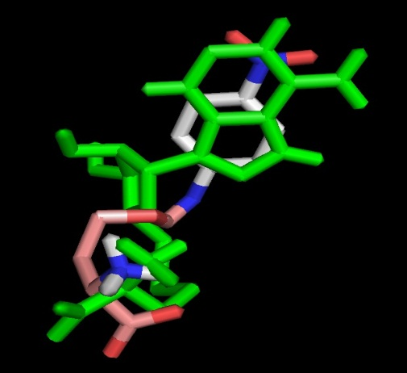
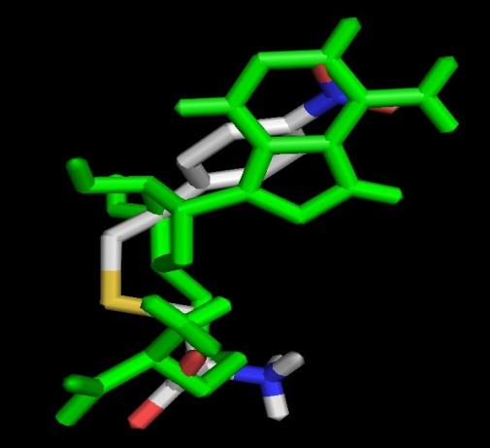
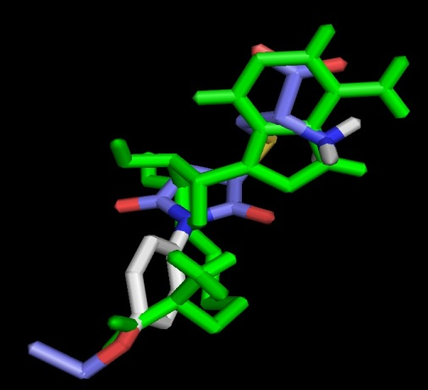
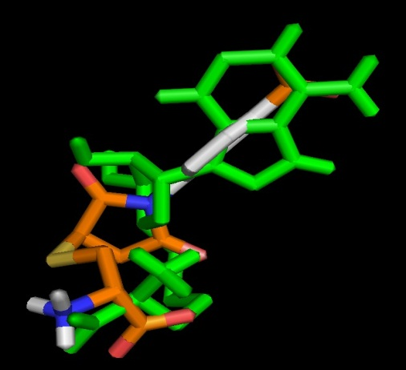
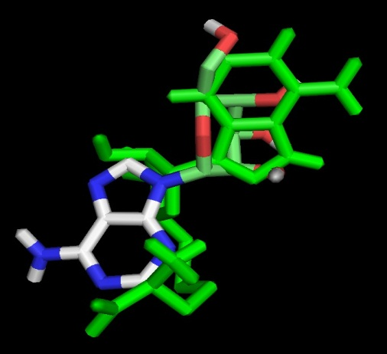
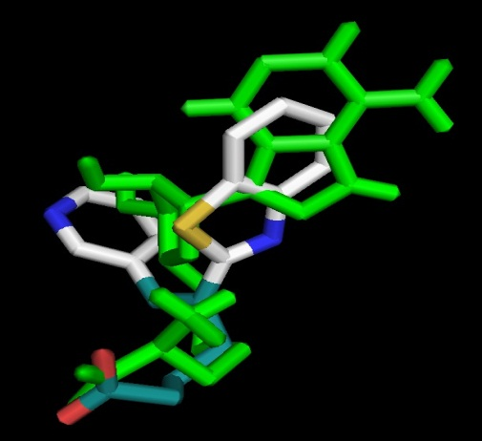
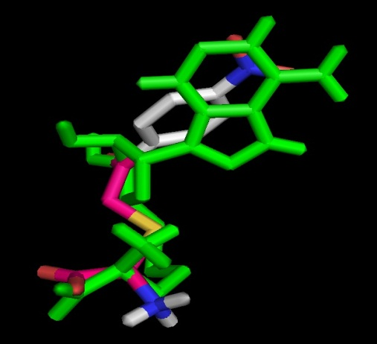
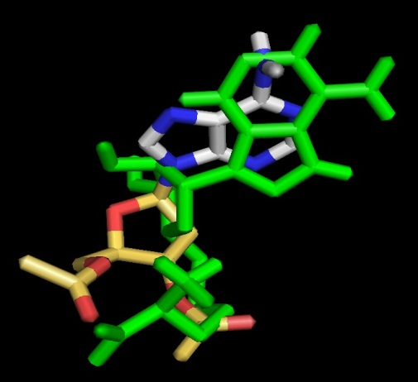
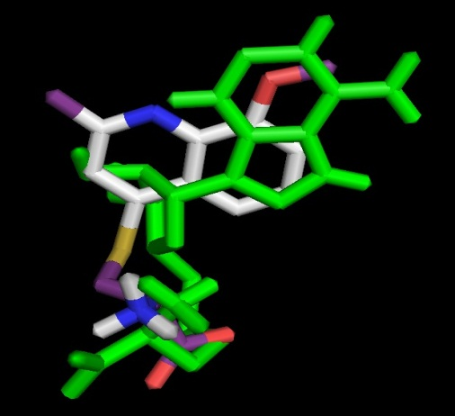
Superimposed poses of Top 9 compounds (G9a Methyltransferase)
Green = SAH taken from G9a protein crystal structure (2O8J)
Confidential : Do Not Copy or Distribute

Slide 9
Functional screening of virtual hits: ELISA scheme of H3K9 methyltransferases
G9a Activity / Inhibition Assay
Inhibitor candidates
G9a
SAH
G9a
SAM
Biotin-H3K9
Me0 ( Me1, or
Me2) peptides
B
1 hr incubation
B
B
B
B
B
B
Streptavidin coated plate
Mono- ( di-, or
Tri-) methylated H3K9
Add H3K9 mono-, di-, or trimethy specific Ab
Add Poly His HRP Ab
B
B
B
B
B
B
B
B
H3K9 mono- ( di-, or tri-) methyl specific Ab
Poly His HRP Ab
Add HRP chemiluminescent substrate
Read chemiluminescence in a luminometer
Confidential : Do Not Copy or Distribute

Slide 10
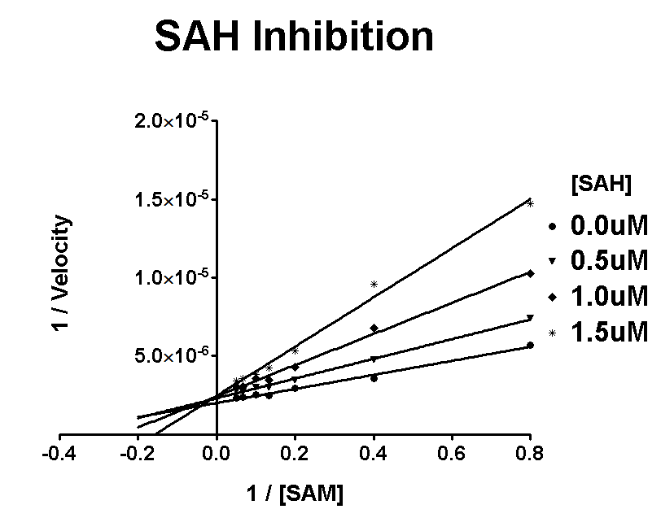
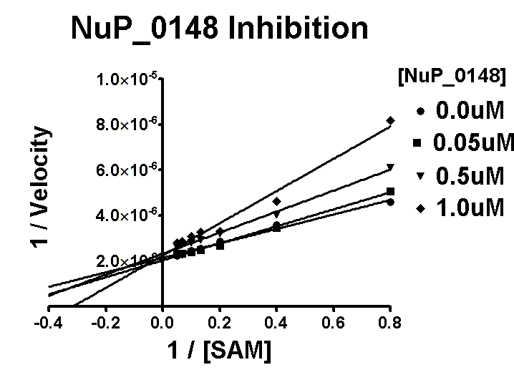
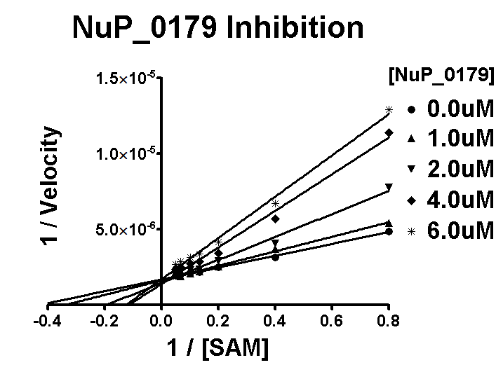
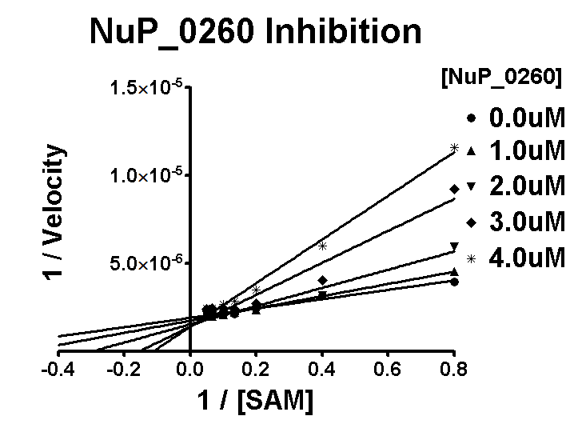
Inhibition of G9a by Nu_P VS Hits
Figure. Lineweaver-Burk plots showing G9a H3K9 inhibition
in a competitive mode with SAM.
Confidential : Do Not Copy or Distribute

Slide 11
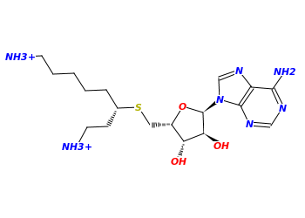
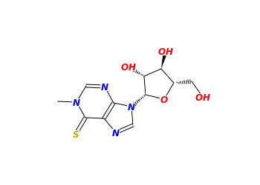
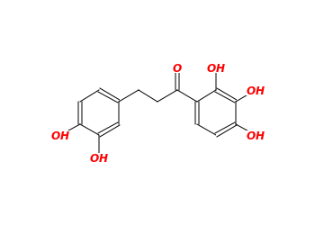
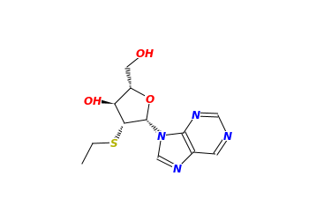
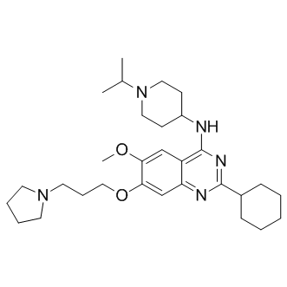
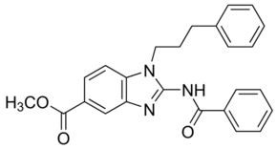
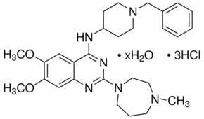
IC50 of Hits
IC₅₀ | G9a H3K9 |  |  | G9a H3K27 |  | GLP H3K9
Compound | Mono | Di | Tri | Mono | Di | Mono | Di | Tri
SAH | 38.7 uM | 1.253 uM | 1.704 uM | 14.08 uM | 7.655 uM | 10.7 uM | 4.921 uM | 84.01 uM
BIX01294 | 16 uM | 0.131 uM | 0.871 uM | 0.583 uM | 1.01 uM | 3.424 uM | 0.075 uM | 0.104 uM
BRD4770 | N.C. | >200 uM | N.C. | N.C. | N.C. | >429 uM | >393 uM | >264 uM
NuP_0148 | 3.384 uM | 1.1 uM | 3.596 uM | 2.49 uM | 4.217 uM | 14.54 uM | 53.52 uM | 55.97 uM
NuP_0179 | 140 uM | 5.086 uM | 0.298 uM | 34.45 uM | 5.01 uM | 44.03 uM | 7.461 uM | >221 uM
NuP_0260 | N.C. | 3.095 uM | 0.348 uM | 16.45 uM | 3.281 uM | >181 uM | >136 uM | 19.29 uM
NuP_0318 | N.C. | N.C. | 2.579 uM | >732 uM | 82.14 uM | N.C. | >762 uM | N.C.
N. C. indicates Not Calculated
NuP_0148
NuP_0179
NuP_0260
NuP_0318
BIX01294
UNC0638
BRD4770
Confidential : Do Not Copy or Distribute

Slide 12
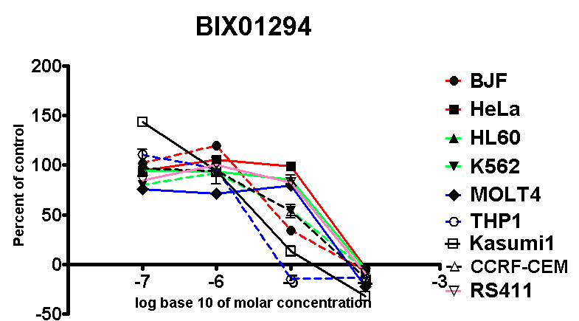
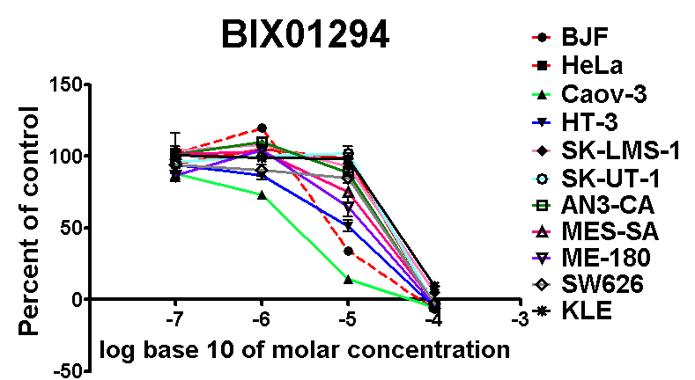
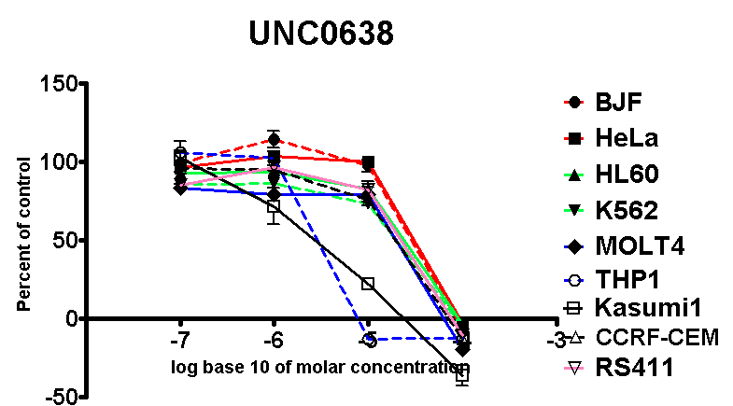
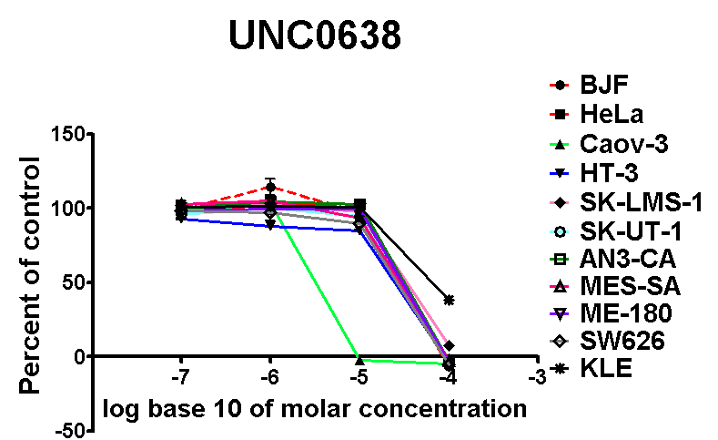
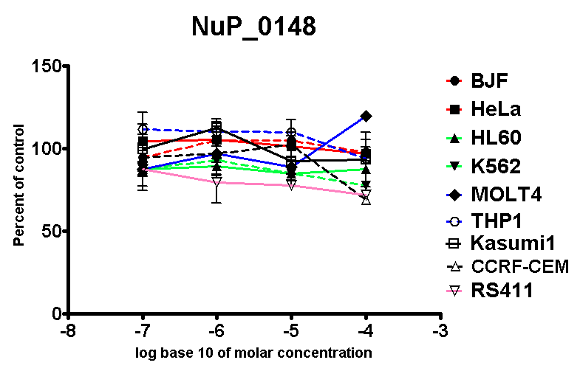
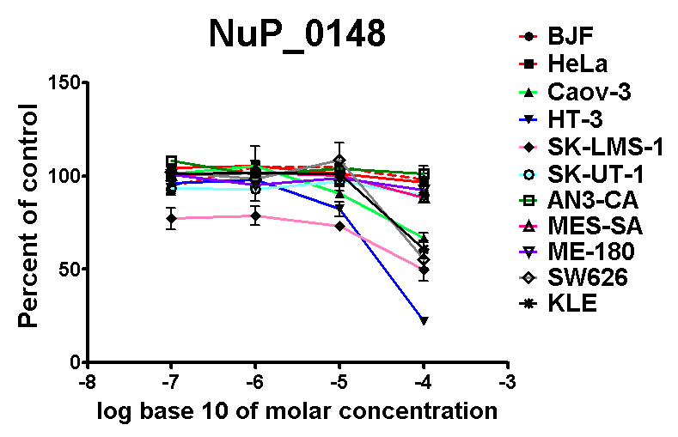
Cell proliferation assay
Confidential : Do Not Copy or Distribute
Leukemia cells
Gynecological cancer cells
BJF
HeLa
HL60
K562
MOLT4
BJF
HeLa
Caov-3
HT-3
SK-LMS-1
SK-UT-1
THP1
Kasumi1
CCRF-CEM
RS411
AN3-CA
MES-SA
ME-180
SW626
KLE

Slide 13
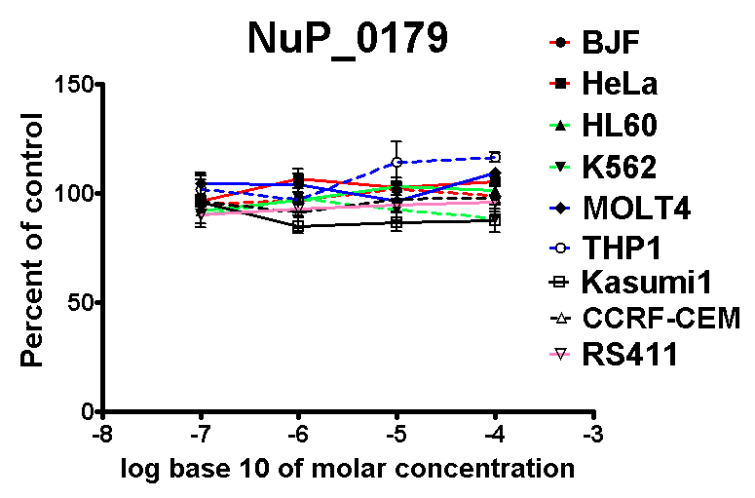
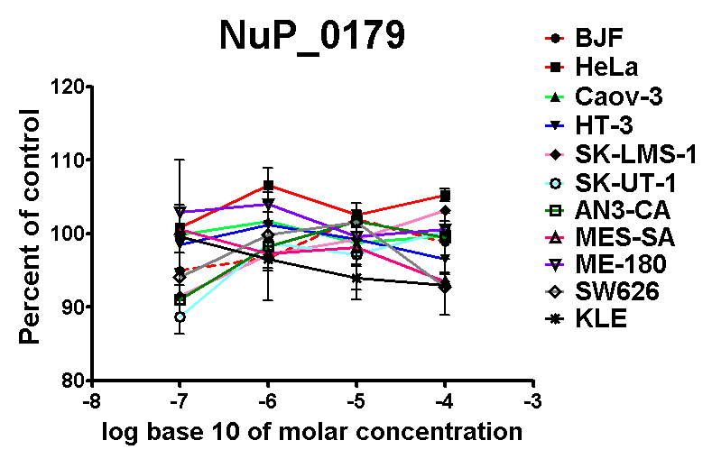
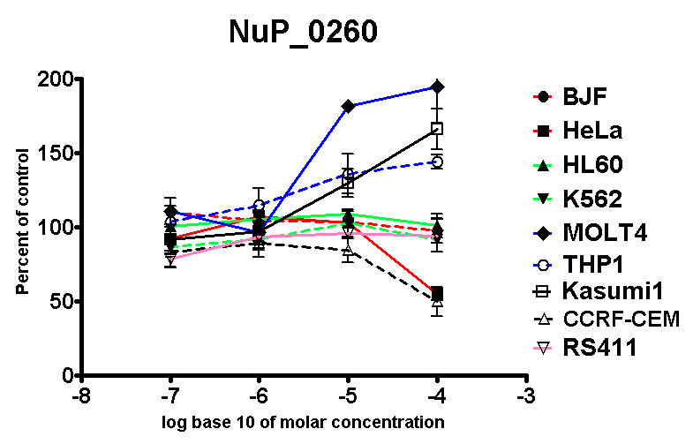
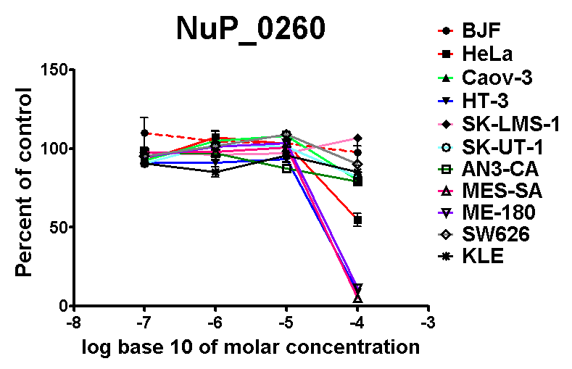
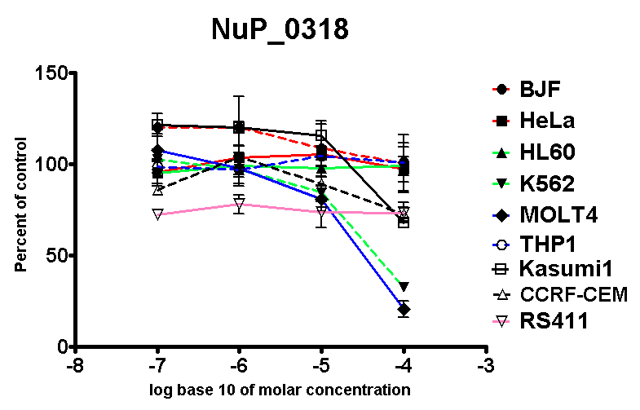
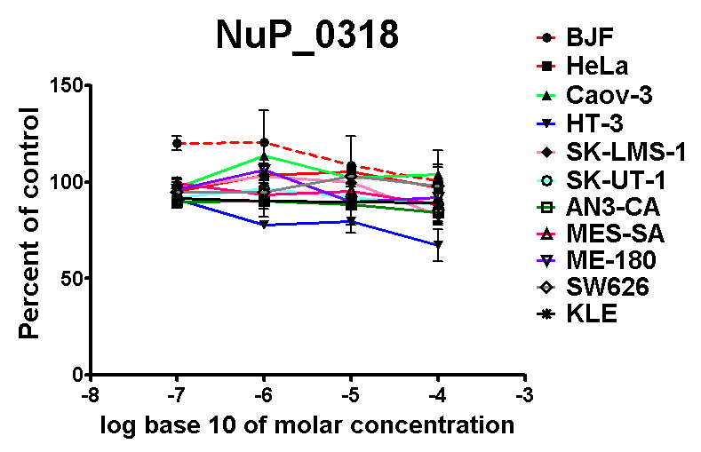
Cell proliferation assay
Confidential : Do Not Copy or Distribute
Leukemia cells
Gynecological cancer cells
BJF
HeLa
HL60
K562
MOLT4
BJF
HeLa
Caov-3
HT-3
SK-LMS-1
SK-UT-1
THP1
Kasumi1
CCRF-CEM
RS411
AN3-CA
MES-SA
ME-180
SW626
KLE

Slide 14
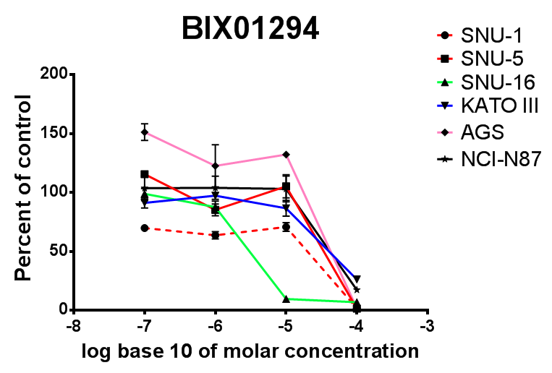
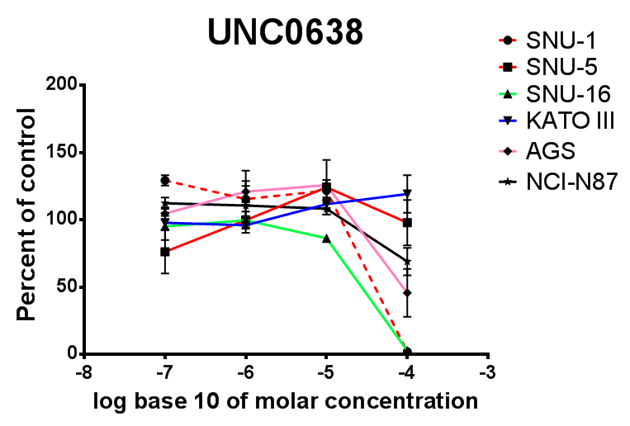
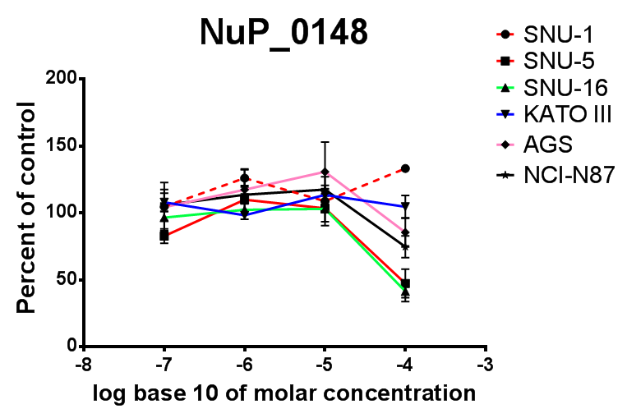
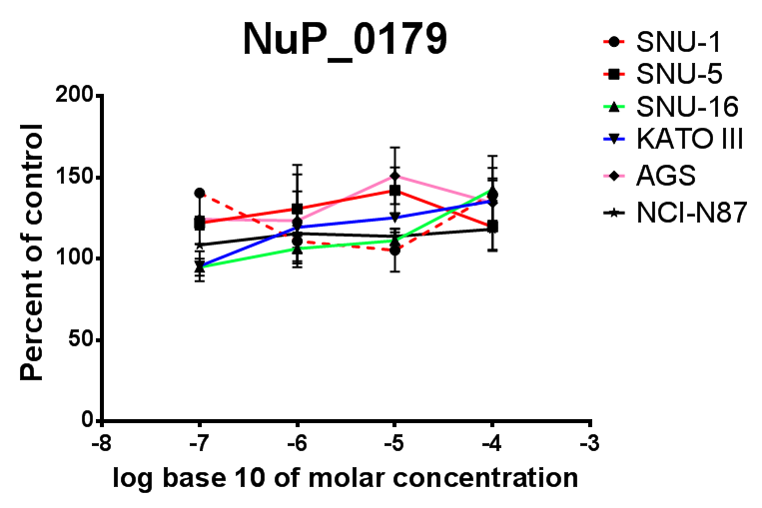
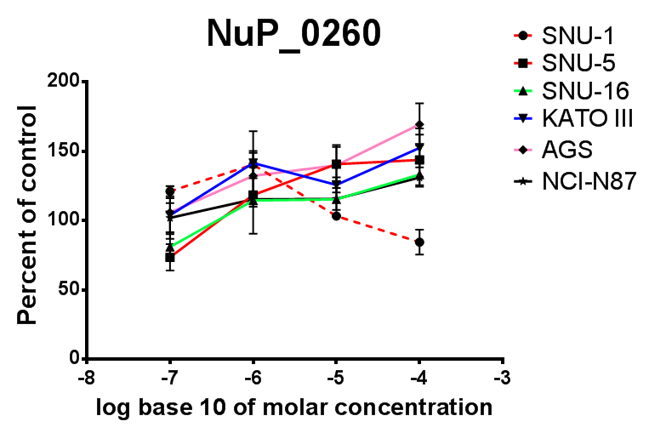
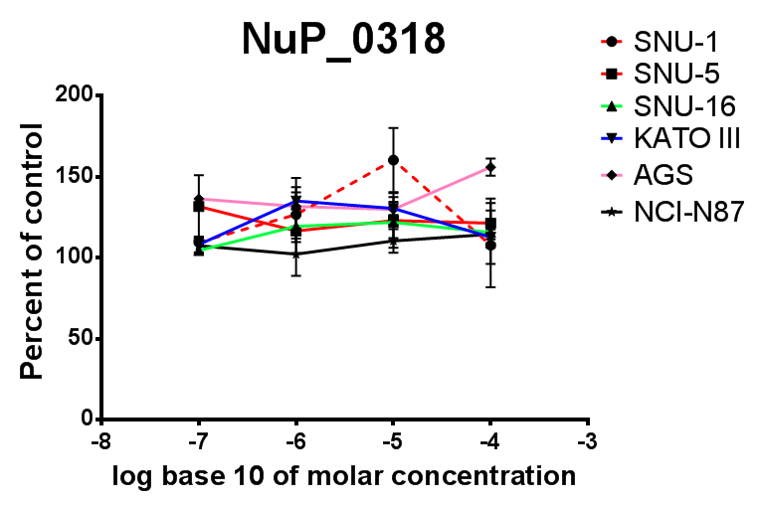
Cell proliferation assay
Confidential : Do Not Copy or Distribute
Cell proliferation assays in 6 gastric cancer cell lines
(G9a inhibitor-treated for 48h)

Slide 15

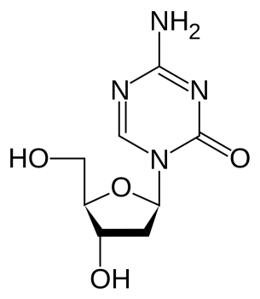

Release of Epigenetic Gene Regulation by NuP0148
HT-3 gynecological cell line was treated with inhibitors for a week
GAPDH
CCNA1
CHFR
FHIT
PAX1
PTEN
SFRP4
CADM1
CEACAM6
CDH1
1st lane: Untreat (DMSO)
2nd lane: 100uM of Decitabine
3rd lane: 100uM of NuP_0148
CST6
ESR1
SCNN1A
LCN2
DNMT1
Amplication with 30 cycles
DNMT3a
DNMT3b
Β-Actin
RUNX3
MLH1
DLC1
GSTP1
EPCAM
TP53
CDKN1A
BAX
PMNP1
PIDD
IGF1R
FAS
BCL2
G9a
GLP
APC
RASSF1
RB1
TFAP2A
PGR
RARA
BRCA1
CDKN2A
PCDHGB6
Confidential : Do Not Copy or Distribute
Notes:
Decitabine, a cytidine analog:
DNA methylation Inhibitor
Activation of tumor suppressor genes.

Slide 16





RARB
CCND2
Twist2
THRB
ATM
1st lane: Untreat (DMSO)
2nd lane: 100uM of Decitabine
3rd lane: 100uM of NuP_0148
BRCA2
CDKN2B
CDKN3
E2F1
IGF2R
MEN1
MGMT
NF1
NF2
S100A4
Amplication with 30 cycles
SERPINB5
SMAD4
STK11
TP73
TSC1
VHL
WT1
WWOX
XRCC1
Confidential : Do Not Copy or Distribute

Slide 17
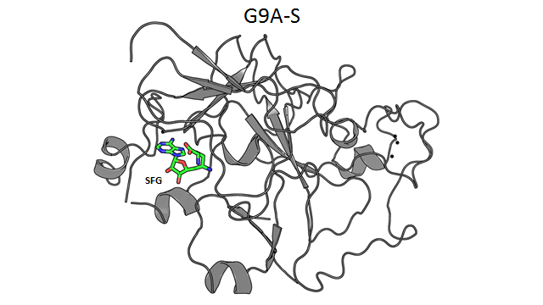
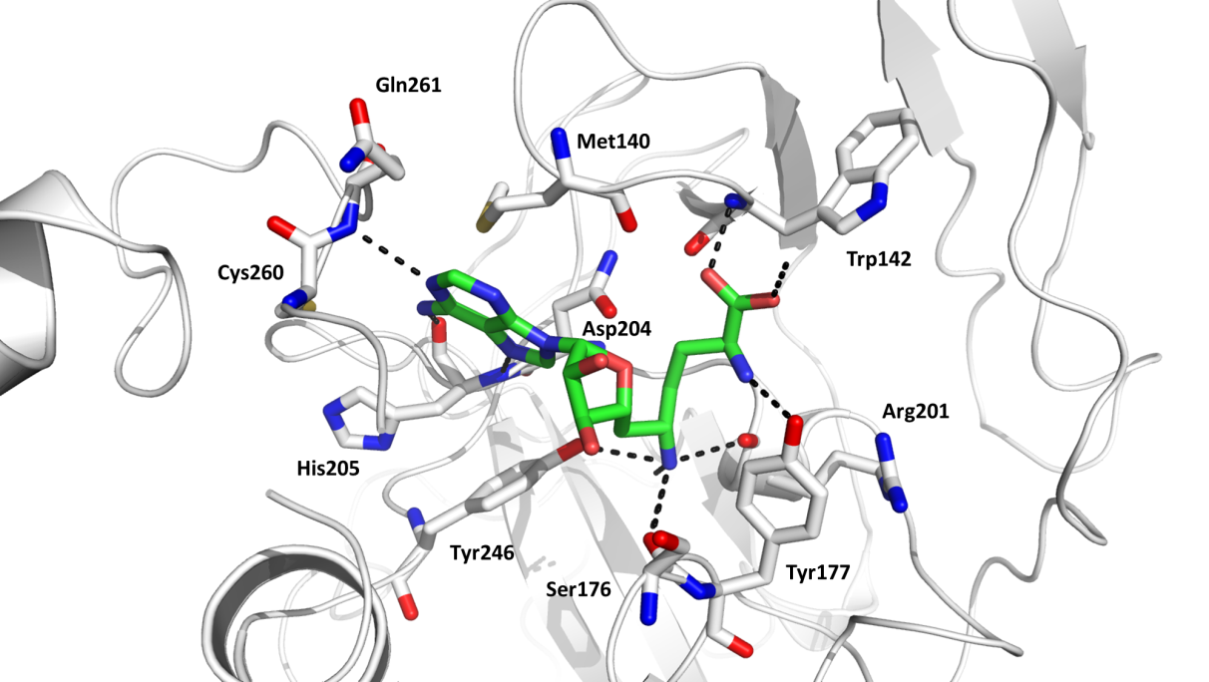
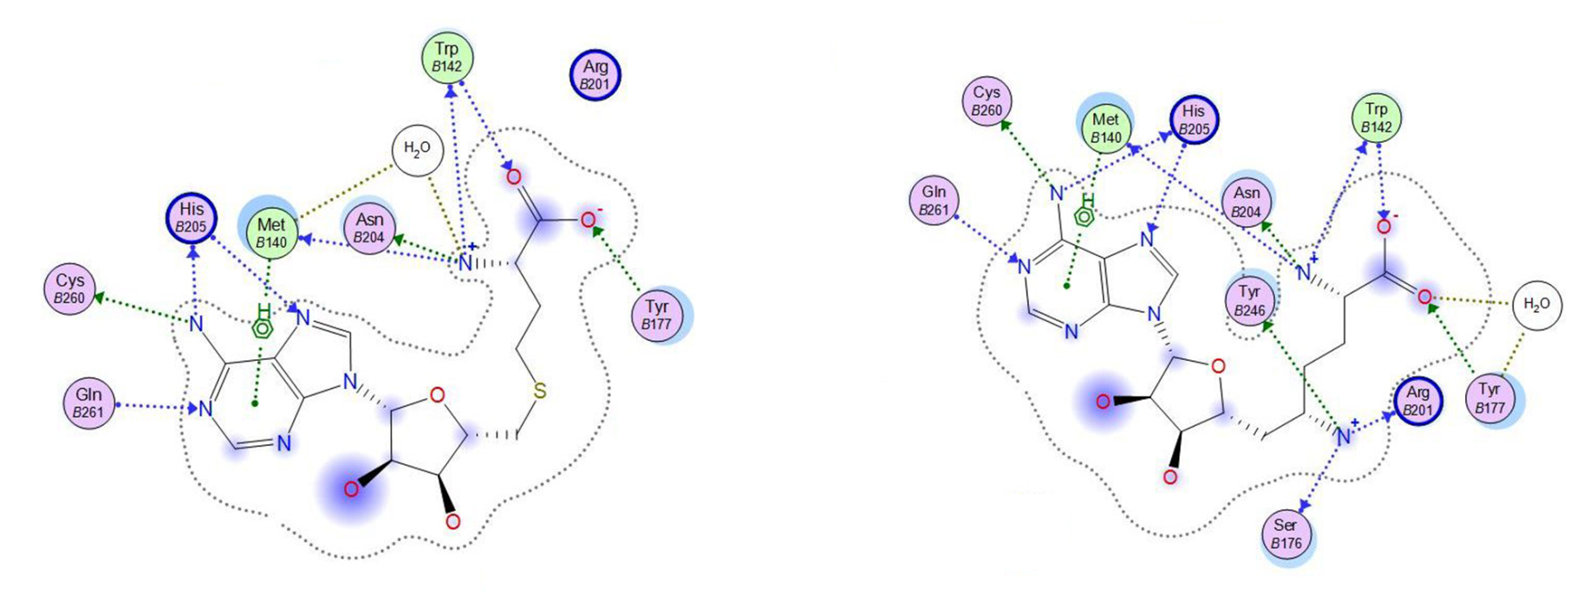
Structure of G9a complexed with SFG
2.4 Å R_{work}/R_{free} = 0.224/0.265

