Slide 1


PubChem’s Support for Medicinal Chemistry and Drug Discovery
Yanli Wang
MedChem & CADD 2015
Atlanta, Georgia
November 4th, 2015

Slide 2
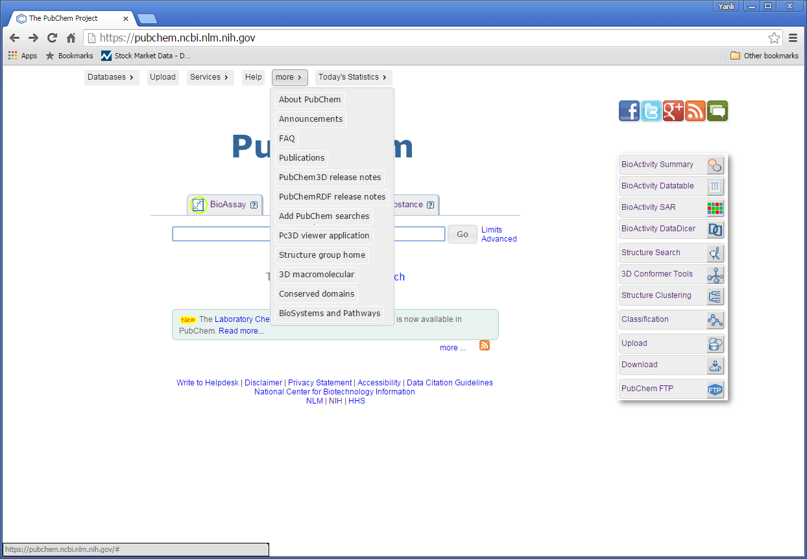
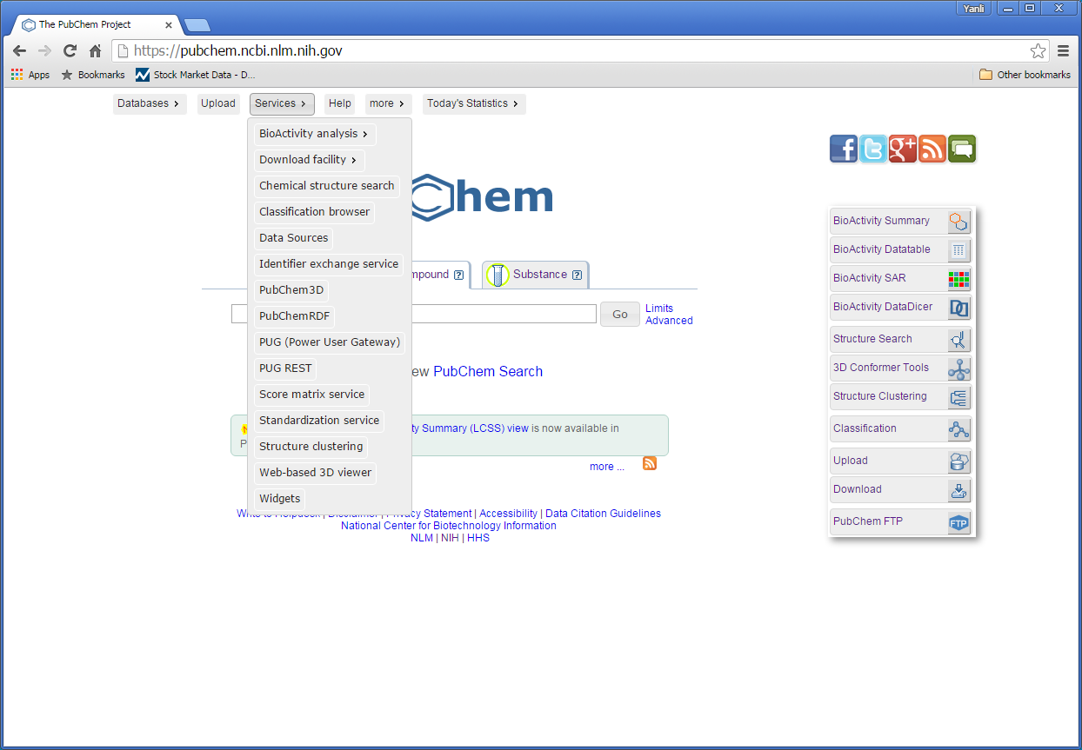
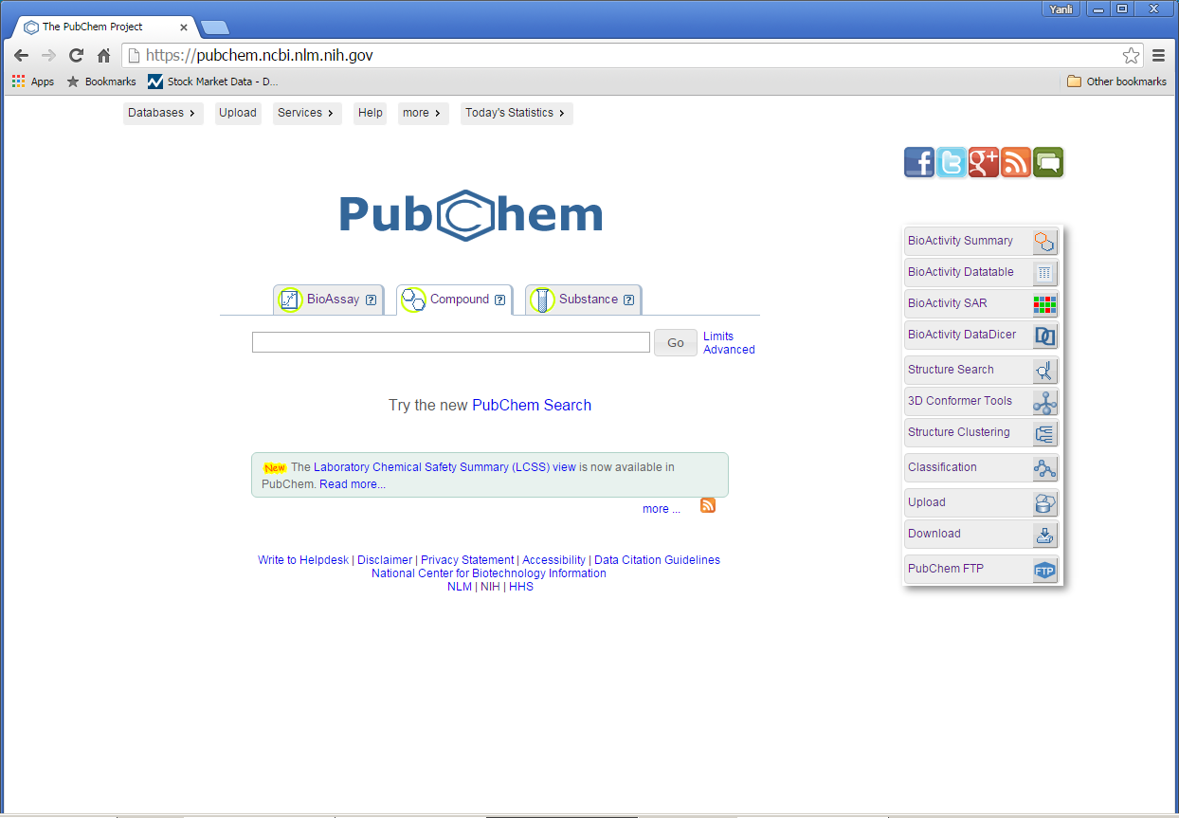
PubChem … http://pubchem.ncbi.nlm.nih.gov
biological test result and target
small molecule and RNAi reagent
Three connected databases
… A public resource providing chemical structures and comprehensive information on the biological activities of small molecules and other reagents including RNAi

Slide 3
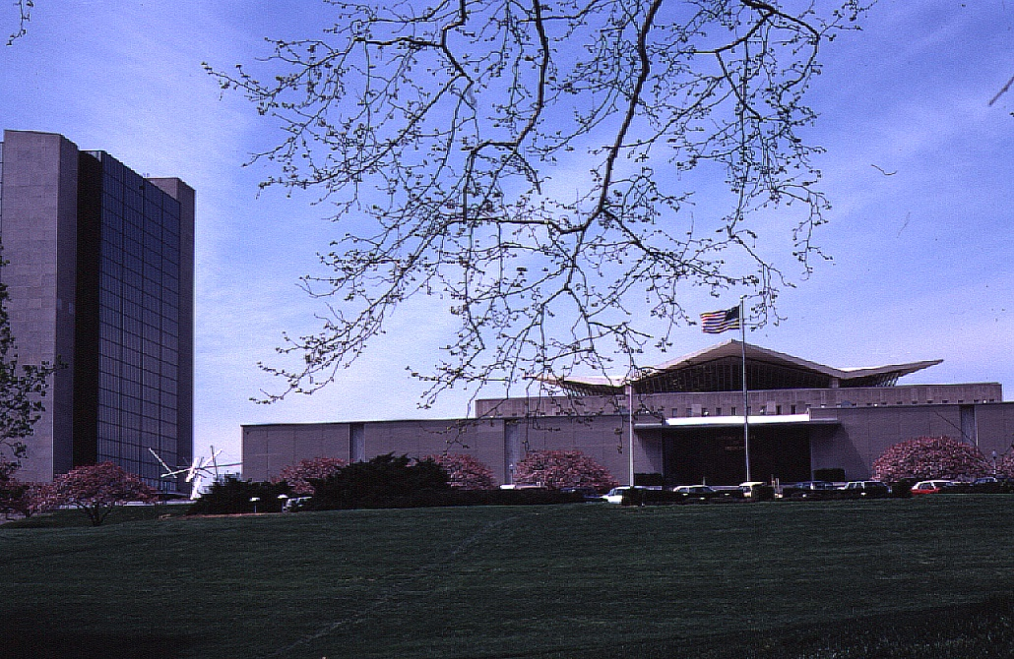
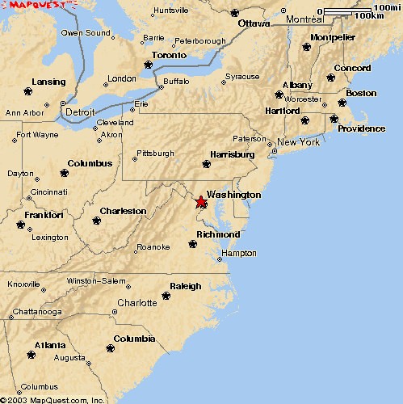
The National Center for Biotechnology Information
Bethesda,MD
Created in 1988 as a part of the
National Library of Medicine at NIH
Establish public databases
Research in computational biology
Develop software tools for sequence analysis
Disseminate biomedical information

Slide 4

PubChem links to many other databases
PubMed
OMIM
Protein
BioSystems
assay target
research data
a pathway db
Gene
assay target
MeSH
Nucleotide
Depositor links
GEO
Taxonomy
Structure
CDD
conserved protein family domain
a mirror of Protein Data Bank (PDB)
Notes:
*to this end
*hosted by NCBI
*providing additional annotation
Nucleotide: AID 1637

Slide 5
More about PubChem …
• An open archive
– anyone can contribute
• chemical structures
• biological experiments
• annotations
– links external resources
– data exchange via Upload
– voluntary data push
– automated updates & version
– data on hold & release management
• A public resource
– anyone can access
• data downloadable
• search, browse, retrieve
– integrated
– analysis capabilities
– programmatic layers
• PUG, PUG/SOAP
• Entrez Utilities
• URL-based interfaces

Slide 6
More about PubChem …
• An open archive
– anyone can contribute
• chemical structures
• biological experiments
• cross references
• records versioned
– Data exchange - Upload
– links external resources
– voluntary data push
– automated updates
• A public resource
– anyone can access
• browse, search & view
• data download
– integrated
– analysis capabilities
– programmatic layers
• PUG, PUG/SOAP/REST
• Entrez Utilities
• URL-based interfaces

Slide 7
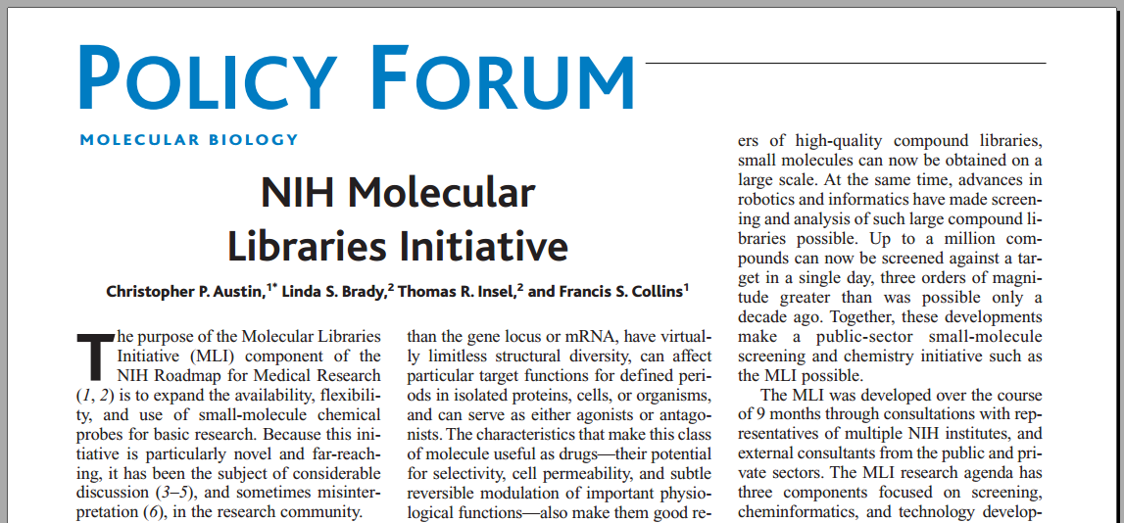
PubChem history: the MLI initiative (http://mli.nih.gov/mli/ 2004-2014)
identify and develop small-molecule chemical probes through high-throughput screening (HTS)
expand the use of chemical probes for basic research (e.g. understanding the unknown biological systems, rare diseases)
all data must be deposited into PubChem to be public
pilot & production phase, 16 MLI screening centers/labs founded,
Science, 2004, 306:1138-1139
Notes:
*PubChem started as a component of MLI, which aims to …
*the policy requires that all data generating from MLI must be deposited in PubChem
*makes PubChem different from other chemical biology database, such HTS, pharmaceutical companies,
*Finalized in last year, 10th anniversary.
*MLP was over, but PubChem goes beyond

Slide 8
PubChem: go beyond the MLI
300 sources
for substance
70 sources for bioassay
academic institution & university (Broad Institute, Scripps, John Hopkins U. New Mexico, Peter MacCallum Cancer Center, Gurdon Institute, Leiden U. Medical Center, Weizmann Institute of Science )
screening facility (DRSC, ICCB-Longwood/NSRB, )
government agency (NIH, EPA, NSF)
private foundation (Bill & Melinda Gates Foundation)
pharmaceutical company (GlaxoSmithKline, Novartis, Genentech, GE Healthcare Dharmacon, Abbott)
journal publisher (Nature Publishing Group)
database provider (DrugBank, ChEMBL, IUPHAR, BindingDB, PDBbind)
other
See full list at: http://pubchem.ncbi.nlm.nih.gov/sources/
Notes:
*here we show a growth figure for PubChem depositors
*initially, we have 16 from MLI, but now
*the contributing organizations include

Slide 9
PubChem: go beyond the MLI
See full list at: http://pubchem.ncbi.nlm.nih.gov/sources/
Substance:
300 data sources
158,000,000 records (SID)
60,000,000 unique chemical structures (CID)
BioAssay:
70 data sources
1, 100, 000 datasets (AID)
Notes:
*here we show a growth figure for PubChem depositors
*initially, we have 16 from MLI, but now
*the contributing organizations include

Slide 10






















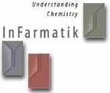












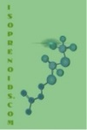


































… a community hub …

Slide 11
PubChem BioAssay Depositors…
academic institution & university (Scripps, Broad Institute, Peter MacCallum Cancer Center, Gurdon Institute, Leiden U. Medical Center, Weizmann Institute of Science )
screening facility (DRSC, ICCB-Longwood/NSRB, )
government agency (NIH, EPA, NSF)
private foundation (Bill & Melinda Gates Foundation)
pharmaceutical company (GlaxoSmithKline, Novartis, Genentech, GE Healthcare Dharmacon, Abbott)
journal publisher (Nature Publishing Group)
database provider (DrugBank, ChEMBL, IUPHAR, BindingDB, PDBbind)

Slide 12
PubChem BioAssay …
Data content:
small molecule datasets: 1, 100, 000
RNAi datasets: 74
protein targets: 9,000; 50,000 gene targets
bioactivity outcomes: 2,290,000 (1,000, 000, 000 data points)
Data type:
HTS experiment
Chemical biology research
Medicinal chemistry study
Literature based data
Bioactivity
Toxicity
Selectivity Profiling
Physicochemical property profiling

Slide 13
PubChem BioAssay …
Substances tested assays: 3, 000, 000
drug
known biological compound
natural product
targeted library
diverse chemical structure
Bioactivity outcomes:
1,200,000 bioactivity < 1uM
65,000 bioactivity < 1nM
300 chemical probes

Slide 14
Literature Based BioAssay Data Content – Small molecule data from 50,000 publications
Journal Name | Number of unique Pubmed ID (pmid) | Number of BioAssay records (AID)
Journal of medicinal chemistry | 17516 | 319947
Bioorganic & medicinal chemistry letters | 15313 | 166466
Journal of natural products | 5438 | 41378
Bioorganic & medicinal chemistry | 4954 | 67392
European journal of medicinal chemistry | 3192 | 51580
Antimicrobial agents and chemotherapy | 2125 | 67750
The Journal of biological chemistry | 179 | 3410
Nature chemical biology | 171 | 6559
ACS medicinal chemistry letters | 155 | 2524
Proceedings of the National Academy of Sciences of the United States of America | 117 | 4154
The Journal of pharmacology and experimental therapeutics | 99 | 663
Science (New York, N.Y.) | 17 | 970
Nature | 14 | 501

Slide 15
Protein BioAssay Target …

Slide 16
Biological Pathways for Protein Target …
BioSystems name | KEGG id (conserved pathway) | Count of genes
Neuroactive ligand-receptor interaction | ko04080 | 623
Calcium signaling pathway | ko04020 | 329
cAMP signaling pathway | ko04024 | 299
PI3K-Akt signaling pathway | ko04151 | 279
MAPK signaling pathway | ko04010 | 252
Ribosome | ko03010 | 220
Proteoglycans in cancer | ko05205 | 194
cGMP-PKG signaling pathway | ko04022 | 190
Focal adhesion | ko04510 | 189
Rap1 signaling pathway | ko04015 | 186
Oxytocin signaling pathway | ko04921 | 181
Retrograde endocannabinoid signaling | ko04723 | 168
Inflammatory mediator regulation of TRP channels | ko04750 | 168
HTLV-I infection | ko05166 | 165
Vascular smooth muscle contraction | ko04270 | 165
Chemokine signaling pathway | ko04062 | 163
Alzheimer's disease | ko05010 | 161
Epstein-Barr virus infection | ko05169 | 155
Adrenergic signaling in cardiomyocytes | ko04261 | 155
Dopaminergic synapse | ko04728 | 153

Slide 17
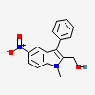
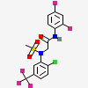
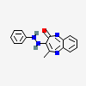
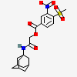
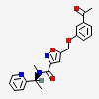
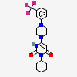
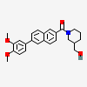
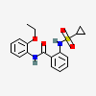
Chemical Probe
… 200 more
F2RL3 antagonists
IC50: 0.139 uM
(CID: 2333)
mGlu5 positive
allosteric
Potentiator
EC50: 2.411 uM
(CID: 1318633)
EGFR inhibitor
IC50: 0.7079 uM
(CID: 2303746)
Thyroid Hormone Receptor /
Steroid Receptor Coregulator 2
interaction inhibitor
Potency: 1.4uM
(CID: 5184800)
CHRM5 antagonists
IC50: 0.44uM
(CID: 42519285)
STAR inhibitor
IC50: 2.12 uM
(CID: 45100448)
mGluR3 modulator
IC50: 2.611 uM
(CID: 60210836)
MRGPRX1
allosteric activator
EC50: 0.19 uM
(CID:71598556)
Notes:
*here we show some examples of aspirin in …
*generic name, brand name
*same/different structure representation
*but user just want one aspirin

Slide 18
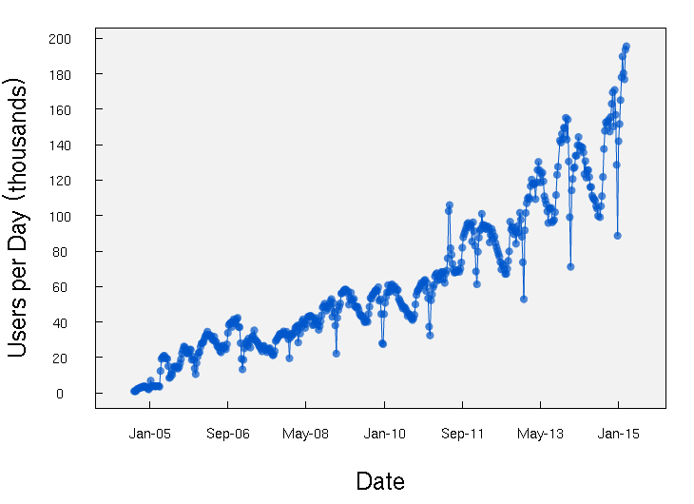
Growth In PubChem Usage

Slide 19
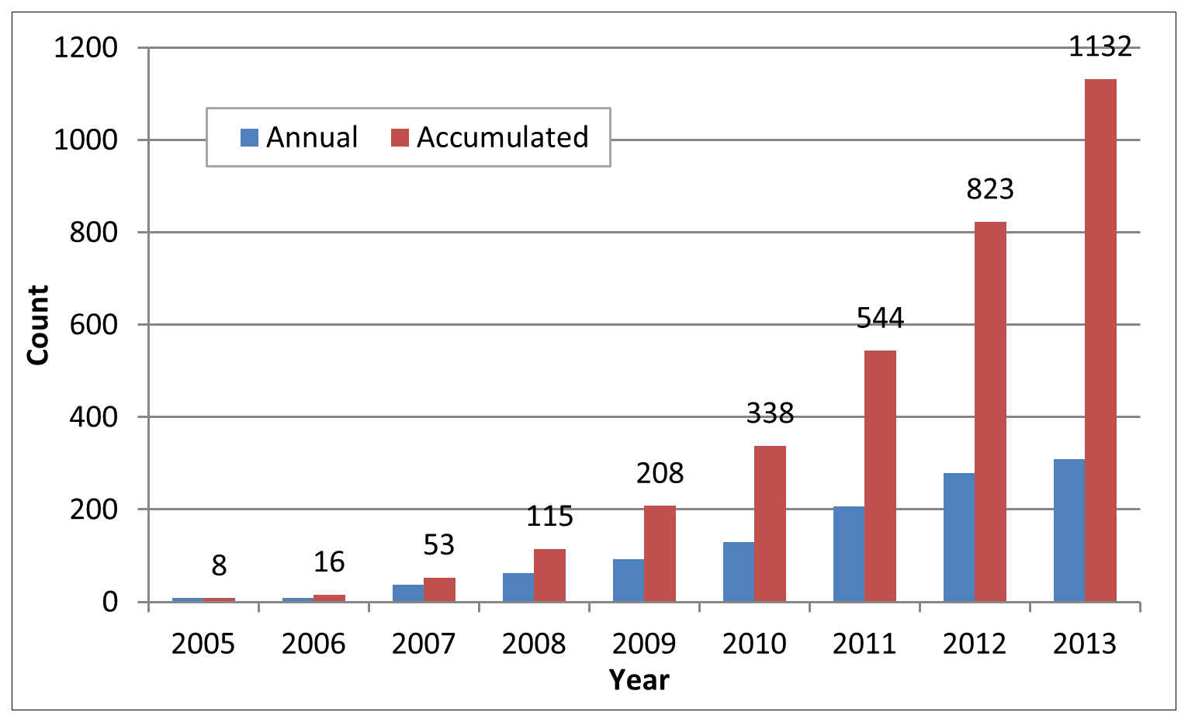
Distribution of research articles citing PubChem by year
Drug Discovery Today, 2014 Nov;19(11):1751-6

Slide 20
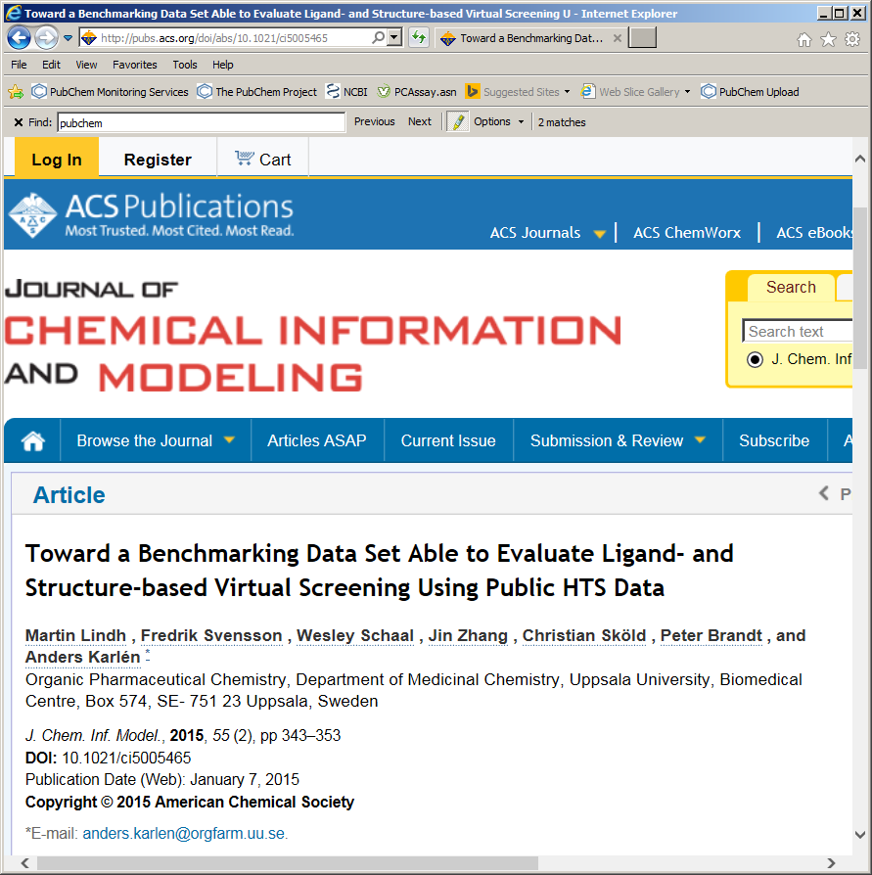
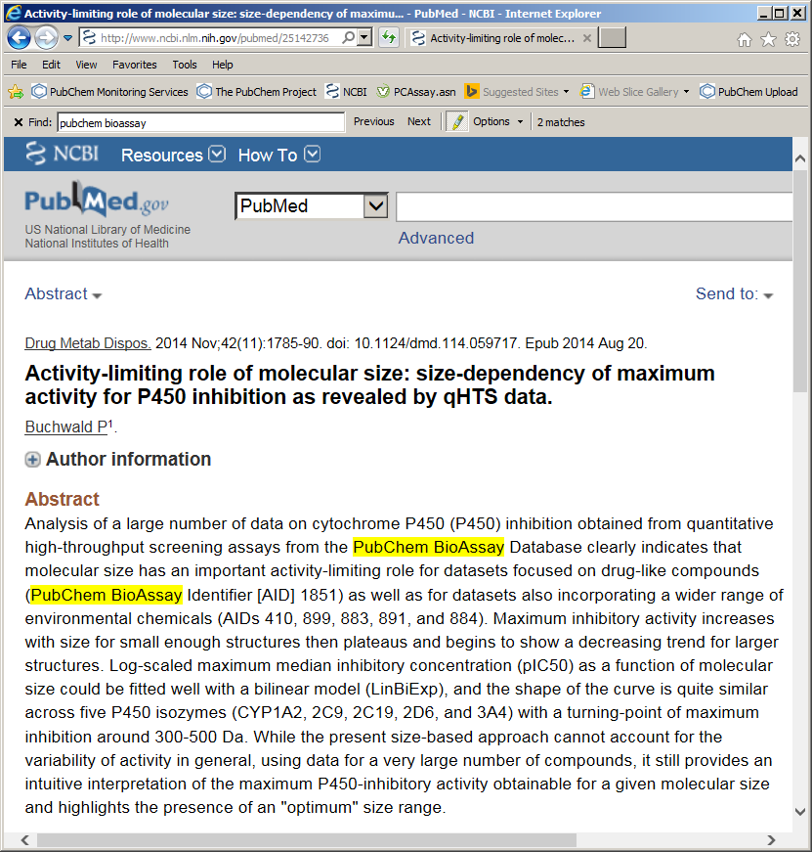
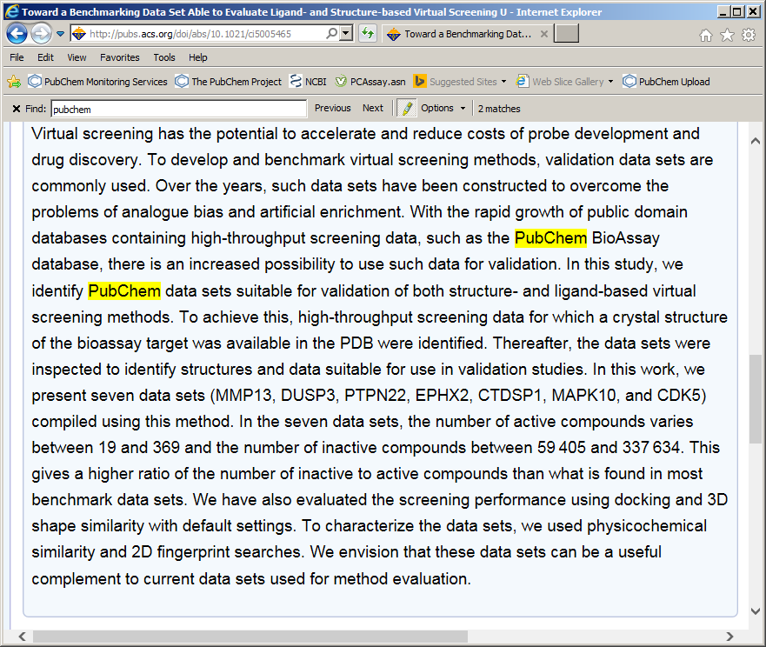
PubChem Citation… Search “PubChem” finds 1256 hits in PubMed,2132 in PMC

Slide 21
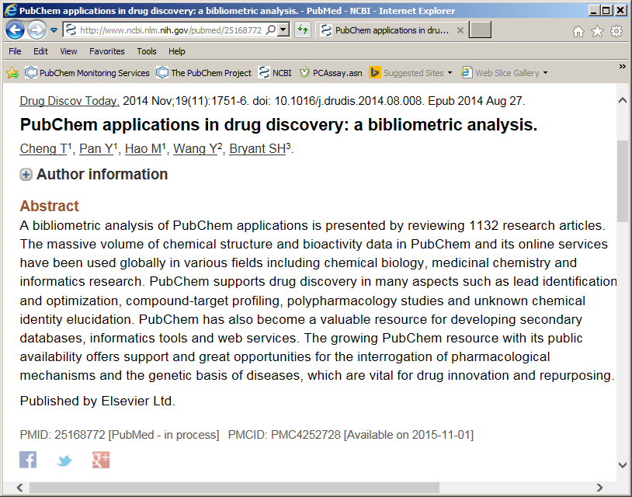
Analyze PubChem Applications

Slide 22
PubChem applications by biomedical research community
■ Data retrieval, exchange and service utilization using PubChem services & tools
■ Secondary resources and tools involving PubChem
■ Application in informatics research
■ Application in web-lab experiments
Drug Discovery Today, 2014 Nov;19(11):1751-6

Slide 23
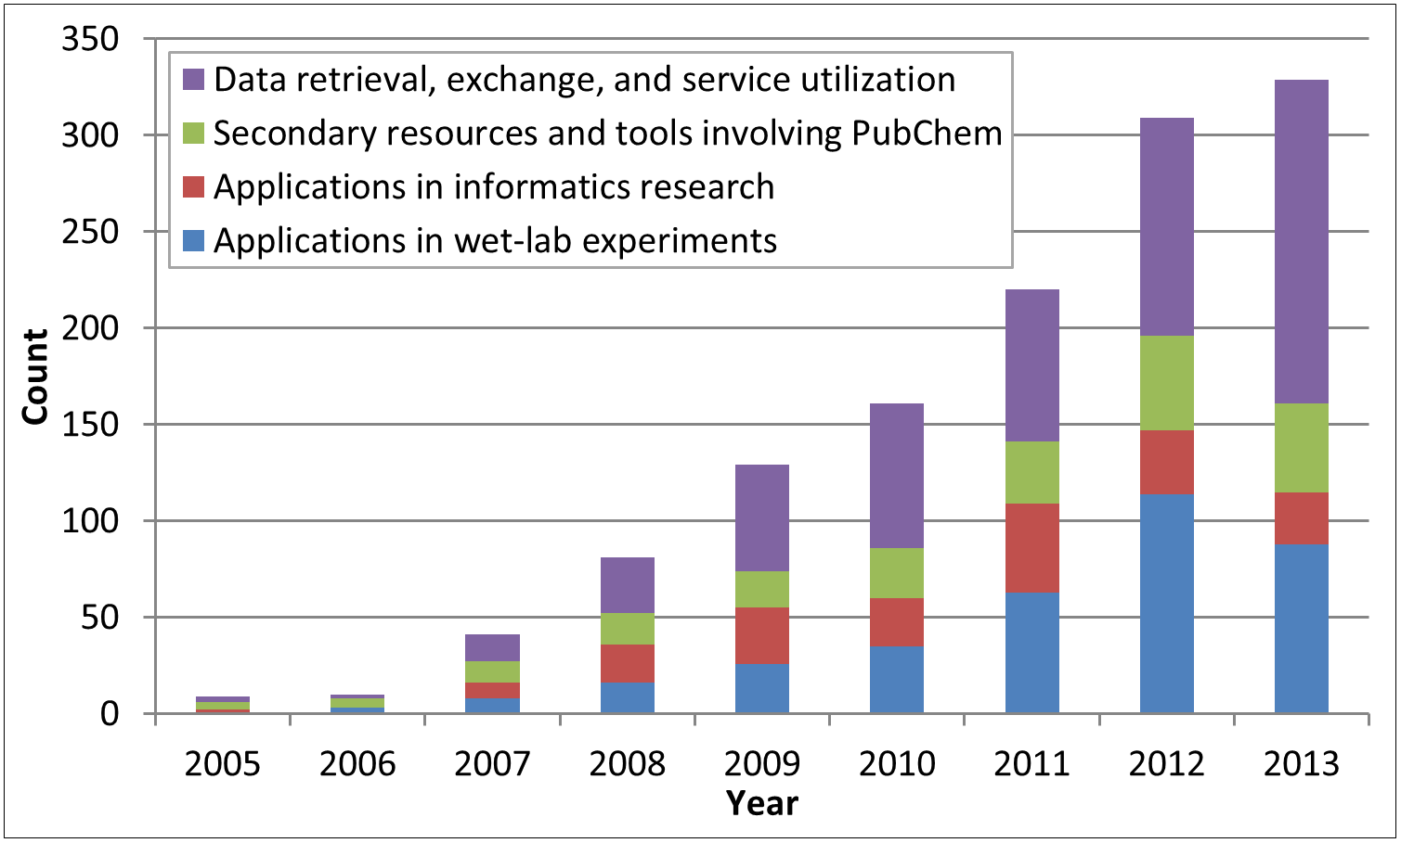
Distribution of research articles citing PubChem by year and application category. A single article may be assigned to multiple categories for this plot.
Drug Discovery Today, 2014 Nov;19(11):1751-6

Slide 24
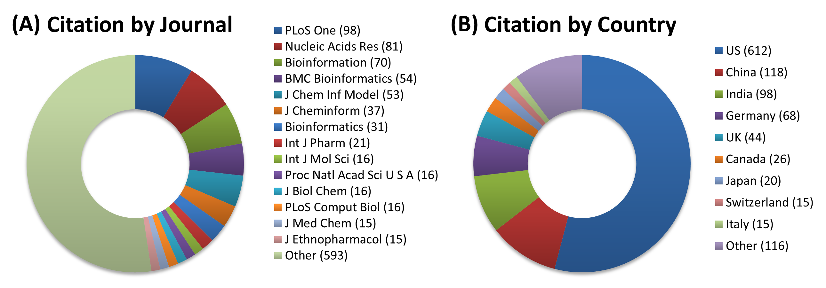
Distribution of research articles citing PubChem in terms of journal (A) and country (B). Respective article counts are shown in the parenthesis.
Drug Discovery Today, 2014 Nov;19(11):1751-6

Slide 25
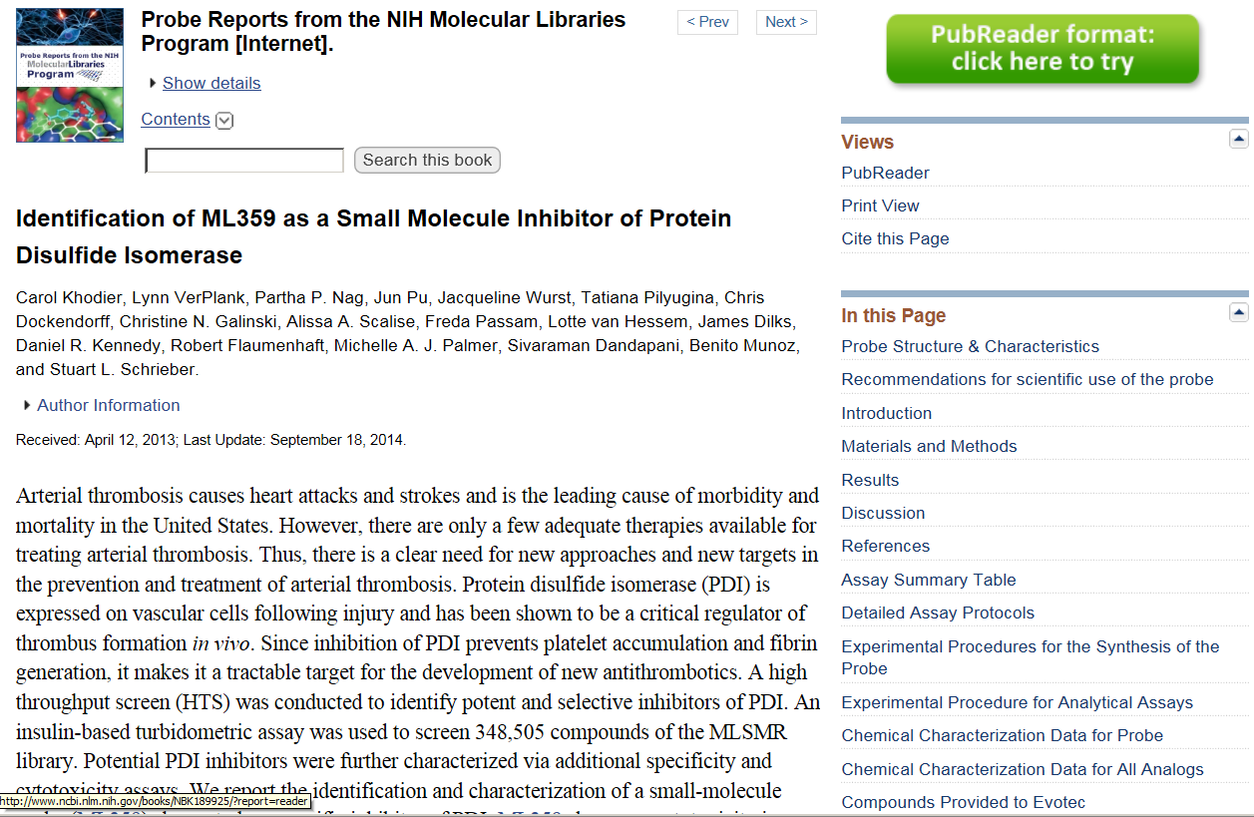
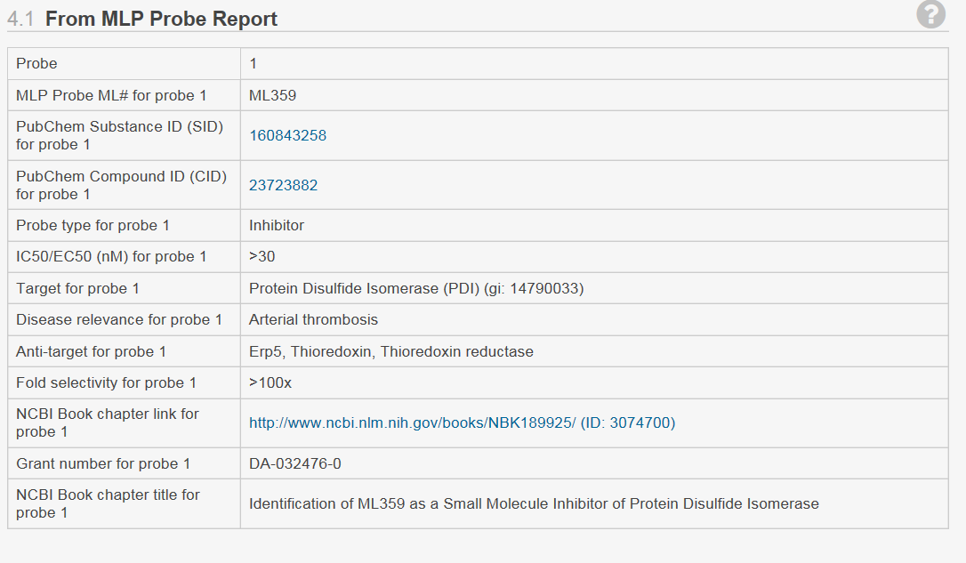
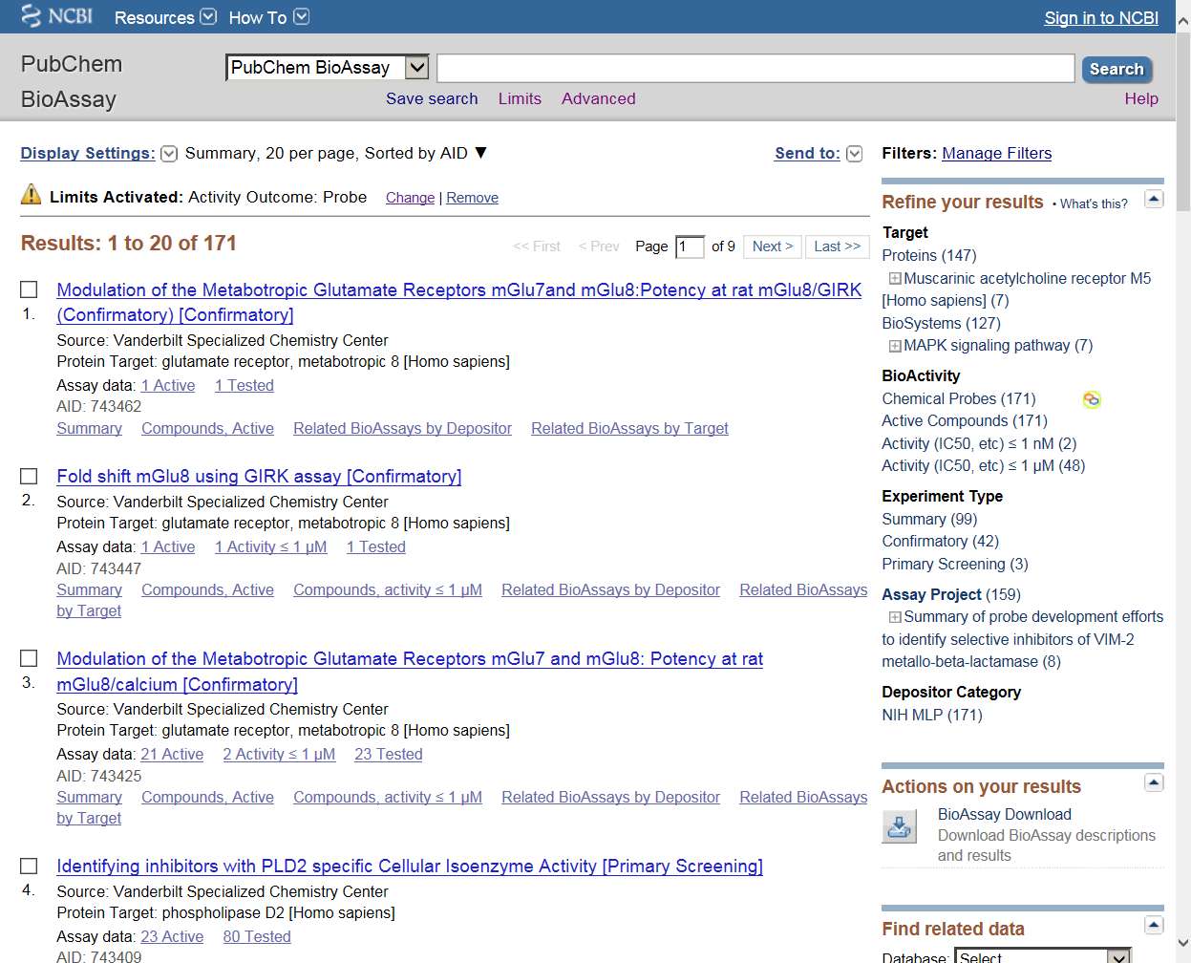
Chemical Probe
… 200 more
F2RL3 antagonists
IC50: 0.139 uM
(CID: 2333)
mGlu5 positive
allosteric
Potentiator
EC50: 2.411 uM
(CID: 1318633)
EGFR inhibitor
IC50: 0.7079 uM
(CID: 2303746)
Thyroid Hormone Receptor /
Steroid Receptor Coregulator 2
interaction inhibitor
Potency: 1.4uM
(CID: 5184800)
CHRM5 antagonists
IC50: 0.44uM
(CID: 42519285)
STAR inhibitor
IC50: 2.12 uM
(CID: 45100448)
mGluR3 modulator
IC50: 2.611 uM
(CID: 60210836)
MRGPRX1
allosteric activator
EC50: 0.19 uM
(CID:71598556)
Notes:
*here we show some examples of aspirin in …
*generic name, brand name
*same/different structure representation
*but user just want one aspirin

Slide 26
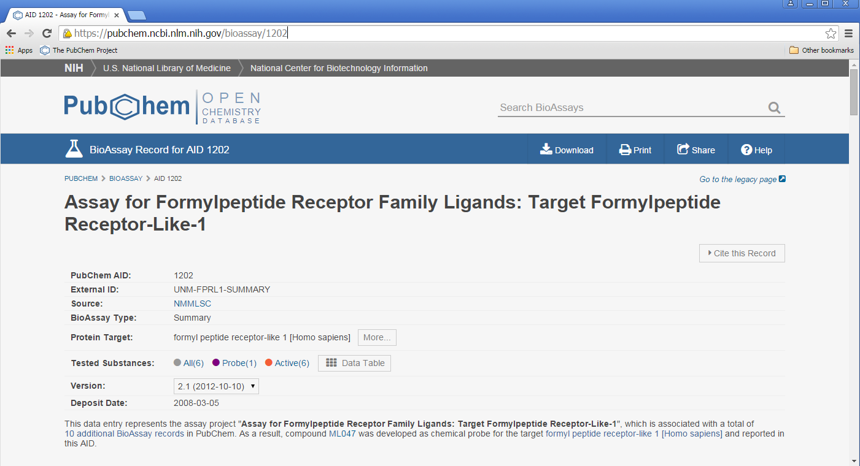
A Small Molecule BioAssay Record… https://pubchem.ncbi.nlm.nih.gov/bioassay/1202

Slide 27
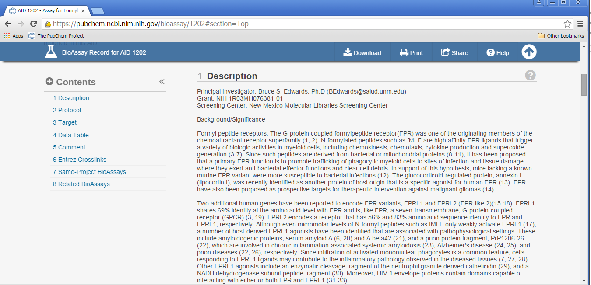
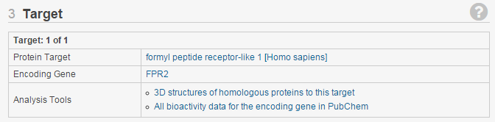
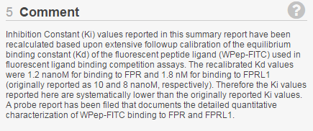
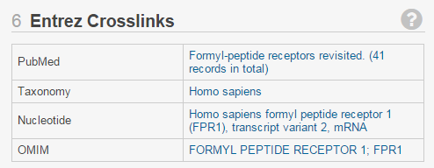
BioAssay Descriptions & Data … https://pubchem.ncbi.nlm.nih.gov/bioassay/1202

Slide 28
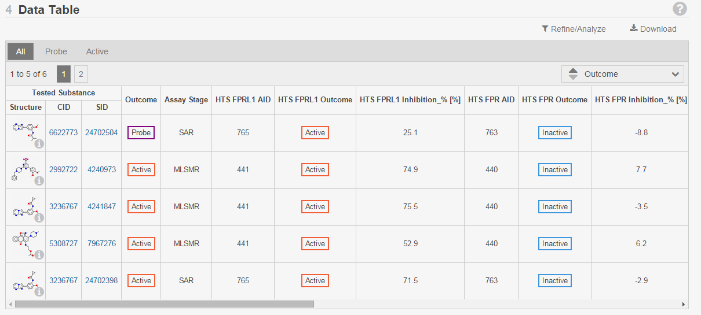

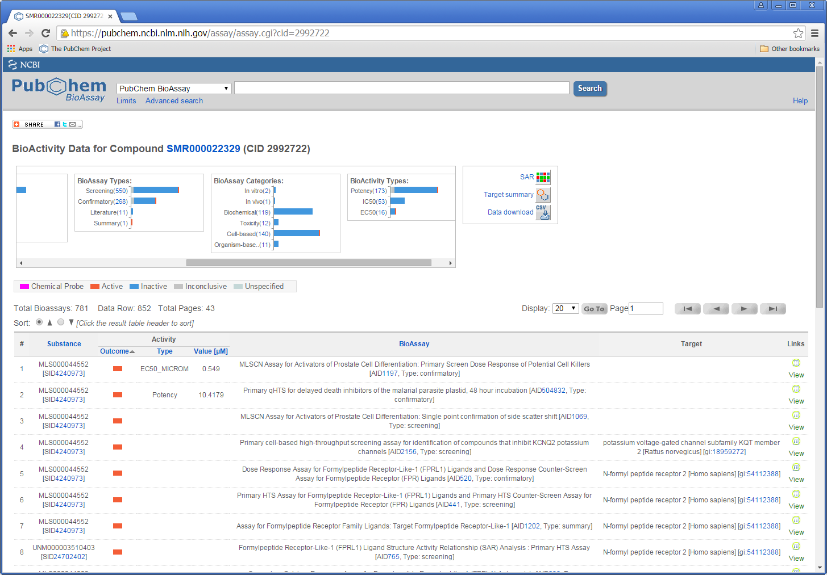
BioAssay Descriptions & Data … https://pubchem.ncbi.nlm.nih.gov/bioassay/1202

Slide 29
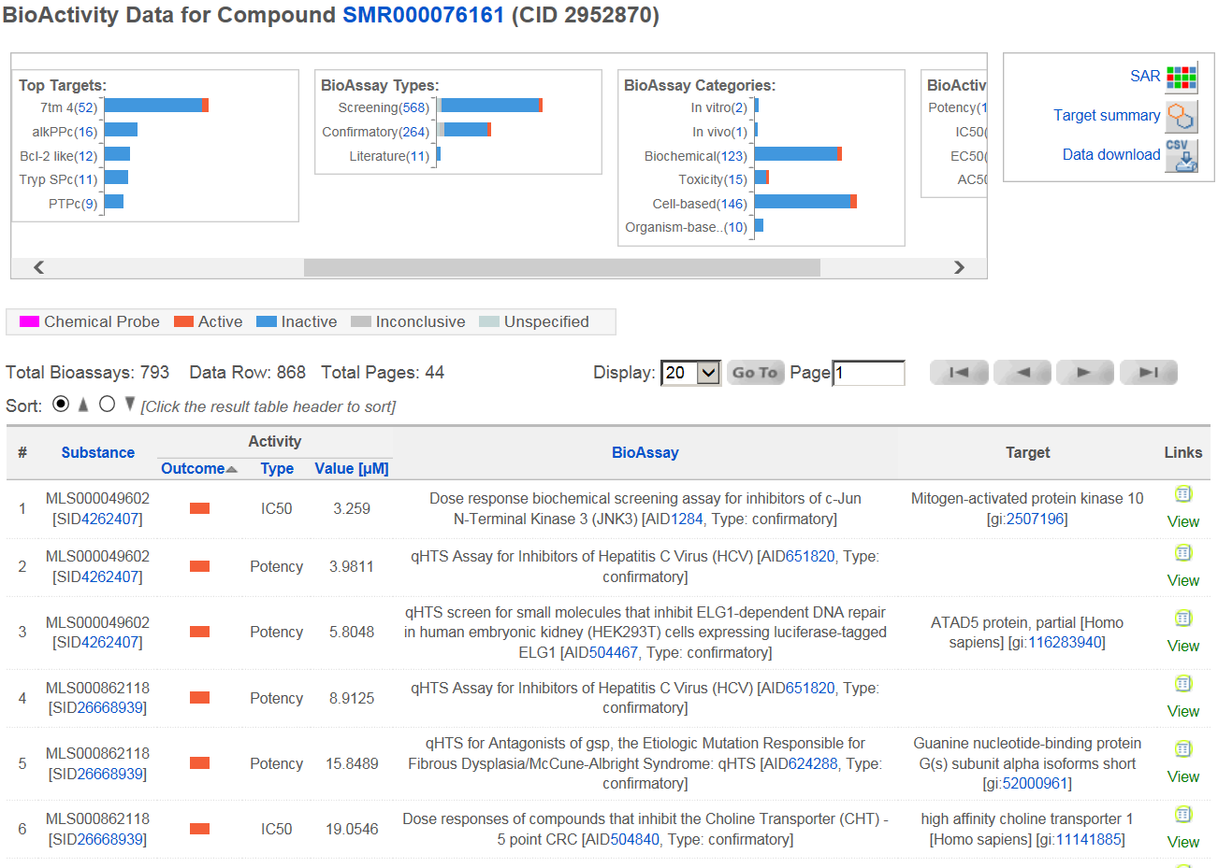
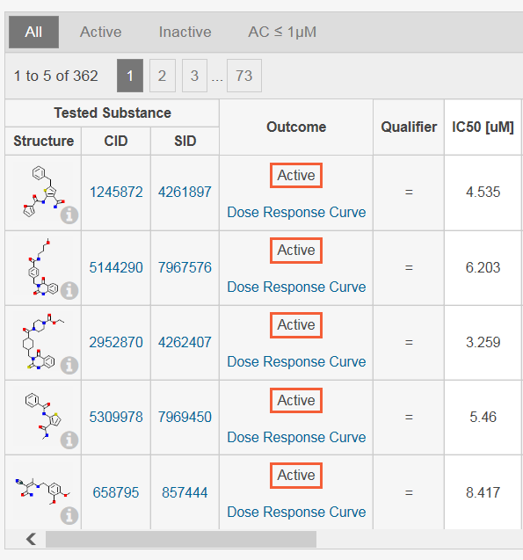
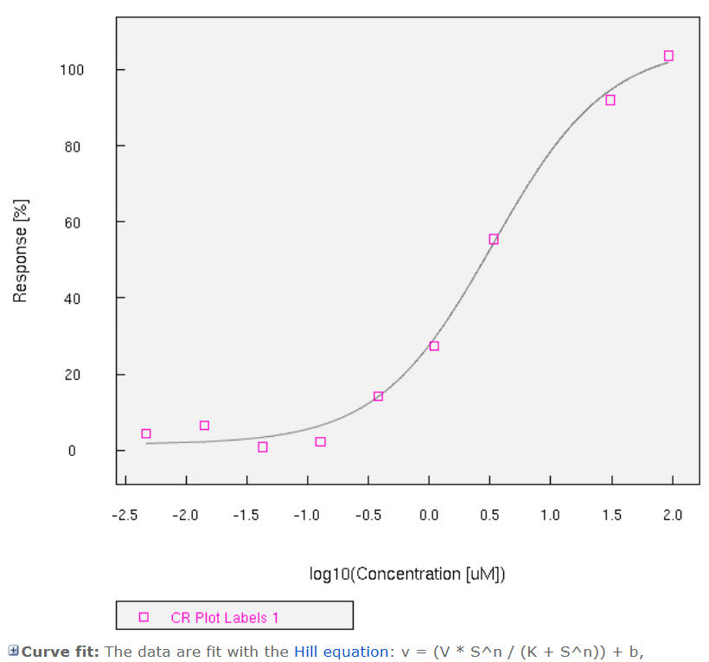
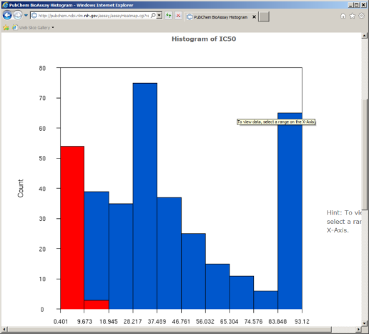
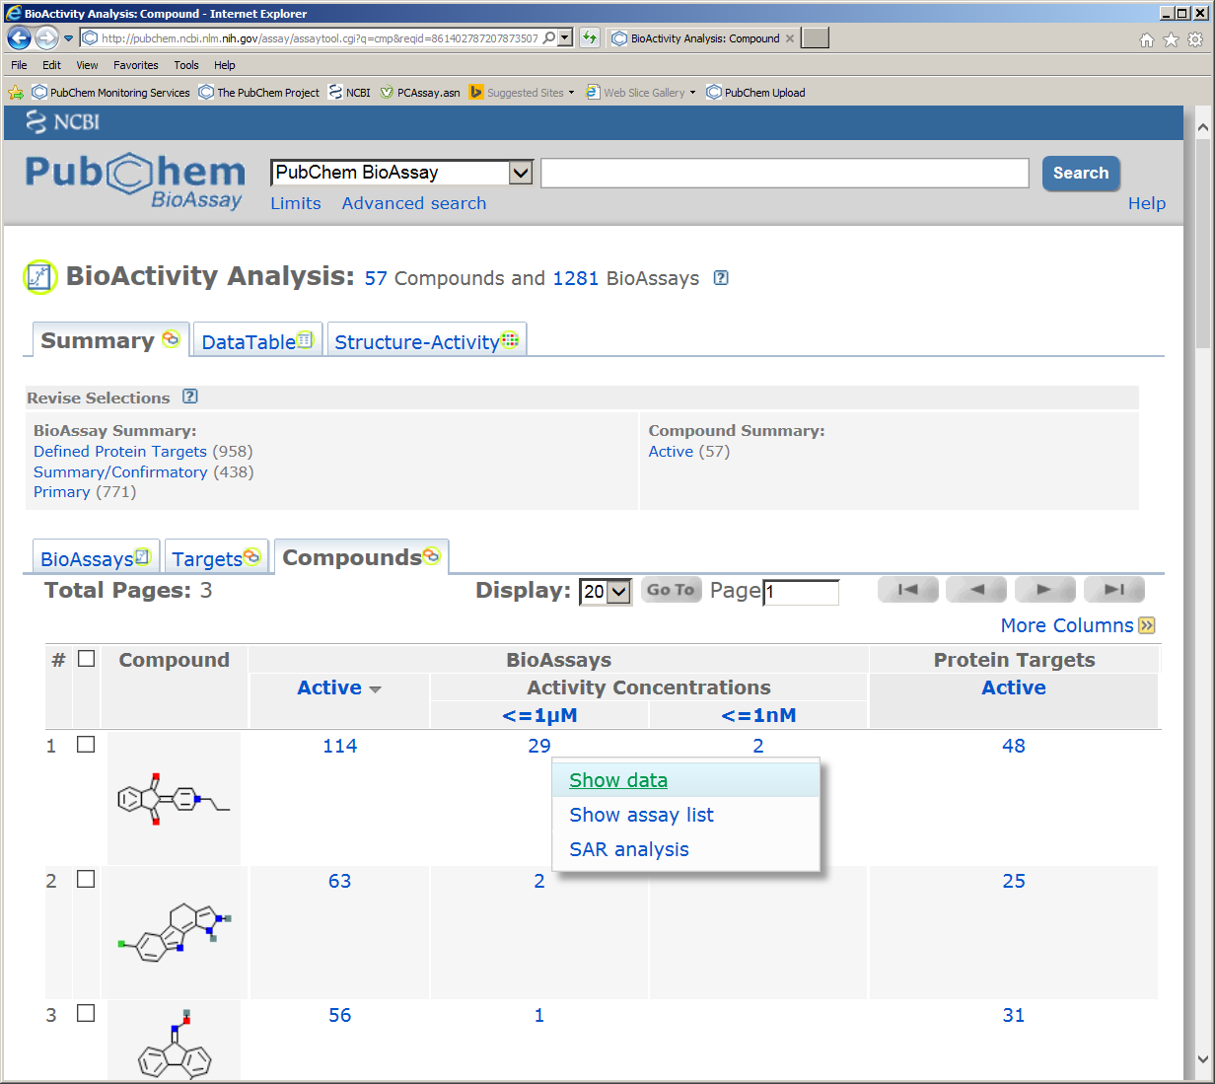
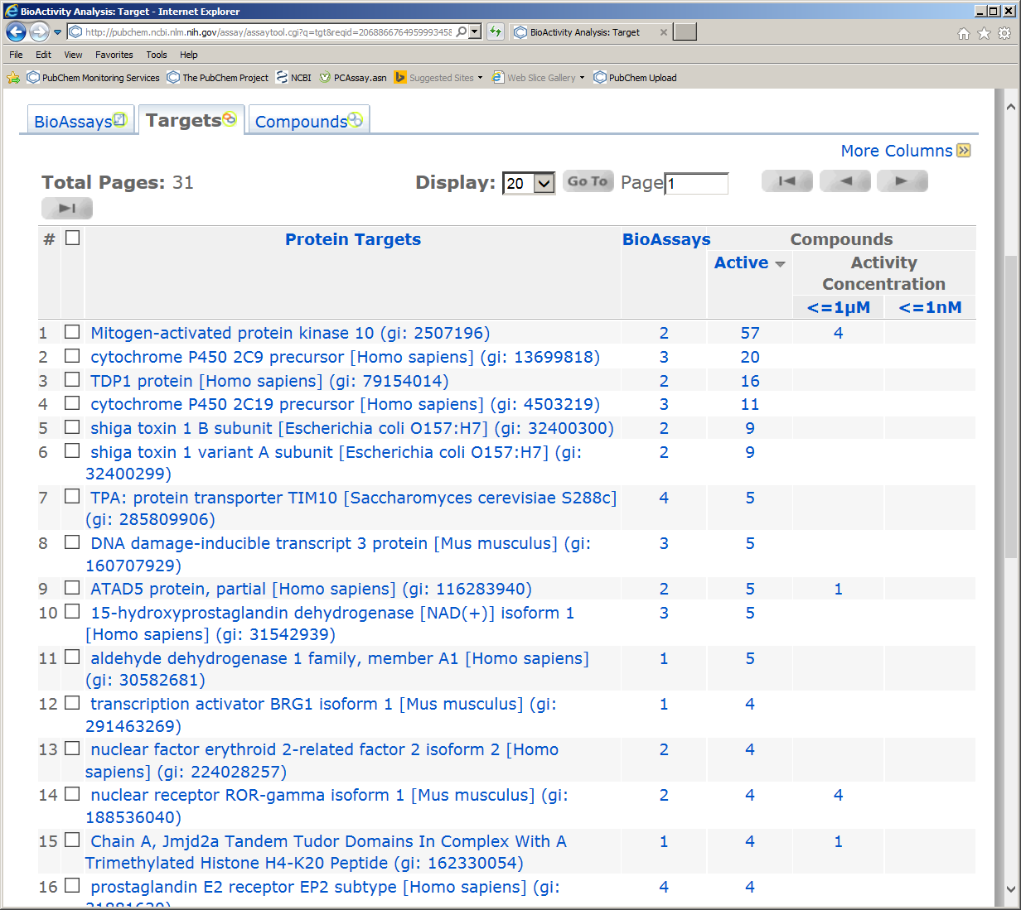
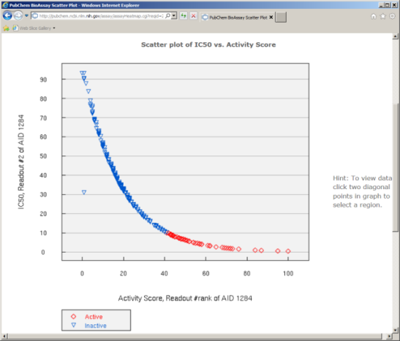
Assay Data & Analysis Tools … https://pubchem.ncbi.nlm.nih.gov/bioassay/1284

Slide 30
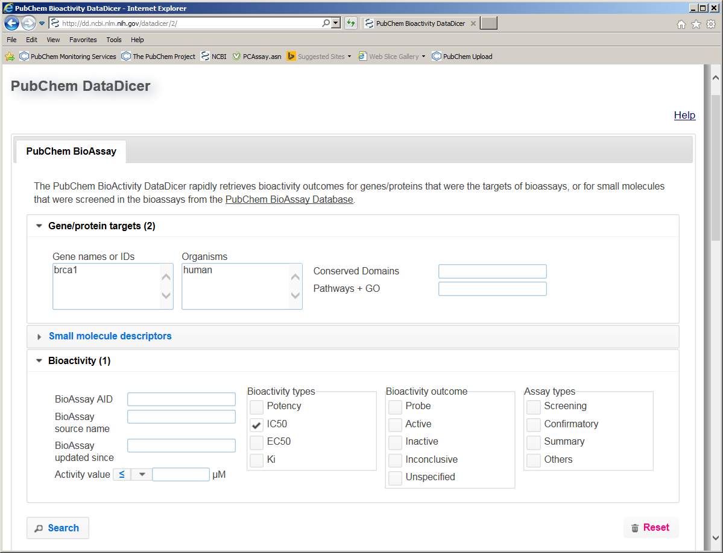
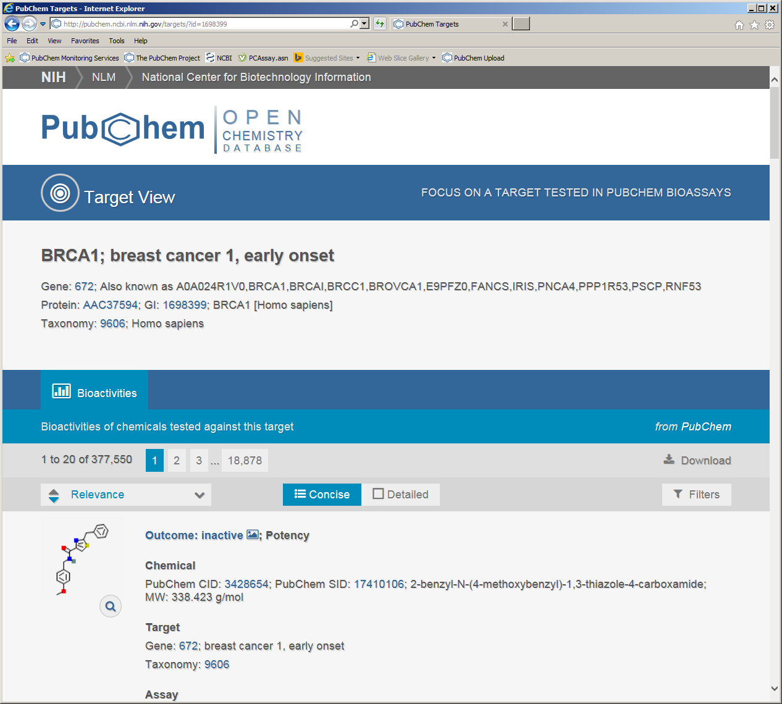
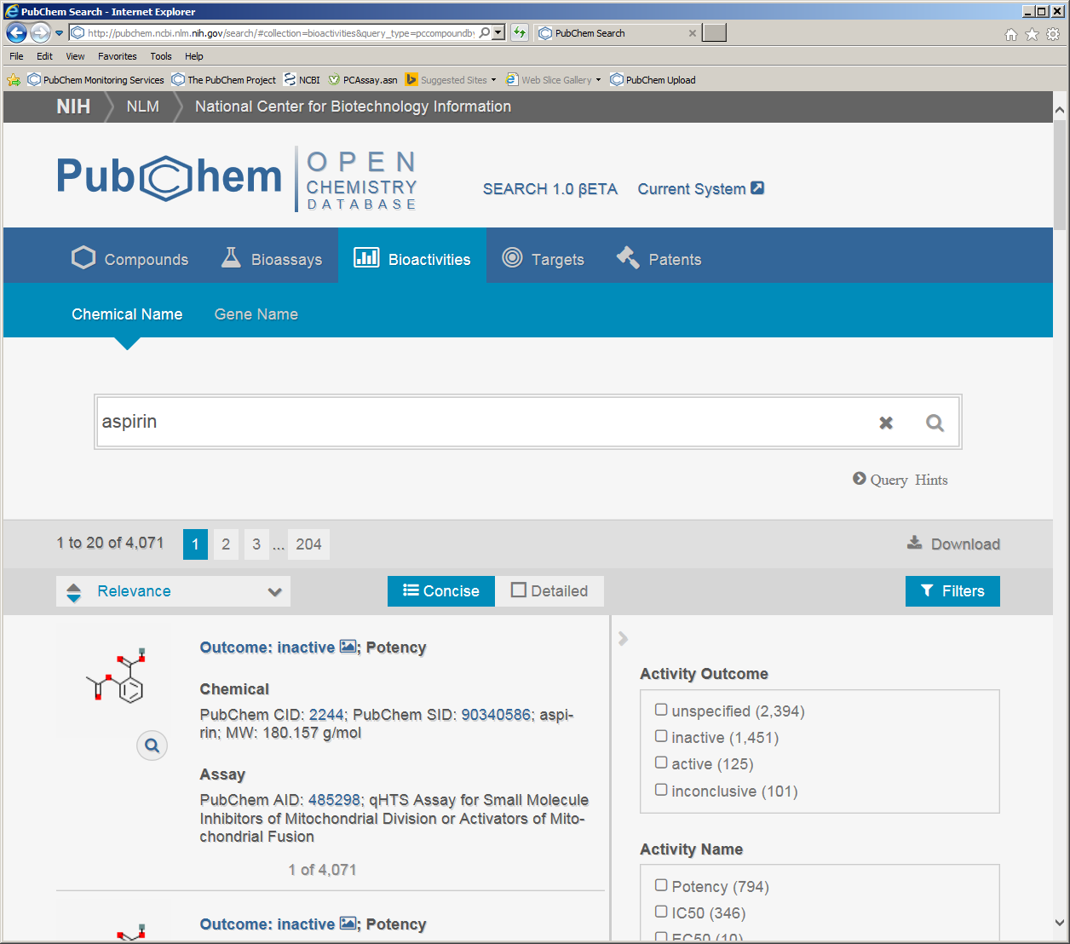
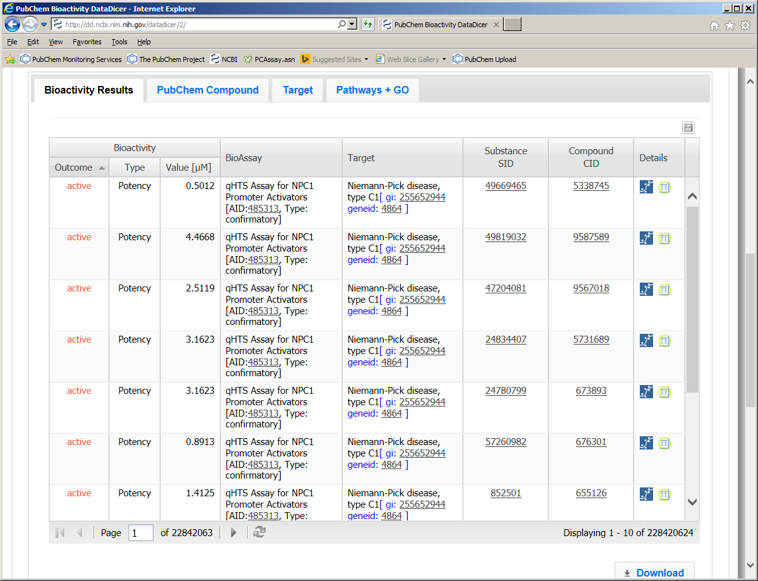
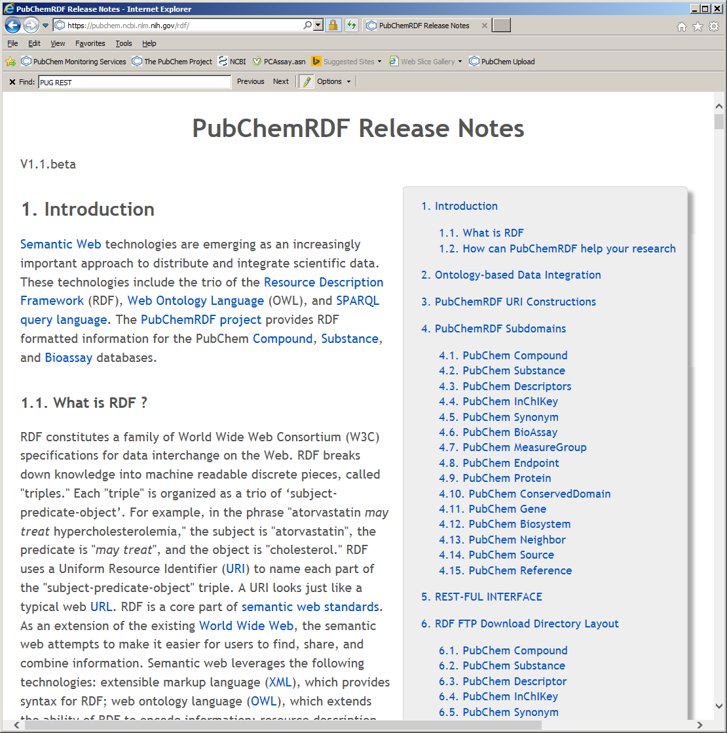
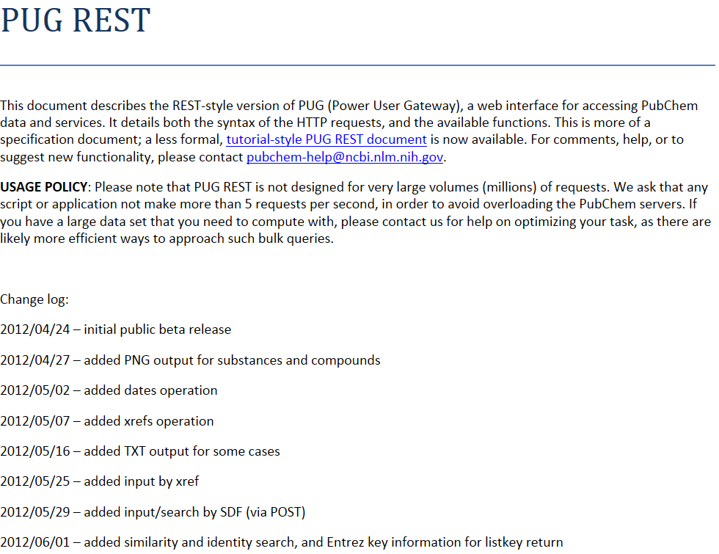
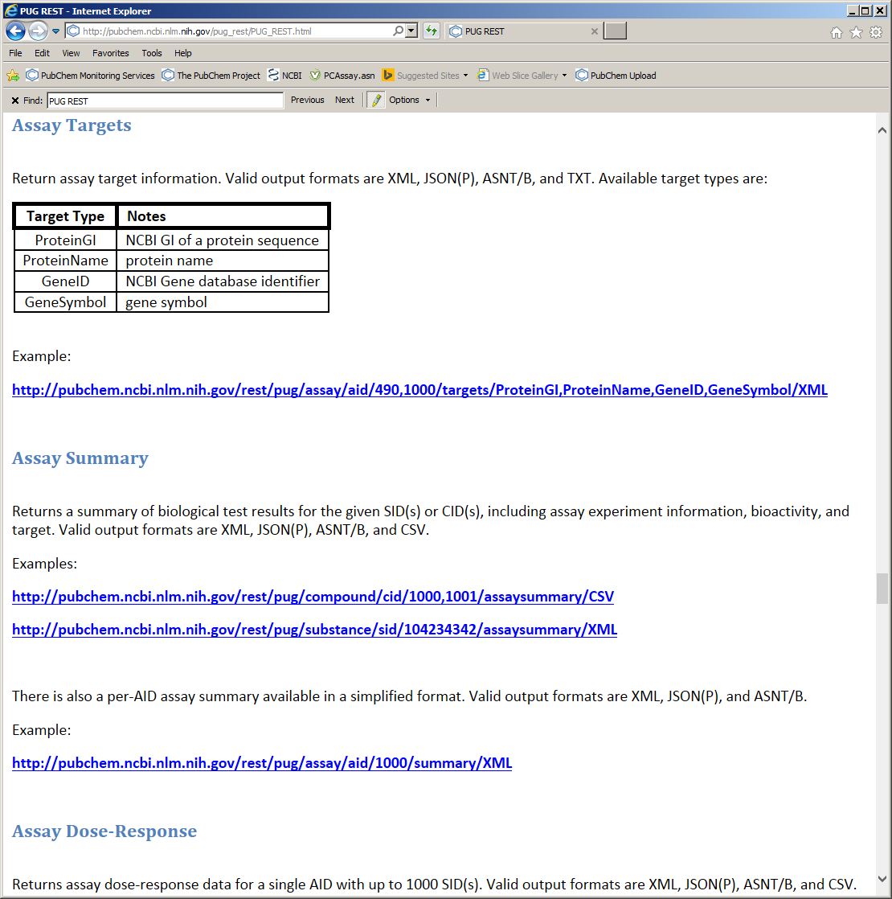
More services …

Slide 31
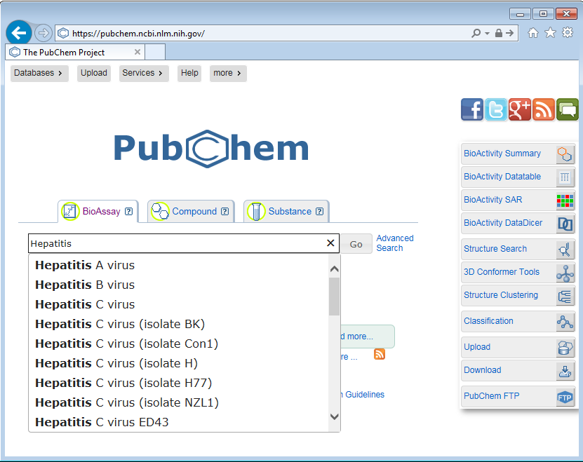
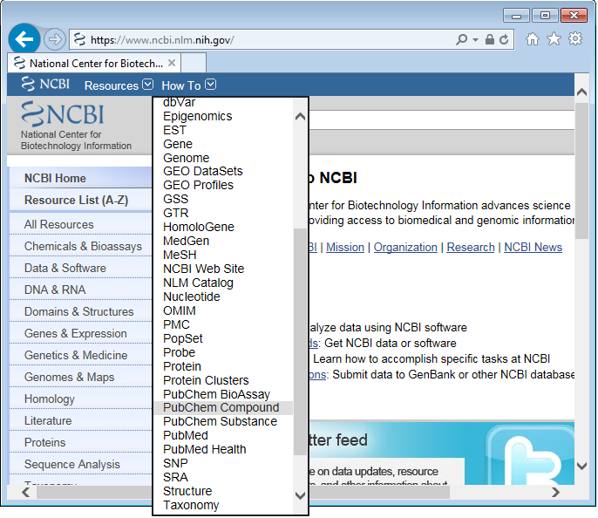
PubChem Search
http://PubChem.ncbi.nlm.nih.gov/
http://www.ncbi.nlm.nih.gov/
Notes:
*autocomplete

Slide 32

BioAssay search by target name

Slide 33


Advanced BioAssay Search Interface … http://www.ncbi.nlm.nih.gov/pcassay/limits?

Slide 34




BioAssay from NCBI Gene search

Slide 35



BioAssay from NCBI PubMed search
Notes:
PMID: 21179498
https://www.ncbi.nlm.nih.gov/pcassay?term=21179498[pmid]

Slide 36





BioAssay from NCBI PubMed search
Notes:
PMID: 21179498
https://www.ncbi.nlm.nih.gov/pcassay?term=21179498[pmid]

Slide 37


Slide 38







Search anti-malarial bioactivity …
Anti-malarial vs cytotoxicity
Notes:
PMID: 21179498
https://www.ncbi.nlm.nih.gov/pcassay?term=21179498[pmid]

Slide 39
BioAssay from NCBI PubMed search
Notes:
PMID: 21179498
https://www.ncbi.nlm.nih.gov/pcassay?term=21179498[pmid]

Slide 40
PubChem applications by biomedical research community
Data retrieval, exchange, and utilization of services provided by PubChem
Molecular information: annotations, synonyms, formula, physicochemical properties, ontology, pharmacological/drug information…..
Molecular structures and images
Structure, bioassy, and fingerprint download
Structure search (key word, similarity, substructure, formula based)
Small molecule high-throughput screening (HTS) data search
siRNA screening data search
SAR analysis
Clustering
Other tools for advanced users
Structure and bioassay deposition by investigators
Drug Discovery Today, 2014 Nov;19(11):1751-6

Slide 41
PubChem applications by biomedical research community
Services and tools involving PubChem
Databases derived from PubChem
Web services & tools compatible with PubChem
Additional resources for chemical biology research
With value added annotations
Improve data flow & minimize manual work
Lower barriers of data exchange
Extracting data from PubChem
Accepting PubChem identifiers
Cross-linking to PubChem
Drug Discovery Today, 2014 Nov;19(11):1751-6

Slide 42

Require PubChem Identifier …

Slide 43


Stand on top of PubChem…

Slide 44
PubChem applications by biomedical research community
Applications in informatics research
Data mining PubChem, chemical structures, bioactivity data
Developing and validating informatics methods, tools
Chemical space analysis, scaffold, diversity, drug like property
Polypharmacology analysis
Drug bioactivity profile
Compound-target-pathway network
Virtual screening
Generate & validate SAR model
Drug Discovery Today, 2014 Nov;19(11):1751-6

Slide 45



Data mining PubChem BioAssay…

Slide 46


Data mining PubChem BioAssay…

Slide 47




Data mining PubChem BioAssay…

Slide 48
PubChem applications by biomedical research community
Applications in wet-lab experiments
Utilized in lead identification & optimization
Facilitate drug discovery and design of drug candidate
Evaluate compound/drug bioactivity profile, selectivity, promiscuity, novelty, cytotoxicity
Assisted by informatics research
Validated with experiments
Compile specific screening library, specific chemical space
Bioassay data/target/outcome guided compound selection
Enable drug-target interaction study
Pools of assay protocols
Help analytic chemists to identify biomarkers, metabolites, exact mass, molecular formula, fragment search
Drug Discovery Today, 2014 Nov;19(11):1751-6

Slide 49
Submit data to PubChem
Maximize the benefit of your research.
Link your data to widely-used biological and literature databases
Save time and effort in open-access data sharing
Maintain control over when your data becomes public

Slide 50

Uploading data is easy
Minimal startup time
Flexible interface
Spreadsheet data accepted via file or web interface

Slide 51


Upload screening results
Spreadsheet load
File or web
Include all test results
E.g. an article table

Slide 52


On-hold Record Flexibility
Time the public release of your data
Satisfy journals and funding agencies
Receive PubChem Ids up-front
Create View Keys to privately share URLs with collaborators
Keep data on-hold as long as necessary

Slide 53
PubChem Upload System…
… Important documents
Upload Help:
http://pubchem.ncbi.nlm.nih.gov/upload/docs/upload_help.html
Sample files for assay submission - http://pubchem.ncbi.nlm.nih.gov/upload/docs/upload_help.html#AssaySampleFile
On-hold:
http://pubchem.ncbi.nlm.nih.gov/upload/docs/
Share on hold data with collaborators:
upload_help_complete.html#DataReleaseHoldUntilDate
PubChem Upload Blogs:
http://pubchemblog.ncbi.nlm.nih.gov/2014/07/
http://pubchemblog.ncbi.nlm.nih.gov/2013/11/

Slide 54
PubChem references
Bolton E, Wang Y, et al. PubChem: Integrated Platform of Small Molecules and Biological Activities. Chapter 12 IN Annual Reports in Computational Chemistry, Volume 4, Elsevier: Oxford, UK; 2008, pp. 217-240.
Wang Y, et al. PubChem BioAssay: 2014 update. Nucleic Acids Res. 2014 Jan 1;42(1):D1075-1082.
Li Q, Cheng T, Wang Y*, Bryant SH*. PubChem as a public resource for drug discovery. Drug Discov Today. 2010, 15(23-24):1052-1057.
Pan Y, Cheng, T, Wang Y*, Bryant SH*. Pathway Analysis for Drug Repositioning Based on Public Database Mining. J Chem Inf Model. 2014, 54, 407−418
Cheng T, Pan Y, Hao M, Wang Y*, Bryant SH*. PubChem Applications in Drug Discovery – a Bibliometric Analysis, Drug Discovery Today (invited review, to be submitted)

Slide 55
Summary
A public repository of chemistry research data
Search structure similarity and bioactivity
Identify target and off-targets
Evaluate selectivity, promiscuity, toxicity
SAR analysis
Compare to prior art
Explore biological and chemical space
Derive biological profile
Construct target network
Drug repositioning

Slide 56

Acknowledgement
Steve Bryant
Evan Bolton
Jie Chen
Tiejun Cheng
Gang Fu
Haehnke Volker
Lewis Geer
Renata Geer
Asta Gindulyte
Lianyi Han
Jane He
Siqian He
Sunghwan Kim
Ben Shoemaker
Paul Thiessen
Jiyao Wang
Bo Yu
Jian Zhang

Slide 57
PubChem … Open & Public Resource http://pubchem.ncbi.nlm.nih.gov
Send questions to:
pubchem-help@ncbi.nlm.nih.gov
pubchem-deposit-help@ncbi.nlm.nih.gov
ywang@ncbi.nlm.nih.gov
Thank you!

