Slide 1
Thermodynamics and Topological investigations of ternary mixtures containing ionic liquid with organic solvents: excess molar volumes and excess isentropic compressibilities
Dr. V.K. Sharma
Prof. & Head
Department of Chemistry
Maharshi Dayanand University,
Rohtak-124001, Haryana, INDIA

Slide 2
Importance of thermodynamic data of ionic liquid mixtures in industries
As challenge emerged in the burgeoning chemical industries and environmental pollution due to use of volatile organic solvents, researchers were confined in a box what they could and could not do.
Large quantities of liquids or their mixtures are used as solvents for numerous processes in chemical and related industries; thus the challenge of non-harmful solvents, because of new environmental regulations, has promoted great developments of innovative products like ionic liquids to protect the environment and also to replace traditional volatile and corrosive organic liquid in industries.
Creating new thermodynamic data on liquid liquids mixtures containing ionic liquid due to their unique properties will foster new opportunities for their use in chemical industries.
such data could also be utilized for the applications of ionic liquids or their mixtures with organic liquids to design new chemical and technical processes; and for chemical engineering applications like mass transfer and heat transfer.
The thermodynamic properties like excess molar volumes, VE, excess molar enthalpies, H^{E}, excess heat capacities, and excess isentropic compressibilities, of liquid mixtures is indispensable for the choice and design of equipments, namely, heat exchangers, reactors, separation unit etc.
These properties are also required to establish theoretical models/theories and information about molecular interactions in mixtures.

Slide 3
Precise density data of liquid mixtures have immense significance in designing engineering processes and production in chemical and biological industries. Engine performance characteristics such as cetane number (which expresses heating value and ignition quality) of fuel are directly affected by the densities.
Excess molar volumes, VE is considered as a first-order thermodynamic quantity and is very sensitive to change in the structure or randomness during the mixing processes. Thus, order creation and order destruction processes in mixtures can be determined through experimental data of VE.
The speeds of sound, u data and related derived acoustic properties have been found to be a very powerful tool in industries for the design of industrial plants, pumps and pipelines etc.

Slide 4
Excess molar enthalpies, H^{E} data are of great implication in engineering applications in the fields of heat transfer, thermo-fluids, energy conversions, design engines and power plants, heating, ventilation and air conditioning systems, heat exchangers, heat sinks, radiators, refrigeration etc.
The heat capacity, C_{P} of a substance is one of the most important thermo-physical properties. It is widely used in physics and chemistry as well as in chemical engineering, energy resources, and material engineering. The heat capacity data of liquid mixtures are also demanded in modern industrial and engineering designs. A precise knowledge of heat capacities of liquids as a function of temperature provides insight into their molecular structure and information on intermolecular interactions.

Slide 5
Importance of studied mixtures
1-ethyl-3-methylimidazolium tetrafluoroborate [emim][BF₄] (i) + water (j) + formamide [FD] (k)
1-ethyl-3-methylimidazolium tetrafluoroborate (i) + water (j) +
N,N- dimethylformamide [DMF] (k)
Among the varieties of ionic liquids, the imidazolium based ionic liquid (1-alkyl-3-methyl imidazolium) is the most commonly investigated group. The anions in the structures of ionic liquids are BF₄⁻,
PF₆⁻, trifluoromethane sulphonate etc. However, ion is widely used due to its competitive properties and low cost.
The 1-ethyl-3-methylimidazolium tetrafluoroborate is one of the imidazolium based ionic liquid and has received much attention for use in a variety of commercial applications such as batteries, photovoltaics, metal deposition, and capacitors

Slide 6
Formamide and N,N-dimethylformamide are good solvents in many chemical syntheses as well as in the manufacturing of synthetic fibers and leathers. N,N-dimethylformamide is also widely used in industry for the production of resins, protective coatings, adhesives, films, printing inks, condensers and in electroplating.
Water is a universal solvents and is used in industries for several applications.
Consequently, [emim][BF₄] (i) + water (j) + Formamide or N,N-dimethylformamide (k) mixtures may, therefore, comprise a class of mixtures which may be useful for various industrial and technical processes.

Slide 7
Experimental
The densities, ρ, speeds of sound, u of 1-ethyl-3-methylimidazolium tetrafluoroborate (i) + water (j) + formamide or N,N- dimethylformamide (k) ternary mixtures at 293.15, 298.15, 303.15, 308.15 K have been measured over entire mole fraction using DSA-5000 (M/s Anton Paar, Austria).
Uncertainty in density
measurement = ±0.5 Kg. m⁻³
Uncertainty in speed of sound
measurement = 0.1 m. s⁻¹
DENSITY & SOUND ANALYZER
(Anton Paar DSA-5000)
DENSITY AND SOUND VELOCITY CELL

Slide 8
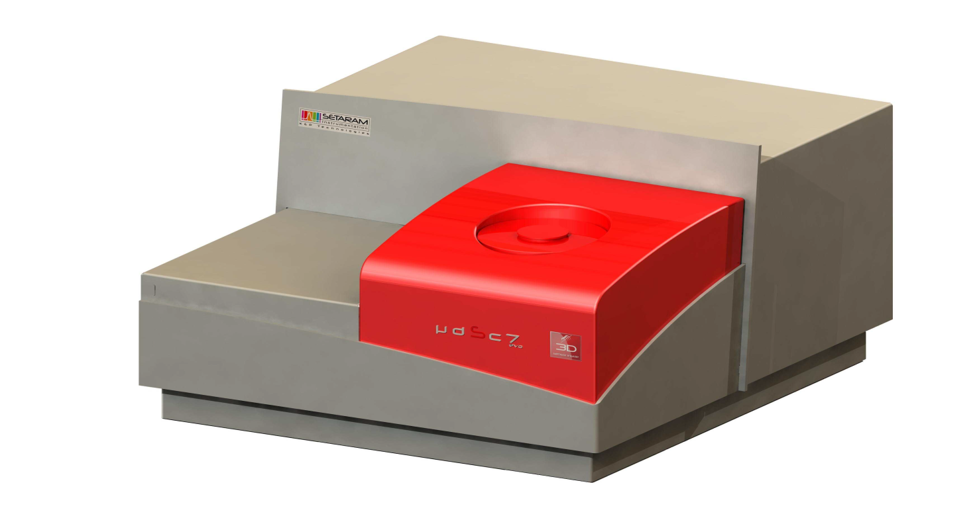
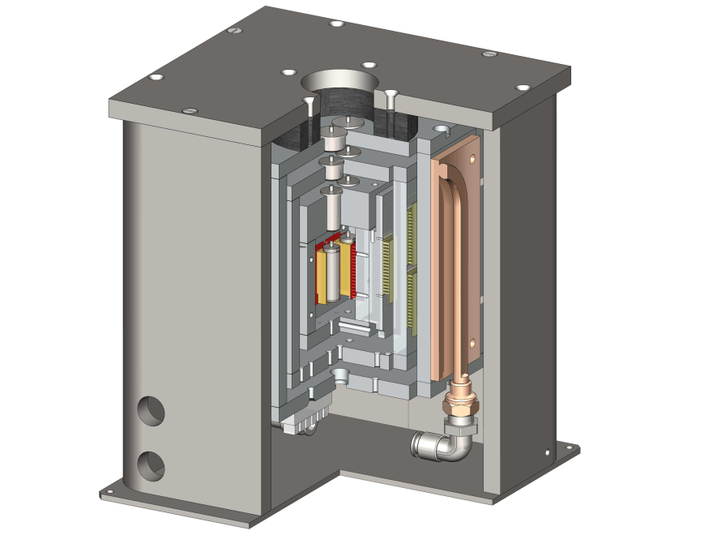
The heat capacities, C_{p} of the pure studied liquids were measured by high sensitivity differential scanning calorimeter (Model – μDSC 7 Evo) manufactured by SETARAM instrumentation, France.
Uncertainty in heat capacity measurement = ± 0.3 %
μDSC 7 Evo
Calorimetric transducer

Slide 9
Results
The densities and speeds of sound data were utilized to determine
excess molar volumes, and isentropic compressibilities,
of ternary mixtures using relations:
(1)
(2)
where , M_{i} and are the mole fraction, molar mass, and density of pure component (i) and is the densities of ternary mixtures.
The excess isentropic compressibilities, for the studied mixtures
were determined using
(3)
(the compressibility for ideal mixtures) values were calculated in the manner as suggested by Benson and Kiyohara using

Slide 10
(4)
Where , , , and (i = i or j or k) are the volume fraction, isentropic compressibility, molar volume, thermal expansion coefficient and molar heat capacity of pure component (i).
The and data for the present mixtures were fitted to Redlich-Kister equation

Slide 11
(5)
where , , (n = 0-2) and (X = V or ) (n = 0-2) are binary and ternary adjustable parameters of (i + j), (j + k), (i + k) binaries and (i + j + k) mixtures respectively.
The (X = V or ) (n = 0-2) were determined by fitting the measured
( ) (X = V or ) data to Eq. (5) by least-squares method. The resulting parameters along with standard deviations,σ ( )(X = V or ) expressed by the relation:
σ ( )
= {[ ∑ - ]² / (m-n)}^{0.5}
(6)
{where m is the number of data points and n is the number of adjustable
parameters of Eq. (5)} are reported in table.
The standard deviations in the measured properties suggest that observed data are of required accuracy to be used in industries for various applications.

Slide 12
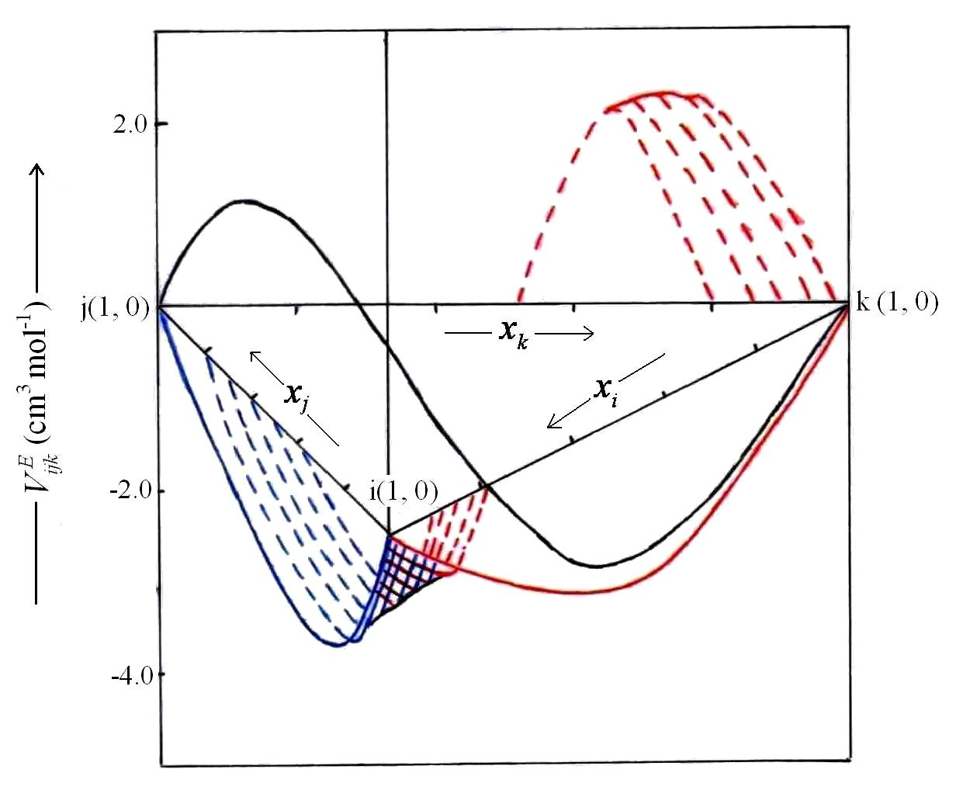
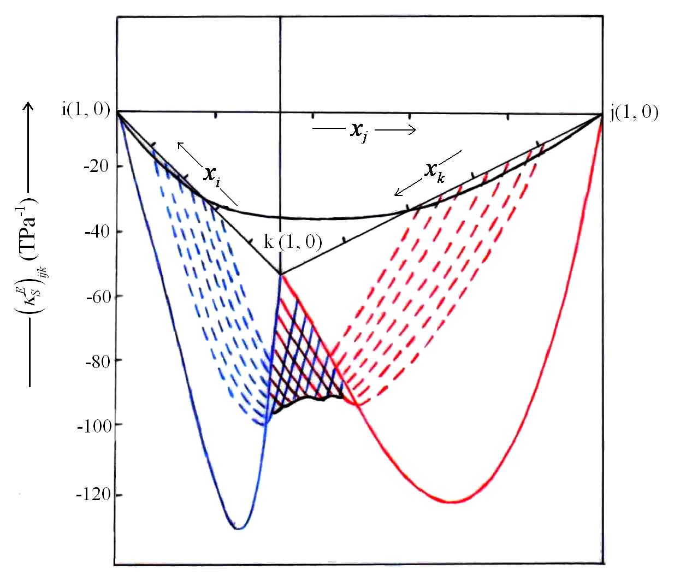
The various surfaces generated for the ternary mixtures by and
values {evaluated by employing Eq. (5)} at 298.15 K are shown in Figs.
Excess molar volumes for 1-ethyl-3-methy limidazolium tetrafluoroborate (i) + Water (j) + Formamide (k) ternary mixture at 298.15 K,
( ), the experimental data in front of the plane; ( ­­­­­­­­­-- ), the experimental data behind the plane.
Excess isentropic compreesibilities for 1-ethyl-3-methylimidazolium tetrafluoroborate (i) + Water (j) + Formamide (k) ternary mixture at 298.15 K,
( ), the experimental data in front of the plane; ( ­­­­­­­­­-- ), the experimental data behind the plane.

Slide 13
DISCUSSION
The values for the studied mixtures are negative over whole mole fraction range.
Further, while values for [emim][BF₄] (i) + water (j) + DMF (k) mixture are negative over entire composition range at the studied temperatures; those for [emim][BF₄] (i) + water (j) + FD (k) mixtures are negative at 293.15, 298.15 K and sign of values at 303.15, 308.15 K is dictated by the relative proportion of components.
The sign of and provides information about the molecular arrangement and molecular interactions operating among the constituent mixtures.
[emim][BF₄] is capable of interacting with water, FD and DMF via ionic, hydrogen bonding and dipole interactions.
The negative and values suggests a more packed arrangement of [emim][BF₄] or water or FD or DMF in their mixed state as compared to pure state and also attractive molecular interactions among the constituents of mixtures .
V. K. Sharma, S. Bhagour, S. Solanki, J. Kataria, Int. J. Pharma Bio. Sci. 6(2), 611-633, 2015.
The observed and data were next analyzed in terms of graph theory.

Slide 14
Graph theory
Excess molar volumes and excess isentropic compressibilties
A ternary (i + j + k) mixture is assumed to comprise of these (i+j), (j+k) and (i+k) binary mixtures. Thermodynamic properties of ternary mixtures can be predicted if state of component i or j or k in their pure and mixed state are known in their sub-binary mixtures. The addition of (i) to (j) would change the topology of i/j in their mixed state, and as VE reflects PACKING EFFECT. So, it is worthwhile to analyze the molar excess volumes, VE data of [emim][BF₄] (i) + FD or DMF or water ( j) binary mixtures in terms of Graph theory (which deals with topology of constituent molecules) to extract information about
1) the state of [emim][BF₄] or FD or DMF or water in pure and mixed state
For this purpose, we analyze the VE data of [emim][BF4] + FD or DMF or water binary mixtures in terms of Graph theory. According to Graph theory, VE is given by:
(7)
P.P. Singh, V.K. Sharma, Thermochim. Acta 106 (1986) 293-307

Slide 15
where (³ξ_{i})_{m} (i-i or j) and (³ξ_{i}) etc refers to ³ξ_{i} if i/j in the mixture and pure state respectively.
e.g.
If i or j undergo association in the (i+j)) mixture, (³ξ_{i})_{m} may or may not be equal to ³ξ_{i} etc. and as such an analysis of VE data in terms of Eq.(7) will provide valuable information regarding the state of association of the components of mixtures in pure and mixed state
2
2
2
δ^{υ} = Z_{m}- h_{m}
2
2
³ξ = 6 [1 /√2x2x2x2] = 1.5
2
δ^{υ} (C) = 4 - 2 = 2
Benzene
P.P. Singh, V.K. Sharma, Thermochim. Acta 106 (1986) 293-307

Slide 16
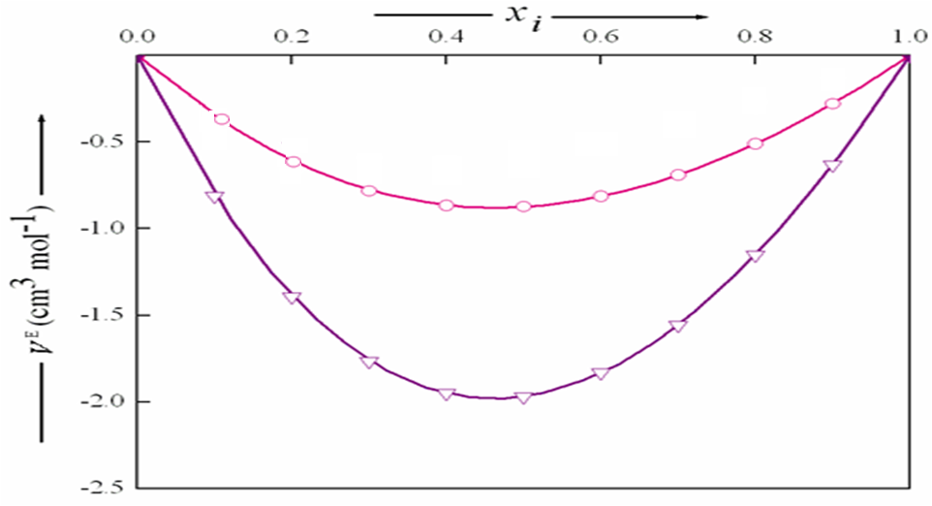
The degree of association of (i) or (j) in pure and mixture state is not known, therefore, we regarded (³ξ_{i})(i = i or j) and (³ξ_{i})_{m} (i = i or j) as adjustable parameters. These parameters were evaluated by fitting VE data of mixtures to Eq. (7). Only those values of parameters were retained that best reproduced the experimental VE data. Also values {evaluated by employing Eq. (7)} at various mole fraction of (i), x_{i} , are plotted in Fig. and are compared with their corresponding experimental values. A perusal of Fig. reveals that values compare well with their corresponding experimental values. Thus (³ξ_{i})(i = i or j) and (³ξ_{i})_{m}(i = i or j) values can be relied upon to extract information about the state of aggregation of (i) or (j) in pure and mixed state.
Excess molar volumes at T = 298.15 for (I) 1-ethyl-3-methylimidazolium tetrafluoroborate (i) + formamide (j) Exptl. ,Graph ;(II) 1-ethyl-3-methylimidazolium tetrafluoroborate (i) + N,N-dimethyl formamide (j) Exptl. , Graph .
V. K. Sharma, Soniya, J. Solution Chem. 42, 800-822, 2013. Impact Factor 1.128

Slide 17
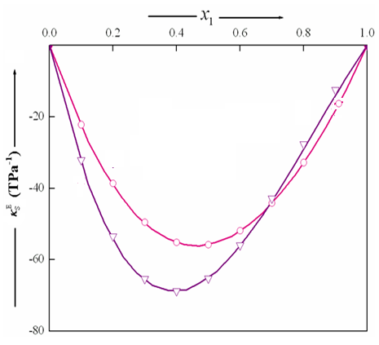
Excess molar volumes at T = 298.15 for (I) 1-ethyl-3-methylimidazolium tetrafluoroborate (i) + formamide (j) Exptl. ,Graph ;(II) 1-ethyl-3-methylimidazolium tetrafluoroborate (i) + N,N-dimethyl formamide (j)
Exptl. , Graph .
V. K. Sharma, Soniya, J. Solution Chem. 42, 800-822, 2013. Impact Factor 1.128

Slide 18
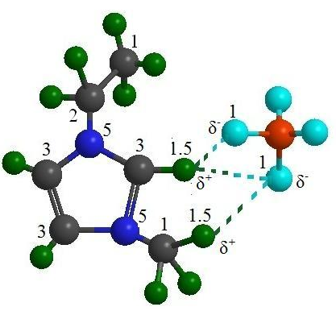
[emim][BF₄] (i) + FD or DMF (j) mixtures
It was assumed that [emim][BF₄ in pure state exist as molecular entity I
I
[emim][BF₄]
³ξ / = 1.639
Boron
Carbon
Fluorine
³ξ = 1.504
Hydrogen
Nitrogen
Our observation about the state of [emim][BF₄] is consistent with earlier observations inferred from IR, Raman spectra and scaled quantum mechanics analysis of [emim][BF₄] which suggest that (i) [BF4] is positioned over the imidazolium ring and has short contacts not only with H–C(2), but also with a proton of the –CH3 group; and (ii) the ion pair formation strongly influences three antisymmetric B–F stretching vibrations of the anion, and out-of-plane and stretching vibrations of the H–C(2) moiety of the cation.
D. Sharma, S. Bhagour, V. K. Sharma, J. Chem. Eng. Data 57, 3488-3497, 2012. Impact factor 2.004

Slide 19
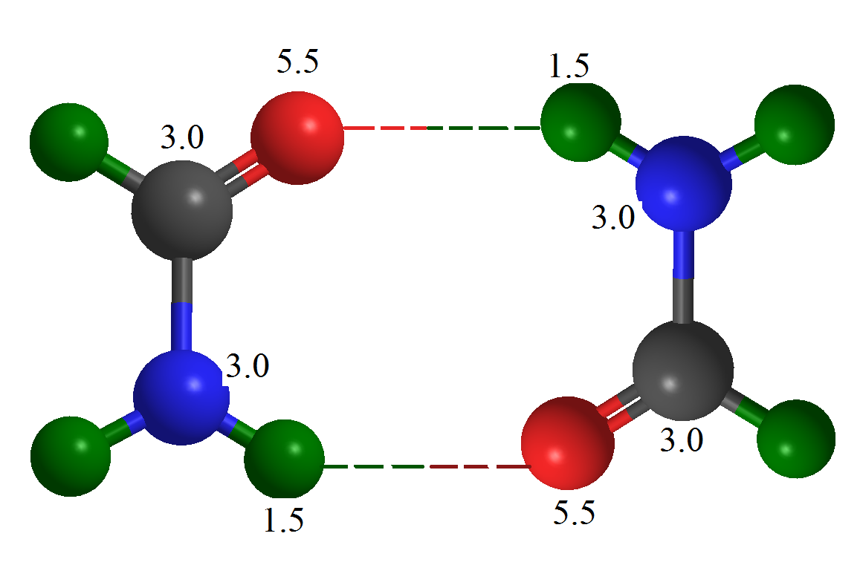
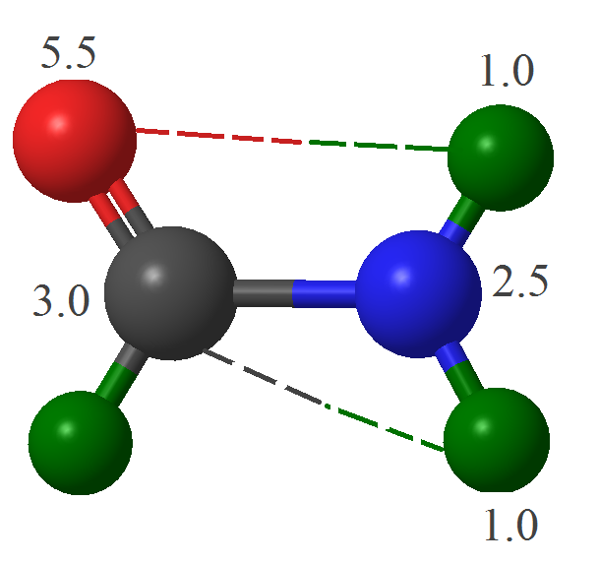
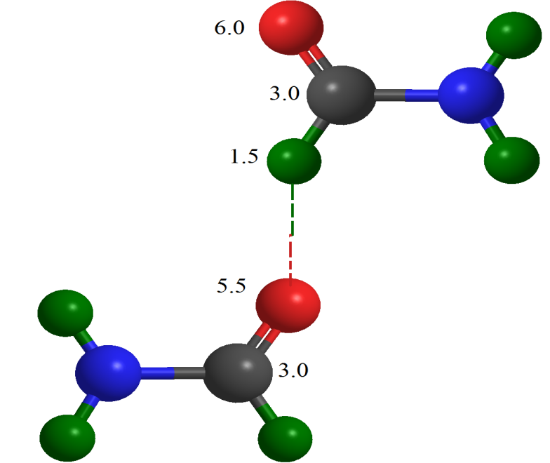
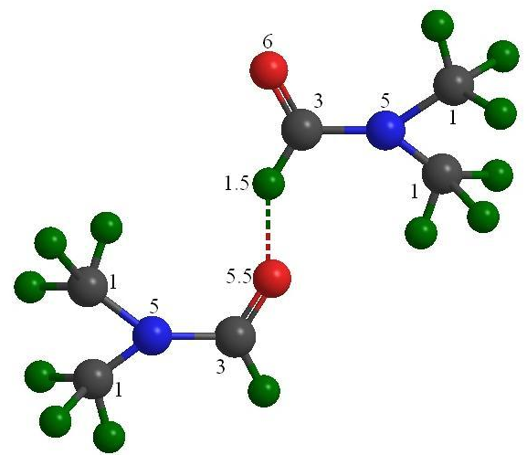
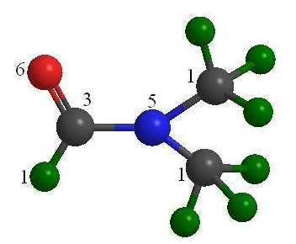
FD
³ξ / = 0.312
FD
³ξ / = 0.491
FD
³ξ / = 0.582
³ξ = 0.543
Carbon
Hydrogen
DMF
³ξ / = 0.809
Nitrogen
DMF
³ξ / = 0.211
Oxygen
³ξ = 1.095
V. K. Sharma, Soniya, J. Solution Chem. 42, 800-822, 2013. Impact Factor 1.128

Slide 20
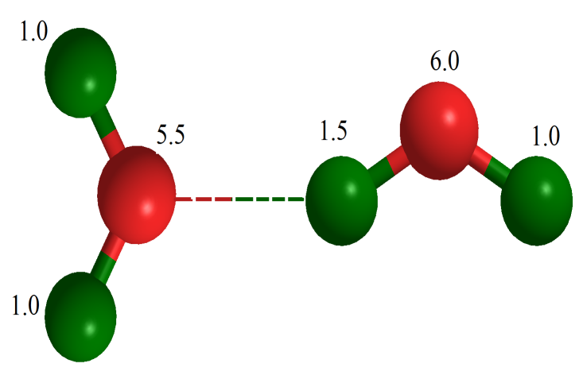
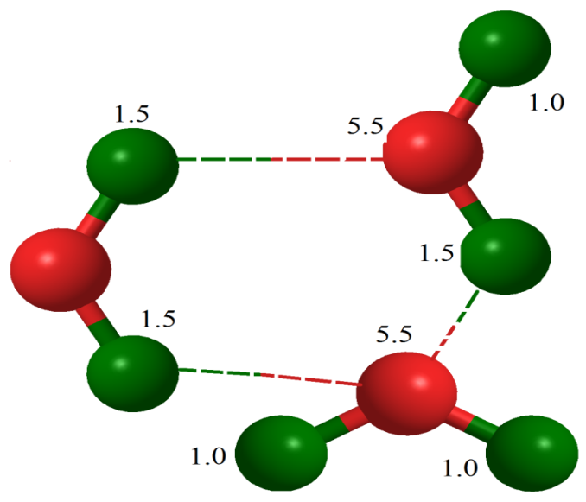
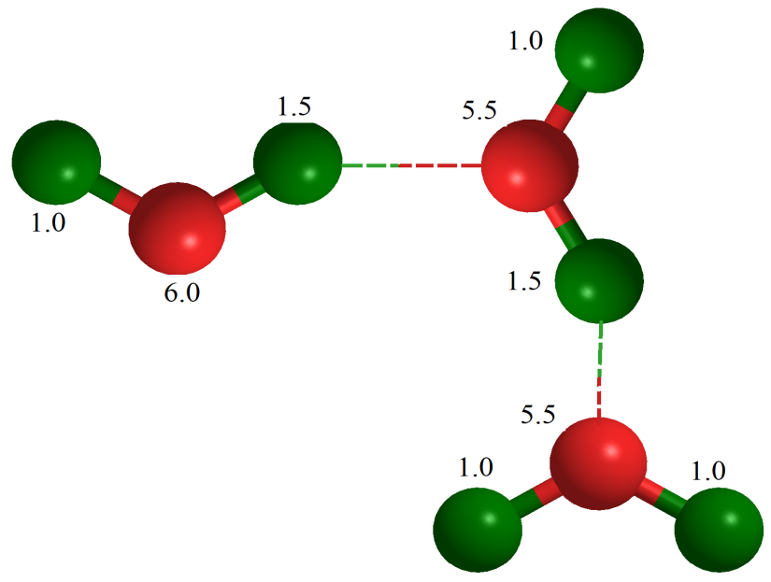
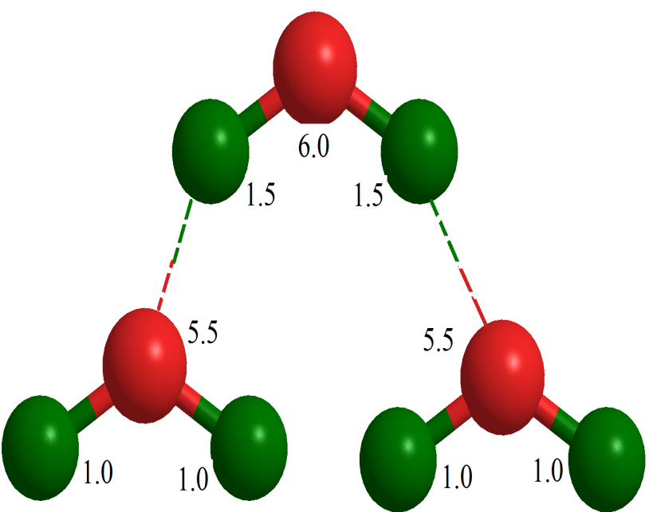
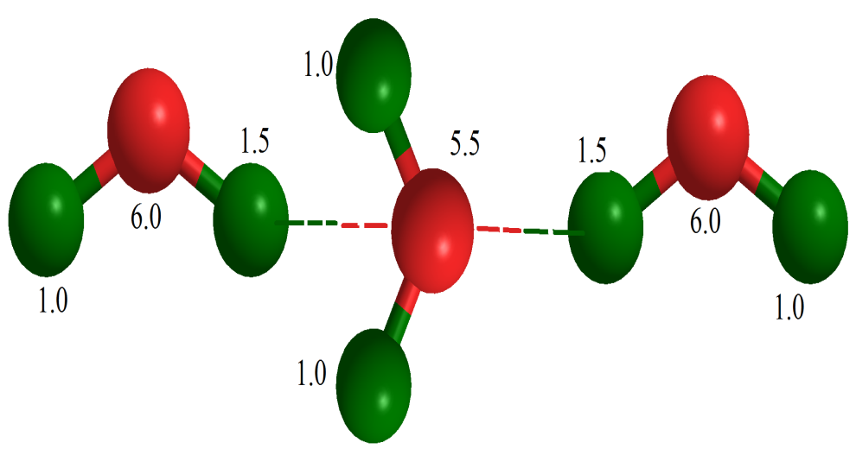
Water
³ξ / = 0.426
Water
³ξ / = 0.462
Water
³ξ / = 1.379
³ξ = 1.08
Water
³ξ / = 1.328
Water
³ξ / = 1.229
Hydrogen
Oxygen

Slide 21
The analyses of VE data of the investigated mixtures in terms of Graph theory have revealed that (1) [emim][BF₄] exist as monomer; (2) water or FD or DMF exists as associated molecular entities.
Graph theory
Excess molar volumes and excess isentropic compressibilties
If the component FD or DMF (k) are added to [emim][BF₄] (i) + water (j) mixture then ternary [emim][BF₄] (i) + water (j) + FD or DMF (k) mixtures formation may be assumed to involve processes;
(i) formation of unlike contacts (a) i-j_{n} (n=2); (b) j_{n}-k_{n} (n=2); and (c)
i-k_{n} between the constituents of mixtures;
(ii) unlike contact formation leads to rupture of associated (a) j_{n}; and
(b) k_{n} molecular entities to give their respective monomers; and
(iii) monomers of i, j and k undergo interactions to form (a) i:j (b) j:k
(c) i:k molecular complexes.
V. K. Sharma, S. Bhagour, S. Solanki, J. Kataria, Int. J. Pharma Bio. Sci. 6(2), 611-633, 2015.

Slide 22
If , ; , ; , , are molar volumes, molar
compressibilities interaction energies parameters for unlike
i-j, j-k and i-k contacts; molar volumes, molar compressibilities
interaction parameters for rupture of j-j, k-k contacts and
specific interactions respectively, The overall change in the
thermodynamics properties, (X = V or ) due to process
(i) (a)-(c), (ii) (a)-(b), (iii) (a)-(c) were then given by
=
+
V. K. Sharma, J. Kataria, S. Solanki, J. Chem. Thermodyn. 86, 43-56, 2015.
V. K. Sharma, S. Solanki, S. Bhagour, J. Chem. Eng. Data 59, 1140-1158, 2014.
V. K. Sharma, A. Rohilla, S. Bhagour, J. Mol. Liquid, 193, 94-115, 2014.
+
(8)
V. K. Sharma, S. Bhagour, S. Solanki, J. Kataria, Int. J. Pharma Bio. Sci. 6(2), 611-633, 2015.

Slide 23
For the present mixtures, if it be assumed that ; ; and Eq. (11) then reduced to
=
+
+
(9)
Eq. (9) is comprised of four unknown , , , parameters and we determined these parameters by employing experimental and
values at four arbitrary compositions. Such parameters were then utilized to determine (X= V or ), at various values of x_{i} and x_{j}.
The estimated and values along with experimental values are listed in Tables.
V. K. Sharma, S. Bhagour, S. Solanki, J. Kataria, Int. J. Pharma Bio. Sci. 6(2), 611-633, 2015.

Slide 24
Table 1. Molar excess volumes of [emim][BF₄] (i) + water (j) + FD (k) ternary mixture at 298.15 K
x_{i} | X_{j} | VE (Exptl) | VE (Graph)
0.1596 | 0.7695 | -0.0401 | -0.0515
0.1809 | 0.7349 | -0.0520 | -0.0585
0.1947 | 0.7076 | -0.0637 | -0.0637
0.2047 | 0.6876 | -0.0721 | -0.0673
0.2217 | 0.6541 | -0.0851 | -0.0729
0.2441 | 0.6168 | -0.0976 | -0.0784
0.2604 | 0.5856 | -0.1036 | -0.0824
0.2839 | 0.5491 | -0.1075 | -0.0864
0.3004 | 0.5245 | -0.1079 | -0.0884
0.3259 | 0.4912 | -0.1061 | -0.0906
0.3475 | 0.466 | -0.1036 | -0.0918
0.3643 | 0.4472 | -0.1006 | -0.0924
0.3884 | 0.4218 | -0.0959 | -0.0927
0.4031 | 0.4069 | -0.0927 | -0.0926
0.4332 | 0.3785 | -0.0873 | -0.0919

Slide 25
X_{i} | X_{j} | VE (Exptl) | VE (Graph)
0.4461 | 0.3671 | -0.0857 | -0.0914
0.4707 | 0.3461 | -0.0832 | -0.0902
0.4848 | 0.3344 | -0.0821 | -0.0893
0.5029 | 0.3192 | -0.0802 | -0.0879
0.529 | 0.299 | -0.0804 | -0.0856
0.5461 | 0.2854 | -0.0799 | -0.0837
0.5829 | 0.2557 | -0.0784 | -0.0785
0.5977 | 0.2442 | -0.0789 | -0.0761
0.6194 | 0.2265 | -0.0786 | -0.0718
0.6347 | 0.2092 | -0.0705 | -0.0662
0.6467 | 0.1928 | -0.0600 | -0.0600
0.6525 | 0.188 | -0.0605 | -0.0583
0.6632 | 0.1801 | -0.0613 | -0.0556
0.6781 | 0.169 | -0.0668 | -0.0516
0.6904 | 0.1587 | -0.0685 | -0.0473
V⁽⁰⁾= 6.9720; V⁽¹⁾ = -107.1962; V⁽²⁾ = -16.5653; σ(VE) = 0.0002 cm³. mol ⁻¹

Slide 26
Table 2. Excess isentropic compressibilities of [emim][BF4] (i) + water (j) + FD (k) ternary mixture at 298.15 K
x_{i} | x_{j} | κ_{S} | κ_{S}^{E} (Exptl) | κ_{S}^{E}(Graph)
0.1596 | 0.7695 | 340.34 | -76.27 | -79.25
0.1809 | 0.7349 | 331.57 | -80.51 | -82.45
0.1947 | 0.7076 | 326.46 | -82.19 | -82.19
0.2047 | 0.6876 | 323.16 | -82.98 | -81.64
0.2217 | 0.6541 | 318.39 | -83.55 | -80.34
0.2441 | 0.6168 | 313.12 | -83.96 | -79.89
0.2604 | 0.5856 | 310.71 | -82.43 | -77.60
0.2839 | 0.5491 | 307.98 | -80.33 | -75.74
0.3004 | 0.5245 | 306.36 | -78.66 | -74.65
0.3259 | 0.4912 | 304.64 | -75.78 | -72.94
0.3475 | 0.466 | 303.49 | -73.33 | -71.53
0.3643 | 0.4472 | 302.92 | -71.18 | -70.17
0.3884 | 0.4218 | 302.37 | -67.99 | -67.99
0.4031 | 0.4069 | 302.2 | -65.94 | -66.47
0.4332 | 0.3785 | 301.91 | -61.90 | -63.21

Slide 27
x_{i} | x_{j} | κ_{S} | κ_{S}^{E} (Exptl) | κ_{S}^{E}(Graph)
0.4461 | 0.3671 | 301.78 | -60.25 | -61.75
0.4707 | 0.3461 | 301.6 | -57.11 | -58.77
0.4848 | 0.3344 | 301.53 | -55.31 | -56.94
0.5029 | 0.3192 | 301.58 | -52.84 | -54.39
0.529 | 0.299 | 301.39 | -49.72 | -50.80
0.5461 | 0.2854 | 301.4 | -47.50 | -48.24
0.5829 | 0.2557 | 301.51 | -42.59 | -42.52
0.5977 | 0.2442 | 301.44 | -40.78 | -40.30
0.6194 | 0.2265 | 301.38 | -38.00 | -37.02
0.6347 | 0.2092 | 301.74 | -35.14 | -34.50
0.6467 | 0.1928 | 301.94 | -32.70 | -32.70
0.6525 | 0.188 | 301.73 | -32.15 | -32.06
0.6632 | 0.1801 | 301.26 | -31.30 | -30.97
0.6781 | 0.169 | 360.88 | 30.17 | -29.58
0.6904 | 0.1587 | 299.88 | -29.19 | -28.61
κ_{S}^{(o)} = -223.27; κ_{S}⁽¹⁾ = 117.38; κ_{S}⁽²⁾ = -58.75; σ(κ_{S}^{E}) = 0.09 TPa⁻¹

Slide 28
CONCLUSION
The densities, speeds of sound data for the present mixtures at 293.15,
298.15, 303.15, 308.15 K have been used to determine excess molar
volumes, and excess isentropic compressibilties, .
The and data have been fitted Redlich-Kister equation to calculate ternary adjustable parameters and standard deviations.
The standard deviations in the measured properties suggest that observed data are of required accuracy to be used in industries for various applications.
The analysis of VE data of [emim][BF4] (i) + FD or DMF or water (j) mixtures in terms of Graph theory has suggested that [emim][BF4] exist as monomer; FD or DMF or water exist as associated molecular entities
The topology of the constituent molecules of the mixtures containing
ionic liquid as one of the component has been utilized (Graph theory)
to obtain expression that describe well , values.

Slide 29
List of Publications (2014-15)
1. Topological studies of molecular interactions in binary and ternary liquid mixtures containing lactams and isomeric chlorotoluenes, V. K. Sharma, A. Rohilla, S. Bhagour, J. Mol. Liquid, 193, 94-115, 2014. Impact factor 2.551
2. Topological and thermodynamic investigations of mixtures containing o-chlorotoluene and lower amides, V. K. Sharma, R. Dua, J. Chem. Thermodyn., 71, 182-195, 2014. Impact factor 2.679
3 Themodynamic properties of mixtures containing linear and cyclic ketones: V. K. Sharma, J. Kataria, S. Bhagour, J. Mol. Liqs, 195, 132-138, 2014. Impact factor 2.551
4 Molecular interactions in binary mixtures of lactams with cyclic alkonones, V. K. Sharma, J. Kataria, S. Solanki, J. Solution. Chem. 43, 486-524, 2014. Impact factor 1.083
5 Excess heat capacities of binary and ternary mixtures containing 1-ethyl-3- methylimidazolium tetrafluoroborate and anilines, V. K. Sharma, S. Solanki, S. Bhagour, J. Chem. Eng. Data, 59, 1852-1864, 2014. Impact factor 2.045
6 Thermodynamic properties of ternary mixtures containing ionic liquid and organic liquids: excess molar volume and excess isentropic compressibility: V. K. Sharma, S. Solanki, S. Bhagour, J. Chem. Eng. Data 59, 1140-1158, 2014. Impact factor 2.045
7 Densities, speeds of sound, excess molar enthalpies and heat capacities of o- chlorotoluene and cyclic ether mixtures: V. K. Sharma, R. Dua, J. Chem. Eng. Data 59, 684-695, 2014. Impact factor 2.045
8 Excess molar volumes, excess isentropic compressililities of binary and ternary mixtures of o-chlorotoluene and cyclic ether and amides or cyclohexane at different temperatures: V. K. Sharma, R. Dua and D. Sharma J. Chem. Thermodyn. 78, 241- 253, 2014. Impact Factor 2.679

Slide 30
9 Excess heat capacities of (binary + ternary) mixtures containing [emim][BF₄] and organic liquids, V. K. Sharma, S. Bhagour, S. Solanki, D. Sharma, J. Chem. Thermodyn., 79, 19-32, 2014. Impact factor 2.679
10 Excess molar enthalpies of binary and ternary liquid mixtures, V. K. Sharma, S. Solanki, S. Bhagour J. Therm. Anal. & Calorim. 119, 1293-1302, 2015. Impact Factor 2.206
11 Excess heat capacities of mixtures containing 1-methylpyrrolidin-2-one, chlorotoluenes and benzene, V. K. Sharma, A. Rohilla, S. Bhagour and J. S. Yadav J. Chem. Thermodyn., 85, 1- 12, 2015. Impact factor 2.679
12 Thermodynamic properties of ternary mixtures containing 1-ethyl-3-methylimidazolium tetrafluoroborate with cyclic amides and cyclopentanone or cyclohexanone at 293.15, 298.15, 303.15 and 308.15 K, V. K. Sharma, J. Kataria, S. Solanki, J. Chem. Thermodyn. 86, 43-56, 2015.Impact factor 2.679
13 Excess heat capacities of mixtures containing 1-ethyl-3-methylimidazolium tetrafluoroborate, lactams and cyclic alkanones. V. K. Sharma, J. Kataria and D. Sharma J. Therm. Anal. Calorim. 121, 2, 777-796, 2015 . Impact factor 2.206
  Topological investigation of excess heat capacities of binary and ternary liquid mixtures containing o-chlorotoluene, amides and cyclohexane at 298.15, 303.15 and 308.15 K, V. K. Sharma, R. Dua, D. Sharma, J. Solution Chem., 44, 7, 1452-1478, 2015. Impact factor 1.083
  15 Thermodynamics and topological investigations of ternary mixtures containing ionic liquid with organic solvents: excess molar volumes and excess isentropic compressibilities. V. K. Sharma, S. Bhagour, S. Solanki, J. Kataria, Int. J. Pharma Bio. Sci. 6(2), 611-633, 2015. Impact factor 2.93
16 Excess molar enthalpies of binary and ternary liquid mixtures: V. K. Sharma, S. Solanki, S. Bhagour, J. Therm. Anal. & Calorim., 119, 1293-1302, 2015. Impact Factor 2.042

Slide 31


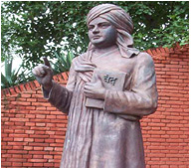
Prof. & Head V.K. Sharma
Department of Chemistry
M.D. University, Rohtak
Haryana (INDIA)
Research
Group
Students Supervised
Mr. Rajesh Kumar
Mrs. Yameeka
Mr. Sunil Jangra
Miss Neeti
Dr. Dimple
Dr. Jaibir S. Yadav
Dr. Subhash
Students Pursuing Ph.D. degree
Mrs. Rajni
Mrs. Jyoti
Miss Heena

Slide 32
Thanks…….

