Slide 1
CASE STUDY ON
PULMONARY ARTERIAL HYPERTENSION (PAH)
BY:
SYED MUZZAMMIL
4TH YEAR PHARM.D
MRPC

Slide 2
INTRODUCTION
Pulmonary arterial hypertension is a progressive disorder characterized by abnormally high blood pressure in the pulmonary artery, the blood vessel that carries blood from the heart to the lungs.
It is said to be PAH if the mPAP ≥25 mmHg at rest or ≥30 mmHg with exercise and PWP <15mmHg.
Hypertension occurs when most of the very small arteries throughout the lungs narrow in diameter, which increases the resistance to blood flow through the lungs. To overcome the increased resistance, pressure increases in the pulmonary artery and in the heart chamber that pumps blood into the pulmonary artery.

Slide 3
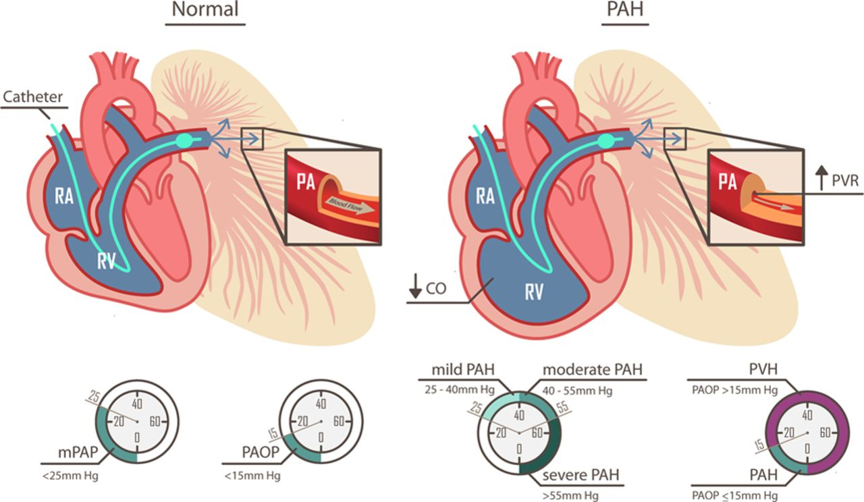
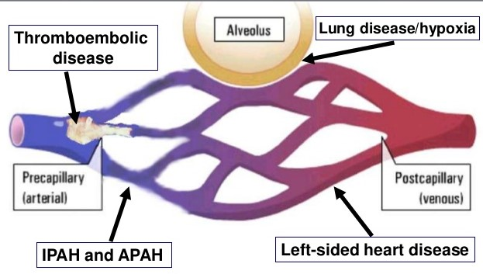
Shortness of breath (dyspnea) during exertion and fainting spells are the most common symptoms of pulmonary arterial hypertension.
Other symptoms include dizziness, swelling (edema) of the ankles or legs, chest pain, and a racing pulse.

Slide 4
SUBJECTIVE DATA
A 45 year old female patient presented to the emergency with complaints of Severe cough, palpitations, generalised weakness and difficulty in breathing during household work.

Slide 5
OBJECTIVE DATA
The patient is a known case of pulmonary arterial hypertension with complete hoarsening of voice from past 10 years.
The patient was on medication:
Viagara 50mgt.i.d,
Lasix 40mgb.d,
Aldactone 25mgb.d,
Warf 2mgo.d and Pantodac 40mgo.d.

Slide 6
On examination, the vital signs were:
  Temperature: Afebrile
  Blood pressure: 130/80mmHg
  RBS: 124mg/dl
  Pulse: 90beats/min.
  Respiratory rate: 25/min
  CVS: S1S2+
  SP0₂: 88%

Slide 7
The physician ordered the following examinations:
Complete Blood Picture:
Normal
Erythrocyte Sedimentation Rate: Normal

Slide 8
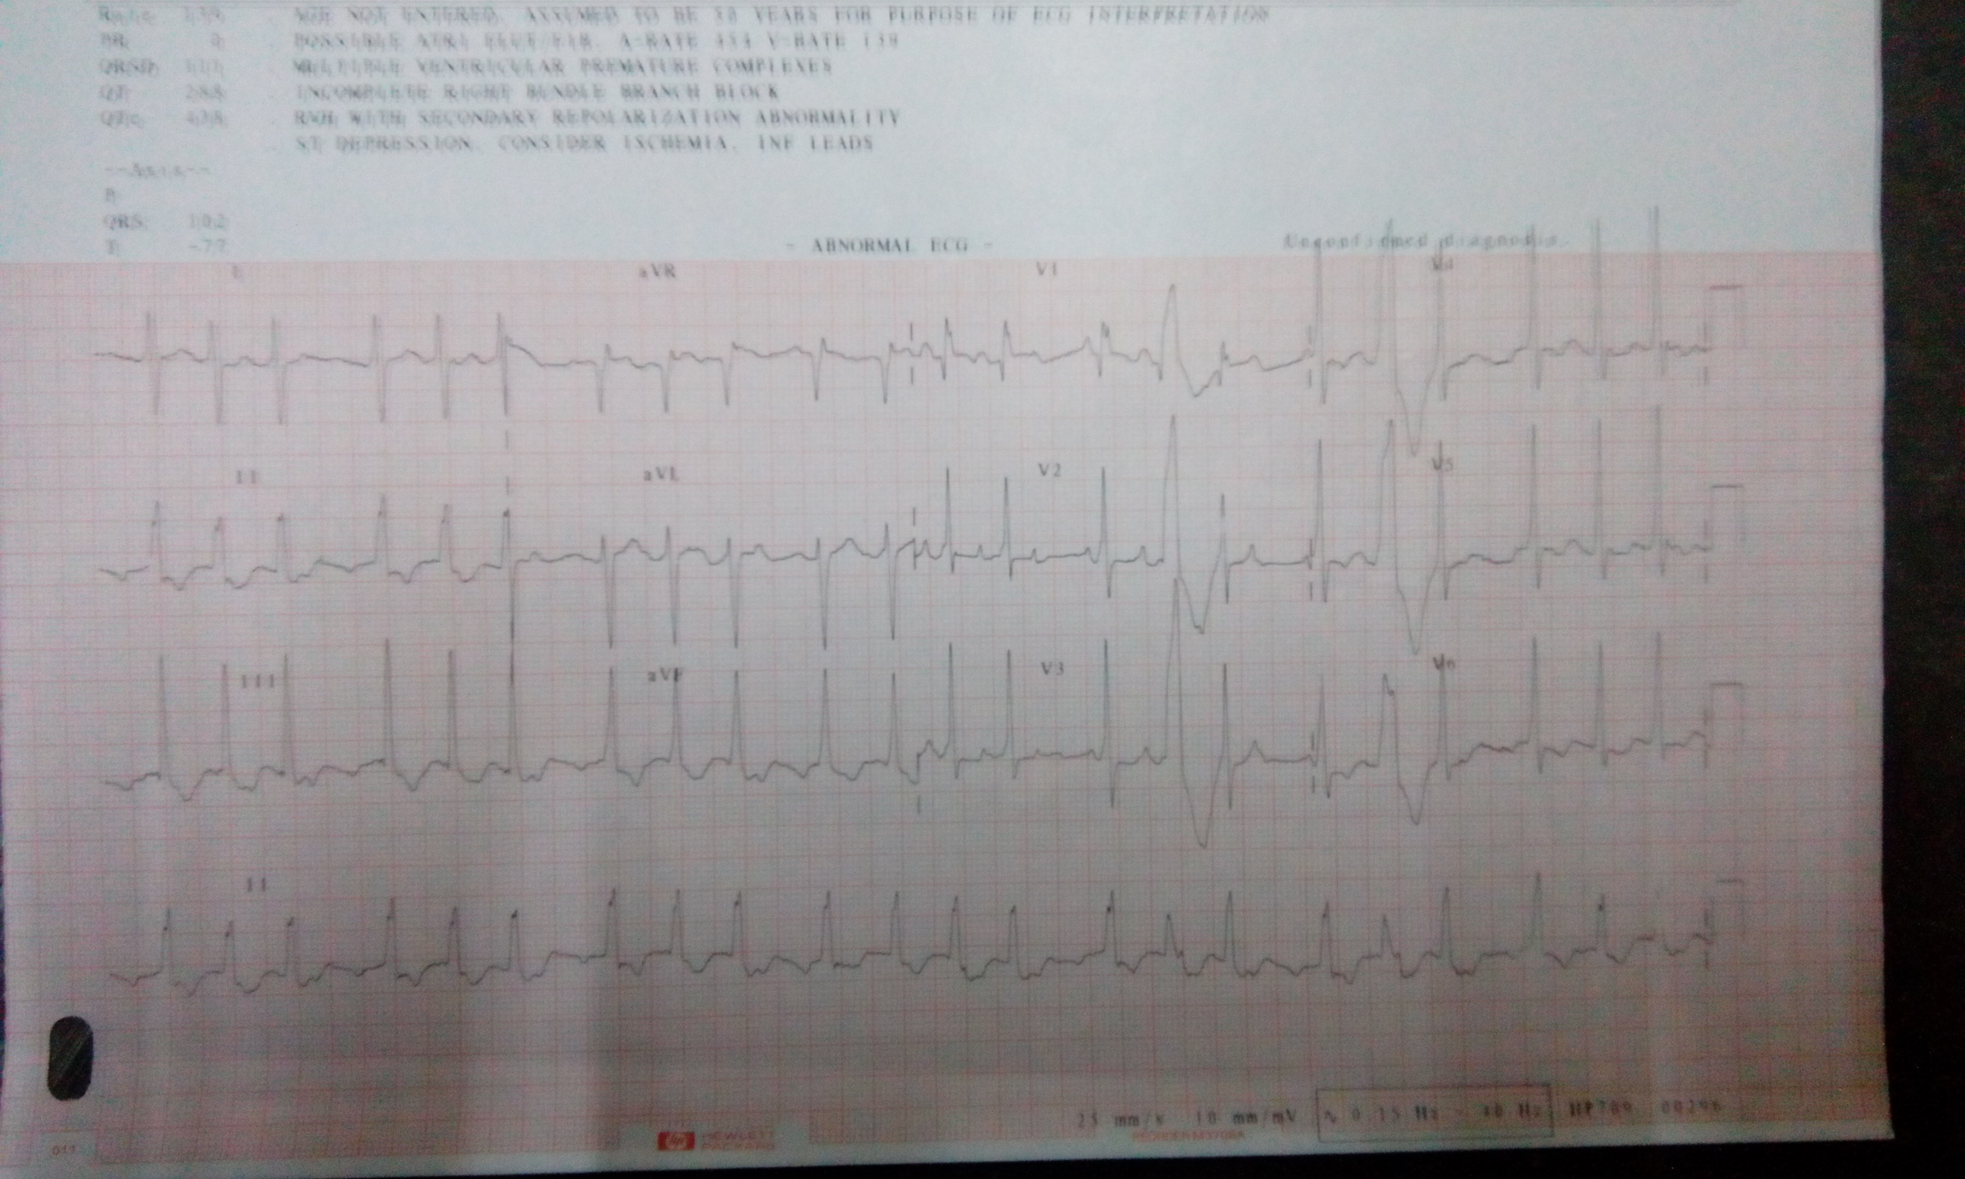
Electrocardiogram Revealed:
Possible Atrial Flutter/fibrillation
Multiple ventricular premature complexes
Incomplete right bundle branch block
RVH with secondary repolarization abnormality
ST depression

Slide 9
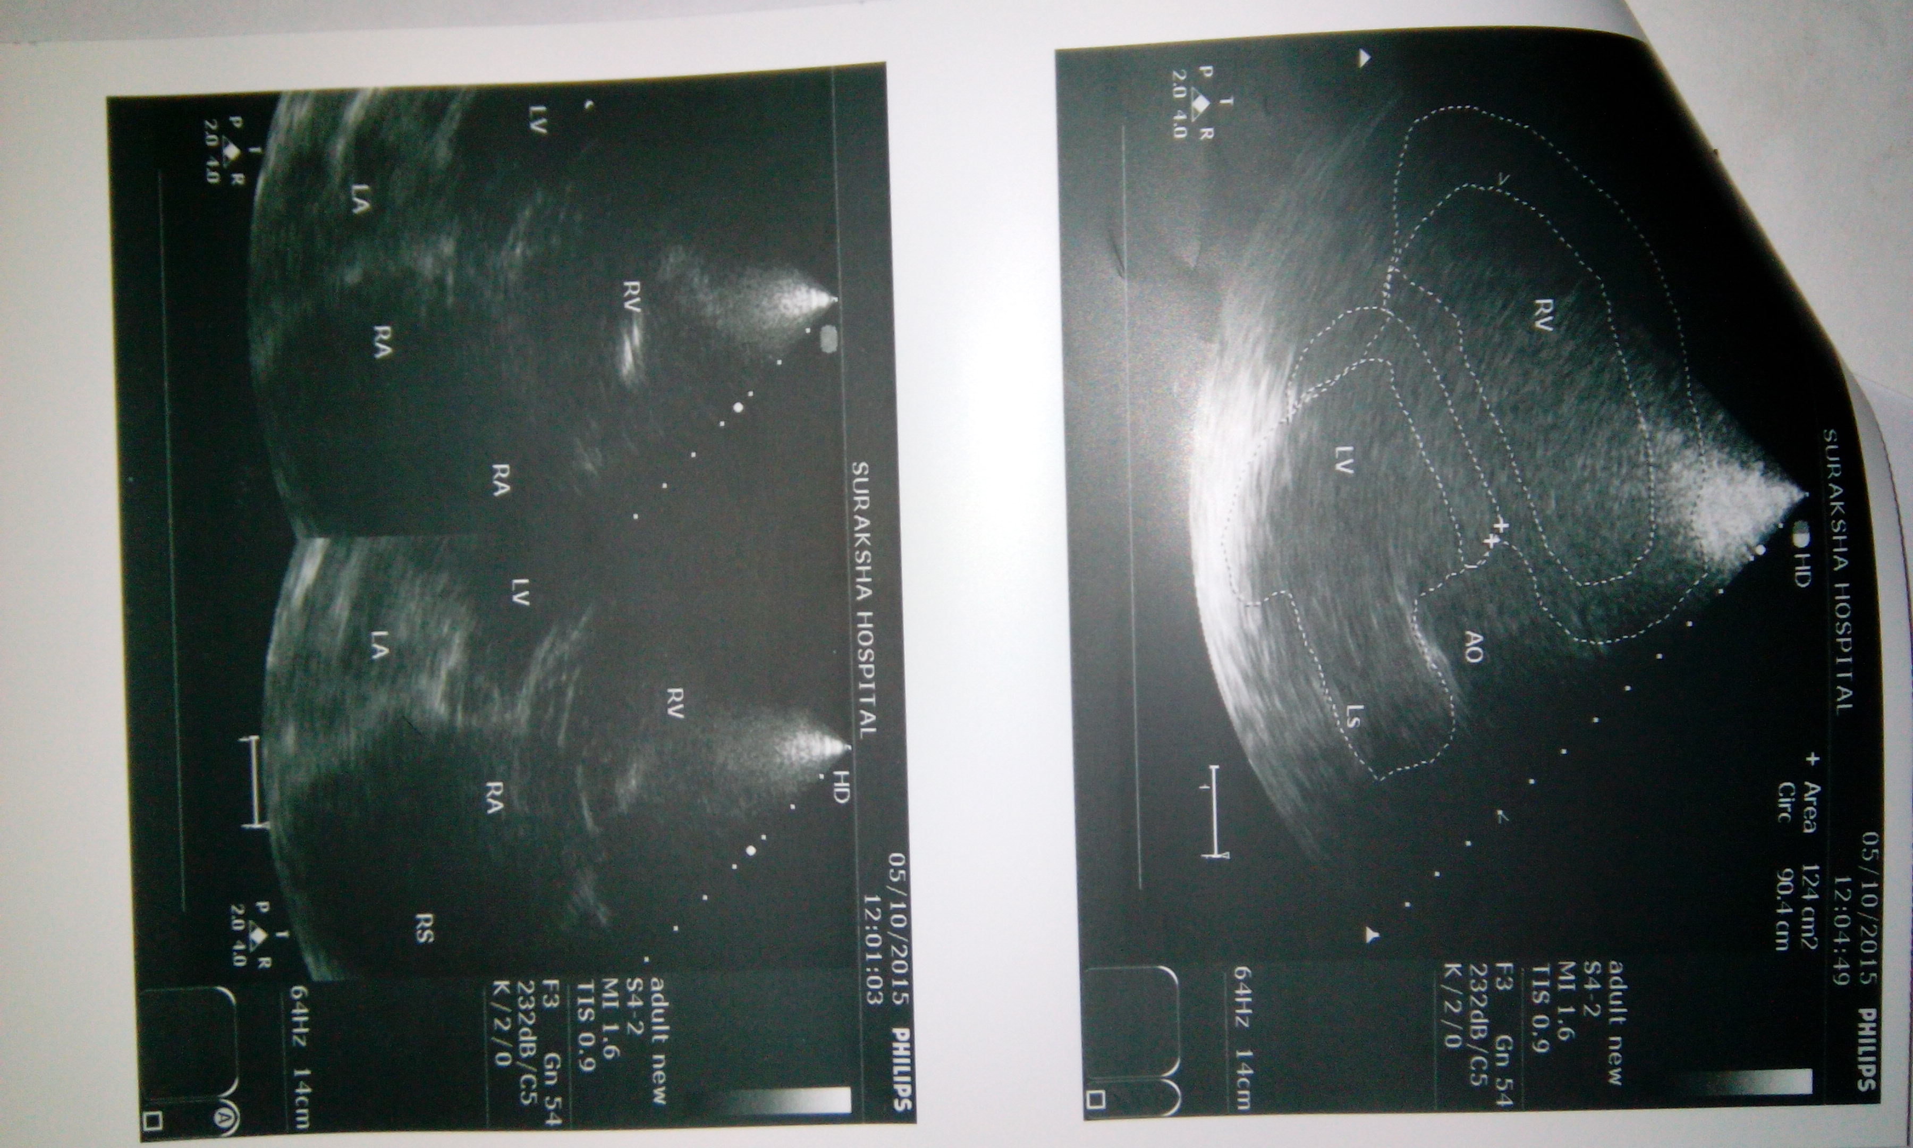
2D-Echo showed:
RA/RV/LA dilatation.
paradoxical motion of IVS
MPA, LPA, RPA enlarged.
EF=65%

Slide 10
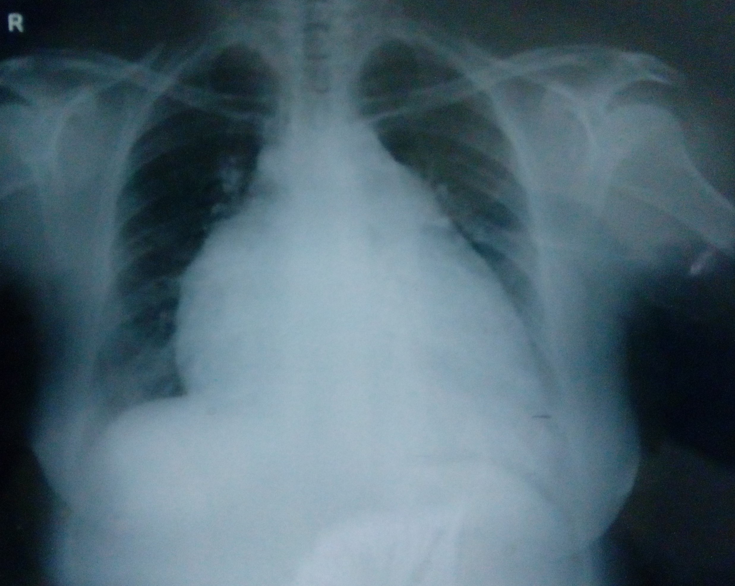
X-ray showed: Cardiomegaly

Slide 11
ASSESSMENT DATA
The above examinations were suggestive of pulmonary arterial hypertension(PAH)
Apart from the past medications, Pulmonext 5mgo.d, lanoxin 0.25mgo.d were added and the sildenafil tablet was maintained at 20mgt.i.d.
The patient was kept on oxygen for a week since her partial pressure was not contained.

Slide 12
STANDARD THERAPY FOR PAH
Currently, there are four main classes of medications used to treat PAH,
Calcium-channel blockers | Phosphodiesterase type 5 inhibitors | Endothelin receptor antagonists | Prostacyclin analogues
Amlodipine Diltiazem Nifedipine | Sildenafil Tadalafil | Bosentan Ambrisentan* | Epoprostenol Iloprost Treprostinil*
Anticoagulant
Warfarin sodium

Slide 13


TREATMENT PLAN
DRUG(GENERIC NAME) | DOSE | MECHANISM OF ACTION | SIDE EFFECTS
ASSURANCE (SILDENAFIL CITRATE) | 20MG T.I.D | Sildenafil is a selective potent inhibitor of PDE type 5 which specifically degrades cGMP which is found in high concentrations in pulmonary arteries. | headache, flushing, dyspepsia, abnormal vision.
PULMONEXT (AMBRISENTAN) Approved June 2007 Approved for combination therapy with tadalafil in 2015. | 5MG O.D | ambrisentan) is a potent type-A selective endothelin receptor antagonist. Endothelin is a peptide made by the body in the endothelium | Headache, peripheral edema.

Slide 14
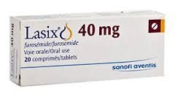
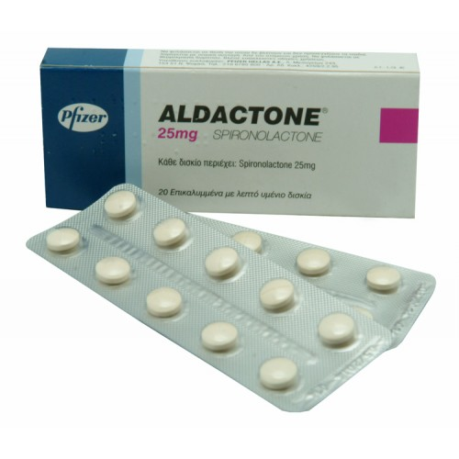
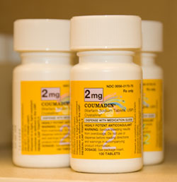
LASIX(FUROSEMIDE) | 40MG O.D. | Diuretics are commonly used to help treat heart failure. Diuretics help eliminate excess fluid in the body | deep venous thrombosis, hyponatremia.
ALDACTONE (SPIRONOLACTONE) | 25MG B.D. | Spironolactone is a specific antagonist of aldosterone, that increased amounts of sodium and water to be excreted. | Hyperkalemia, hyponatremia.
WARF (WARFARIN SODIUM) | 2.5MG O.D. | Warfarin is an anticoagulant, which is given to allow free flow of blood. | Alopecia, haemorrhage.

Slide 15
TOLVASKA (TOLVAPTAN) | 15MG O.D/S.O.S | Tolvaptan is a vasopressin antagonist that causes increased water excretion with low sodium excretion, | thirst, dry mouth, asthenia, constipation.
PANTODAC (PANTOPRAZOLE) | 40MG O.D. | It is a proton pump inhibitor that reduces gastric acid secretion. | Abdominal pain, nausea, headache.

Slide 16
RECENT DRUG DEVELOPMENT
Riociguat (Adempas®), which acts on the nitric oxide pathway and further downstream as a direct guanylate cyclase stimulator, as well as sensitizing the receptor to endogenous nitric oxide. Because it acts on the nitric oxide pathway, it should not be given with phosphodiesterase-5 (PDE-5) inhibitors. It was developed by Bayer In 2014.
Macitentan (Opsumit®) which is an endothelin receptor antagonist (ERA). It was developed by actelion in 2013.
Treprostinil, marketed as Orenitram™ is a prostacyclin analogue which is a vasodilator.
Considerable additional research is needed to better refine the most appropriate therapies for individuals with the pulmonary arterial hyprtension.

Slide 17


