Slide 1


MACROPHAGES REPROGRAMMED IN VITRO TOWARDS
M1 PHENOTYPE EXTEND LIFETIME OF MICE WITH
EHRLICH ASCITES CARCINOMA
Lyamina S.V., Kalish S.V., Malyshev I.Yu.
03 November 2015

Slide 2
TUMOR ASSOCIATED MACROPAHGES
Notes:
Macrophages play a key role in disorders of the immune response in carcinogenesis. Macrophages located in the
tumor growth area are called tumor-associated macrophages (TAM). Depending on the microenvironment created by the
growing tumor and lesion tissue, macrophages acquire a M1 or M2 phenotype.

Slide 3
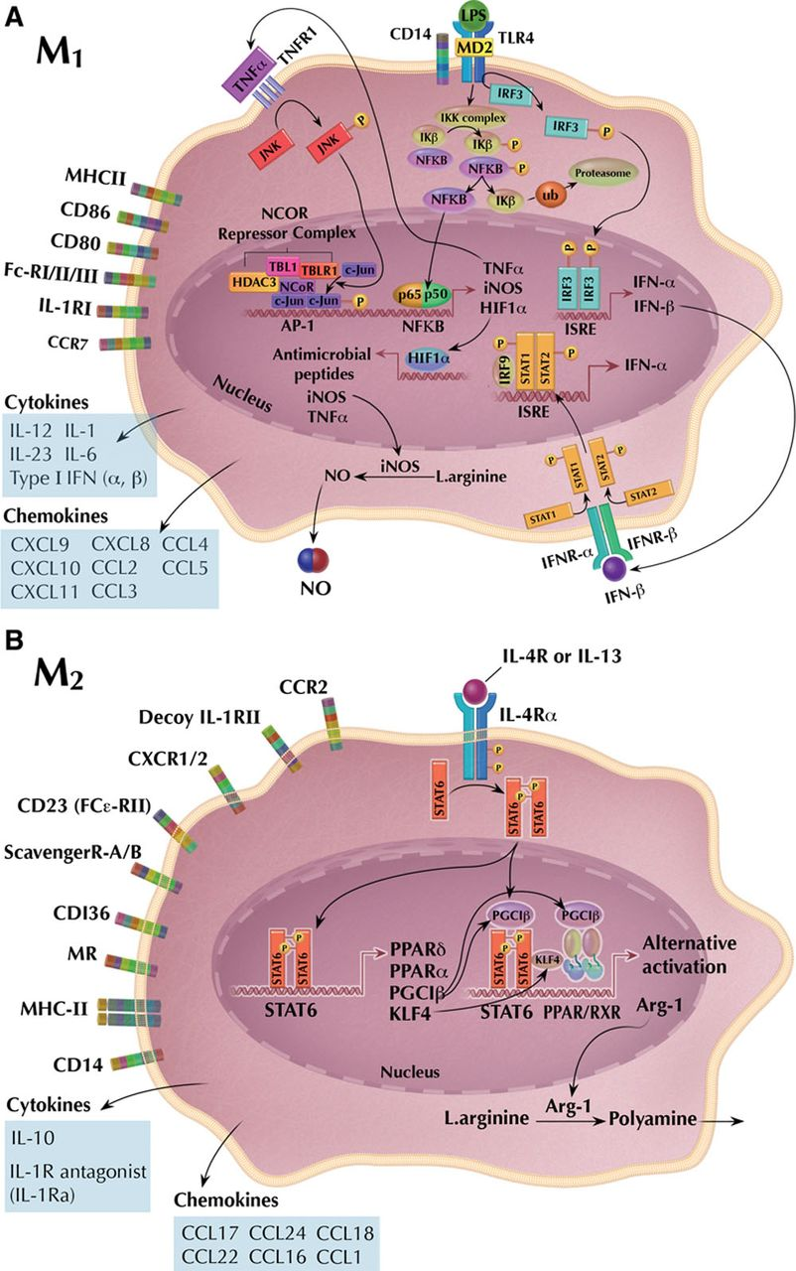
TAM: M1 and M2 phenotypes
TAM-M1
nitric oxide (NO) production,
proinflammatory cytokines secretion, natural killer cells activation,
tumor antigens presentation to lymphocytes
TAM-M2
suppress the anti-tumor immunity,
promote growth and vascularization of the tumor,
promote cell invasion and cancer dissemination
Notes:
The M1 phenotype of TAM (TAM-M1) exhibits anti-tumor features and contributes to destruction of the tumor by means of nitric oxide (NO) production, secretion
of proinflammatory cytokines, activation of natural killer cells, and presentation of tumor antigens to lymphocytes. However the majority of tumors, especially malignant ones, trigger mechanisms of macrophage reprogramming. Tumor cells begin producing anti-inflammatory cytokines
TGF-b1, IL-4, IL-10, and PGE2, which restrict production of anti-tumor factors, such as NO, TNF-a, and IFN-g, and reprogram
macrophages towards the M2 pro-tumor phenotype. Furthermore, tumor cells deteriorate the antigen-presenting
function of macrophages. As a consequence, macrophages that migrate to the tumor area specifically to destroy
tumor cells become tumor “team-mates”. The M2 phenotype of TAM (TAM-M2) suppresses the anti-tumor immunity, promotes
growth and vascularization of the tumor, as well as tumor cell invasion and cancer dissemination. Indeed, according
to clinical and experimental data, the amount of TAM-M2s in the tumor area correlates with a poor prognosis during tumor
growth. Recently, the concept of a continuum has been proposed. This concept implies that the TAM phenotype
varies along a continuous proinflammatory spectrum, in a range from M1 (anti-tumour) to M2 (pro-tumour).

Slide 4
HYPOTHESIS
M1 macrophages accumulating
in the tumor area could limit carcinogenesis and
extend the lifetime of the tumor host
Notes:
Based on these data, we suggested that M1 macrophages accumulating in the tumor area could limit carcinogenesis and extend the lifetime of the tumor host.

Slide 5
THE AIM OF THE STUDY
was to verify this hypothesis with respect of
Ehrlich ascites carcinoma (EAC).

Slide 6
OBJECTIVES:
1) ascitic fluid from mice with EAC on a macrophage phenotype and NO-producing activity of macrophages in vitro, and
2) macrophages reprogrammed in vitro towards the M1 phenotype and activated with LPS on the lifetime of mice with EAC.
Notes:
The objectives of the study were to evaluate effects of 1, 2.

Slide 7
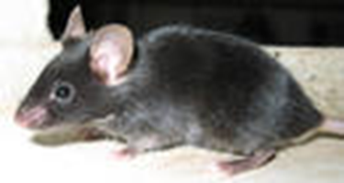
MATERIAL AND METHODS
Antitumor properties of reprogrammed macrophages were evaluated on an experimental model of Ehrlich ascites carcinoma (EAC)
Experiments were performed on C57BL/6J mice (n=80) injected with EAC cells and murine peritoneal macrophages (PM) reprogrammed in vitro towards M1 phenotype (0% FBS, 20 ng/ml IFN-γ)
Assessment of changes in macrophage phenotype and secretory activity
Methods of in vitro macrophage reprogramming towards M1 phenotype and activating with LPS
Methods of removing macrophages from the plates and injecting into the peritoneal cavity of mice

Slide 8
STUDY DESIGN
Five groups of mice were formed (n = 16 per group):
“EAC” (control);
“EAC+PBS” – injection of 0.5 ml PBS (3, 7, 11 days) to EAC mice;
”EAC+M1” – injection of 4000 in vitro reprogrammed M1 PM in 0.5 ml PBS (3, 7, 11 days);
“EAC+M0” - injection of 4000 native M0 PM in 0.5 ml PBS (3, 7, 11 days);
“EAC+cisplatin” (comparison group) - injection of cisplatin (0.05 ml, 0.5 mg/ml) on 3, 7, 11 days.
Notes:
The study design implicated formation of 5 groups. They are presented on the slide.
1. “Tumor” group, mice injected with EAC cells;
2. “Tumor + PBS” group, mice injected with EAC cells with subsequent
infusion of PBS 0.5 ml at 3, 7 and 11 days;
3. “Tumor + M0-Mac” group, mice injected with EAC cells with
subsequent injections of a suspension of 4×106 non-reprogrammed
and stimulated with LPS macrophages in 0.5 ml
of PBS on days 3, 7 and 11 of the experiment;
4. “Tumor + M1-Mac” group, mice injected with EAC cells
with subsequent injections of a suspension of 4×106 reprogrammed
in vitro towards M1 phenotype and stimulated
with LPS macrophages in 0.5 ml of PBS on days 3, 7 and 11
of the experiment;
5. “Tumor + cisplatin” group, mice injected with EAC cells with
subsequent infusion of 0.05 ml of cisplatin (0.5 mg/ml), an
antitumor drug , on days 3, 7 and 11 experimental
days. Cisplatin has been often used as a reference drug.

Slide 9
Macrophage reprogramming by 0% FBS and IFN-γ
Notes:
On the slide we can see changes in the nitrite concentration in a culture medium after in vitro reprogramming towards the M1 phenotype.
Macrophages cultured in the absence of FBS but in the presence of added INF-g both increased the basal nitrite concentration
(Basal) and significantly increased the nitrite production response to LPS (LPS). These changes
reflect formation of the M1 phenotype with typical, high NO generating activity. Thus, by removing FBS and adding IFN-g,
we have successfully reprogrammed the functional phenotype of murine macrophages towards the M1 phenotype.

Slide 10
EFFECT OF REPROGRAMMING ON
MACROPHAGE CYTOKINE PRODUCTION
Cytokines, pg/ml | Non-reprogrammed macrophages + LPS | Reprogrammed macrophages + LPS
IL-2, M1 | 546.74±67.20 | 1894.72±351.2*
INF-γ, M1 | 8602.36±1045.91 | 14639.49±684.55*
TNF-α, M1 | 3548.06±733.62 | 9675.58±647.65*
IL-6, M1 | 7645.63±748.86 | 15240.60±872.30*
IL-5, M2 | 132.45±41.48 | 67.80±8.45*
IL-10, M2 | 468.25±81.85 | 272.21±12.47*
*p<0.05
Notes:
To confirm the effectiveness of macrophage reprogramming we also evaluated the secretory activity of LPS-stimulated macrophages
by cytokine production. Macrophage reprogramming towards the M1 phenotype resulted in reduced production of
the anti-inflammatory cytokines, IL-5 and IL-10, and increased production of the proinflammatory cytokines, IL-2, IL-6, TNF-a
and INF-g, as compared with the cytokine production by nonreprogrammed macrophages. All these changes in cytokine
levels were statistically significant (p<0.05). The most noticeable effects of reprogramming were an almost 3.5-fold
increase in the level of the proinflammatory cytokine, IL-2, and an almost 50% decrease in the level of the anti-inflammatory
cytokine, IL-5. Such change in the cytokine production is a feature of macrophage reprogramming towards
the M1 phenotype . Secretory activity specifically of LPS activated macrophages was evaluated for two reasons. First,
phenotypic differences are most evident in activated macrophages; and second, these were, specifically,
LPS-activated, reprogrammed macrophages that were injected into mice with tumor to restrict the tumor growth.

Slide 11
EFFECT OF REPROGRAMMING ON
MACROPHAGE CD RECEPTORS EXPRESSION
CD markers of phenotype, %
Cd marker of M1 phenotype, CD80 | 6.4±1.4 | 12.1±2.2**
Cd marker of M2 phenotype, CD206 | 38.0±2.7 | 27.6±2.3**
** p<0.001
Notes:
The phenotype shift towards M1 was confirmed by changes in expression of CD markers. After reprogramming, macrophages
expressed more CD80, the M1 phenotype surface marker, and less CD206, the M2 phenotype marker, than macrophages before
reprogramming.

Slide 12
THE EFFECT OF THE INJECTED MACROPHAGE
ON LIFETIME OF MICE WITH EAC
Notes:
This slide shows effects of injected macrophages and cisplatin on lifetime of mice with EAC in Kaplan-Meier survival
plots. The survival duration of mice injected with EAC cells was 13.6±0.2 days (“Tumor” group) whereas the survival duration
of mice injected with macrophages reprogrammed towards the M1 phenotype and stimulated with LPS (“Tumor +
M1-Mac” group) was 22.8±0.8 days (p<0.01), i.e., 68% longer than in the “Tumor” group. Survival duration of mice injected
with macrophages reprogrammed towards the M1 phenotype and stimulated with LPS was longer than survival duration of
mice injected with the antitumor drug cisplatin («Tumor + cisplatin » group).
Infusion of PBS (“Tumor + PBS” group) or non-reprogrammed, LPS-stimulated macrophages (“Tumor + M0-Mac” group) did not
significantly influence the survival duration in mice with EAC. The toxic effect of EAC in all groups was evident as progressive
ascitic fluid accumulation in peritoneal cavity and, therefore, increasing body weight of mice. However, in mice injected with macrophages reprogrammed towards the M1 phenotype and stimulated with LPS (“Tumor + M1-Mac” group), the body weight increased by 6.5±1.1% at 11 days of EAC development
from the 1st day, whereas in mice not injected with macrophages (“Tumor” group), the body weight increased by
12.7±1.8% (p<0.01), i.e., twice as much as in macrophage treated mice.

Slide 13
THE EFFECT OF THE INJECTED MACROPHAGE
ON MICE WITH EAC
Notes:
On this slide you can see mice on day 11 after the EAC cell injection. It is
obvious that peritoneal accumulation of ascitic fluid was significantly
less severe in mice injected with macrophages reprogrammed
towards the M1 phenotype and stimulated with
LPS than in mice not injected with macrophages.
Infusion of PBS (“Tumor + PBS” group) or non-reprogrammed,
LPS-stimulated macrophages (“Tumor + M0-Mac” group) did
not significantly influence the weight gain of mice with EAC.

Slide 14
Injection of reprogrammed in vitro M1 macrophages significantly increased the resistance of mice to development of EAC, which is confirmed by
Differences in survival duration and
Peritoneal accumulation of ascitic fluid
Notes:
Therefore, injection of macrophages reprogrammed in vitro towards the M1 phenotype and stimulated with LPS significantly
increased the resistance of mice to development of EAC, which is confirmed by differences in survival duration and peritoneal
accumulation of ascitic fluid between mice injected and not injected with macrophages
The main result of the study was that the macrophages reprogrammed in vitro towards the M1 phenotype and activated
by LPS prolonged the lifespan of mice with EAC. The antitumor effect of these macrophages in EAC is consistent with
the view that M1 macrophages possess antitumor properties.

Slide 15
CONCLUSION
Culturing without FBS but with added INF-g reprograms macrophages towards the M1 phenotype and significantly increases the basal and stimulated macrophage NO production.
Macrophages reprogrammed in vitro towards the M1 phenotype and activated by LPS extend the survival duration of mice with EAC. This effect was superior to that of the known antitumor drug, cisplatin.

Slide 16
PERSPECTIVE OF USE –
TRANSLATION TO CLINICAL PRACTICE
The finding can be the basis for the development and use of cell biotechnology of the directed macrophage phenotyping in oncology. This biotechnology can provide the basis for personalized management in clinical practice.

Slide 17
THANK YOU
FOR YOUR ATTENTION!

