Slide 1


Atom-Economical and Sustainable C-N Bond Formation Reactions from Alcohols and N-Sources via Catalytic Hydrogen Transfer Reactions
September 15th, 2015
Past and Present Research Systems of Green Chemistry
Seoul National University, Republic of Korea
Soon H. Hong

Slide 2
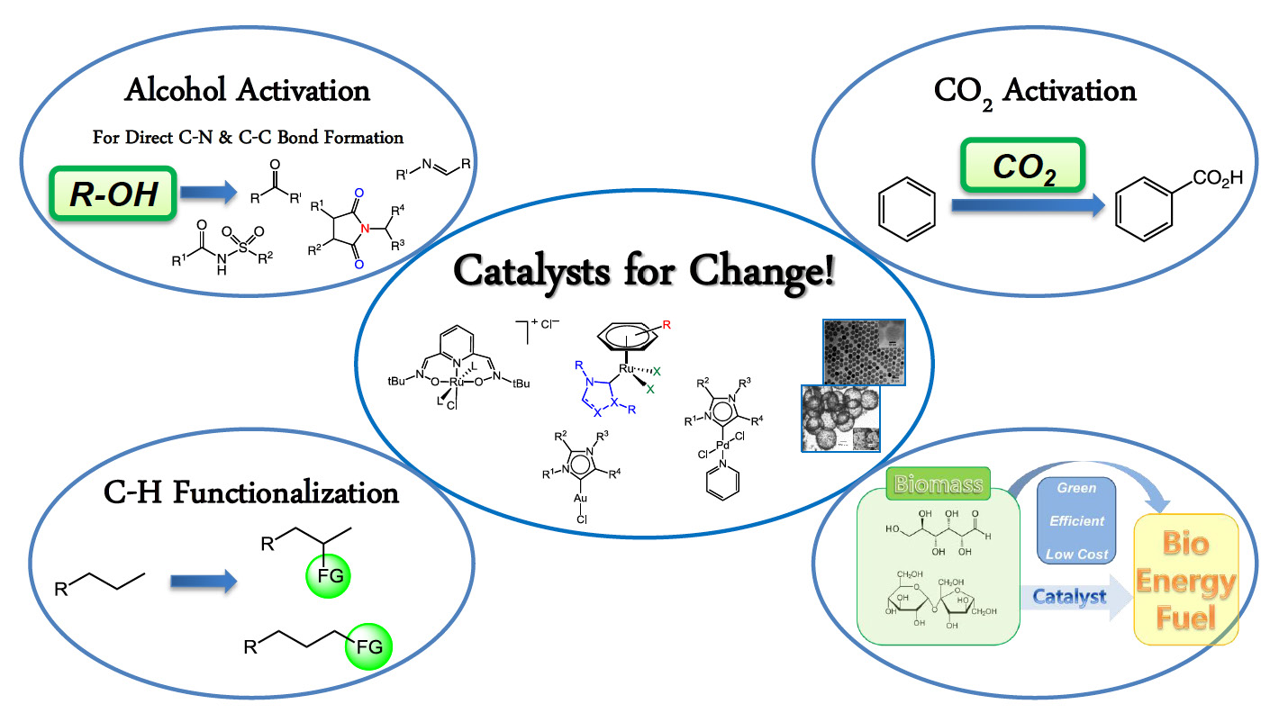
The HongSH Group @ SNU
Classical Chemical
Synthesis
Catalysis
Sustainable Chemical
Synthesis

Slide 3
Outline

Slide 4

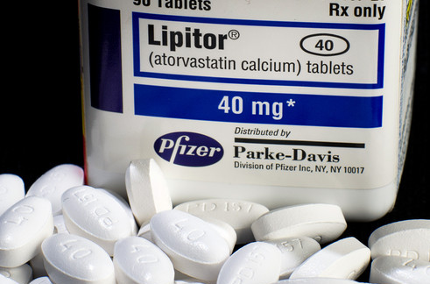
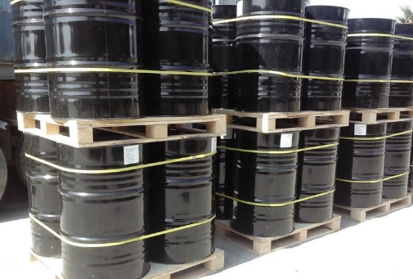
Amide: A Central Functional Group in Nature
Amide Bond

Slide 5
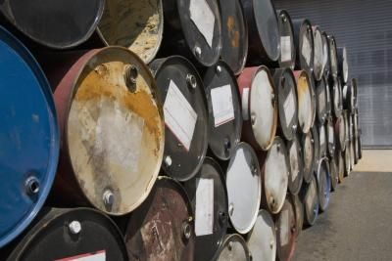
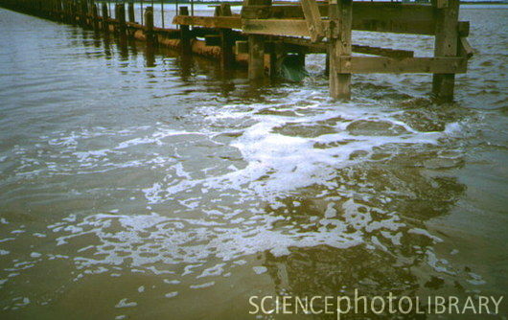
Traditional Amide Synthesis
Generate huge amount of toxic waste
High Atom Economical Amide Synthesis
– A Key Green Chemistry Research Area from Pharmaceutical Manufacturers –
(ACS, Green Chemistry Institute Pharmaceutical Roundtable)
Green Chem. 2007, 9, 411

Slide 6
Direct Amide Synthesis from Alcohol

Slide 7
Basic Concept of Our Reaction Development:
Alcohol Activation
Acceptorless, External Oxidant- and Base-free Catalytic Cycle
Adv. Synth. Catal. 2012, 354, 3045

Slide 8
Dehydrogenative Amide Synthesis from Alcohol
Mechanism study (Ru Hydride)
Organometallics 2010, 29, 1374
J. Org. Chem. 2010, 75, 3002
Catalyst improvement
Adv. Synth. Catal. 2009, 351, 2643
Eur. J. Org. Chem. 2010, 4266
Organometallics 2010, 29, 1374
ACS Catalysis 2014, 4, 2889 (Fe)
Expansion of the scope
J. Org. Chem. 2011, 76, 10005
Angew. Chem. Int. Ed. 2010, 49, 6391
Organic Lett. 2012, 14, 4646
Organic Lett. 2012, 14, 6028
Organic Lett. 2012, 14, 2992
J. Am. Chem. Soc. 2013, 135, 11704
Organic Lett. 2014, 16, 4404
Reviews
Org. Biomol. Chem. 2011, 9, 20
Synlett 2011, 1481

Slide 9

Amide Synthesis with Complete Atom Economy
Direct Amide Synthesis from Nitrile and Alcohol
Byungjoon Kang
Atom, Step, Redox Economy!
J. Am. Chem. Soc. 2013, 135, 11704

Slide 10
Amide Synthesis with Complete Atom Economy
Direct Amide Synthesis from Nitrile and Alcohol
J. Am. Chem. Soc. 2013, 135, 11704

Slide 11
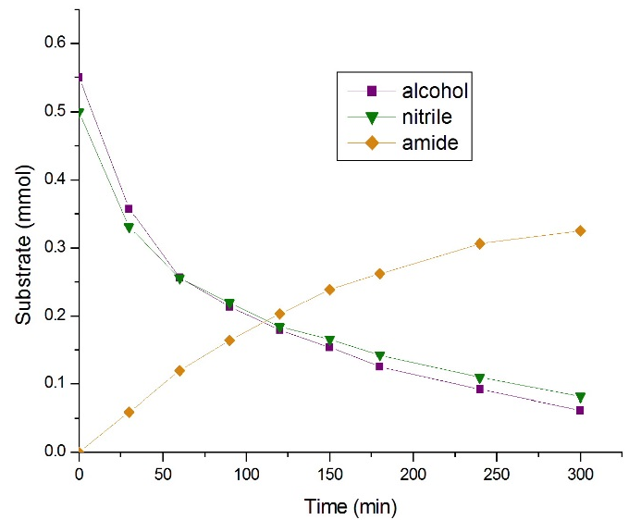
Amide Synthesis with Complete Atom Economy
Direct Amide Synthesis from Nitrile and Alcohol
Sabo-Etienne, J. Am. Chem. Soc. 2010, 132, 7854
J. Am. Chem. Soc. 2013, 135, 11704
(Computational mechanistic study: Z.-X. Wang ACS Catal. 2014, 4, 2854

Slide 12

Cyclic Imide from Nitrile and Diol
Jaewoon Kim

Slide 13
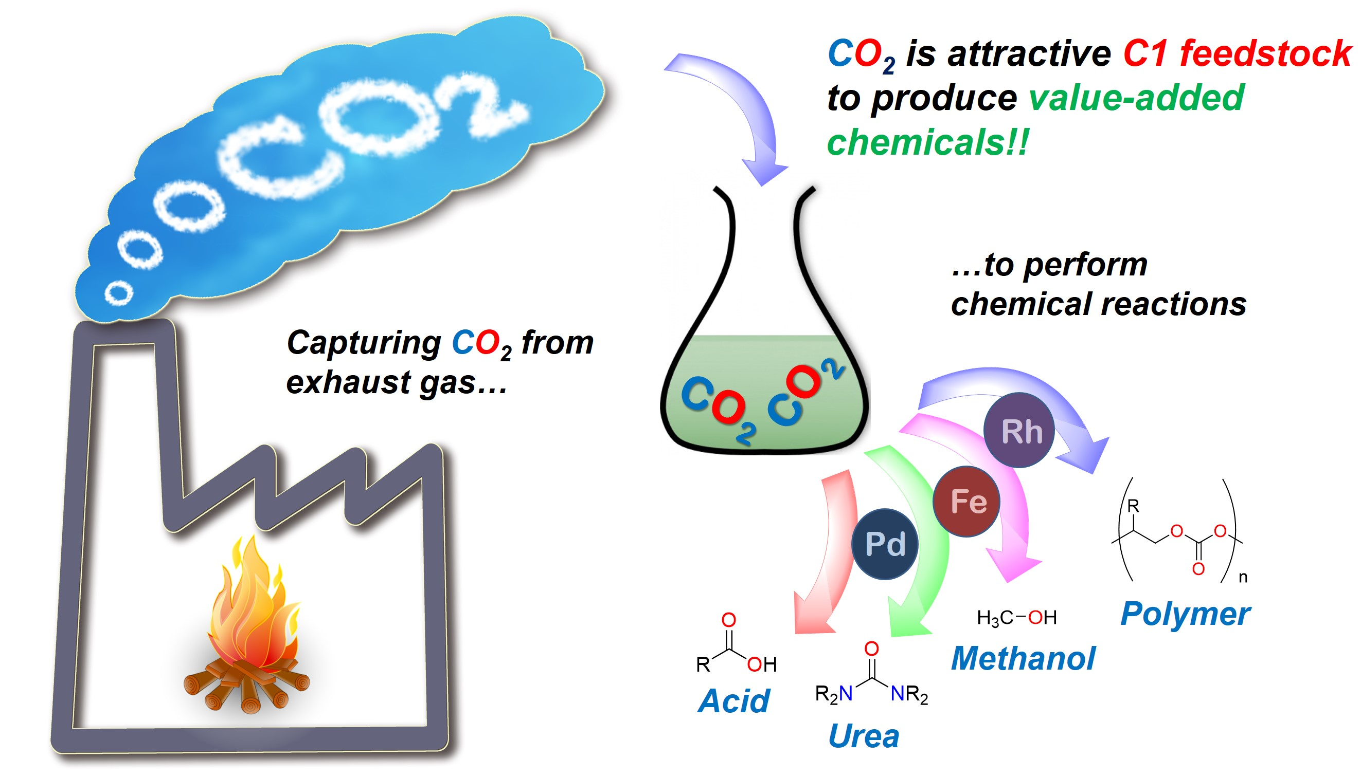
CO₂ Conversion

Slide 14

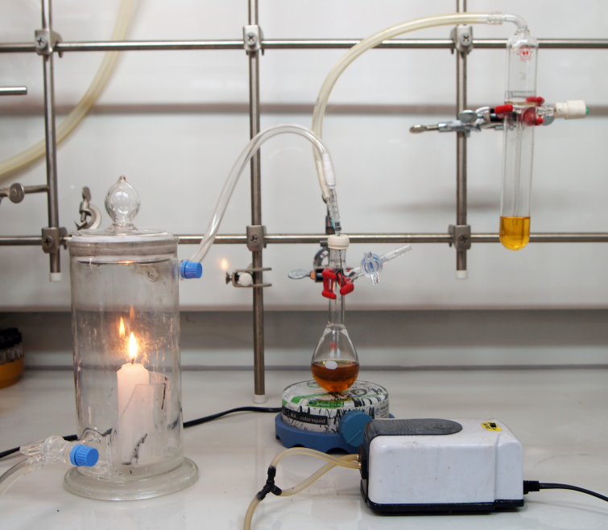
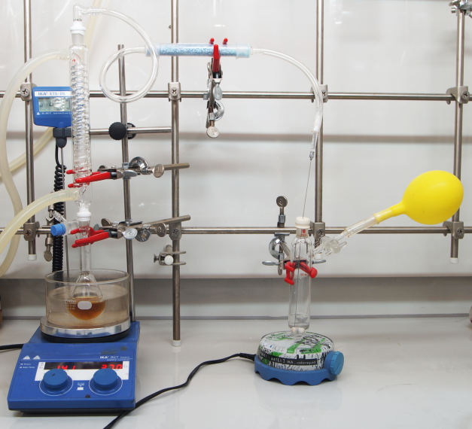
CO₂ Capture & Utilization Strategy
Seunghyo Kim
Same reaction efficiency with commercial >99.999% CO₂ gas
Angew. Chem. Int. Ed. 2014, 53, 771-774.

Slide 17
Angew. Chem. Int. Ed. 2014, 53, 771-774.

Slide 18
Eco-friendly Methanol Production
The Highest Oxidation State of Carbon
> Thermodynamically Stable

Slide 19
Homogeneous Catalyst
Advantages of homogeneous catalyst
- High selectivity
- Rational tuning of the reactivity
- Mild reaction condition

Slide 20
Indirect Way to Produce Methanol
Hydrogenation : High pressure of H₂ gas is used
Transfer hydrogenation (TH) :
2-propanol is used as both solvent and hydrogen source

Slide 21

Indirect Way to Produce Methanol
Seunghyo Kim
The first transfer hydrogenation of cyclic carbonates and formyl esters.
ACS Catalysis 2014, 4, 3630-3636.

Slide 22
N-Formamide Synthesis from Nitrile & Amine:
Using Methanol as C1 Source
Byungjoon Kang
◦ Thermodynamic huddle of methanol utilization
◦ One of the most abundant chemical on earth (> 100 Mtonne/year).
◦ Harmless, renewable, and environmentally benign.
◦ Easily handled in laboratory scale. (O₂ and moisture stability)
◦ Can be synthesized by environmental friendly method.
Methanol utilization is relatively unexplored compare to normal alcohol !
Notes:
Trichloroacetyl chloride, chloroformate

Slide 23
N-Formamide Synthesis from Nitrile & Amine:
Using Methanol as C1 Source
◦ C-C Bond Formation
◦ C-N Bond Formation
N-methylation
N-formylation
: Stoichiometric amount of activating reagent required !
Long reaction time !

Slide 24
N-Formamide Synthesis from Nitrile & Amine:
Using Methanol as C1 Source
◦ High redox- and step-economy.
◦ No base. No hydrogen acceptor. No stoichiometric oxidant.

Slide 25
N-Formamide Synthesis from Nitrile & Amine:
Using Methanol as C1 Source

Slide 26
N-Formamide Synthesis from Nitrile & Amine:
Using Methanol as C1 Source
◦ Reaction Profile Study
◦ Deuterium Labelling Study
: Hydrogen transfer from methanol to nitrile !
: RuH₂ mediated activation of nitrile α carbon !
◦ N-Formylation with formaldehyde is also possible!
◦ Proposed Mechanism
Explanation for side product generation

Slide 27
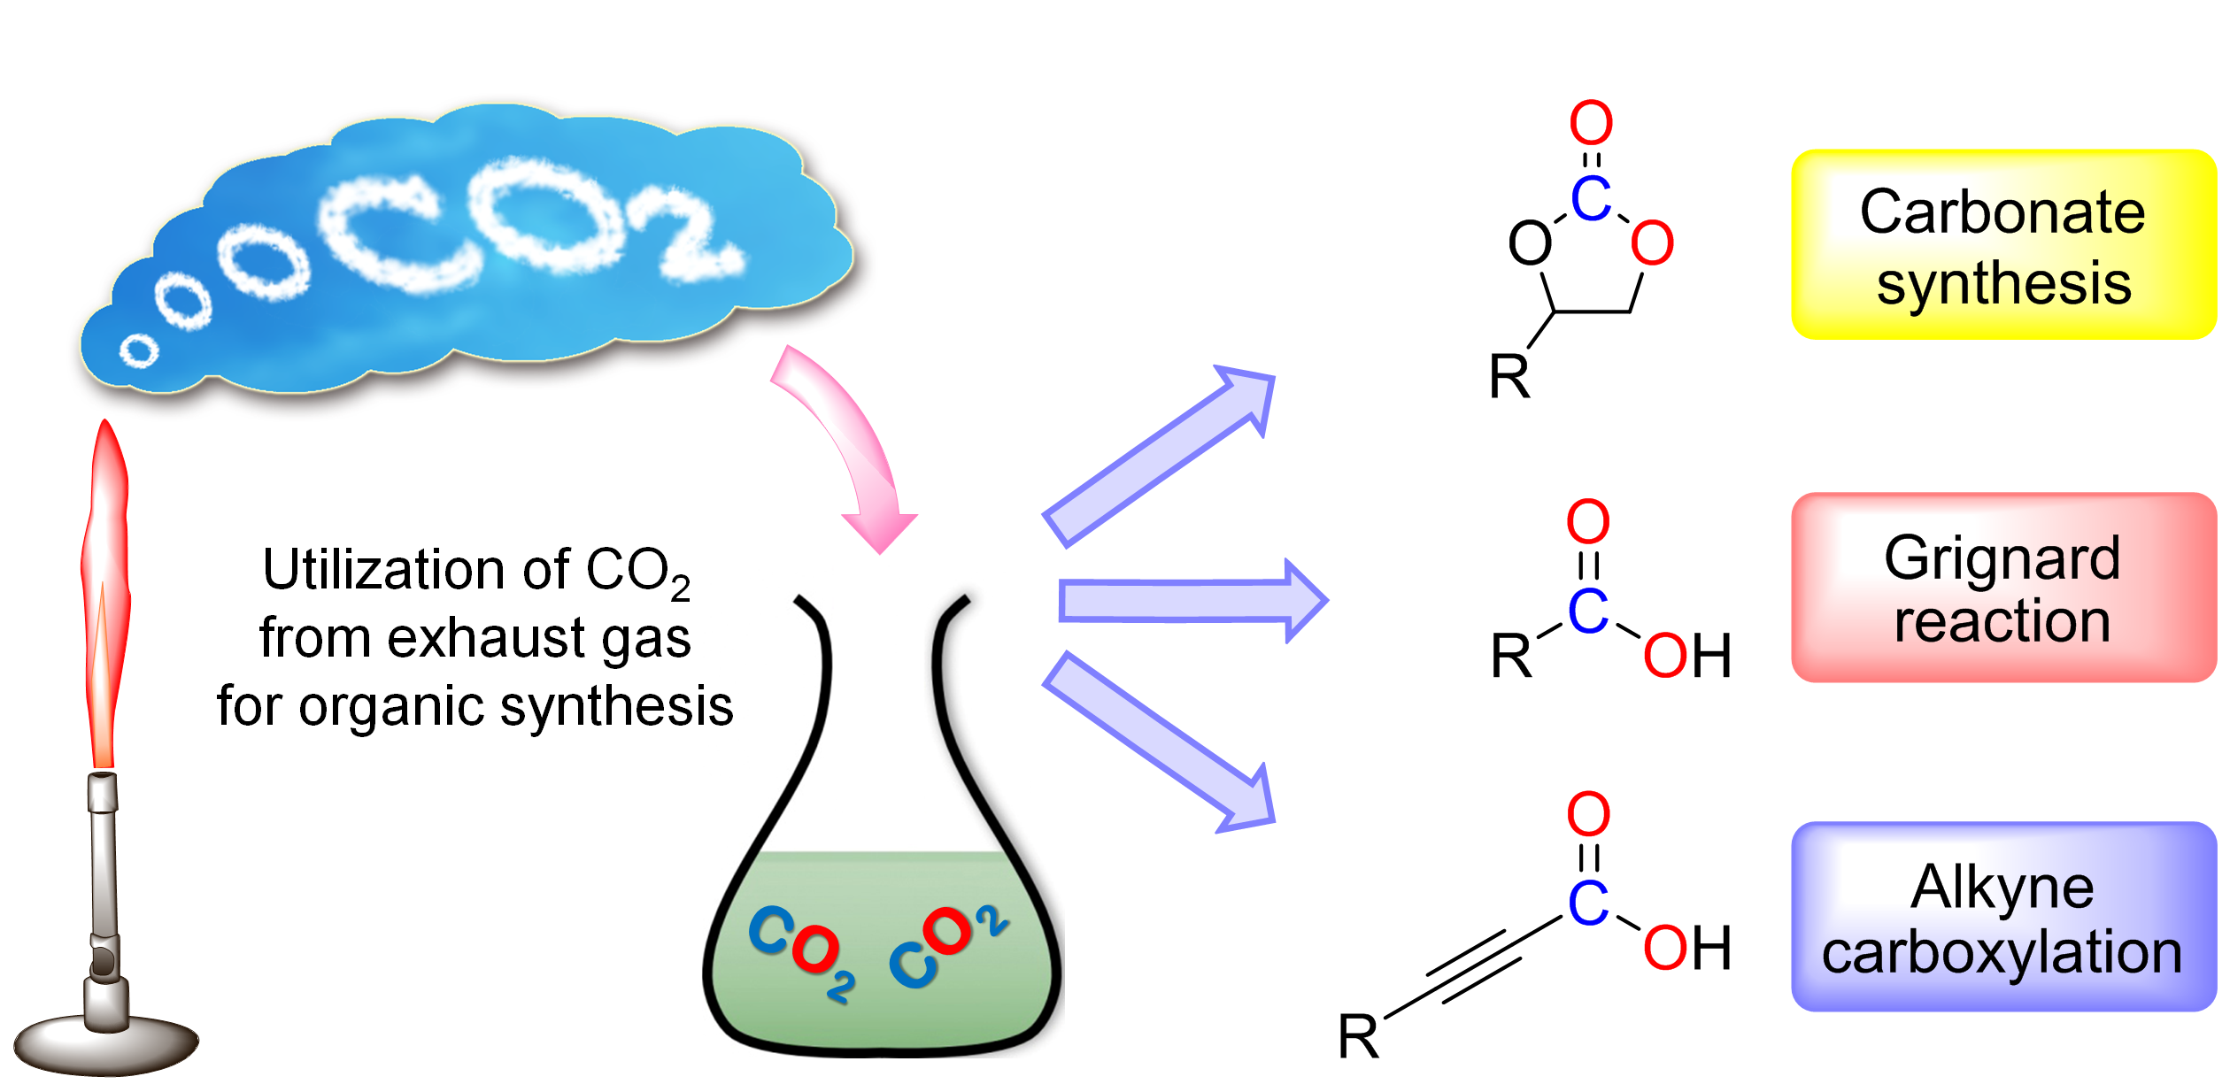
Summary

Slide 28

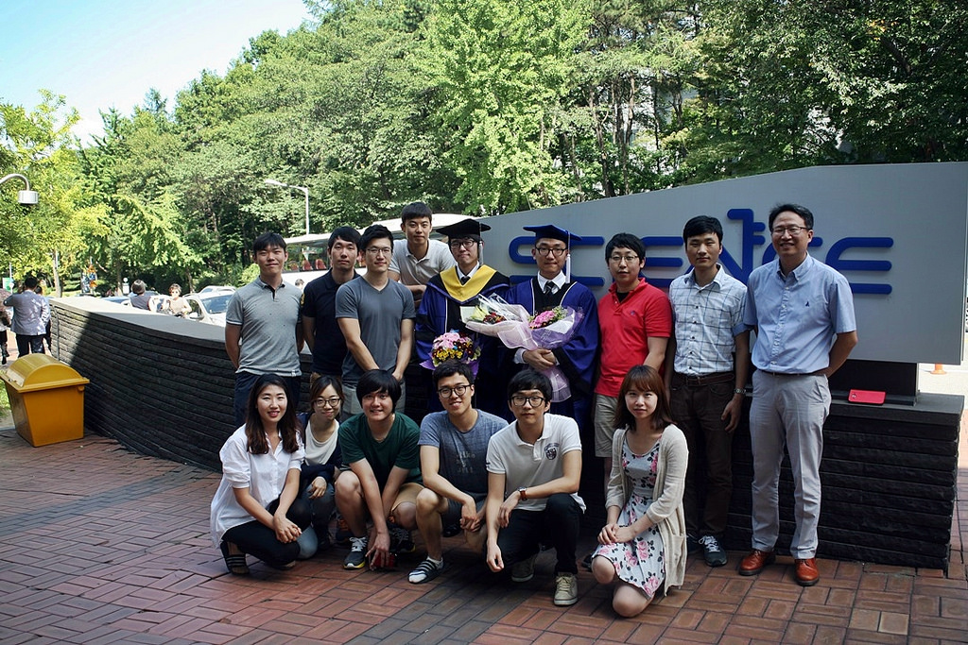




Classical Chemical
Synthesis
Catalysis
Sustainable Chemical
Synthesis
Catalysts for Change!
current
Jeong-Bin Lee
Byungjoon Kang
Seung Hyo Kim
Kicheol Kim
Jaewoon Kim
Jungwon Kim
Seoksun Kim
Sangseung Park
Minha Kim
Sang Min Kim
Gunsoon Kim
alumni
Dr. Jong-Tai Hong
Benjamin Pooi
Hansoo Song
Prof. Hajime Hirao (computional study)
Dr. Xiangya Xu
Dr. Zhenqian Fu

Slide 29

Fe-catalyzed Dehydrogenation
Hansoo Song
>99%
>99%
>99%
>99%
>99%
93%
70%
87%
97%
94%
87%
93%
ACS Catalysis 2014, 4, 2889-2895

Slide 30
Amide Synthesis with Complete Atom Economy
Direct Amide Synthesis from Nitrile and Alcohol
J. Am. Chem. Soc. 2013, 135, 11704

Slide 31
Mechanistic Difference
Org. Lett. 2014, 16, 4404-4407.

Slide 32
N-Formamide Synthesis from Nitrile & Amine
: Using Methanol as C1 Source
◦ General Concept
◦ Selected Examples

Slide 33
Mechanism Study
ACS Catalysis 2014, 4, 3630-3636.
Notes:
I performed transfer hydrogenation reaction with cyclic carbonate and formic ester under ruthenium pincer complex.
In compared to milstein system in which high pressure of hydrogen gas was used, efficiency of my system is better.

