Slide 1
Development of Novel Talus Implant based on Artificial Neural Network prediction of Talus Morphological Parameters

Slide 2
Presentation Outlines
1.0 INTRODUCTION
  1.1 Project Background
  1.2 Problem Statement
  1.3 Objectives
  1.4 Scope of Study
2.0 LITERATURE REVIEW
3.0 METHODOLODY
4.0 RESULTS & DISCUSSION

Slide 3
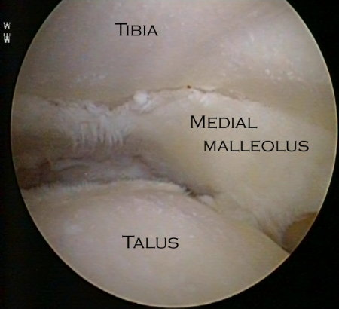
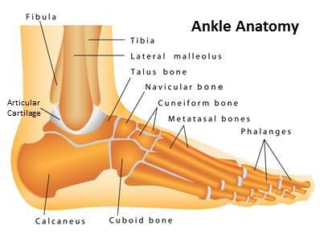
1.0 Introduction
Total ankle arthroplasty less successful compare to hip and knee replacement due to the complexity of joint kinematics.
Besides, there are no ankle implants base on Malaysian ankle size.
A new design implant is construct base on Malaysian ankle bone size by parameter existing using 3D CT scan.
By using Finite Element Method, the existing implant and proposed design are analyzed.
Analyzed data is use to compared the implant size and bone size to obtain the suitability.

Slide 4
Problem statement
Total ankle arthroplasty use to treat ankle arthritis. In Malaysia, there are no data base for Malaysian bone implants.
Basically, proposed design for Malaysian size of implants needed to suit the bone size. The size implants may differ bone size in aspect of gender and age of patients.
The existing implants did not undergo simulation to identify the stress distribution and deformity. Thus, the existing implants and the proposed design will undergo simulation by using Finite Element Method software.

Slide 5
Objectives
To develop conceptual design of Malaysian total ankle arthroplasty (MTAA).
To analyze the performance of MTAA compare to existing Total Ankle Arthroplasty.
Study the effect of different size of implant on ankle bone structure.

Slide 6
Scope of Project
Construction of existing ankle implant and proposed designs using Solid Work software.
Analysis proposed designs using finite element method to identify the stress distribution and minimum displacement.
Limitation data on Malaysia population only.

Slide 7
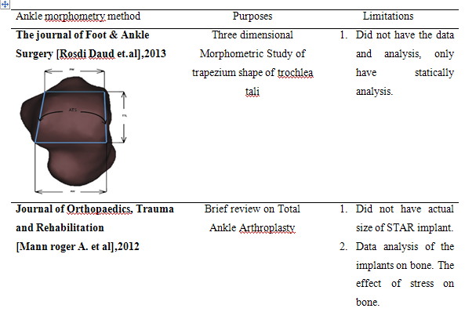
2.0 Literature Reviews

Slide 8
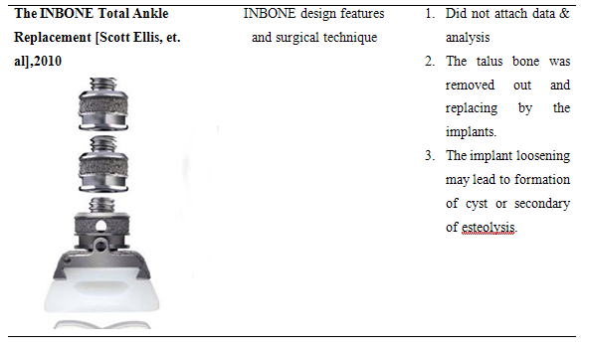
2.0 Literature Reviews

Slide 9
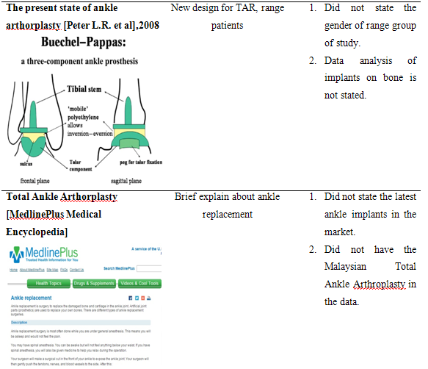
2.0 Literature Reviews

Slide 10
METHODOLOGY

Slide 11
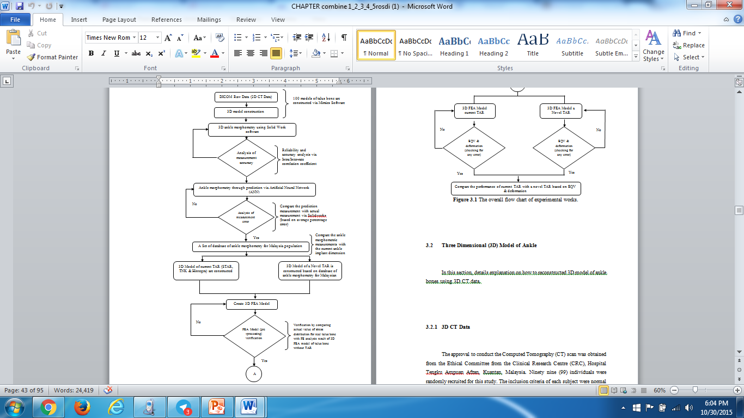

Slide 12
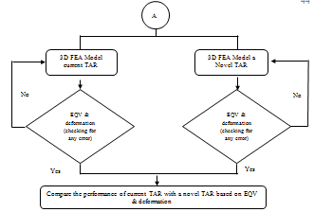

Slide 13
3D CT Data
The approval to conduct the Computed Tomography (CT) scan was obtained from the Ethical Committee from the Clinical Research Centre (CRC), Hospital Tengku Ampuan Afzan, Kuantan, Malaysia. Ninety nine (99) individuals were randomly recruited for this study. The inclusion criteria of each subject were normal lower limb alignment, no clinical symptoms or sign of ankle arthritis and a normal anatomical profile of talus. Subjects with a known history of trauma to the lower limb or congenital abnormalities were excluded from this study. A four-row multi-slice CT scanner (Somatom, Volume Zoom, SIEMENS) was used with 3mm slice thickness and recon increment of 1.5mm. During the scanning procedure, the foot was placed within a custom-designed foot jig to standardise the position and angulations of the lower limb.

Slide 14
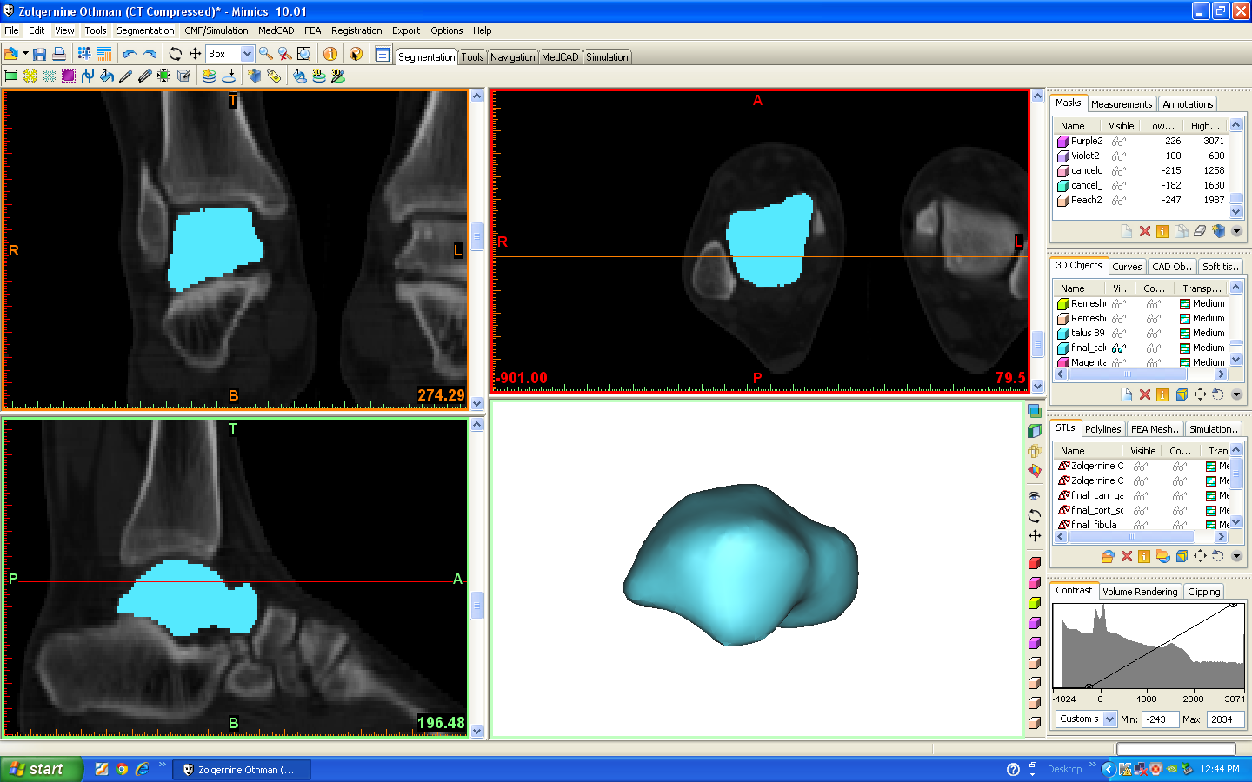
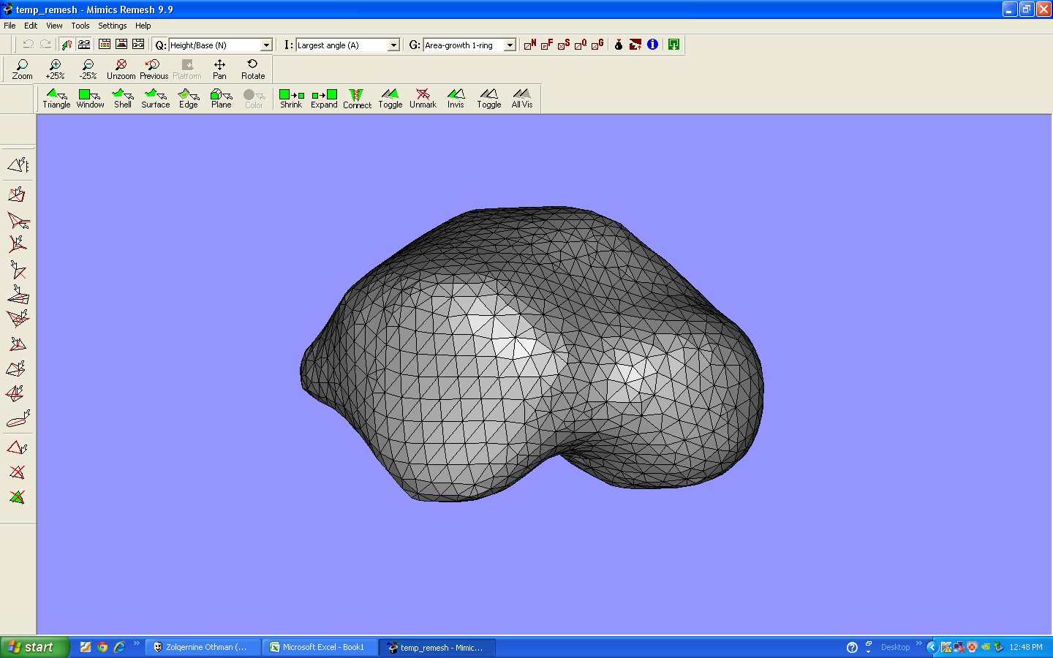
Reconstruction of 3D Ankle Bones (Talus and Tibia)
Three dimensional model of talus and tibia was reconstructed from two dimensional (2D) Computed Tomography (CT) datasets of human lower limbs using an image processing software (Mimics 10.01, Materialise, Belgium). Two dimensional mask regions were marked in coronal, axial and sagittal views to generate the 3D model of talus & tibia as shown in Figure 1. The surface of generated 3D models was then edited by refining the triangular meshes. The example of refining triangular meshes on talus is shown in Figure 3.3. The 3D reconstruction was repeated for another 100 talus and 100 tibia 2D CT data which considered both left and right ankles for fifty (50) individuals.
Figure 1 Two dimensional mask regions in coronal, axial and sagittal views
Figure 2 Triangular meshes using Magic Software.

Slide 15
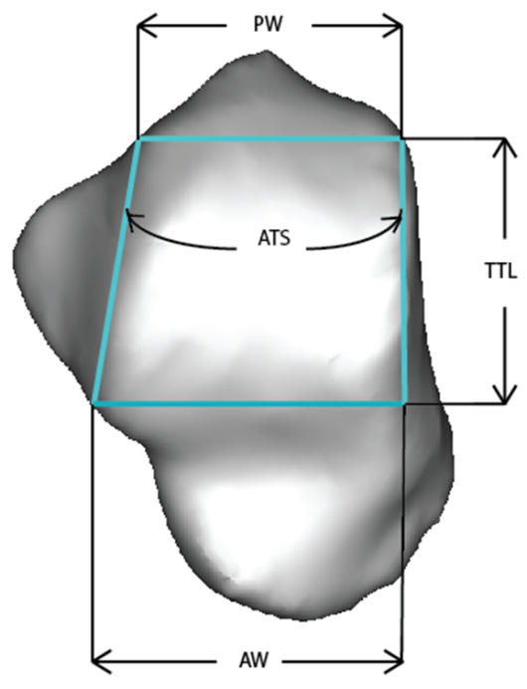
3D Ankle Morphometry using Solidworks
The raw DICOM files from the CT scan was used to virtually construct three dimensional (3D) models of both left and right talus bones using Mimics (Materialise NV). The total 100 of talus and tibia three dimensional (3D) models were then exported to SolidWorks (Dassault Systemes Solidworks Corporation) to measure their morphometric parameters. – trochlea tali length (TTL), talus anterior width (TaAW), talus posterior width (TaPW), Sagittal radius of talus (SRTa), width/length ratio of talus (WLRTa), tibia length (TiL) and tibia width (TiW) and width/length ratio of tibia (WLRTi). In this study the main morphometric parameters of superior trochlea tali which is the most important in designing ankle implant were measured in the transverse plane of three dimensional talus models as shown in Figure 3.
Trochlea Tali Length (TTL): length of the medial side of talus connecting the most posterior and the most anterior points of the superior articular surface of trochlea tali.
Anterior Width (AW): distance between the lateral and medial border at the anterior end of the trochlea tali, measured vertically to the trochlea tali length, TTL.
Posterior Width (PW): distance between the lateral and medial border at the posterior end of the trochlea tali, measured vertically to the trochlea tali length, TTL.
Angle of Trapezium Shape (ATS): The angle between two lines; one line for the trochlea tali length at medial side of talus, and another line at the lateral side of talus connecting anterior width, AW and posterior width, PW.
Figure 3 Ankle morphometric parameters.

Slide 16
Ankle Morphometric Prediction via ANN Model
The ANN used in this study was a feed forward network, with a hidden layer of sigmoid transfer function and an output layer of linear transfer function. The number of neurons in the hidden layer was selected from 2 to 30 through a trial-and-error process. The input to the neural networks includes age, height, and weight. The TTL, TaAW, WLRTa, TiL, TiW, and WLRTi was selected as targets. The training, validation and testing of the ANN model was performed using MATLAB software (The MathWorks, Inc., USA) with ANN tool box. The MATLAB Neural Network Toolbox is used to program the BPG. Backpropagation is a gradient descent algorithm, in which the network weights are moved along the negative of the gradient of the performance function. For the problems of this type, the backpropagation type of neural network is more available than other types of network. The BPG will provide a reasonable results if it is trained properly with the inputs that the network has never seen.
In the ANN study, the data set consist of 99 subjects (49 females and 50 males) were randomly divided into three equal parts as training, validation, and test data. The training sample (70 subjects) was used during network training, 14 subjects for the validation sample and 15 subjects for the testing sample. The mean squared error was employed as the performance measure during training. The framework of early stopping was performed to improve the generalization. The training was stopped when the error at the validation increased. The main goal of the BPG was to find the solution with the minimum error and fastest convergence. To decrease the error, modifying the network topology should be performed. The process involved changing the number of neurons in the hidden layer and by changing the learning rate. The accuracy of the ANN model was determined by comparing the predicted values with the 3D measurements using Solidworks software. Parametric statistical correlations (Pearson’s r) were used to clarify relationships between the predicted values and actual values of ankle morphometric measurements.

Slide 17
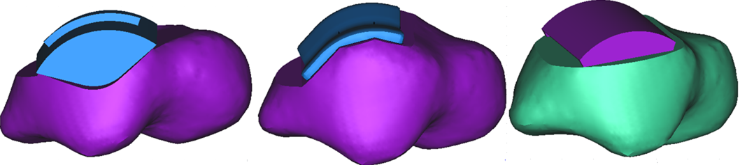
Assembly of the Models – Virtual Surgical Procedure
When a TAA is performed, the ankle joint’s articular surfaces are resected and then replaced with specially designed prosthetic components. Thus, the intention at this stage was to create the models in which the ankle joint’s articular surfaces are substituted by prosthetic components, which may be termed by virtual surgical procedure. This procedure was performed for STAR, BOX & TNK prostheses, and based on surgical technique manuals provided by the DePuy Orthopaedics, Inc. Moreover, this procedure was also performed according to what was advised by Prof Tunku Kamarul (experienced orthopaedic surgeon) whom clinical collaborators from Faculty of Medicine of the University of Malaya. As result, the models after the insertion of the STAR, BOX & TNK prostheses were created (refer Figure 4).
Figure 4 The STAR (at left), the BOX model (at middle) and the TNK model, (at right). Software used: SolidWork and Mimics

Slide 18
Finite Element (FE) Modelling
The three models under study (STAR, BOX and TNK) were imported from the SolidWorks® to ABAQUS® for cleaning up the geometries and meshing. Then, the models were exported to MSC_Marc Mentat Software for converting to STL format and then exported to Mimics software for assembly process with the talus bone as shown in Figure 3.8. After completed the assembly process, the models export to 3 matics Software for mesh refining (mesh size 1.5 based on convergence test) and then convert it to volume mesh. Then, the stress analysis in MSC Marc Mentat software took place after volume mesh of the models completed. Initially, for the stress analysis, the bone was considered linearly elastic, heterogeneous and isotropic. The materials of talus components were considered isotropic with linear elastic behaviour, whose properties are shown in Table 1
Table 1 Material properties defined in the four models under study (intact talus, STAR, BOX and TNK).
Component | Material | Young’s modulus, E (MPa) | Poisson’s ratio, ν
Cortical Bone |  | 19000 | 0.3
STAR Talar Component | Co-Cr-Mo | 210000 | 0.3
BOX Talar Component | Co-Cr-Mo | 210000 | 0.3
TNK Talar Component | Alumina Ceramic | 215000 | 0.3

Slide 19
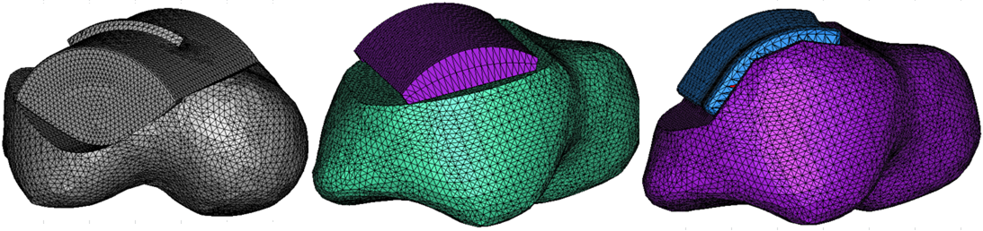
Finite Element (FE) Modelling Validation
The contact stress distribution in the articular surfaces is commonly used to validate FE models, which is a very important step before any further investigation. Thus, the comparison between experimental and FE results obtained by other authors and the present FE results could help establishing the validity of the present computational model. The applied loading conditions used in this work were based on the data provided. Three different static load cases were applied to each model (intact, STAR, BOX and TNK prostheses), according to the dorsiflexion, neutral and plantarflexion positions. Regarding the stress analysis, each of the three load cases was considered individually for each model according to the position. Moreover, another two loading conditions were included in this work. Firstly, an axial force of 600 N was applied to the three positions. Then, the axial forces of 1600 N, 600 N and 400 N were applied to dorsiflexion, neutral and plantarflexion positions, respectively. Regarding the boundary conditions, the talus was fixed in two positions.
Due to the limitation for the automatic-meshing algorithms in 3 Matics software to produce hexahedral meshes, 4-noded tetrahedral elements were used for meshing all the constituent parts of the three models under study. The resulting FE meshes for the three models of ankle prostheses under study are shown in Figure 5
Figure 5 The STAR (at left), the TNK model (at middle) and the BOX model (at right). Software used: Solidworks and Mimics.

Slide 20
RESULTS & DISCUSSION

Slide 21
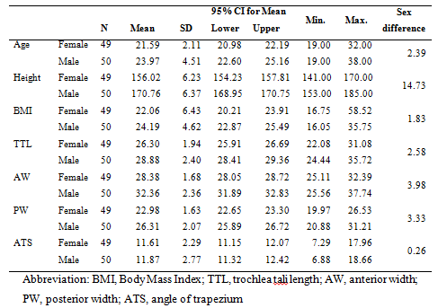
Ankle Morphometric Measurement using CT Scan Data
The group of 99 participants consisted of 49 female and 50 male adults with a mean age of 21.59 ± 2.11 and 23.97 ± 4.51 years respectively. The mean BMI for female and male was 22.06 ± 6.43 and 24.19 ± 4.62 respectively as shown in Table 2. There were significant correlations between the height of the subjects and TTL, TaAW, TiL and TiW . The morphometric analysis of the talocrural joint for left and right ankles showed no differences with the measured parameters. However, significant differences were observed between the male and female populations (p<0.001) . This indicates that absolute measurements for ankles were significantly different between males and females, with the latter having a smaller measurement in all aspects. However, this does not appear to affect the ratios of TaAW/TTL and TiW/TiL in either gender. The intra class correlation coefficient (ICC) values for all measured parameters showed a high degree of reliability.
Table2 Descriptive statistics of different demographical parameters and morphological parameters of trochlea tali of our population.

Slide 22
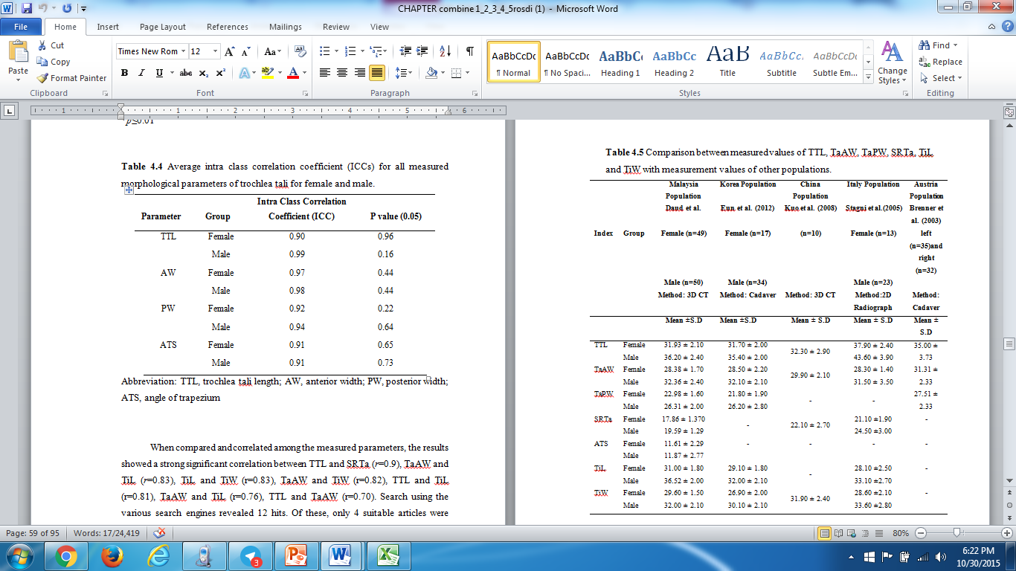
When compared and correlated among the measured parameters, the results showed a strong significant correlation between TTL and SRTa (r=0.9), TaAW and TiL (r=0.83), TiL and TiW (r=0.83), TaAW and TiW (r=0.82), TTL and TiL (r=0.81), TaAW and TiL (r=0.76), TTL and TaAW (r=0.70). Search using the various search engines revealed 12 hits. Of these, only 4 suitable articles were included in this study [13-16].The mean values and standard deviation of TTL, TaAW, TaPW, SRTa, TiL and TiW when compared with four different populations (Korea, China, Italy and Austria) is illustrated in Table 3. It is important to note that the mean values of TTL for Asians (Malaysia, Korea and China) are smaller than their European counterparts (Italy and Austria). Whilst, mean value of TiL for Malaysian is significantly bigger than Korean and Italian. However, the mean values of TaAW and TaPW were similar for all cohorts. The comparison between the different sexes and different populations were not possible since data presented in other publications I based on a pooled data from both sexes.
Table 3 Comparison between measured values of TTL, TaAW, TaPW, SRTa, TiL and TiW with measurement values of other populations.

Slide 23
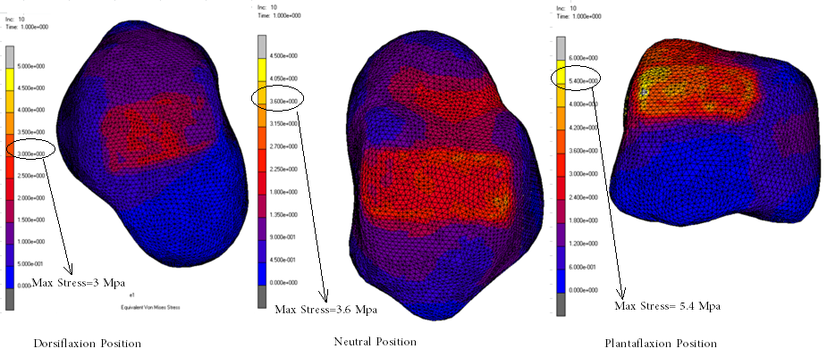
Finite Element Analysis
Contact Stress Distribution in the Intact Ankle Joint
The FE-computed contact stresses in the ankle joint for dorsiflexion, neutral and plantarflexion positions are displayed on the superior articular surface of the intact talus, in Figure 6. Three loading conditions were considered in this study For reasons of synthesis, only an axial load was included aiming to compare the results with the available studies in the literature that included the same loading condition.
Figure 6 superior views of the talus’s throclea tali, overlaid with FE-computed contact stresses (MPa) for the dorsiflexion, neutral and plantarflexion positions, considering only an axial force of 600 N to the three positions.

Slide 24
Regarding the magnitude of contact stress, using the same axial force for the three positions under study, the maximum contact stresses increased from the dorsiflexion to plantarflexion positions, which were also observed in [46] and so the higher magnitude of the loads applied in dorsiflexion position resulted in higher maximum contact stresses. The FE-computed results of the present study show good comparison among the global magnitude of the contact stresses reported by Anderson et al. [47], as shown in Table 4. Besides the limitations of this study, these results show reasonable comparison and are, for the most part, consistent with previous studies. Thus, this validation establishes confidence in results from the FE models.
Table 4 Comparison of the contact stresses reported in the study of Anderson et al. [47], D.Rodrigues et. al and the FE results of the present study
Source | Method | Maximum Contact Stress (MPa)
Anderson et. al | FEM | 3.74
 | Tekscan | 3.69
D.Rodrigues et al | FEM | 3.95
Present study | FEM | 3.6

Slide 25
Contact Stress Distribution in the Talar Component of Ankle Prostheses
The FE-computed contact stress distributions in the talar component of ankle prostheses surfaces for S.T.A.R., BOX and TNK prostheses for dorsiflexion, neutral and plantarflexion positions are displayed in Figure 7. Once again, as done for the intact ankle joint, three loading conditions were considered in this study. For reasons of synthesis, only the results when considering an axial force of 600 N to the three positions are shown (the other results were similar). Besides not shown here, the problem of edge-loading was evident in TNK for the three loading conditions, and also for S.T.A.R. prosthesis. These problems have been reported in several studies [10, 13, 50, 51].

Slide 26
Figure7 FE-computed contact stress distributions in the talar component of ankle prostheses surfaces for S.T.A.R., BOX and TNK prostheses for dorsiflexion, neutral and plantarflexion positions

Slide 27
The reported maximum contact stresses from the literature are in the range of 5.7-36 MPa. In the present study, for STAR, the maximum contact stresses were in the range of 4.95-9.9 MPa. While the BOX were in range 3.6-6.4 MPa. The highest range of maximum contact stress are for TNK, 5.5-12.6 MPa. The comparison of the present results with previous studies from the literature is difficult because of the different designs analysed, the different boundary and loading conditions applied, etc. Larger values of the contact stresses were observed in the present study, mostly for the TNK and STAR prosthesis. The main reason is probably related to the loading conditions considered in the present study. As it has been confirmed, there is an increased contact stress with loading, and so the larger values observed in the present study may be related to that fact. In general, the FE-computed contact stresses in the present study show good comparison among the reported contact stresses from the literature
Furthermore, some studies [10, 53] have indicated that to achieve a successful TAA the contact stresses should not exceed 10 MPa on superior surface of talus. However, both prostheses (BOX and STAR) exceeded the recommended value for the talus component (10 MPa) eventhough the maximum contact stress of STAR in plantarflexion position is 9.9 Mpa. So do with the TNK prostheses which gave the highest maximum contact stress 12.26 MPa in plantarflexion position. The higher contact stress maybe due to higher bone loss during resection procedure which the design of STAR & TNK required higher bone resection. In fact, these prostheses still have some untested features and the optimal articulation configuration is currently not known.

Slide 28
By analysing the results, it is possible to notice that the intact talus distributes stresses evenly throughout the bone and that there is a preferential area for the transmission of force from talus to the calcaneus. After the insertion of prostheses major changes occurred in the talus, in particular, in its internal stress distribution. There was an increase of the magnitude of stresses in trabecular bone for the three models. When comparing the three prostheses (STAR, BOX and TNK), the wider shape of the design of STAR and BOX at the anterior edge led to a decrease of the maximum stresses in the talus. To conclude, the present results agree that excessive bone resection results in the prosthesis being seated on trabecular bone that may not support the forces at the ankle, which consequently may contribute to early loosening and subsidence of the talar component, as also reported in [54, 55]. Thus, minimal bone resection is required in order to remain firm the bone-prosthesis interface.

Slide 29
REFERENCES

Slide 30
1. Nishikawa M, Tomita T, Fujii M, Watanabe T, Hashimoto J, Sugamoto K, Ochi T, Yoshikawa H. Total ankle replacement in rheumatoid arthritis. International Orthopaedics 28. (2.) (2004). 123-126
2.Dettwyler M, Stacoff A, Kramers-de Quervain IA, Stüssi E. Modelling of the ankle joint complex: Reflections with regards to ankle prostheses. J Foot Ankle Surg 10. (3.) (2004). 109-119
3.Guyer AJ,Richardson EG. Current Concept Review: Total Ankle Artroplasty. Foot and Ankle International 29. (20.) (2008). 256-264
4.Cenni F, Leardini A, Cheli A, Catani F, Belvedere C, Romagnoli M, Giannini S. Position of the prosthesis components in total ankle replacement and the effect on motion at the replaced joint. International Orthopaedics (2011). 1-8
5.Fessy MH, Carret JP, Béjui J. Morphometry of the talocrural joint. Surgical Radiologic Anatomy 19. (1997). 299-302
6.Stagni R, Leardini A, Catani F, Cappello A. A new semi-automated measurement technique based on X-ray pictures for ankle morphometry. Journal of Biomechanics 37. (7.) (2004). 1113-1118
7.Stagni R, Leardini A, Ensini A, Cappello A. Ankle morphometry evaluated using a new semi-automated technique based on X-ray pictures. Clinical Biomechanics 20. (3.) (2005). 307-311
8.Hayes A, Tochigi Y, Saltzman CL. Ankle morphometry on 3D-CT images. IOWA Orthopaedic Journal 26. (2006). 1-4
9.Hatzantonis C, Agur A, Naraghi A, Gautier S, McKee N. Dissecting the Accessory Soleus Muscle: A Literature Review, Cadaveric Study, and Imaging Study. Clinical Anatomy 24. (7.) (2011). 903-910
10.Vanschaik JJP, Verbiest H, Vanschaik FDJ. Morphometry of lower lumbar vertebrae as seen on CT scans - newly recognized characteristics. American Journal of Roentgenology 145. (2.) (1985). 327-335
11.Muller R, Hahn M, Vogel M, Delling G, Ruegsegger P. Morphometric analysis of noninvasively assessed bone biopsies: Comparison of high-resolution computed tomography and histologic sections. Bone 18. (3.) (1996). 215-220
12.van der Linden-van der Zwaag H, Bos J, van der Heide H, Nelissen R. A computed tomography based study on rotational alignment accuracy of the femoral component in total knee arthroplasty using computer-assisted orthopaedic surgery. International Orthopaedics 35. (6.) (2011). 845-850
13.Kuo C-C, Lee G-Y, Chang C-M, Hsu H-C, Leardini A, Lu T-W. Ankle morphometry in the Chinese population. Journal of Foot and Ankle Research 1. (2008). 1-2
14.Asla R, Kozánek M, Wan L, Rubash H, Li G. Function of anterior talofibular and calcaneofibular ligaments during in-vivo motion of the ankle joint complex. Journal of Orthopaedic Surgery and Research 4. (1.) (2009). 1-6

Slide 31
15.Niladri Kumar M. Morphology of sustentaculum tali: Biomechanical importance and correlation with angular dimensions of the talus. The Foot 21. (4.) (2011). 179-183
16.Michael JM, Golshani A, Gargac S, Goswami T. Biomechanics of the ankle joint and clinical outcomes of total ankle replacement. Journal of the Mechanical Behavior of Biomedical Materials 1. (4.) (2008). 276-294
17.Kleipool R,Blankevoort L. The relation between geometry and function of the ankle joint complex: a biomechanical review. Knee Surgery, Sports Traumatology, Arthroscopy 18. (5.) (2010). 618-627
18.Kakkar R,Siddique MS. Stresses in the ankle joint and total ankle replacement design. J Foot Ankle Surg 17. (2.) (2011). 58-63
19.Brenner E, Piegger J, Platzer W. The trapezoid form of the trochlea tali. Surgical and Radiologic Anatomy 25. (3-4.) (2003). 216-225
20.Tochigi Y, Rudert MJ, Saltzman CL, Amendola A, Brown TD. Contribution of articular surface geometry to ankle stabilization. Journal of Bone & Joint Surgery 88. (2006). 2704–2713
21.Tochigi Y, Rudert MJ, Saltzman CL, Amendola A, Brown TD. The mechanisms of ankle stabilization: The role of articular surface geometry as the primary restraint. Osteoarthritis and Cartilage 13, Supplement 1. (0.) (2005). S73
22.Giannini S, Romagnoli M, O'Connor JJ, Catani F, Nogarin L, Magnan B, Malerba F, Massari L, Guelfi M, Milano L, Volpe A, Rebeccato A, Leardini A. Early Clinical Results of the BOX Ankle Replacement Are Satisfactory: A Multicenter Feasibility Study of 158 Ankles. J Foot Ankle Surg 50. (6.) (2011). 641-647
23.Kofoed H,Sorensen TS. Ankle arthroplasty for rheumatoid arthritis and osteoarthritis. J Bone Joint Surg Br 80-B. (1998). 328-332
24.Yip R, Binkin NJ, Trowbridge FL. Altitude and childhood growth. The Journal of Pediatrics 113. (3.) (1988). 486-489
25.Puustinen L, Numminen K, Uusi-Simola J, Sipponen T. P101 Radiation exposure during nasojejunal intubation for MRI. Journal of Crohn's and Colitis 6, Supplement 1. (0.) (2012). S50
26.de González AB,Darby S. Risk of cancer from diagnostic X-rays: estimates for the UK and 14 other countries. The Lancet 363. (9406.) (2004). 345-351
27.Dalbeth N, Doyle A, Boyer L, Rome K, Survepalli D, Sanders A, Sheehan T, Lobo M, Gamble G, McQueen FM. Development of a computed tomography method of scoring bone erosion in patients with gout: validation and clinical implications. Rheumatology (2010).
28.Brix G, Nissen-Meyer S, Lechel U, Nissen-Meyer J, Griebel J, Nekolla EA, Becker C, Reiser M. Radiation exposures of cancer patients from medical X-rays: How relevant are they for individual patients and population exposure? European Journal of Radiology 72. (2.) (2009). 342-347
29.Balonov MI,Shrimpton PC. Effective dose and risks from medical x-ray procedures. Annals of the ICRP 41. (3–4.) (2012). 129-141

Slide 32
THANK YOU
For your attention

