Slide 1
Efficient Cubane Catalysts for Artificial Water Splitting
Sandra Luber
September 14th, 2015

Slide 2
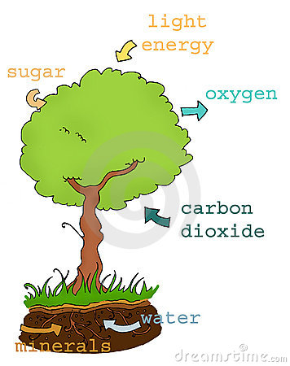
Nature: water splitting for carbohydrates & oxygen
Chemistry: 2H₂O → 2H₂ + O₂

Slide 3
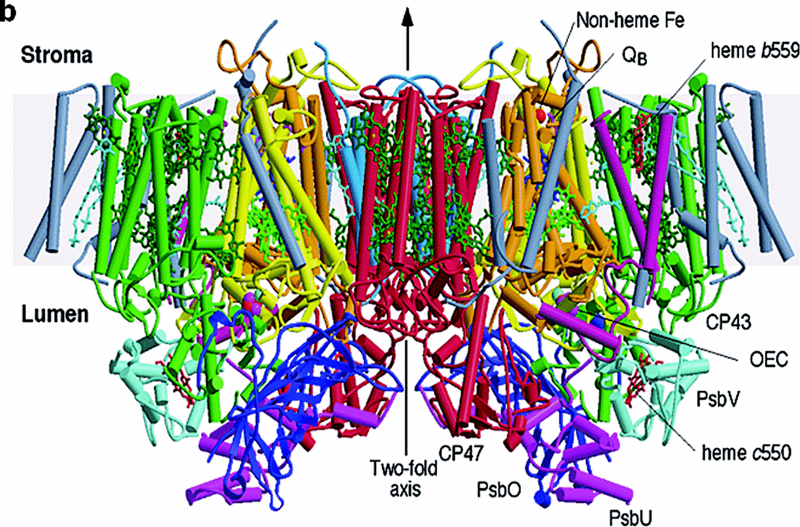
Nature’s photosystem II
Y. Umena, , K. Kawakami, J.-R. Shen, N. Kamiya, Nature 2011 (473) 55.

Slide 4
Oxygen evolving complex (OEC)
2H₂O → 4 H⁺ + 4 e⁻ + O₂
Y. Umena, K. Kawakami, J.-R. Shen, N. Kamiya, Nature 2011 (473) 55.
K. N. Ferreira, T. M. Iverson, K. Maghlaoui, J. Barber, S. Iwata, Science 2006 (303) 1838.

Slide 5
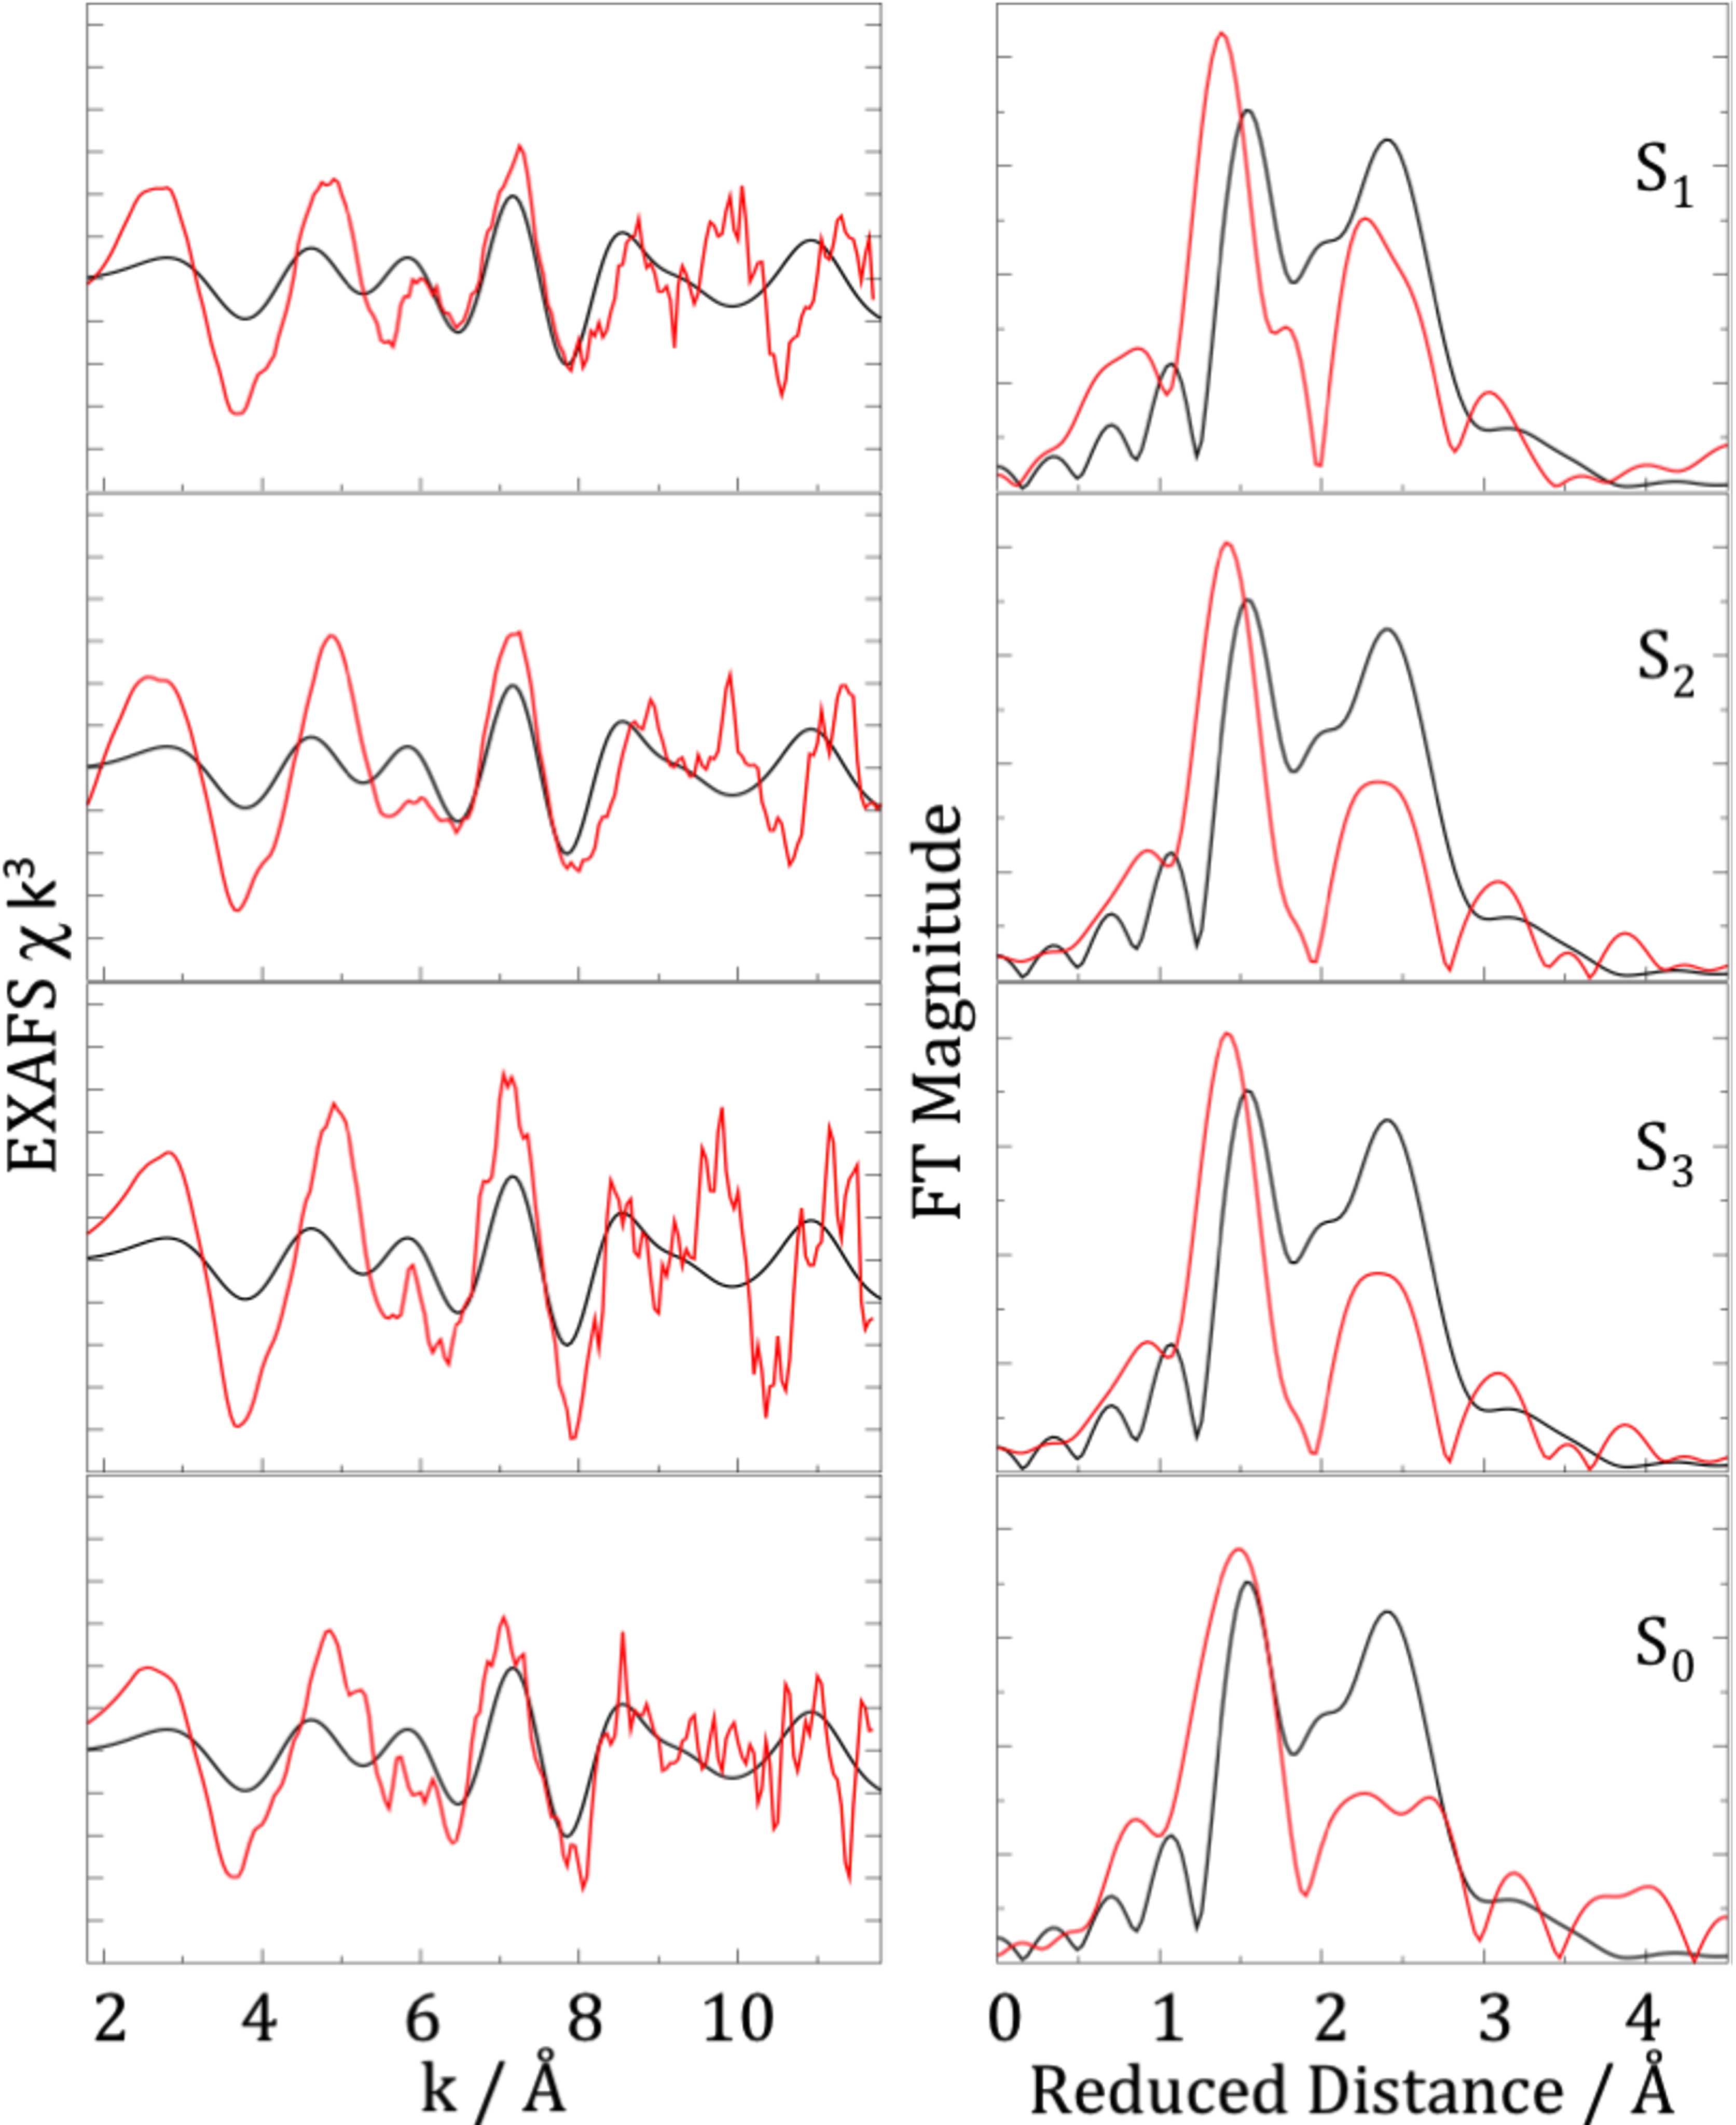
Does the crystal structure belong to the catalytic ground state?
EXAFS and DFT calculations:
New X-ray structure suffers
from oxidation damage
S. Luber, I. Rivalta, Y. Umena, K. Kawakami, J.-R. Shen, N. Kamiya, G. W. Brudvig, V. S. Batista, Biochemistry 2011 (50) 6308.

Slide 6
S1-state model via DFT QM/MM
Dark blue:
XRD model
Model in agreement with
(anisotropic) EXAFS data
S. Luber, I. Rivalta, Y. Umena, K. Kawakami, J.-R. Shen, N. Kamiya, G. W. Brudvig, V. S. Batista, Biochemistry 2011 (50) 6308.

Slide 7

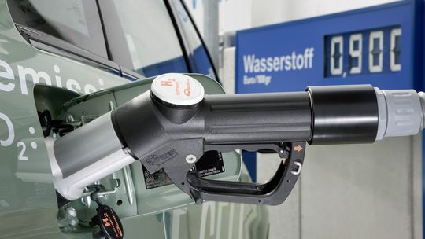
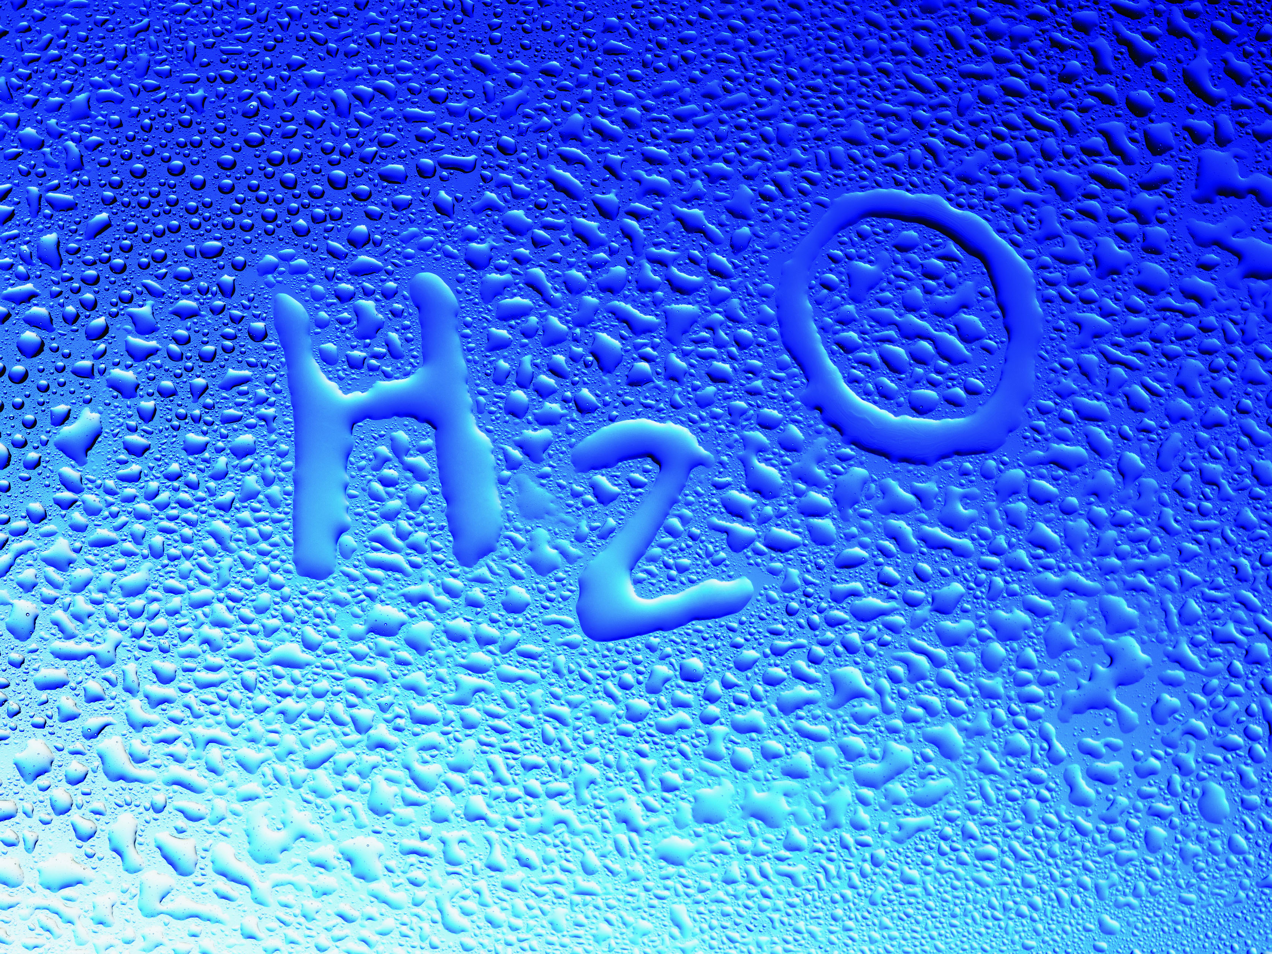
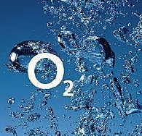
Artificial photosynthesis at University of Zurich
H₂O
Hydrogen: lightweight fuel
Oxygen: challenging half reaction
www.zeit.de
www.welldays.ch
www.aerzteblatt.de
University Research Priority Program: Light to Chemical Energy Conversion (LightChEC)

Slide 8

The LightChEC Strategy
Mimicking millions of years of evolution with molecules?
Water Oxidation Catalysts (WOCs) = bottleneck
Light transfer
H₂O
Efficiency
H₂O
Cat 1
LINK?
Cat 2
-
-
-
-
O₂
-
-
H₂
Electronic chain
Robust WOCs with abundant metals (Co, Mn)

Slide 9
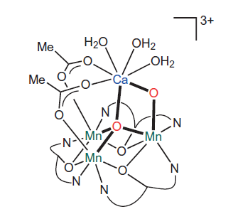
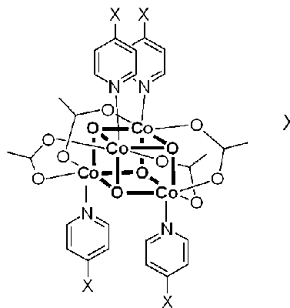
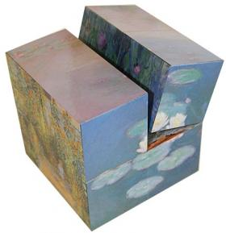
PSII mimics
Mn PSII mimics: No WOC activity
Only Co-cubane: [Co^{III}₄O₄(OAc)₄(py)₄]
+ derivatives
Magic cube
E. Y. Tsui, R. Tran, J. Yano, T. Agapie, Nat. Chem. 2013 (5) 293
N. S. McCool, D. M. Robinson, J. E. Sheats, G. C. Dismukes, J. Am. Chem. Soc. 2011 (133) 11446 M. Bonchio et al., J. Am. Chem. Soc. 2012 (134) 11104
OUR MISSION: Active Co-cubane
closer to PSII
BUT: WOC activity results
from Co^{II} impurities
A. M. Ullman, Y. Liu, M. Huynh, D. K. Bediako, H. Wang, B. L. Anderson, D. C. Powers, J. J. Breen, H. D. Abruna, D. C. Nocera, J. Am. Chem. Soc. 2014 (136) 17681

Slide 10
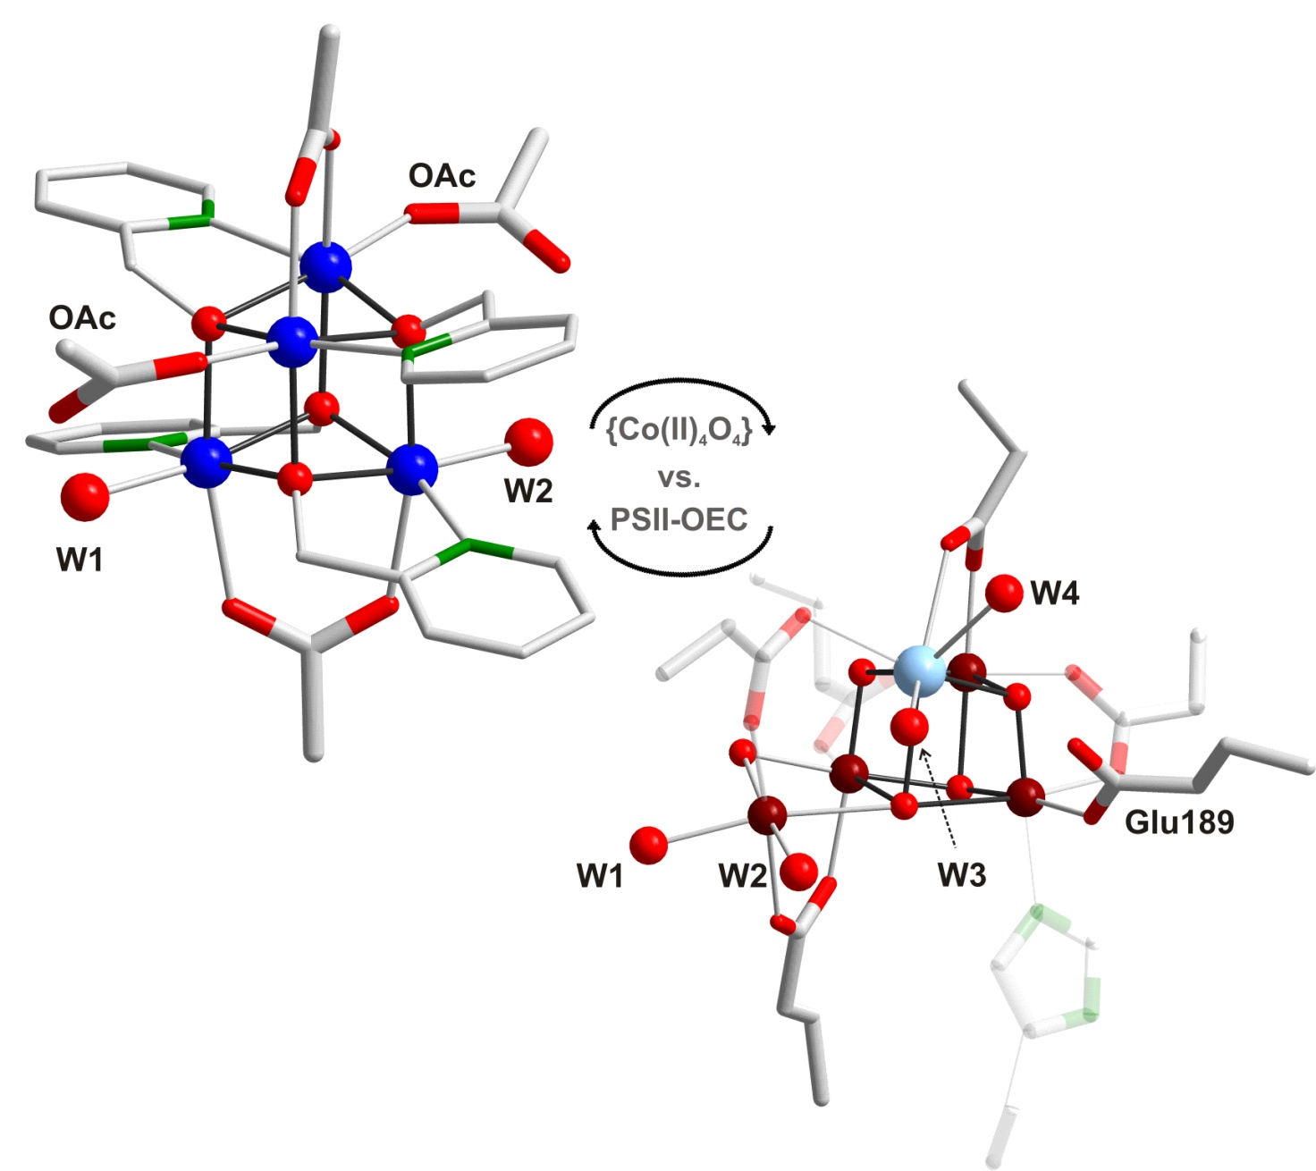
New Co(II)-cubane WOC
[Co^{II}₄(hmp)₄(μ-OAc)₂(μ₂-OAc)₂(H₂O)₂]
hmp = 2-(hyxdroxymethyl)pyridine
First cubane with Co(II) metal centers
F. Evangelisti, R. Güttinger, R. Moré, S. Luber, G. R. Patzke, J. Am. Chem. Soc. 2013 (135) 18734 & CHIMIA 2014 Highlight
Collaboration with G. R. Patzke (UZH)

Slide 11
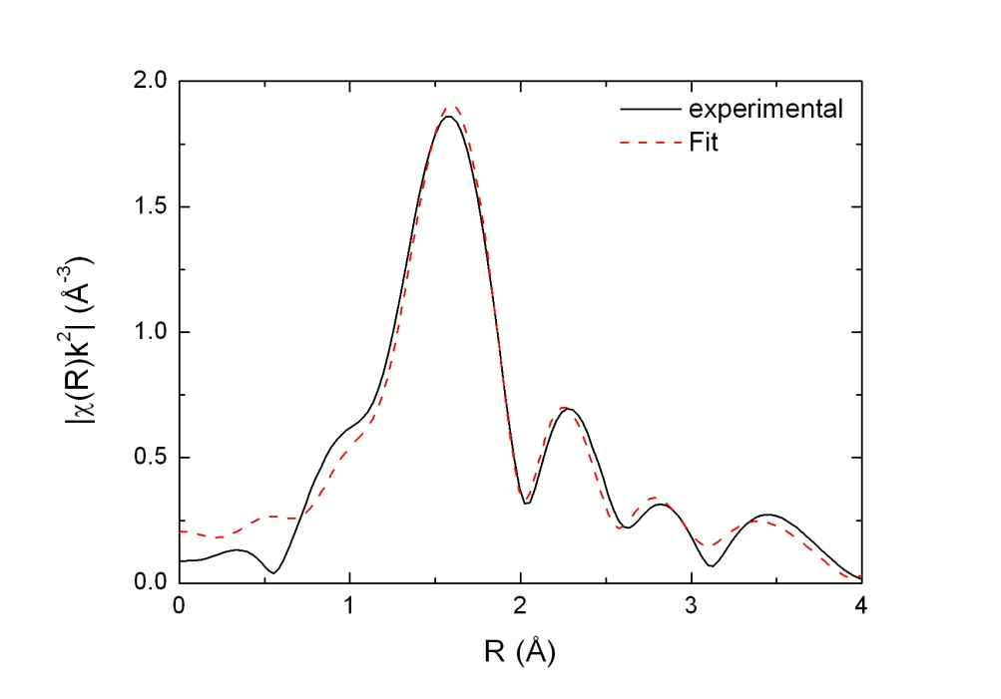
{Co^{II}₄O₄} Cubane: Stability
Solid state EXAFS spectrum: agrees with crystal structure
DFT calculations: HS Co(II), S = 6 ground state
Solution EXAFS: {Co₄O₄} core intact
Radical coupling mechanism as for HS Mn centers in OEC?

Slide 12
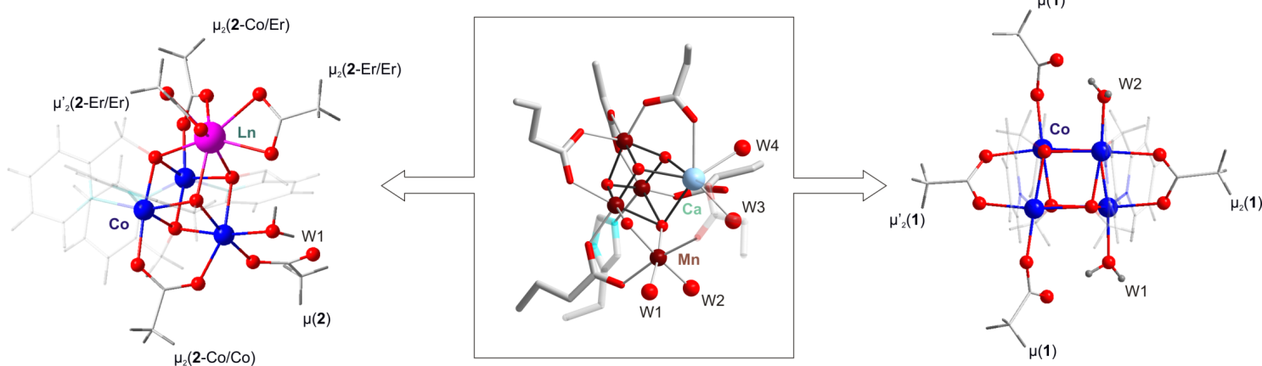
Closer to OEC: mimic redox-inert metal center
{Co₃LnO₄}
{Mn₄CaO₅}
{Co₄O₄}
Ln = Er, Ho, Yb, Tm
OEC
F. Evangelisti, R. Güttinger, R. Moré, S. Luber, G. R. Patzke, J. Am. Chem. Soc., 2013 (135) 18734.
F. Evangelisti, R. Moré, F. Hodel, S. Luber, G. R. Patzke, J. Am. Chem. Soc., 2015 (137) 11076.

Slide 14
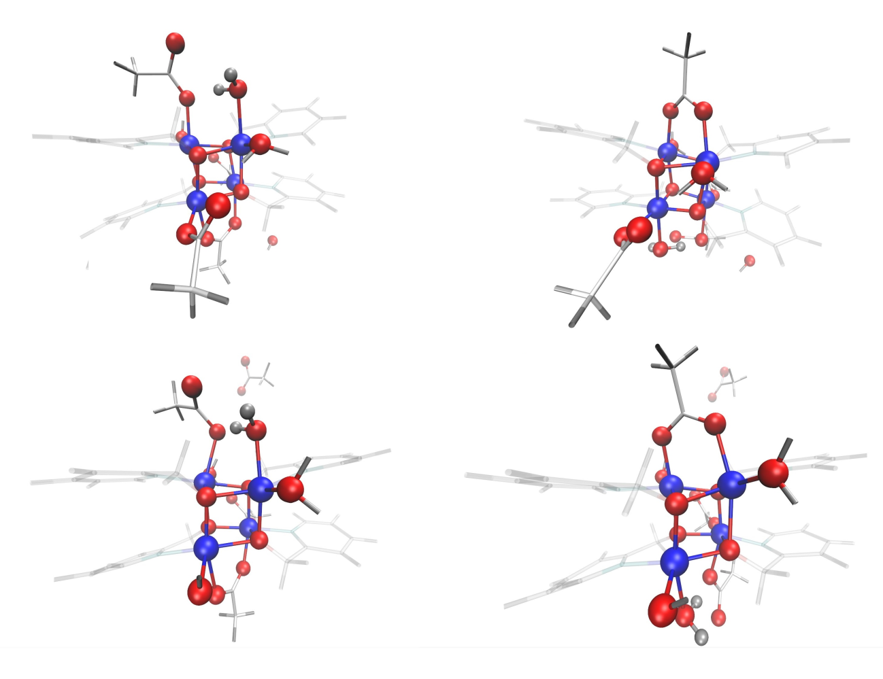
What is the catalytic ground state of {Co₄O₄}?
ΔE [kcal/mol]
COSMO solvent continuum model | -30.7
COSMO + 45 H₂O | 8.7
68 H₂O (QM) + 260 H₂O (MM) | 14.9
1st solvation shell (68 H₂O) | 5.4
1st solvation shell 2 | 11.6
1st solvation shell 3 | 10.9
DFT-based molecular dynamics (328 H₂O) | 30.0
F
Detailed reaction path further investigated
via minimum energy path calculations
and metadynamics
F. Hodel, J. Hutter, S. Luber, to be submitted.

Slide 15
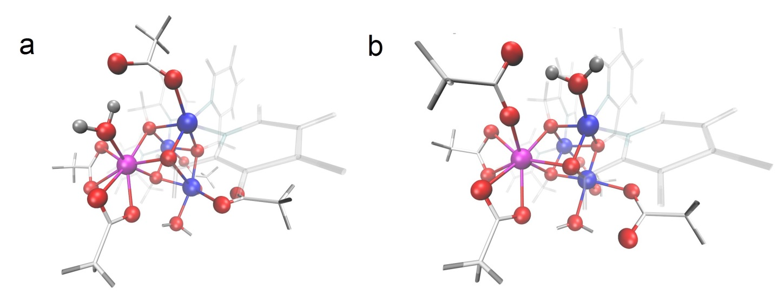
Partial detachment of acetate ligand – {Co₃ErO₄}
System | ΔE [kcal/mol]
a | -50
b | -75
DFT-based molecular dynamics

Slide 16
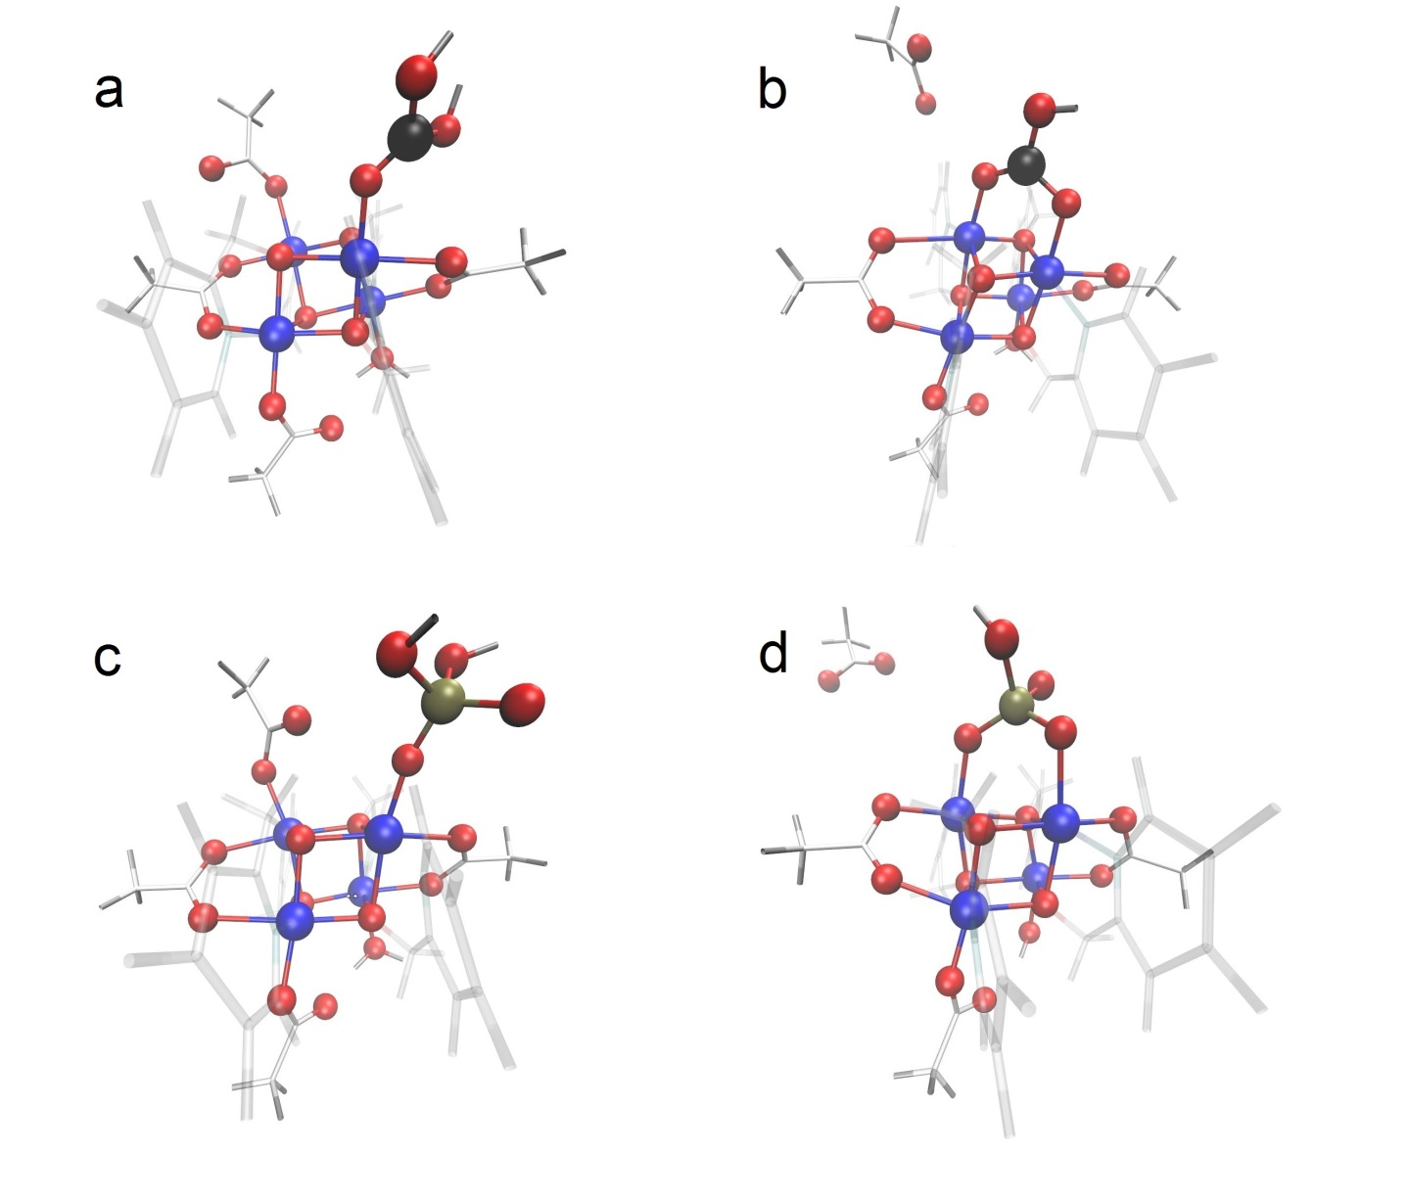
Influence of buffer molecules
System | ΔE [kcal/mol]
a | 31
b | 38
c | 44
d | -6
DFT-based
molecular dynamics
F. Evangelisti, R. Moré, F. Hodel, S. Luber, G. R. Patzke, J. Am. Chem. Soc., 2015 (137) 11076.

Slide 17
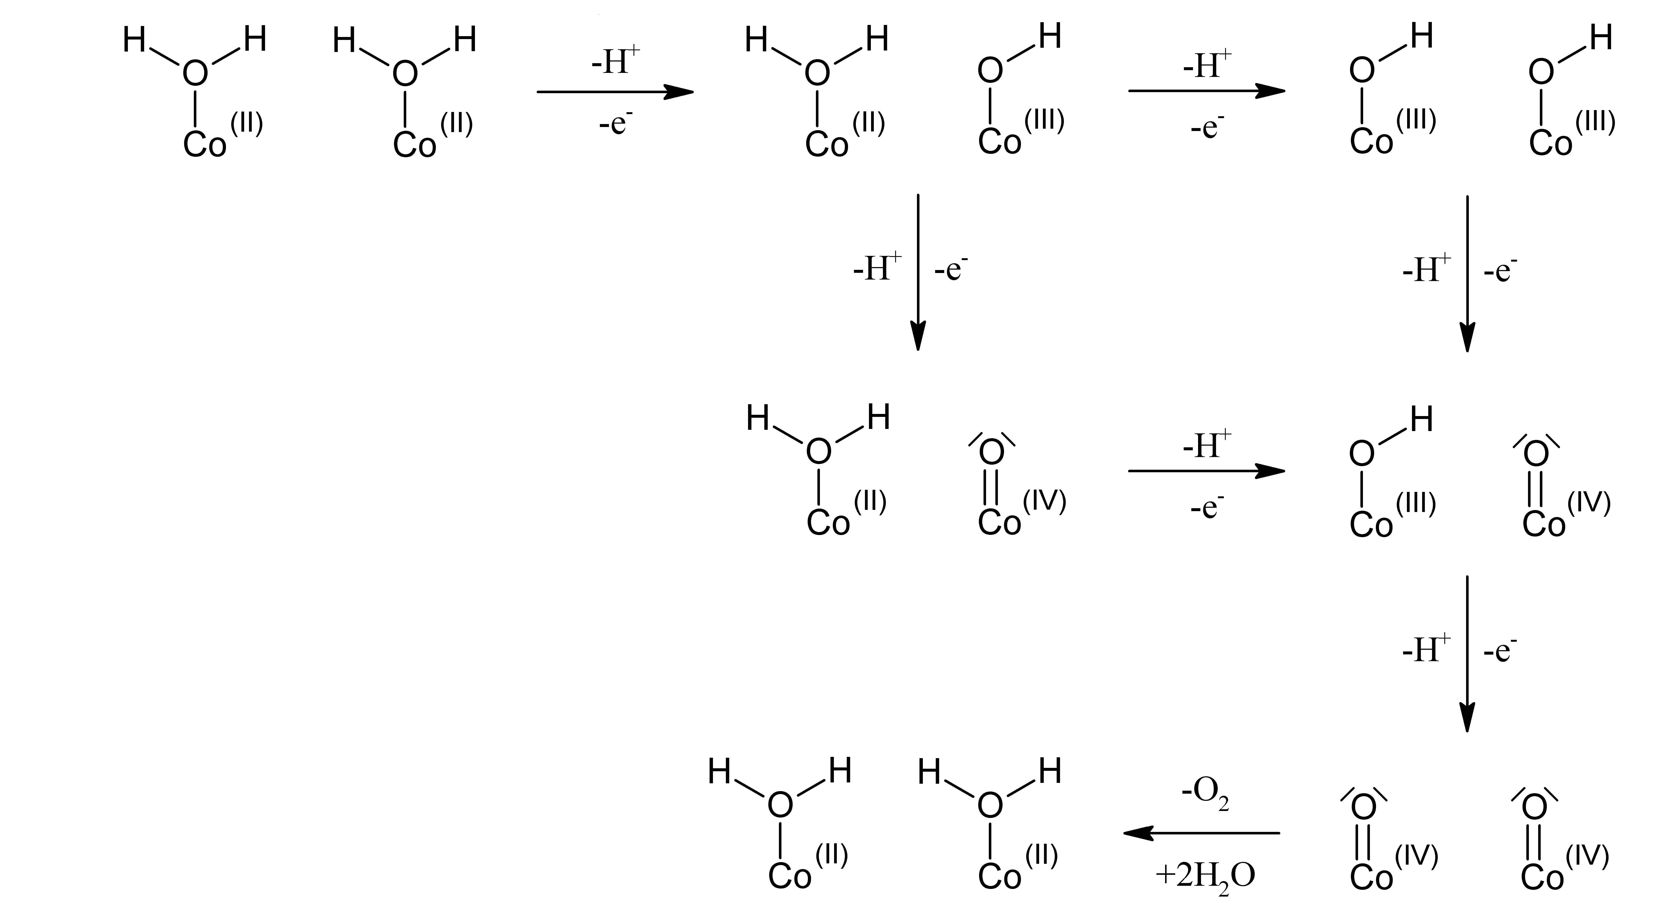
What is the oxidation mechanism? Oxo-oxo coupling?

Slide 18
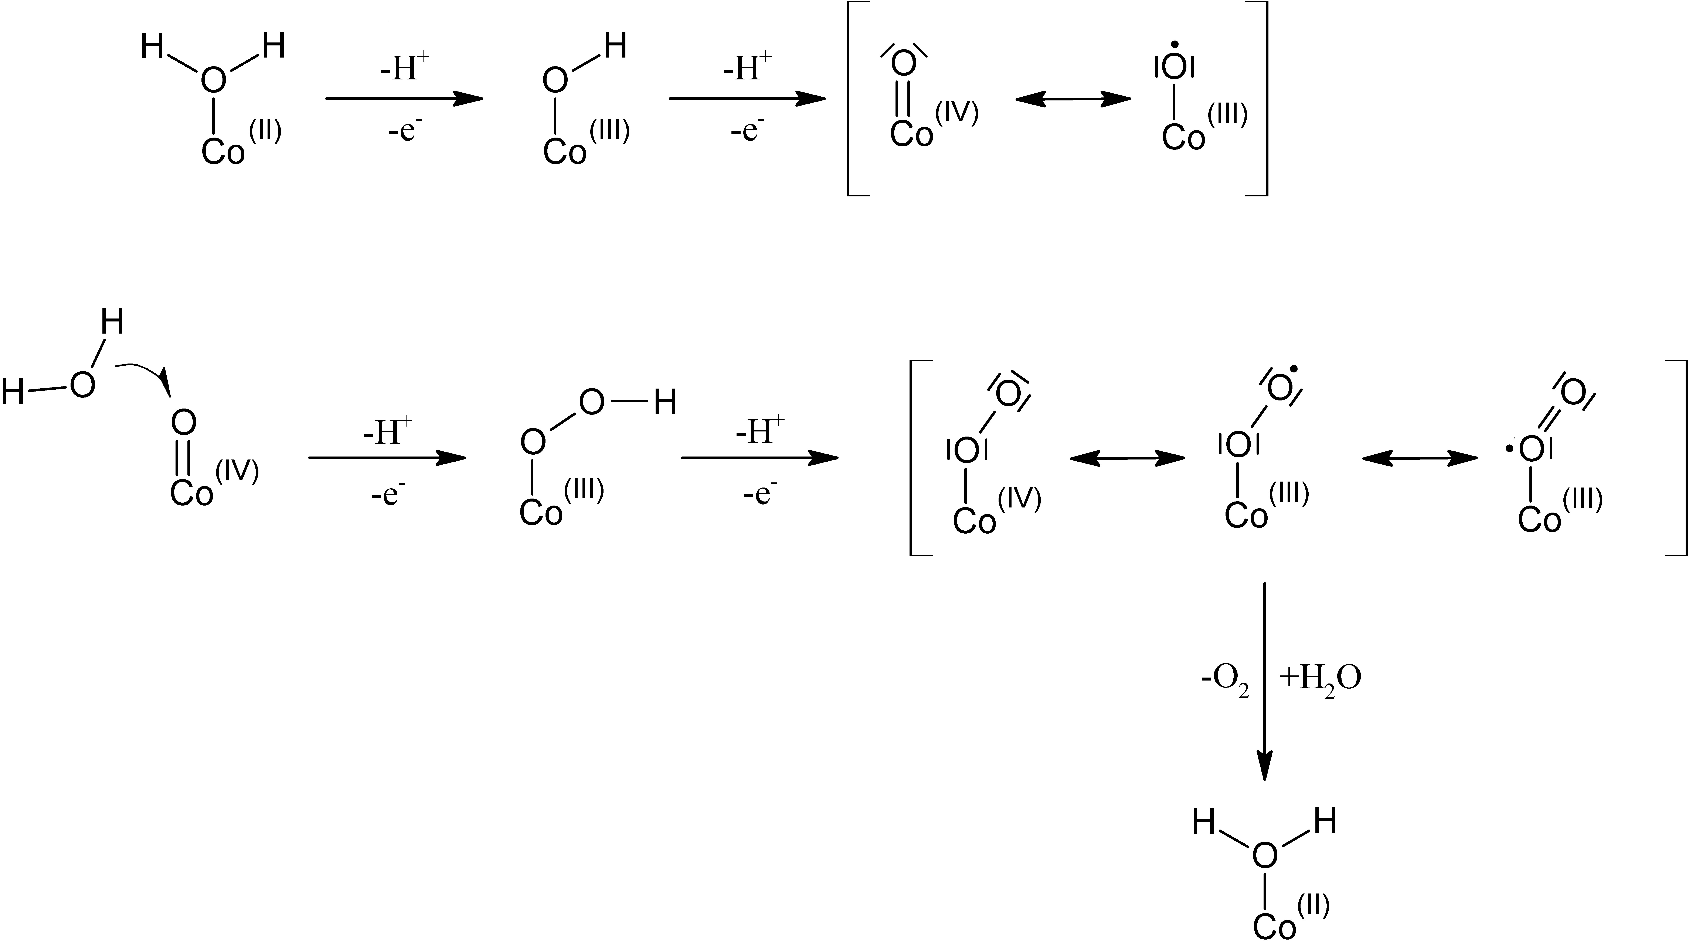
Alternative: single site water attack

Slide 19
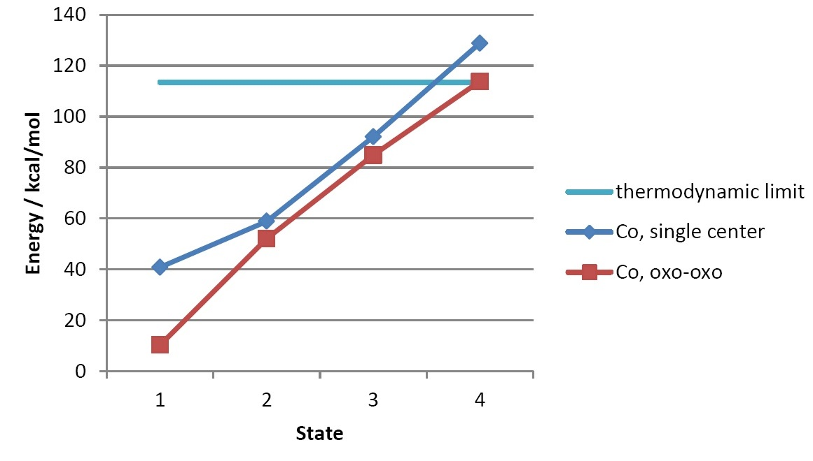
Free energy profiles: single center vs. oxo-oxo coupling
F. Hodel, J. Hutter, S. Luber, to be submitted.

Slide 20
Oxo-oxo coupling

Slide 21
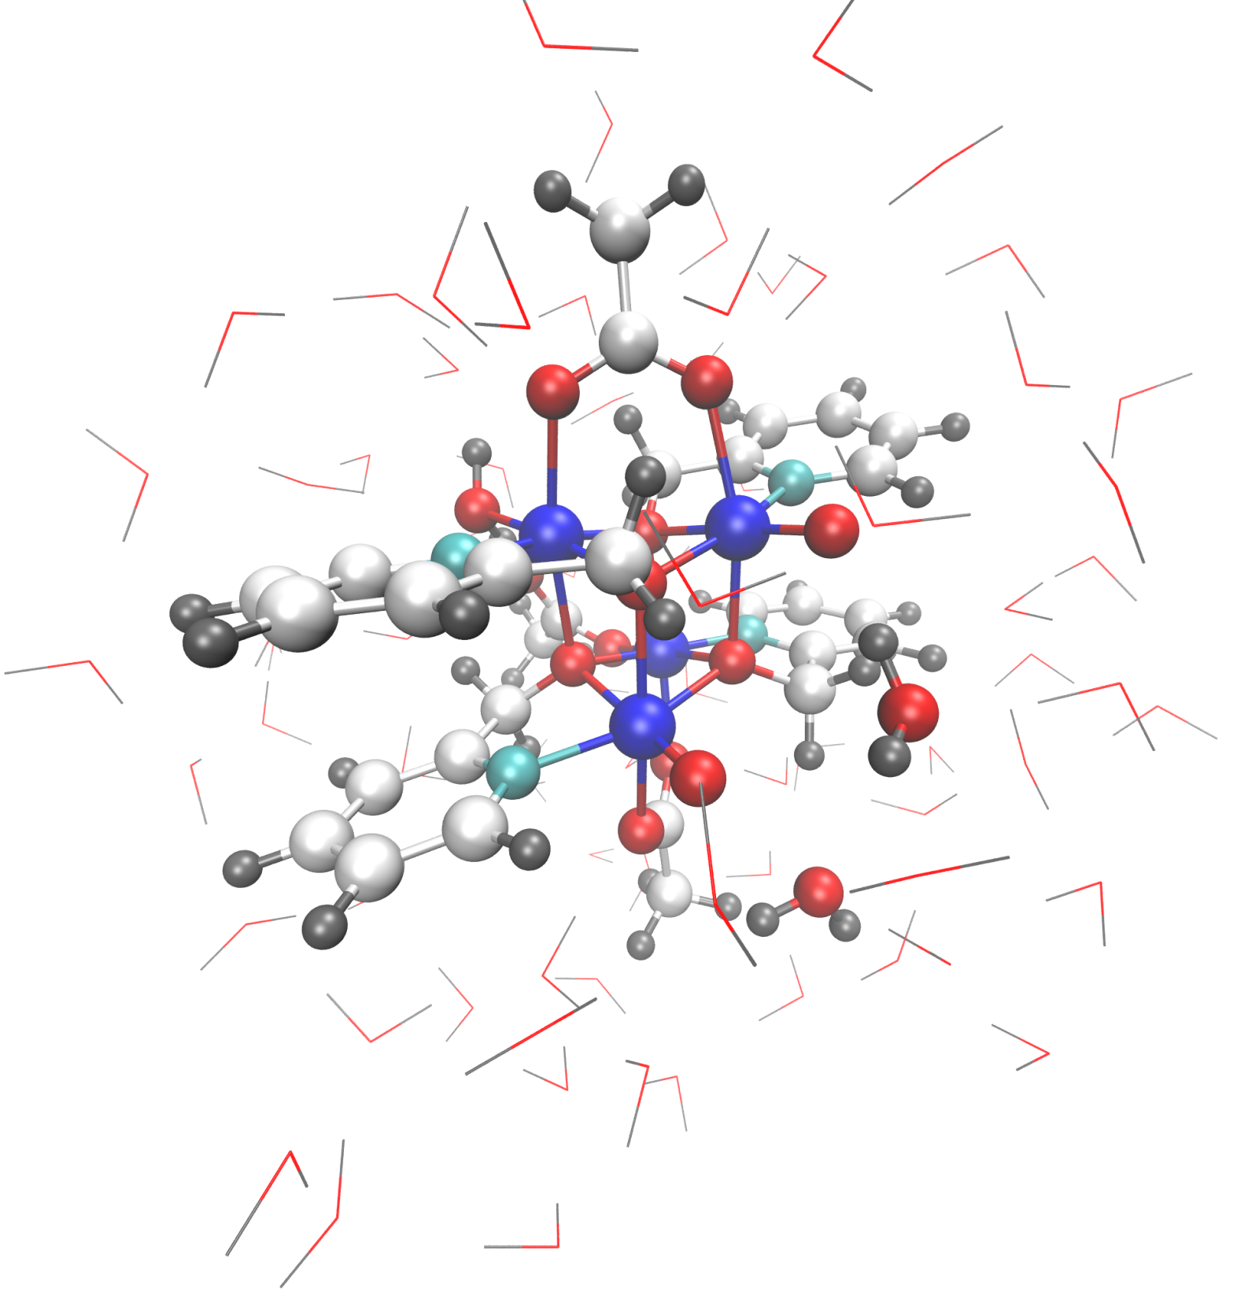
Energy profile: oxo-oxo coupling

Slide 22
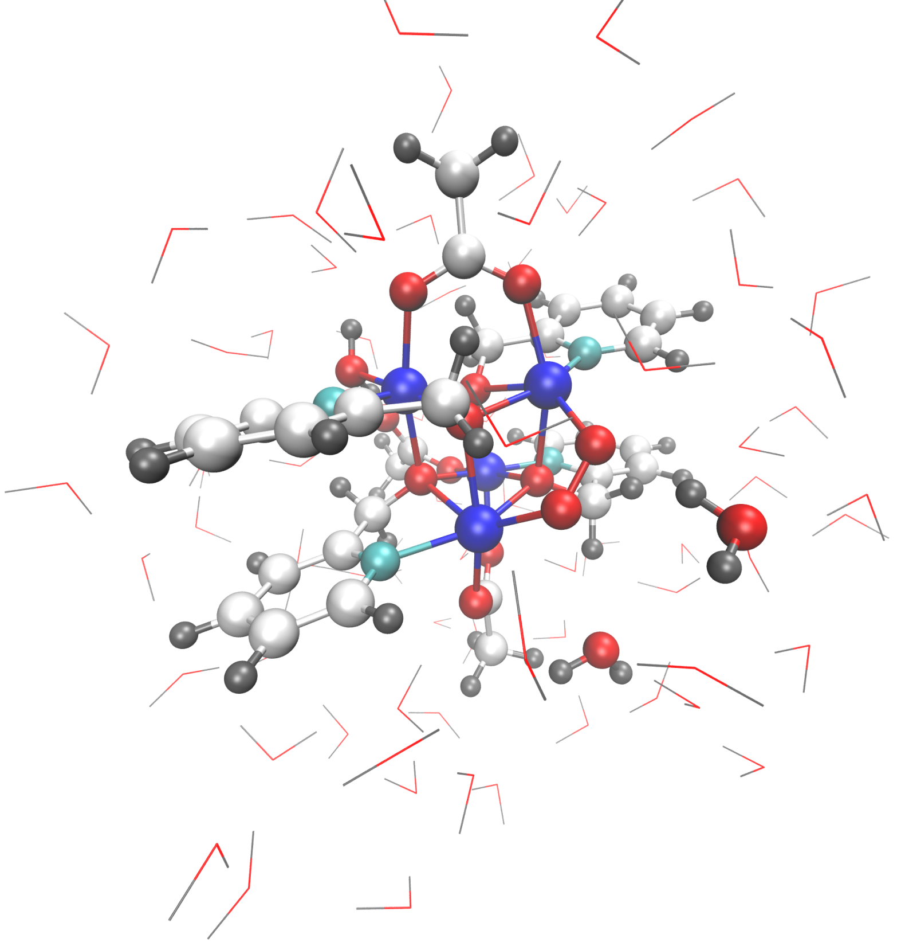

Slide 23
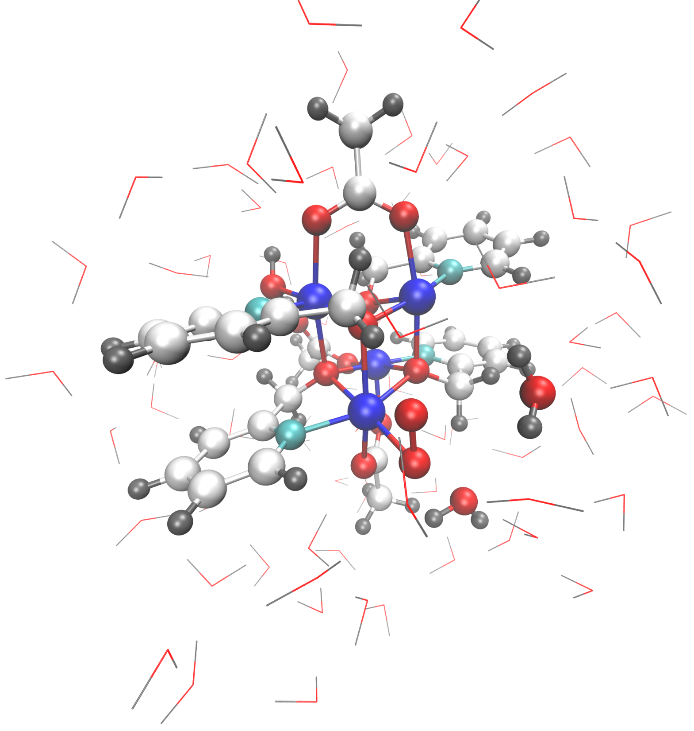

Slide 24
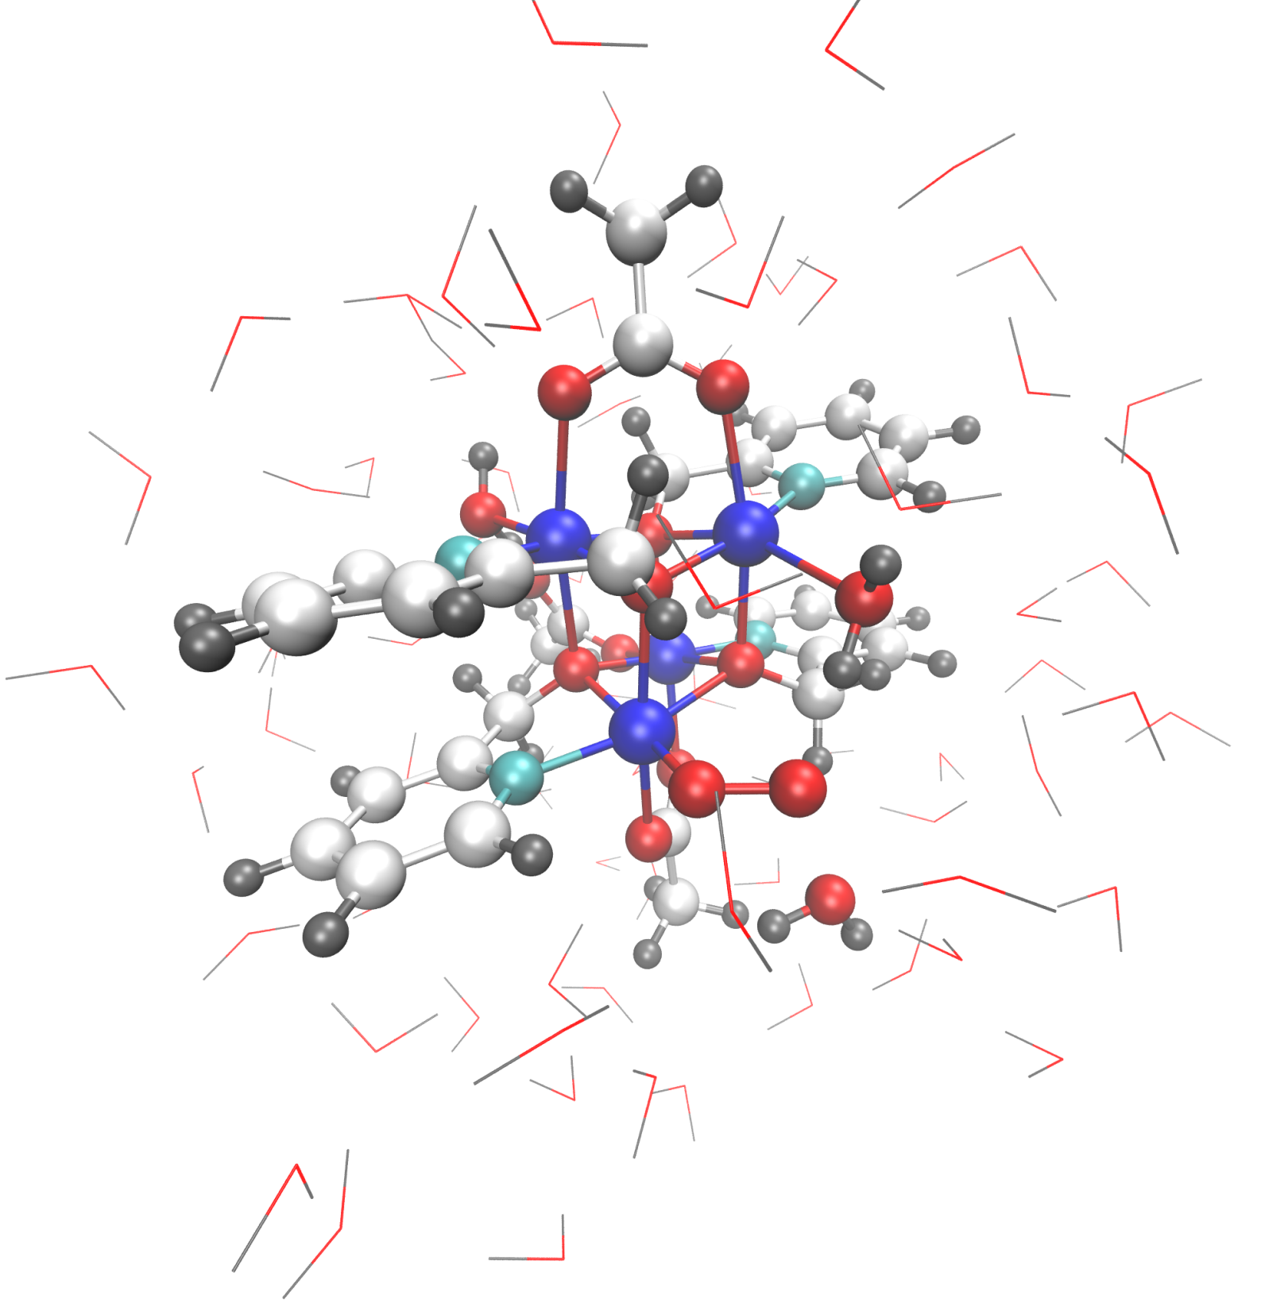

Slide 25


Slide 26


Slide 27
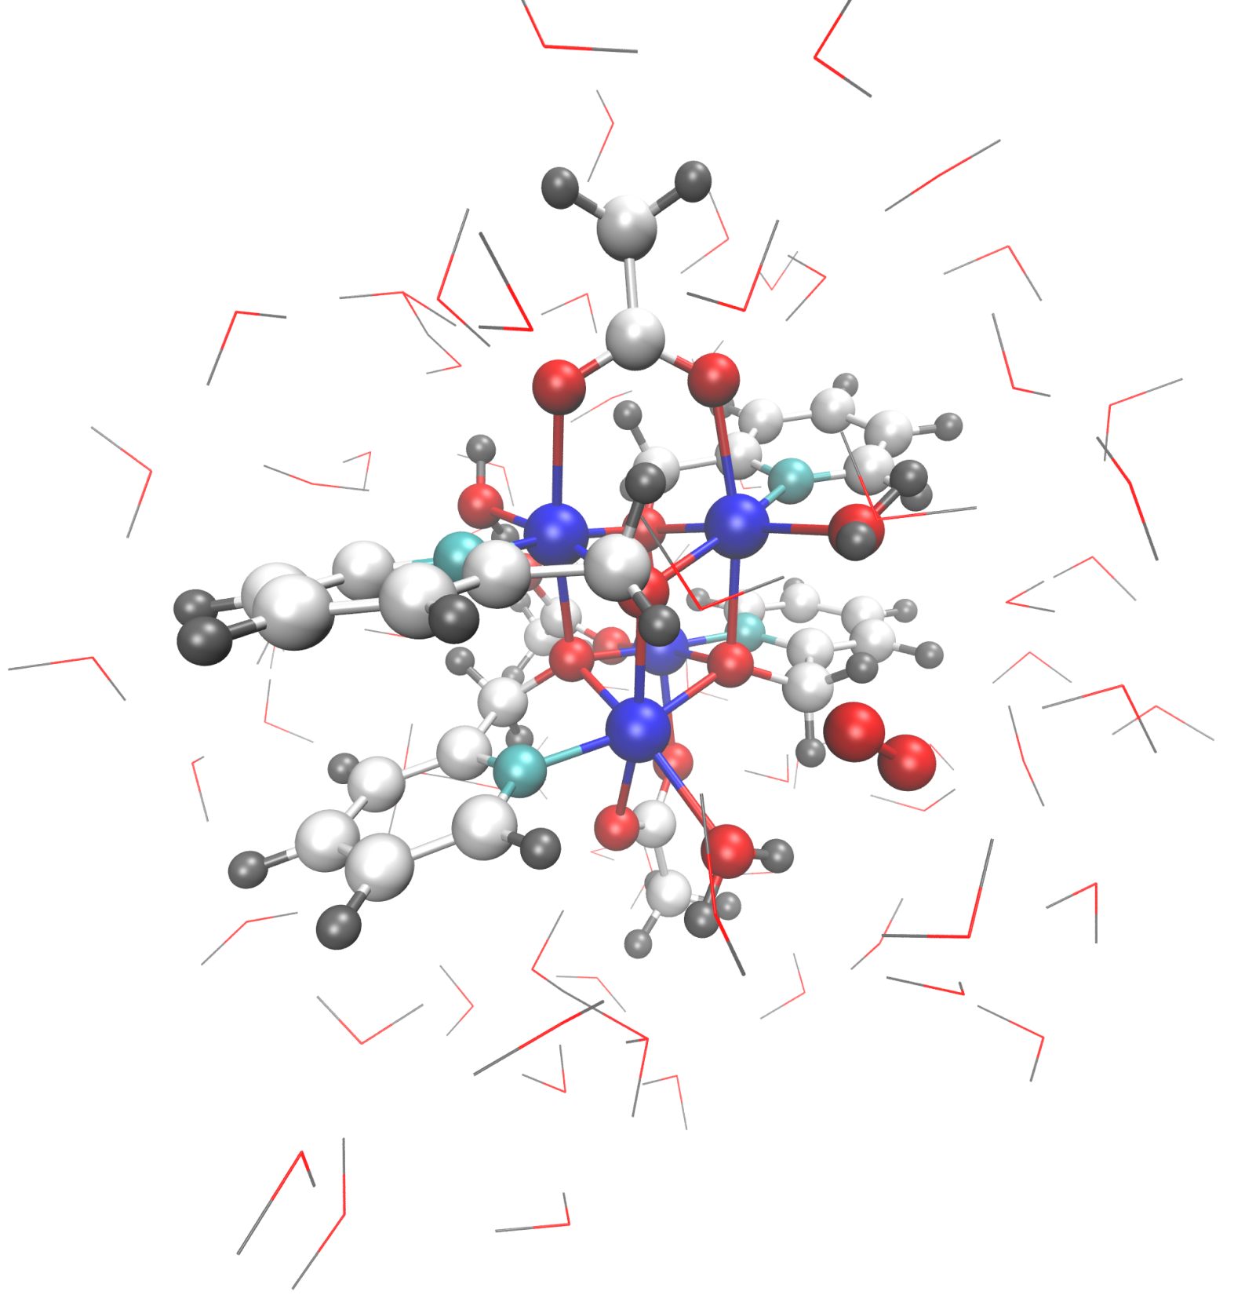

Slide 28


Slide 29
Summary
Artificial water splitting: promising route for sustainable hydrogen production (LightChEC program, UZH)
Cubanes as mimics for the oxygen-evolving center of nature’s photosystem II
{Co^{II}₄O₄} cubanes: stable water oxidation catalysts
F. Evangelisti, R. Güttinger, R. Moré, S. Luber, G. R. Patzke, J. Am. Chem. Soc., 2013 (135) 18734
{Co^{II}₃LnO₄}: more efficient and excellent model systems for investigation of nuclearity and influence of redox-inert cations
-> higher ligand flexibility
F. Evangelisti, R. Moré, F. Hodel, S. Luber, G. R. Patzke, J. Am. Chem. Soc., 2015 (137) 11076
In depth study of ligand-exchange reactions via both static and dynamic computational methods
Pioneering calculations of water oxidation mechanisms
F. Hodel, J. Hutter, S. Luber, to be submitted.

Slide 30
Acknowledgement
Fabio Evangelisti, René Moré, Greta R. Patzke (UZH)
Florian Hodel, Mauro Schilling (UZH)
Jürg Hutter (UZH)
Funding: UZH, National Center of Competence in Research MARVEL (Materials’ Revolution)
Swiss national supercomputing center (project s502)

Slide 31
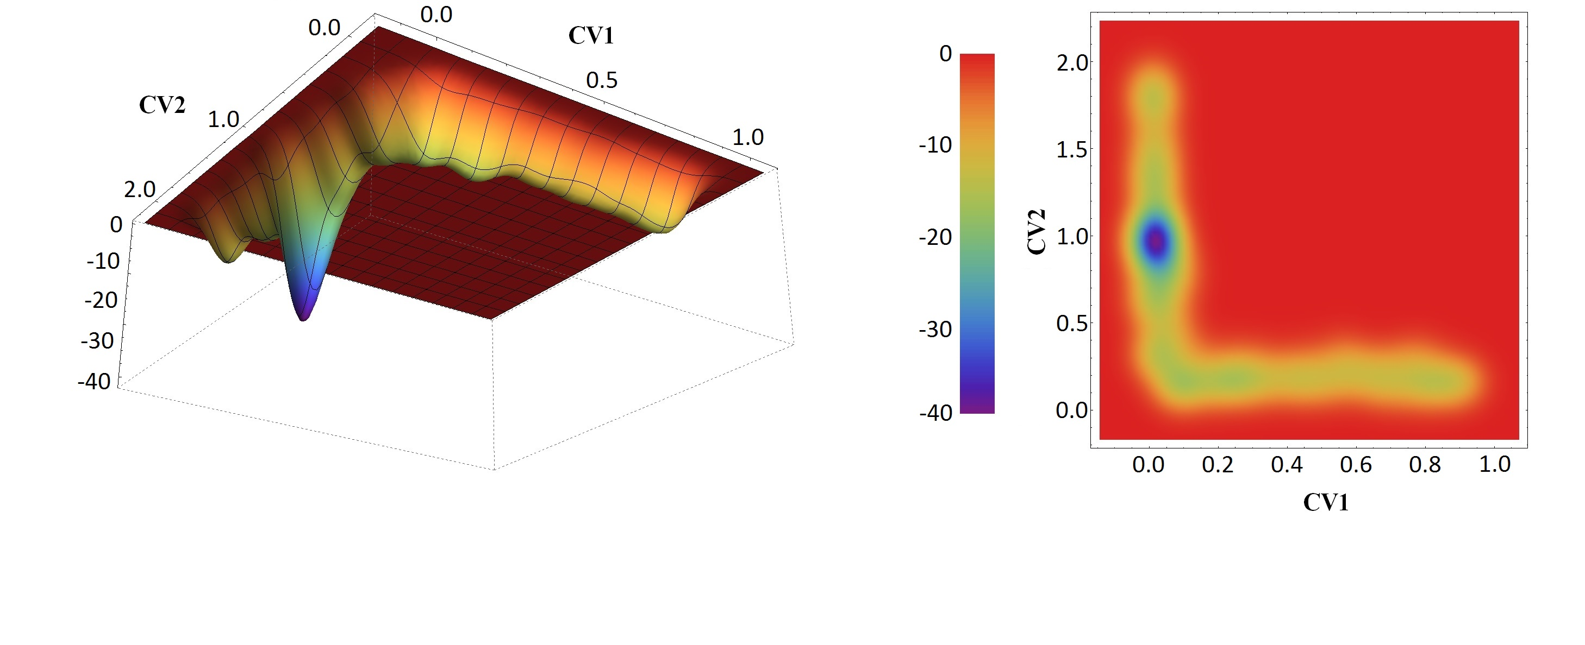
Metadynamics: replacement of monodentate acetate by hydroxide

