Slide 1
High-quality, domain-based protein interaction mapping:
An integrated solution to identify your proteins partners and application for target identification of bioactive compounds
Dubai Bio Expo
04/11/2015
Samy SAKR, Ph.D
Business Development Manager

Slide 2
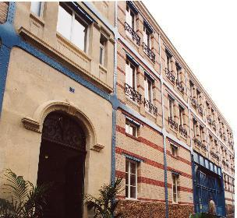
Hybrigenics Group
Founded in 1998 in Paris as a spin off of Pasteur Institute
Hybrigenics Pharma: research and development in oncology
  Inecalcitol: clinical trials Phase II in chronic lymphoid leukemia
  Ubiquitin proteasome system
Hybrigenics Services
  Fee-for-service proteomics activities since 2003
Hybrigenics Corporation
  Hybrigenics US subsidiary in Cambridge, Massachusetts
  Helixio : Hybrigenics genomics entity
  Microarray & Next Generation Sequencing services
Notes:
Focused in the R1D in oncology. It has a drug candidate in drug development phase II and its research is based on the ubiquitin proteasome system to discover and developpment of new cancer therapeutics.
Validate and inhibit: come to our stand for more information

Slide 3
Why study protein interactions ?
Protein interactions
Genotype
Phenotype
Protein-protein interactions (PPI) as a clue to function
  Targeted approach : one protein of interest as a ‘bait’
  Interactomics, networks : large-scale protein interaction mapping
  ⇨ elucidation of cellular pathways and molecular machines
  Cancer relevance : mechanism of action for clinical oncogenes / TSG; target identification for therapeutic intervention
Protein interactions as pharmacological and therapeutic targets
Notes:
So why study protein interactions in cancer signaling?
Simply because the way proteins interact with each other is key to link the genotype to the cellular phenotype.
This is true locally, to understand the function of a given protein, or globally, to elucidate cellular pathways or molecular machines.
This is of course highly relevant to cancer research but also for virtually all life sciences.
Finally, protein interactions themselves are increasingly targeted to obtain pharmacological tools to probe these interactions in cell, or develop novel drugs.

Slide 4
Some protein interactions techniques
biochemical
GST pulldown
Co-immunoprecipitation
cellular
Affinity purification
+ mass spectrometry
Proximity ligation assay
Protein interactions
FRET (fluorescence)
Yeast two-hybrid
BRET (bioluminescence)
Protein microarray
Time-resolved FRET
…
screening
Imaging in cells / in vitro
Surface Plasmon
Resonance (Biacore)
Fluorescence
polarization
Microcalorimetry
biophysical
Notes:
A lot of different techniques to study protein interactions are obviously available, some quite recent, some allowing to probe the interactions in cell, others to access the kinetics of the interaction, etc…
but when it comes to the unbiased screening to discover novel protein interactions, there are really only 2 methods of choice:
Y2H, which started at a time where no genome was sequenced yet, and AP / MS which benefited from major improvements in the last decade but relies on the availability of genomic data.

Slide 5
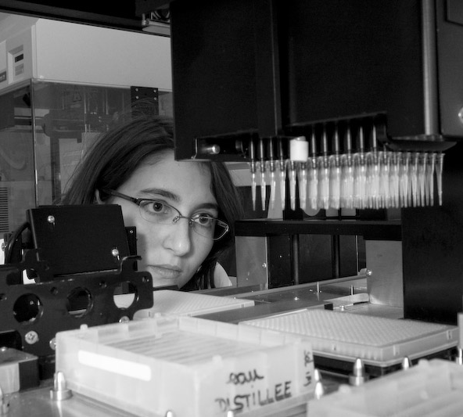
Hybrigenics Services SAS
3 lines of services to study protein interactions:
    Discover
      ULTImate Y2H: protein – protein; ULTImate Y2H+1 (co-expressed protein)
      MBmate Y2H : between TM proteins
      ULTImate Y1H : DNA – protein
      ULTImate RNA Y3H: RNA– protein
      ULTImate YChemH: small molecule – protein
    Validate
      1-by-1 Y2H, Interaction Domain Mapping
    Inhibit
      Modulation of protein interactions with small molecules
Notes:
Focused in the R1D in oncology. It has a drug candidate in drug development phase II and its research is based on the ubiquitin proteasome system to discover and developpment of new cancer therapeutics.
Validate and inhibit: come to our stand for more information

Slide 6

International collaborations
Customers
©1999-2014 Hybrigenics Services SAS - CONFIDENTIAL

Slide 7
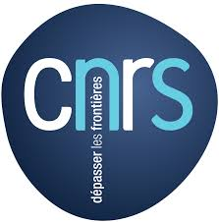

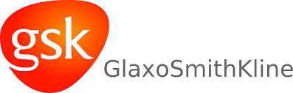















International collaborations
65% Academia
35% Industry
Al jawhara
Centre-Bahrain
©1999-2014 Hybrigenics Services SAS - CONFIDENTIAL

Slide 8
Hybrigenics Services: Key Numbers
300+ publications in top-ranking journals
  Mean impact factor 8.2; for the 19 top journals is 19.4
  Full list available at www.hybrigenics-services.com

Slide 9



Yeast Two-Hybrid (Y2H) principle
Prey
Bait
Interaction
Transcription
Gal4 DNA binding domain
Yeast growth on medium lacking Histidine
Gal4 transcriptional activation domain
Promoter
Reporter gene (His3, LacZ…)
Positive selection on a medium lacking histidine
→ Search for bait partners by screening a library of preys

Slide 10
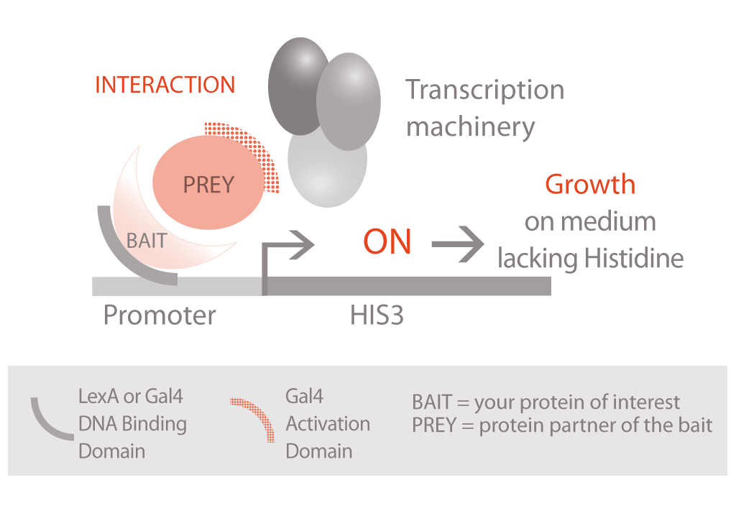
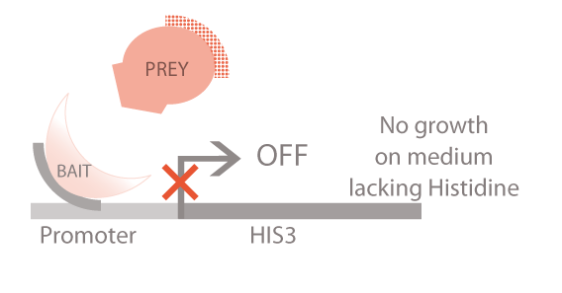
Yeast Two-Hybrid (Y2H) principle
Positive selection on a medium lacking histidine
→ Search for bait partners by screening a library of preys
Notes:
VERSION IMPRIMABLE

Slide 11
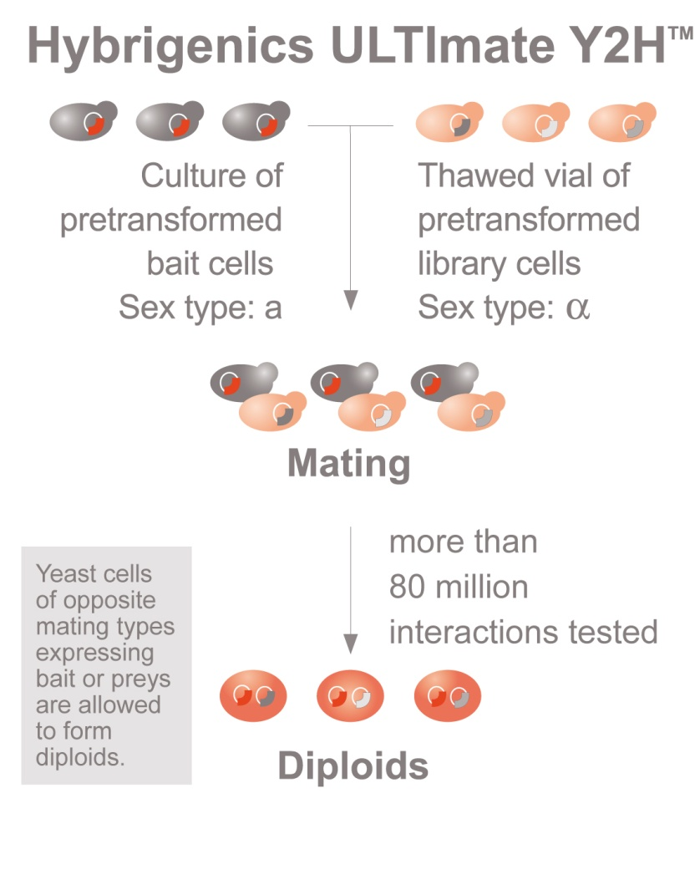
ULTImate Y2H™: cell-to-cell mating
Hybrigenics libraries
  complexity: 10 million primary clones in yeast
  domain libraries
87 million interactions tested on average

Slide 12
Selected Interacting Domain (SID)®
Delineation of a “Selected Interacting Domain” common to all prey fragments
Protein
identified
N -
- C
Interacting fragments
(Preys from the library)
SID

Slide 13

Predicted Biological Score (PBS)®
bait
Local analysis of each screen: statistical
Global analysis of all screens performed at Hybrigenics
  Highly connected domains (false positives) (1)
  Interactions confirmed in several independent screens (2) (domains, rebounds)
  Cycles(3)
  Score categories:
bait
bait
SID
bait
bait
1
bait
SID
bait
bait
SID
2
A
B
C
D
E
F
bait
SID
A
Very high confidence in the interaction
bait
SID
F
Y2H technical artifacts
(experimentally tested in our labs)
3

Slide 14
ULTImate Y2H™ Key Benefits
Specific screening conditions adapted for each bait
(autoactivation, toxicity, domain, topology)
Highly complex random-primed libraries
10 million independent fragments in yeast
average size = 800 bp
-80°C aliquots
Saturation screening
97 million interactions tested
(10 x library coverage)
5’ and 3’ sequencing of up to 380 positive clones
automatic BLASTN on GenBank
⇨ Exhaustivity, >80% reproducibility
⇨ Identification of a minimal interacting domain,
comparison with known functional domains
⇨ Confidence score for each interaction
(# frags, local and global connectivity)
Identification of highly connected domains
≥ 10 connections organism-wide
Bait protein / domain
Random-primed cDNA library
LexA or Gal4 BD
N-ter or C-ter fusion
constitutive or inducible
Gal4 AD
X
Mating
Notes:
Garder la Key benefits que pour version courte?
Ou choisir entre celle là et les deux dernières?

Slide 15
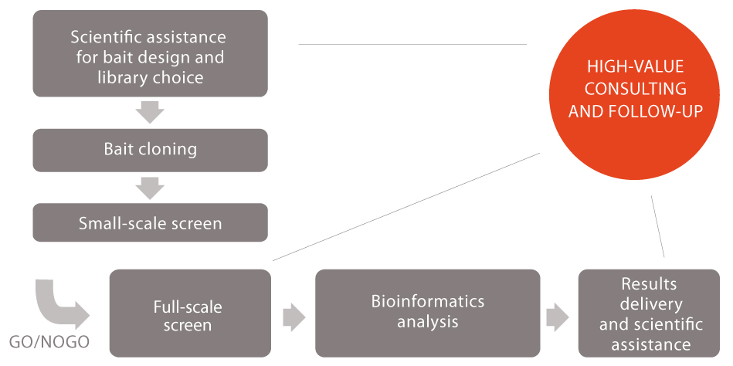
ULTImate Process
A comprehensive offer from the bait design to the results delivery…
…We do all the work for you.

Slide 16
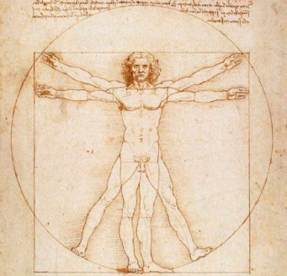
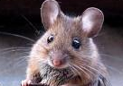
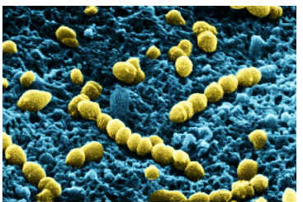
80+ domain libraries available
  Highly complex Libraries of protein fragments:
    random-primed cDNA libraries, domain approach
    complexity: 10 million primary clones in yeast
Human
Human cancers
Rodents
Bacteria
Brain
Retina
T cells
Skin
Liver
Colon
Heart…
HeLa
Breast
Colon
Lung
B cell lymphoma
Brain
Inner Ear
Kidney
ES cells…
E. coli
S. aureus
H. pylori…
  + plants, model organisms, parasites…
+ custom / exclusive libraries upon request

Slide 17
Example : human / rodents random-primed libraries
Mouse (Mus musculus)
Brain adult
Brain embryo (E10.5 and E12.5)
Brain embryo (E14, E16 and E18)
Embryonic stem cells
Inner Ear
Kidney
Neurosphere adult
…
Rat (Rattus norvegicus)
Hippocampus
Rear brain
Human Tissues
  Brain Adult (Whole)
  Brain Fetal (20 weeks)
  Breast Normal (Glandular)
  Colon
  Heart Adult/Fetal
  Muscle Skeletal Adult/Fetal
  Placenta
  Reconstituted skin
  Testis
  Pancreas
  …
15 new libraries per year based on customer’s requests / community needs

Slide 18
Example :
DrosoMan project

Slide 19
Example : DrosoMan project goals
Identification of potential cancer targets through functional and comparative proteomics
  Entry points : proteins from cancer-relevant pathways / involved in basic cellular functions
  Domain-based Y2H
    Screening of random-primed cDNA libraries
    Domains or full-length proteins used as baits
Comparison of protein interactions in 2 species
  D. melanogaster : Genome Res., 2005, 15, 376
  H. sapiens : unpublished
  Orthologous proteins / domains used as primary baits
Selection for further validation
  Putative new pathway regulators / effectors
  Unexpected connections between 2 pathways
  Protein interactions conserved in H. sapiens and Drosophila

Slide 20
Why comparative proteomics ?
Human map
Conserved
interaction network
Inference
Drosophila map

Slide 21
DrosoMan collaborators
9 associated research institutes
Insitut Curie, INSERM, CNRS, Ecole Normale Supérieure, Collège de France, Institut J. Monod, Duke University, Mass. General Hospital, University of Texas
35 academic labs

Slide 22
DrosoMan : targeted proteins
DrosoMan : human map details
230 screens
Transcription
Cell cycle
DNA repair
Small GTPases
RTK pathways
Notch pathway
Hedgehog pathway
Vesicular and membrane trafficking
Other cellular functions
20,316 prey fragments
5’ + 3’ sequencing
45,614 sequences
Genbank
4,089 PPI – 2,412 proteins
Scoring
1,212 PPI – 998 proteins
  Mean connectivity : 2.4
  Mean interactions / bait protein : 9.1

Slide 23
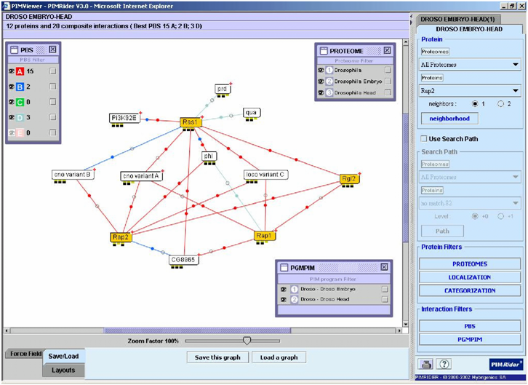
Pathway Exploration Tool: PIMRider®
PIMViewer : network visualization

Slide 24
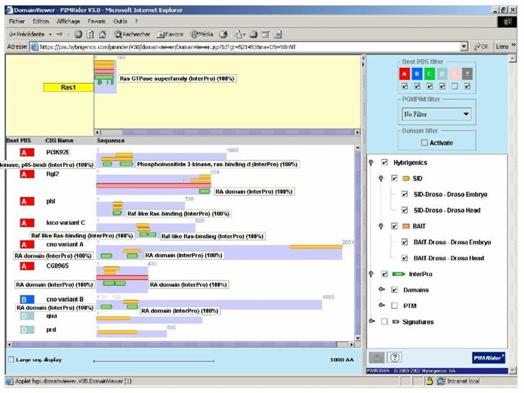
Pathway Exploration Tool: PIMRider®
DomainViewer : baits, Interaction Domain, InterPro domains

Slide 25
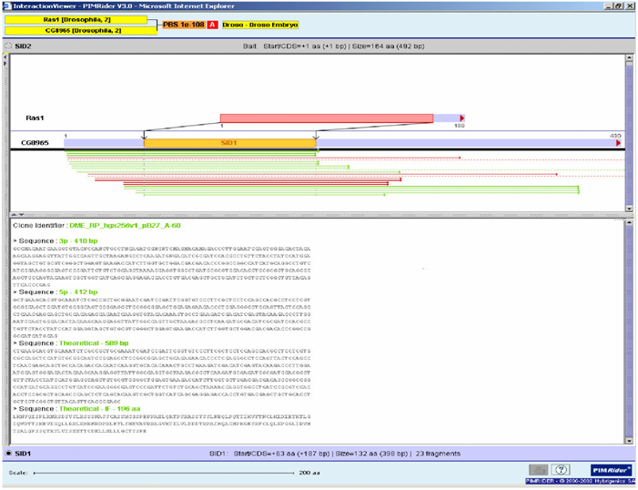
Pathway Exploration Tool: PIMRider®
InteractionViewer : graphical view of the Interaction Domain

Slide 26
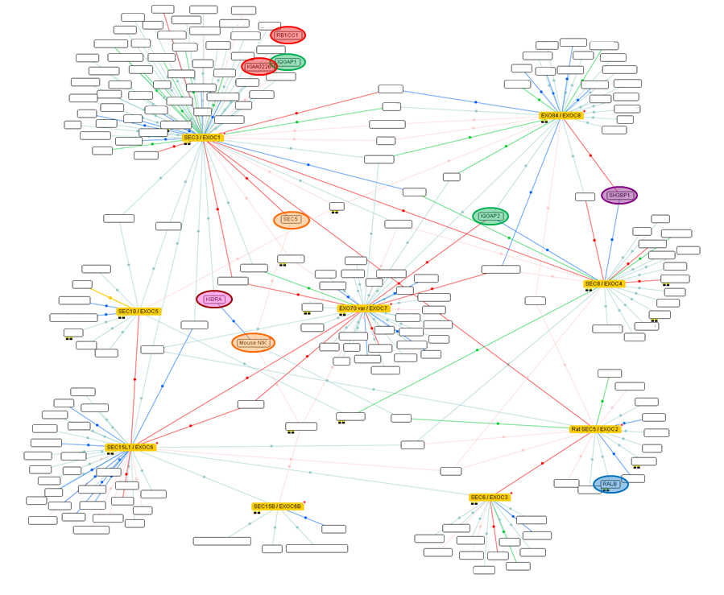
Protein Interaction Map of the Exocyst Complex
Sakurai-Yageta et al., JCB 2008
Collaboration with J. Camonis, Ph. Chavrier, Y. Bellaïche (Curie), M. White (UTSW)
Bodemann et al., Cell 2011
Monteiro et al., JCB 2013
RUBICON
Ou et al., Mol Cell 2011
RB1CC1
IQGAP1
WASH
EXO84
SEC3
Parrini et al., Mol Cell 2011
SH3BP1
IQGAP2
Rossé et al., PLoS Biol. 2009
KIBRA
RALA/B
SEC8
SEC10
EXO70
SEC5
SEC15L1
SEC6
NIK
SEC15B
Balakireva et al., MCB 2006
New functions of the Exocyst in autophagy, cell migration,
cell proliferation, cell survival, AKT and PKC signaling…

Slide 27
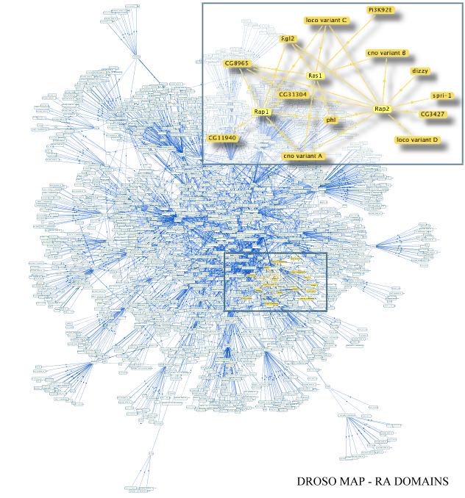
DrosoMan conclusion
Generation of large-scale PPI dataset for human and drosophila:
1,860 proteins connected
(13% of the proteome)
35/45 (78%) interactions confirmed by other techniques (coIP, pulldown…)
‘Local’ functional validation on-going : 45+ publications
Identification of putative cancer targets
Full PIM-Rider and flash demo available at pim.hybrigenics.com, cross-referenced in Flybase

Slide 28
Variations on Y2H:
Small molecule – protein interactions
Application to target de-convolution

Slide 29
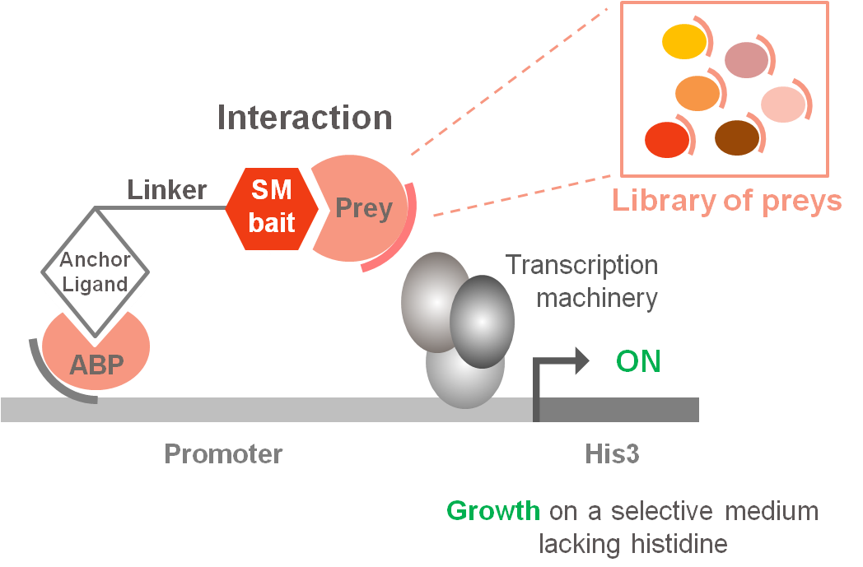
YChemH: small molecule-protein interactions
SM Bait = Small Molecule of Interest
ABP = Anchor Binding Protein
DBD = Gal4 DBD
AD = Gal4 AD
AD
DBD
2 anchorage systems (protein/ligand) selected :
  Dihydrofolate Reductase (DHFR) / Trimethoprim
  SNAP-Tag (AGT) / O⁶-benzylguanine derivatives

Slide 30
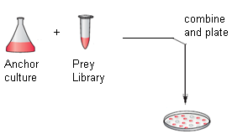

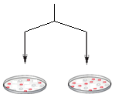
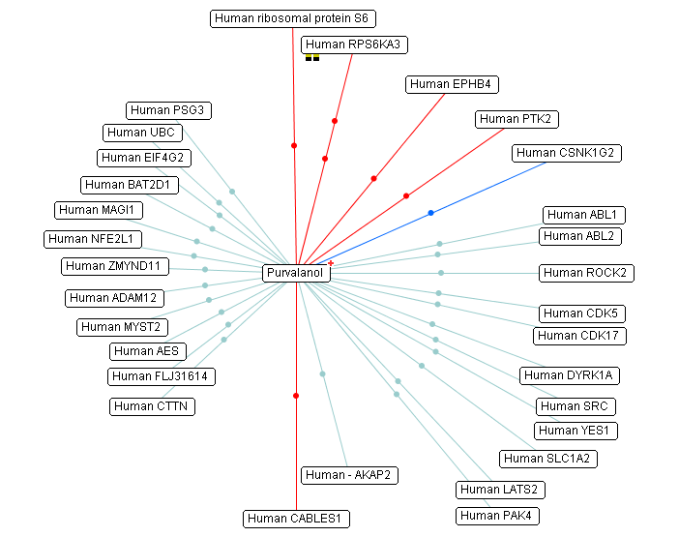
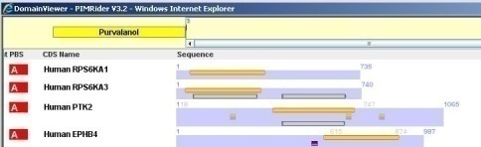
ULTImate YChemH
Process
Synthesis of the
derivatized molecule
Permeation test in yeast
ULTImate YChemH screening
-
+
Molecule dependency evaluation
Derivatization strategy
Bioinformatics analysis
High value consulting and follow up
Results delivery
Small molecule of interest (Bait)

Slide 31
ULTImate YChemH
Benefits
Unbiased and direct approach to identify the target(s) of your bioactive molecule
No competition by abundant or strong binders (each putative partner tested individually)
High sensitivity (transcriptional read-out, no washing steps)
Simplified and fastened analysis of the results thanks to sophisticated bioinformatics
Access to scientific expertise both in chemistry and biology

Slide 32
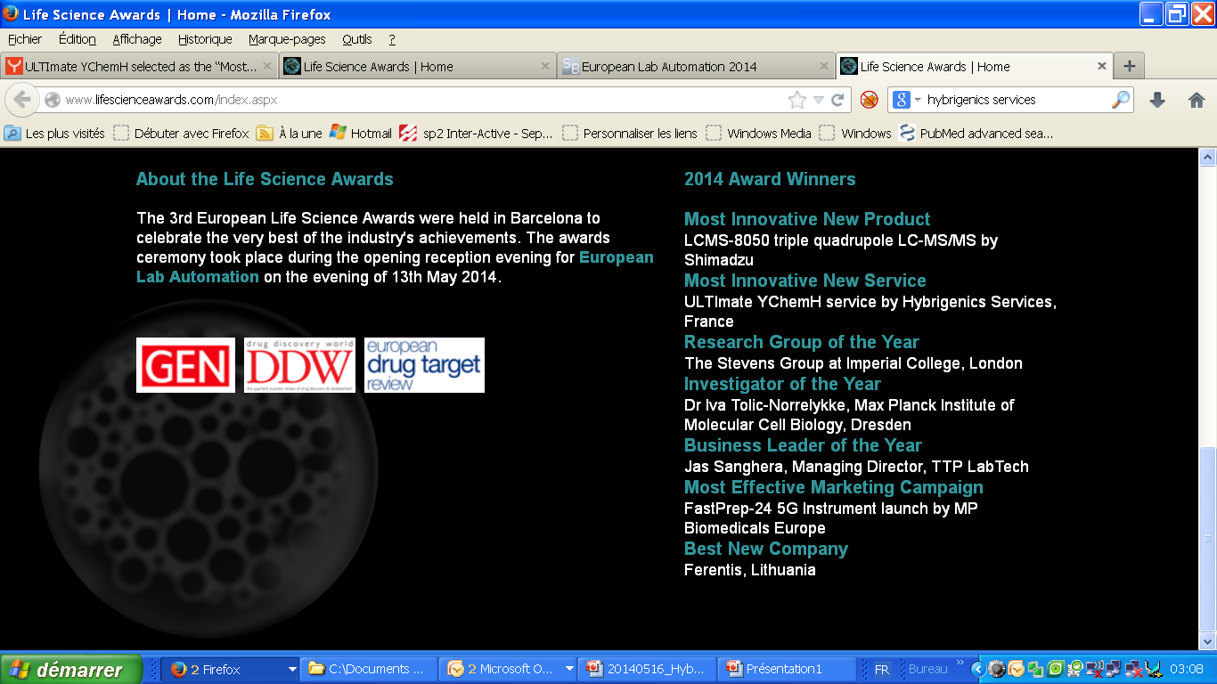


Slide 33
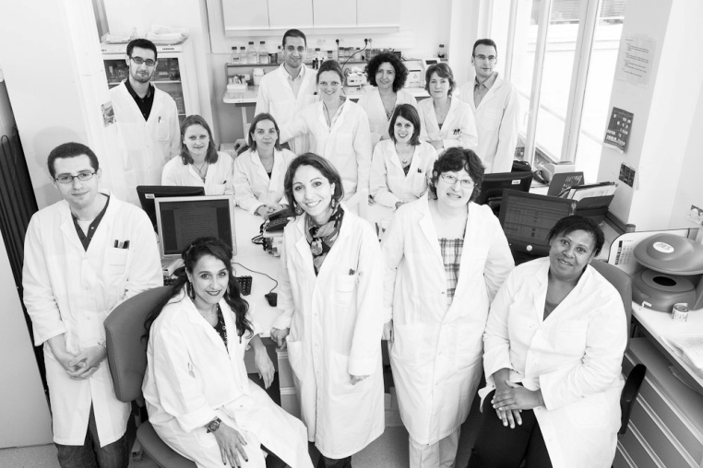

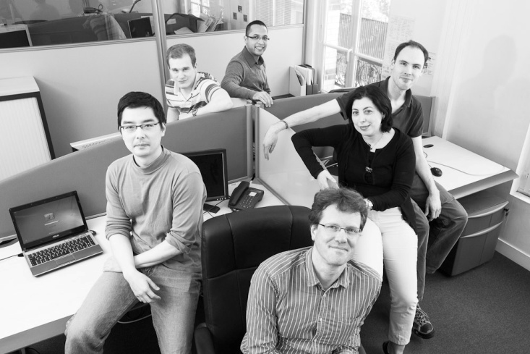
THE PROTEIN INTERACTIONS EXPERT
Samy Sakr, PhD
Business Development
ssakr@hybrigenics.com
services@hybrigenics.com
Tel : +33 (0)1 58 10 38 21
Fax: +33 (0)1 58 10 38 48
Hybrigenics Services SAS
3-5 impasse Reille, 75014 PARIS, www.hybrigenics-services.com

