Slide 1

METABOLIC SYNDROME
By:-
S.Shravanthi
Pharm.D 4th year
Malla Reddy Pharmacy college.

Slide 2

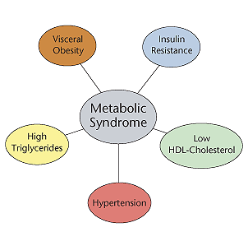
INTRODUCTION:-
Metabolic syndrome is the name for a group of risk factors that raises the risk for heart disease and other health problems,such as diabetes and stroke.

Slide 3
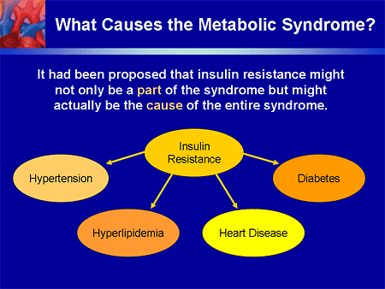
ETIOLOGY:-

Slide 4
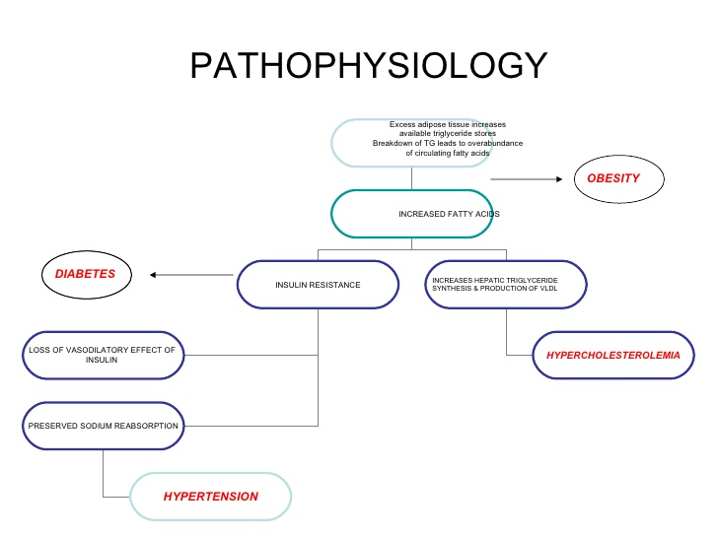
PATHOPHYSIOLOGY:-

Slide 5
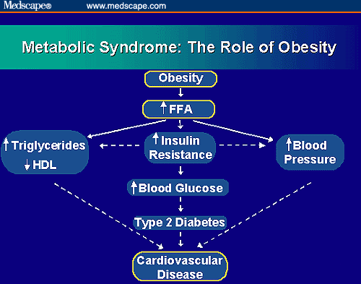
Obesity is the major factor causing Obesity

Slide 6
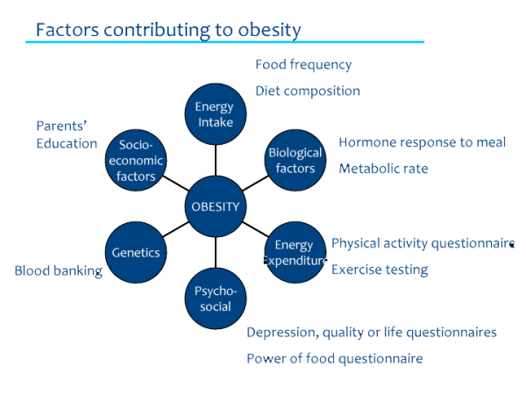

Slide 7
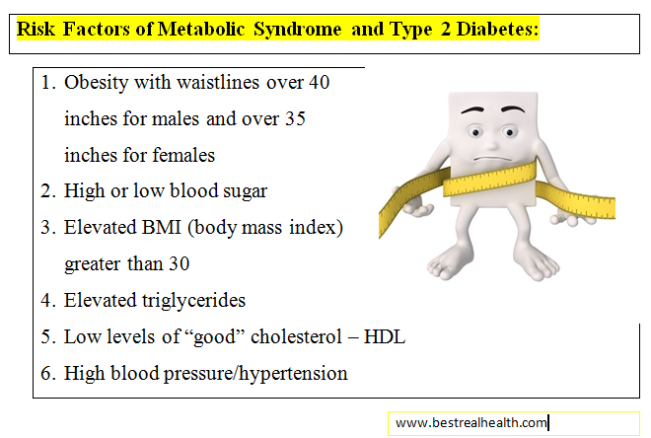

Slide 8
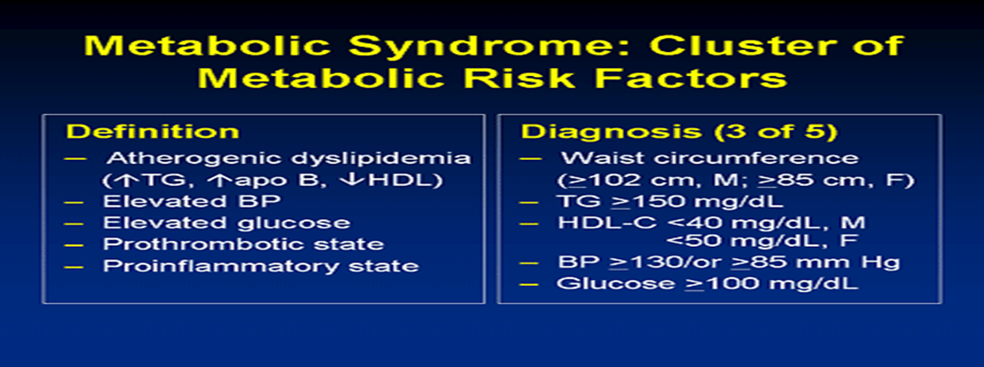

Slide 9
The is no singular therapy for treating metabolic syndrome.
Therapy is given according to patients condition and compatiability.
For HYPERTENSION:-
High blood pressure medicines like
ACE inhibitors(Captopril and enalpril)
Angiotensin 2receptor blockers(Losartan and Valsartan)
Diuretics(Thiazides,Furosemide)
Beta blockers(Atenolol,Propranolol) are widely used.
CHOLESTEROL Medicines:-
Statins (Rosuvastatin,Fluvastatin,Atorvastatin,Lovastatin,Pravastatin and Simvastatin)
Cotd….

Slide 10
Niacin(Niacor,Niaspan and Nicolar)
Bile Acid resins(Colestyramine ang Cholestipol)
Diabetes medicines:-include Glucophage, Pioglitazone and Avandia.
Low dose asprin may reduce the risks of heart attacks and stroke.
Healthy diet
Exercise

Slide 11

CASE PRESENTATION

Slide 12

Subjective data:-
A 32 year old obese(89kgs) female patient presented with complaints of fever,chills,rigour and nausea since 5days
She has a h/o HYPERTENSION since 3years and is on Tab.Amlokind-5mg, DIABETES MELLITUS(type 2) since a year on Tab.Glycomet-500mg.
Patient is a chronic alcoholic since 5years.

Slide 13
Objective Data:-
When the physician examined the patient:-
Temperature:-102*F
B.P:-130/80 mmHg
Pulse Rate:-68bpm
The patient was ordered to undergo:-
Complete blood picture
Peripheral smear showed the evidence of Thrombocytopenia.
Blood sugar levels showed:-
Glucometer measured blood sugar levels were:-
RBS(Random blood sugar level):-246mg/dl
FBS(Fasting blood sugar level):-203mg/dl
Contd…

Slide 14
Lipid Profile(DAY 3)
Complete Urine Examination:-It revealed
colour:-Yellow
Appearance:-Hazy
Albumin:- ++
Total Cholestrol :-241
HDL:-38( )mg/dl
LDL:-137mg/dl
VLDL:-66mg/dl
TG:-333mg/dl
ESR:-62mm/hr
Clinical Biochemistry:-
HbA1C:-13.5% Cotd…..

Slide 15
Day wise Assessment:-
Day 1
Patient was conscious.
B.P:-130/80 mmHg
Pulse Rate:-66bpm
Complaints & 0bservation:-
Slurring of speech
Weakness,dizziness.
GRBS:-588mg/dl
MEDICATIONs:-
Tab.Dolo(650mg),BD
Tab.Pan(40mg),OD
Inj.Optineuron with 100ml Ns
Inj.H.mixtard
Tab.Caripill,TID

Slide 16
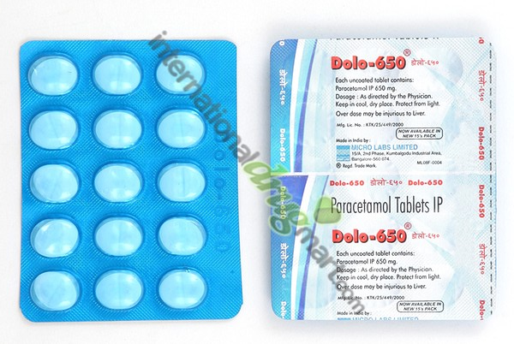
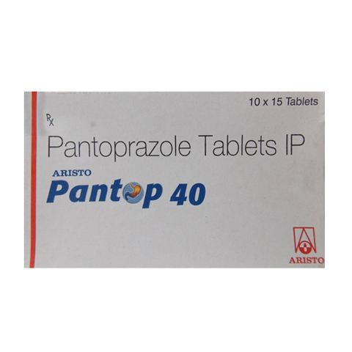
Tab.Dolo-650mg,OD
It is an anti-pyretic drug
Possible ADR`s:-
Thrombocytopenia, leucopenia, pancytopenia, neutropenia.
Inj.Optineuron:-
It is a complex of VitB+Vit C
It is the source of vitamins to the body.
Inhibits gastric acid secretion.
Possible ADR`s:-
Headache, dizziness, nausea, vomiting, abdominal pain
Contd…..
Tab.Pan-40mg,OD

Slide 17
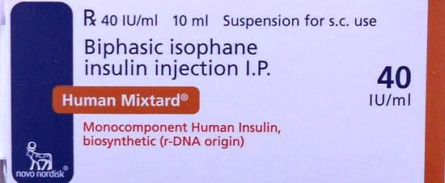
IV FLUIDS-(normal saline):-
Inj.H.Mixtard:-
Insulin lowers blood glucose levels.
Possible ADR`s:-
Hypoglycaemia, insulin resistance
It is important in electrolyte and fluid balance.
Contd….

Slide 18
Day 2:-
Patient was conscious and weak.
B.P:-130/80 mmHg
Temperature:-Normal
Complaints:-
Tremors
Medication:-
Inj.H.Actrapid
Inj.Neurobin-1amp,OD
Inj.Taxim-1gm,BD
Inj.Pan-40mg,OD
Tab.Dolo-650mg,sos
Tab.Amlokind-5mg,OD
Tab.Caripill,TID

Slide 19
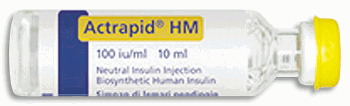
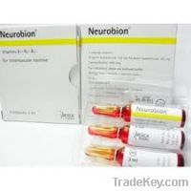
Inj.H.Actrapid(Insulin):-
Insulin lowers blood glucose levels.
Possible ADR`s:-
Hypoglycaemia, insulin resistance.
Inj.Neurobin(Mecobalamin ):-
Mecobalamin is the neurologically active form of vitamin B12 and occurs as a water-soluble vitamin in the body.
Possible ADRs:-
Anorexia, nausea, vomiting and diarrhoea.
Contd….

Slide 20
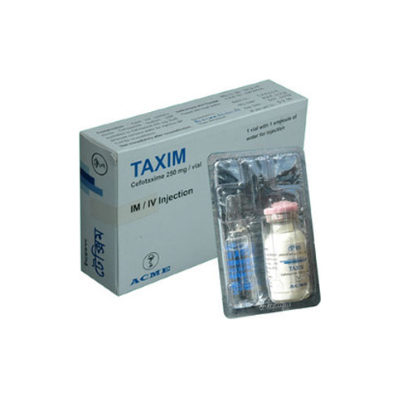
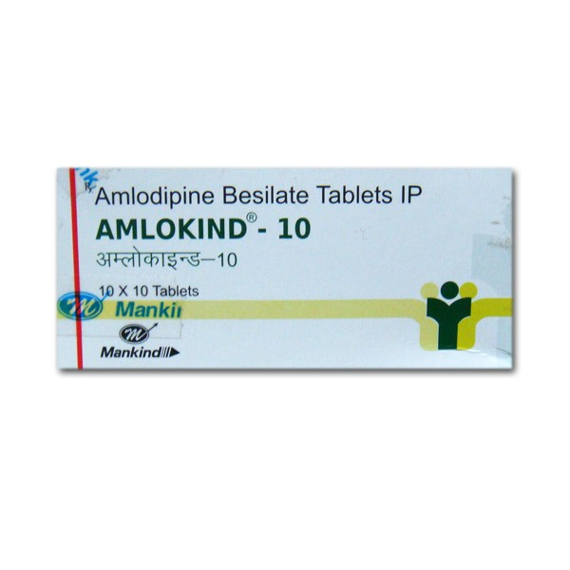
Tab.Amlokind:-
Inj.Taxim:-
Cefotaxime is an Antibiotic
Possible ADR`s:-
Hypersensitivity reactions, rash, pruritus; diarrhoea, nausea, vomiting.
Amlodipine relaxes peripheral and coronary vascular smooth muscle.
Possible ADR`s:-
headache, ankle swelling, oedema
Contd….

Slide 21
Day 3:-
No fresh complaints.
B.P:-130/80mmHg
Medication:-
Inj.Neurobin-1amp,OD
Inj.Taxim-1gm,BD
Inj.Pan-40mg,OD
Tab.Amlokind-5mg,OD
Inj.H.Actrapid
Tab.Rosuvas 1tab,BD

Slide 22
Day 4
No fresh complaints.
Medication:-
Tab.Amlokind-5mg,OD
Tab.Rosuvas-100mg,OD
Tab.Glycomet-TID
Tab.Pan-40mg,OD
Tab.Neurobin-100mg,BD
Inj.H.Mixtard
Tab.Caripill,TID

Slide 23
Day 5:-
Complete blood picture was done.
Thrombocytopenia was identified.
Glucometer measured GRBS-194mg/ml
Medication:-
Tab.Caripill-TID
Tab.Amlokind-5mg,OD
Tab.Rosuvas-100mg,OD
Tab.Glycomet-TID
Tab.Pan-40mg,OD
Tab.Neurobin-100mg,BD
Inj.H.Mixtard

Slide 24
Day 6:-
Complete blood picture was done.
Thrombocytopenia was found to be recovered.
Glucometer measured GRBS value was 161mg/dl
Observation:-
Platelet count was stabilised.
Blood sugar levels were stabilised too.

Slide 25
Day of Discharge:-
Observation:-
Patient`s platelet count and blood glucose levels were stabilised.
Patient was feeling better.
Medication:-
Inj.H.Mixtard-12U s/c
Tab.Glycomet-500mg,TID
Tab.Amlokind-5mg,OD
Tab.Rosuvas-1tab,OD
Tab.Neurokind-10mg,BD
Tab.Pan-40mg,OD

Slide 26
ROLE OF PAHARMACIST:-
Patient was monitored regularly and all the data related to case was noted.
Patient Counselling was done.
She was given instructions:-
Related to diet
Physical activity
Frequency of drugs
Do not miss the dose,if missed do not double it the next tyme.
Consult the physician if necessary.

Slide 27

THANK YOU☺

