Slide 1
Comparison and Associations of Comprehensive HIV/AIDS Knowledge and Attitude towards HIV/AIDS among Women 15-49 Years Old in Three East African Countries: Burundi, Ethiopia and Kenya
Mr. Russom Teshome
Huazhong University of science and technology, School of Public Health.
3rd International conference on HIV/AIDS, STI and STD in Atlanta, USA 30 November 2015.

Slide 2
Presentation Outlines
Abstract
Introduction
Methodology
Result
Discussion
Conclusion

Slide 3
Introduction
Global estimates for adults and children in 2013
People living with HIV 35.0 million [33.2 million – 37.2 million]
New HIV infections 2.1 million [1.9 million – 2.4 million]
Deaths due to AIDS 1.5 million [1.4 million – 1.7 million]
Source: UNAIDS

Slide 4
Introd…
Adults and children estimated to be living with HIV in 2013
North America and Western and Central Europe 2.3 million
[2.0 million – 3.0 million]
Eastern Europe & Central Asia
1.1 million
[980 000– 1.3 million]
Middle East & North Africa
230 000
[160 000 – 330 000]
Caribbean
250 000
[230 000 – 280 000]
Asia and the Pacific 4.8 million
[4.1 million – 5.5 million]
Latin America
1.6 million
[1.4 million – 2.1 million]
Sub-Saharan Africa
24.7 million
[23.5 million – 26.1 million]
Total: 35.0 million [33.2 million – 37.2 million]
Source: UNAIDS

Slide 5
Introd…
Estimated number of adults and children newly infected with HIV in 2013
Eastern Europe & Central Asia
110 000
[86 000 – 130 000]
North America and Western and Central Europe
88 000
[44 000 – 160 000]
Middle East & North Africa
25 000
[14 000 – 41 000]
Caribbean
12 000
[9400 – 14 000]
Asia and the Pacific
350 000
[250 000 – 510 000]
Latin America
94 000
[71 000 – 170 000]
Sub-Saharan Africa
1.5 million
[1.3 million – 1.6 million]
Total: 2.1 million [1.9 million – 2.4 million]
Source: UNAIDS

Slide 6
Introd…..
Estimated adult and child deaths from AIDS2013
Eastern Europe & Central Asia
53 000
[43 000 – 69 000]
North America and Western and Central Europe
27 000
[23 000 – 34 000]
Middle East & North Africa
15 000
[10 000 – 21 000]
Caribbean
11 000
[8300 – 14 000]
Asia and the Pacific
250 000
[210 000– 290 000]
Latin America
47 000
[39 000 – 75 000]
Sub-Saharan Africa
1.1 million
[1.0 million – 1.3 million]
Total: 1.5 million [1.4 million – 1.7 million]
Source: UNAIDS

Slide 7
Introd…
HIV/AIDS is leading cause of death among women reproductive age in SSA (WHO, 2009), claiming around one million lives every year since 1998 (UNAIDS, 2011).
Women are disproportionately affected by HIV/AIDS in SSA, which accounts 59 percent of the total people living with HIV in 2013 (UNAIDS, 2014) and bear the greatest burden of care (HIV/AIDS, 2012) .
Unlike other regions, the primary route of transmission in SSA is unsafe heterosexual intercourse and every minute, a young woman is newly infected with HIV (UNAIDS, 2012a).

Slide 8
Introd…
As a result, women and girls are mentioned as one of key populations for intervention (UNAIDS, 2005, 2014).
Next to Southern SSA, the area severely affected by HIV/AIDS epidemic in the globe is Eastern Africa. The prevalence rate among non-pregnant women was 14.5% (95%CI 11.2-18.4) (Ramjee et al., 2008).
Moreover, studies revealed that young women were three to six times more likely to have HIV compared with males of the same age in Kenya and Tanzania (Kenya, 2009; Tanzania, 2008).
  Therefore, It has great importance to study on women related to HIV/AIDS epidemics.

Slide 9
Introd…
Comprehensive knowledge about HIV/AIDS is an indicator commonly used to measure knowledge of the essential facts about HIV transmission and prevention.
According to UNGASS convention, 95% of young adult need to have correct and comprehensive knowledge of HIV/AIDS (UNAIDS, 2010).
However, this is far below the target, since only 33% of young women demonstrated comprehensive knowledge of AIDS in national household surveys in SSA (UNAIDS, 2013).

Slide 10
Introd…
Studies showed that in Mozambique, despite the nearly universal awareness of HIV/AIDS, only 31.8% women of age 15-49 have accurate and, comprehensive knowledge of HIV/AIDS (Saude, 2010).
Study in Northern Uganda among youths revealed that, 23 percent of young women had comprehensive knowledge of HIV/AIDS (Ciccio, Makumbi, & Sera, 2010) .
High awareness level alone is not enough to combat HIV/AIDS infection. Therefore, Women in East Africa should know methods of prevention, transmission as well as to understand and reject misconceptions about the disease (Burgoyne & Drummond, 2008)

Slide 11
Introd…
Acceptance attitude towards PLWHA is another fundamental subject in the study of HIV/AIDS in women.
  Negative attitudes are barriers for HIV prevention and decrease individuals disclosure of HIV status, voluntary HIV test, access and adherence to treatment (Genberg et al., 2008; Maman et al., 2003) .
  Moreover, Negative Attitude and beliefs towards PLWHA was related to individual’s incorrect knowledge of prevention and transmission about the disease (Castro & Farmer, 2005; Mohamed & Mahfouz, 2013; Ugarte, Hogberg, Valladares, & Essen, 2013).
  Study conducted in SSA countries suggested that, large amount of people remains to have discriminatory attitude towards PLHA (Mishra, Agrawal, Alva, Gu, & Wang, 2009).

Slide 12
Introd…
For instance, Demography Health Survey of Lesotho in 2009 showed that, 4 in 10 of women have acceptance attitude towards PLHA (HIV/AIDS & HIV/AIDS).

Slide 13
Introd…
Noticeably, comprehensive knowledge on HIV/AIDS as well as acceptance attitude towards PLHA are fundamental subjects in prevention and halting HIV infection among women of reproductive age.
Therefore, women from three east African countries namely Burundi, Ethiopia and Kenya were involved in this study.
Several studies were conducted on HIV/AIDS knowledge and attitude towards PLWHA in the three East African countries (Chiao, Mishra, & Sambisa, 2009; Girma et al., 2014; Gurmu & Etana, 2015; Lifson et al., 2012; Ngayimbesha & Chen, 2011; Ochako, Ulwodi, Njagi, Kimetu, & Onyango, 2011; Oljira, Berhane, & Worku, 2013).
However, they were not nationally representative or were not based on the AIDS indicators survey (AIS) measures, which are internationally accepted and standardized tools.

Slide 14
Introd…
To the best of our knowledge, there are no studies concerning associates of comprehensive knowledge and attitude towards PLWHA among women in the three selected countries.
Hence, there could be no comparative study conducted as well. To fill this gap, nationally representative data from DHS was taken to:
investigate associates of comprehensive knowledge and attitude related to HIV/AIDS,
2) compare the level of comprehensive knowledge and attitude towards PLWHA, among women 15-49 years old for the three countries.
This study will help to policy makers in providing vital information on key HIV-related indicators to monitor, evaluate, and design new strategies at national and international level for prevention.

Slide 15
Methodology
Data Source:
  Demographic and Health Surveys (DHS), three countries of East Africa :Burundi 2010, Ethiopia 2011 and Kenya 2009.
  Cross-sectional, Multistage probability sampling technique was used in DHS in order to provide nationally representative data.
  The samples for this study were women reproductive age 15-49, with sample size from Burundi (n=9,389), Ethiopia (n=16,515), and Kenya (n=8,444).

Slide 16
Methodology
Dependent Variables
  Two binary variables, comprehensive HIV/AIDS Knowledge and acceptance attitude towards people living with HIV/AIDS.
To measure comprehensive knowledge of HIV/AIDS, each woman was asked the following five statements and allowed for binary yes or no response:
  condoms can be used to prevent HIV transmission:
  2) HIV can be prevented by limiting sex to one faithful uninfected partner;
  3) a person can get HIV from mosquito bites;
  4) a person can get HIV by sharing a meal with someone infected;
  5) a healthy looking person can have HIV.

Slide 17
Methodology
Similarly, acceptance attitude of each women were assessed using the following four statements and allowed for a binary response:
  Would be willing to care for a family member who became sick with the AIDS virus;
  2) would buy fresh vegetables from a vendor whom they knew was HIV positive;
  3) Female teacher who is HIV positive but not sick should be allowed to continue teaching in school;
  4) Would not want to keep the HIV positive status of a family member a secret.

Slide 18
Methodology
Independent Variables
Socio-demographic and economic characteristics includes
Age,
Place Of Residence,
Religion,
Educational Level,
Marital Status And
Wealth Index.

Slide 19
Methodology
Statistical Analysis
Descriptive statistics and multivariate logistic regression were used.
comprehensive HIV/AIDS knowledge and acceptance attitude towards PLHA, was constructed to be a binary outcome.
The binary outcome was defined as; “Yes” if women answered all the five questions about HIV/AIDS correctly and “No” if the women had any incorrect answers for comprehensive knowledge.
On the other hand for acceptance attitude, “yes”, if women answered all the four questions towards PLHA correctly and “No”, if the respondent had any incorrect answer.

Slide 20
Methodology
Finally, the three countries were compared among each other using adjusted odds ratio.
The results of all logistic regression analyses were reported as adjusted odds ratios (AOR) with 95% confidence intervals (95% CI) taking p-values less than 0.05 as significant.
All analyses were done using Predictive Analysis Software (SPSS version 20).

Slide 21
Result
Table 1.
  percentage distribution among three east African women of age 1-49.
Table 2.
  Associates of comprehensive HIV/AIDS knowledge among women 15-49 years of three in three East African countries.
Table 3.
  Associates of acceptance attitude towards people living with HIV/AIDS among women 15-49 years of three East African countries.
Table 4.
  Multivariate analysis comparison of comprehensive HIV/AIDS knowledge and acceptance attitude towards PLWHA among women age 15-49 in three east Africa countries

Slide 22
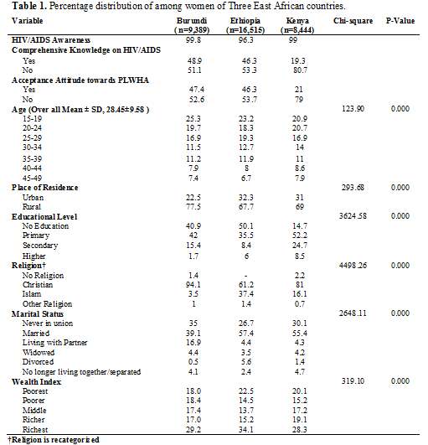

Slide 23
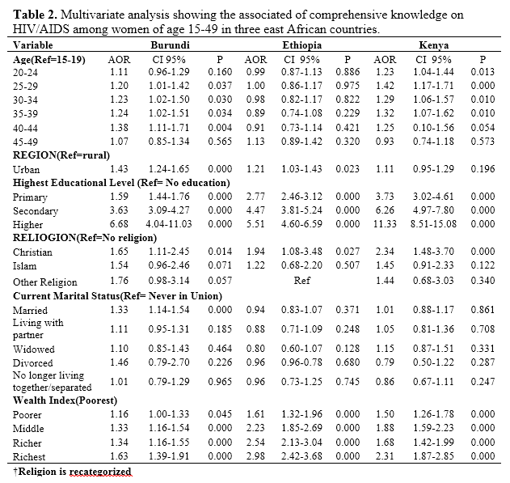

Slide 24
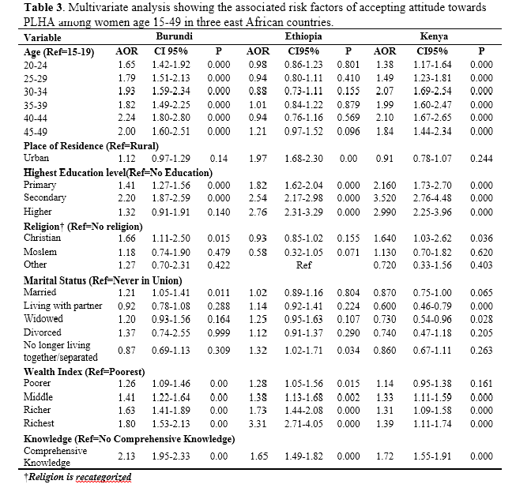

Slide 25
Table 4. Multivariate analysis comparison of comprehensive HIV/AIDS knowledge and acceptance attitude towards PLWHA among women age 15-49 in three east Africa countries
Country | Reference | Comprehensive Knowledge |  |  | Acceptance Attitude
 |  | AOR | 95%CI | P | AOR | 95%CI | P
Burundi | Ethiopia | 4.01 | 3.79-4.24 | 0.000 | 3.39 | 3.21-3.58 | 0.000
Burundi | Kenya | 1.11 | 1.04-1.18 | 0.001 | 1.93 | 1.82-2.05 | 0.000
Kenya | Ethiopia | 3.62 | 0.34-3.83 | 0.000 | 1.75 | 1.65-1.86 | 0.000

Slide 26
Discussion
Comprehensive Knowledge on HIV/AIDS
  Women of all the three east Africa countries had nearly universal awareness.
  Similar studies were reported in SSA (Deribew et al., 2010; Ngayimbesha & Chen, 2011; Nketiah-Amponsah & Afful-Mensah, 2013), while in Bangladesh only 70 percent of women heard about HIV/AIDS (Jesmin, Chaudhuri, & Abdullah, 2013).
  However, women of the three East African countries they lack Comprehensive knowledge on HIV/AIDS.
  Less than half percent of the participants had comprehensive knowledge of HIV/AIDS in Burundi (48.9%), Kenya (46.3%) and Ethiopia (19.3%).

Slide 27
Discussion
Similarly, Population-based study in Bolivia (Sucre) revealed that, women had 31% adequate knowledge of HIV/AIDS (Terán Calderón et al., 2015).
Moreover, research conducted in Bangladesh DHS 2007 showed that, comprehensive knowledge in transmission and prevention of HIV/AIDS was 45.4 percent (Jesmin et al., 2013).
Globally, less than 30 percent of young women have comprehensive and correct knowledge on HIV/AIDS.

Slide 28
Discussion
Women living in urban were more likely to have higher comprehensive knowledge of HIV/AIDS compared to women living in rural areas of Burundi and Ethiopia.
A broad difference between rural and urban areas related to HIV/AIDS comprehensive knowledge has been also reported from Sub-Sahara Africa and other areas (Jesmin et al., 2013; Lifson et al., 2012; Ngayimbesha & Chen, 2011; Terán Calderón et al., 2015; Veinot & Harris, 2011).
Women living in urban areas might have more access to Education, mass media and campaigns related to HIV/AIDS information than rural areas.

Slide 29
Discussion
Our result showed that, married respondents from Burundi have significant difference in comparison the reference group (never in union) in comprehensive knowledge of HIV/AIDS.
However, studies conducted among Kenyan young women, Ochako et al. (2011) revealed that ever married women had less comprehensive knowledge of HIV/AIDS than never in union (Ochako et al., 2011).

Slide 30
Discussion
Studies revealed that education have a great role in determining person’s social status, income and access to information (Rahman & Rahman, 2007) .
This study showed educated women were more likely to have comprehensive knowledge of HIV/AIDS than women with no education.
As educational level of women increase, they are more likely to have highest comprehensive knowledge on HIV/AIDS.
In line to this, study conducted in Kenya (2007) AIDS Indicator Survey (KAIS) also reported that, women with higher educational level had higher comprehensive knowledge than women with no education (Kenya, 2009).
Moreover, similar studies reported in Sub-Sahara Africa, South Asia, South and North America (Barden-O'Fallon et al., 2004; Jesmin et al., 2013; Jung, Arya, & Viswanath, 2013; Lifson et al., 2012; Terán Calderón et al., 2015; Veinot & Harris, 2011)

Slide 31
Discussion
Wealth index was significantly associated towards comprehensive knowledge of HIV/AIDS in the selected three east African countries.
Wealthier people may have more access to education as well as mass media. Hence they can get correct and comprehensive knowledge of HIV/AIDS in comparison to the poorest people.
People living in lower Socio-Economic Status (SES) tend to gain less benefit from information flows than their counter parts higher SES (Viswanath, Thomson, Mitchell, & Williams, 2006). Similar result were reported elsewhere (Lifson et al., 2012; Terán Calderón et al., 2015).

Slide 32
Discussion
Gender inequalities, taboos associated with the discussion of sexuality and sexual health, the submissive role of women in a relationship, and male control of decision-making regarding sexual relations might also explain why African women are less knowledgeable about HIV/AIDS (Burgoyne & Drummond, 2008).

Slide 33
Discussion
Acceptance Attitude towards people living with HIV/AIDS
Results highlighted that participants acceptance attitude towards people living with HIV (PLHIV) was below average, Burundi (47.4%), Kenya (31.8%) and Ethiopia (21%).
UNAIDS (2014) report, negative attitudes are common in many parts of the world.
However, Increasing HIV knowledge and awareness among the general population enables people to protect themselves and works to reduce stigma and discrimination against people living with HIV (UNAIDS, 2014).

Slide 34
Discussion
In this study, all age groups had significantly higher acceptance attitude towards PLHA in comparison to the reference group women age 15-19 in Burundi and Kenya.
Our result is consistent with the research conducted previously elsewhere (Chiao et al., 2009).
However, women from Ethiopia do not show any statistical significance and similar result was reported (Lifson et al., 2012).

Slide 35
Discussion
Women living in urban had higher acceptance attitude towards PLHA than those in rural areas in Ethiopia.
Similar studies were reported (Burgoyne & Drummond, 2008; Gurmu & Etana, 2015; Lifson et al., 2012).
People living in urban areas have more accesses to education, mass media exposure and Health services such as voluntary counselling test (VCT), hence they can avoid misconceptions and misunderstanding about the disease.

Slide 36
Discussion
Acceptance attitude towards PLHA were significantly more in women with higher, secondary and elementary educational level than women with no education (except in Burundi for higher education).
The likelihood of Acceptance attitude towards PLHA increases with getting of Better education.
In line to this, similar researches were reported elsewhere (Deribew et al., 2010; Lifson et al., 2012; Ngayimbesha & Chen, 2011; Terán Calderón et al., 2015).

Slide 37
Discussion
Married women from Burundi and No living together/Separated from Ethiopia had higher acceptance attitude towards PLHA than women never in union.
However, married and living together women from Kenya had less acceptance attitude than women never in union, this finding is consistent with the previous reported research (Chiao et al., 2009).

Slide 38
Discussion
Wealth index in all the three east African countries has statistically significant association on acceptance attitude towards PLHA.
Women in highest socioeconomic status were more likely to have highest accepting attitude towards PLHA, even though the pattern is not uniform.
Similar results were reported elsewhere (Chiao et al., 2009; Lifson et al., 2012) .

Slide 39
Discussion
Results showed that women with comprehensive knowledge has more acceptance attitude towards PLHA than the counterparts with no comprehensive knowledge.
This revealed that, comprehensive knowledge is basic and necessary factor to build accepting attitudes towards PLHA. Similar results showed that women with good knowledge were more favorable towards PLHA (Deribew et al., 2010; Lifson et al., 2012; Mall, Middelkoop, Mark, Wood, & Bekker, 2013).

Slide 40
Limitations
This study have limitations
  The objective and self-reported measures of Comprehensive Knowledge on HIV/AIDS and Accepting attitudes towards PLHA (questionnaire) might affect the quality of data.
  Individuals may not be willingly to express their negative attitudes during face to face interview.
  Due to the Cross-sectional nature of the study method, we are unable to make any casual inferences based on the associations presented.

Slide 41
Conclusion
Our study findings highlighted that, majority of Women of the Three East African countries were aware of HIV/AIDS.
However, comprehensive knowledge on HIV/AIDS as well as acceptance attitude towards PLHA were remained low.
Women from Burundi have higher HIV/AIDS Comprehensive knowledge and Acceptance attitude towards PLHA than women in Kenya and Ethiopia.

Slide 42
Conclusion
The associate variables in Burundi and Kenya were age, Women living in urban areas, educated Women and women with higher socioeconomic status.
In the other hand, in Ethiopia associate variables were Women living in urban areas, educated Women and women with higher socioeconomic status.
Education and information on HIV/AIDS prevention and transmission methods are necessary to all women of east African countries and particularly to women living in rural areas, women with no educational background and women in the lower economic status of the society.

Slide 43
Acknowledgement
Study Team: Russom Teshome, Eyasu Habte and Nuredin Mohammed Kasim.
Supervisor :Prof. Wang Youjie Tongji Medical College.
Data Source: The Demography Health Surveys (DHS) Program ICF International Rockville, USA.

Slide 44
Thank You

