Slide 1


IDENTIFICATION OF 12 STD PATHOGENS IN SEMEN USING
POLYMERASE CHAIN REACTION (PCR) AND
“FLOW-THROUGH” HYBRIDIZATION TECHNOLOGY
Rubina Ghani,
Professor
Department of Biochemistry,
Pathological & Molecular Laboratories,
Karachi , Pakistan

Slide 2
Sexually transmitted diseases (STD)
Sexually transmitted diseases (STDs) are caused by several pathogens, including bacteria, viruses and protozoa, and can induce male infertility through multiple pathophysiological mechanisms.
Sexually transmitted infections (STI)
Illnesses that have a significant probability of transmission between humans by means of sexual behavior
vaginal intercourse
anal sex
oral sex

Slide 3
19 million new cases of sexually transmitted infections every year in the United State.¹
In 2005, the World Health Organization estimated that 448 million people aged 15–49 were being infected a year with curable STIs (such as syphilis, gonorrhea and chlaymadia).²
There were an estimated 34 million people living with human immunodeficiency virus (HIV) in 2010. ³
Ochsendorf, F. R. Sexually transmitted infections: impact on male fertility. Andrologia 40, 72–75 (2008).
World Health Organization (WHO) Sexually transmitted infections Fact sheet N°110 August 2011 [Internet] Geneva: WHO; c2013
UNAIDS. UNAIDS world AIDS day report 2011 [Internet] Geneva: Joint United Nations Programme on HIV/AIDS (UNAIDS); [cited 2013 Jan 30].

Slide 4
High prevalence of sexual transmitted infections around the globe ¹
Europe 47 million
East med. 26 million
SE Asia
79 million
Western Pacific 128 million
America
126 million
Africa
26 million
1http://www.who.int/mediacentre/factsheets/fs110/en/

Slide 5
STDs can be bacterial, viral and parasitic
Bacterial
Neisseria gonorrhoeae(NG) Mycoplasma genitalium(MG)
Ureaplasma parvum(UP) Mycoplasma hominis(MH)
Chlamydia trachomatis (CT) Ureaplasma urealyticum(UU)
Viral
Herpes Simples Virus 1 / 2 (HSV 1, HSV 2)
Human Papillomavirus 6 / 11 (HPV 6, HPV 11)
Parasitic
Trichomonas vaginalis(TV)

Slide 6
STDs can lead to serious outcomes
Mother to child transmission route is possible.¹
Emerging trend of drug resistant NG. ²
STDs are associated with HIV infection ³
1Jaiyeoba, O., Amaya, M. I., Soper, D. E., & Kilby, J. M. (2012). Preventing neonatal transmission of herpes simplex virus.Clinical Obstetrics and Gynecology,55(2), 510-520.
2Unemo, M., & Nicholas, R. A. (2012). Emergence of multidrug-resistant, extensively drug-resistant and untreatable gonorrhea.Future microbiology,7(12), 1401-1422.
3Nusbaum, M. R., Wallace, R. R., Slatt, L. M., & Kondrad, E. C. (2004). Sexually transmitted infections and increased risk of co-infection with human immunodeficiency virus.JAOA: Journal of the American Osteopathic Association,104(12), 527-535

Slide 7
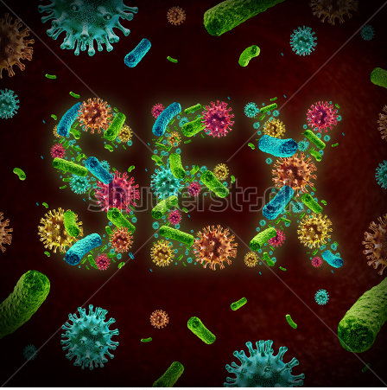
Reasons to genotype STD pathogens
•Many STDs are asymptomatic
•Different STDs have overlapping symptoms
•Different STDs have different treatments
•Co-infection rate is unexpectedly high

Slide 8
Most STD are asymptomatic
•~85% of women have asymptomatic CT infection¹
•HPV is the most common asymptomatic STD among younger patients²
•Asymptomatic infection of NG accounts for around 10% in men and 50% in women³
1Eng, T. R., & Butler, W. T. (Eds.). (1997).The Hidden Epidemic:: Confronting Sexually Transmitted Diseases. National Academies Press.
2Lehtinen, M. (2005). Preparations for implementing human papillomavirus vaccination should begin.Euro Surveill,10(9), E050915.
3Shmaefsky, B. R. (2009).Gonorrhea. InfobasePublishing

Slide 9
Different STDs share common symptoms
Clinical symptoms | Causative pathogens
. Urethritis | N. gonorrhoeae C. trachomatis Mycoplasma genitalium Trichomonasvaginalis HSV 1/2 Ureaplasmaurealyticum
Cervicitis | C. trachomatis N. gonorrhoeae M. genitalium HSV 2 Bacterial vaginosis(BV)

Slide 10
STD co-infection: more than you expect
MG: 30.4% with NG¹
•MH: 3.4% with UU²
•UU/UP: High UU-MH co-infection pattern (13.91%)³
•HPV: HSV and CT are associated with HPV infections⁴
MG
MH
NG
UU/UP
CT
HPV
HSV
TV
1Mobley, V. L., Hobbs, M. M., Lau, K., Weinbaum, B. S., Getman, D. K., & Sena, A. C. (2012). Mycoplasma genitaliuminfection in women attending a sexually transmitted infection clinic: diagnostic specimen type, coinfections, and
predictors. Sexually transmitted diseases, 39(9), 706-709.
2 Wang, Q.-Y., R.-H. Li, et al. (2014). "Prevalence and antimicrobial susceptibility of< i> Ureaplasmaurealyticum</i> and< i> Mycoplasma hominis</i> in female outpatients, 2009–2013." Journal of Microbiology, Immunology and
Infection.
3Zhu, Changtai, Liu, Jinming, Ling, Yang, Dong, Chunlei, Wu, Tingting, Yu, Xiaoyuan, . . . Cheng, Xiaowei. (2012). Prevalence and antimicrobial susceptibility of Ureaplasmaurealyticumand Mycoplasma hominisin Chinese
women with genital infectious diseases. Indian Journal of Dermatology, Venereology, and Leprology, 78(3), 406.
4Alberts, C. J., et al. (2013). "Association of Chlamydia trachomatis infection and herpes simplex virus type 2 serostatuswith genital human papillomavirus infection in men: the HPV in men study." Sex TransmDis 40(6): 508-515.

Slide 11
STD co-infection: more than you expect
TV: 5-13% with MG¹
•HSV 1&2: 1.4% with CT/NG²
•CT: Among MG positive samples, 25% with CT co-infection³
•NG: Among MG positive samples, 73.3% of female with NG co-infection⁴
MG
MH
NG
UU/UP
CT
HPV
HSV
TV
1Getman, D. (2014). Prevalence of M Genitalium, T Vaginalis, C Trachomatis and N Gonorrhoeaein Women Enrolled in a Prospective Multi-Center US Clinical Study. 2014 National STD Prevention Conference, CDC.
2Vahidnia, A., et al. (2013). "A retrospective study into the prevalence of herpes simplex virus 1&2 in female patients tested for Chlamydia trachomatis and/or Neisseria gonorrhoeaeusing vaginal swabs." Clinical Microbiology and Infection 19(3): E166-E168.
3 Mobley, V. L., Hobbs, M. M., Lau, K., Weinbaum, B. S., Getman, D. K., & Sena, A. C. (2012). Mycoplasma genitaliuminfection in women attending a sexually transmitted infection clinic: diagnostic specimen type, coinfections, and predictors. Sexually transmitted diseases, 39(9), 706-709
4Gaydos, C., Maldeis, N. E., Hardick, A., Hardick, J., & Quinn, T. C. (2009). Mycoplasma genitaliumas a contributor to the multiple etiologies of cervicitis in women attending sexually transmitted disease clinics. Sexually transmitted diseases, 36(10),
598

Slide 12
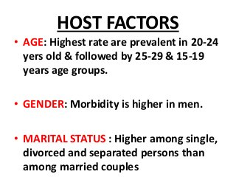

Slide 13
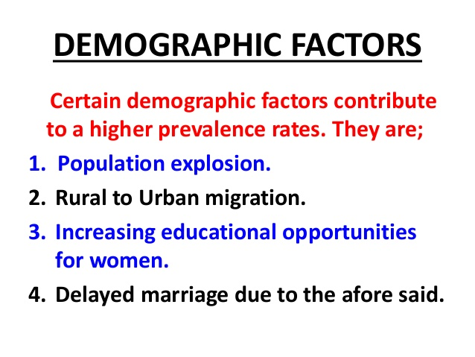

Slide 14
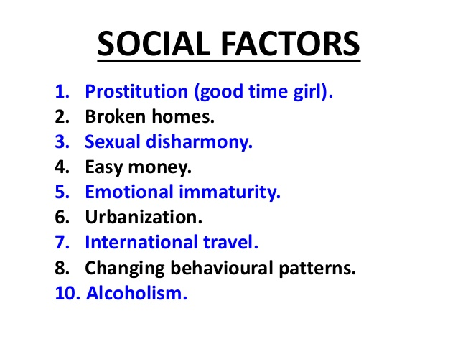

Slide 15
OBJECTIVE

Slide 16
Identify the cause of infertility in Male.
To access in health care facilities for diagnosis and common pathogens of STDs,
Those causing infertility and see the cause of Chlamydia trachomatis, Neisseria gonorrhoeae, human papillomavirus(HPV) and Mycoplasma hominis transferred in female.
Genital wart is a highly contagious sexually transmitted disease caused by some sub-types of human papillomavirus (HPV).

Slide 17
Causes of Infertility

Slide 18
Causes of Male Infertility
It affects approximately 7% of all men.
Male infertility is commonly due to deficiencies in the semen, and semen quality is used as a surrogate measure of male fertility
One third of fertility problems occur solely in women.
One third in men
The remaining third are mutual.

Slide 19
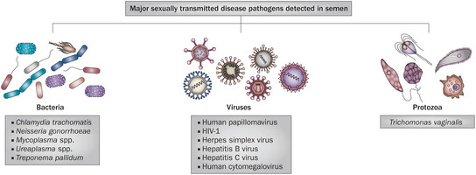
Sperm Abnormalities
Major sexually transmitted disease pathogens detected in semen
http://www.nature.com/nrurol/journal/v11/n12/carousel/nrurol.2014.285-f1.jpg

Slide 20
Risk factors for male infertility include:
Aging, which can reduce sperm counts and motility and decrease the genetic quality of sperm
Sexually transmitted diseases, which can cause scarring in the male reproductive system or impair sperm function
Lifestyle factors such as smoking and substance abuse
Long-term or intensive exposure to certain types of chemicals, toxins, or medications

Slide 21
DNA damage
Common inherited variants in genes that encode enzymes employed in DNA mismatch repair are associated with increased risk of sperm DNA damage and male infertility
Others Causes
Environmental toxins such as chemicals
Radiation
Pollution
Drugs / Street drug use
Stress
Cigarette smoking
Frequent sex/ Lifestyle habits
Heavy metal exposure/ Poor diet
Overuse of alcohol

Slide 22
Materials and Methods

Slide 23
Semen Analysis
Screening Strategy I
Screening Strategy II
PCR
Basic Analysis
STD /11 PATHOGENS
DNA Extraction
PCR
Flow –Through Hybridization
Normal Count /Infection
Abnormal Count
Culture/
Sensitivity
Infertility
PCR

Slide 24
PCR-preparation
Thermo cycle
Component | Volume (μl)
PCR premix | 18.6
DNA TaqPolymerase (5U/μl) | 0.4
25 x Primer Mix | 01
DNA template | upto 5
Total | 25
95 °C | 10 min
95 °C | 30 sec
61 °C | 30 sec | 43 cycles
72 °C | 60 sec
72 °C | 7 min
4 °C | for ever

Slide 25
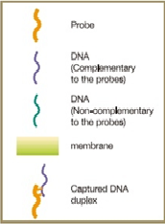
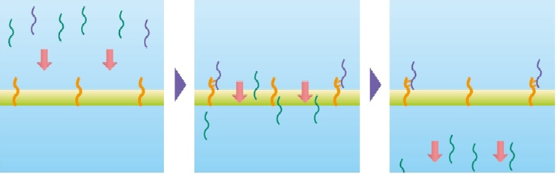
The uniqueness of "Flow-through" hybridization is by directing the amplicons toward the DNA probes to form duplexes
The "Flow-through" hybridization is changing from traditional passive to active channeling process allowing the recombination reactions to complete in seconds.
DNA hybridization assays are known to have excellent signal-to-noise ratio.
It enables unambiguous detection of multiple pathogens/disease genotypes in one single reaction.

Slide 26
Working Protocol for DiagCor STD
Hybridization-at-a-glance
Solution | Volume (µl) |  | Incubation | After incubation
43 °C FT ^{pro}
Pre-hybridization |  | 150 | 2 min | Drain
Hybridization |  | 150 + 25 PCR product | 5 min | Drain
Hybridization solution wash |  | 200 x 3 | - | Drain
25 °C
Blocking |  | 150 | 5 min | Drain
Enzyme Conjugate |  | 150 | 5 min | Drain
36 °C
Wash A solution |  | 200 x 4 | - | Drain
Detection Solution |  | 150 | 3 min | Drain
Wash A solution |  | 200 x 3 |  | Drain
Stop |  | 150 | 1 min | Drain

Slide 27
Results

Slide 28
Screening Strategy I
 | Rapid progressive | Slow progressive | Non progressive | Immotile
Motility | Normal | Watery | Viscous
Viscosity | ≤ 20% | ≥ 40% | ≥ 40
 | Normal Form | Head Defective | Mid Piece & Neck Defective | Tail Defective | Teratozoo-spermia index
Sperm Morphology | ≤ 20 | ≥30 | ≥20 | ≥10 | ≥2:1
 | Debris | Round cell | Epithelial cells | Erythrocytes
Culture / Sensitivity | Moderate or Heavy | ≥ 10 % | ≥ 4% | Present
 | Normal | Head to Head | Head to Tail | Tail to Tail
Agglutination | ≤ 10 | ≥ 20 | ≥ 10 | ≥ 10

Slide 29
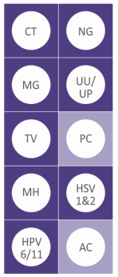
GenoFlow STD Array Test - 11 STD pathogens in 1 go
Screening Strategy II
Detect 11 common STD pathogens:
1. Chlamydia trachomatis (CT)
2. Neisseria gonorrhoeae (NG)
3. Mycoplasma genitalium (MG)
4. Ureaplasma urealyticum (UU)
5. Ureaplasma parvum (UP)
6. Trichomonas vaginalis (TV)
7. Mycoplasma hominis (MH)
8. Human papillomavirus type 6
9. Human papillomavirus type 11
10. Herpes simplex virus type 1
11. Herpes simplex virus type 2
12. Amplification Control (AC)*
13. Positive Control (PC)*

Slide 30
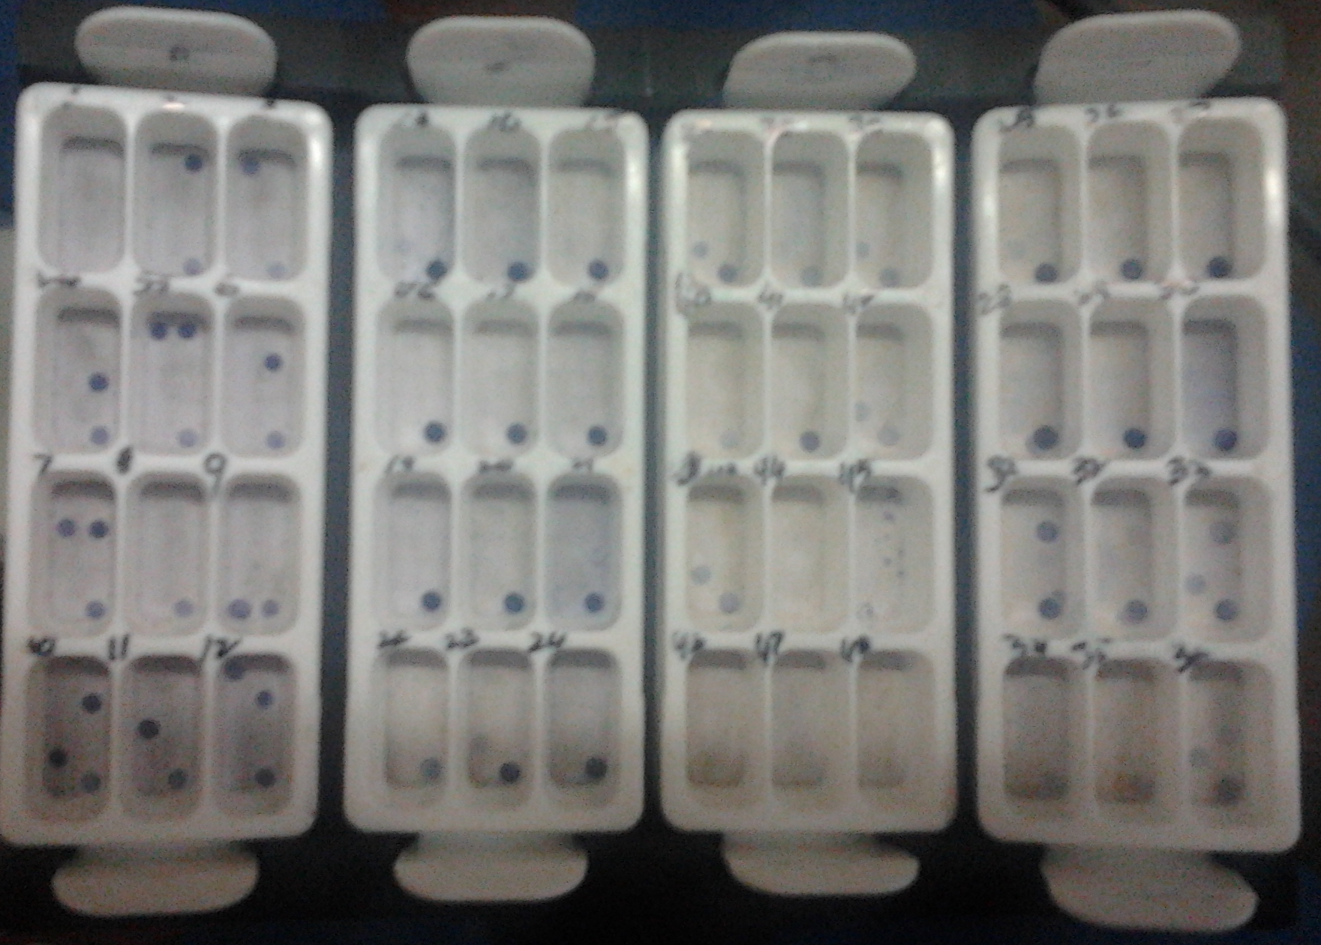
PCR
The Target pathogens detected by Gene Flow - Through from Semen sample

Slide 31
The percentage of Target pathogens detected by Gene Flow from Semen sample to see the reason of infertility
NAME OF THE STD (N=46) | DETECTED | PERCENTAGE
Chlamydia trachomatis | 02 | 4.3
Neisseria gonorrhoeae | 05 | 10.8
Mycoplasma hominis | 11 | 23.9
Treponema pallidum | 01 | 2.1
Human Papillomavirus | 01 | 2.1

Slide 32
Co -infection rate
Co- Infection | Percentage
CT/NG | 4.3
CT/HPV | 6.5
MH/UU | 2.1
MG/UU | 2.1

Slide 33
Higher infection rate of CT and NG in positive sample
CT and NG infection: most important STD screening parameters
NG infection: asymptomatic or often mistaken as virginal or bladder infection¹. May progress to serious complications as skin pustules or petechial, septic arthritis, meningitis, or endocarditis².
~85% of women have asymptomatic CT infection³
¹http://www.cdc.gov/std/gonorrhea/stdfact-gonorrhea.htm
²Moran, J. S. (2007). Gonorrhoea. BMJ Clinical Evidence, 2007, 1604.
³Eng, T. R., & Butler, W. T. (Eds.). (1997). The Hidden Epidemic:: Confronting Sexually Transmitted Diseases. National Academies Press.

Slide 34
CT/HPV co-infection may worsen the clinical outcomes
Co-infection may prolong both pathogen’s infection, and increasing the risk of cervical cancer or infertility¹
CT/ HPV co-infection may delay HPV lesion clearance^{2,3}
Monitoring and control of both pathogens are necessary
The co-infection effects of other STD pathogens are also concerned
1.Denks, K., Spaeth, E. L., Jõers, K., Randoja, R., Talpsep, T., Ustav, M., & Kurg, R. (2007). Coinfection of Chlamydia trachomatis, Ureaplasma urealyticum and human papillomavirus among patients attending STD clinics in Estonia.Scandinavian journal of infectious diseases, 39(8), 714-718.
2. Verteramo, R., Pierangeli, A., Mancini, E., Calzolari, E., Bucci, M., Osborn, J., ... & Degener, A. M. (2009). Human Papillomaviruses and genital co-infections in gynaecological outpatients. BMC infectious diseases, 9(1), 16.
3. Simonetti, A. C., de Lima Melo, J. H., de Souza, P. R. E., Bruneska, D., & de Lima Filho, J. L. (2009). Immunological's host profile for HPV and Chlamydia trachomatis, a cervical cancer cofactor. Microbes and Infection, 11(4), 435-442.

Slide 35
Conclusion

Slide 36
STD screening and treatment should be a primary intervention and a standard of care in all health care settings.
Screening for bacterial STI pathogens, Mycoplasma hominis, Chlamydia trachomatis and Neisseria gonorrhoeae are strongly recommended because these pathogens can cause serious reproductive complications such as pelvic inflammatory disease, ectopic pregnancy.
Studies show STD and HIV co-infection increases HIV virus shedding in the patients’ genital secretions.

Slide 37
STD
Multiple infection
STD infection rates are common around the globe
HPV/STD co-infection may worsen the clinical outcome
Close monitoring of both HPV and STD infection is necessary
Cost effect technology should be used
HPV/STD
coinfection
Worse clinical outcome
Close monitoring
Cost effect technology

Slide 38


