Slide 1
Pentavalent outer membrane vesicles of V. cholerae induce adaptive immune response and protective efficacy in both adult and passive suckling mice model
Ritam Sinha
Senior Research Fellow
Division of Bacteriology
National Institute of Cholera and Enteric Diseases
P-33, C.I.T. Road, Scheme XM, Beliaghata, Kolkata-700010. India

Slide 2
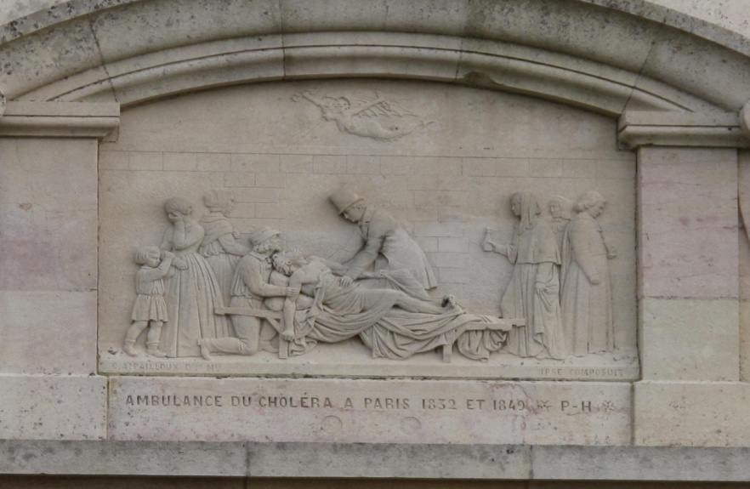
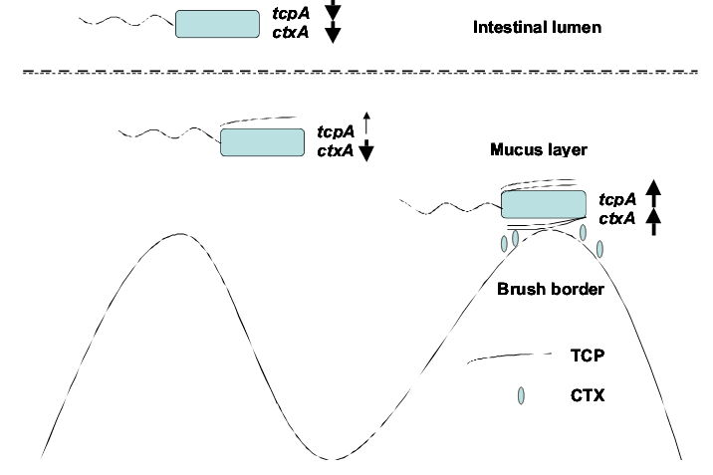
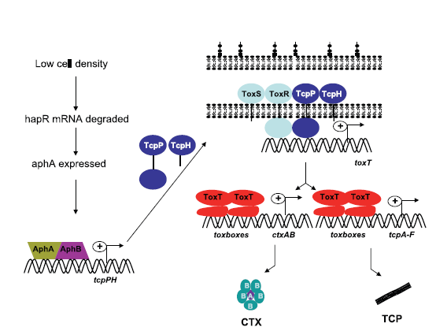
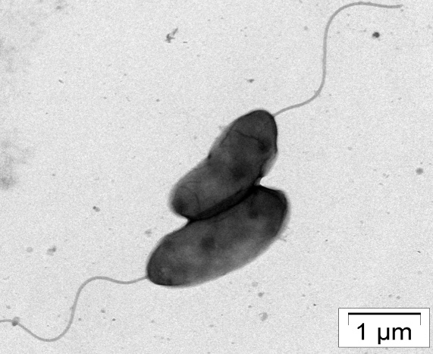
What is Cholera ?
Since 1817, cholera is one of the major clinical problems in many of the developing countries in Asia, Africa and South America
Cholera is an ancient disease
In 2013, Haiti cholera outbreaks occurs causes death 8,231 Haitians
V. cholerae is the causative agent of cholera and a natural inhabitant of aquatic environments.
Soon after oral ingestion, V. cholerae reaches to the small bowel, its primary site of colonization, and induces virulence factors - toxin-coregulated pilus (TCP) and cholera toxin (CT).
Notes:
Approx 200 years we are fighting against cholera. Still not suitable vaccine are available. After infection of

Slide 3
Enteric Pathogens of Global Importance
Cholera
(150,000 deaths)
ETEC diarrhea
(500,000 deaths)
Typhoid fever
(600,000 deaths)
2.9 Million Deaths/ Years
Shigellosis
(800,000 deaths)
Rotavirus diarrhea
(800,000 deaths)
*World Health Organization GBD_report_2014update_part4

Slide 4
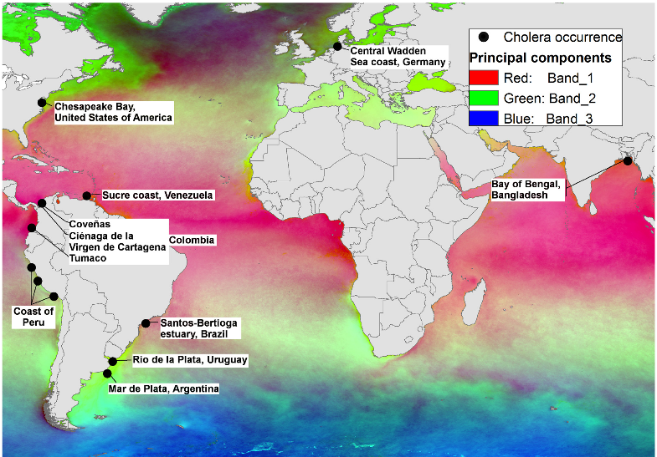

Global occurance of V.cholerae infection

Slide 5
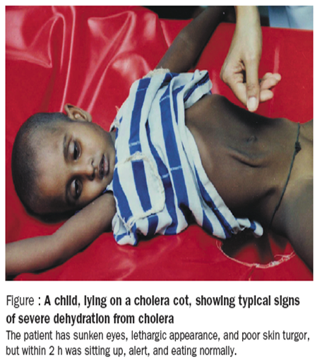
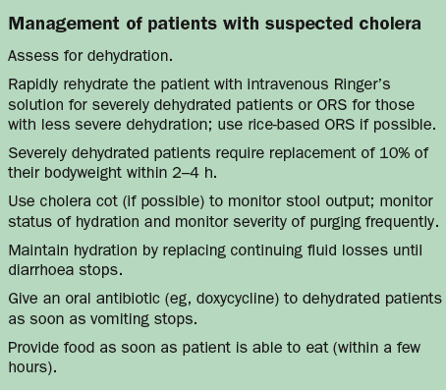
Typical Sign of Cholera
Sack, David, et al. 2004. Seminar: Cholera. The Lancet. 363: 223-233.

Slide 6
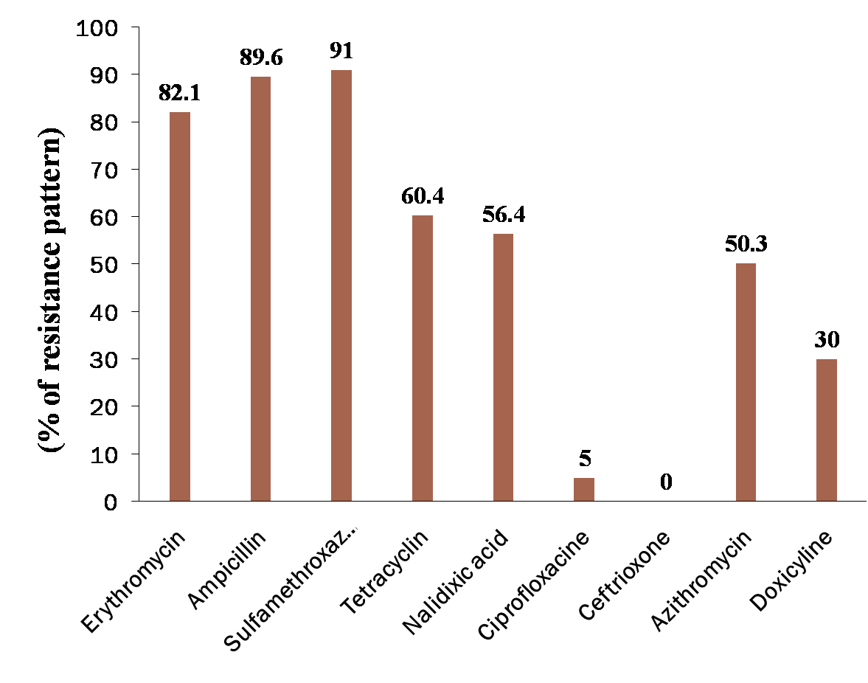
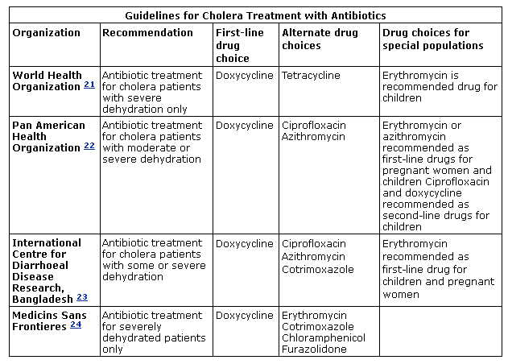
Development of multi drug resistance V. cholerae in Asia
Drug resistance pattern
Drug of Choice
According to the CDC
Yu L,et al.. PLoS One. 2014;7(6):, Faruque AS,et al. J Health Popul Nutr. 2007 Jun;25(2):241-3., . Tariq Bhat et al. JK-Practitioner ,2012

Slide 7
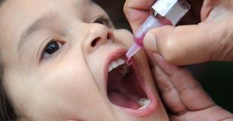
Vaccination will be the ultimate solution

Slide 8
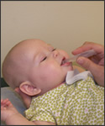
The Ideal Vaccine
What is Vaccine
  Attenuated or killed microorganisms or proteins derived from them, administered for the prevention, treatment, or amelioration of infectious diseases
Immunogenic
Long lasting immunity
Safe
Stable in field conditions
Combined
Single dose
Affordable (and accessible) to all

Slide 9
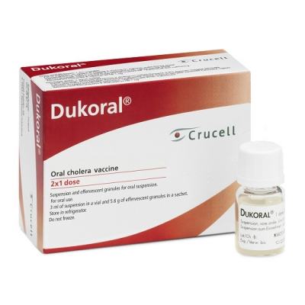
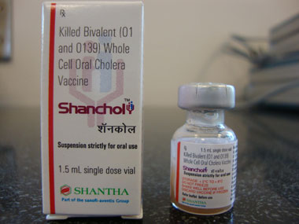
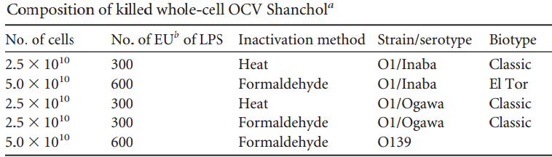
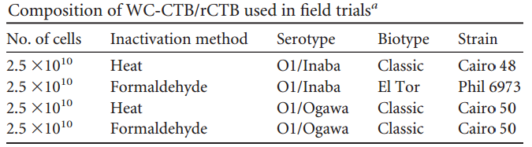
Oral Cholera Vaccine
WHO approved two licensed vaccine
Drawback:
Recent epidemic in Haiti and Zimbabwe was due to El Tor biotype.
Both Durakol and Shancol vaccine have questionable composition using three preparation of classical O1 strain and only one preparation of El Tor strain
Short duration of Protection.
Although Shancol contains large propotion of killed V. cholerae O139 cells, field trial showed the protective efficacy was low in both adult and children under 18 (less than 30%)
Need cold chain store
Need:
Scientists, academicians and public health experts have been searching for a suitable candidate vaccine to combat cholera

Slide 10
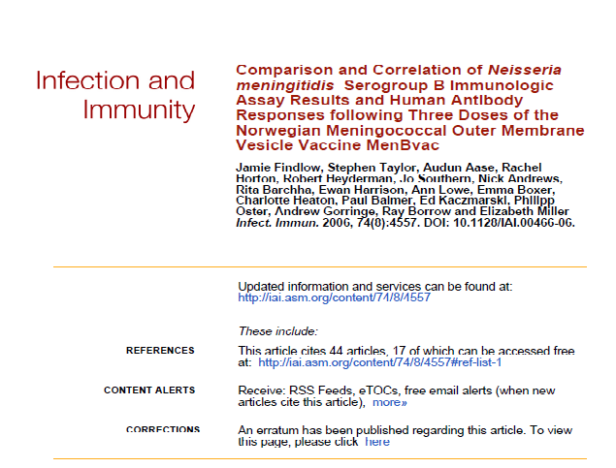

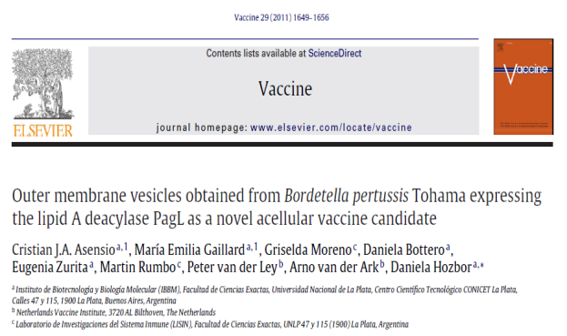
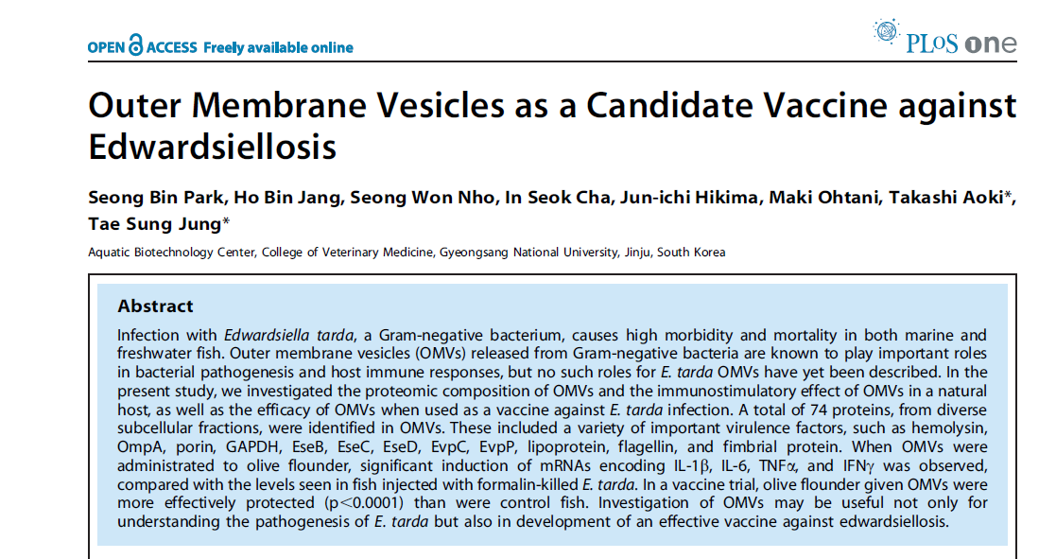
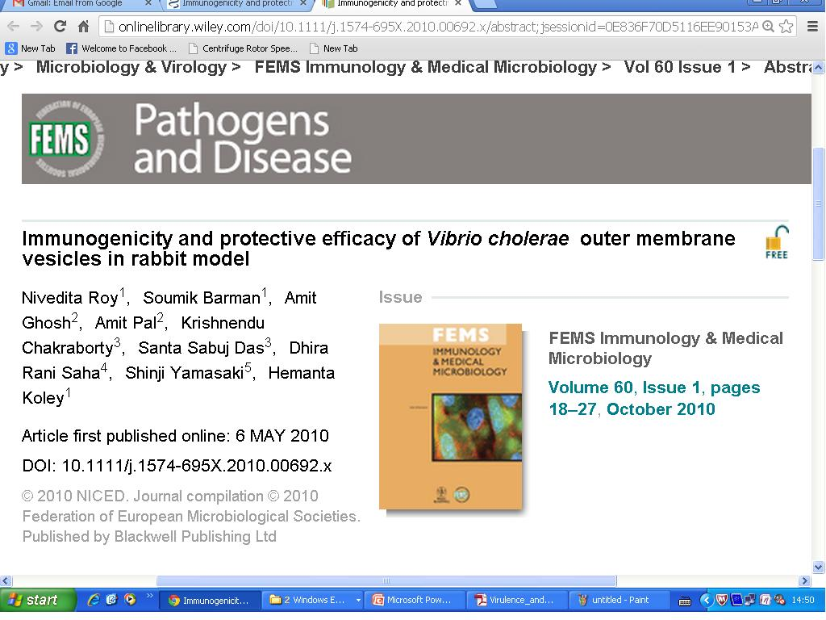
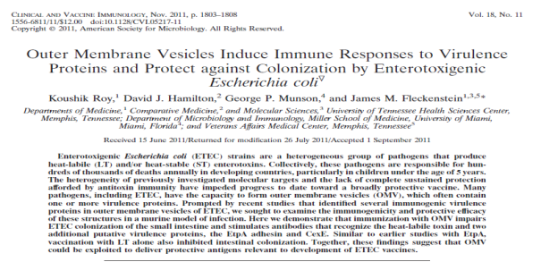
Outer membrane vesicles of gram negative bacteria as a next generation vaccine candidate

Slide 11
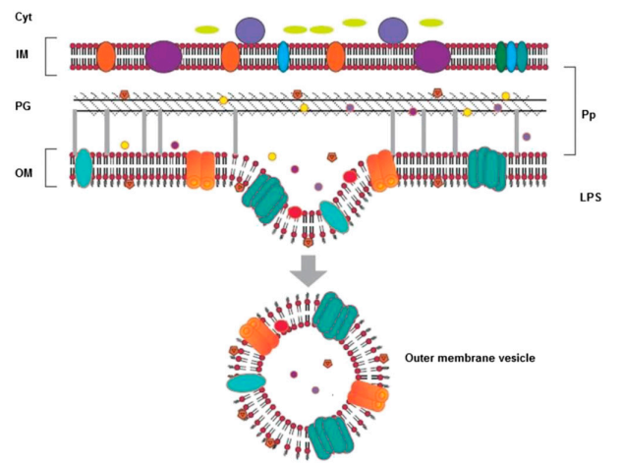
What is OMV?
Outer membrane vesicles (OMVs) produced by a wide variety of Gram-negative bacteria are spherical nanostructure (20-250 nm)
The surface of OMVs is thought to reflect the outer membrane composition of the bacterial cells
OMVs are heterogeneous complexes of pathogen-associated molecular patterns (PAMPs), such as LPS, peptidoglycan, flagellin and CpG DNA, as well as other outer membrane proteins, virulence factors or immunomodulatory compounds that are important for pathogenesis
Naturally secreted OMVs of V.cholerae contain both LPS and immunomodulatory proteins like OmpU, OmpT and OmpW.

Slide 12
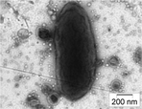
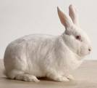
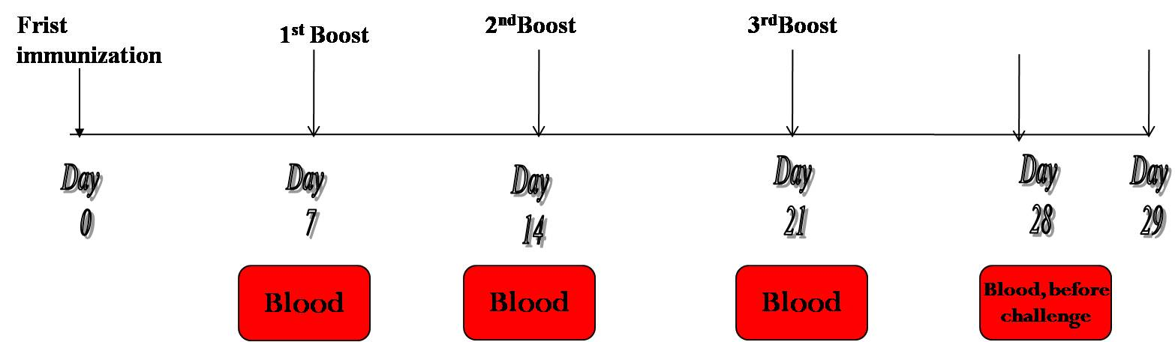
Back ground of my study
Isolation Of OMVs from V.cholerae O1 El Tor Inaba (N16961)
To check its immunogenicity we immunized rabbit four times and check its protective efficacy by RITARD model.
OMVs of V.cholerae O1 El Tor Inaba
Immunization schedule
Serum IgG titer showed exponential increase during immunization and it picked on 21st day to 51st days significantly and persist at relatively high titer for 87th days.
Koley H et al. 2010

Slide 13
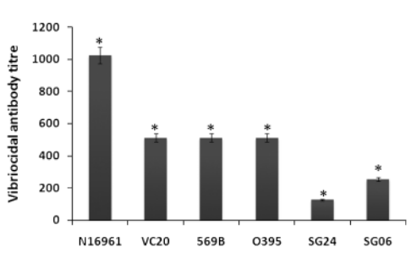
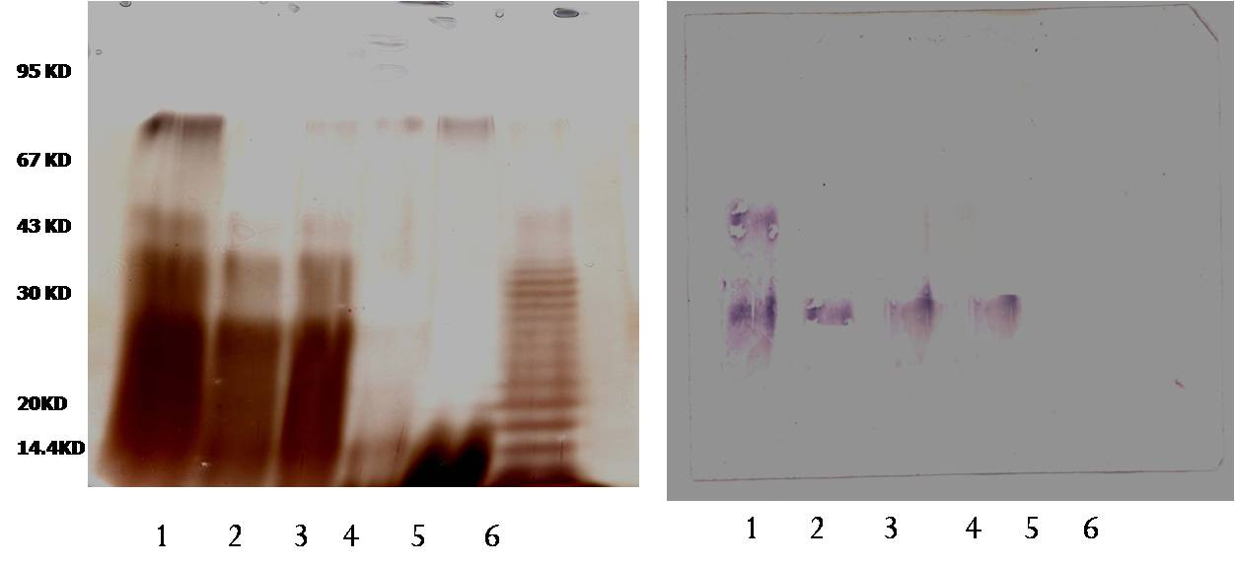
Immunogenicity of OMVs from V. cholerae N16961
Vibriocidal activity of OMV-induced antibody. Rabbits were immunized with OMVs as described under Materials and methods.Antiserum was collected on day 28 and the homologous and fiveheterologousVibrio choleraestrains were used for the serum vibriocidal antibody assay as described above. Lane 1: N16961, lane 2: VC20, lane3: 569B, lane 4: O395, lane 5: SG24 and lane 6: SGO6
A
B
LPS separated by 10% SDS-PAGE ( A) Western blot analysis ( B) with rabbit antibody raised against N16961 OMV Lane1-N16961,Lane2-VC20,Lane3-569B,Lane4-O395,Lane5-SG24,Lane6-SGO6
Koley H et al. 2010

Slide 14
Protective efficacy study of OMVs from V. cholerae N16961 in rabbit
Homologous protection
Experimental Group | Immunogen | Challenged Strain | Number of animal used | Protective efficacy (%)
PBS Control | Nil | N16961 | 3 | 0% ( 0/3)
Immunized group of animal | OMVs of N16961 | N16961 | 3 | 100% (3/3)
Heterologous protection
Challenge strain | Serogroup | Challenge dose | Experimental group | Experimental Rabbit | Protective efficacy (%)
VC 20 | O1, El Tor Ogawa | 3±1×10⁹/ml | Control | 3 | 84.4
 |  |  | Immunized | 3
569B | O1, Classical Inaba | 2±1×10⁹/ml | Control | 3 | 84.4
 |  |  | Immunized | 3
SG 24 | O139 | 3±1×10⁹/ml | Control | 3 | 75.3
 |  |  | Immunized | 3
SGO6 | O6 (Non-O1,non O139) | 3±1×10⁹/ml | Control | 3 | 75.4
 |  |  | Immunized | 3
Koley H et al. 2010

Slide 15
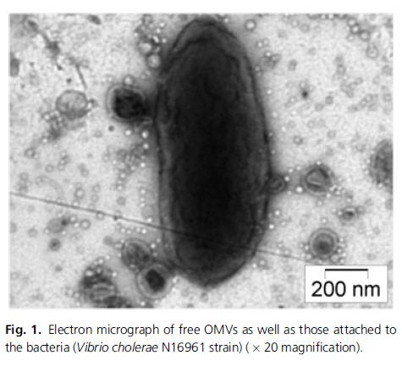
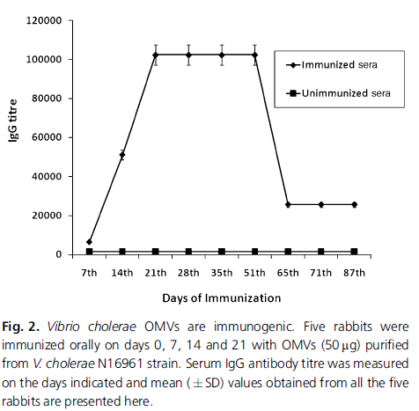
Correspondence: Hemanta Koley, Division Bacteriology, National Institute of Cholera and Enteric Diseases
In the current study, we thoroughly investigated the safety, immunogenicity and protective efficacy of outer membrane vesicles (OMVs) derived from V. cholerae and their potential use as an orally administered candidate vaccine
Oral immunization with purified (OMVs) of Vibrio cholerae conferred significant protective immunity against subsequent bacterial challenges
Oral immunization with OMVs of V. cholerae may induce long-term immunity and may be useful as a ‘nonliving’ vaccine candidate for the future.

Slide 16

Though 100% homologous protection was quite satisfactory,
75% average heterologous protective efficacy bestowed by the OMVs of N16961 (O1 El Tor Inaba) was not at all promising from the purview of disease prevalence and severity.

Slide 17

Concept of Pentavalent Formulation
Protective immune response against V. cholerae are serogroup /serotype specific
Formulation of licensed heat-killed vaccine
Epidemic Scenario:
O1 El Tor Ogawa are predominant in world wide
O1 El Tor Inaba and O139 frequently occurs in In Indian sub continental.
O6 serogroup of Non O1,non O139 serogroups are predominant in India
Pentavalent formulation:
OMV of
O1 El Tor Inaba.
O1 El Tor Ogawa
O1 Classical Ogawa
O139
O6

Slide 18
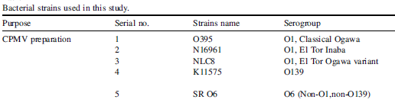
OMVs secretion from different wild type V. cholerae strains
1) O1 El Tor Inaba
2) O1 El Tor Ogawa
3) O1 Classical Ogawa
4) O139
5) O6

Slide 19
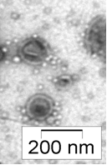
Preparation of outer membrane vesicles (OMVs)
8 to 10hr grown bacterial culture was centrifuged at 5000g for 30min.
5 µl of OMV suspension was observed under Tecnai 12 (Bio Twin Transmission electron Microscope, FEI, Netherland) operating at 80 KV by negative staining method.
Supernatant was passed through 0.45 and 0.22µm Millipore filter twice.
Resultant culture supernatant was subjected for ultra centrifugation (38,000 rpm for 3 hrs at 4° C)
Pellet was collected and resuspended in sterile PBS and the protein concentration was estimated by Bradford assay

Slide 20
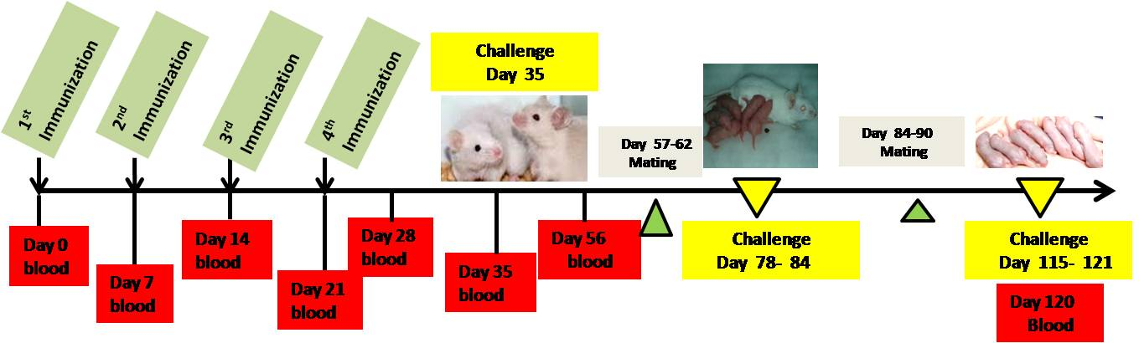
Study design
Purified CPMVs
Adult female mice were orally immunized with CPMVs(25μg/200μl).
We examined immunogenicity of our newly formulated CPMVs.
Adaptive immune response:
i) Humoral Immunity
ii) Cell mediated Immunity
At day 35, protective efficacy were measured in adult female mice using mice illeal loop model.
we also measured passive immunity in suckling mice model in different time interval

Slide 21
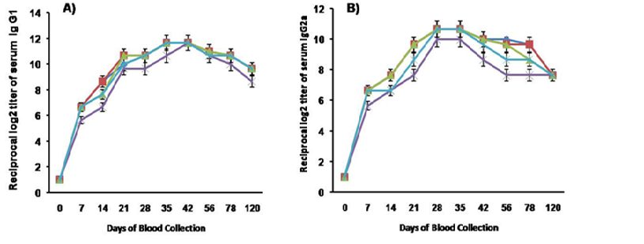
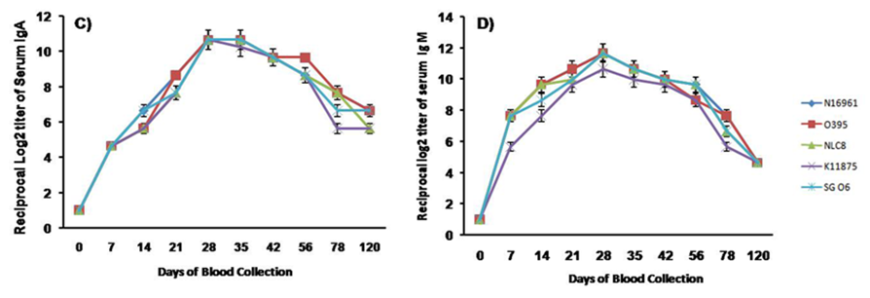
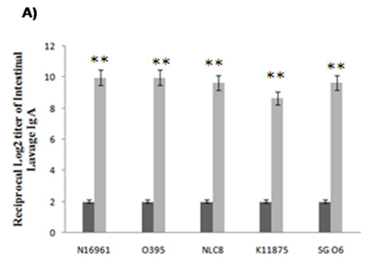
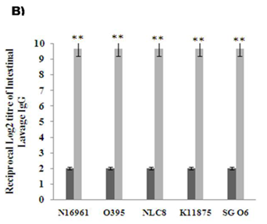

Induction of Humoral Immunity
Conclusion:
PentavalentOMVs of V.cholerae are potent immunogen significantly induce systemic and mucosal immune system
The consistently high and sustained systematic and mucosal antibacterial immunoglobulins denote an underlying T helper response, which is essential for B cell activation, differentiation and generation of memory B cell response .
Significantly higher level of serum IgG1, IgG2a, IgM and IgA responses to each of the serotypes and serogroups specific antigens during and post immunization period till 120 days.
In case of bivalent OCV, better immunogenicity was noticed against O1 than O139. But in our case no significant difference of immunoglubilin titers between O1 and O139 serogroups was observed.
CPMVs immunization triggered higher IgG1 than IgG2a against each component of CPMVs which indicate Th2 cell mediated immune response.
Sinha R et al. 2015

Slide 22
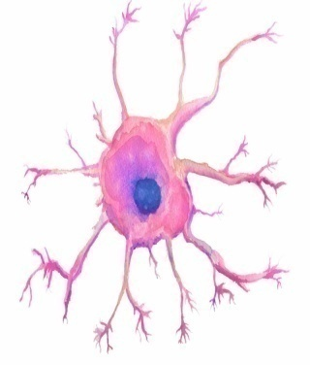
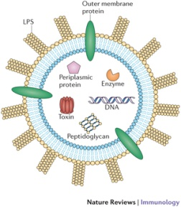
Activation of Dendritic cell
Secretion of T-cell polarizing cytokines from activated dendritic cells
Conclusion:
Indication of generation Th2 and Th17 cell mediated immune response
BMDC
OMVs
Th17 polarizing cytokines = IL-6,IL-12p40,IL-1ß
Th2 polarizing cytokines = IL-4
Sinha R et al. 2015

Slide 23
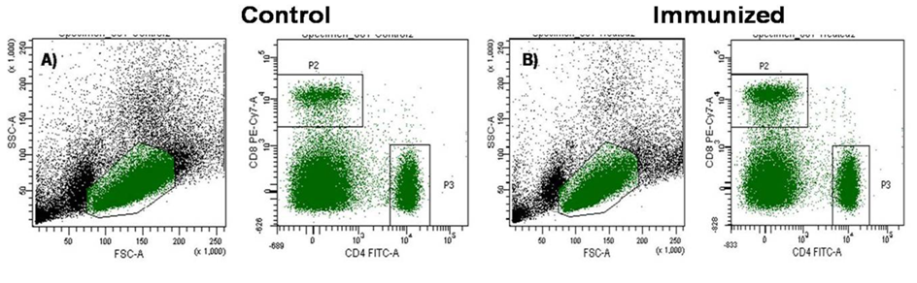
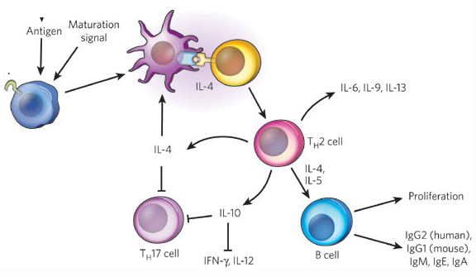
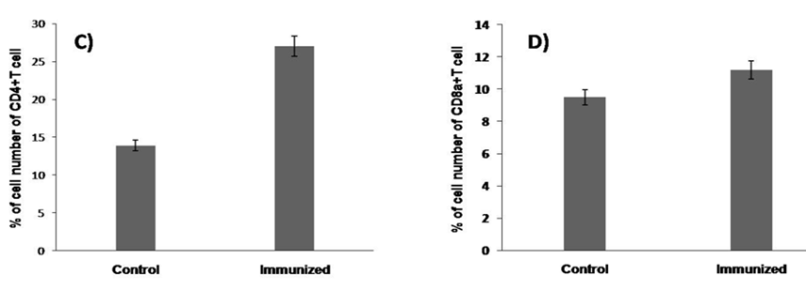
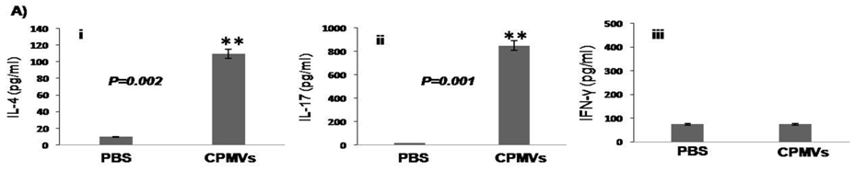
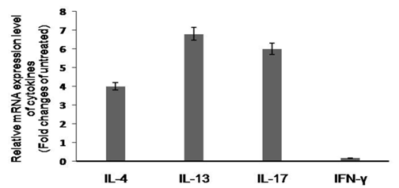
Induction of Cell Mediated Immune Response
Conclusion:
Induction of long term Th2 and Th17 immunity could provide new therapeutic approaches for preventing V. cholerae induced inflammation and memory B cell response.
we also found secretion of IL-4, IL-13 (Th2) and IL-17 (Th17) from CD4+T cell of immunized mice.
Th2 cytokines such as IL-4, IL-5 are important stimulant for protective antibody production.
Newly identified Th cell lineage, Th17, which secrete IL-17, IL-21, IL-22, IL-6 and TNF-α, have protective role against intestinal bacterial infection .
Sinha R et al. 2015

Slide 24
Protection Study in Adult Mice Model
Impact of the study:
The lipopolysaccharide O-antigen is the major protective OMVs antigen,which may contribute to the protection against V. cholerae by inhibiting bacterial motility. Since this inhibition of bacterial motility prevent intestinal mucin penetration which is necessary for adherence of V. cholerae to epithelial cells.
After four successive oral immunizations with CPMVs, protective efficacy was observed in adult mice ileal loop assaymeasuring fluid accumulation ratio of weight and length of ligated intestine significant
We observed no amount of fluid accumulation in immunized group, whereas non-immunized group of animal’s intestine showed significant amount of fluid accumulation.
But fluid accumulation was observed in both loop of immunized and non-immunized mice introduced with cholera toxin
Sinha R et al. 2015

Slide 25
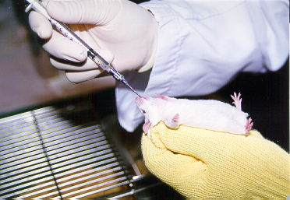
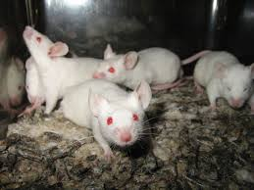
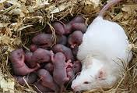
Protective Efficacy study- passive protection model
Adult male mice
Immunized female mice were mated with age matched males
Suckling mice
7 week old adult female mice
Immunized with the CPMVs
Challenged with wild type virulent Wild type strains to study the protective efficacy of the multi-serotype OMVs vaccine formulation

Slide 26
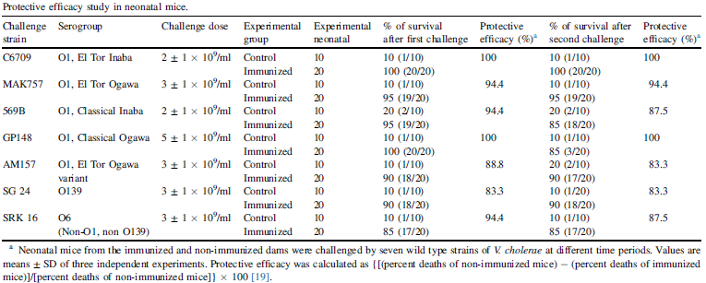
Passive protection study
Sinha R et al. 2015

Slide 27
Passive protection study
From human perspective, effect of breast-feeding against cholera in endemic areas has been shown
The above result suggested that generation of long term passive protection would lead to increase significant protection in children against cholera during epidemics.
To understand passive protection , we designed experiment with 5-6 day neonates were returned back to their mother after oral challenge with wild type strains. Passive protection study in suckling mice has supported our data by conferring higher rate of survivality and lesser intestinal colonization of V. cholerae when compared with neonates from non-immunized dams due totransferring anti-OMVs immunoglobulins through breast milk
Sinha R et al. 2015

Slide 28

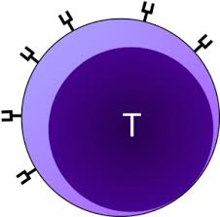
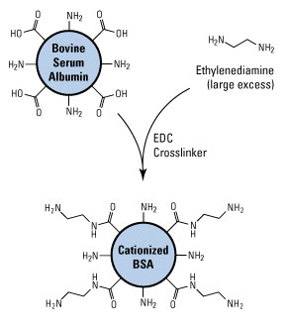
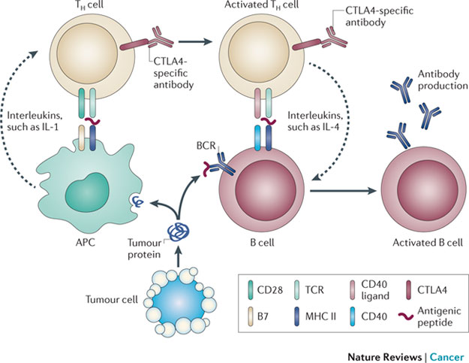
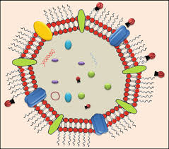
OMVs as a better immunogen
OMV

Slide 29

OMVs towards an ideal vaccine against V. cholerae
Immunogenic =
Long lasting immunity =
Safe =
Stable in field conditions =
Combined=
Dose = ??

Slide 30


Salient findings
Immunized sera showed significant increase different immunoglobulin during immunizationi.
Induction of Th2/Th17 cell mediated adaptive immune response without any adjuvant, in adult mice.
Up to 80-100% passive protection was observed in neonatal mice against diseases.

Slide 31







Acknowledgement
My Lab Members
Hemanta Koley MSc PhD
Nivedita Roy MSc PhD
Soumik Barman MSc PhD
Soma Mitra MSc PhD
Dhrubajyoti Nag MSc
Priyadarshini Mukherjee MSc
Debaki Ranjan Howlader MSc

Slide 32


