Slide 1
Petrochemistry 2015
Pyrolysis and Properties of Endothermic Fuel
in Minichannels at temperatures up to 750°C
BI Qincheng*, LIU Zhaohui
YANG Zhuqiang, YAN Jianguo, GUO Yong, PAN Hui, FENG Song
State Key Laboratory of Multiphase Flow in Power Engineering
Xi’an Jiaotong University, Xi’an 710049, China
Email: qcbi@mail.xjtu.edu.cn

Slide 2
Outlines
Introduction
Test facilities
Results
Conclusions
Notes:
First is the motivation, and then I will introduce the method of two-capillary viscometer, next are the experimental set up and procedures. And the last are the results of cyclohexane and conclusions.

Slide 3

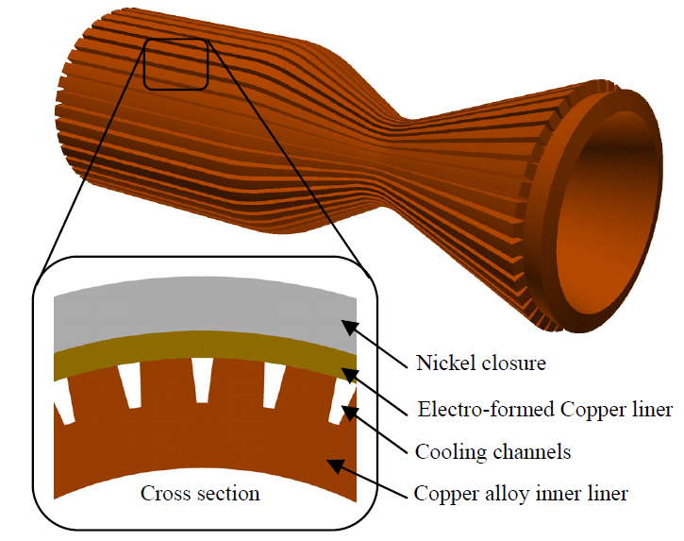
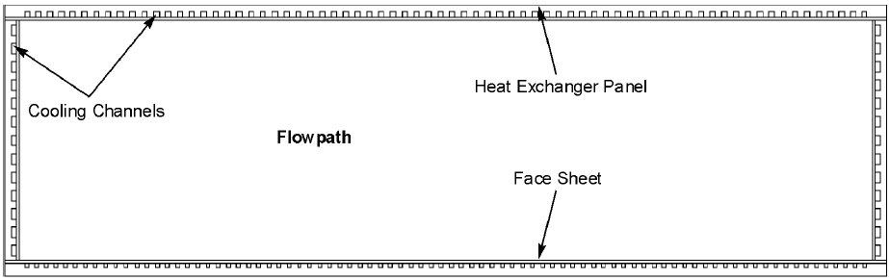
Introduction
Air-breathing hypersonic vehicles
Aerodynamic heat is proportional to square of flight speed
Wall temperature of combustion chamber up to 3000K
Hydrocarbon fuel
Used as both propellant and coolant
Coolant temperature up to 750℃
Thermophysical properties are necessary
Endothermic Chemical Reaction Pyrolysis
Cross section of the combustion chamber
Notes:
In the field of high temperature application, fluids are usually used as coolant to provide heat protection. Hydrocarbons used as propellant can also be used as coolant in aerospace craft. The figure in the lower right corner shows a combustion section of rocket. Hydrocarbon fuel pass through the minichannels distributed in the wall. Temperature increase to absorb the excess heat. In the air-breathing a hypersonic vehicles, the coolant temperature may go up to 750C. In order to design of the cooling structure and the investigation of heat transfer behaviour and thermal management system, thermophysical properties are necessary.

Slide 4
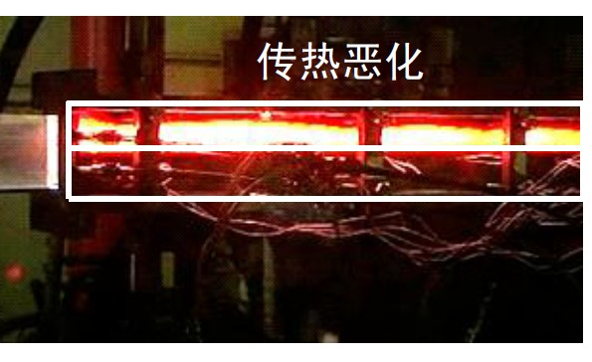
Introduction
Challenges in the design of cooling structures
Heat transfer deterioration in the heating plate with parallel multi-channels, due to the uneven flow rate distribution.
Coke deposits in the cooling passage, which affect the long-period flight safety.

Slide 5
Introduction
Challenges: lack of property data
Few literatures at temperatures above 473.15K (200℃)
From DECHEMA
1911 to 2010
211 literatures
Gas
Liquid
Most literatures
In all the 186 papers resulting in 1427 data points:
The vast majority (165 papers, 504 data points)
at atmospheric pressure around room temperature
Notes:
In this work, we focused on the viscosity of hydrocarbons. The left figure summarized the viscosity measurement of cyclohexane in the last 100 years. The point in the figure represents the highest measured temperature in the relevant literature. Most literatures concentrated on temperature around 300K. In near 200 papers, the vast majority only measured at atmosphere pressure around room temperature. Only a few literatures reported at temperatures above 400K. Therefore the high temperature viscosity measurement was meaningful. In this work, we will mainly measure the viscosity of hydrocarbons covering the whole liquid phase range below the saturation line. We can see there are big blank space here. It’s our job to fill it.

Slide 6
Introduction
Research interests：
1. Fluid flow characteristics
such as pressure drop characteristics, flow instabilities.
2. Heat transfer characteristics
such as supercritical heat transfer, effects of chemical reaction and coking on heat transfer, and heat transfer correlations.
3. Coking propensities
coking evaluation methods like hydraulic resistance, visualization method.
4. Thermal physical and chemical properties
such as heat sink, specific heat, density, viscosity, conductivity, critical parameters.

Slide 7
Outlines
Introduction
Test facilities
Results
Conclusions
Notes:
First is the motivation, and then I will introduce the method of two-capillary viscometer, next are the experimental set up and procedures. And the last are the results of cyclohexane and conclusions.

Slide 8
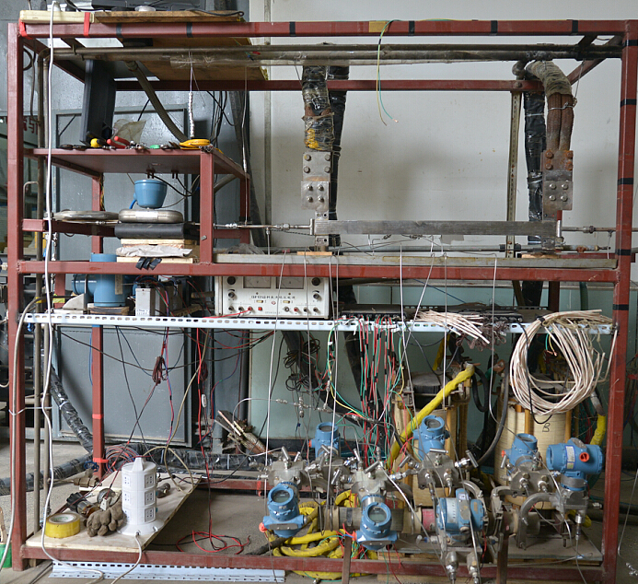
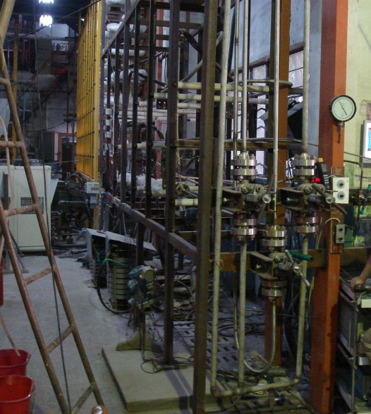
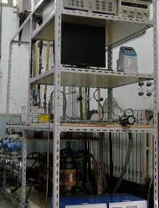
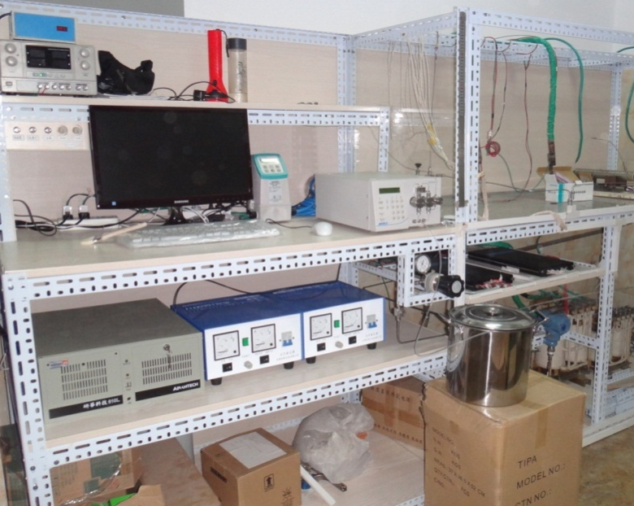
Test facilities
b
a
d
c
No. | Mass flow rate
a | ~ 278 g/s
b | ~ 56.7 g/s
c | ~ 6.67 g/s
d | 0.1~3.0 mL/min
Pressure：0.1~10 MPa
Fuel Tem：~750 °C
Wall Tem：~ 1000 °C
Heat flux：~3 MW/m²
Heating power: ~1.4MW
Notes:
掌握了吸热型碳氢燃料的高温超临界流动传热和阻力特性，研究范围覆盖单通道/多通道、层流/湍流、高密度液态/低密度气态/裂解态。

Slide 9
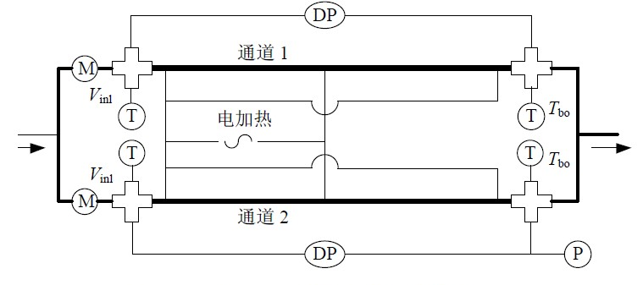



Test facilities
Test sections
Single channel
Parallel channels
Plates
with multi-channels

Slide 10
Outlines
Introduction
Test facilities
Results
Conclusions
Notes:
First is the motivation, and then I will introduce the method of two-capillary viscometer, next are the experimental set up and procedures. And the last are the results of cyclohexane and conclusions.

Slide 11
Fluid flow characteristics
Ledinegg instability
Two parallel channels is used to simulate the regeneratively cooled structure of hypersonic vehicles.
The ledinegg instability was found in the two-phase flow boiling system to explain the static flow excursion.
pressure drop vs. flow rate characteristic curves are modeled from the thermophysical properties of hydrocarbon fuel.

Slide 12
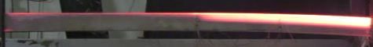
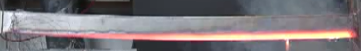
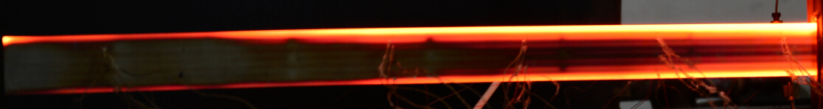
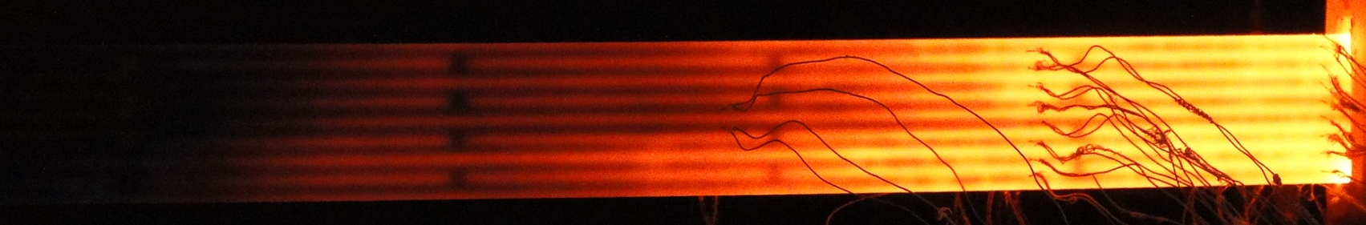
Fluid flow characteristics
Structure optimization

Slide 13
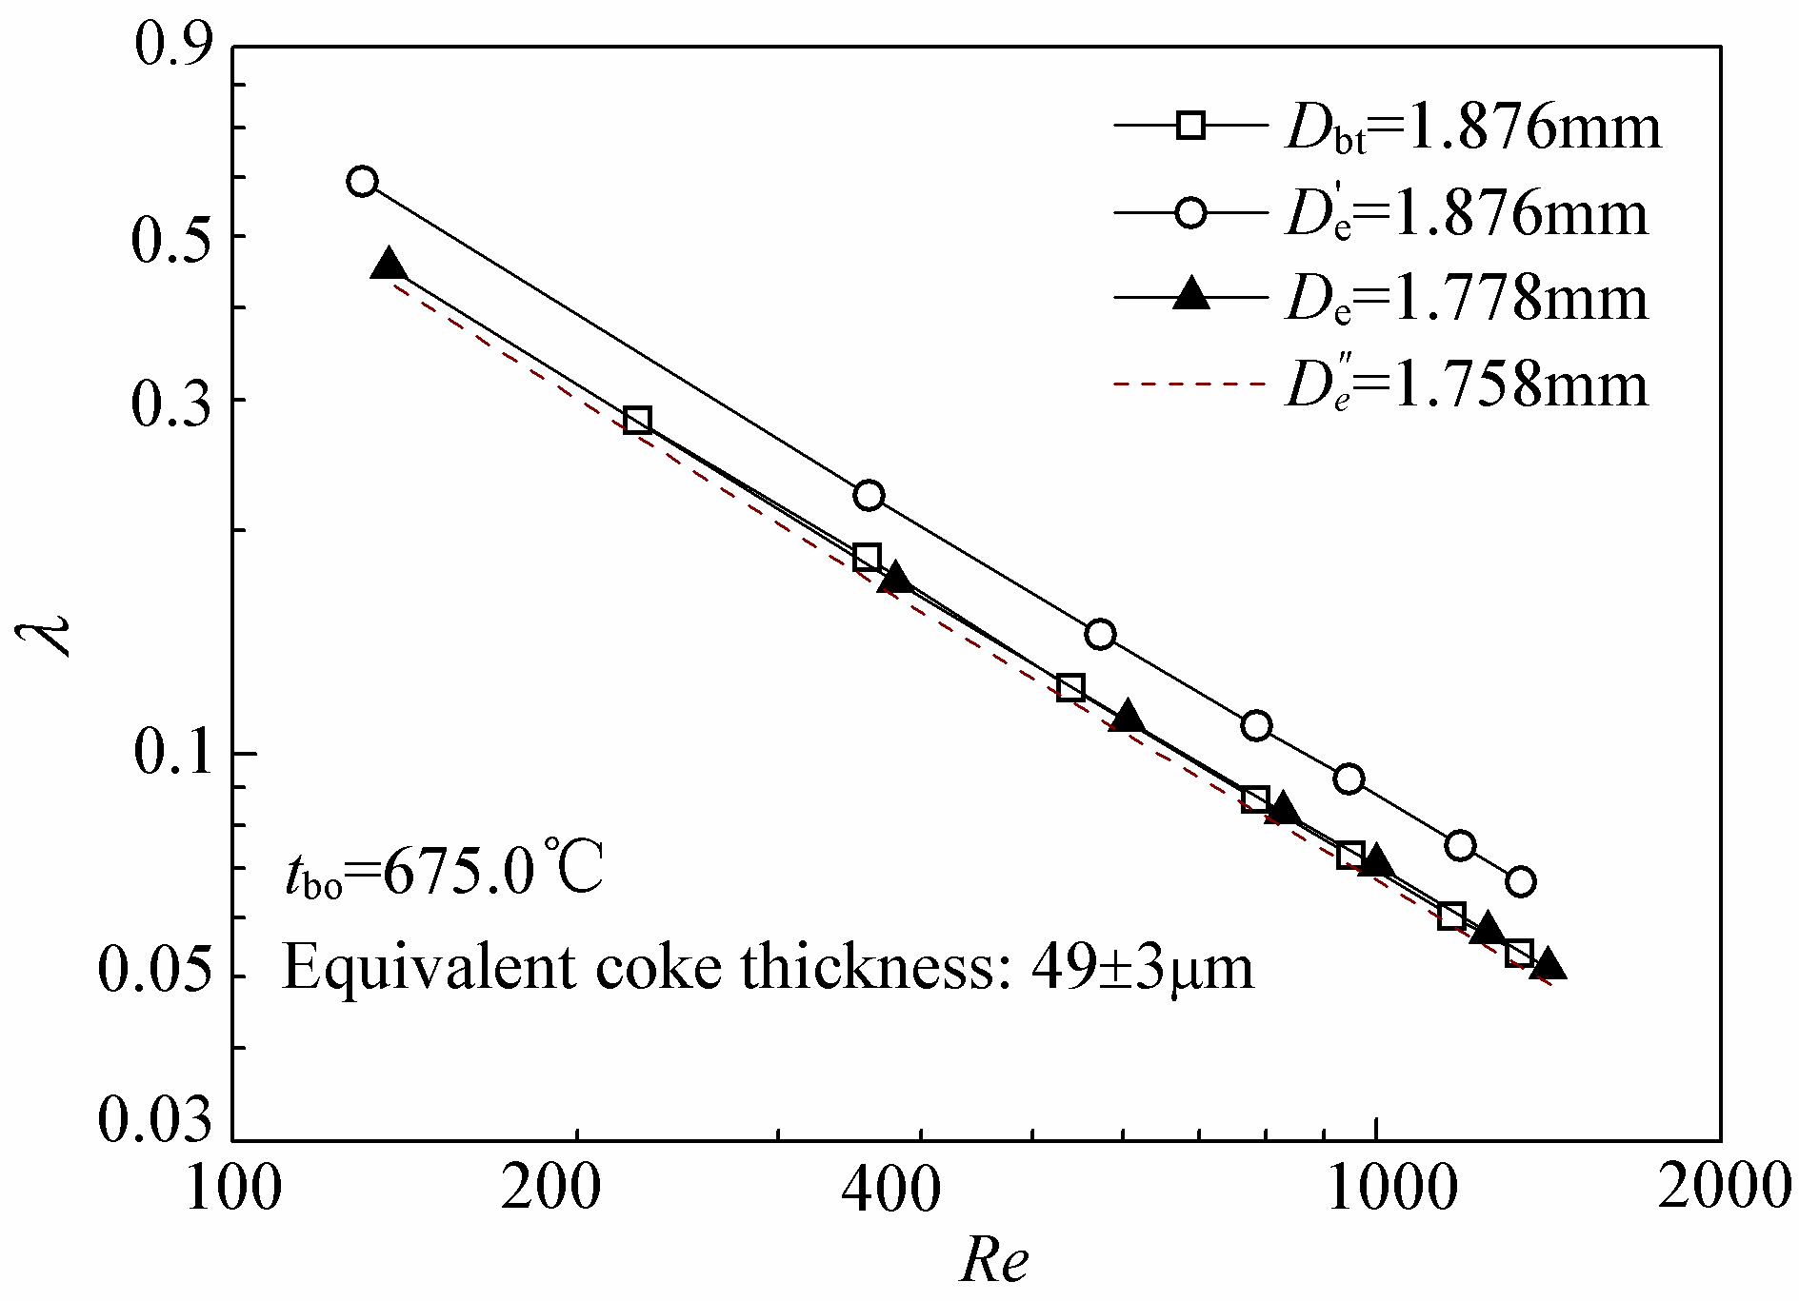
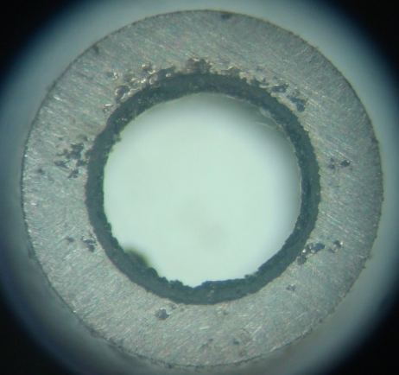


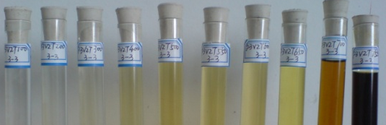
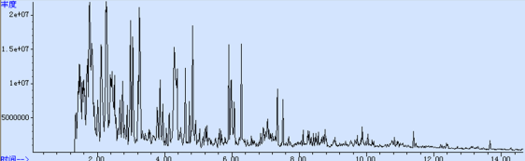
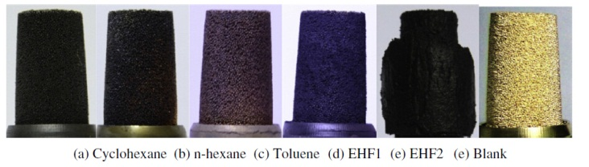
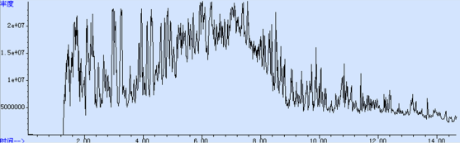
Coking propensities
Methods for coking and deposition evaluation
Qualitative methods | Quantitative methods | Feasibility testing
Hydraulic resistance | Visualization | Spray through nozzle
Liquid and solid products | Liquid and gas products

Slide 14
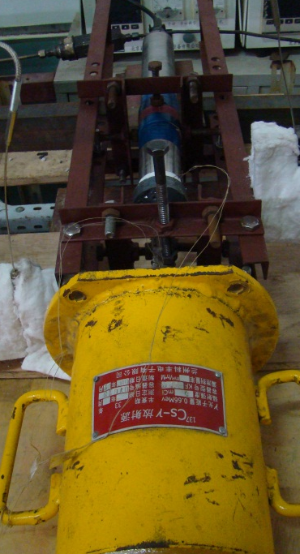
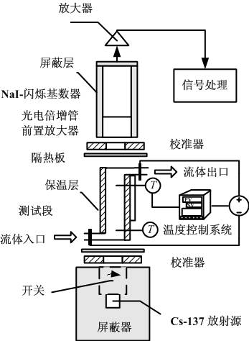
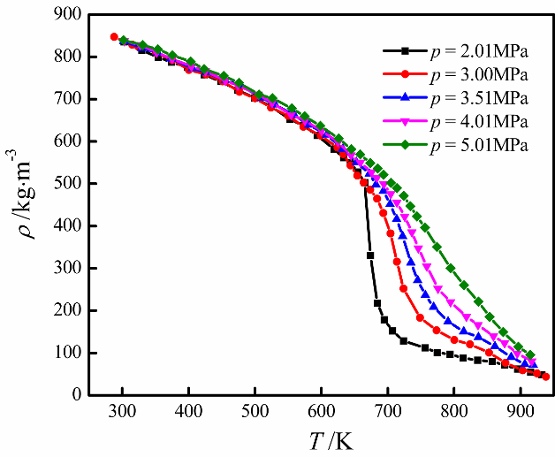
Density measurement by γ-ray densitometer
Gama-ray densitometer based on the source (Cs-137)，can realize the in-situ density measurement at high temperature and high pressure.
Temperature of 280-950K，pressure of 0.1-10MPa. Expanded relative uncertainty of (0.29-2.29)% in confidence of 95%。
Density of pure substances like cyclohexane, binary mixtures and hydrocarbon fuels were measured.
γ-ray densitometer
Experimental result of fuel density

Slide 15
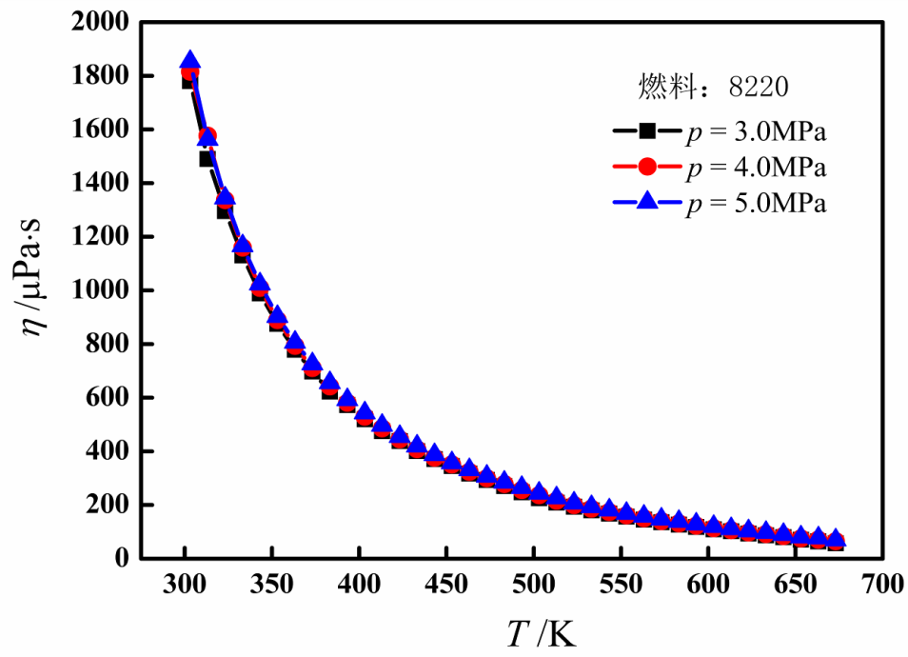
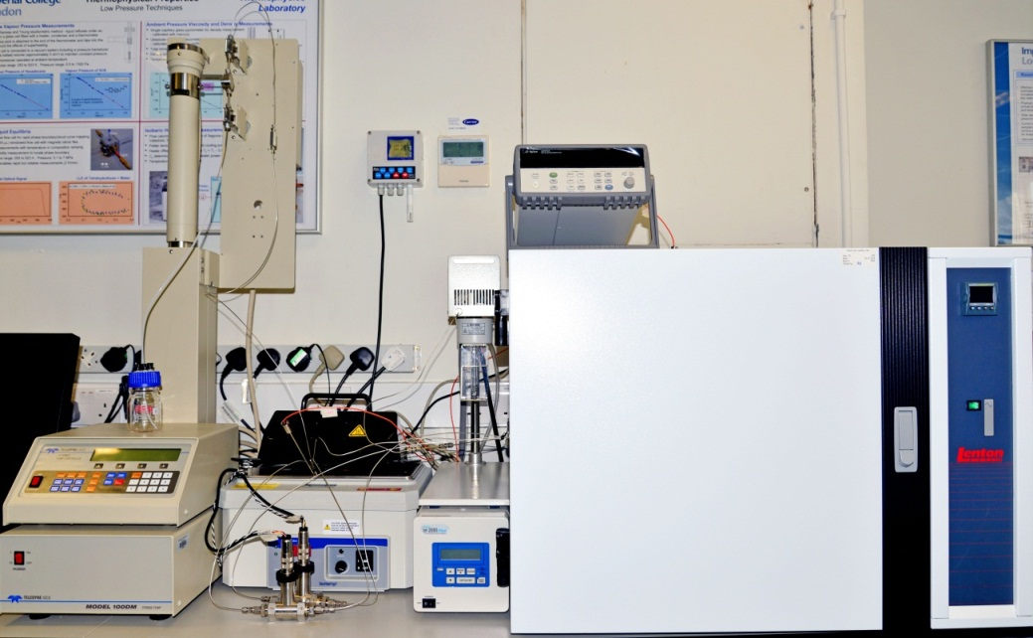
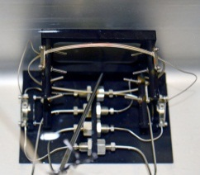
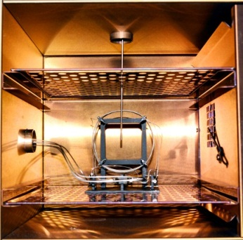
Viscosity measurement by capillary viscometer
Dual-capillary viscometer worked at temperatures up to 400 °C now， and was expected to operate at higher temperature conditions.
Temperatures of 303.2-673.2K，pressure of 0.1-10 MPa. Expanded relative uncertainty of 2.20-5.27% in confidence of 95%.
Viscosities of pure substance like cyclohexane, binary mixtures, and hydrocarbon fuel were measured.
Dual-capillary viscometer
Experimental result of fuel viscosity

Slide 16
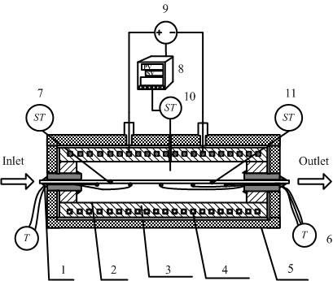
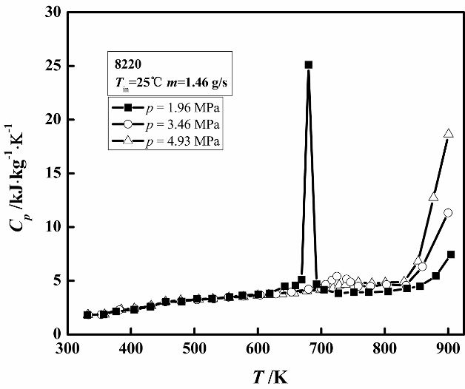
Heat capacity measurement by calorimeter
An calorimeter constructed to measure specific heat and heat sink
Temperatures ranging of 330-970 K, pressures of 0.1-10 MPa. Expanded relative uncertainty of 2.42-3.54% in confidence of 95%.
Heat capacity of pure substance like cyclohexane, binary mixtures, and hydrocarbon fuel were measured.
Calorimeter
Experimental result of heat capacity

Slide 17
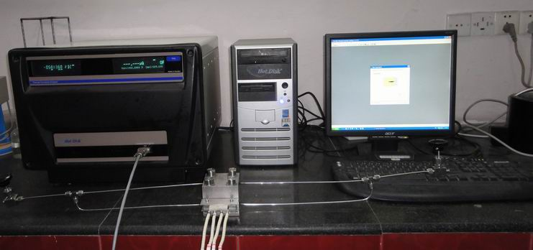
Thermal conductivity measurement
Based on transient hot-wire method, a thermal conductivity analyzer for hydrocarbon fuel was constructed.
Temperatures ranging of 330-773 K, pressures of 0.1-10 MPa. Expanded relative uncertainty of 5% in confidence of 95%.
Pure substance like cyclohexane, and hydrocarbon fuel were measured.
Hot disk TPS2500 thermal constant analyzer
Experimental result of cyclohexane

Slide 18
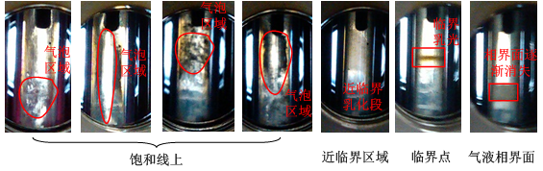
Critical parameters
Critical properties measured by critical opalescence phenomena.
Critical properties of cyclohexane
Results well agreed with the NIST values with errors not exceeding 0.95%；
Experimental results：3.03MPa，507.52K
NIST values：3.034MPa，507.82K

Slide 19
Most recent publications
Heat transfer characteristics
1. Zhaohui Liu, Qincheng Bi. Onset and departure of flow boiling heat trasnfer characteristics of cyclohexane in a horizontal minichannel. International Journal of Heat and Mass Transfer, 2015, 88: 398-405.
2. Zhaohui Liu, Qincheng Bi, Zhuqiang Yang,Yong Guo, Jianguo Yan. Critical heat flux of cyclohexane in uniformly heated minichannels with high inlet subcooling. Experimental Thermal and Fluid Science, 2015, 63: 106-114.
3. Yang ZQ, Bi QC, Liu ZH, et al. Heat transfer to supercritical pressure hydrocarbons flowing in a horizontal short tube[J]. Experimental Thermal and Fluid Science, 2015, 61:144-152.
4. Jianguo Yan, Qincheng Bi, Zhaohui Liu∗, Ge Zhu, Laizhong Cai. Subcooled ﬂow boiling heat transfer of water in a circular tube under high heat ﬂuxes and high mass ﬂuxes. Fusion Engineering and Design, 2015, http://dx.doi.org/10.1016/j.fusengdes.2015.07.007.
5. Zhaohui Liu, Qincheng Bi, Yong Guo, Jianguo Yan, Zhuqiang Yang. Convective heat transfer and pressure drop characteristics of near-critical-pressure hydrocarbon fuel in a mini-channel. Applied Thermal Engineering. 2013, 51: 1047-1054.
6. Zhaohui Liu, Qincheng Bi, Yong Guo, Qianhua Su. Heat transfer characteristics during subcooled flow boiling of a kerosene kind hydrocarbon fuel in a 1mm diameter channel. International Journal of Heat and Mass Transfer, 2012, 55: 4987-4955.

Slide 20
Most recent publications
Thermal physical properties
1. Zhaohui Liu, J P Martin Trusler, Qincheng Bi. Viscosities of liquid cyclohexane and decane at temperatures between (303 and 598) K and pressures up to 4 MPa measured in a dual-capillary viscometer. Journal of Chemical Engineering & Data, 2015, 60: 2363-2370.
2. Zhuqiang Yang, Zhaohui Liu*, Qincheng Bi, Yong Guo, Jianguo Yan, Song Feng, and Hui Pan. Design of a Flow Calorimeter for Hydrocarbon Fuel at Temperatures from (330 to 900) K and Pressures up to 6.0 MPa. Journal of Chemical Engineering & Data, 2015, 60, 1434−1439.
3. Zhuqiang Yang, Zhaohui Liu∗, Qincheng Bi, Song Feng, Hui Pan, Yong Guo. Viscosity measurements of hydrocarbon fuel at temperatures from (303.2 to 513.2) K and pressures up to 5.1 MPa using a two-capillary viscometer. Thermochimica Acta, 2015, 617: 1–7.
4. Zhuqiang Yang, Qincheng Bi,* Yong Guo, Zhaohui Liu, Jianguo Yan, and Qiang Zhang. Design of a Gamma Densitometer for Hydrocarbon Fuel at High Temperature and Supercritical Pressure. Journal of Chemical Engineering & Data 2014, 59, 3335−3343

Slide 21
Most recent publications
Coking characteristics
1. Zhaohui Liu, Qincheng Bi, Jiangtao Feng. Evaluation of heat sink capability and deposition propensity of supercritical endothermic fuels in a minichannel. Fuel, 2015, 158: 388-398.
2. Zhaohui Liu, Hui Pan, Song Feng, Qincheng Bi. Dynamic behaviors of coking process during pyrolysis of China aviation kerosene RP-3. Applied Thermal Engineering 2015, 91: 408-416.
3. Zhaohui Liu, Qincheng Bi, Yong Guo, Xuesong Ma, Zhuqiang Yang, Jianguo Yan, Shenlin Hu. Hydraulic and thermal effects of coke deposition during pyrolysis of hydrocarbon fuel in a mini-channel. Energy & Fuels, 2012, 26: 3672-3679.

Slide 22
Conclusions
Our lab has a experimental capacity of heating power up to 1.4 MW, flow rate from 0.1mL/min to 4t/h with mini-scale to conventional scale test facilities.
Flow and heat transfer of supercritical fluids, coking and deposition, thermal physical properties have been widely investigated in our lab at fluid temperatures up to 800 °C, wall temperatures up to 1000 °C and pressures up to 37 MPa.
We accumulated numerous experiences for the measurement of thermal physical properties like density, heat capacity, viscosity, thermal conductivity, critical properties at temperatures up to 750 °C and pressures up to 10MPa.

Slide 23
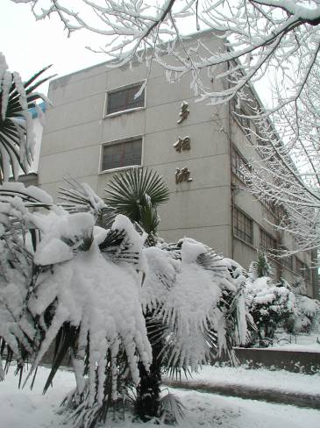
Thanks for your attention!

