Slide 1



Prevalence and risk factors for self-reported sexually transmitted infections among adults in the Diepsloot informal settlement, Johannesburg, South Africa.
Basera T ^{1,5} Takuva S^{2,3} Muloongo K⁴ Tshuma N⁴ Nyasulu P^{1, 5}
¹ Monash University, Department of Public Health, ²Perinatal HIV Research Unit, Department of Internal Medicine, University of the Witwatersrand, ³Centre for HIV and Sexually Transmitted Infections, National Institute for Communicable Diseases ⁴Community AIDS Response, ⁵School of Public Health, Faculty of Health Sciences, University of the Witwatersrand,

Slide 2
Background
South Africa has the fourth highest prevalence of HIV/AIDS.
HIV prevalence of 18.8% in the 15–49 year age-group; 30% among antenatal women.
Estimated prevalence of HIV in Gauteng is 16.5%
Significant variation in risk of HIV infection between males and females with females being 1.6 times more likely to be HIV positive (p<0.001)
Wide variation in prevalence of HSV-2 among HIV+ve & HIV-ve women (89.1% vs 42.5)
STIs are among the key drivers of HIV in this population
Shisana, O, Rehle, T, Simbayi LC, et al.(2014). ) South African National HIV Prevalence, Incidence and Behaviour Survey, 2012. Cape Town, HSRC Press; UNAIDS, Report on the Global AIDS Epidemic, 2010 ;
NDOH, 2012. The National Antenatal HIV & HSV-2 prevalence survey in SA.

Slide 3


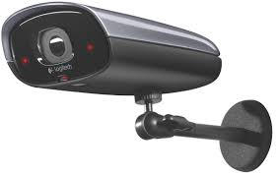

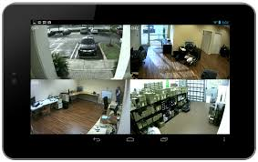
STI Surveillance

Slide 4
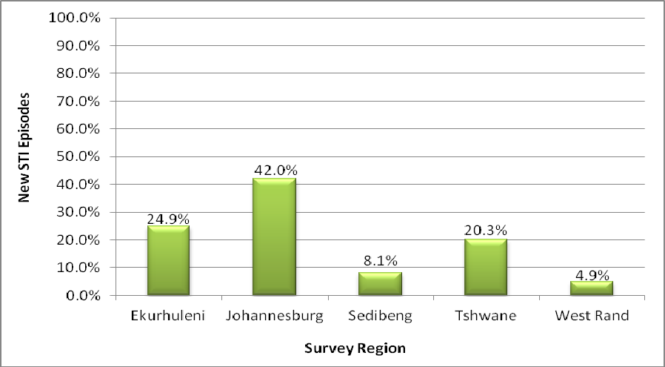
New STI syndrome episodes per surveillance region in Gauteng Province, 01 January to 31 December 2012

Slide 5

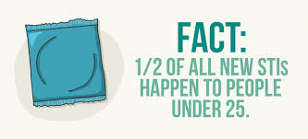
Why STIs matter
Increase the acquisition and transmission of HIV
Treating STIs early:
–Maintains mucosal integrity
–Less mucosal inflammation
–Lowers risk of viral load in HIV positives

Slide 6
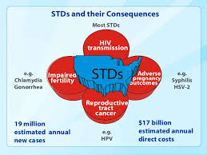

Slide 7



Asymptomatic STIs
Just because you cant see it doesn’t mean its not there

Slide 8
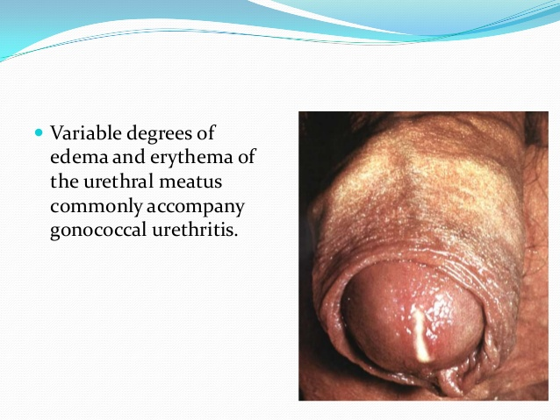
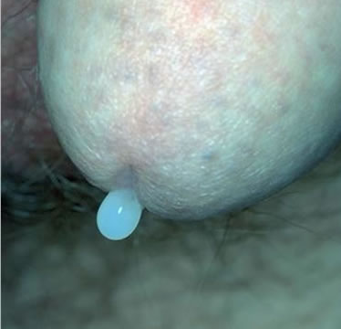
Gonococcal & Non-Gonococcal Urethritis

Slide 9
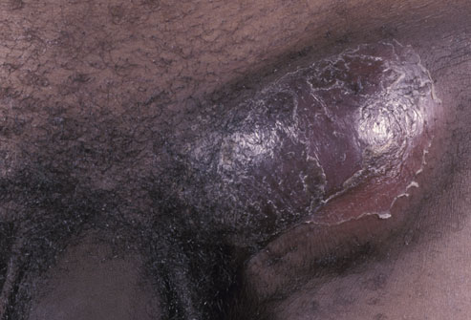
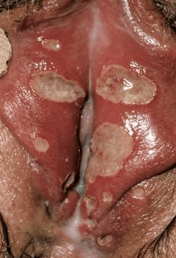
Genital Ulcer Diseases
LGV (Lymphogranuloma Venereum)
Chancroid

Slide 10
Aim
To estimate the prevalence of self-reported STIs among adults in Diepsloot informal settlement, Johannesburg, South Africa.
To determine the risk factors of self-reported STIs among adults in Diepsloot informal settlement, Johannesburg, South Africa.

Slide 11
Methods
Secondary analysis of data collected in a survey among adults living in Diepsloot in 2013 Da
Data from 3953participants were analysed
Explored factors that could potentially be associated with self-reported STIs
Used univariable and multivariable logistic regression models to identify risk factors
Effect Measures were reported as Odds Ratios with corresponding (95% CI).
pvalue <0.05 determined statistically significant factors
.

Slide 12
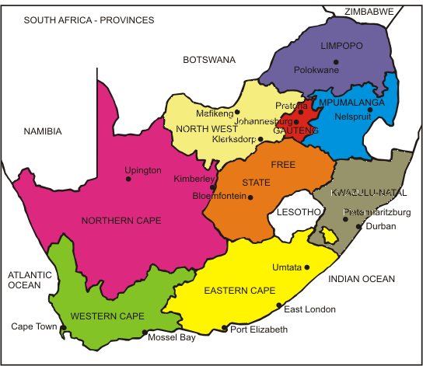
Study site
Republic of South Africa
Gauteng Province
Surveillance sites
Estimated population size: 12 272 263; 16.5% HIV infected

Slide 13
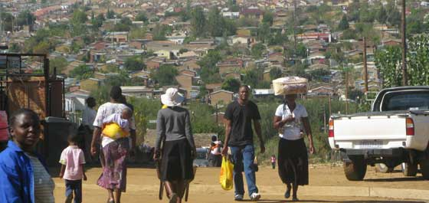
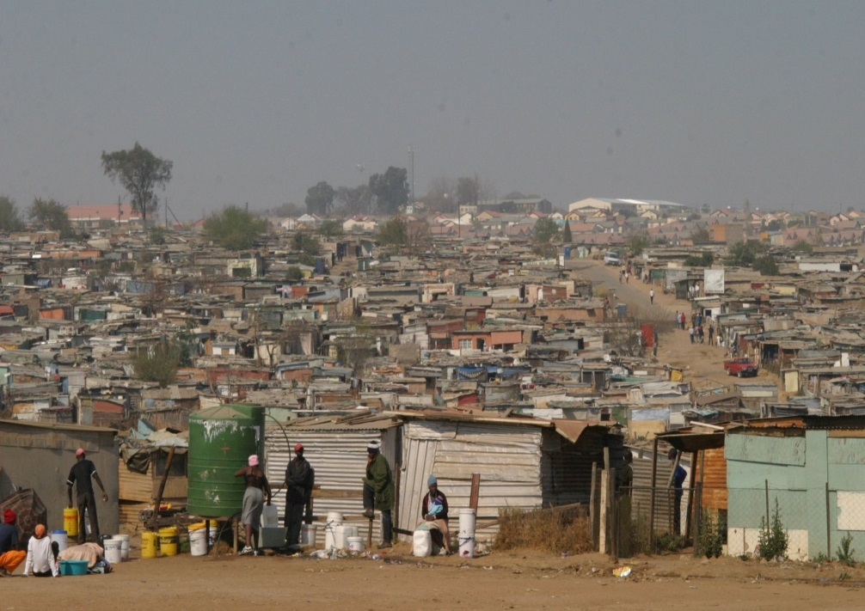
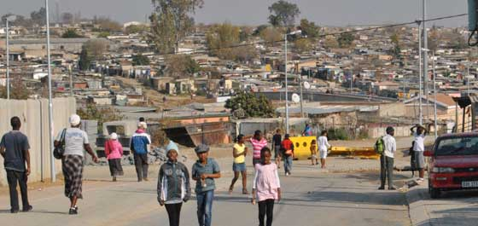
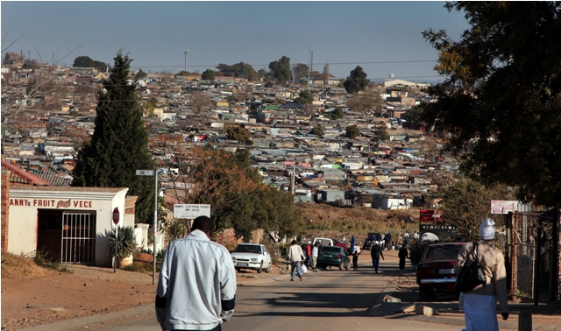
Diepsloot Informal Settlement

Slide 14
Results
Of the 3953 participants, 2481 (62.8%) were female
Self-reported prevalence of STIs was 20.4% (n=808)
Of the study participants, 815 (25.9%) people were HIV positive
Among those with HIV infection 19.9% reported an STI

Slide 15
Factors associated with self-reported STIs
 |  | Univariate Analysis |  | Multivariable Analysis
Characteristic | Self-reported STI | Odds Ratio (95% CI) | p-value | Odds Ratio (95% CI) | p-value
Sex
Male | 310/1472(21.1) | 1 |  | - | -
Female | 498/2481(20.1) | 0.96(0.80-1.10) | 0.46 | - | -
Age
20-29 | 373/1873(19.9) | 1 |  | -
30-39 | 287/1345(21.3) | 1.09(0.92-1.30) | 0.32 | - | -
40+ | 148/735(20.1) | 1.01(0.82-1.25) | 0.90 | - | -
Marital status
Married | 155/837(18.5) | 1 |  | 1
Single | 180/738(24.4) | 1.42(1.11-1.81) | 0.01 | 1.82(1.08-3.05) | 0.02
Cohabiting | 473/2378(19.9) | 1.09(0.89-1.34) | 0.39 | 1.39(0.90-2.15) | 0.14
Employment status
Unemployed | 634/3235(19.6) | 1 |  | 1
Employed | 174/718(24.2) | 1.31(1.08-1.59) | 0.01 | 1.36(0.89-2.06) | 0.15
Alcohol use
Yes | 534/2728(19.6) | 1 |  | 1
No | 274/1225(22.4) | 0.84(0.72-1.00) | 0.04 | 1.50(1.04-2.16) | 0.03
Victim of GBV/sexual assault
Not a victim | 717/3701(19.4) | 1 |  | 1
Victim | 89/252(35.3) | 2.26(1.73-2.97) | <0.0001 | 2.25(1.39-3.63) | 0.001
Health care visits
At least once a month | 229/1160(19.7) | 1 |  | 1
At least once a year | 369/1980(18.6) | 0.93(0.78-1.12) | 0.45 | 1.43(0.96-2.13) | 0.08
Never in past 2 years | 210/813(25.8) | 1.42(1.14-1.75) | 0.001 | 2.30(1.44-3.68) | 0.001
HIV status |  |  |  |  | -
Positive | 162/815(19.9) | 1 |  | 1
Negative | 646/3138 | 1.04(0.86-1.22) | 0.66 | 0.26(0.14-0.50) | <0.0001

Slide 16
Key findings
STIs were a common occurrence in Diepsloot informal settlement, Johannesburg, South Africa.
Factors such as:
being single
HIV status,
alcohol use,
prior exposure to gender based violence/sexual assault,
having not utilised healthcare services in the past 2 years
Significantly associated with self-reported STIs.

Slide 17
Conclusion
The reported prevalence of self-reported STIs among adults aged 20 to 82 years in Diepsloot, indicates a substantial burden of STIs in this population.
Drivers of STI in this population i.e. gender based violence, alcohol, lack of access to health care services needs an effective impact mitigation from all stakeholders.

Slide 18

Aggression and team work achieves success!!
New Zealand welcomed visitors off the pitch, but on the pitch it was war

Slide 19

Recommendations
Continued STI surveillance to monitor trends
Integrate sexual health, and health promotion to improve health seeking behaviour
Enhance HCT as well as screening of STIs of the at risk populations
Scale up behavioural interventions to prevent gender based violence
Policy on alcohol restriction in the Gauteng province.

Slide 20

There is power in unity and togetherness!!

Slide 21
Acknowledgements
Monash South Africa for sponsoring the conference attendance
Community AIDS Response (CARe) for conducting the STI survey
All participants in Diepsloot for taking part in the survey

Slide 22


Welcome to JOZI, the Beautiful City!!, South Africa

Slide 23
Thank you!!!!!

