Slide 1
Potential role of cytochrome P450s in mediating the effects of alcohol on HIV pathogenesis
P.S.Shantanu Rao, Ph.D.
Pharmaceutical Sciences
College of Pharmacy
University of Tennessee Health Science Center
Memphis, TN

Slide 2
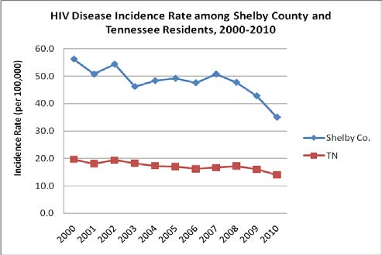
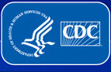
RATES OF HIV DIAGNOSES PER 100,000 POPULATION
~21,400 Tennesseans with HIV/AIDS.
10th in the country in the rate of new HIV infections.
5th in the country in the rate of HIV/AIDS deaths.
Memphis among the top 10 cities for HIV infection rates.
Shelby county
report, 2013

Slide 3
Alcohol use amongst HIV-infected population
Prevalence of mild-to-moderate alcoholic (7-14 drinks/week for Men and 4-7 drinks/week for Women): 3-fold (50-60%) higher in HIV-infected population
Alcohol
↑ HIV-1 infection
↑ AIDS and neuroAIDS
↑ Neuronal damage and neuropsychological impairments
↑ Mortality risk of AIDS and other diseases

Slide 4
Effects of alcohol on HIV-1 infection
↑ Oxidative stress
↓ Response to antiretroviral therapy (ART)
↑ Viral replication
↓ Immune function
↑ CNS barrier permeability
CYTOCHROME P450 (CYP)?

Slide 5
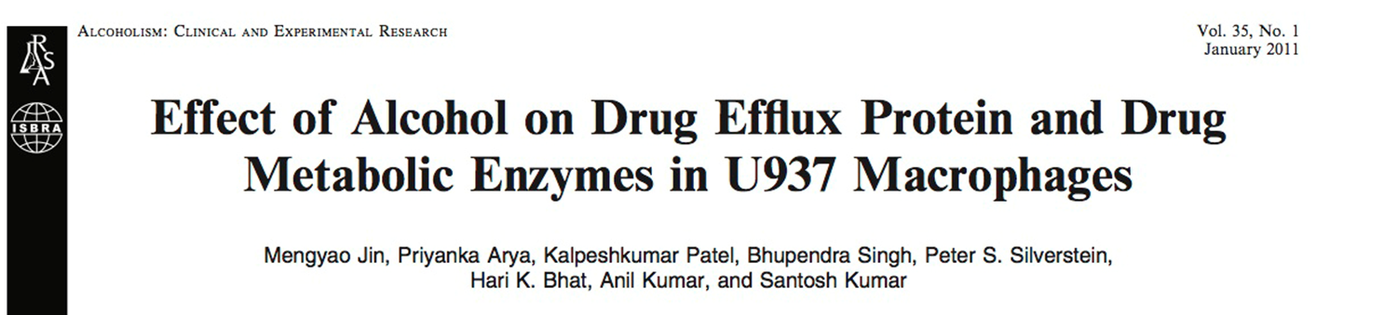
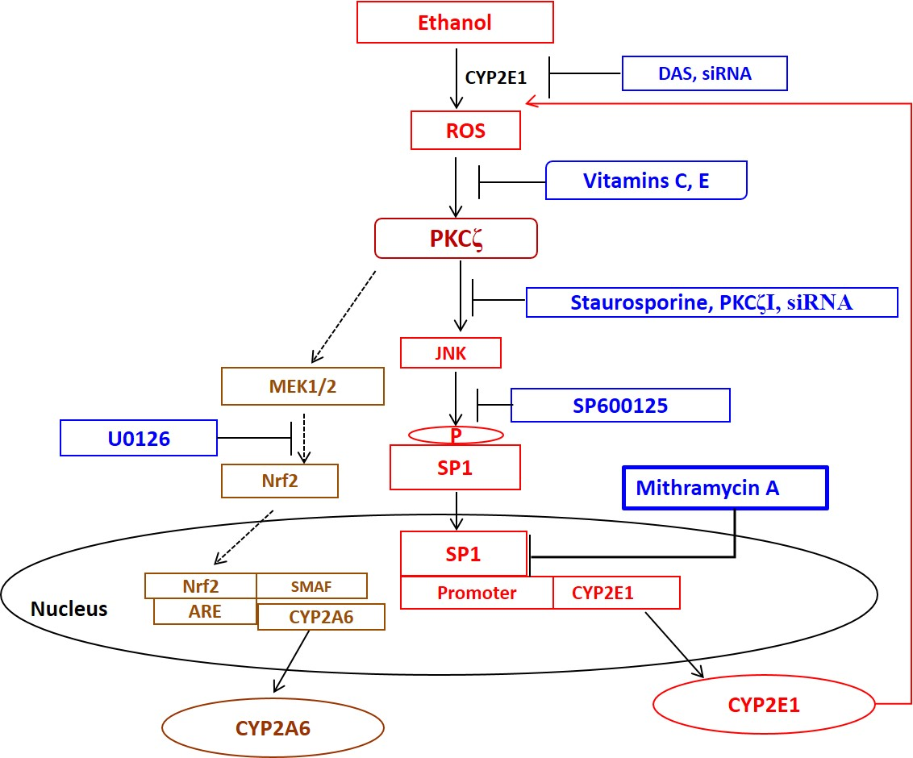
Alcohol induces CYP2A6, CYP2E1, CYP3A4.
Alcohol produces reactive oxygen species (ROS).
Alcohol induces anti-oxidants: SOD1, catalase.

Slide 6
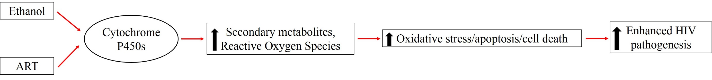
Hypothesis
In vitro: U937 monocytic cells
In vitro: Primary HIV-infected macrophages
In vitro: ART metabolism: Effects of ethanol
Ex vivo: Human monocytes/macrophages
Model:

Slide 7
Experimental Design
Day 1
Day 5
Day 9
Day 13
Every 12h; 0.5mL fresh media
Every 12h; 0.5mL fresh media
Every 12h; 0.5mL fresh media
U937 cells
(0.2*10⁶/mL)
Collect and Replate
(0.2*10⁶/mL)
Collect and Replate
(0.2*10⁶/mL)
Collect cells
Ethanol: 50 mM
ART: Darunavir (Dar) 4µM and Ritonavir (1µM)

Slide 8
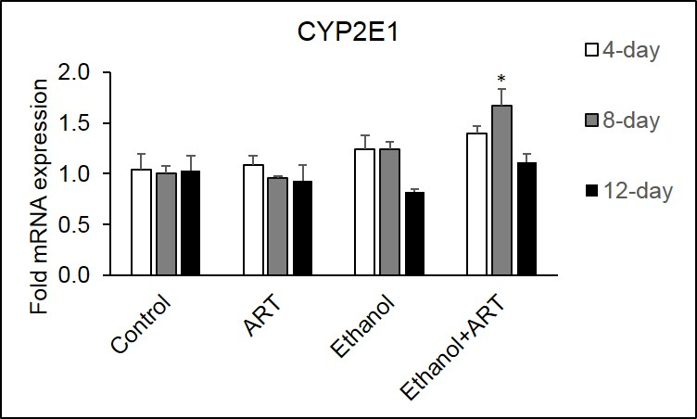
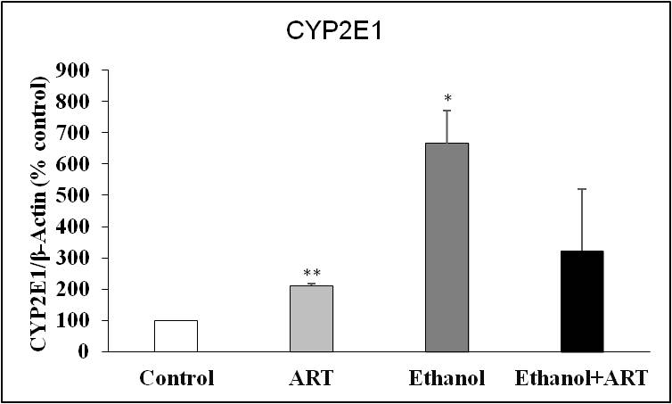
Results: Expression of ethanol metabolizing enzyme
CYP2E1
β-ACTIN

Slide 9
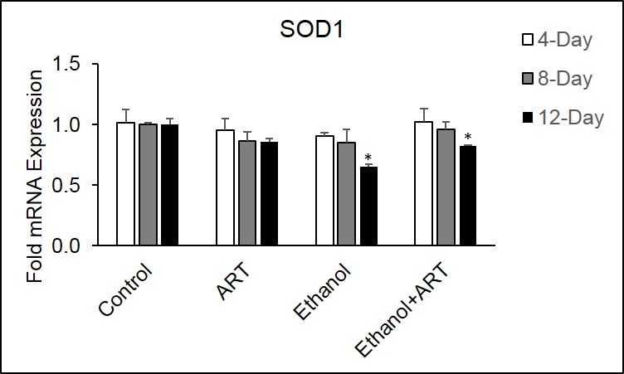
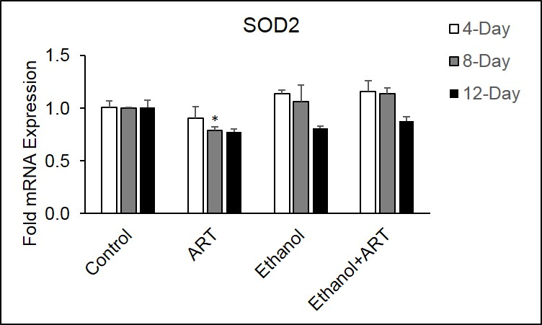



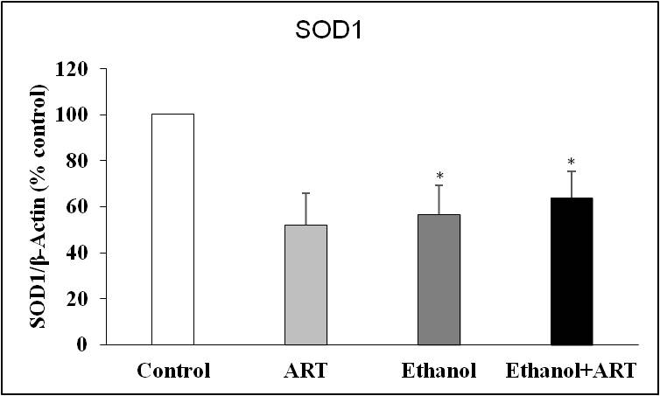
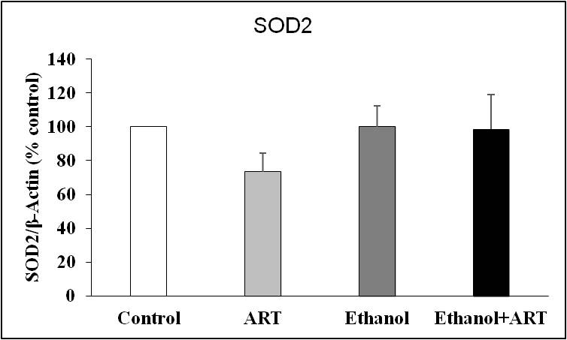
Expression of major AOEs
SOD1
SOD2
β-ACTIN
β-ACTIN

Slide 10
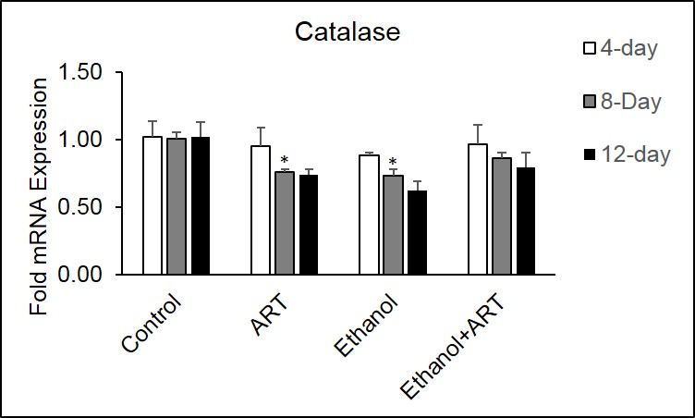
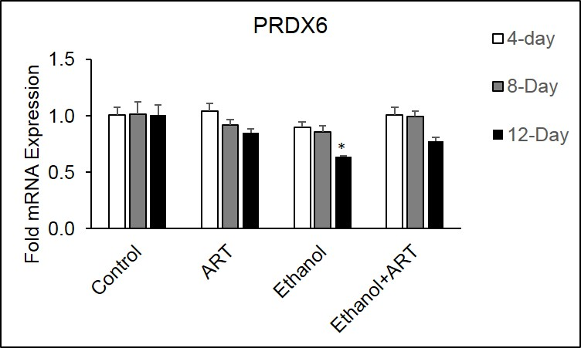
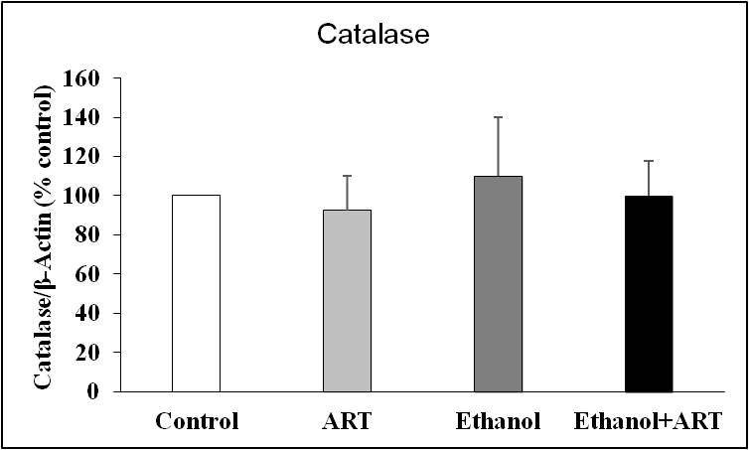
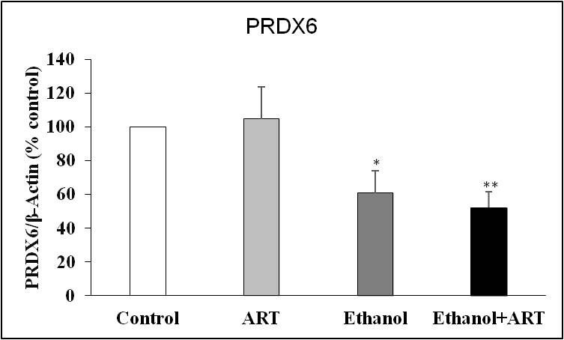
Expression of major AOEs
Catalase
PRDX6
β-ACTIN
β-ACTIN

Slide 11
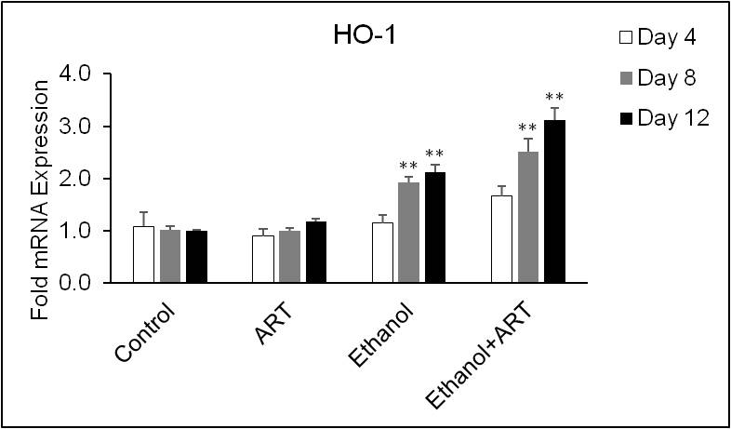
Transcription of HO-1
Inducible heme degrading enzyme in cells
Stress response protein induced under oxidative stress
Reported to play a critical role in cellular protection

Slide 12
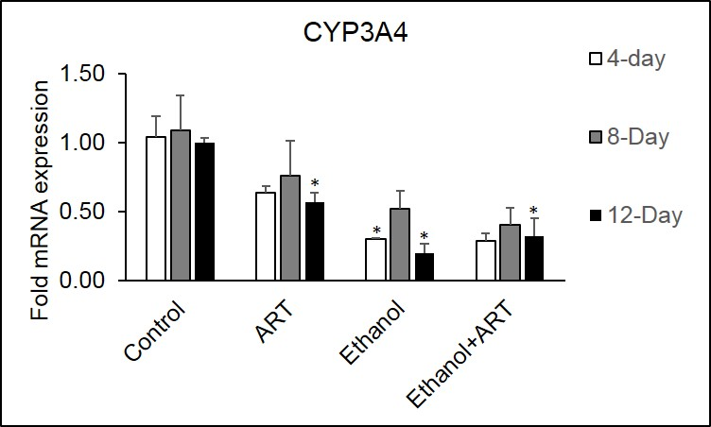

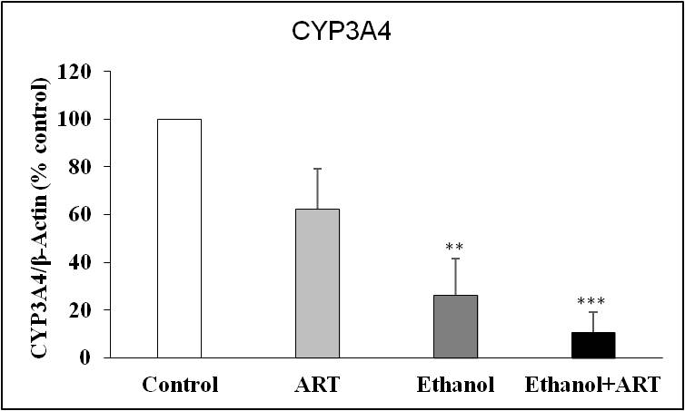
Expression of major ART metabolizing enzyme
CYP3A4
β-ACTIN
Major ART metabolizing enzyme in U937 cells.

Slide 13
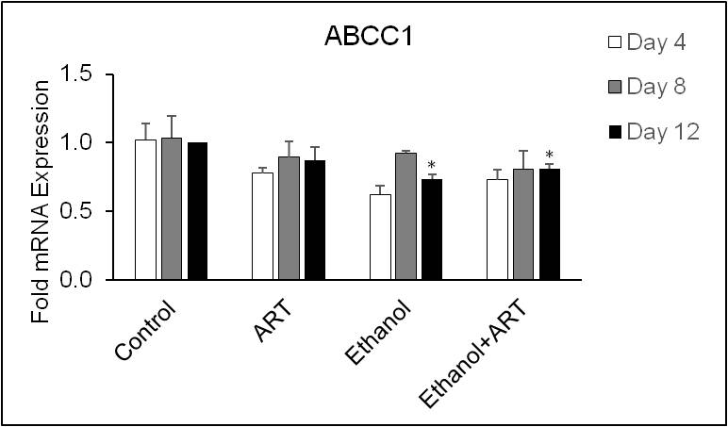
Transcription of major drug efflux transporter
Major drug efflux transporter expressed in U937 cells.

Slide 14
Results so far suggest---
CYP2E1
AOEs
Increase ROS/oxidative stress/cell death
CYP3A4
ABCC1
Increase drug accumulation/toxicity/cell death
ROS/Cell death?

Slide 15
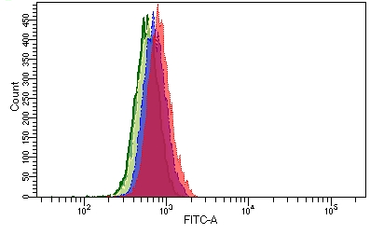
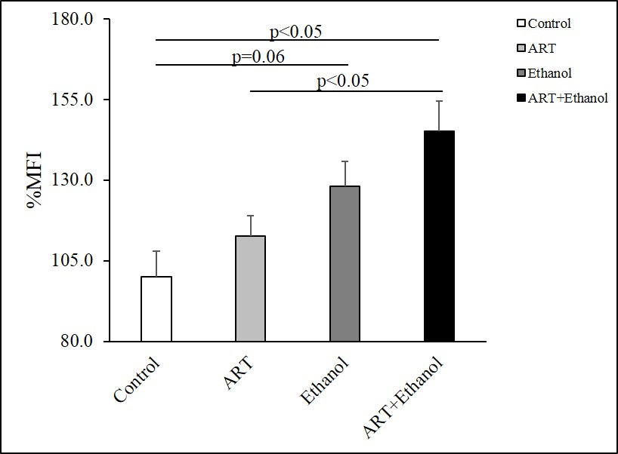

ROS measurement

Slide 16
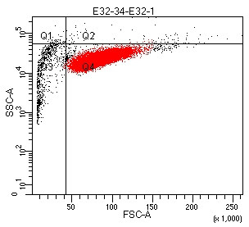
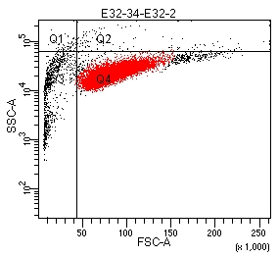
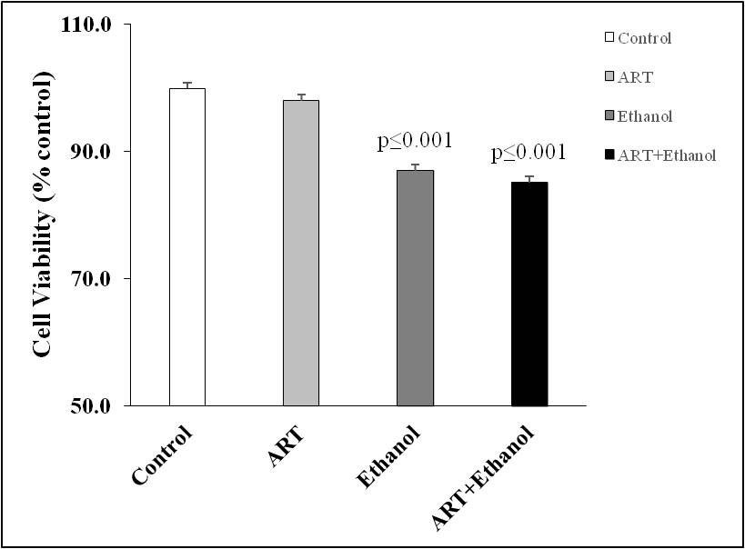
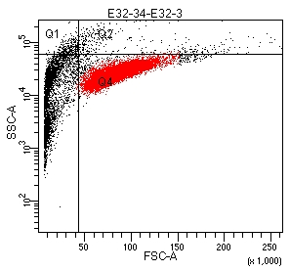
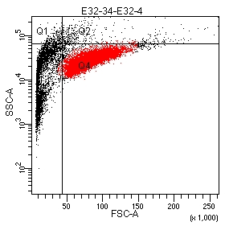
Cell viability (FACS)

Slide 17
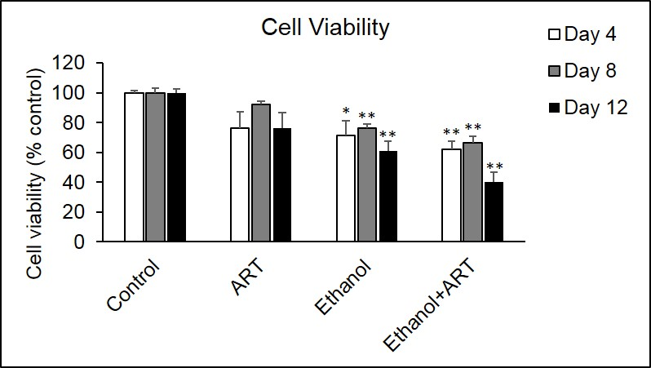
Cell viability (XTT)

Slide 18
U937 microscopic image (10x)
Control
ART
Ethanol
Ethanol+ART
Day 0
Day 5

Slide 19
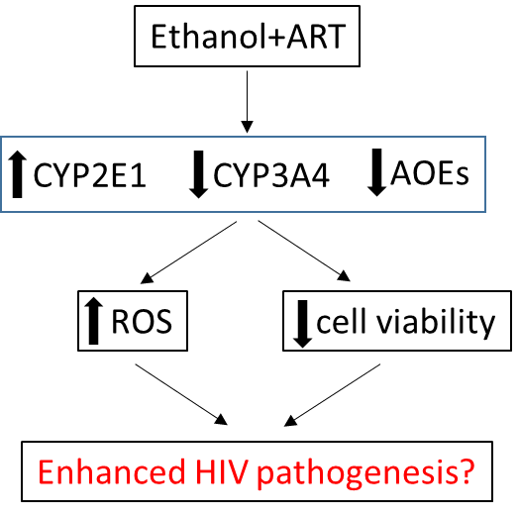
Rationalized effects of chronic ethanol+ART on HIV pathogenesis

Slide 20
Hypothesis
In vitro: U937 monocytic cells
In vitro: Primary HIV-infected macrophages
In vitro: ART metabolism: Effects of ethanol
Ex vivo: Human monocytes/macrophages
Model:

Slide 21
Experimental design
Collect PBMCs
(buffy coat)
Macrophage
differentiation
mCSF (50 ng/ml)
7-10 days
HIV-Ada strain
20ng/10*10⁶ cells
Collect, infect, and plate
(1.5-2.5*10⁶/well)
Monitor p24 titer
7-10 days
Control
Ethanol
20 mM ethanol
14 days
0.5 ml fresh media
each day
Collect RNA/Protein

Slide 22
Effect of chronic ethanol on p24 production
*

Slide 23



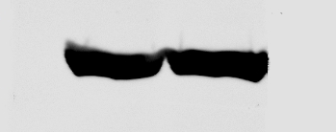




CYP2E1
CYP3A4
Catalase
β-Actin
β-Actin
β-Actin
PRDX6
SOD1
SOD2
β-Actin
β-Actin
β-Actin

Slide 24
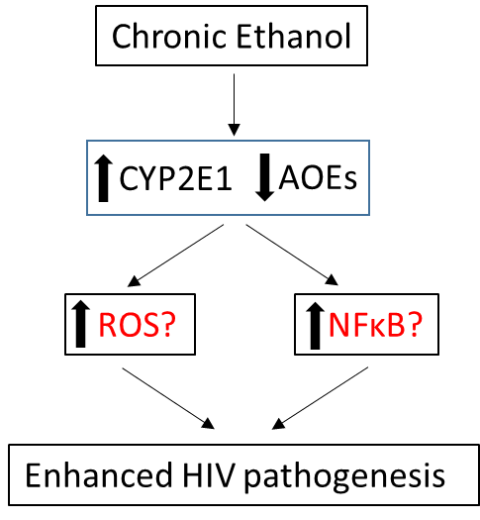
Possible cellular pathways mediating the effects of chronic alcohol

Slide 25
Hypothesis
In vitro: U937 monocytic cells
In vitro: Primary HIV-infected macrophages
In vitro: ART metabolism: Effects of ethanol (on-going)
Ex vivo: Human monocytes/macrophages
Model:

Slide 26
Experimental design
Recruited patients
Mild-to-moderate
Alcohol user
Non-smokers
Non ART/infectious diseases
Alcohol Users
N=6
HIV+alcohol Users
N=4
Collect Plasma and Monocytes
Collect RNA/DNA/Protein

Slide 27
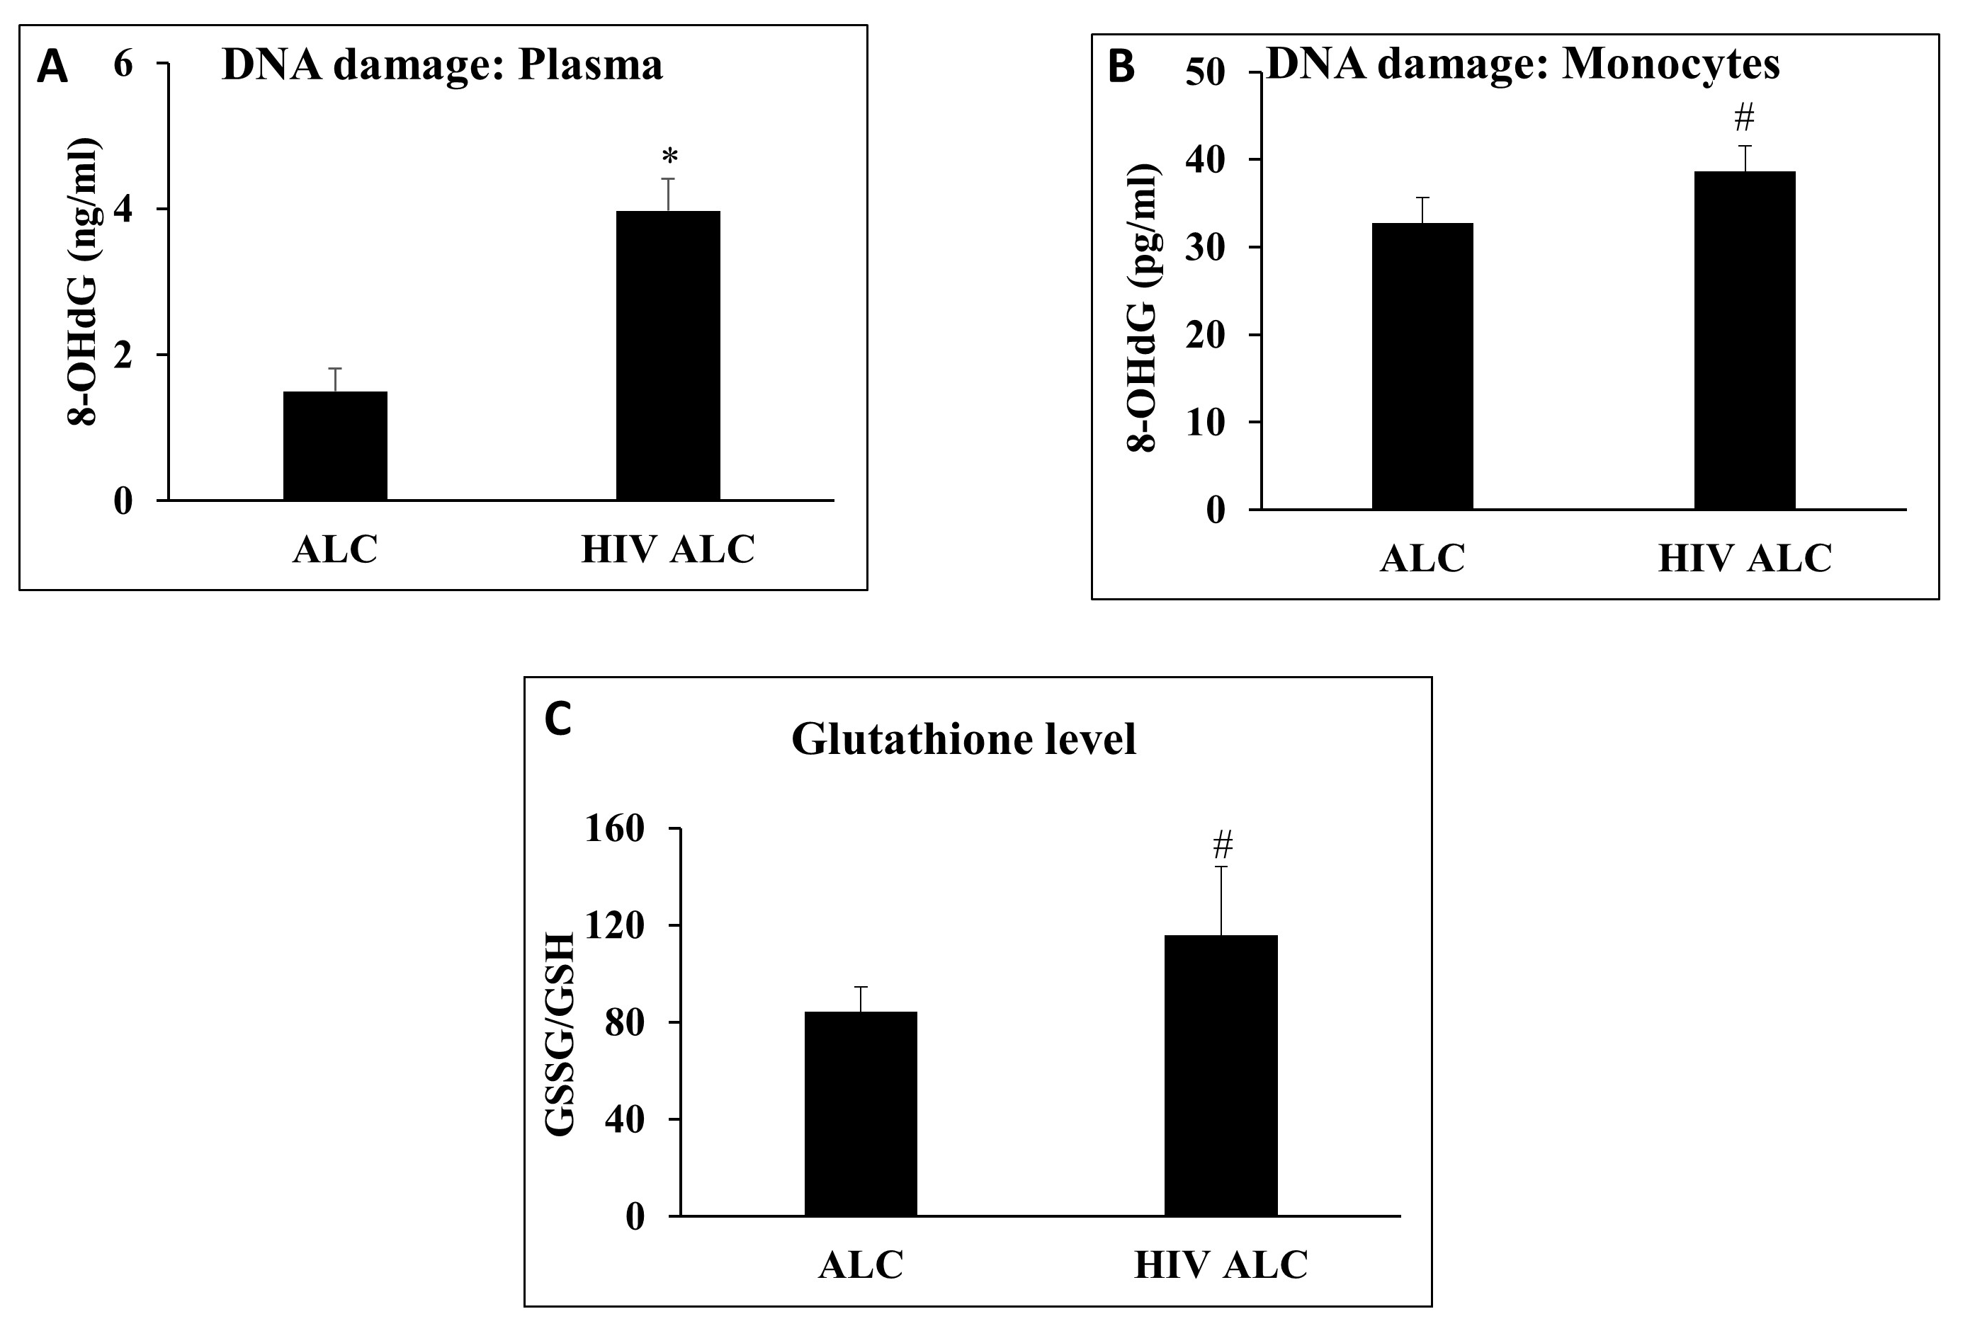
Oxidative stress parameters

Slide 28
Relative alcohol metabolism

Slide 29
Antioxidant enzymes - expression in monocytes

Slide 30
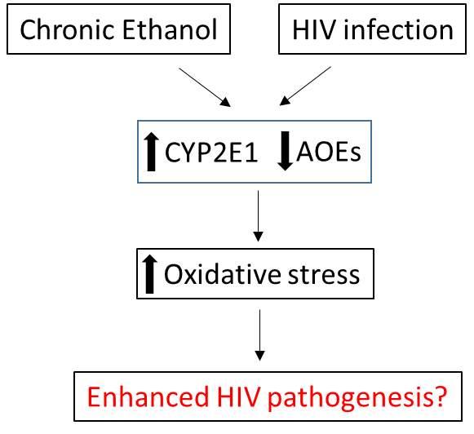
Observed interactions between alcohol intake and HIV infection

Slide 31
Conclusions
In vitro studies
Chronic ethanol and/or ART treatment significantly alter the expression of CYPs and AOEs.
These changes were associated with enhanced production of reactive oxygen species and decreased cell viability.
HIV replication in primary MDM is enhanced following chronic ethanol treatment.
Preliminary data suggests associated changes in expression of CYPs and AOEs.
Ex vivo study
Alcohol use amongst HIV infected patients was associated with enhanced oxidative stress compared to non-infected alcohol users.
Overall, chronic ethanol mediated changes in CYPs and AOEs are rationalized for the enhancement in HIV replication.

Slide 32
Acknowledgement
Dr. Santosh Kumar (PI)
Kumar research group
College of pharmacy, UTHSC
NIH - AA022063-01A1 and DA031616
Thank you for your attention!!!

Slide 34
Ethanol metabolism
CYP3A4 and CYP1A2 (minor role)
CYP2E1 (Induction by ethanol): Brain, Hearth, Lungs, Macrophages
ADH/ALDH: primarily in Liver
The Km of CYP2E1 for alcohol is 10 mM ,10-fold higher than the Km of ADH for ethanol
Samir Zakhari, Overview: How Is Alcohol Metabolized by the Body? NIAAA publication

Slide 35
Ethanol 50mM
Methods: “via an indwelling intragastric catheter to achieve an alcohol concentration of 50 to 60 mM for 4 consecutive days per week for the duration of the study”

Slide 36
In vitro studies with primary human hepatocytes
Alcohol (35-85 mM)
Peripheral Blood Lymphocytes
Alcohol treatment: up to 40mM
No effect on cell viability with 80 mM ethanol

Slide 37
ART concentration
Darunavir median plasma concentration (with ritonavir): 7.2µM
Yilmaz et al., AIDS Res Hum Retroviruses. 2009 Apr; 25(4): 457–461
Combination ratio: PI+ritonavir: 4:1 (with lopinavir as Kaletra®)

Slide 38
ART affects ethanol metabolism
Ethanol concentration in untreated HIV patients: 28mM (Dosed 1g/kg ethanol)
In patients on ART: 25 mM
DOI: 10.1097/QAI.0b013e318256625f, 2012.

Slide 39
Chronic Ethanol
HIV infection
Chronic Ethanol
Ethanol+ART
CYP2E1
AOEs
CYP2E1
AOEs
CYP2E1
CYP3A4
AOEs
Oxidative stress
ROS?
NFκB?
ROS
cell viability
Enhanced HIV pathogenesis?
Enhanced HIV pathogenesis
Enhanced HIV pathogenesis?

