Slide 1


THE STRUCTURAL CHANGES OF ASPHALTENES DURING HYDROCONVERSION
3rd World Congress on Petrochemical and Chemical Engineering
Olga Zaitceva^{1,2},
MChEng., Junior Researcher
¹Topchiev Institute of Petrochemical Synthesis, Russian Academy of Sciences
²Gubkin Russian State University of Oil and Gas
Atlanta, 2015

Slide 2
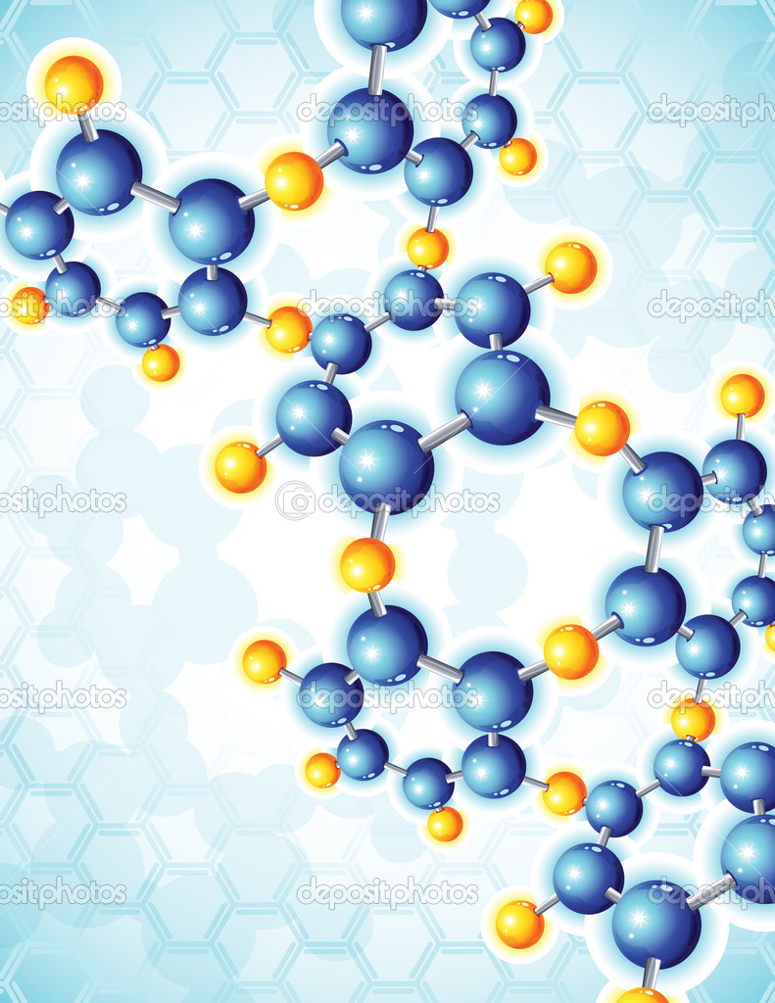
Introduction
Are the heaviest aromatic component of crude oil
Are precipitated on the catalyst surface and block the pore mouth
Act as coke precursors
May limit the maximum level of feedstock conversion
ASPHALTENES
Catalyst deactivation
Investigation of the structure, composition and properties of macromolecular weight components
Study of their behavior and features of transformations during refining
Increase the efficiency of refining and control the process parameters and feedstock conversion

Slide 3
Introduction
Hydroconversion in the presence of nanosized catalyst particles МоS₂
Refining of different feedstock regardless of content:
heteroatoms;
heavy metals;
asphaltenes and resins.
Process provides:
high conversion of feedstock;
low coke formation;
decrease in the pressure to 6-7 MPa.
Catalyst precursors – Water-soluble salts of catalytically active metals, that are introduced as emulsions followed by conversion to the slurry in heat treatment
Synthesis of nanosized catalyst particles
“in situ” in the reaction zone:
Т= 50-95 °С
Т= 120-150 °С
Т= 350-400 °С
Petroleum feedstock
Emulsified droplet
r = 0,1-1 µm
Cluster (NH4)Mo7O24
r = 0,015-0,15 µm
Cluster MoS2
r = 0,005-0,05 µm

Slide 4
Experimental part
1st experimental session:
Various temperatures (425, 440, 445 и 450 °С)
T = 425–450°C, P = 7.0 MPa, liquid hourly space-velocity (LHSV) of 2,0 - 2,2 h^{–1}, and hydrogen/feedstock ratio up to 1000 n L/L
2nd experimental session:
Various number of asphaltene conversion stages in the reaction zone
T = 440–445°C, P = 7.0 MPa, liquid hourly space-velocity (LHSV) of 1.5 h^{–1}, and hydrogen/feedstock ratio up to 1000 n L/L
Vacuum residue
IBP-520 °С
Modifier
Hydroconversion
R-0
A-V distillation of product
Fraction > 520 °С
Catalyst precursor
Recycle I
Vacuum residue
Hydroconversion
R-1
A-V distillation of product
IBP-520 °С
Modifier
Catalyst precursor
Fraction > 520 °С
Experiments from R-0 to R-5:
6 conversion stages of feedstock components including asphaltenes;
Experiment R- 0 is zero stage of hydroconversion without recycle.
Recycle II
to Hydroconversion R-2

Slide 5
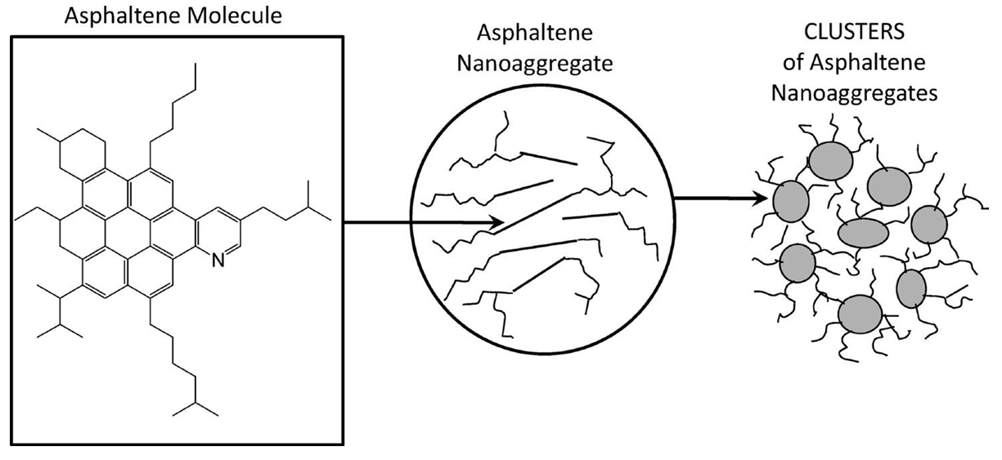
Object of investigation
Asphaltenes from petroleum feedstock
Asphaltenes from hydroconversion products
Molecular structure
Colloidal structure
Analyzed type of asphaltene molecules with single, moderate-sized polycyclic aromatic
hydrocarbon (PAH) ring system with peripheral alkanes

Slide 6
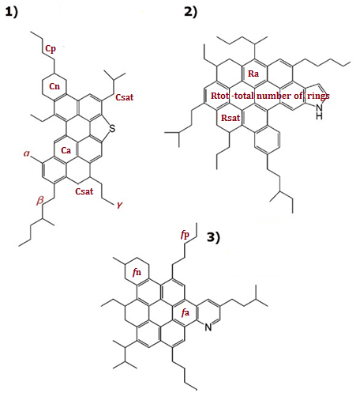
The structural parameters of asphaltene molecules
Average distribution of carbon atoms between the structural elements
- Elemental composition;
- Average molecular weights;
- Distribution of hydrogen atoms;
Structural group analysis
Number of carbon atoms of different types
Ring composition
Distribution of C atoms, %

Slide 7
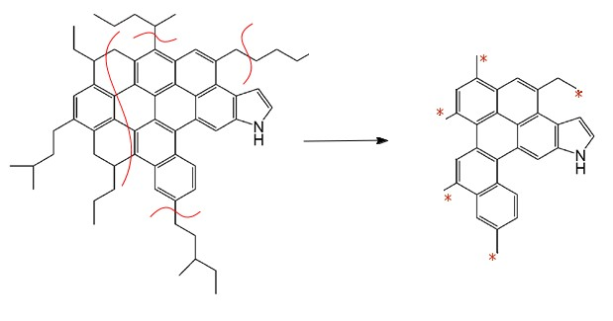
Change in molecular weight of asphaltenes at various temperatures
One of the main features is the nonmonotonic character of changes in MW.
It has been noted:
Characteristic temperature ranges –
425-440 °C and 445-450 °C;
Low temperatures (below 425 °C) and the range 440-445 ⁰С – transitional states.
1st transitional state
2nd transitional state
Dealkylation
450°С
Nucleation and growth in the asphaltene structure of a mesophase
Cracking and cyclohexan ring opening

Slide 8
Change in the ring composition (1), the amount of aromatic and saturated carbon atoms (2) in the structure of asphaltene molecules
1
2
Rtot – total number of rings
Ra – number of aromatic rings
Rsat – number of saturated rings
(Ca/Csat)×10
Ca – number of aromatic carbon atoms
Csat – number of saturated carbon atoms
Prevalence of the hydrogenation reactions
Increase in rate of cracking, dehydrogenation and cyclohexane ring opening reactions
Vacuum residue
Vacuum residue
Increase in the hydroconversion temperature
Stability of the size of the condensed aromatic core (Ra≈const)
Redistribution of carbon between aromatic and saturated fragments (Са/Сsat>1);
Increase in aromaticity;
Stability of the size of the condensed aromatic core (Са≈ const)
Increase in the proportion of unsubstituted aromatic rings (Ra/Rtot ≈1)

Slide 9
Change in the amount of carbon atoms in naphthenic and paraffinic (1), influence of temperature on the yield of coke (2)
1
2
Dealkylation
Cracking, dehydrogenation and cyclohexane ring opening reactions
Vacuum residue
*column height corresponds to the total number of Csat
Increase in the hydroconversion temperature to 440⁰ С
Increase in the amount of unsubstituted aromatic rings
Significant increase in the amount of coke
Nucleation and growth in the asphaltene phase of a mesophase

Slide 10
Scheme of structural transformations of asphaltene molecules depending on hydroconversion temperature
Reduction in the amount saturated structures in the condensed naphthenic-aromatic core by considerable enhancement cracking and cyclohexan ring opening reactions; insignificant change in the amount of Ra
2nd TRANSITIONAL STATE
Asphaltenes of hydroconversion products
(425-440°С)
Prevalence of saturated over aromatic structures
Са/Сsat < 1
Increase in aromaticity by the rise in the rate of dehydrogenation reactions of Rsat
Low extent of suppression of hydrogenation reactions, stability of Rtot in the condensed naphthenic-aromatic core
High degree of dealkylation
Increase in the rate of dehydrogenation reactions, decrease in the degree of dealkylation
Stability of Rtot
Increase in the proportion of unsubstituted aromatic fragments
Asphaltenes of vacuum residue
Asphaltenes of hydroconversion products
(445-450°С)
Prevalence of the hydrogenation reactions of aromatic fragments;
High rate of dealkylation Са/Сsat > 1
1st TRANSITIONAL STATE
INCREASE IN THE HYDROCONVERSION TEMPERATURE
Reduction in MW by the cracking, dealkylation and C-S, -N, -O bond opening reactions;
Stability of the condensed aromatic core;
Redistribution of carbon between aromatic and saturated fragments (Са/Сsat>1); increase in the aromaticity.

Slide 11
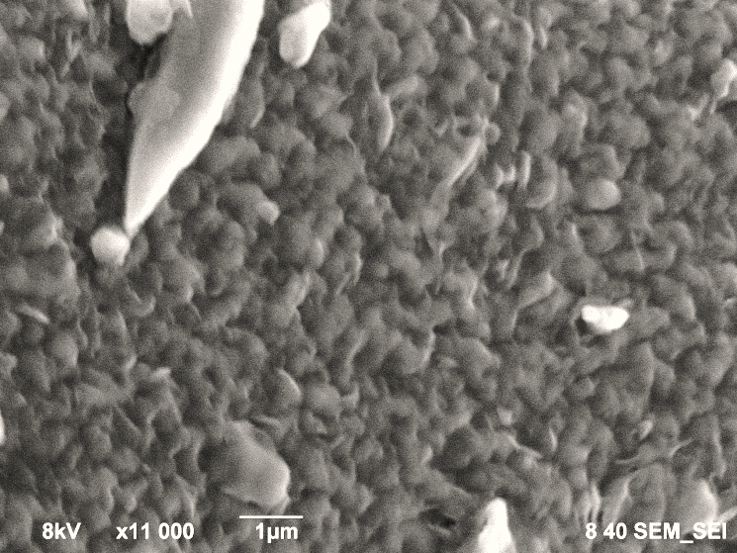
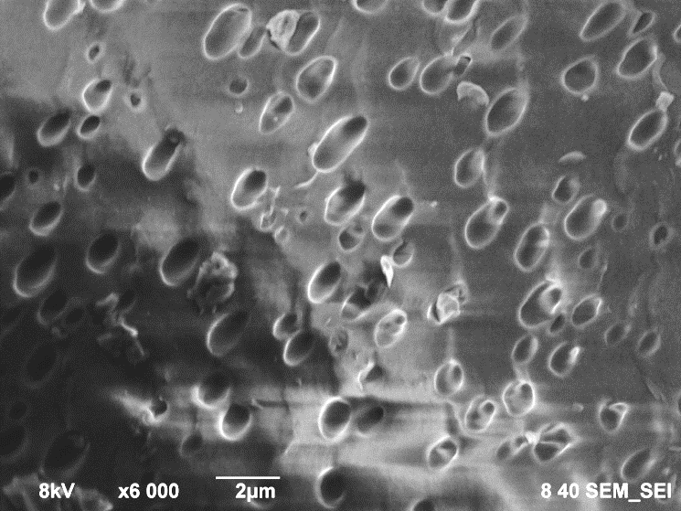
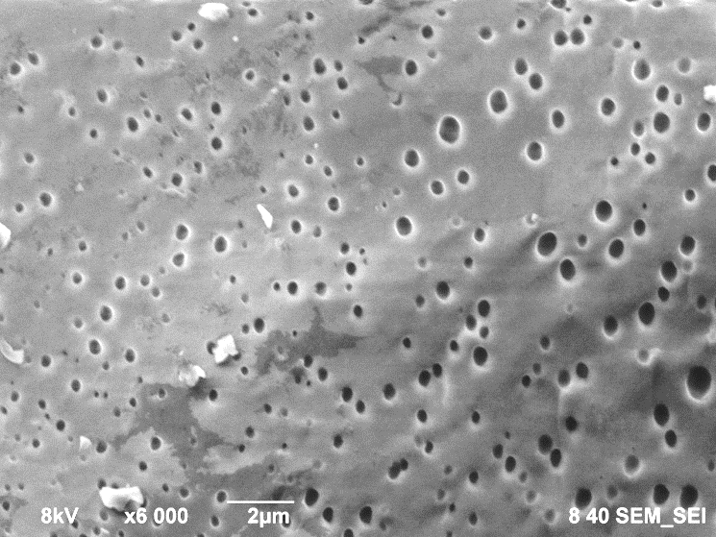
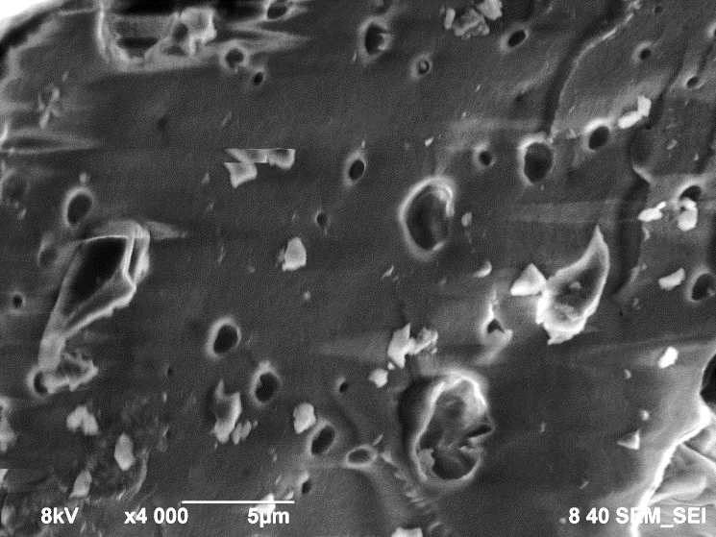
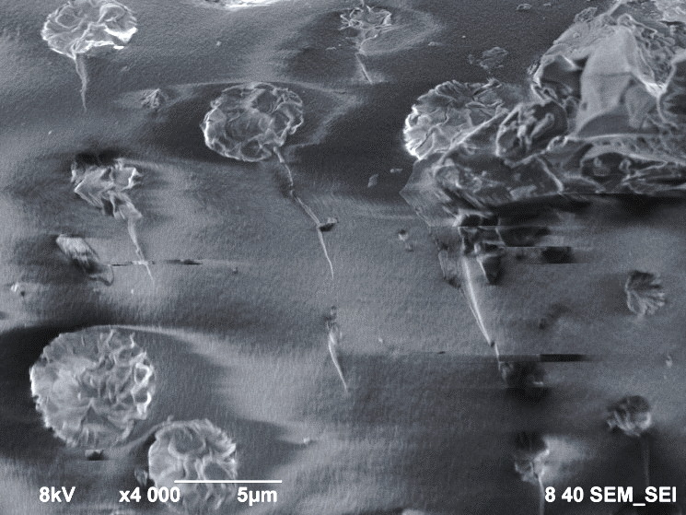
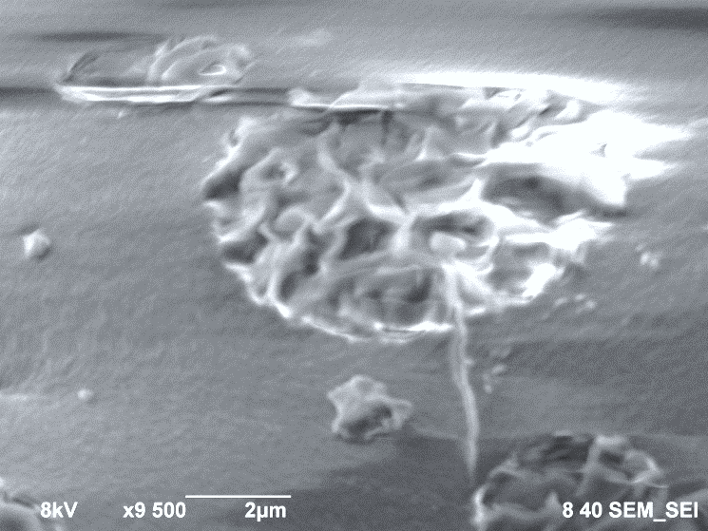
Change in asphaltene morphology depending on hydroconversion temperature
SEM images
Asphaltenes from initial vacuum residue
Asphaltenes from hydroconversion products at various temperatures
1st transitional state
Rough structure formed by the asphaltene aggregates, which are adsorbed on the surface of the resins.
425°С
440°С
Smooth surface with pores;
Increasing temperature reduces pore size
2nd transitional state
Removal of alkyl chains and increase in the proportion of unsubstituted aromatic fragments
Formation of stereospecific condensed structure in two-dimensional plane;
Nucleation and growth in the asphaltene phase of a mesophase
445°С
450°С

Slide 12
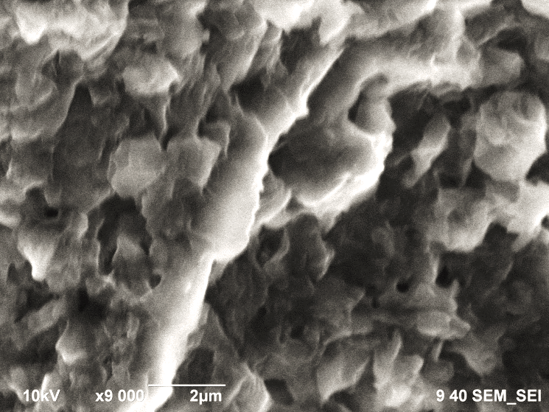
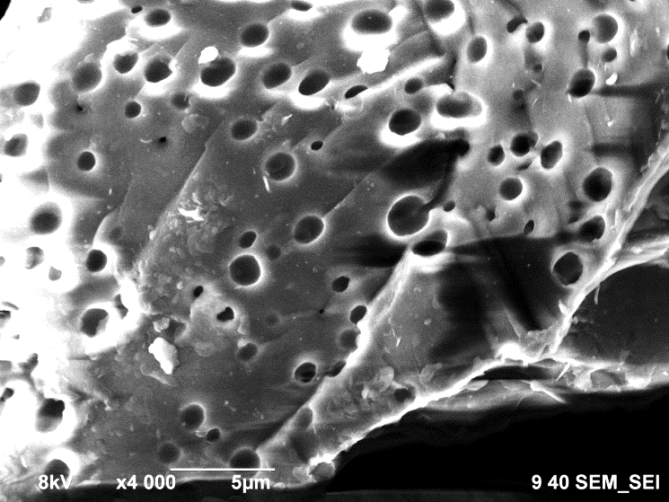
Change in asphaltene morphology depending on hydroconversion temperature
SEM images
The complex structural unit of resin-asphaltene constituents
Emulsion – vacuum residue/ aqueous solution of catalyst precursor
The core (dispersed particles) is formed by paramagnetic asphaltene molecules
Adsorption-solvate layer composed of diamagnetic resin molecules and mono-, bi-, polycyclic aromatics
Spatial redistribution of macromolecular components and colloidal asphaltene structures
Slurry – vacuum residue/ nanosized catalyst particles MoS₂
Aqueous solution of catalyst precursor
Structured interfacial layer (asphaltenes and resins)
Synthesis of catalytically active phase MoS₂ “in situ” in the reaction zone
Additional dispergation of colloidal asphaltene structures, resins desorption
Increase in efficiency of contact between reactive molecules, catalyst and hydrogen

Slide 13
Change in molecular weight depending on the number of asphaltene conversion stages
Asphaltenes of initial feedstock
Asphaltenes of hydroconversion products (>520°C fraction)
Conversion of >520°C fraction per cycle
Increase in the feedstock conversion per cycle
Decrease in MW of asphaltenes from processing products compared to MW of 1635 g/mol for initial feedstock asphaltenes
R-0 R-1 R-2 R-3 R-4 R-5
Increase in the number of asphaltene conversion stages
Nonmonotonic character of changes in MW
Asphaltenes from vacuum residue
1st transitional state
Asphaltenes from hydroconversion products
2nd transitional state
Asphaltenes from hydroconversion products
Zero stage of hydroconversion (R-0)
On the boundary between R-3 and R-4

Slide 14
Average structural parameters for asphaltene molecules
Parameter | Asphaltenes of initial feedstock | Asphaltenes of hydroconversion product at different numbers of conversion stages
 |  | R-0 | R-1 | R-2 | R-3 | R-4 | R-5
Average number of atoms in molecule
C | 110.2 | 73.2 | 65.1 | 67.7 | 82.7 | 43.6 | 58.7
H | 118.2 | 61.7 | 58.0 | 56.4 | 70.0 | 38.5 | 50.3
N | 2.0 | 1.7 | 1.4 | 1.6 | 2.0 | 0.8 | 1.2
S | 3.7 | 1.8 | 1.8 | 1.7 | 2.2 | 0.8 | 1.2
O | 2.9 | 1.5 | 1.5 | 0.8 | 0.1 | 2.2 | 2.4
Ring composition
Ra | 16.3 | 13.8 | 11.6 | 13.1 | 15.3 | 7.3 | 10.2
Rsat | 4.6 | 2.8 | 2.9 | 2.2 | 4.3 | 3.2 | 4.0
Rtot | 20.9 | 16.6 | 14.5 | 15.3 | 19.6 | 10.5 | 14.2
Average number of carbon atoms of different types in molecule
Са | 61.4 | 53.4 | 45.0 | 50.9 | 59.2 | 28.7 | 39.6
Сsat | 48.8 | 19.8 | 20.1 | 16.8 | 23.5 | 14.9 | 19.1
Сc | 80.3 | 65.4 | 56.9 | 60.2 | 77.2 | 41.9 | 56.6
Сn | 18.9 | 12.0 | 11.9 | 9.3 | 18.0 | 13.2 | 17.0
Сp | 29.9 | 7.8 | 8.2 | 7.5 | 5.5 | 1.7 | 2.1
Asphaltenes from vacuum residue
1st transitional state
Asphaltenes from hydroconversion products
2nd transitional state
Asphaltenes from hydroconversion products
High rate of dealkylation
Increase in the rate of cracking of cyclic structures

Slide 15
Correlation of MW with the proportion of C atoms in the cyclic structures (1), change in the amount of heteroatoms depending on the amount of aromatic C atoms (2)
1)
Stability of the condensed aromatic core (Ra≈const)
Variation of temperature
Change in the number of recycling stages
Destruction of cyclic fragments including the most stable heteroaromatic structures having low reactivity, with the high reaction rate of dealkylation
2)
Nitrogen
Sulfur
As the number of asphaltene conversion stages increases, the amount of the most reactive compounds of sulfur decreases
Level of denitrogenation is less than desulfurization
Increase in the number of asphaltene conversion stages

Slide 16
Dependence of the aromaticity (1) and the yield of condensation products (2) on the temperature and the number of conversion stages
1)
Even and continuous growth of aromaticity molecules
Dependence on the number of recycling steps
Temperature dependence
Increase in the hydroconversion temperature
Increase in the number of recycling stages
Decrease in aromaticity molecules
R-0 R-1 R-2 R-3 R-4 R-5
2)
Increase in the hydroconversion temperature to 440⁰ С
Increase in the amount of unsubstituted aromatic rings
Temperature dependence
Dependence on the number of recycling steps
Significant increase in the amount of coke
R-0 R-1 R-2 R-3 R-4 R-5

Slide 17
Conclusion
It is shown that, the molecular structure of asphaltenes depending on different process conditions vary in a discrete manner, passing through a step of transitional state (TS), in which system is the most susceptible to the action of external factor.
It is noted that, the changes in the structural parameters of asphaltene molecules at each TS step are due to the prevalence of characteristic reactions, which are similar as in variation of temperature and change in the number of recycling stages. However, there are significant differences between structural transformations of asphaltenes depending on various process parameters.
Investigations of changes in asphaltene morphology confirm the main features of the structural transformations of asphaltenes, which were established by structural-group analysis of asphaltene molecules. It is shown that the quality rearrangement of the asphaltene molecular structure by passing through the TS, where the system is most active, leads to quality changes in the asphaltene morphology and change of colloidal-chemical structure of the system.
Hydroconversion parameter intervals, corresponding to the TS, are the most favorable in terms of regulation of structural transformations of macromolecular components and increasing level of conversion with low coke formation.

Slide 18
Thank you for attention!

