Slide 1


Differentiation study of periodontal ligament stem cells to urothelial cells.
Nizar M. Abuharfeil*, Shaleemar Shadeed* and Abdalla A. Abbadi**
* Department of biotechnology, faculty of science, Jordan university of science and technology, Irbid, Jordan
** Therapeutic stem cell center, Jordan university, Amman, Jordan

Slide 2
There are a number of conditions of the urinary bladder that can lead to loss of function: sever chronic urinary inflammations, cancer, spinal cord injury and congenital abnormalities
At present, GI substitution is commonly employed for bladder reconstruction. However, complications include recurrent infections, bladder stones, metabolic disturbances, and carcinomas
Every 10 min., someone is added to the national transplant waiting list
On average, 21 people die each day while waiting for a transplant

Slide 3
Urothelium
Urothelium is a specialized epithelium lining the distal portion of the urinary tract which comprises the renal pelvis, ureters, urinary bladder, upper urethra and glandular ducts of the prostate.
Urothelium consists of approximately 3 cell layers: Umbrella, intermediate, and basal cells,
classified as transitional epithelium.
Highly specific to the urinary tract
Urothelium is a slowly cycling tissue during the normal physiological conditions .
urothelium has a remarkable regenerative capacity, with tissue damage resulting in a very rapid proliferation coupled to differentiation

Slide 4
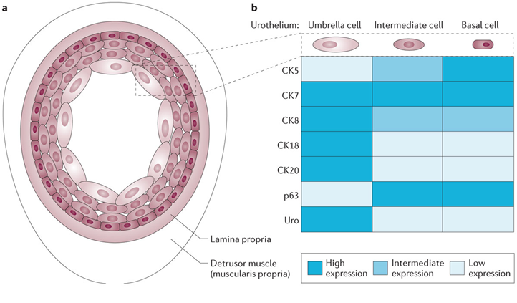
Urothelium cells
a: bladder anatomy and cell types.
b: | Summary of expression of cytokeratins (CKs), p63 and uroplakin (Uro) in bladder urothelial cells.

Slide 5
Urothelium Stem Cells
To date adult stem cells displaying clonogenicity, self-renewal and differentiation capacity have not been characterized in human urothelium.
Urothelial stem cells have been described in mice and were found to express sonic-hedgehog proteins in the basal cell layers of the bladder.
A more recent report has demonstrated that mouse urothelial stem cells are p63-positive (a member of the p53 family of transcription factors).

Slide 6
There is, to our knowledge, currently no marker available to distinguish the subpopulation of urothelial stem cells from the remaining basal cells
Another difficulty about urothelial stem cells is that the relationship between in vivo stem cell properties and in vitro clonogenic properties is equivocal as, for example, in the epidermis. Classical clonogenic analysis of epidermal cells yields three types of colonies :
holoclones, i.e. cells with an extensive proliferative capacity,
meroclones, i.e. cells of limited proliferative capacity, and
paraclones – colonies of terminally differentiated keratinocytes that could not be sub-cultured at all

Slide 7
Sources of Mesenchymal stem cells
Bone marrow
Adipose tissue
Dental ligament
Urine
Considering the inconvenience of obtaining BMMSCs such as pain and trauma from invasive BM aspiration and low No of harvested cells: several attempts to harvest MSCs from dental tissues including periodontal ligaments, gingiva and others

Slide 8
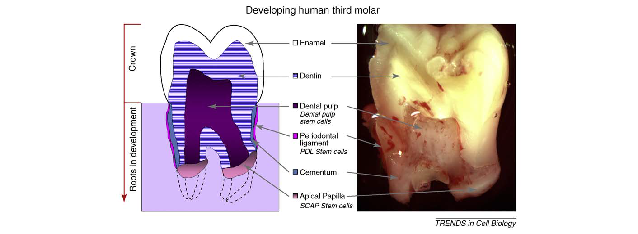
Dental stem cells

Slide 9
Stem cell populations of the tooth
1. The dental pulp stem cells ( DPSCs)
-has the potential capacity of self renewing and multilineage differentiation
-contribute to the formation of dentin-bulb complex
2. The apical papilla stem cells (APSC)
-located at the tips of growing tooth roots
-present only during root development before the tooth erupts into the oral cavity.
3. Human exfoliated deciduous stem cells (SHED)
-Fast proliferation, greater pop doubling
- sphere-like cluster formation
- multipotent cells capable of differentiating into different cell types.

Slide 10
4. The periodontal ligament stem cells (PDLSCs)
a highly fibrous and vascular tissue, has one of the highest turnover rates in the body.
Give rise to adherent clonogenic clusters resembling fibroblasts that may develop into adipocytes, osteoblast and cementoblast cells in vitro, and
into cementum and periodontal ligament-like tissues in vivo
Have immunomodulatory ability:
Low immunogenecity
Immunosuppressive effects

Slide 11
PDLSCs
They are similar to stem cells of dental pulp, and to bone marrow mesenchymal stem cells
Possess Sc properties similar to MSCs
Have CD105, CD90, CD73
Lack CD45, CD34, HLA II
Periodontal stem cells are isolated either non-invasively or with minimally invasive procedures yielding high number of cells suitable for tissue engineering applications.
Promising for tissue-engineering studies
And therapeutic applications

Slide 12
Aims of the study
- Assess PDLSCs proliferation and differentiation potential to urothelial cells in vitro
-Assess the effect of HPL concentration on PDLSCs growth compared to FBS.

Slide 13
Donors
All donors were healthy without any clinically evident disease, had not taking any medications, nonsmokers and non-alcohol consumers. Signed informed consent was obtained from all donors.
Teeth were collected from 10 adult donors undergoing third molars extraction.

Slide 14
Isolation of PDLSC
The enzymatic dissociation method:
1. Teeth were disinfected by 5% chlorohexidine.
2. For each primary tooth, the tooth was drilled to remove the remnant pulp tissue from the coronal part of the tooth.
3. For PDLSCs isolation, ligament tissue was removed by using a scalpel from the surrounding area of the tooth.
4. Each tissue was then digested in a solution of 3mg/ml collagenase type I and 4 mg/ml dispase for 1 h at 37 ̊C.

Slide 15
5. Single-cell suspensions were obtained by passing the cells through a 70 µm strainer
6. PDLSCs cells were seeded at 2 ×10⁵ cells/well in 6-well plates. Each well contains: 10% FBS and 0, 5 and 10% PL, then cells were incubated at 37 ̊C in 5% CO2 atmosphere.
7. The cells number was counted every 24 h . Three replicates for each time point of 24, 48, and 72 h, have been performed respectively.

Slide 16
Platelet lysate (PL).
Two derivatives for platelets:
Platelets rich plasma (PRP) and Platelet lysate (PL).
PRP contains a high concentration of human platelet growth factors in a small volume of plasma.
PL contains only the growth factors of the platelets
Experimental evidence have revealed that PL enhances the proliferation of MSCs from various sources in vitro.
Recently used as an alternative and substitutive source for FBS in human

Slide 17
PL Preparation
.
Expired human platelet units of 100 ml were taken from the blood bank at the Jordan university hospital.
The platelet unit was frozen at - 80°C, and then rapidly thawed at 37°C (twice).
The resulting PL was centrifuged at 5000 rpm for 10 min at 4 °C to remove platelet bodies.
The PL was filtered through 0.22μm filters to remove platelet membranes.

Slide 18
Morphological characteristics of PDLSC
In HPL:
-appeared small and long-spindle shaped
-Have the tendency to grow overlapping to each other forming condensed colonies.
-Took 3-4 days to reach confluency
-Greater density at different passages
In FBS:
-form thicker flattened loosely segregated cells
-Took 6 days to reach confluence
-Less density

Slide 19
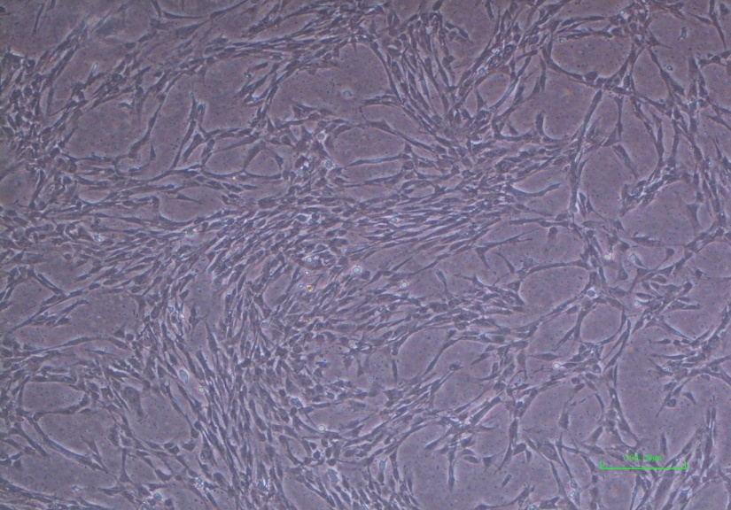
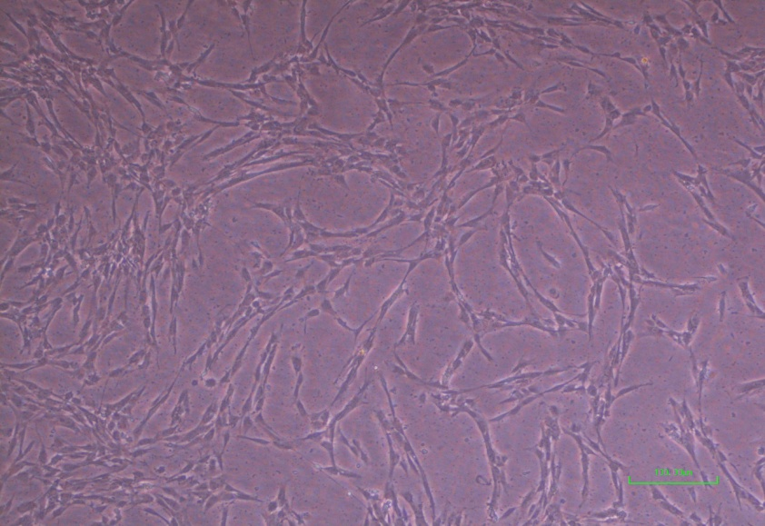
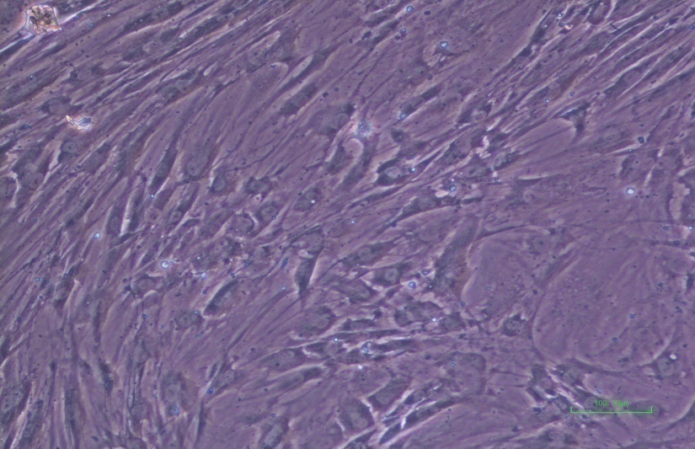
PDLSC using different conc. of PL
A
B
5% HPL
10% HPL
C
!0%FBS
Notes:
Figure 1. The morphological characteristics of PDLSCs when grown using different types of serums A) PDLSCs at day 3, passage 1 (P1), grown in 10% HPL. B) PDLSCs, at day 3 (P1) grown in 5% PL. C) PDLSCs, P1 at day 3, grown in 10% FBS.

Slide 20
Growth curve for PDLSCs in HPL and FBS
Notes:
Figure 2. Growth curve of PDLSCs from passage 1-5 respective to the serum cells were grown in (HPL and FBS).

Slide 21
Immunophenotyping
Flow cytometry
The cells were incubated with different fluorescinated monoclonal antibodies against different MSC-like markers and Hematopoietic stem cell markers .
Cell fixative was added to the cells, and were centrifuged at 1000 rpm for 5 min. Then, the cells were resuspended in PBS.
The expression profile was analyzed by Fluorescent activated cell sorter (FACS).

Slide 22
Antibodies utilized for cell surface marker analysis.
Antibody | Source | Dilution
CD44-PE | BD Pharmingen | 1:20
CD105-PerCP | BD Pharmingen | 1:20
CD90-FITC | BD Pharmingen | 1:20
CD19-FITC | BD Pharmingen | 1:5
CD73-APC | BD Pharmingen | 1:20
CD34-PE | eBioscience | 1:20
CD117-PE | eBiosciences | 1:20
SSEA1-PE | BD Pharmingen | 1:20
SSEA3-FITC | BD Pharmingen | 1:20
SSEA4-PerCP | BD Pharmingen | 1:20
CD14-PE | BD Pharmingen | 1:5
CD31-FITC | eBioscience | 1:20
CD33-FITC | eBioscience | 1:20
CD45-FITC | eBioscience | 1:20
HLADR-FITC | eBioscience | 1:20
CD29-FITC | eBioscience | 1:20
IgG-FITC | BD Pharmingen | 1:5
IgG-APC | BD Pharmingen | 1:5
IgG PerCP-Cy5 5-A | BD Pharmingen | 1:5

Slide 23
RESULTS:
At day 9: A high expression of PDLSCs
MSC-like Expressed markers: CD29, CD146, CD73, CD90, CD105, SSEA-4, CD117
Absent Hematopoietic stem cell markers: CD14, CD19, CD31, CD34, CD33, CD45, HLADR, SSEA-1, SSEA-3

Slide 24
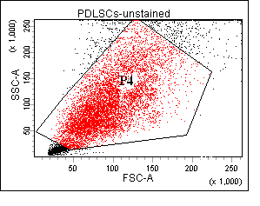
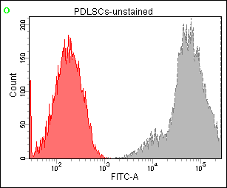
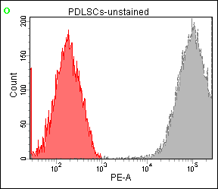
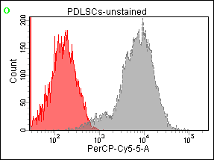
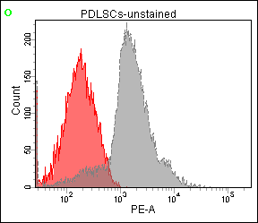
Flow cytometry results for PDLSCs in 10% HPL at 70% confluency
CD-73
CD44
CD73
CD44
74.8%
63.8%
63.8%
7ddsds7777777.4%74.8%
A)
B)
c)
CD90
OCN/OPN
CD90
CDss1SSsss05
OCN/OPN
CD105
78CccD90.3%
78.3%
14%
77.4%
14%
77.4%
D)
D)
E)
F)

Slide 25
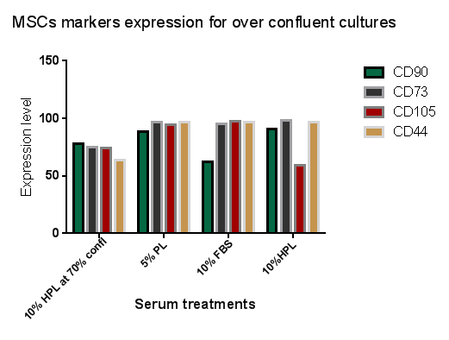

Slide 26
Cell proliferation Assay
MTT method
Cells were cultured in 96-well plates, 5000 cells/ well.
SHED and PDLSCs were cultured with AMEM medium without serum as a negative control, 5% PL and 10% FBS supplemented media.
The test was performed at day 8
20 µl Tetrazolium MTT salt were added to the cells, and incubated for 4 hrs.
100 µl DMSO were added and incubated for 15 min.
Optical density was measured at 570 nm.
Results:
Cells cultured in HPL had higher prolif rate compared to FBS
10% more than 5% while there was no s.d between 5 and 10% FBS

Slide 27
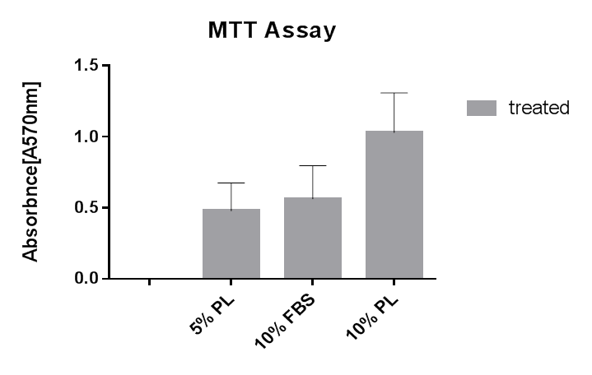
MTT proliferation assay
Notes:
Figure (9) MTT proliferation curve for 3 different groups: HPL-DMEM, FBS-DMEM in different serum conditions (5%, 10%).

Slide 28
Osteogenic Differentiation
PDLSCs and SHED cells were maintained in the growth media until reaching nearly 70% confluence.
The cells were grown in the osteogenic media containig: DMZ, Ascorbic A and βOH-GP.
The following conc. of PL: 0, 1, 5, or 10% FBS
Cells were stained with Alizarin red for 20 m at r. t.
Washed twice (2×) with distilled water and observed under the microscope.
Results:
The alizarin red staining showed tat PDLSC formed mineralized matrix and red nodules due to Ca deposition

Slide 29
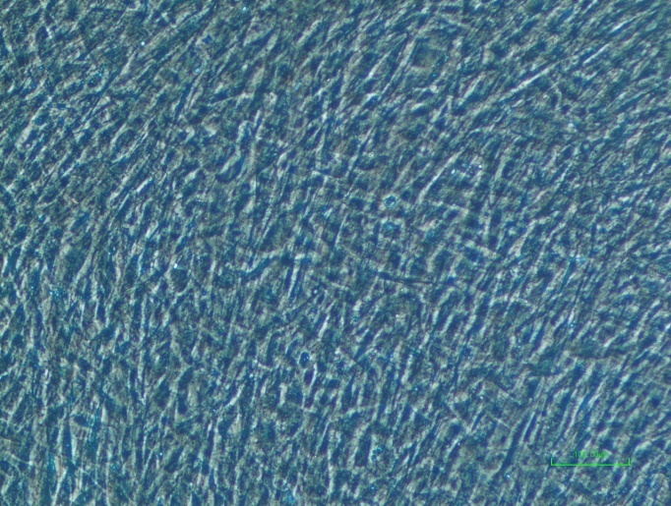
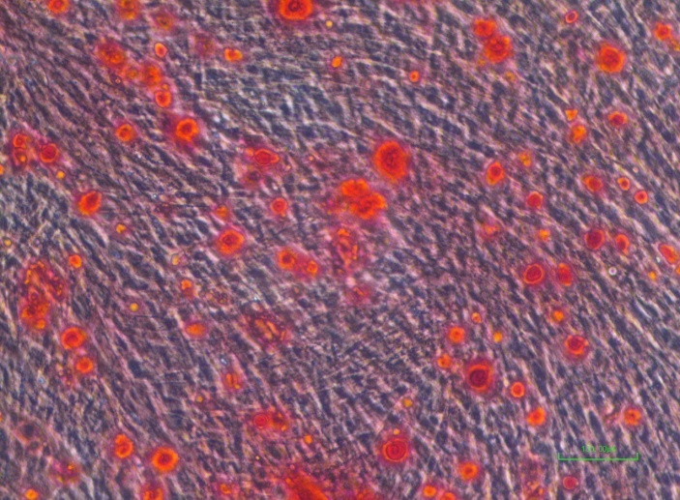
Osteogenic differentiation
A)
B)

Slide 30
Adipogenic differentiation
PDLSCs and SHED cells were plated at 1×10⁵ cells/well in 6-well plates and maintained in the growth media until reaching nearly 70% confluence.
maintained in the adipogenic media containing dexamethasone, insulin and isobutylmethylxanthine.
To visualize oil droplets for the detection of induced cells were stained with oil red stain pH 4.2 for 20 min at room temp.
Finally, the cells were washed twice (2×) with distilled water and were observed under the microscope.
Results:
Lipid vacuoles with oil red lipid microdroplets were observed in adipogenic induction media

Slide 31
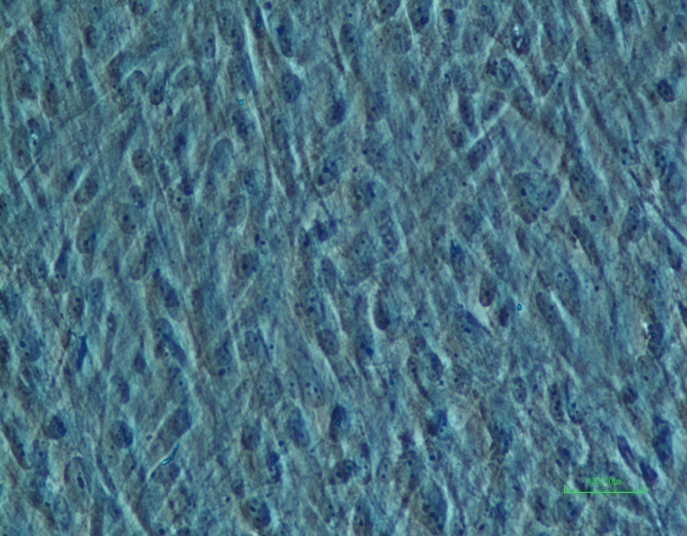
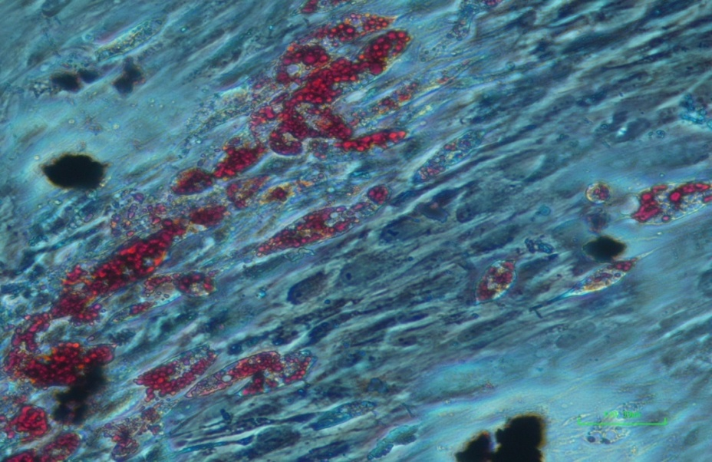
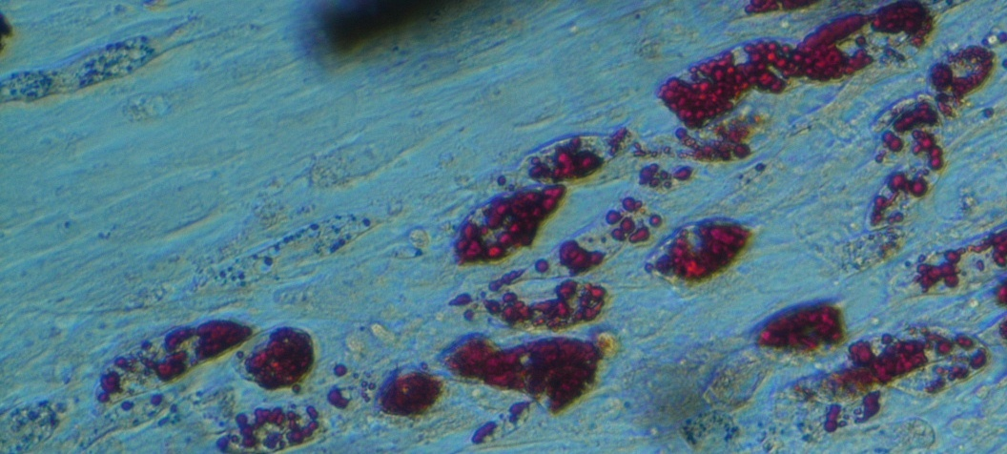
Adipogenic differentiation
A)
B)
C)
Notes:
Figure11. PDLSCs induction to adipocytes through incubation in specialized media for 21 days.
A) Negative control is PDLSCs in adipogenic basal media without induction supplements. B-C) red droplet formation after stating with old red stain showing that PDLSCs have successfully differentiated to adipocytes. Scale bars: 100 μm

Slide 32
Differentiation of PDLSC to UCs
Effect of media:
DMEM with and without conditioned media in the presence of 5%HPL or 5% FBS
KSFM with and without conditioned media in the presence of 5%HPL or 5%FBS
KSFM: EGF, bovine pituitary extract, cholera toxins
cF12K: conditioned media in which SV-HUCI urothelium cell line in complete kaighn’s nutrient mixture and was collected from 70-90% confluent, centrif and filtered

Slide 33
Morphology of PDLSC before and after differentiation induction to Urothelial cells
Before differentiation: PDLSC exhibited spindle-shaped morphology (characteristic of monolayer growth pattern.
After induction using CM: cell morphology changed to polygonal epithelium shape similar to urothelial cells
In FBS: cells formed thicker-flattened loosely segregated cells
In HPL: Cells appear smaller, more compact had the tendency to grow overlapping to each other forming condensed culture. With greater confluence rate

Slide 34
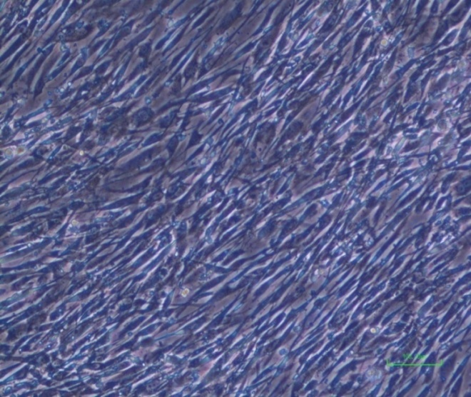
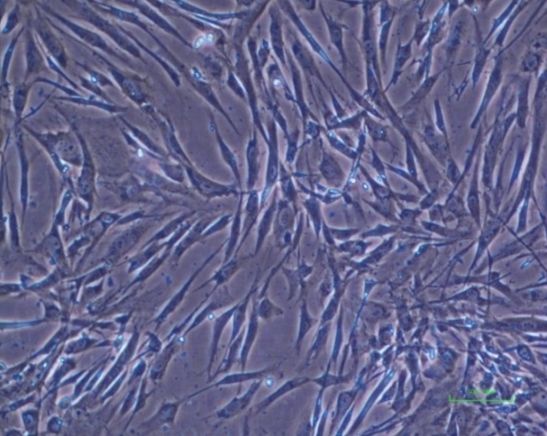
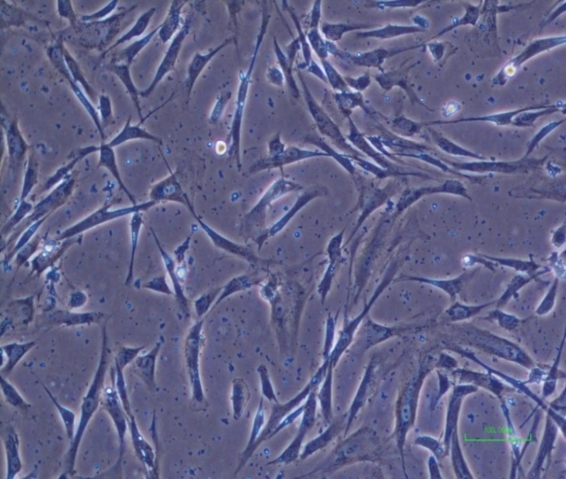
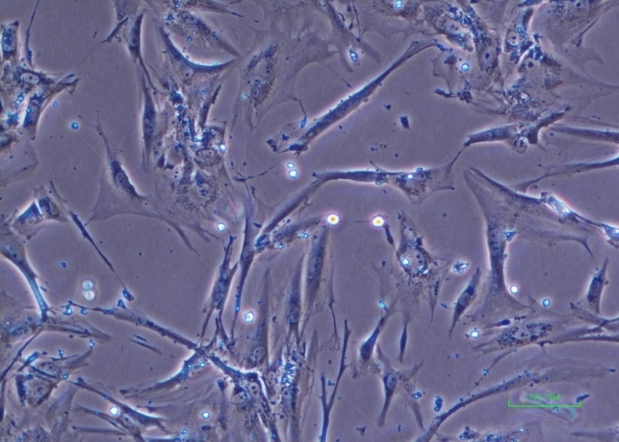
PDLSC induction to urothelial cells
5% HPL in DMEM (Control)
5% HPL in DMEM/CM
A)
B)
5% FBS in DMEM (Control)
5% FBS in DMEM/ CM
C)
D)

Slide 35
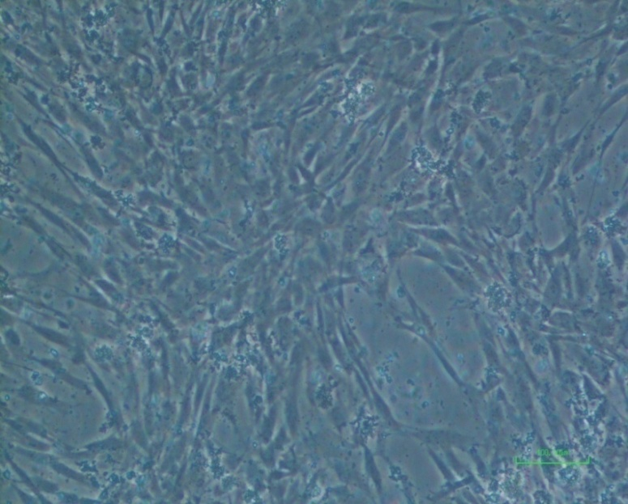
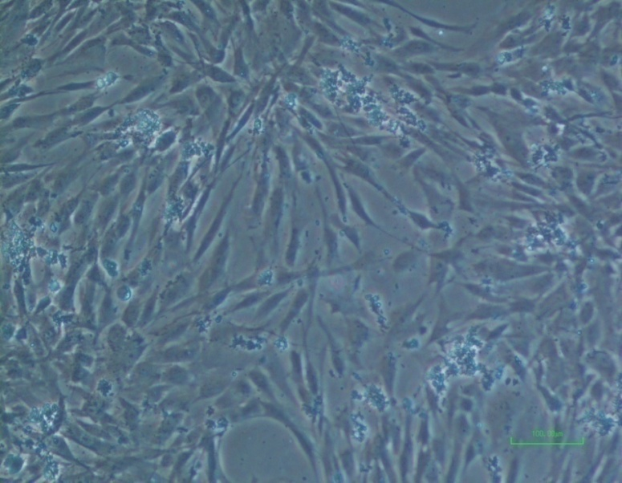
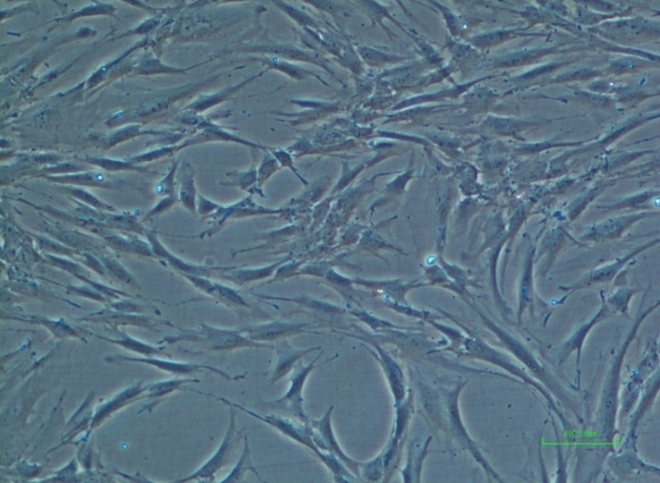
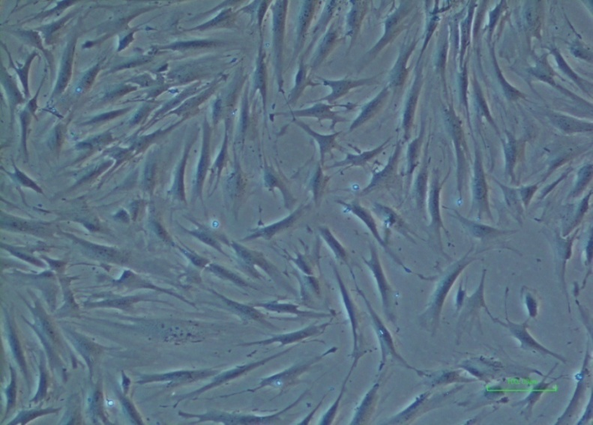
5% HPL in K-F12(Control)
5% HPL in K-F12/ CM
E)
F)
5% FBS in K-F12(Control)
5% FBS in K-F12/ CM
G)
K)

Slide 36
Immunoflouresence for Urothelial markers
PDLSC cell culture 2 weeks in several differentiation media:
K5 : (KSFM-DMEM) in 5% HPL
K2: KSFM-DMEM) in 2.5% HPL
KF: KSFM-DMEM) in 5% FBS
CM5: cF12K-DMEM in 5% HPL
CM2: cF12K-DMEM in 2.5% HPL
CMF: cF12K-DMEM in 5% FBS
Fixation by formaldehyde and Permeabilization with Triton X100
Blocking solution of BSA
First Ab to cytokeratin-18 or uroplakin-2 incubation
Secondary Ab

Slide 37
Transdifferentiation
International color consortium ICC for K-18 and UP-2
Photomicroscopy of Immunofluorescent labelled Cells
The slides were observed using Nikon eclipse 2000 fluorescinated microscope under the blue, green and red filters.
Merged IF images of blue, green and red channels detecting DAPI (nuclear stain), FITC (K18) and Cy3 (UP-2), respectively
Image analysis was conducted using image J software. From each slide the intensity of 50 cells from 5 randomly picked fields were measured and averaged over triplicate slides.
The immortalized sv-HUC urothelial cells were used as a + control and non-induced cells as a – control

Slide 38
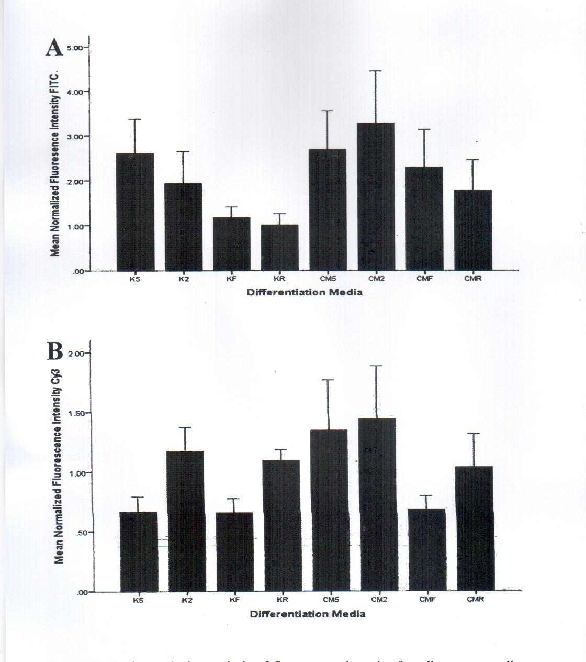
Semiquantitative analysis of fluorescence intensity for PDLSCs using Image J
FITC detects K-18, Cy3 detects UP-2

Slide 39
Normalized fluorescence intensity of urothelium markers in PDLSC
 | K-18 | UP-2
K5 | 2.81 | 1.33
K2 | 1.92 | 1.25
Kf | 1.65 | 3.24
CM5 | 2.74 | 1.42
CMF | 2.63 | 0.85
CM2 | 3.22 | 3.51
K-18 was expressed in K5, CMF, CM2, CM5
UP-2 was detected in K2, CM2, CM5

Slide 40
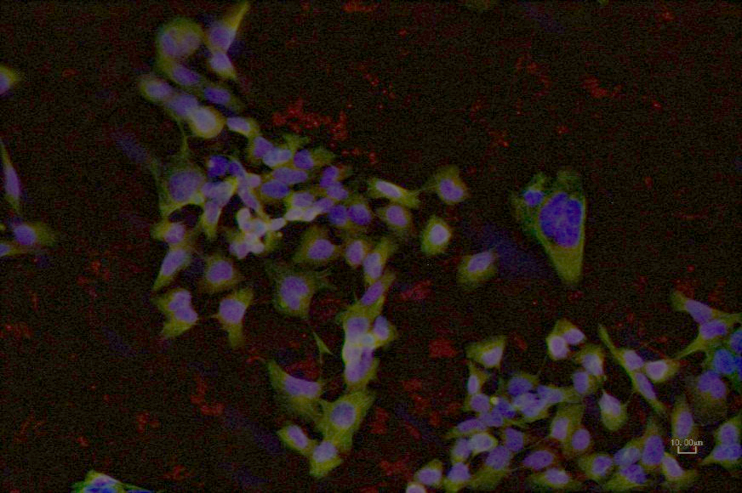
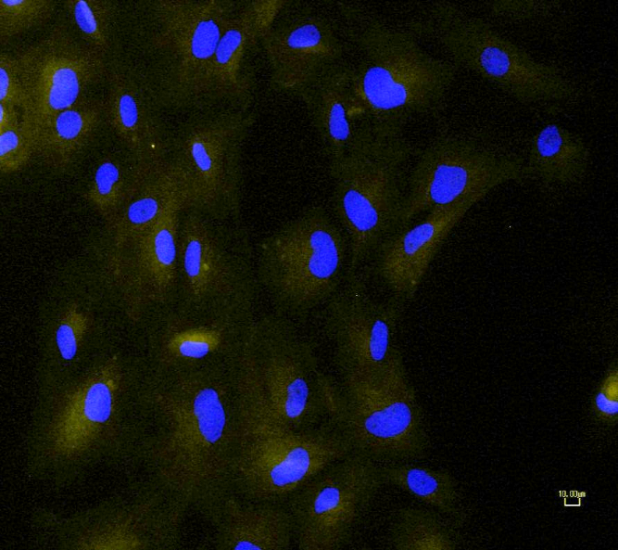
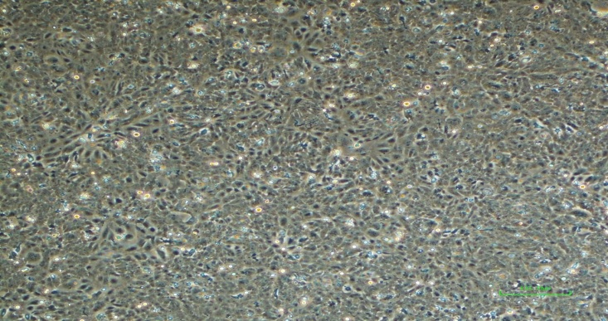
Positive control
sv-HUC urothelial cells
Negative control
non-induced cells
SV-Human Urothelial cell line cultured in K-F12 in 10% FBS. Scale bars: 100 μm

Slide 41
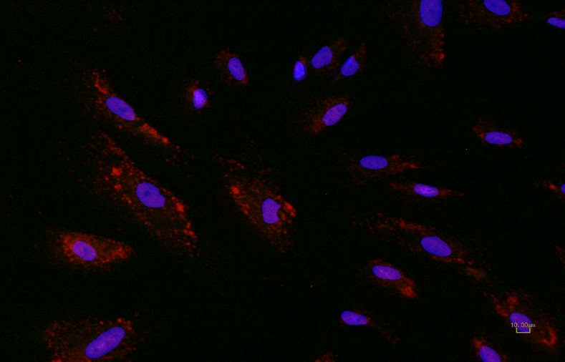
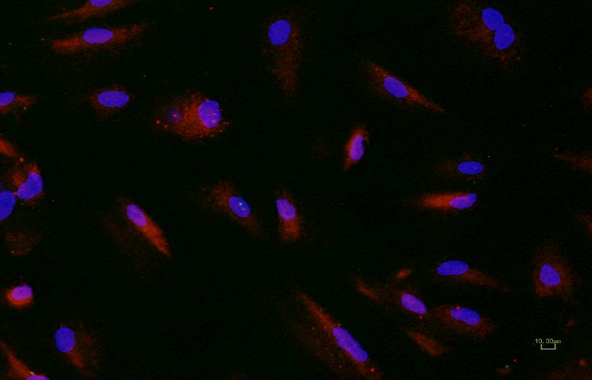
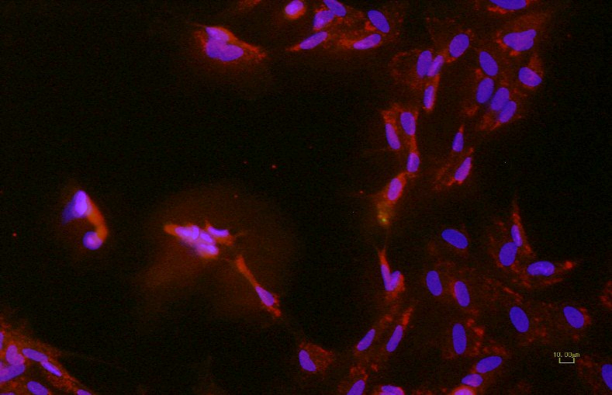
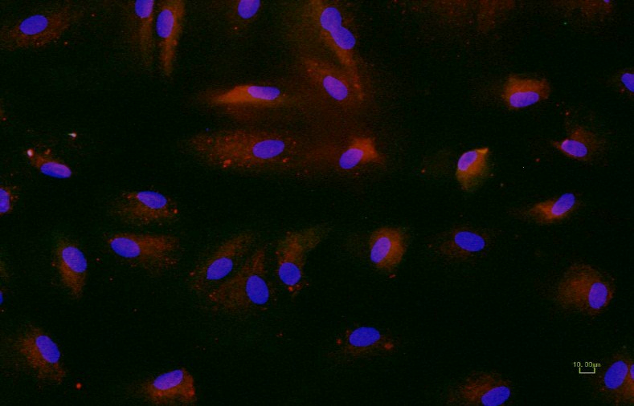
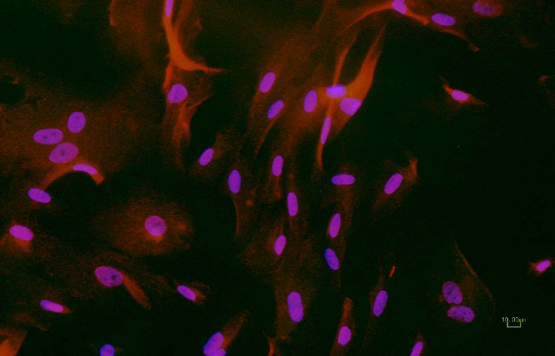
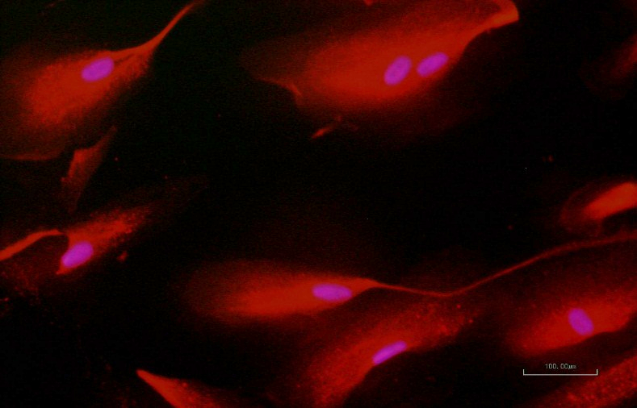
C
PDL SC K5
D
PDL SC K2
E
PDL SC KF
F
PDL SC CM5
G
PDL SC CM2
H
PDL SC CMF

Slide 42
RT-PCR Analysis
RNA Extraction
Total RNA was extracted from cells at days 0, 9, 15 and 21 after induction of osteogenic differentiation.
Cells were detached by removing the growth media, then washing with 1X PBS and the cells were treated with 1X Trypsin EDTA (0.25%.).
Trizol 600µL were added to the suspension and mixed.
chloroform 200µl of were added and mixed, the mixture was incubated for 2 min at room temp, then centrifuged at 13,000 rpm for 15 minutes.
isopropanol 600µl: The aqueous layer was transferred and centrifuged for 10 min at 13000 rpm.
70% ethanol 700 µl were added to the pellet, centrifuged at 9000 rpm for 5 min.
The supernatant was discarded and kept at air dry.
Finally, RNA samples were rehydrated in Nuclease Free Water.

Slide 43
RT/ PCR Amplification
RNA was reverse transcribed by using Reverse transcriptase kit to produce cDNA.
Diluted cDNA (5 µl) was amplified using GoTaq®qPCR Master mix , mixed with 25 pmole of forward and reverse primers .
The conditions for the amplification are :
95 ̊C for 2 min, as initial denaturation ,
95 ̊C for 15 sec, 60 ̊C for 60̊ sec, and 72 ̊ C for 30 sec, for 40 cycles.
Rxns were loaded on a RT-PCR plate and run on the BioRad CFx90 devise

Slide 44
Oligonucleotides primers
Cytokeratin-18:
F: 5’-GGTCAGAGACTGGAGCCATTA3’
R: 5’- GGCATTGTCCACAGTATTTAGC-3’
Uroplakin-2:
F: 5’- CAGTGCCTCACCTTCCAACA-3’
R: 5’- TGGTAAAATGGGAGGAAAGTCAA-3’
Glycealdehyde-3-P dehydrogenase:
F: 5’- CTCTGACTTCAACAGCGACA-3’
R: 5’- TCTCTCTCTTCCTCTTGTGC-3’

Slide 45
Expression of urothelial specific markers in PDLSC
Results:
To confirm the expression levels of mRNA of urothelium specific markers of PDLSC, total RNA was isolated and quantitative RT-PCR was performed for UP-2 and K-18
After 14 days of induction by DMEM-KSFM,
the treated group had a significant change in expression of both UP-2 (2 folds) and K-18 under all treatment conditions (5% HPL) compared to untreated.
While group supplemented with FBS (KF) and 2,5% HPL showed no sig increase in the expression of both markers
Culturing PDLSC with CM resulted in elevated expression of both markers regardless of the serum.

Slide 46
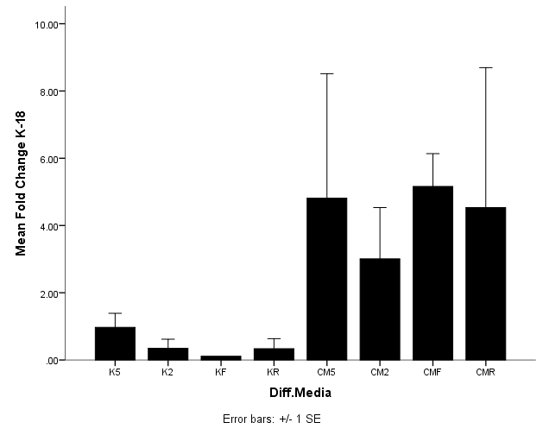
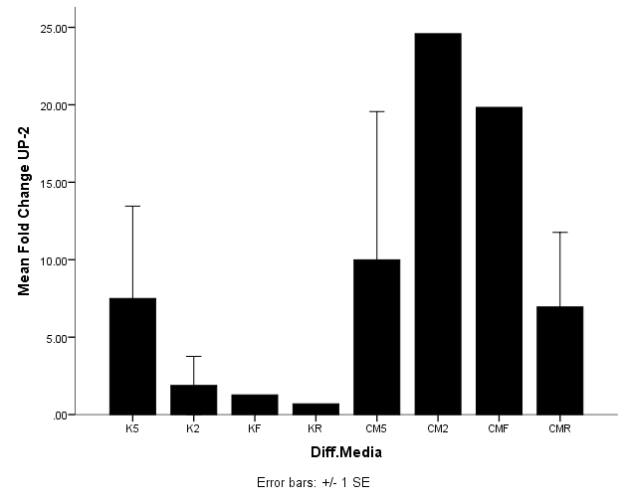
A
B

Slide 47
Determination of Growth Factors by ELISA
As the periodontium is comprised of cementum, alveolar bone and the periodontal ligaments, the use of various growth factors to induce PDLSCs differentiation into different directions is of interest.
VEGF: enhance osteogenic differentiation
TGF-β enhance fibroblastic differentiation
FGF: promoted proliferation of PDLSCs
The conc. Of 3 growth factors secreted by PDLSC using different media at the end of differentiation period were analyzed.
ELISA using Abcam kits
Results: s.d. was noticed in the secretion of
EGF in case of CM5, CM2
VEGF: K2, K5, CM2, CM5
PDGF : K2, K5, CM2, CM5
The data suggest that SCs at different stages may need different types of GF to support their prolif. And differentiation. The sequential use of GF appears promising and effective for improving SC regeneration.

Slide 48
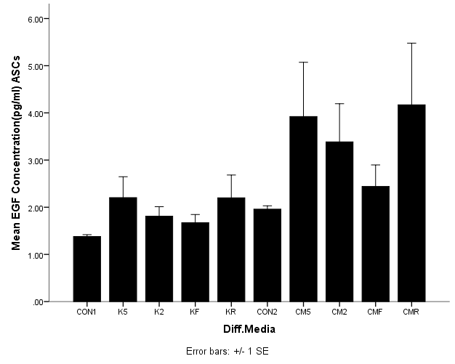
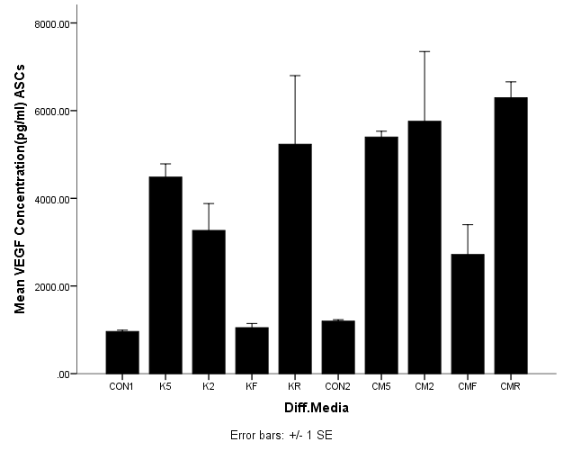
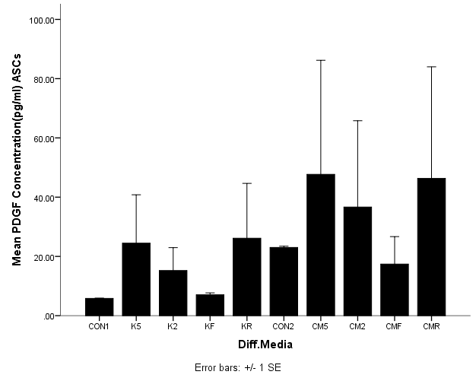
A
B
B
A
C
C
*
*
*
*
*
*

Slide 49
Statistical Analysis
Data were analyzed using graphPad Prism (Version 6) and microsoft windows (Excel, 2007). All assays were performed in three independent experiments (n = 3), with duplicates of each and the results were expressed as Means ±Standard Deviations (SD).
A paired t-test and one way ANOVA analysis were used to determine the differences in the proliferation and differentiation rates of the DPSCs and SCAP, and to analyze the differences in their gene expression patterns in presence of platelet lysate (PL) (Significance assumed for p < 0.05)

Slide 50
Biological Challenges.
Despite biological evidence that periodontal regeneration can occur in humans, complete and predictable regeneration remains an exclusive clinical goal and the molecular processes that underlie stem cell proliferation and differentiation are largely unknown.
While the use of stem cells can minimize the processing time compared with somatic cells, possible karyotypic instability and gene mutations of the cells after prolonged culture can limit their usefulness.
Immune rejection after administration, oncogenic properties of stem cells and functional integration on transplanted tissues into the host are significant challenges.

Slide 51
Conclusion
10%HPL enhanced cell growth better than FBS
PDLSCs can be trans differentiated to Urothelial tissue using the conditioned medium

Slide 52

The End

