Slide 1
Molecular epidemiology of HIV-1 in central region of Nepal
Nirajan Bhusal^{1,2}, Navin Horthongkham¹, Niracha Athipanyasilp¹, Wannee Kantakamalakul¹, Ruengpung Sutthent¹
¹Department of Microbiology, Faculty of Medicine Siriraj hospital, Mahidol University, Thailand.
² Department of Microbiology, Kathmandu University School of Medical Sciences, Kavre, Nepal

Slide 2
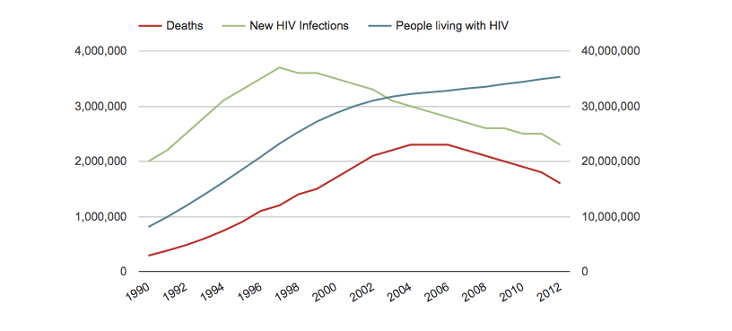
Trend of global HIV Infection and Death 1990-2013
data sources:AIDSinfoonline.org

Slide 3
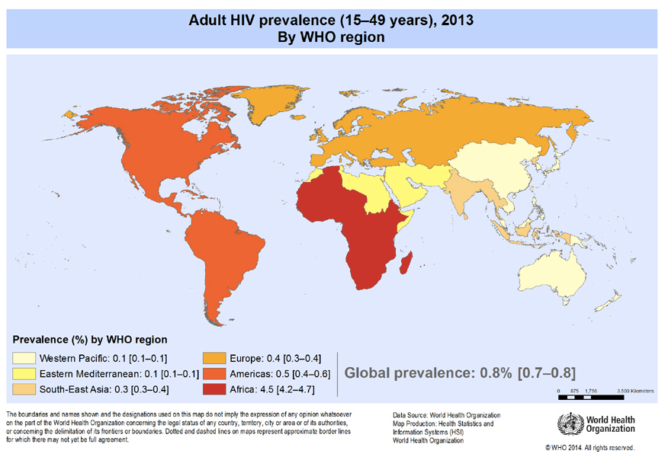

Slide 4
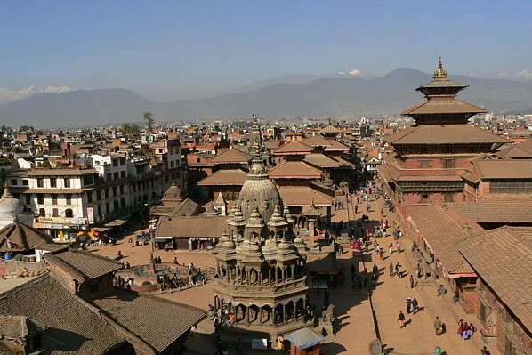
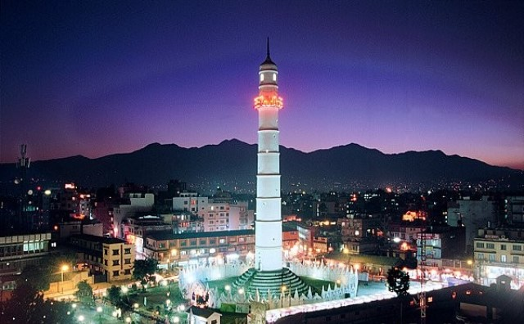


Slide 5
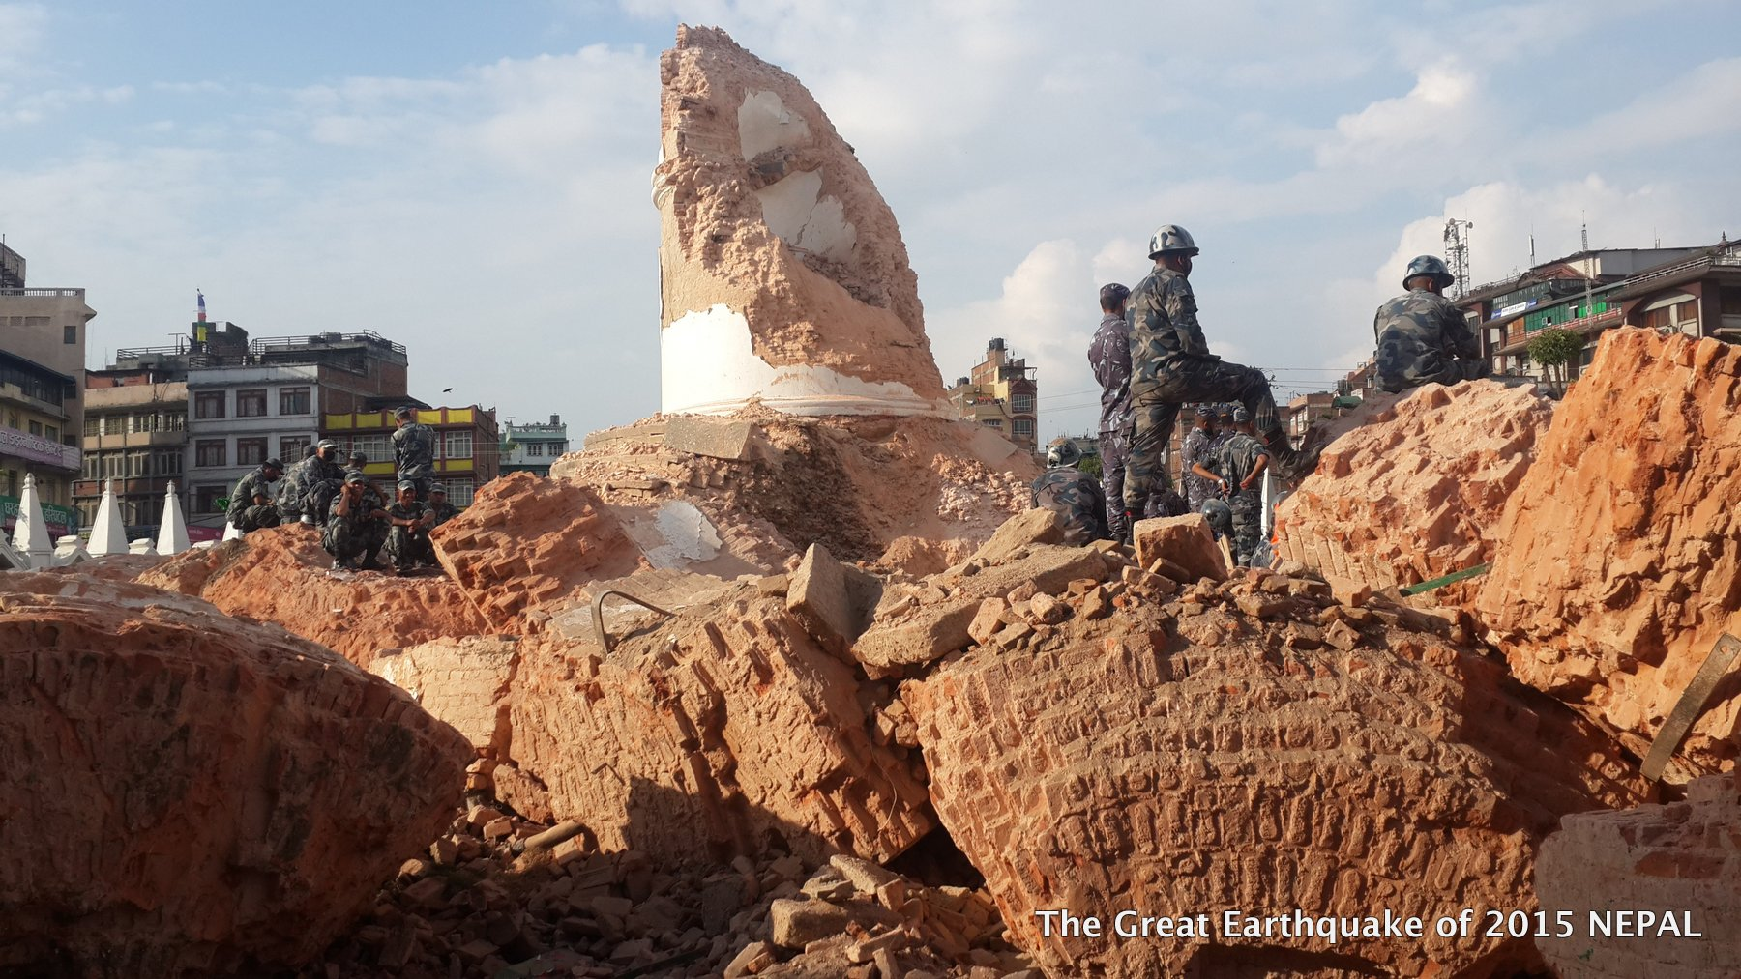
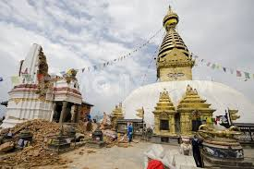
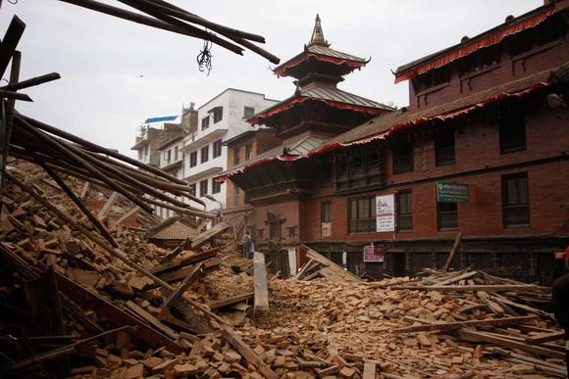

Slide 6
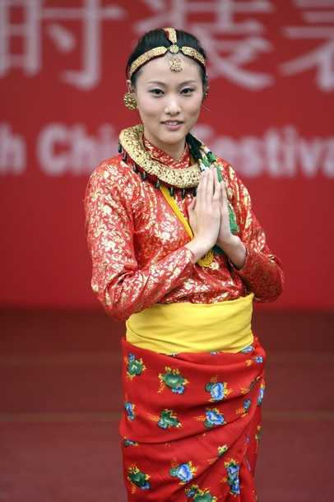


Slide 7
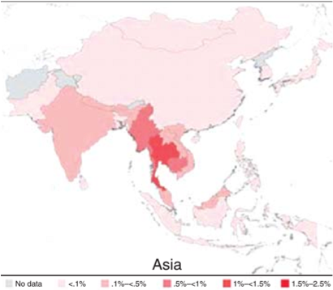

HIV Prevalence:

Slide 8
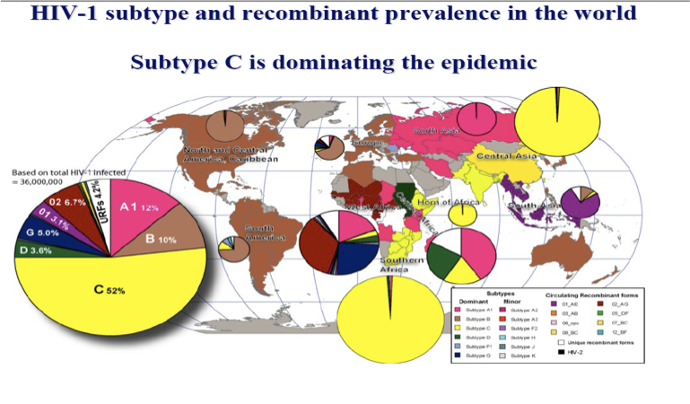

Slide 9
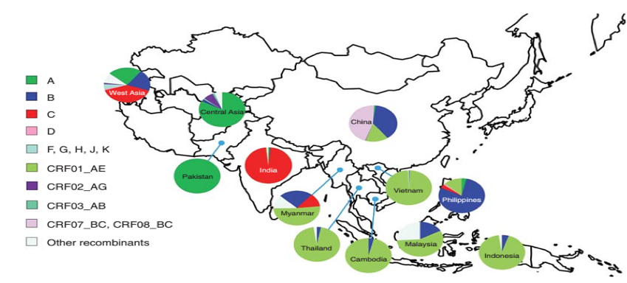
Subtypes and CRFs distribution in Asia:

Slide 10
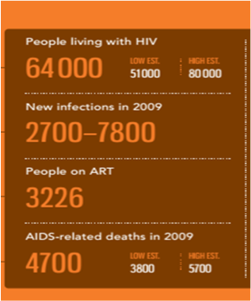
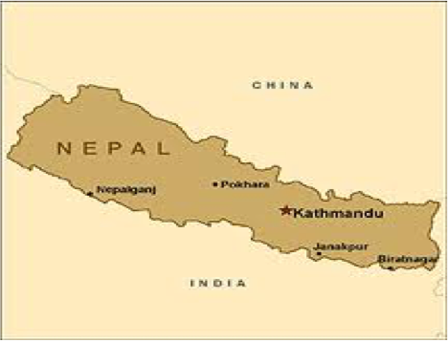


Epidemic snapshot of HIV in Nepal

Slide 11



Slide 12
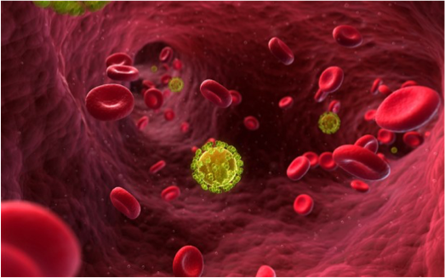



Slide 13
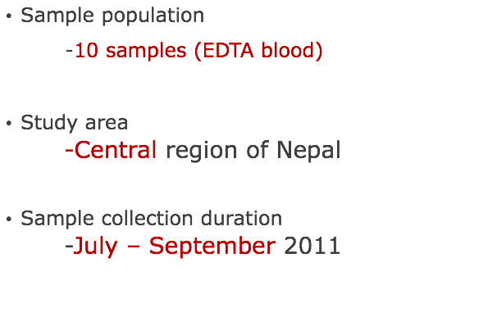
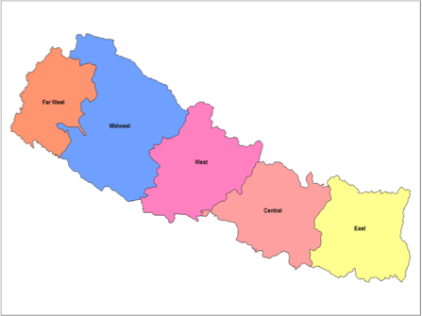
Subjects

Slide 14
Clinical characteristics of selected sample
Sample I.D | Year of Infection | Location | Risk Group | Viral load | ART status
NP003 | 2007 | Nawalparasi | HSR | 3,685 | NONE
NP004 | 2008 | Chitwan | HSR | 79,787 | AZT,3TC,NVP
NP005 | 2008 | Nawalparasi | HSR | 5,942 | NONE
NP007 | 2009 | Chitwan | IDU | 3,298 | AZT,3TC,NVP
NP008 | 2011 | parsa | MTCT | 31,940 | NONE
NP010 | 2001 | Chitwan | HSR | 10,413 | AZT,3TC,NVP
NP014 | 2011 | Chitwan | HSR | 5,942 | AZT,37C,NVP
NP015 | 2011 | Chitwan | HSR | 63,485 | NONE
NP016 | 2011 | Chitwan | HSR | 14,420 | AZT,3TC,NVP
NP021 | 2011 | Gorkha | HSR | 4,599 | AZT,3TC,EFV
NP023 | 2008 | Chitwan | HSR | 22,777 | AZT,3TC,NVP
NP028 | 2011 | Makwanpur | HSR | < 40 | AZT,3TC,NVP
NP035 | 2011 | Chitwan | MTCT | 8,64,318 | d4T,3TC,EFV
NP041 | 2010 | Chitwan | IDU | 4,599 | AZT,3TC,NVP
NP046 | 2009 | Chitwan | IDU | 40,192 | NONE
NP051 | 2010 | Chitwan | HSR | 159,488 | AZT,3TC,NVP
NP054 | 2003 | Chitwan | IDU | 25,980 | AZT,3TC,NVP
NP065 | 2010 | Chitwan | MSM | 2,176 | NONE
NP068 | 2007 | Gorkha | HSR | 2,230 | NONE
NP069 | 2011 | Chitwan | MTCT | 6,067 | NONE
NP071 | 2009 | Chitwan | IDU | 51,218 | AZT,3TC,NVP
NP074 | 2011 | Nawalparasi | HSR | 86,103 | AZT,3TC,NVP
NP075 | 2009 | Nawalparasi | HSR | 7,314 | NONE
NP076 | 2009 | Nawalparasi | HSR | 9,649 | NONE
NP078 | 2011 | Chitwan | MTCT | 3,186 | NONE

Slide 15
Clinical characteristics of selected sample
Sample I.D | Year of Infection | Location | Risk Group | Viral load | ART status
NP079 | 2011 | Chitwan | HSR | 9,649 | NONE
NP080 | 2005 | Nawalparasi | HSR | 21,253 | NONE
NP082 | 2011 | Nawalparasi | HSR | 32,235 | NONE
NP084 | 2008 | Chitwan | HSR | 44,285 | NONE
NP086 | 2011 | Parsa | HSR | 4,695 | AZT,3TC,NVP
NP089 | 2001 | Chitwan | HSR | 60,480 | NONE
NP091 | 2007 | Chitwan | HSR | 3,535 | NONE
NP092 | 2006 | Nawalparasi | MSM | 21,265 | AZT,3TC,NVP
NP093 | 2010 | Chitwan | HSR | 5,545 | NONE
NP095 | 2011 | Chitwan | HSR | <40 | AZT,3TC,EFV
NP097 | 2009 | Nawalparasi | MSM | 1,819 | NONE
NP100 | 2011 | Nawalparasi | MTCT | 9,625 | NONE
NP101 | 2011 | Chitwan | HSR | 5,807 | NONE
NP102 | 2010 | Nawalparasi | HSR | 31,794 | AZT,3TC,NVP
NP103 | 2010 | Chitwan | HSR | 2,612 | AZT,3TC,NVP
NP104 | 2010 | Chitwan | HSR | 159,488 | NONE
NP107 | 2003 | Chitwan | IDU | 25,980 | AZT,3TC,NVP
NP111 | 2010 | Chitwan | HSR | 2,176 | NONE
NP113 | 2003 | Gorkha | HSR | 2,230 | AZT,3TC,NVP
NP115 | 2011 | Chitwan | MSM | 6,067 | NONE
NP119 | 2011 | Chitwan | HSR | 51,218 | NONE
NP120 | 2008 | Nawalparasi | HSR | 86,103 | AZT,3TC,NVP
NP122 | 2009 | Nawalparasi | HSR | 7,314 | NONE
NP128 | 2009 | Nawalparasi | HSR | 9,649 | NONE
NP131 | 2011 | Chitwan | MTCT | 3,186 | NONE

Slide 16
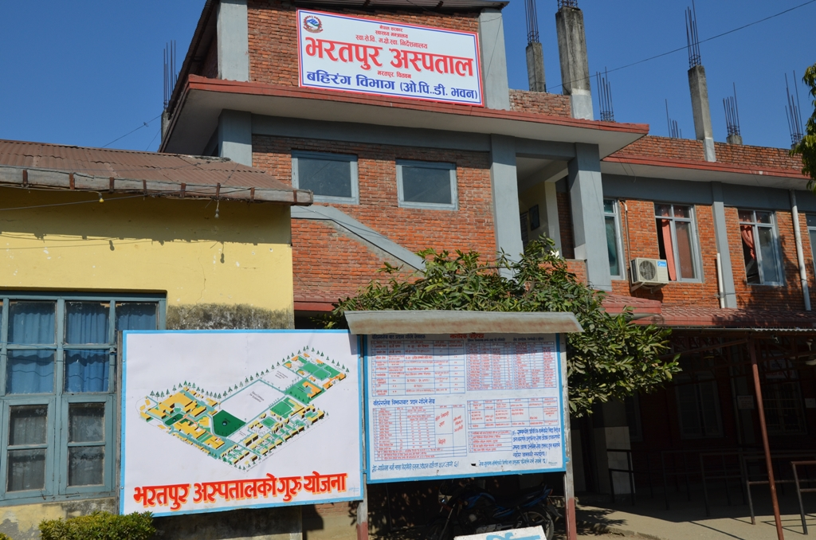
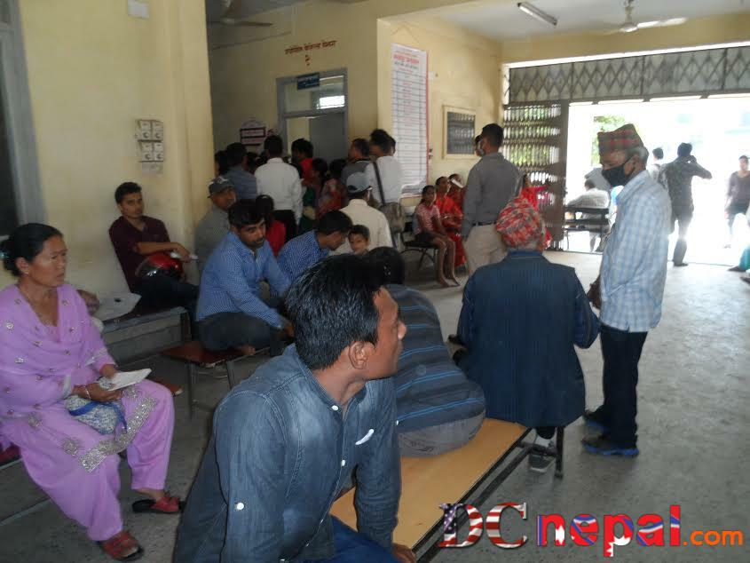

Slide 17
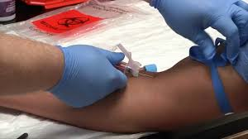

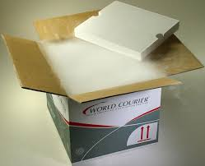
Siriraj hospital in bangkok

Slide 18
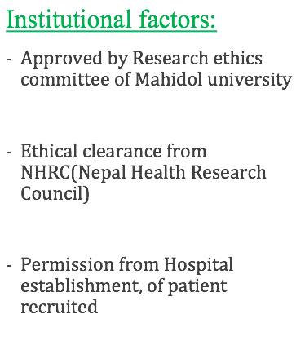
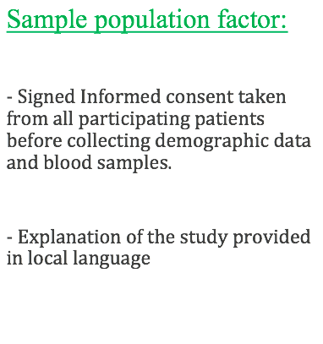
Ethical issues

Slide 19
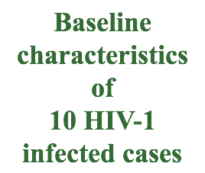
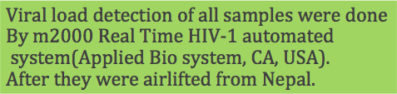
Characteristics | Total patients | ART Naïve patients | ART experienced
 | n | n | n
Number of patients | 10 | 7 | 3
Male | 6 | 4 | 2
Female | 4 | 3 | 1
Transmission mode
Heterosexual | 5 | 4 | 1
Homosexual | 1 | 1 | 0
MTCT | 2 | 1 | 1
IDU | 2 | 1 | 1
 | median | min-max | median
Age (years) | 33 | 5-57 | 30
CD4⁺ T cells | 365.5 | 8 - 1188 | 443
Viral load (log copies/ml) | 3.3 | 1.60 – 6.00 | 3.61

Slide 20
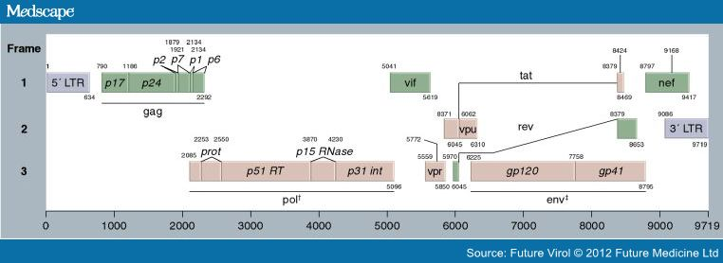

Slide 21
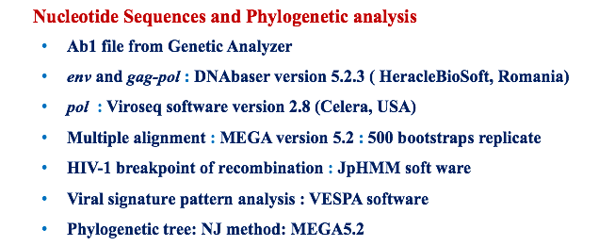

Slide 22


Slide 23
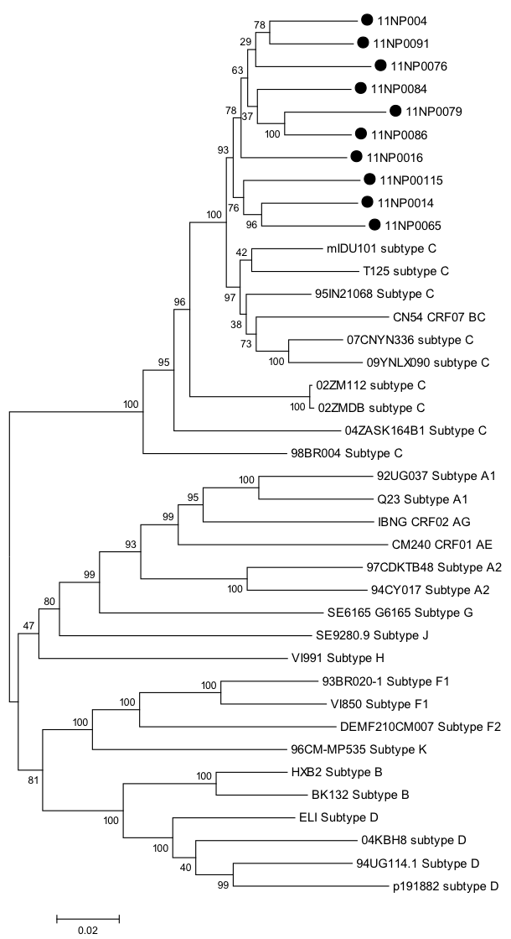

Phylogenetic analysis of 10 HIV-1 nearly full length nucleotide sequences

Slide 24
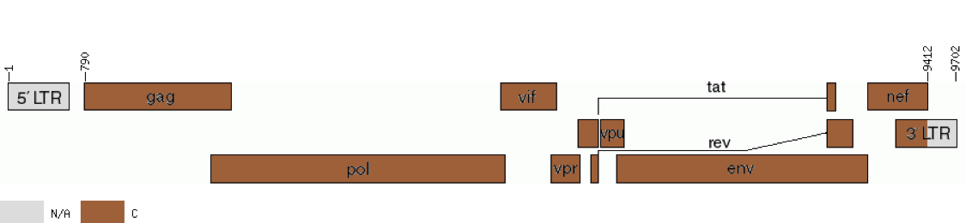
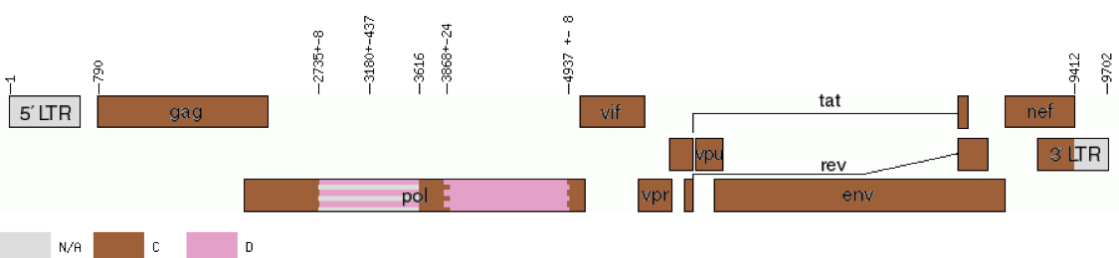
9 samples :
11NP004,11NP014, 11NP016, 11NP065, 11NP076, 11NP084, 11NP086, 11NP091 and 11NP115
1 sample 11NP079

Slide 25
Fragment Start Position | Uncertainty Region Start - End | Breakpoint Interval Start - End | Fragment End Position | Fragment Subtype
Position in the original sequence [pred_recombination], [recombination_incl_UR_and_BPI], [UR_and_BPI]
1 | - | - | 789 | N/A
790 | 2701 - 2716 | - | 2716 | C
2717 | 2717 - 3590 | - | 3590 | D
3591 | 3591 - 3597 | 3818 - 3865 | 3828 | C
3829 | - | - | 4902 | D
4903 | - | - | 9390 | C
9391 | - | - | 9681 | N/A
Position based on HXB2 numbering [pred_recombination] [recombination_incl_UR_and_BPI] [UR_and_BPI]

Slide 26
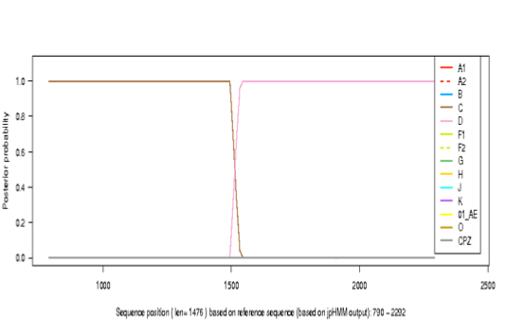
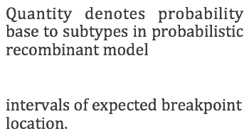

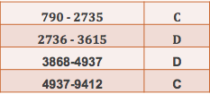

Slide 27
Mutation pattern of amino acids and drug resistance
Sample ID | HIV diagnosis year | Route of infection | Plasma HIV-1 RNA level (copies/ml) | HIV DRM
 |  |  |  | PI NRTI NNRTI |  |  | Drugs
11NP008 | 2011 | MTCT | 31,940 | - | - | K103R | Efavirenz
11NP010 | 2010 | HSR | 10,413 | - | - | V179D | Delavirdine
11NP068 | 2009 | HSR | 2,230 | - | - | E138A | Etravirine
11NP071 | 2009 | IDU | 51,218 | - | - | K103R | Efavirenz
11NP82 | 2010 | HSR | 32,325 | A71V | - | - | Ritonavir
11NP103 | 2010 | HSR | 2,612 | A71T | - | - | Indinavir
11NP104 | 2010 | MTCT | 159,297 | - | - | V108I | Efavirenz
11NP122 | 2011 | MSM | 58,782 | A71T | - | -

Slide 28
Amino acid polymorphism in different subtypes
Position 31 32 33 34 35 36 37 38 39 40 41 42 43 44 45 46 47 48 49 50 51 52 53 54 55 56 57 58 59 60
B-cons T V L E E M N L P G R W K P K M I G G I G G F I K V R Q Y D
C-cons . . . . . V S . . . K . R . . . . . . . . . . . . . . . E
NP008 . . . . . D I . . . . . . . . . . . . . . . . . . . . . D Q
NP015 . . . . . . . N . . . . . . . . . . . . . . . . . . . . D H
Position 71 72 73 74 75 76 77 78 79 80 81 82 83 84 85 86 87 88 89 90 91 92 93 94 95 96 97 98 99
B-cons A I G T V L V G P T P V N I I G R N L L T Q I G C T L N F
C-cons . . . . . . . . . . . . . . . . . . M . . . . . . . . . .
NP008 . . . . . . I . . . . . . . . . . . . . . . . . . . . . .
NP015 . . . . . . . . . . . I . . . . . . . . . . . . . . . . .
Subtype C NP015 one major mutation at position 82 one minor at 60
CRF-08BC NP008 three minor mutation at position 36,60 and 77

Slide 29
Signature sequence pattern analysis
295-----------------------------305---------------------------315
NP003- HSR T C T R P S N N T R K S I I G P G Q T F Y
NP131- MSM N . . . . N . . . . . . . . . . . . . . .
----------------------------325---------------
NP003- HSR A T G D I I G D I R Q A H C N I
NP131- MSM . . . . . . . A V . . . . . . .
295------------------------------305-----------------------------315
NP003-HSR T C T R P S N N T R K S I I G P G Q T F Y
NP128-MTCT N . . . . . . . . . Q R . . . . . . A . .
----------------------------------325---------------
NP003- HSR A T G D I I G D I R Q A H C N I
NP128-MTCT . . . . . . . E . . K . . . . .

Slide 30
Signature sequence pattern analysis
295-----------------------------305---------------------------315
NP003- HSR T C T R P S N N T R K S I I G P G Q T F Y
NP041- IDU V . I . . N . . . . . . . . . . . . . . .
---------------------------------325--------------------
NP003- HSR A T G D I I G D I R Q A H C N I
NP041- IDU . . . . . . . . . . . . . . . .
9 variable positions amino acid sequences between different risk groups
All risk group had GPGQ pattern at v3 loop.

Slide 31
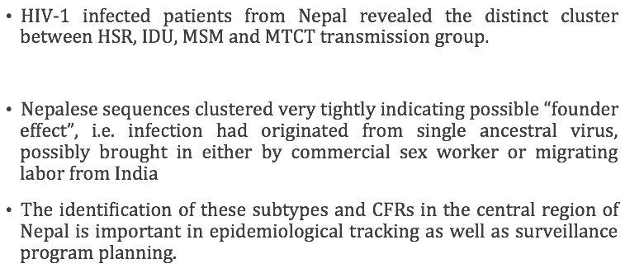

Slide 32
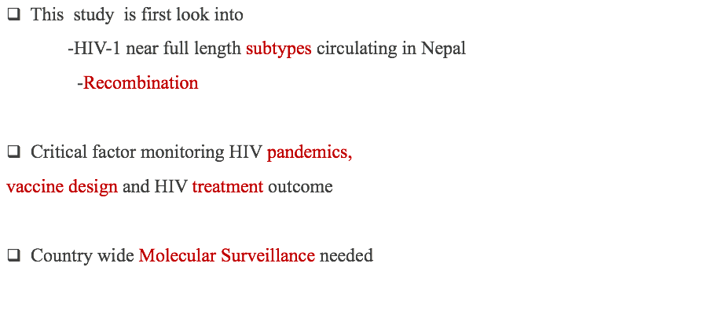

Slide 33

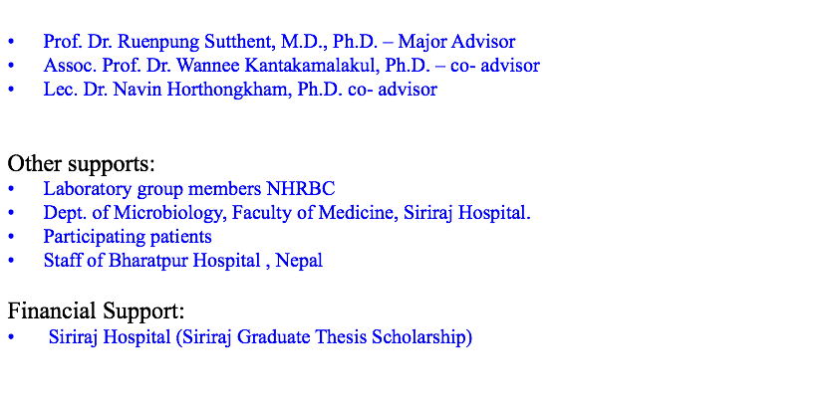

Slide 34

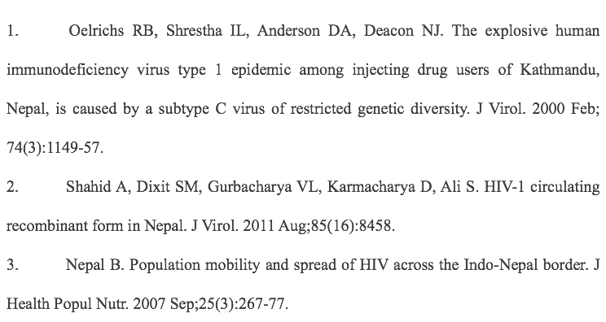

Slide 35
