Slide 1


Engaging Youth in HIV/STD Prevention Hartford Youth HIV Identification & Linkage (HYHIL) Model
Nilda Fernandez, LMSW
Danielle Warren-Dias, MSc.
December 1, 2015
Notes:
In March 2015, The NASTAD issued a Policy Statement on Community Engagement to promote innovative health department community engagement strategies. This policy statement is in alignment with (NHAS) the Hartford Youth HIV Identification and Linkage (HYHIL) Consortia’s mission and goals.

Slide 2
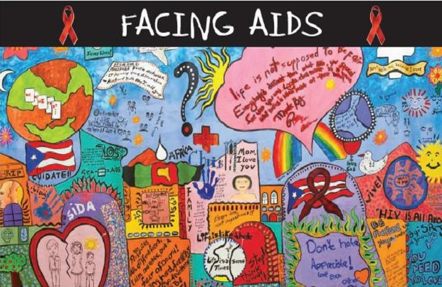
In Recognition of World AIDS DAY

Slide 3
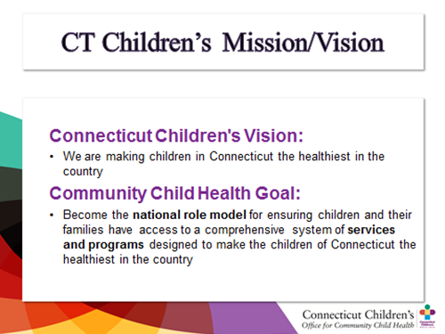
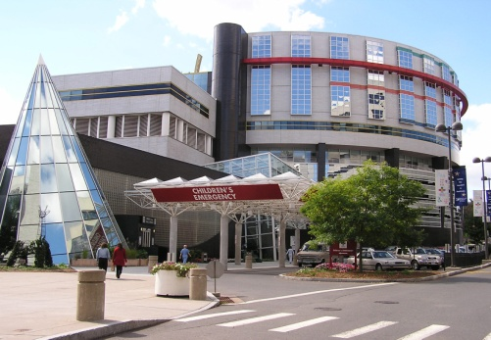


Connecticut Children’s Medical Center

Slide 4
Office of Community Child Health
Vision
Approach
Be a community resource and a national leader in addressing critical health needs and challenges of children on the local, regional, state, national and global levels
Have a strong record of developing, supporting, and spreading innovative programs
Strengthening Programs
- Evaluation tools
- Access to resources
Leveraging synergies across programs
- Best practices
-Promoting partnerships
Incubating new innovations

Slide 5

Hartford Youth HIV Identification & Linkage Consortia Mission
To prevent the transmission of HIV and sexually transmitted infections (STIs) among youth through innovative outreach and preventive education, to enhance youth-focused HIV/STI screenings in collaboration with community agencies, to identify HIV/STI positive youth and link them into care, community resources and employment/career services.
Notes:
The proposed is the crux of HYHIL efforts- finding innovative ways to engage youth, CBOs, stakeholders in collaboration to do outreach and prevention in the community/schools and to offer HIV screenings.
Currently, HYHIL is looking for ways to scale up the HYHIL model and expand to other communities/states.

Slide 6
History of HYHIL
In 1999 Identified Needs:
Collaboration
Advocacy
Improve health outcomes for youth affected HIV Disease
Got out of AIDS in order to prevent AIDS
Community engagement
Convened roundtable discussions
Secured seed funding
Established the Hartford Youth HIV Identification & Linkage Consortium
Notes:
In 1999, our program saw the need to collaborate in order to avoid duplication of services. Our program began to see increases of HIV infections among youth under the age of 24.
Advent of HIV medications (people were living longer and not dying)
Important to advocate for the delivery of youth focused services including outreach efforts and to think out of the box.

Slide 7
Vulnerable Populations Served
10 million new yearly STD infections among 13-24 year olds which are surrogate markers for future HIV infections
2013 CT STD cases reported:
Chlamydia –68% among 15-24 year olds
Gonorrhea –49% among 10-24 year olds
Syphilis – 30% among 20-24 year olds
There are 10,637 current cases of HIV in CT as of 2013
33% Black
32% Hispanic
28% of new HIV cases in 2013 were 20-29 year olds
6% of new HIV cases in 2013 were under 20
CT ranked 7th in AIDS cases
Cost Effective - $16 Billion in health care costs/year
Information from: State of CT DPH and Center for Disease Control & Prevention
Notes:
Many youth are disfranchised and have poor social determinants of health and affected by significant racial/ethnic disparities…such as; live in poverty, are homeless, under insured, low educational attainment, invincibility factor,
National and CT stats:
CDC estimates that half of undiagnosed HIV infections occur among youth ages 13-24
CDC estimates that 18.1% of PLWH are not aware of their status.

Slide 8
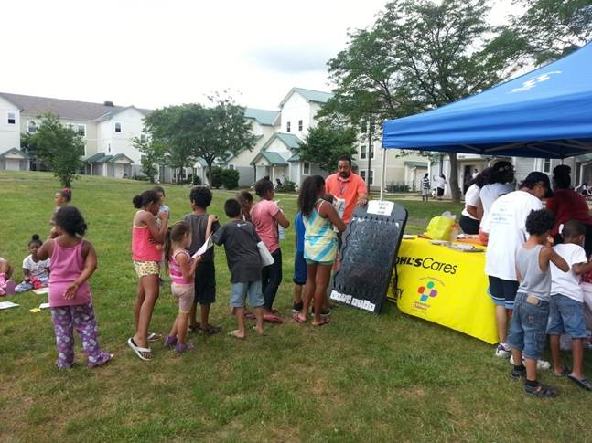
HYHIL Partners/Supporters
AIDS Connecticut
Capital Area Substance Abuse Council
Central CT Area Health Education Center
Charter Oak Health Center
City of Hartford Health & Human Services
Community Health Services of Hartford
Community Renewal Team
Connecticut Children’s Medical Center
Connecticut Department of Public Health
CT Kids Counsel
Connecticut Women’s Education and Legal Fund
Greater Hartford Ryan White Planning Council
Latino Community Services
Hartford Gay and Lesbian Health Collective
Hispanic Health Council
San Juan Center, Inc.
Southside Institute Neighborhood Alliance
The Mobile CPR Project (PENN Medicine)
Trinity College
UConn Health Center
UConn School of Social Work

Slide 9
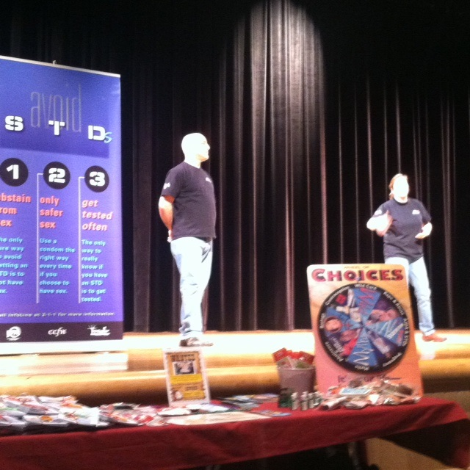
Health Interactive Project (HIP)
Targeted Intervention to students in schools with School-based Health Centers
Stop AIDS Mobile Theater Presentations
40,000 students received preventive education
Health Screenings in school settings:
~3000~HIV tests
~3200~ STD tests
1 HIV Positive (MSM)
1 Positive – HIV & Syphilis
1 newly diag. linked to Care
10% positivity rate for Chlamydia
Seeing increase of GC

Slide 10
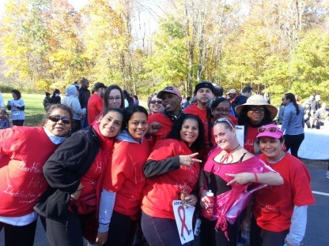
Core Elements
1) Collaboration
Engage other stakeholders (youth, community, CBOs)
Leveraging Resources/funding
Innovative, Holistic approach to prevention
2) Outreach
Raise awareness
Prevent new transmissions
Advocacy
3) Early Detection of HIV/STI
Improved health outcomes for youth
Notes:
Why Early Detection?
CT ranks 7th nationally in the rate of people living with AIDS
HIV/AIDS Continuum*
CT has 10,849 people diagnosed with HIV and 35% are not in care.
CDC estimates that and additional 18.1% of PLWH are not aware of their status. In CT, that means 2,339 are unaware of their HIV status.

Slide 11
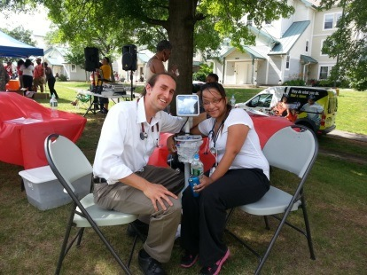
Core Elements
4) Linkage to Care and Community Resources
Medical Case Management, Mental Heath
Employment, Education
5) Structural Components:
Lead Agency
Sustainability (Creative Strategies for Funding)
Blending administrative resources among collaborators
Notes:
community engagement is an essential process in the implementation of high-impact prevention as changes in the health care landscape and HIV service ecosystems take shape. Expanding our reach via crossing sectors to pool resources.
Dissemination of HYHIL Model:
SJC partnership:
Linking youth/young adults to employment services
CORE ELEMENTS are ADAPTABLE

Slide 12
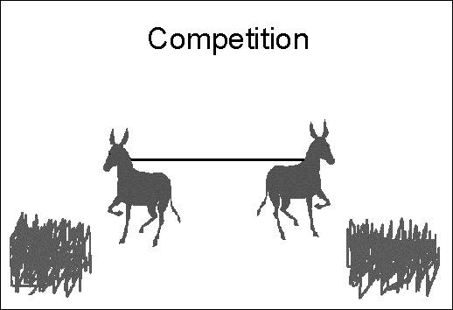
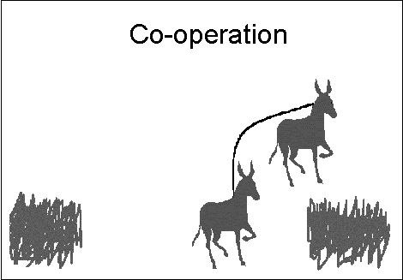


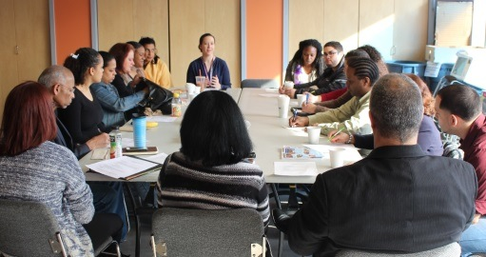
Collaboration is Key…
“Alone we can do so little; together we can do so much,”
Helen Keller
Images Courtesy of Clara Acosta Glynn, LCSW and CCMC Corporate Communications

Slide 13
Diffusion of the HYHIL Model
5 Core Elements are adaptable
Technical Assistance
Collaboration drives Innovation
Social Impact
Vulnerable Groups
Business success based on collaboration -
“…Coordinate efforts across public health and health care system is beyond disease siloes.” Julie Scofield, Executive Director, NASTAD

Slide 14
Process of Diffusion
Local Dissemination:
Ryan White Care Act- Parts A, B, D & Planning Consortium
Connecticut Dissemination:
CT HIV/AIDS Identification & Referral Task Force
New England HIV Implementation Science Network 2nd Annual Symposium
National Reach:
The White House’s Office of National AIDS Policy - National Women & Girls HIV/AIDS Awareness Day
International Reach :
XIV International AIDS Conference, Barcelona, Spain 2002
International Association for Social Workers in Group Symposium 2015
OMICS 3rd International HIV, STD, STI Conference
Notes:
As we disseminate HYHIL across the nation, we, too, are increasingly reframing activities in the context of system building, viewing early detection as but one critical step in a comprehensive process of developmental promotion, early detection, and referral and linkage. The operation of the collaborative informs and inspires our collective efforts.

Slide 15
Challenges and Success
Challenges:
Coordination –Lead Agency
Getting Buy-in from stakeholders
Overcoming Territorial
Ahead of our time
Advocacy
Sustainability
Successes:
Pooling Resources
Effective Advocacy
Effective: Reached over 40,000 youth
Shared Best Practices
Evidence Informed Approach of Prevention
Notes:
Effective Outreach: Use of media . Social, radio etc,
Shift in Culture of Collaboration:
Nat’l HIV Strategy
HYHIL Recognized as Leaders in Collaboration
HYHIL Model

Slide 16

Purpose of the Consortia:
Go beyond AIDS to prevent AIDS
Collaboration
Pooling of Resources
Social Impact
Getting to Zero AIDS Free Generation

Slide 17
Resources
http://store.samhsa.gov/shin/content/SMA14-4884/SMA14-4884.pdf
www.Womenshealth.gov
www.WomensLaw.org
www.hhs.gov/ash/oah
www.plannedparenthood.org
www.NASTAD.org
www.Hartford.gov
National Resource Center on Domestic Violence
www.nrcdv.org

Slide 18
Thank you! Gracias! Follow HYHIL @ connecticutchildrens.org FB: GetTested/HYHIL Twitter: HYHIL

