Slide 1



Modelling of steam-air gasification of char in a circulating fluidised bed
Muktar Bashir¹ and Yassir Makkawi²
¹European Bioenergy Research Institute (EBRI), Aston University ,UK
email:bashima1@aston.ac.uk
²Chemical Engineering Department, American University of Sharjah, United Arab Emirates.

Slide 2
Outline
Introduction and background
Project objectives
CFB Reactor
CFD Model
devolatilisation and gasification model
Results and discussion
Conclusion

Slide 3
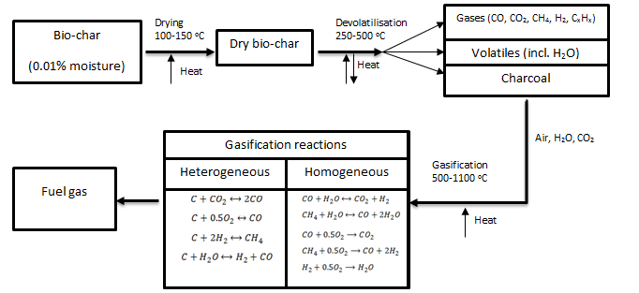
Gasification
  Gasification is the thermal conversion of organic matter(biomass, char, coal etc.) through partial oxidation in normally in air, oxygen and/or steam
  The main products are mainly tar, char and non-condensable gases.
  It consist of three methods to breakdown the organic compound into these product constituents (drying, devolatilisation, and gasification reactions) .

Slide 4
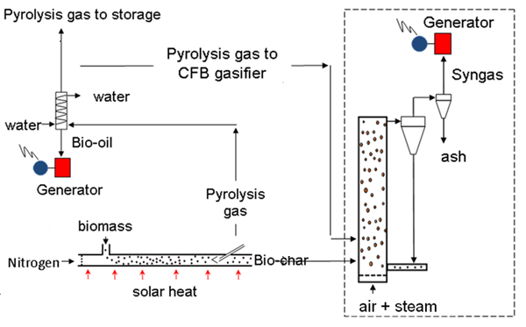
Project objectives
  Develop a CFD model for solar activated bio-char gasification in a circulating fluidised bed
  Predict the hydrodynamics of the process
  Implement tar catalytic cracking of bio-char in the process

Slide 5
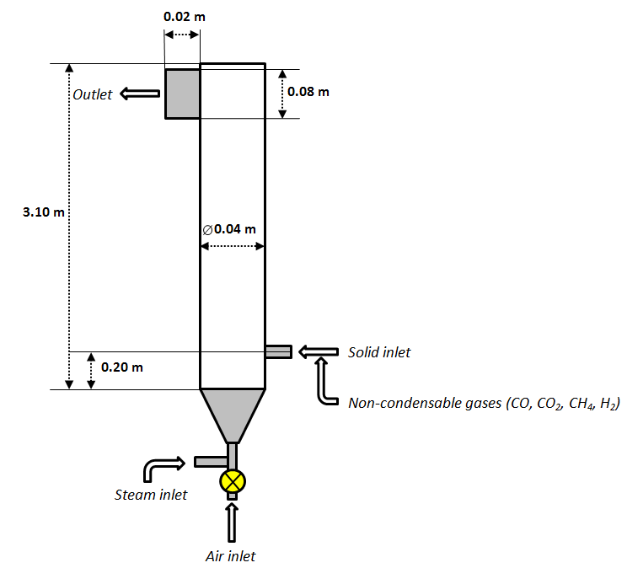
CFB reactor
  The products were assumed to be from a solar induced pyrolysis process
  Circulating fluidised bed offers high heat and mass transfer for gasification at low temperatures

Slide 6
CFD model
  Model
  The two fluid (Eulerian-Eulerian) model was solved using navier-stokes equations of mass, momentum, and granular temperature.
  The kinetic theory of granular flow (KTGF) was implemented to provide closure equations
  The heat transfer coefficient was calculated based on Gunn correlation in terms of Nusselts number
  Boundary Conditions
  Pressure outlet is at atmospheric pressure gradient with a fully developed viscous flow (tube length >> hydraulic entry length)
  No-slip wall condition for the gas phase and shear wall condition for the solid phase
  Adiabatic temperature wall condition

Slide 7
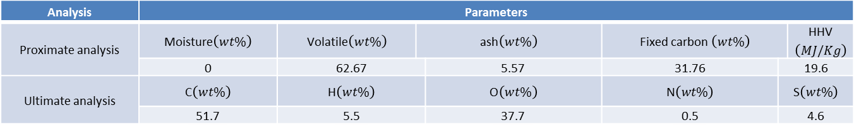
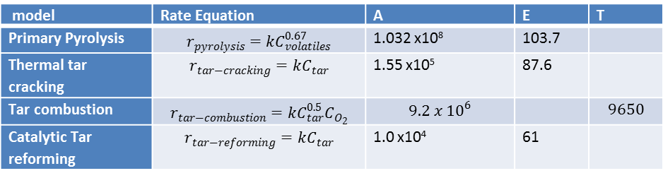
devolatilisation model
Switch grass char
Rate of biomass devolatilisation
Analysis | Parameters
Proximate analysis | Moisture$\left(wt\%\right)$ | Volatile$\left(wt\%\right)$ | ash$\left(wt\%\right)$ |  | Fixed carbon $\left(wt\%\right)$ |  | HHV$\left(MJ/Kg\right)$
 | 0 | 62.67 |  | 5.57 | 31.76 | 19.6
Ultimate analysis | C$\left(wt\%\right)$ | H$\left(wt\%\right)$ |  | O$\left(wt\%\right)$ | N$\left(wt\%\right)$ | S$\left(wt\%\right)$
 | 51.7 | 5.5 |  | 37.7 | 0.5 | 4.6
model | Rate Equation | A | E | T
Primary Pyrolysis | $$r_{pyrolysis}=kC_{volatiles}^{0.67}$$ | 1.032 x10⁸ | 103.7
Thermal tar cracking | $$r_{tar−cracking}=kC_{tar}$$ | 1.55 x10⁵ | 87.6
Tar combustion | $$r_{tar−combustion}=kC_{tar}^{0.5}C_{O_{2}}$$ | $$9.2 x {10}^{6}$$ |  | $$9650$$
Catalytic Tar reforming | $$r_{tar−reforming}=kC_{tar}$$ | 1.0 x10⁴ | 61

Slide 8
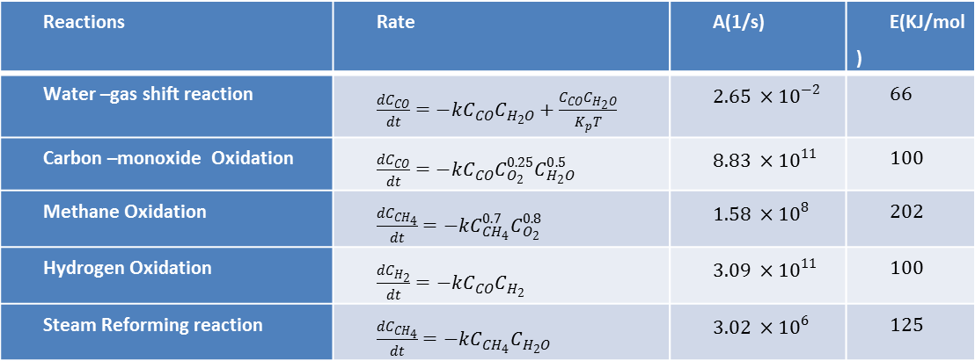
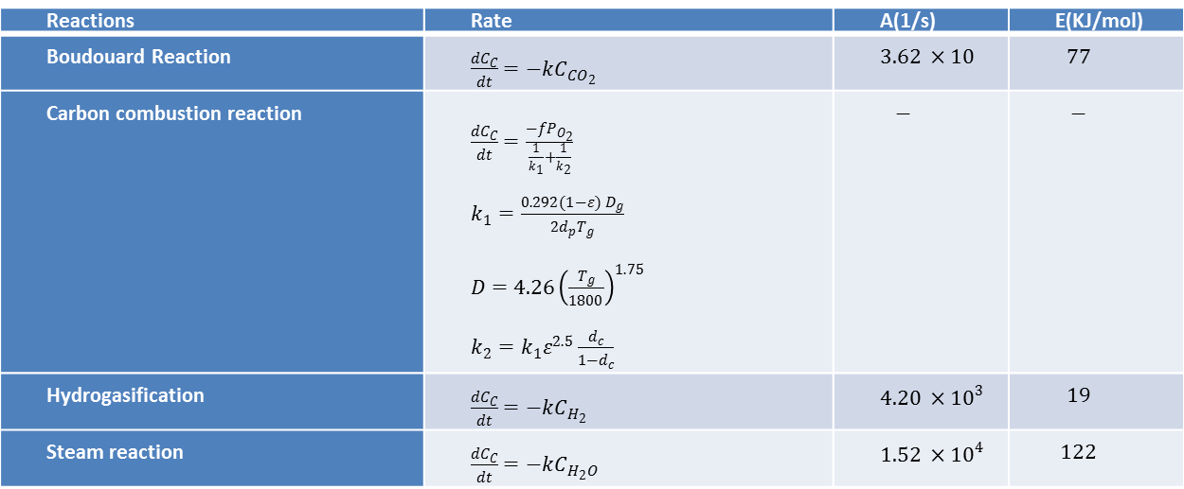
Gasification model
Heterogeneous reactions
Homogeneous reactions
Reactions | Rate | A(1/s) | E(KJ/mol)
Boudouard Reaction | $\frac{dC_{C}}{dt}=−kC_{{CO}_{2}}$ | $3.62 ×10$ | $$77$$
Carbon combustion reaction | $\frac{dC_{C}}{dt}=\frac{−fP_{O_{2}}}{\frac{1}{k_{1}}+\frac{1}{k_{2}}}$ $k_{1}=\frac{0.292(1−ε) D_{g}}{{2d}_{p}T_{g}}$ $D=4.26{\left(\frac{T_{g}}{1800}\right)}^{1.75}$ $k_{2}=k_{1}ε^{2.5}\frac{d_{c}}{1−d_{c}}$ | $$−$$ | $$−$$
Hydrogasification | $\frac{dC_{C}}{dt}=−kC_{H_{2}}$ | $4.20 ×{10}^{3}$ | $$19$$
Steam reaction | $\frac{dC_{C}}{dt}=−kC_{H_{2}O}$ | $1.52 ×{10}^{4}$ | $$122$$
Reactions | Rate | A(1/s) | E(KJ/mol)
Water –gas shift reaction | $\frac{dC_{CO}}{dt}=−kC_{CO}C_{H_{2}O}+\frac{C_{CO}C_{H_{2}O}}{K_{p}T}$ | $2.65 ×{10}^{−2}$ | $$66$$
Carbon –monoxide Oxidation | $\frac{dC_{CO}}{dt}=−kC_{CO}C_{O_{2}}^{0.25}C_{H_{2}O}^{0.5}$ | $8.83 ×{10}^{11}$ | $$100$$
Methane Oxidation | $\frac{dC_{{CH}_{4}}}{dt}=−kC_{{CH}_{4}}^{0.7}C_{O_{2}}^{0.8}$ | $1.58 ×{10}^{8}$ | $$202$$
Hydrogen Oxidation | $\frac{dC_{H_{2}}}{dt}=−kC_{CO}C_{H_{2}}$ | $3.09 ×{10}^{11}$ | $$100$$
Steam Reforming reaction | $\frac{dC_{{CH}_{4}}}{dt}=−kC_{{CH}_{4}}C_{H_{2}O}$ | $3.02 ×{10}^{6}$ | $$125$$

Slide 9
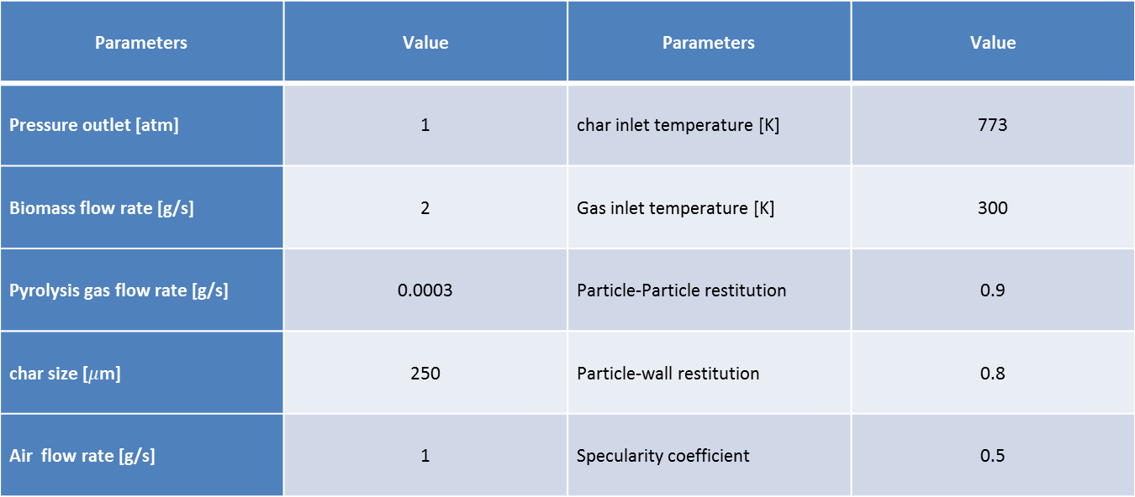
Operating conditions
Parameters | Value | Parameters | Value
Pressure outlet [atm] | 1 | char inlet temperature [K] | 773
Biomass flow rate [g/s] | 2 | Gas inlet temperature [K] | 300
Pyrolysis gas flow rate [g/s] | 0.0003 | Particle-Particle restitution | 0.9
char size [$μ$m] | 250 | Particle-wall restitution | 0.8
Air flow rate [g/s] | 1 | Specularity coefficient | 0.5

Slide 10
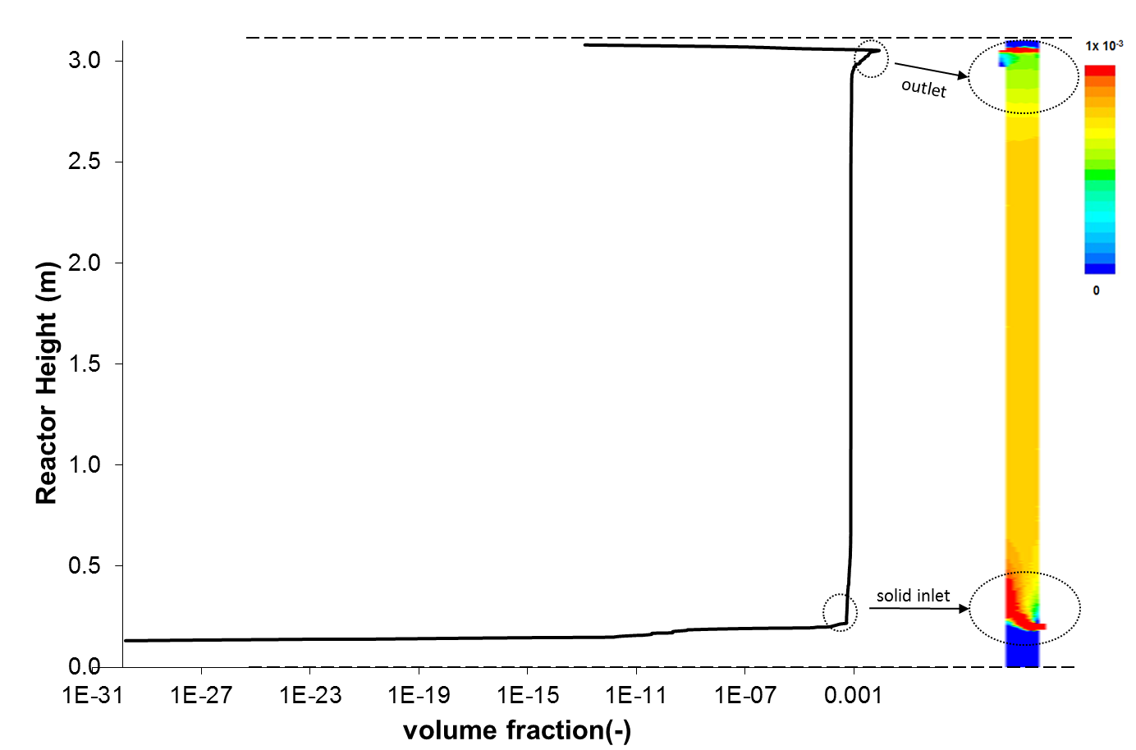
Concentration profiles
  Initial inlet turbulence showing the sweeping effect of the gas
  High concentration of solids at the wall

Slide 11
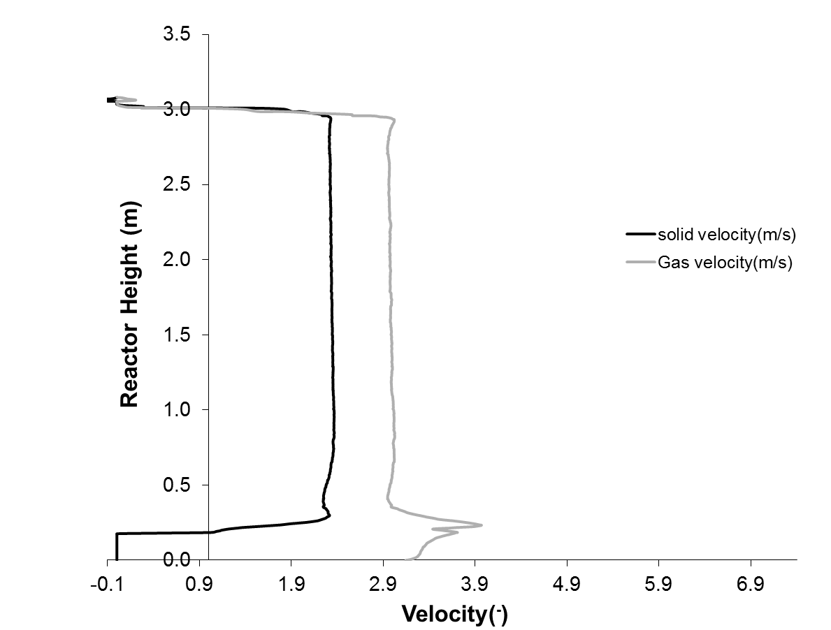
Velocity Profiles
  Uniform flow of char particles observed along the reactor, except towards the exit section
  Highest char velocity is near the core region except at the outlet section due to the effect of cone solid-gas separator

Slide 12
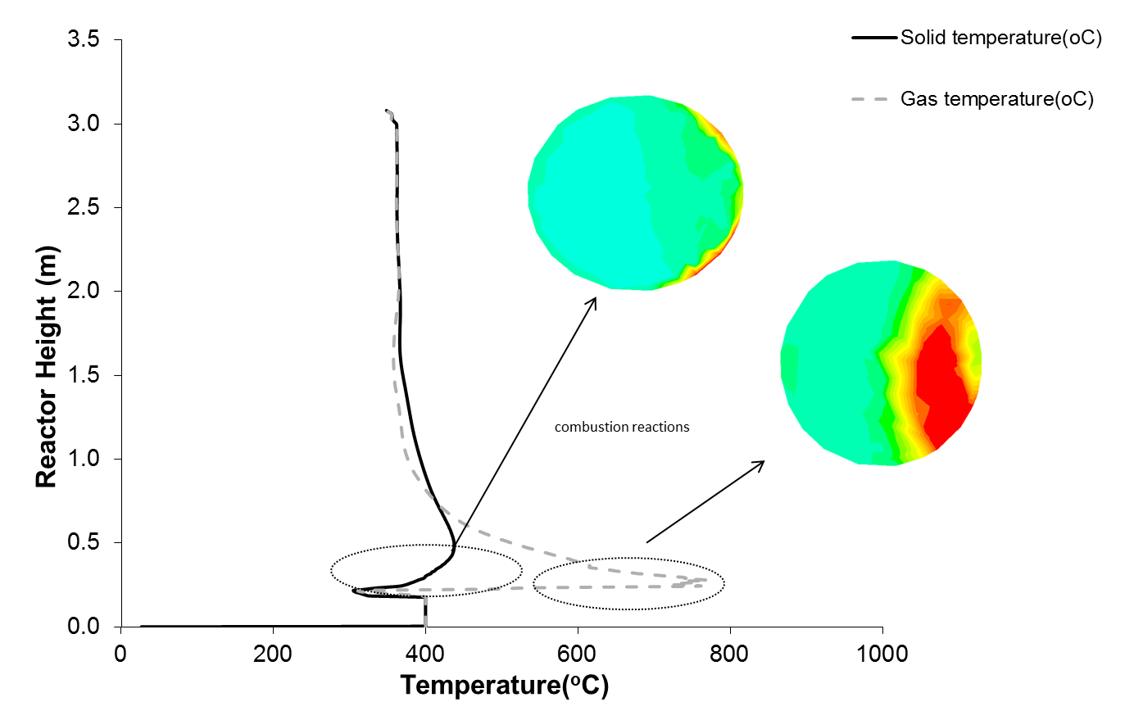
Temperature distribution
  Uniform temperature distribution
  Sort entrance length of ~ 1 m

Slide 13
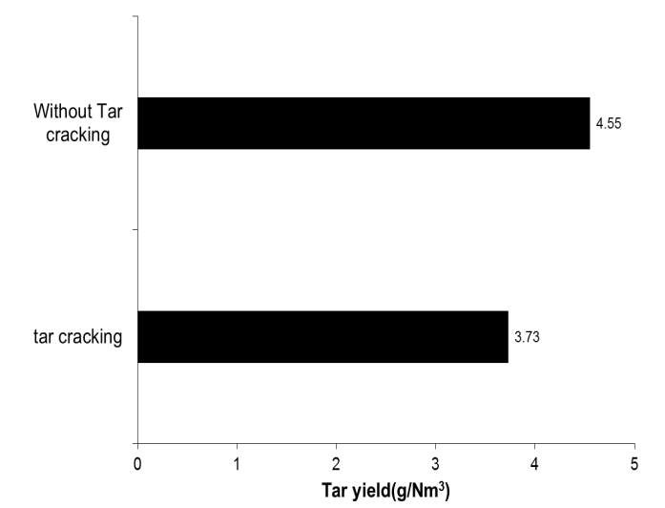
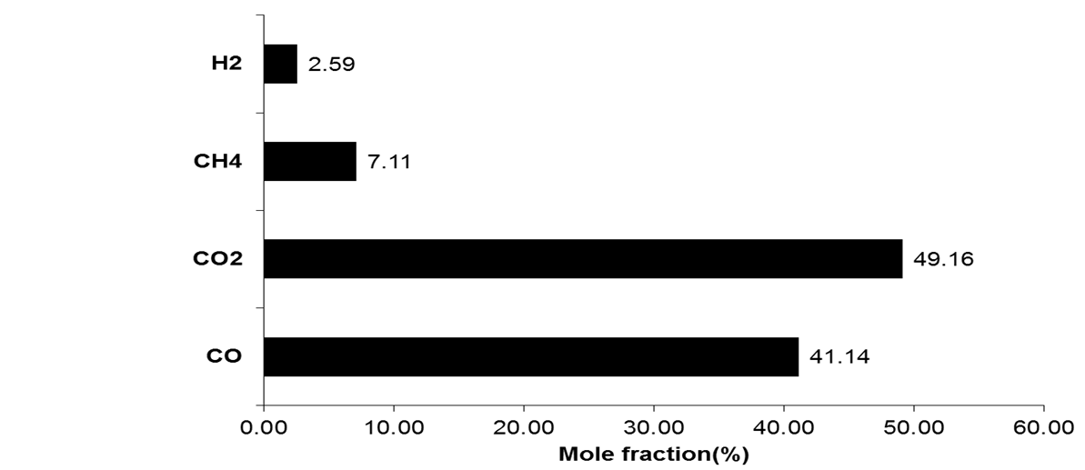
Product composition
  The gas composition produced a heating value of 6.96MJ/Nm³
  The tar content is reduced by 4%

Slide 14
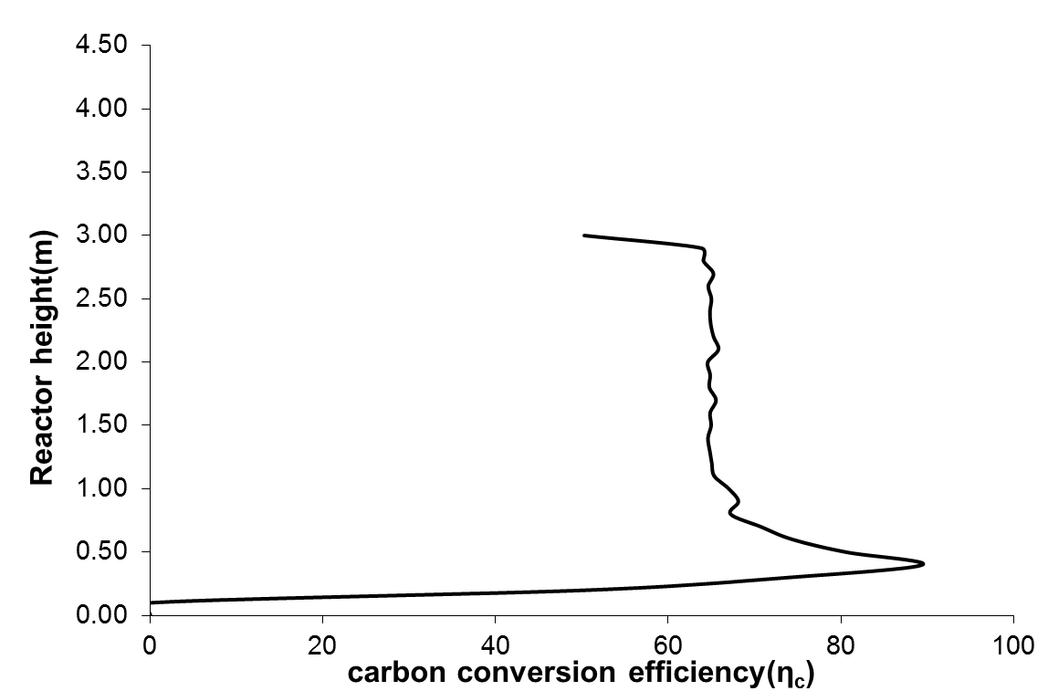
Carbon conversion efficiency
  Achieved carbon conversion efficiency of 65%
  The effect is prevalent at the entrance of the bio-char into the reactor

Slide 15
Conclusion
  Switch grass char gasification has been modelled in circulating fluidised bed
  CFD analysis of the heat transfer and flow along the reactor is studied
  Effect of tar cracking was implemented to simulate a realistic process
  NEXT STEP
  Solve the solid low temperature issue by using sand to improve heat and mass transfer
  Carry out parametric and sensitivity analysis of the reactor

Slide 16

  Thank You

