Slide 1

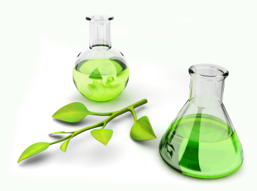

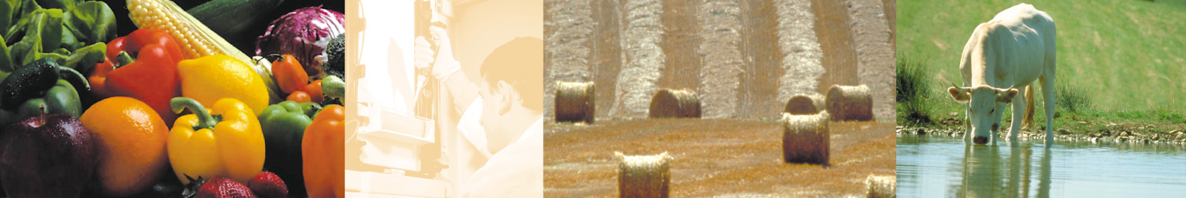
Novel lignocellulosic hydrolyzate detoxification process using pyrochar from digestate: Application for bioethanol fermentation
F. Monlau, C. Sambusiti, A. Barakat
Past and Present Research Systems of Green Chemistry
September 14-16/2015 Orlando (USA)

Slide 2
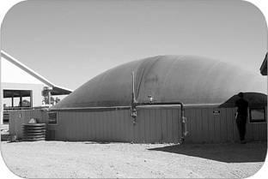
What is Anaerobic digestion ?
Biogas
● mainly composed of CH₄ (55–75%) and CO₂ (25–45%)
● Farm scale: CHP conversion with around 35% electricity efficiency.
An anaerobic biological process using anaerobic micro-organisms to convert biomass into biogas and digestate
Digestate
AD process characteristics
Temperature: ≈35°C (mesophilic), ≈ 50°C (thermopilic)
pH ≈ 6,5-7,5
HRT ≈ 60-100 days⁻¹
● mixture of microbial biomass and undigested material.
● around 45% to 75% of the initial organic matter feed.

Slide 3
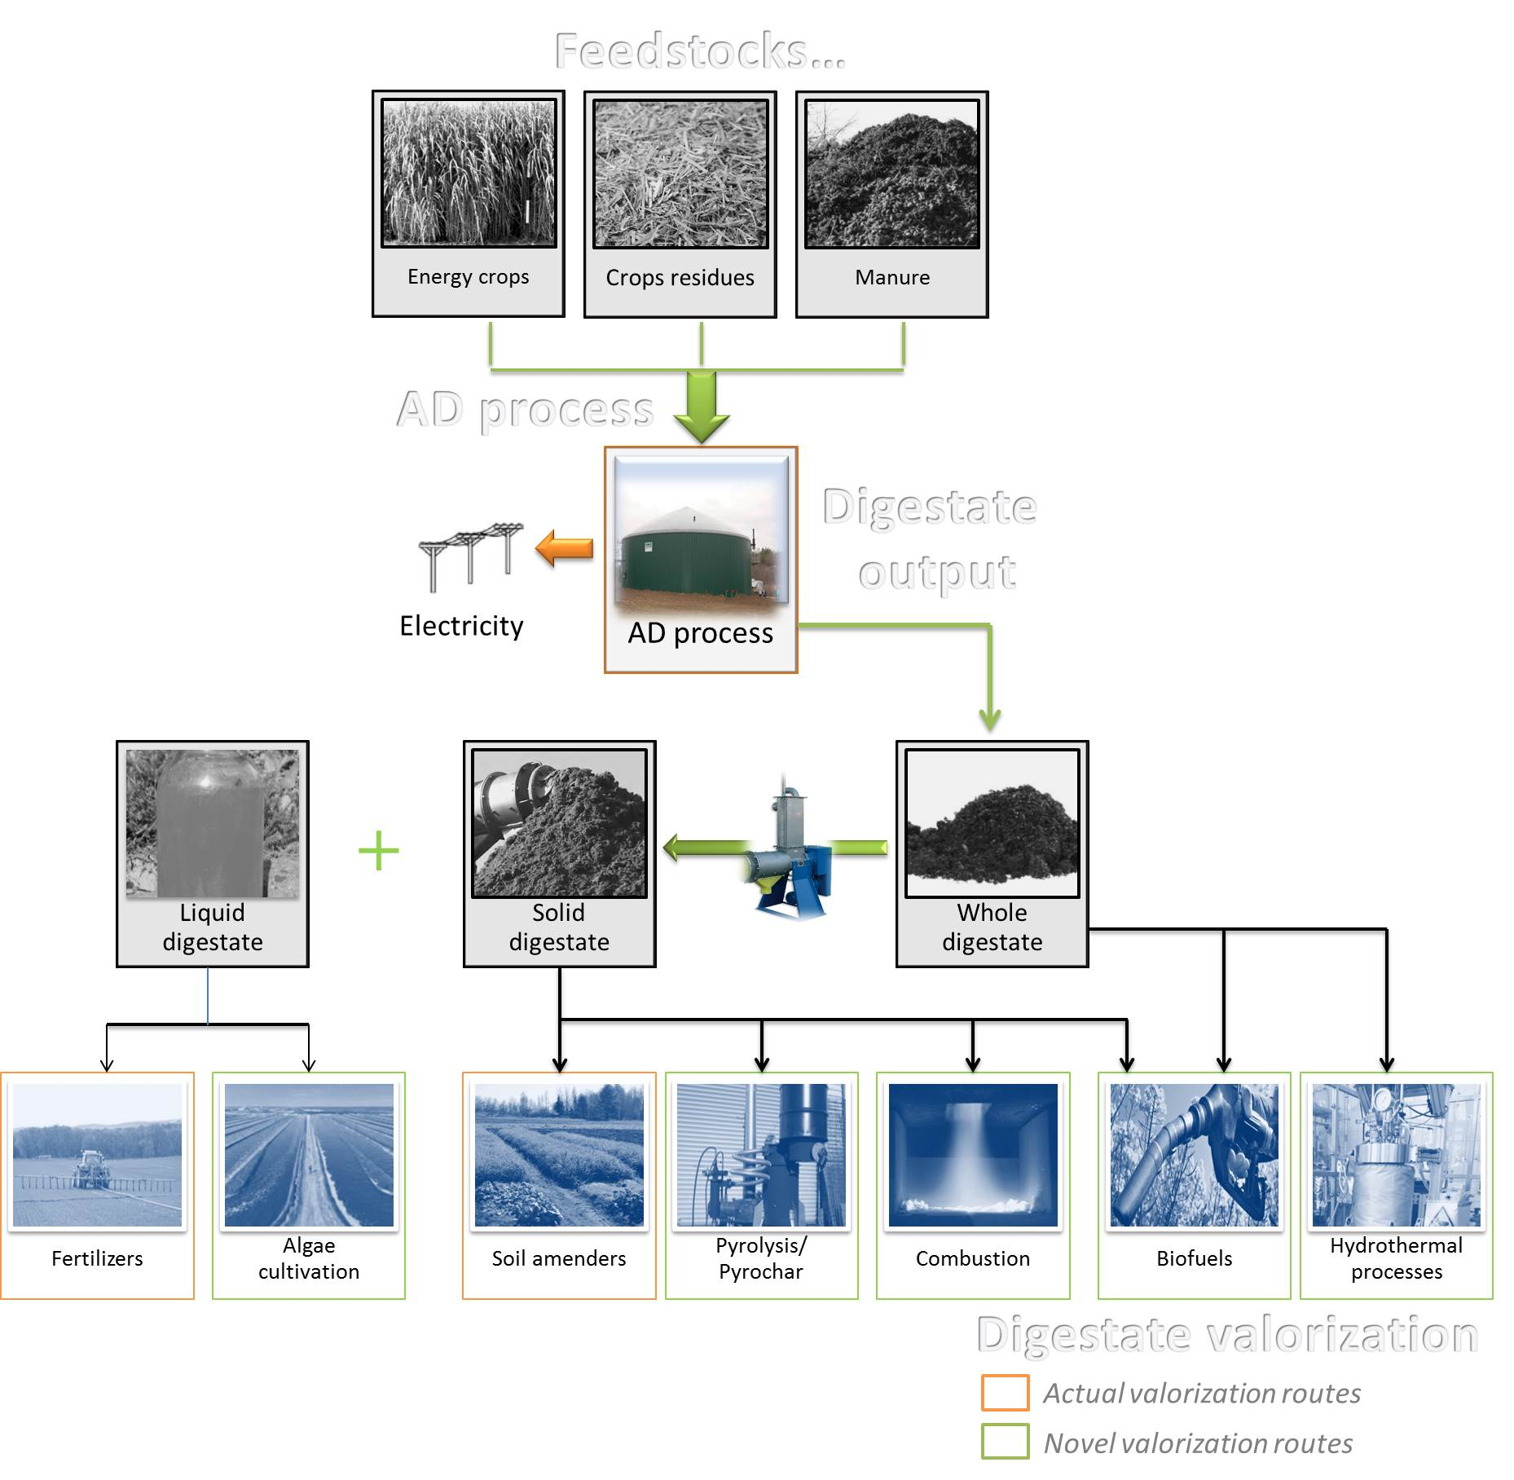
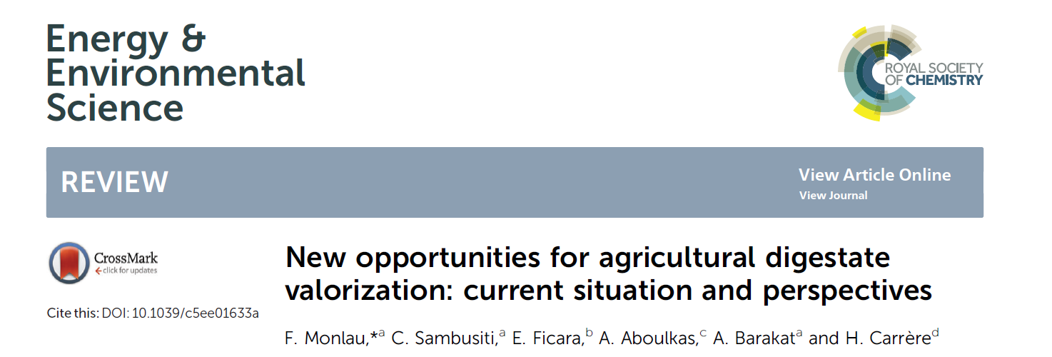
Anaerobic digestates valorization
F. Monlau. New opportunities for agricultural digestate valorization: review and perspectives. Energy&Environmental Science (2015).

Slide 4
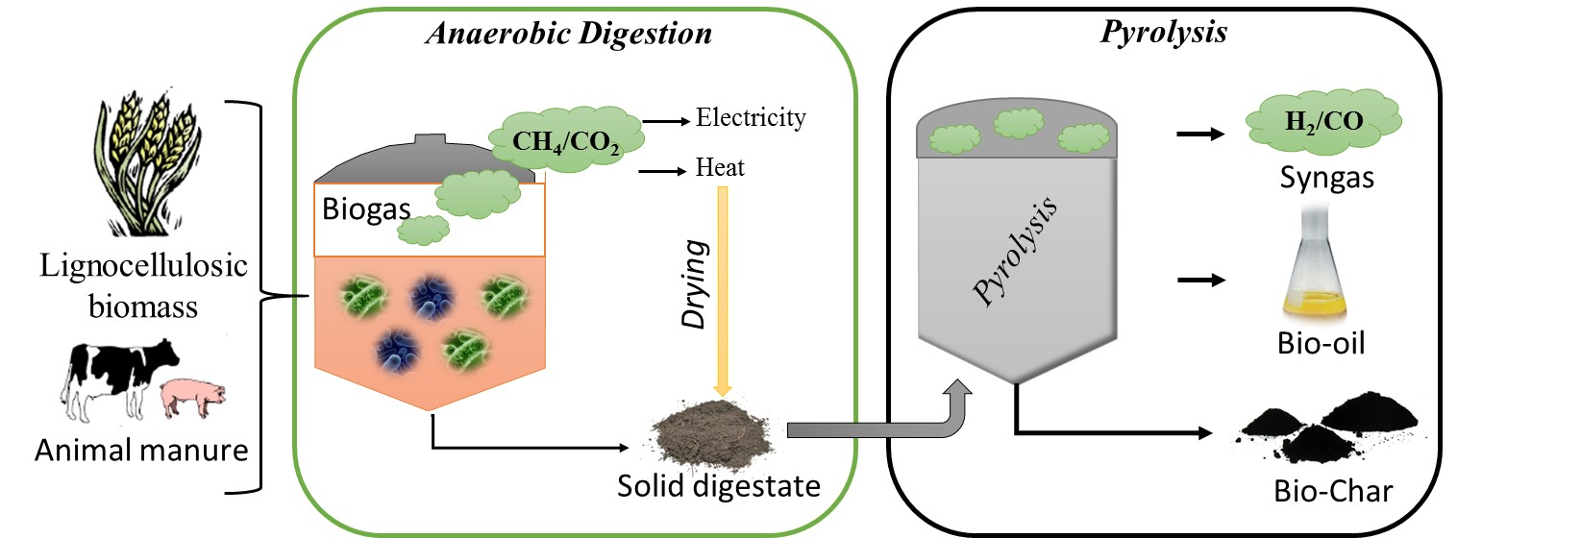
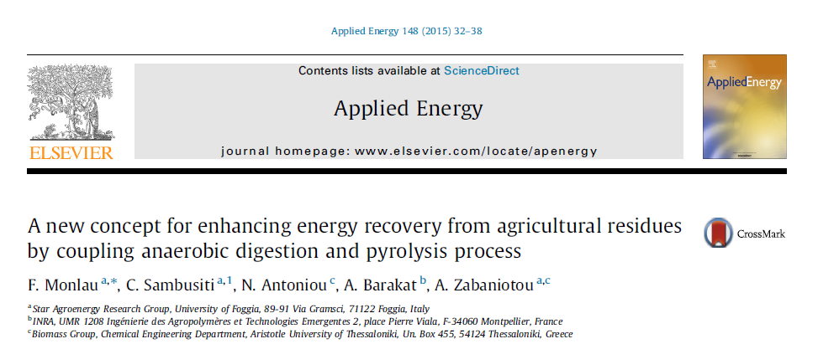
Dual AD/Pyrolysis concept

Slide 5
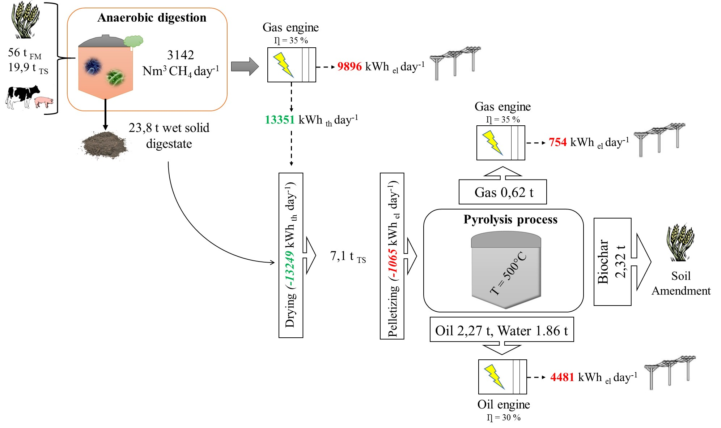
Dual AD/Pyrolysis concept
?
Energetic and mass balances of the dual AD/pyrolysis process
for one day- running

Slide 6
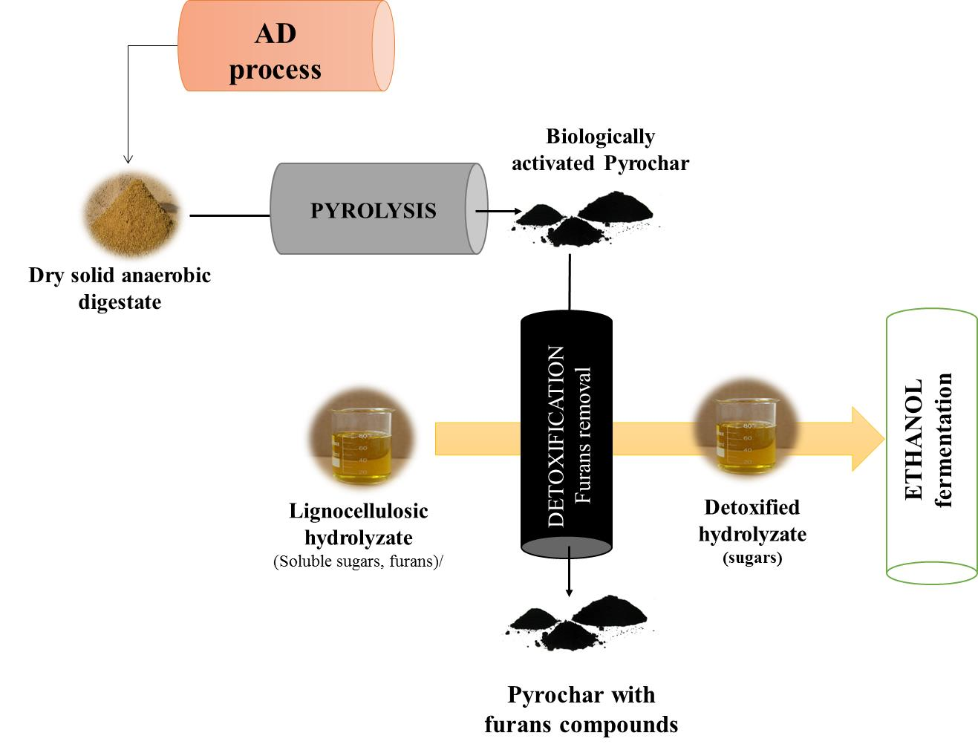
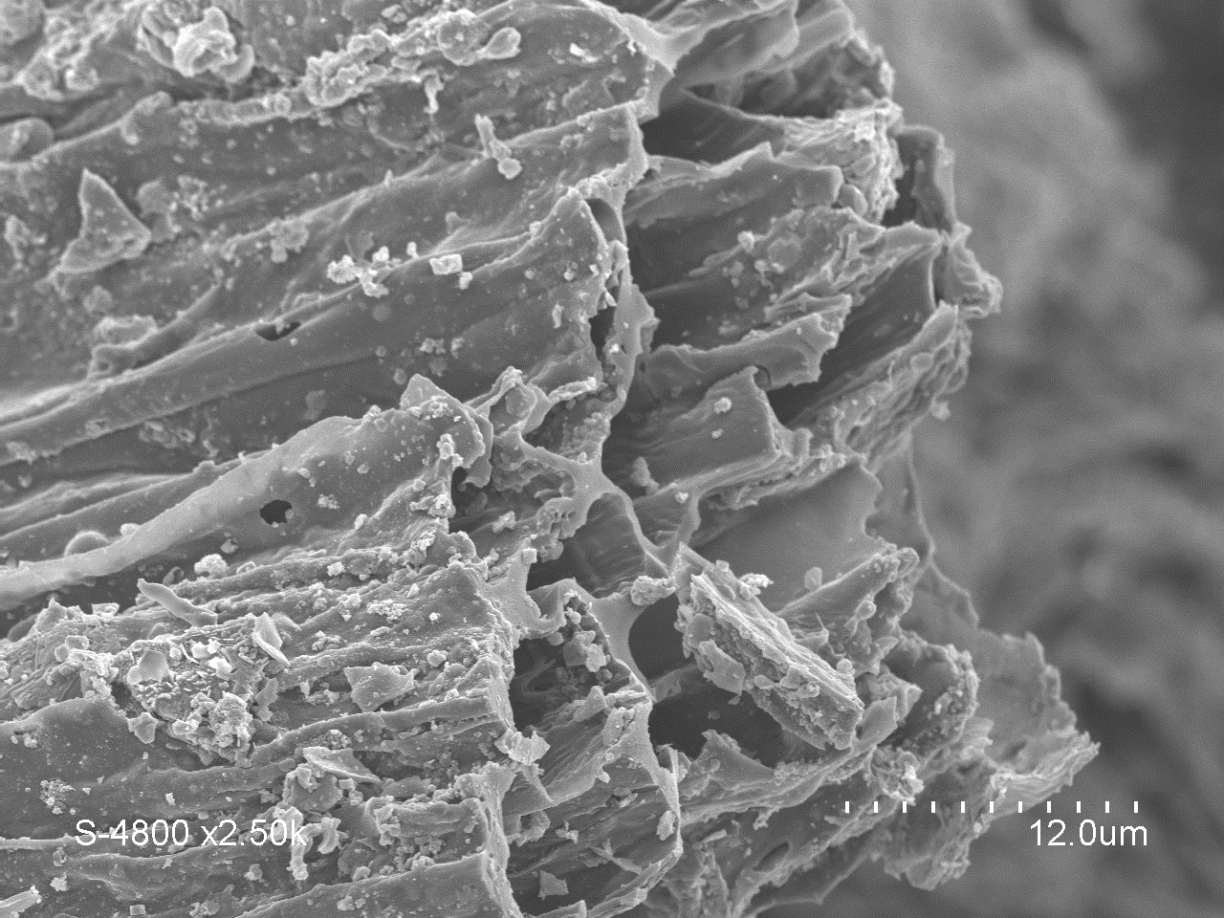
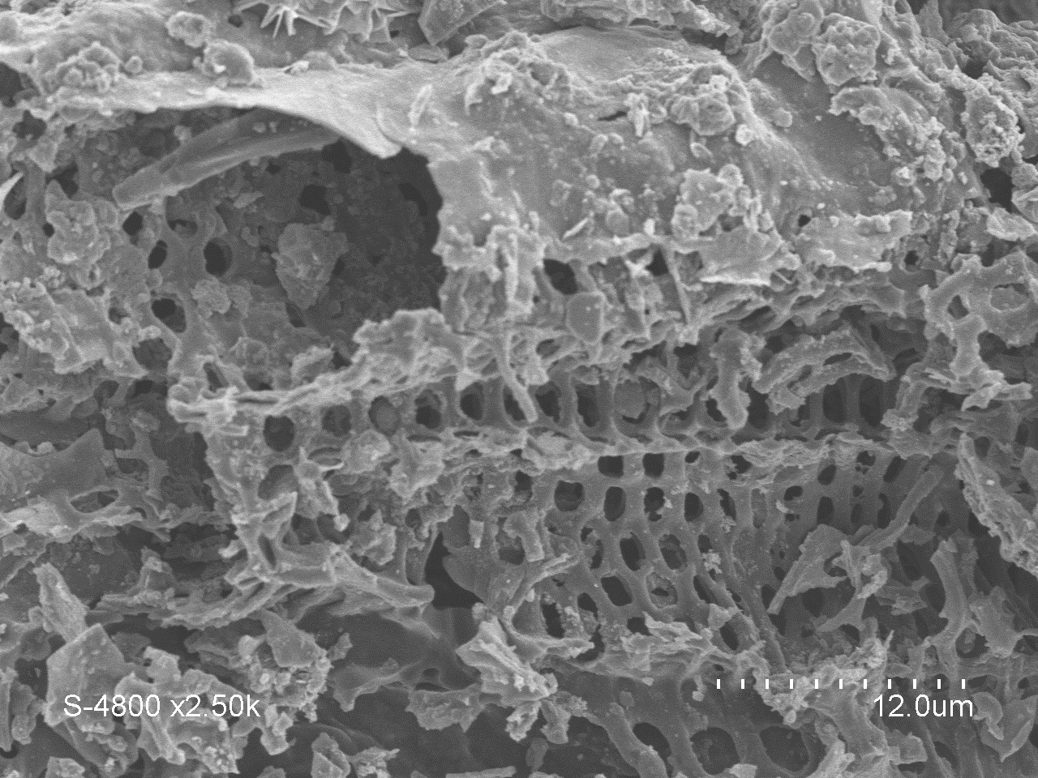
Use of pyrochar as bio-adsorbents
S_{BET} | V_{mi} | V_{tot} | V_{mi}/V_{tot}
(m²/g) | (cm³/g) | (cm³/g) | (%)
88 | 0.039 | 0.055 | 71

Slide 7
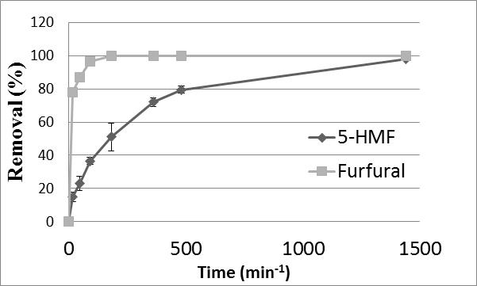
Synthetic Medium: 10 g L⁻¹ glucose; 1g L⁻¹ furfural; 1g L⁻¹ 5-HMF; 24h
Lignocellulosic hydrolyzate detoxification
Pyrochar concentration (24h)
Time adsorption (40g/L)

Slide 8
Corn stalks hydrolyzate:
150°C, 30 min, 5% (w/v) H₂SO₄
Pyrochar concentration : 60g L⁻¹
Detoxification of corn stalk hydrolyzate
Compounds | Corn stalks hydrolyzate
Glucose (g L⁻¹) | 3.53 (±0.02)
Xylose (g L⁻¹) | 5.23 (±0.05)
∑soluble sugars (g L⁻¹) | 8,76
Acetate (g L⁻¹) | 2.02 (±0.06)
Formic Acid (g L⁻¹) | 0.15 (±0.04)
5-HMF (g L⁻¹) | 0.12 (±0.00)
Furfural (g L⁻¹) | 2.92 (±0.01)
∑Furans (g L⁻¹) | 2,94

Slide 9
Synthetic Medium: 8g L⁻¹ glucose; 2 g L⁻¹ xylose; 2,5 g L⁻¹ furfural; 0,5 g L⁻¹ 5-HMF; 1 g L⁻¹ acetate
Pyrochar: 60g L⁻¹
Eth Strains: 30g L⁻¹
Simultaneous detoxification
and fermentation
S. Cerevisae “Red Ethanol”
S. Cerevisae “Lalvin ICV-K1”

Slide 10
CONCLUSIONS
● The dual AD/pyrolysis led to an electricity increase of 42% compared to AD alone.
● Pyrochar from digestate were selective towards furans compounds. Furfural compounds were adsorbed at a faster rate than 5-HMF compounds.
● The simultaneous and fermentation process was efficient in improving the ethanol production rate.
PERSPECTIVES
● Test the simultaneous detoxification and fermentation process at lower ethanol strains concentration.
● Study the inpact of mechanical activation (i.e ball milling, vibro ball milling) on digestate pyrochar characteristics.
● Extent the used of such pyrochars to the adsorption of phenolic compounds (i.e vanilin, syringaldehyde).

Slide 11
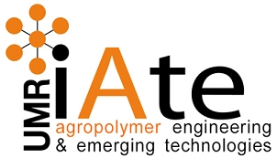

Thanks for your attention !
Monlau Florian
(monlau@supagro.inra.fr)
Past and Present Research Systems of Green Chemistry
September 14-16/2015 Orlando (USA)

