Slide 1
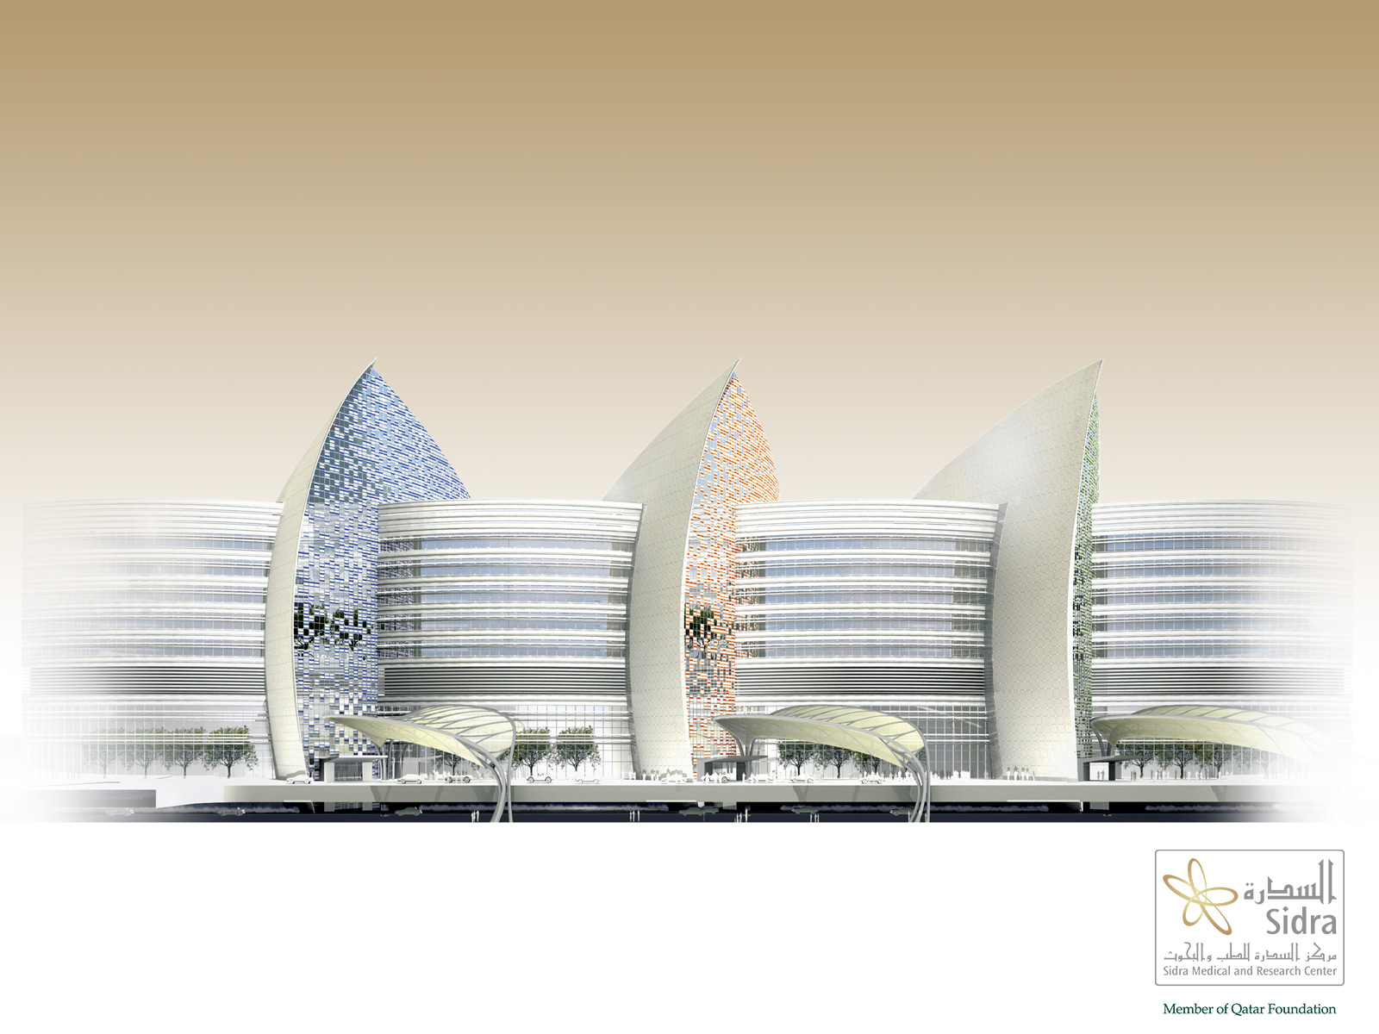
2015 World Bio Summit and Expo
Dubai, UAE
Dr. Mark G. Bloom, CLP, RTTP
Registered U.S. Patent Attorney
Workshop Presentation

Slide 2
Presentation Topic
“Academic Technology Transfer
in the Middle East:
A Focus on Biomedical Innovation”

Slide 3
What is Technology Transfer?
Technology transfer is the legal/economic process of converting scientific/technical findings from research endeavors into useful products.
The movement of new technology from its creator(s) to user(s).

Slide 4
Technology Transfer in an Academic Setting
Academic technology transfer is a field existing at the interface between basic science, for-profit business, and law.
Law = Intellectual Property (IP), contracts, and regulation.
Biggest Challenge: “Expectation Management”

Slide 5
Technology Transfer in an AMC
Technology Transfer within an Academic Medical Center is a multi-dimensional process of technical and economic development… it is an exciting journey shared by everyone involved.

Slide 6
Mark’s Definition of Entrepreneurship
Entrepreneurship is a “state of mind” that is built on the desire to serve the greater good of humanity and fueled by a “sense of wonder” and a “sense of urgency.”
“Sense of Wonder = Passionate Curiosity”

Slide 7
Who are the Source of New Innovations?
Entrepreneurial scientists and clinical staff are the primary sources of new innovations that could become future products.

Slide 8
What is the Ultimate Purpose and Goal of Technology Transfer in an AMC?
The ultimate goal (and purpose) of TT in an AMC is to eventually get new and innovative biomedical products out into the world - so they can benefit patients everywhere.

Slide 9
What is the Ultimate Purpose and Goal of Technology Transfer in an AMC?
The ultimate goal (and purpose) of TT in an AMC is to eventually get new and innovative biomedical products out into the world - so they can benefit patients everywhere.

Slide 10
Biomedical Research at Sidra
Mobile Applications and Remote Monitoring
Application of Augmented Reality in Medical/Surgical Practice
Cancer Immunotherapy (Genomics & Bioinformatics)
Application of 3D Printing to the Biomedical Sciences.
Application of CRISPR/Cas 9 “Gene Editing” Technology to create mouse models of human disease.

Slide 11
For More Information
Mark Bloom
mbloom@sidra.org

