Slide 1
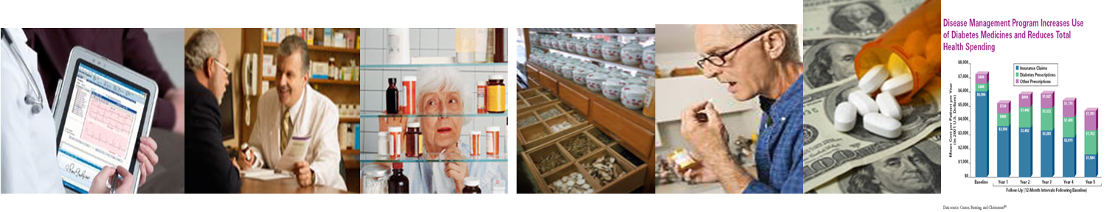
Primary Care Medication Management with a Shared Resource Pharmacists Network: Multi-stakeholder Perspectives
Marie Smith, PharmD, FNAP
Henry A Palmer Professor/Asst. Dean – Practice and Policy Partnerships
UConn School of Pharmacy Email: marie.smith@uconn.edu
2015 International Clinical Pharmacy Conference
Atlanta, GA Dec. 9, 2015

Slide 2
Overview
Intro
Medication Use and Safety Facts
Medication Management Definitions
CT Medicaid MTM Project
Study design
Key Findings
Success Drivers
Physician and Patient Perspectives

Slide 3
Today’s Medication Use and Safety Dilemmas
Primary Care
Multiple chronic conditions: increased costs + risk for med-related misadventures¹
Use of 4+ medications increases risk for falls²
$3.5 billion/year is spent on extra medical costs of Adverse Drug Events (ADEs)³
40% of costs of ambulatory ADEs are estimated to be preventable³
24% Rx meds and 76% OTCs/herbals (reported as actual meds used at home) were not in EHRs; ~ 50% medication discrepancies due to discontinued meds⁴
Care Transitions
up to 40% medication info is missing or incorrect on hospital discharge⁵
700,000 ED visits and 120,000 hospitalizations are due to ADEs annually³
Readmissions
34% of Medicare patients rehospitalized within 90 days⁵
About 20% discharged patients have adverse event; 66% due to ADEs⁶
9% adverse events leading to hospital admission attributed to medications⁷
U.S. Department of Health and Human Services. Multiple Chronic Conditions—A Strategic Framework: Optimum Health and Quality of Life for Individuals with Multiple Chronic Conditions. Washington, DC. December 2010.
WHO Global Report on Falls Prevention in Older Age. World Health Organization. 2007
Mediation Safety Basics. CDC. 2012 http://www.cdc.gov/medicationsafety/basics.html
Smith et al, Health Affairs 2011;30:646-654.
Kripalani et al. JAMA. 2007;297:831-841.
5. Jencks et al, N Engl J Med 2009;360:1418-28.
6. Forster et al. Annals of Internal Medicine, 2003; 138:161-7
7. Budnitz et al. JAMA. 2006;296(15):1858-1866.

Slide 4

Medication Management Services Definition
Medication management….the processes in place for all the patient’s medications (prescriptions, over-the-counter medications, herbal products, and dietary supplements) to be reconciled, optimized, coordinated (across all prescribers, pharmacies, care transitions), and monitored in order to achieve evidence-based and cost-effective treatment goals.

Slide 5
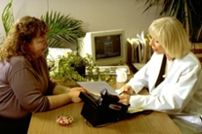

Pharmacist Training and Expertise
Education and Training
Entry-level 6 or 7-yr degree (PharmD)
2 yrs Pharmacotherapeutics
1.5 yr Drug Info/Lit Eval’n
3 yrs Pharmacy problem-solving
4 yrs Patient-care exp + clinical rotations
Postgraduate Residencies and Fellowships
Board-certified Pharmacy Specialties (9)
Ambulatory Care, Geriatrics, Nuclear,
Nutrition Support, Oncology,
Pharmacotherapy, Psychiatric
Pediatrics, Critical Care
Proposed: Pain and Palliative Care
Medication Management Certificate Programs
Advanced Pharmacy Practitioner Credentials
Pharmacist’s Expertise
Pharmacology
Pharmacotherapeutics
Pharmacokinetics and Pharmacodynamics
Drug Toxicities – Adverse Drug Events, Interactions
Drug Information and Evaluation
Patient Medication Safety
Medication Therapy Management (MTM)
Identify, Resolve, and Prevent Med Problems
Medication Adherence Assessment
Compliance and Persistence
Pharmacoeconomics
Outcomes Research
Patient Communications/Health Literacy
Pharmacy Practice Systems
Pharmacist competencies are SYNERGISTIC (not duplicative) with those of other health professionals
…… have most in-depth training in therapeutics, pharmacoeconomics, pharmaceutical systems
Notes:
Lets start with building a team…high performing team members know each other competencies/expertise areas, respect each other's’ roles on the team, and are trying to achieve the same goals.

Slide 6
CT Medicaid MTM Demonstration Project 2009-10
FUNDING SOURCE: CMS Medicaid Transformation Grant
PROJECT TEAM: UConn School of Pharmacy, CT Pharmacists Assn, CT DSS
Patients
INCLUSION Criteria
Adult Medicaid patients with at least 1 chronic diseases
>3 chronic, prescribed medications (based on CT DSS Medicaid paid claims)
Eligible patients identified by CT DSS
EXCLUSION Criteria
Non-English or non-Spanish speaking patients
Cognitive impairment
Unwillingness to sign informed consent
Project Sites
Medicaid patient’s primary care provider location
FQHCs and private primary care practices with Medicaid patient panels
Active use of EHR and ERx for > 12 months
CHC, Inc (4 locations) – Middletown, New London, Meriden, New Britain
Grove Hill Medical – New Britain

Slide 7
CT Medicaid MTM Demonstration Project
Outcomes Parameters
Medication discrepancies
Data sources: EMR, Medicaid claims, patient report of actual med use at home
Drug Therapy problems (DTPs)
Unnecessary drug therapy
Needed additional drug therapy
Different drug needed
Dosage too low/high
Adverse drug reaction
Non-adherence
Impact on health care costs
Examine drug costs and total health care costs for 12 months pre- and post- initial pharmacist MTM visit (patient served as own control)

Slide 8



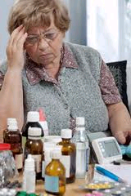


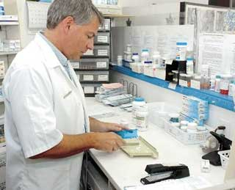
CT Medicaid MTM Workflow
Patient-Pharmacist visit in PCMH between provider visits
Initial visit + follow-up visits in PCMH office
Integrate Data sources:
Assessment: medication discrepancies and medication-related problems
EHR
Rx Claims
Patient Report
MTM EVIDENCE-BASED REPORTS
Comprehensive Med List
Medication Action Plan
MTM Summary Report
w/ Recommendations
MEDICATION CARE COORDINATION
Via EHR
Patient/Caregiver
PCP and Specialists
Home Nurse
Dispensing Pharmacist

Slide 9
CT Medicaid MTM - Key Findings
CT Medicaid beneficiaries have complex medication regimens
Medical conditions ~9-10/ptnt , chronic medications ~ 15-16/ptnt
Pain, GI, Dyslipidemia, HBP, Asthma/COPD, Diabetes, Depression
Mean Age – 51 yrs, Female – 71%
410 patient visits, 88 patients, 20 providers in 5 primary care sites
Medication discrepancies (n= 3248)
… inconsistency in the drug, dose, frequency, route, quantity dispensed, or current medication use by the patient between the Medicaid claims, EHR medication list, or patient’s report of actual medication use at home.
50% were discontinued meds (by prescriber or patient); 39% had drug or dose omitted
Medication-related problems = 917 (mean = 2.3/encounter)
Source: Smith MA, et al. Health Affairs (April 2011) Vol 30:646-654
Most Frequent MRPs | %
Needs additional therapy /drugs not needed (evidence-based guidelines) | 30
Dose too low | 16
Adverse drug event /drug interaction | 16
Adherence - Ptnt doesn’t understand med use instructions | 11
Adherence - Ptnt prefers not to take/forgets | 12
PRESCRIBING
SAFETY
ADHERENCE

Slide 10
CT Medicaid MTM - Key Findings
CARE QUALITY
Patient Treatment Goals Met: 63% at first visit, 91% at last visit
96% of total DTPs were identified and resolved
76% DTPs classified as preventable medication errors that required a pharmacist intervention
CARE GAPS
70-75% DTPs: “UPSTREAM” Clinician-influenced Gaps
Prescribing practices, care coordination, clinical management, medication monitoring
25-30% DTPs: “DOWNSTREAM” Patient-influenced Gaps
Health beliefs, health literacy and numeracy, non-adherence
TEAM-BASED CARE EFFICIENCY
78% DTPs were resolved with patient-pharmacist visit (didn’t require a PCP visit)
Examples: change med administration timing to minimize side effects or drug interactions based on pharmacokinetics;
developed medication action plan with patient; recommend OTC use; meds not to split or crush
Can improve the productivity of PCPs with chronic disease medication management and enhance PCP practice efficiency
COST IMPLICATIONS
Direct Cost Savings (estimated annual savings with actual claims)
Medication savings: $1123/patient
Medical, hospital, ED visit savings: $472/patient
ROI 2.5:1 (based on actual claims, no cost avoidance included)
Source: Smith MA, et al. Health Affairs (April 2011) Vol 30:646-654

Slide 11
CT Medicaid MTM Success Drivers
Pharmacist
Met with patient in PCP office (ptnts view pharmacist as member of their "medical home team")
Had access to patient's EHR (diagnoses, labs, ED/hosp discharge summaries, encounter notes)
Developed and assessed comprehensive active med profile of all meds used at home (included OTCs, herbals, dietary supplements, and discontinued meds)
Built a trusting relationship with patients based on face-to-face visits
Matched patient visit frequency and duration with complexity of patients
Integrated, Team-based Care Model (re-established patient–prescriber-pharmacist relationship)
High level of patient engagement: average 4.6 visits in 6 month study period
Empowered patients: review Medication Action Plan progress at each visit
Holistic patient MTM evaluations (included all comorbidities, not disease-specific)
Physicians accept pharmacist as trusted health care colleague with medication management expertise
Increased PCP productivity by managing/resolving medication-related problems in-between PCP visits

Slide 12
CT Medicaid MTM – Patient/Provider Feedback
PATIENT EXPERIENCE:
“The most important part of meeting with my pharmacist was she communicated with my doctor & then we were all on the same page”
“These programs also offer the patient the opportunity to ask questions that are embarrassing to ask the doctor”
“I get answers to questions that I could not get from a busy pharmacist inside a store”
PROVIDER FEEDBACK:
91% found it helpful to have pharmacists identify DTPs
82% made a med adjustment based on pharmacist recommendations
100% found PCP-Pharmacist collaboration important to assure safe, appropriate, cost-effective medication use
90% wanted pharmacist MTM services for eligible patients

Slide 13

QUESTIONS????

