Slide 1


Computer-Aided Drug Design (CADD), Synthesis and Biological Evaluation of Potential Caspase-3 Inhibitors as Novel Alzheimer Disease Therapy
Lucía Minini^{1,2}
Supervisors: PhD. Alicia Merlino¹ and PhD. María Laura Lavaggi²
1-Computational and Theoretical Chemistry Lab and 2-Medicinal Chemistry Group, Institute of Biological Chemistry, School of Sciences, University of Republic.
Notes:
Good afternoon … Thank you the organizer for give me the opportunity to presesnt my work…. Title …..

Slide 2
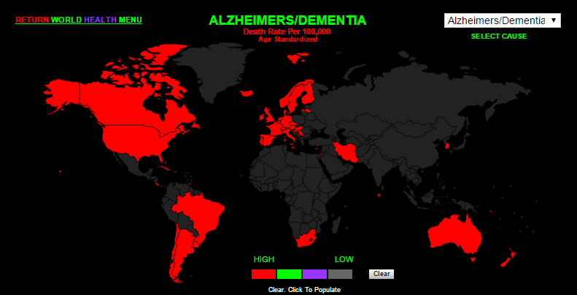
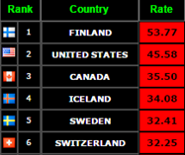
Background
Alzheimer´s disease:
Represents the most prevalent neurodegenerative disorder worldwide.
In the United States of America there are 5.3 million people affected.
US$ 226 billion stand for direct cost of patient care in 2015.
Involve a pretty relevant issue for public health due to its prevalence and its cost for health systems.
http://www.worldlifeexpectancy.com/cause-of-death/alzheimers-dementia/by-country/
Notes:
Alzheimer´s disease represents the most prevalent neurodegenerative disorder worldwide. Here in USA there are 5.3 million people affected besides in the current year had been spend 226 billon dollars on patient care. Therefore this disease symbolize an issue pretty relevant for public health due to its prevalence and its cost for health systems.
This map shows you the countries with more cases with AD in red per a hundred thousand population. That you can see USA is in the second place of the list with an elevate rate.

Slide 3
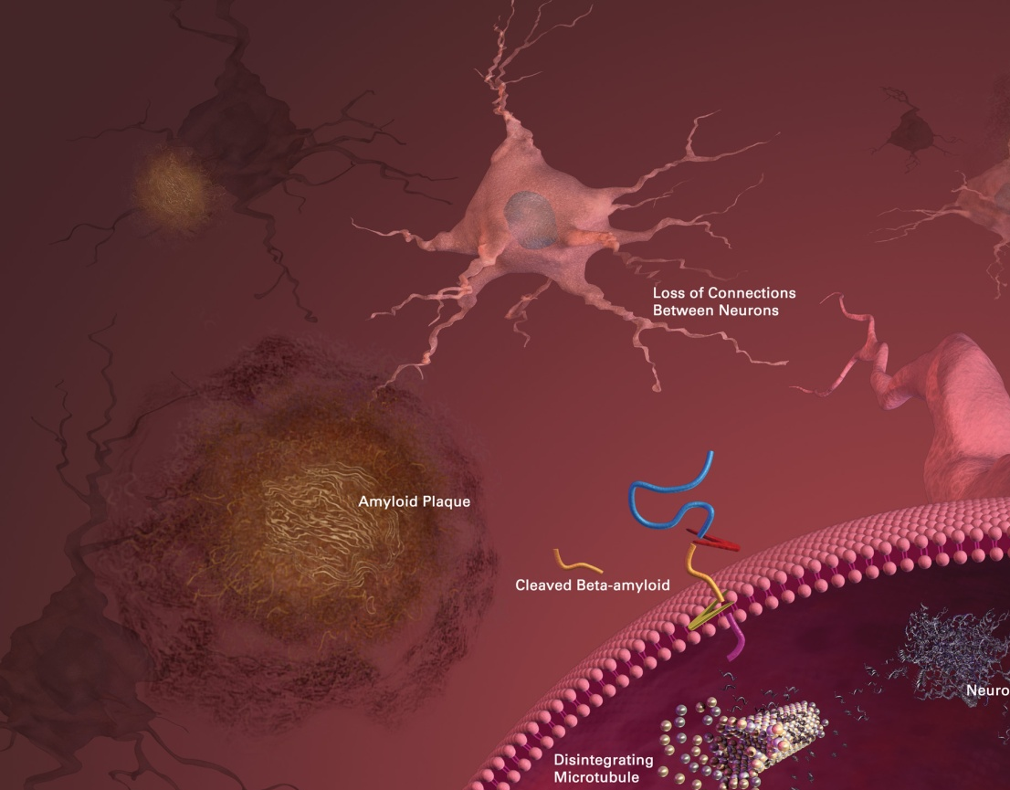
Background
Alzheimer´s disease:
The cause of AD is unknown
Recently 51 drugs for treatment have failed in phase III trials
Two hypothesis try to unravel this:
Amyloid hypothesis
Cholinergic hypothesis
Current treatment use based on this hypothesis is not effective
New therapeutic targets
http://www.nia.nih.gov/alzheimers/scientific-images
Notes:
The reason why AD involve so many cases and elevate cost resides in the lack of information about the cause of the disease.
Something to keep in mind is that 51 drugs for the treatment of AD have failed in phase III trials.
Over the years two hypothesis try to unravel the cause of AD. Amyloid hypothesis propose that neurodegeneration arise from the extracellular accumulation of beta-amyloid peptide in amyloid plaques. As we can notice here the beta-amyloid peptide derive from the cleavage of the amyloid precursor protein for the gama-secretasa complex then this peptides accumulates in the amyloid plaques. Cholinergic hypothesis propose that neurodegeneration arise form the loss of cholinergic neurotransmission therefore a dramatic loss of connections between neurons is notice. An important fact is that this hypothesis have a positive feed back between them.
Unfortunately current therapeutic treatment based in cholinergic hypothesis is not effective, only can improve the patients life but not stop or reverse the disease.
In consequence the need for new therapeutics targets arises. In this context emerge caspase-3 as a new an unexplored therapeutic target.

Slide 4
Background
Caspase-3 as a new therapeutic target:
Why?
Overexpresed at early stages of AD in mouse models
Relationship between active caspase-3 and AD neuropathology features :
APPΔ31- Apoptosis
Senile plaques
AMPAr
NFTs
Active
Caspase-3
Nat. Neurosci. 14 (2011) 69‐79
Notes:
In first have been reported that caspase-3 is overexpresed at early stages of AD in mouse models. In the other hand active caspasa-3 have been related with AD neurophatological features. Caspase-3 cleaves the amyloid precursor protein and generates APPΔ31 fragments that induce apoptosis also actives gamma-secretase which cleaves APP and produce beta-amyloid peptide with an increment in senile plaques. Besides its involved in the phosphorilation and cleavage of tau protein generating an increase in the neurofibrilar tangles. Otherwise this protein generates a decrease in AMPA receptors which cause synaptic depression (agregar algo mas de la espinas dendriticas).

Slide 5
Background
Caspase-3 as a new therapeutic target:
Identity Index between caspase-3 and caspase-7 around 54 %
Conserved active site
Large pocket constituted of five subsites (S1-S5)
Relevant differences between this subsites in
caspase-3 and caspase-7
Selective inhibition of caspase-3
FEBS J., 274 (2007) 4752-4765 J. Mol. Biol. 360 (2006) 654-666
Notes:
Despite caspase-3 is quite relevant for the correct behavior of the organism, this protein has certain interesting features that facilitates its selective inhibition. Is important to keep in mind that caspase-3 is overexpresed at early stages of the disease, therefore we propose to decrease active caspase-3 levels localized in patient´s brain.
Caspase-3 belongs to a conserve cysteine protease family that presents a major identity index with caspase-7. which is 54 %
All active caspases are heterotetramers of heterodimers, each caspase active site consist of a conserved histidine-cysteine motif (the position of each active site is select in red) and a large pocket constituted of five subsites (S1-S5), which are capable of accommodating the P1-P5 of its substrate in an extended conformation. Is worth noting that the residues of this subsites are different in caspase-3 and caspase-7, this differences could allow a selective inhibition of caspase-3

Slide 6
Computer-Aided Drug Design
Docking results
caspase-3
caspase-7
Notes:
Due to the need of new therapeutic targets, the relevance of caspase-3 in AD and the possibility of a selective inhibition in this work we propose a rational design of novel reversible and selective inhibitors of caspase-3 using a Computer-Aidded Drug Design.
This is and scheme of our CADD, in first we based on reported reversible and selective inhibitor of caspase-3, the study of this inhibitor allow us to design new compounds with certain features that could optimize the interactions with caspase-3, and minimizing interactions with caspase-7.
To explain our CADD we divide it into three steps.
In the first step we study the interactions between caspase-3 and caspase-7 with the reported inhibitor. Through molecular docking we found that this inhibitors interacts mainly with caspase-3 at S4 and S5, it was an interesting finding because major differences between caspase-3 and caspase-7 are presents in this subsites. Like we can see in caspase-7 this inhibitor interact at the interface of the protein far from active sites of two heterodimers.

Slide 7
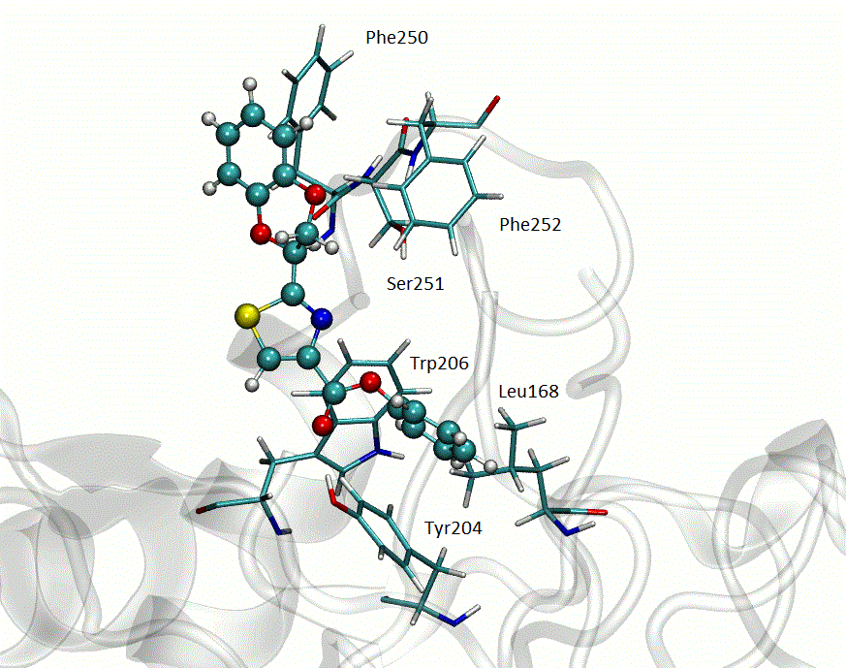
Computer-Aided Drug Design
Molecular dynamics results
50 ns
caspase-3
caspase-7
Notes:
To explore what happened with caspase-3 and caspase-7 conformation in presence of this compound we performed 50 ns of molecular dynamics of this complexes. We could determined that this compound remain in the same region of both caspases after molecular dynamics. As we can see here this compound interact with Phe 250 and 252 and Ser251, these amino acidic residues constitute subsites S4 and S5 while in caspase-7 only interacts with two interface residues.
To evaluate possible conformational changes in both caspases we superpose the structure of caspase in presence and absence of inhibitor. As we can see major differences have been elucidated at caspases loops, caspase-3 present more differences in loops 2, 2´ and 4 in both heterodimers (for caspase-3 are colered in red and in blue for caspase-3 in presence of inhibitor) while in caspase-7 these differences are less relevant (here loops of caspase-7 in presence of inhibitor are colored in pink) only in loop 2 are relevant differences in the positions of residues. Is worth noting that loops 2, 2´ and 4 are vital to a correct performance of active caspase.

Slide 8
Computer-Aided Drug Design
Dioxan moiety is not relevant for interactions with subsites
Two families with aromatic or aliphatic substituent at the esther functional group
New compounds keep certain features like thiazol and aromatic moieties
Notes:
Molecular dynamics results showed that dioxan moiety, colored in red, is not relevant for interaction with caspase-3. Due to the interaction site of this inhibitor in both caspases we proposed similar compounds to reported inhibitor without dioxan moiety as possible selective and reversible inhibitor of caspase-3.
In second step we propose compounds that keep certain features like tiazol and aromatic moieties.
We design two families with aromatic or aliphatic moiety at ester level. Study of the interactions between this families and both caspases allow us to decide about the importance of an aromatic group at this level.
To exemplify we show you only one example of each family in both caspases

Slide 9
Computer-Aided Drug Design
Docking results
Short Aliphatic substituent
Large Aliphatic substituent
Aromatic substituent
caspase-3
caspase-7
Notes:
Docking results show that in both caspases exists two principal interactions sites at interface and at subsites like reported inhibitor. With an aromatic substituent only five of 15 compounds evaluated in caspase-3 interacts in the interface of the protein, the remainder compounds interacts with subsites. While in caspase-7 seven of 15 compounds interacts with subsites of the protein, the remainder compounds interacts with caspase interface.
For compounds with aliphatic substituent in caspase-3 this interacts only with subsites while in caspase-7 for short aliphatic substituent interacts only with subsites but compounds with large aliphatic substituent interacts with the interface. This results allow us to conclude that compounds with short aliphatic substituents are not a useful alternative due to all of them interacts with subsites in caspase-7 therefore they don’t have selectivity between both caspases.

Slide 10
50 ns
caspase-3
caspase-7
Notes:
We take one compound of each family and studied their interactions with both caspses, to do this we performed 50 ns of MD of each complex.
For compound one corresponding to aliphatic family, we determined that interacts with subsite mainly with S5. The interaction between them generates conformational changes in caspase-3 in catalytic loops (L2, L2´ and L4 colored in purple caspase in presence of compound one and red caspase-3 in absence of ligand)
In the case of caspase-7 this compound interact in caspase interface, this interactions dont produce relevant chances in catalytic loop of caspase-7.

Slide 11
Surface mapped electrostatic potential
Apo-caspase3
caspase3+ligand
Important differences at interface and catalytic loops
Apo-caspase7
caspase7+ligand
Catalytic loops doesn’t change
Differences at interface are less relevant
Notes:
We calculate the surface mapped electrostatic potential of caspase in presence an absence of compound one. This compound produce changes in the surface of caspase-3 principally in the interface which expand and become more positive, and at catalytic loop region. This changes could represent a decrese in caspase-3 activity.
In caspase-7 surface changes are less relevant, there are not differences in caspase-7 interface and the loops regions keep with the same conformations in absence and presence of compound one.

Slide 12
50 ns
caspase-3
caspase-7
Notes:
For compound two corresponding to aromatic family, we determined that interacts with subsite mainly with S5. The interaction between them generates conformational changes in caspase-3 in catalytic loops of each heterodimer (L2, L2´ and L4 colored in green caspase in presence of compound two and red caspase-3 in absence of ligand)
In the case of caspase-7 this compound interact in caspase interface, this interactions dont produce relevant chances in catalytic loop of caspase-7.

Slide 13
Surface mapped electrostatic potential
Apo-caspase3
caspase3+ligand
Important differences at interface, conformation and charges on catalytic loops
Apo-caspase7
caspase7+ligand
Conformation and charges of catalytic loops doesn’t change
Differences at interface charges
Notes:
The presence of compound two the surface mapped electrostatic potential of caspase showed thar this compound produce changes in the surface of caspase-3 principally in the interface which expand, and at catalytic loop region besides the surface becomes less charged. This changes could represent a decrease in caspase-3 activity.
In caspase-7 surface changes are less relevant, there are not differences in caspase-7 interface and the loops regions keep with the same conformations in absence and presence of compound two.

Slide 14
Computer-Aided Drug Design
Synthesis
Low yields percentages with aromatic substituent
Aromatic choloroformates was quite unstable
Aliphatic choloroformates was less unstable than aromatic choloroformates
Notes:
Synthesis of compounds with aromatic substituent has low yields percentages due to aromatic choloroformiates derivates was quite unstable. For aliphatic substituent yields percentages was improved but remained moderate.
Because of low yield percentages values and the lack of relevant interactions between caspase-3 and ester moiety we propose a third step on CADD.

Slide 15
Computer-Aided Drug Design
Synthesis
Excellent yields percentages
Aromatic substituent needed for interactions with subsites and selective inhibition
Notes:
In the third step of the CADD we design a new group of molecules which consists in aromatic amines. This compounds remained two aromatic substituent needed for interactions with subsites besides there are relevant for a selective inhibition of caspase-3.
The synthesis of this compounds is simple and has great yields percentages. Due to yields percentages value and the characteristc of this compounds we studied the interactions of this compounds with both caspases. In first with molecular docking to found the interaction region and then with molecular dynamics to study the changes that this compounds produce in both caspases.

Slide 16
Computer-Aided Drug Design
Docking results
caspase-3
caspase-7
Notes:
In caspase-3 only one compound don't interact with subsites (in R=H and in X=Cl) while in caspase-7 all compounds interacts with regions that not correspond with subsites. Compounds with NO2 substituent at R position interacts far away from interface of caspase-7. This results allow us to conclude that this compounds has selective between both caspases.

Slide 17
50 ns
caspase-3
caspase-7
Notes:
In caspase-3 this compound interact with subsites mainly with subsites 5 which has more differences with caspase-7. As we can see this compound interact with S5 through pi stacking also interacts with other subsites S2 and S4. In this picture we can see the conformations changes in caspase-3 structure for the presence of this compound. Loop L4 L2 and L2´ go through major changes compared with caspasa-3 in absence of ligand.
While in caspaspe-7 this compound interacts with residues who are far away from subsites and the catalytic site due to the changes observed in catalytic loops are less relevant as this observed in caspase-3.

Slide 18
Surface mapped electrostatic potential
Apo-caspase3
caspase3+ligand
Important differences at interface, conformation and charges on catalytic loops
Apo-caspase7
caspase7+ligand
Catalytic loops doesn’t change
Differences at interface are less relevant
Notes:
The presence of compound three the surface mapped electrostatic potential of caspase showed that this compound produce changes in the surface of caspase-3 principally in the interface which expand and becomes more positively, and at catalytic loop region besides the surface becomes less charged.
In caspase-7 surface changes are less relevant, there are not differences in caspase-7 interface and the loops regions keep with the same conformations in absence and presence of compound two.

Slide 19
In vitro caspase-3 inhibition
The presence of this compounds produce an important decrease in caspase-3 activity at 100 μM concentration
Notes:
We study in vitro inhibition of caspase-3 of compound 3 and an analog compound 4. In this experiment we measure the fluoresce of a caspase-3 substrate, if a compound inhibit caspase-3 we will see a decrease on fluorescence emission. Compounds were evaluated at a concentration of 100 micromolar. Both compound reduce substrate fluorescence showing that this compounds are capable of inhibit caspase-3.
Something to keep in mind is that this compounds aren't toxic at 100 micromolar in the mouse hipocampal cell line (HT22).

Slide 20
Conclusions
CADD allow us to find novel selective and reversible inhibitors of caspase-3
Compounds with aromatic or larger aliphatic substituent are capable of inhibit caspase-3 because interacts with subsites S5 and S4
Modifications on: catalytic loops, surface and charges are inhibition indicators

Slide 21



Acknowledgments
CSIC, UdelaR
ANII
PEDECIBA QUÍMICA
Notes:
Pedeciba Química and CSIC por economical support
ANII for my scholarship

Slide 23
