Slide 1

Natural Products as Active Agents:
On the Border between Sustainable Application and Risky Use
Lothar Brecker
2. International Conference on Past and Present
Research Systems of Green Chemistry
Orlando (Florida, USA), September 14th – 16th 2015

Slide 2

Natural Products in Green Chemistry …
… are highly appreciable
- in Pharmaceutical Science
- in Crop Science
- in Food Science
- in several other applications
… but hide some risks
- False chemical structures (decomposition)
- Erroneous plant identification
- Herbal interaction (e.g. complex formation)
… or valuable properties!?
02/28

Slide 3
Natural Products in Green Chemistry …
The risk of false chemical structures!
03/28

Slide 4
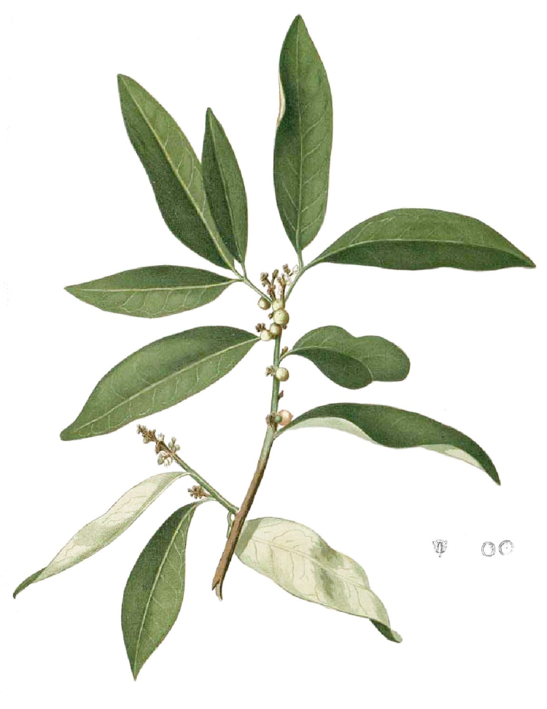
Structure and Activity of Sinharin
H. Greger et al., Tetrahedron, 1992, 48, 1209.
H. Greger et al., Tetrahedron, 1994, 50, 6279.
W. M. Johnson et al., Aust. J. Chem. 1994, 47, 751.
Glycosmis species
NO antifungal activity
?
strong antifungal activity
04/28

Slide 5


Can Modern NMR Analysis help?
Yes!
… but we need some more information and a little bit support
2008/2009:
growing Glycosmis in Vienna
extraction with aprotic solvents
1990:
extraction in rain forest
with methanol
05/28

Slide 6
New and Known Compounds
krabin
ritigalin
isokrabin
penimid B
methoxy-
penimid B
penimid A
strong antifungal activity!
06/28

Slide 7
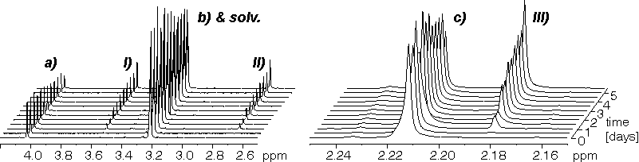
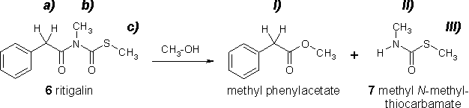
In situ NMR of Ritigalin in Methanol
T. Pacher et al., J. Nat. Prod. 2010, 73, 1389.
07/28

Slide 8
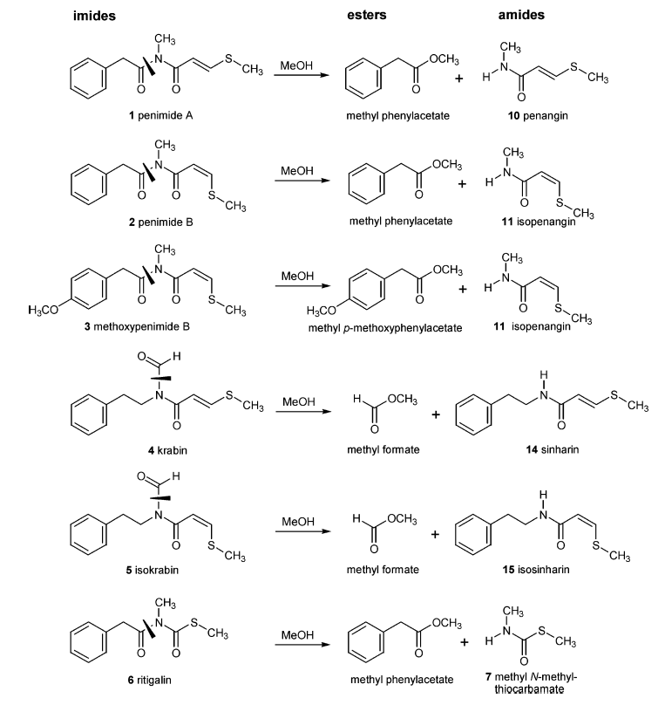
Identification of Artefacts by in situ NMR
natural
products
strong
antifungal
activity!
no natural
products
no
antifungal
activity!
T. Pacher et al., J. Nat. Prod. 2010, 73, 1389.
08/28

Slide 9
Natural Products in Green Chemistry
The risk of erroneous plant identification!
09/28

Slide 10
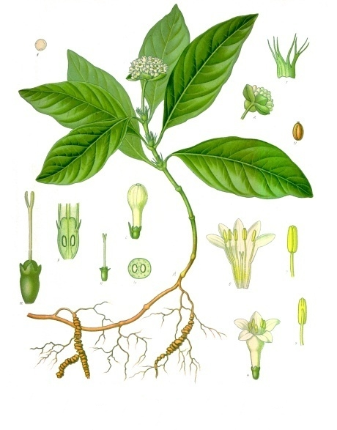
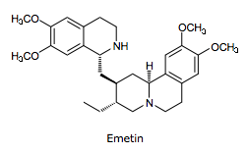
Vomiting Root
Carapichea ipecacuanha
(Ipecac)
10/28

Slide 11
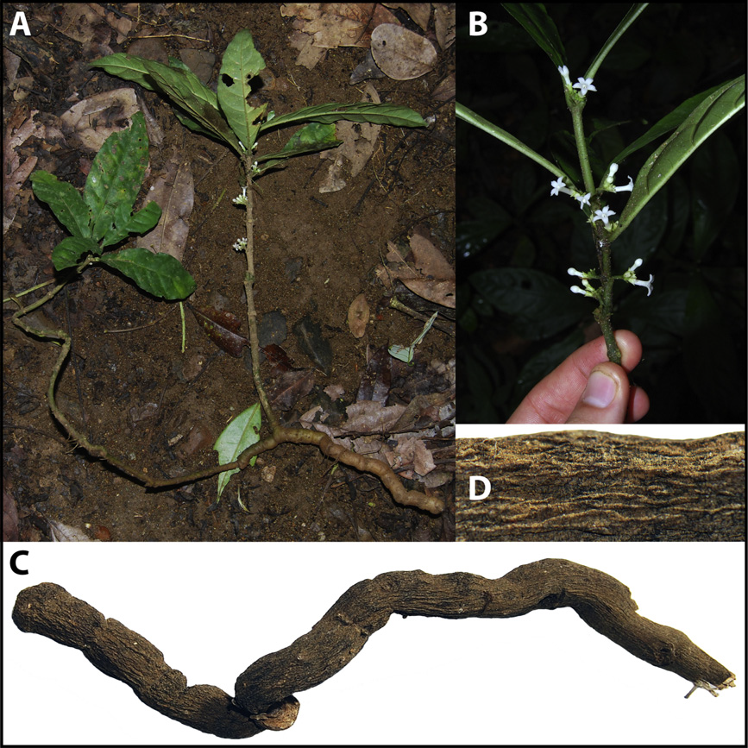
Vomiting Root
Carapichea ipecacuanha
(Ipecac)
Ronabea emetica
(false Ipecac)
11/28

Slide 12
False Vomiting Root
Ronabea emetica
(false Ipecac)
A. Berger et al., J. Ethnopharm. 2011, 137, 756.
12/28

Slide 13
Vomiting Root and False Vomiting Root
Carapichea ipecacuanha
(Ipecac)
Ronabea emetica
(false Ipecac)
- look very similar
- posses some comparable pharmaceutical effects
- contain entirely different natural products
13/28

Slide 14
Natural Products in Green Chemistry
The change of herbal interaction!
14/28

Slide 15
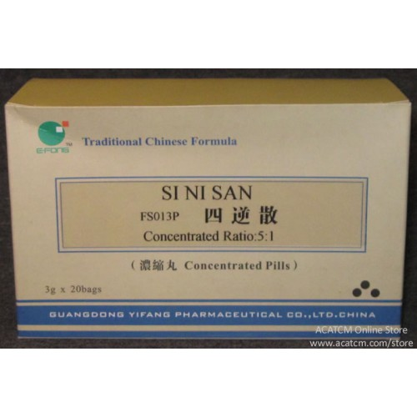
Visit from the Medical School …
Traditional Chinese Medicine (TCM)
- Only medical treatment until 19th century
- Herbal formulation
- Proper combination to reduce side effects and/or toxic impacts
Si Ni Tang (SNT) – Typical Chinese tea
- Treatment of heard failures since the year 150 (!)
- Officially recorded in the Chinese pharmacopoeia (2010)
- Administered as decoction - ‘Warms’ the inner body - Dispels ‘colds’ - Restores the influence of ‘Yang Qi’
15/28

Slide 16
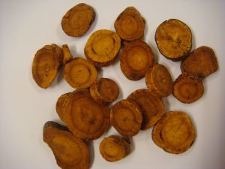
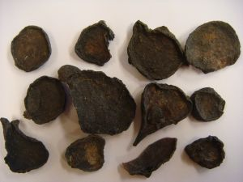
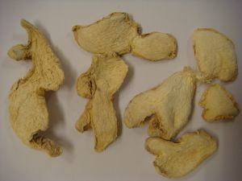
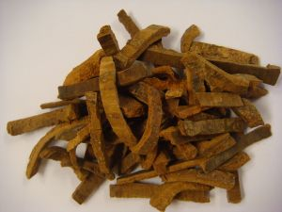
Si Ni Tang - 四逆汤
Glycyrrhiza uralensis
Radix, pretreated
Adjuvant and guiding
8
Aconitum carmichaelii
Radix, pretreated
Monarch drug
6
Zingiber officinale
Rhizoma
Minister drug
3
Cinnamomum cassia
Cortex
Minister drug
1
16/28

Slide 17
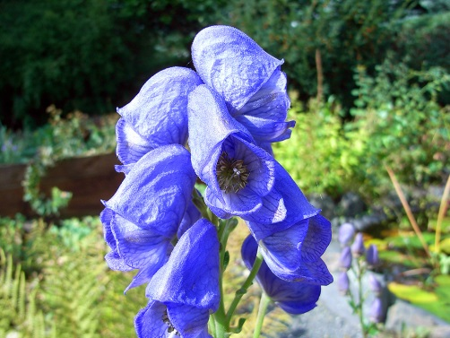
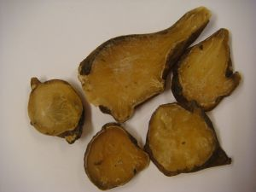

Aconitum carmichaelii
Aconitine
- Diester diterpene alkaloids (DDAs)
- Pretreatment → two-step hydrolysis
Improper pretreatment
(fatal) Poisonings
17/28

Slide 18
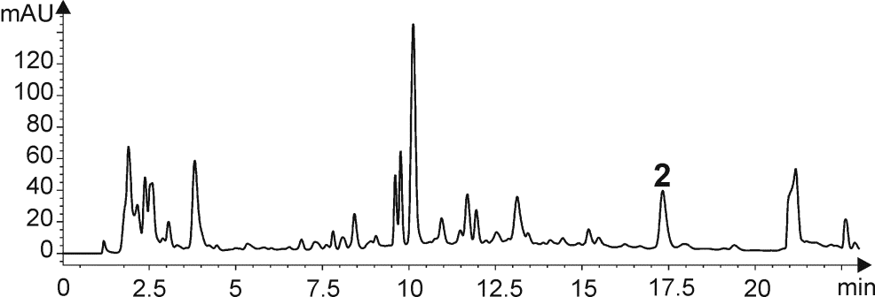
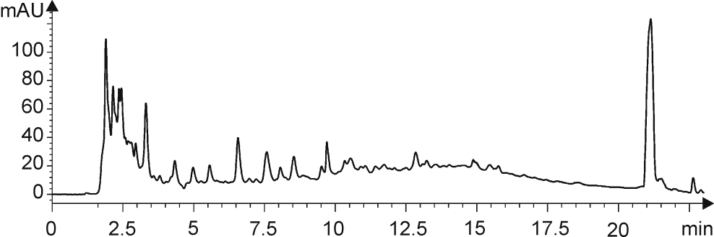
Aconitum carmichaelii
HPLC
Aconitine
Lyophylized :
0.62 µg/mg
Untreated A. carmichaelii
Not detectable
Pretreated A. carmichaelii
18/28

Slide 19
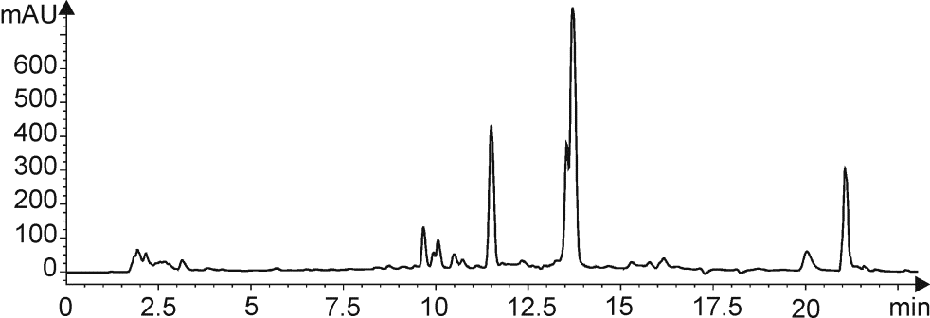
Aconitum carmichaelii
HPLC
Aconitine
Lyophylized :
0.62 µg/mg
Untreated A. carmichaelii
Not detectable
Pretreated A. carmichaelii
Not detectable
Si Ni Tang
with untreated A. carmichaelii
18/28

Slide 20
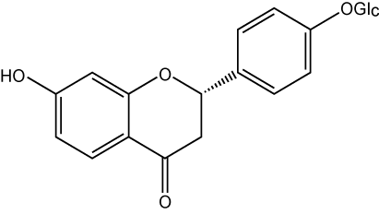
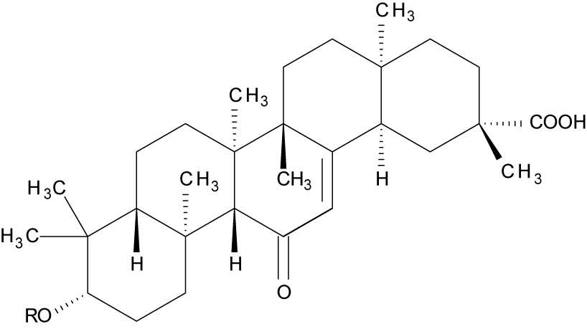
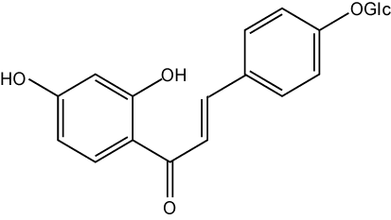
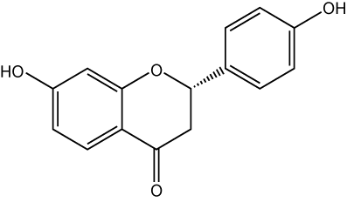
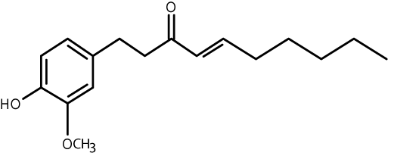
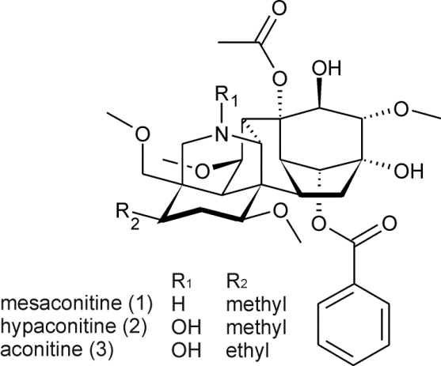
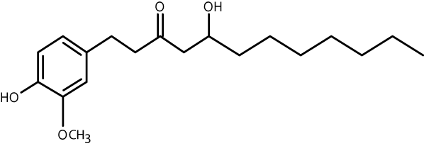
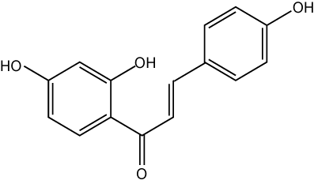
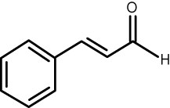
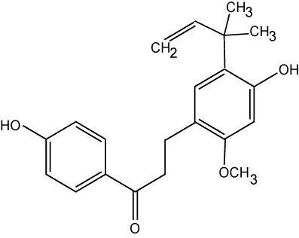
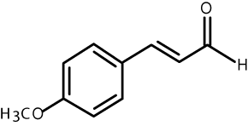
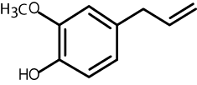
Herbal Interaction
Glycyrrhizic acid
Liquiritin
Isoliquiritin
6-Shogaol
Liquiritigenin
8-Gingerol
Aconitine
Isoliquiritigenin
Cinnamaldehyde
Licochalkon A
4-Methoxy-cinnamaldehyde
Eugenol
19/28

Slide 21
Herbal Interaction
Glycyrrhizic acid
Liquiritin
Isoliquiritin
6-Shogaol
Liquiritigenin
8-Gingerol
Aconitine
Isoliquiritigenin
Cinnamaldehyde
Licochalkon A
4-Methoxy-cinnamaldehyde
Eugenol
19/28

Slide 22
Herbal Interaction
Liquiritin
Isoliquiritin
Aconitine
19/28

Slide 23
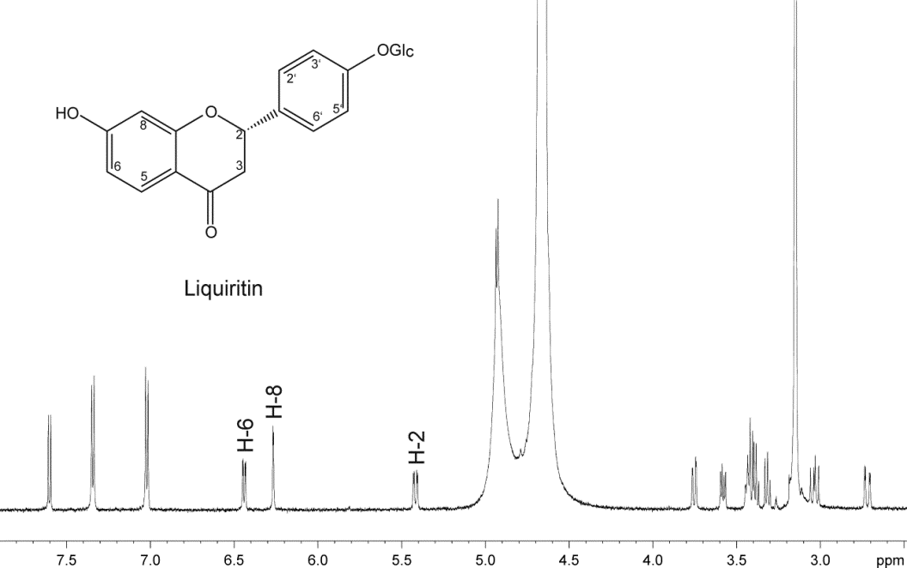
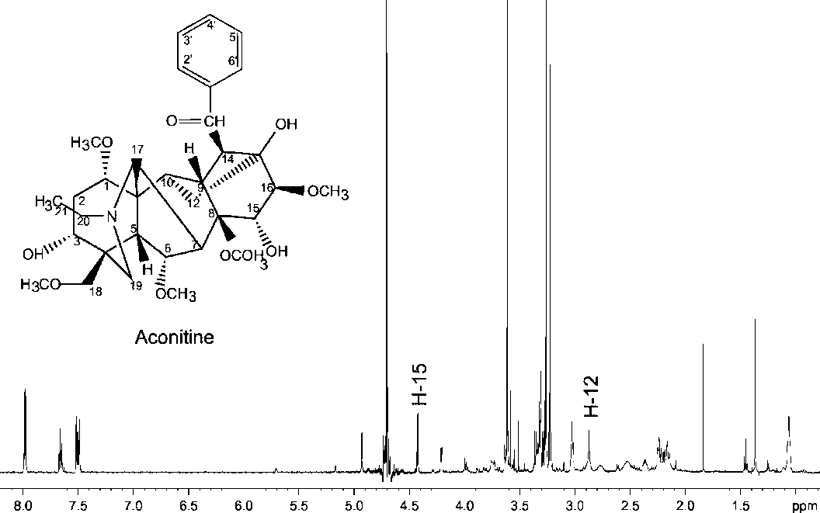
NMR - Jobs Plot Analysis
Liquiritin
Aconitine
20/28

Slide 24
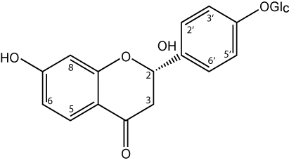
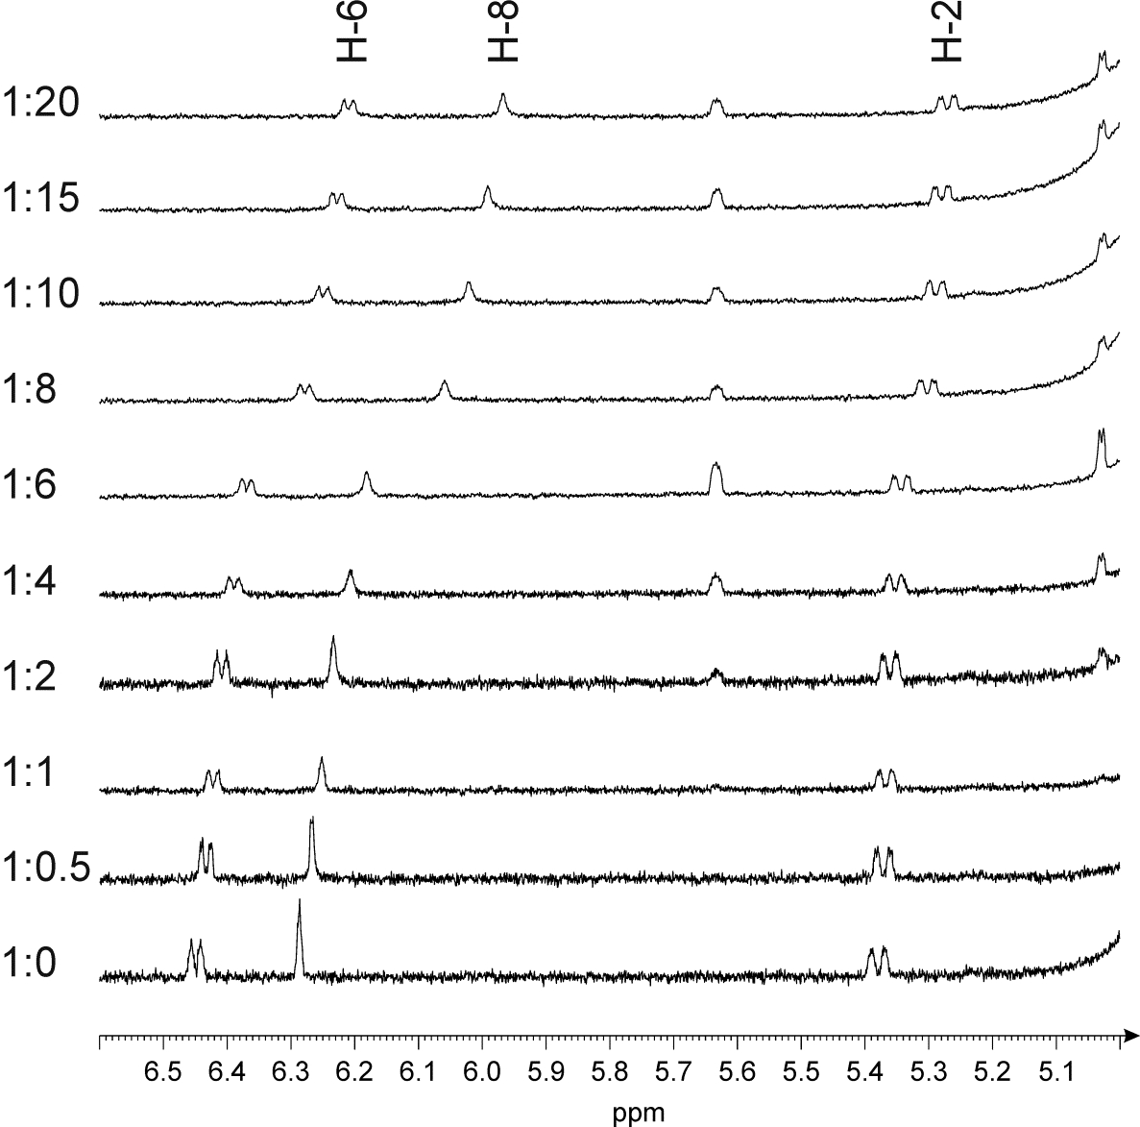
NMR - Jobs Plot Analysis
Liquiritin: stepwise increase Aconitine: stepwise increase
Shift changes
Calculation of Stoichiometry
21/28

Slide 25
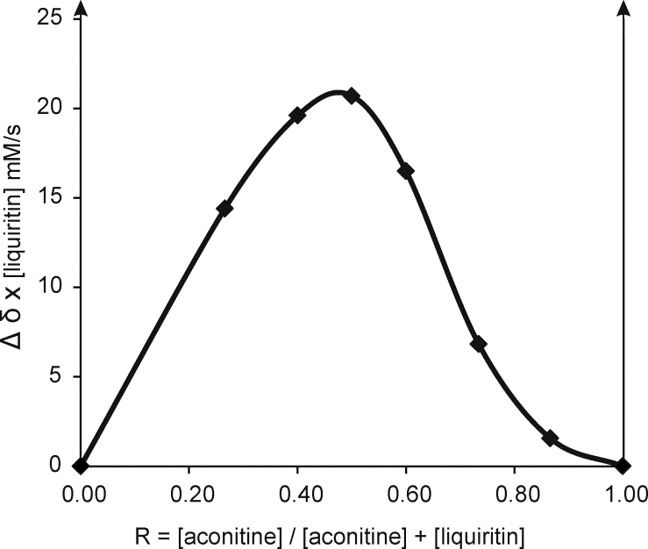
NMR - Jobs Plot Analysis
Total conc. kept constant
Shift changes of a ¹H signal
∆δ x conc. is plottet against mole fraction
aconitine : liquiritin
1:1
aconitine
100 %
liquiritin
100 %
Stoichiometry of the complex: 1:1
22/28

Slide 26
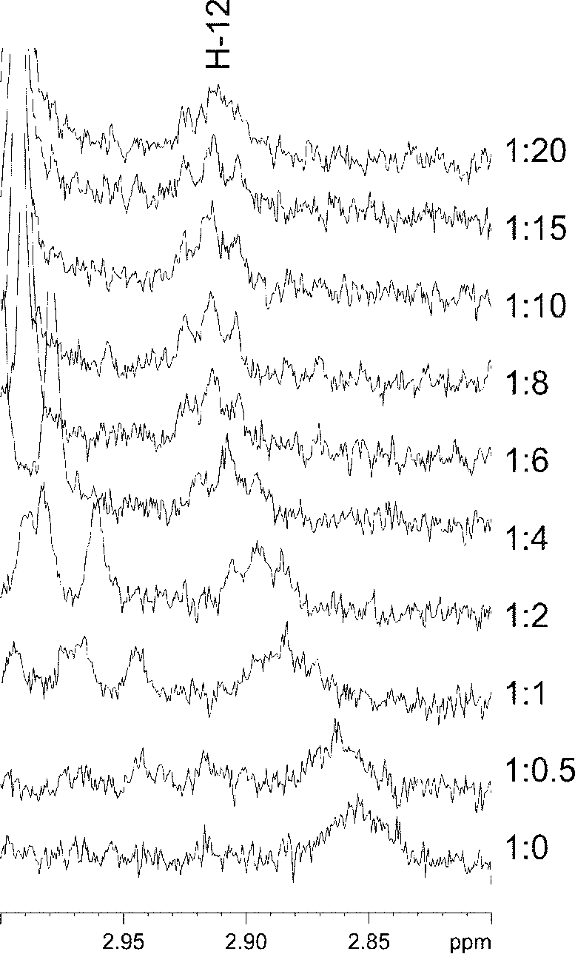
NMR – Binding Constant
12
Aconitine: constant conc.
Liquiritin: stepwise increase
Shift changes of aconitine
Calculation of binding constant
23/28

Slide 27
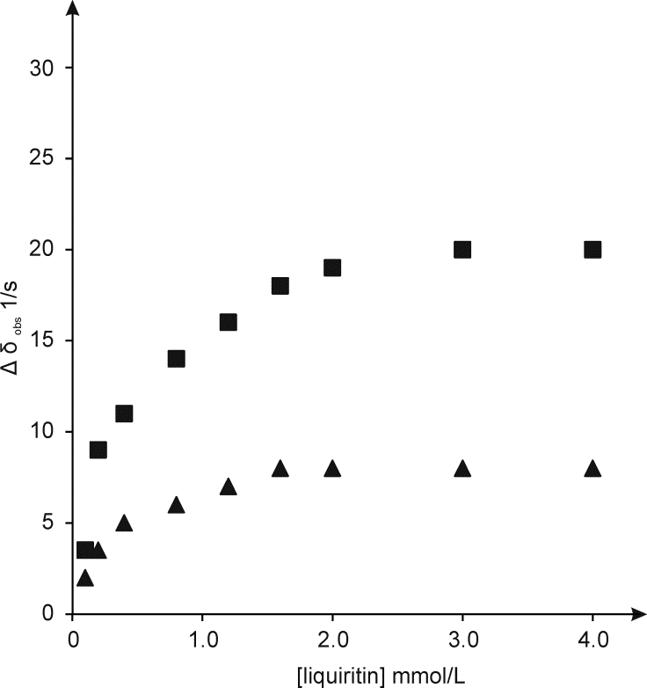
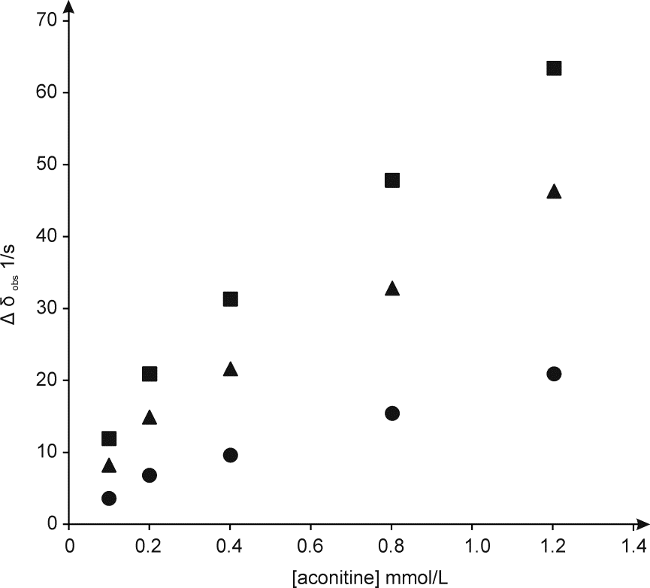
NMR – Binding Constant
∆δ_{obs} = 0.5 ∆δ_{max} [(A + B + 1/K)) – [(A + B + (1/K))² – 4 AB]^{1/2}]/B
K = 4000 ± 600 L/mol
K = 3000 ± 300 L/mol
Aconitine conc. constant
D₂O/MeOD (1:2)
Liquiritin conc. constant
D₂O/MeOD (2:1)
24/28

Slide 28
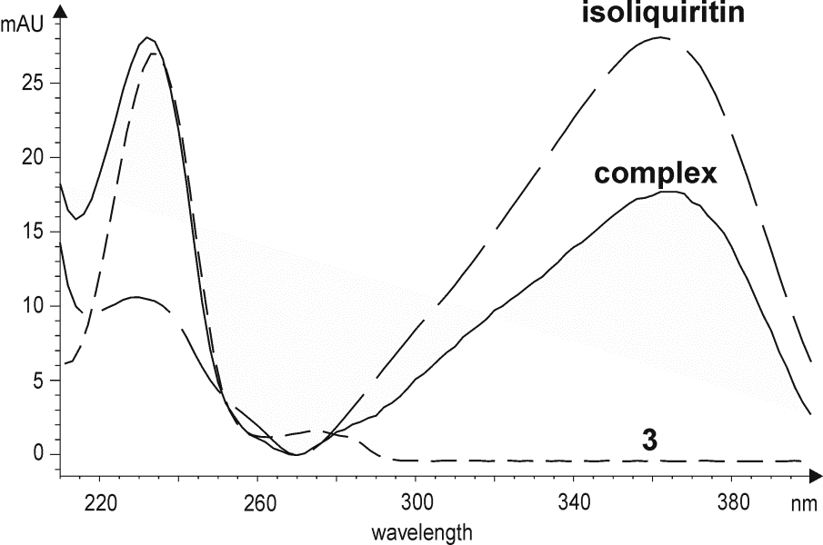
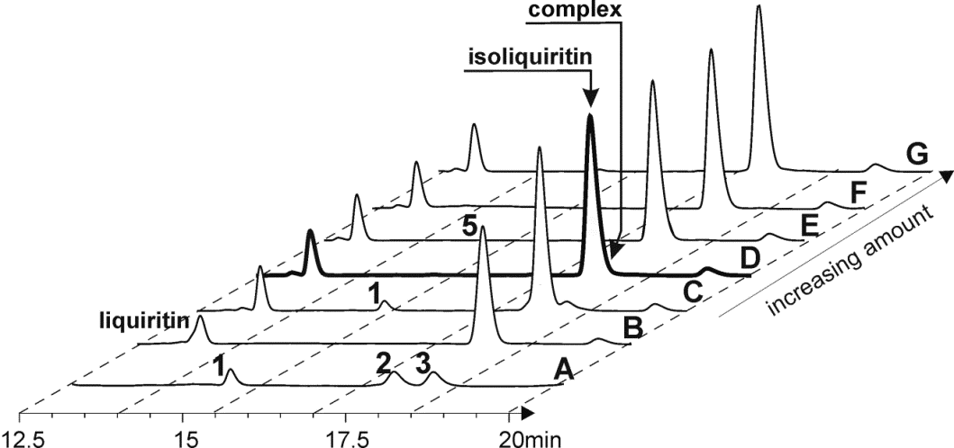
Proof by HPLC and UV
HPLC of
complex formation
UV spectrum
of the complex
aconitine
K. Peter et al., J. Ethnopharm. 2013, 149, 562.
25/28

Slide 29
Natural Products in Green Chemistry
Summery
Risks and Changes:
- Wrong chemical structures (decomposition)
Ritigalin --- Sinharin
- Erroneous plant identification
Vomiting Root and False Vomiting Root
- Herbal interaction (e.g. complex formation)
Si Ni Tang - 四逆汤
26/28

Slide 30


Acknowledgement
Phytochemistry
University of Vienna
TCM
Medical
University of Vienna
NMR
University of Vienna
H. Greger
K. Valant-Vetschera
J. Schinnerl
T. Pacher
A. Berger
M. Bernhard
K. Peter
Y. Ma
O. Hofer †
S. Felsinger
M. Vogl
H. Fasshuber
H. Kählig
W. Robien
E. Lorbeer
27/28

Slide 31
Thank you
for your kind attention !

