Slide 1

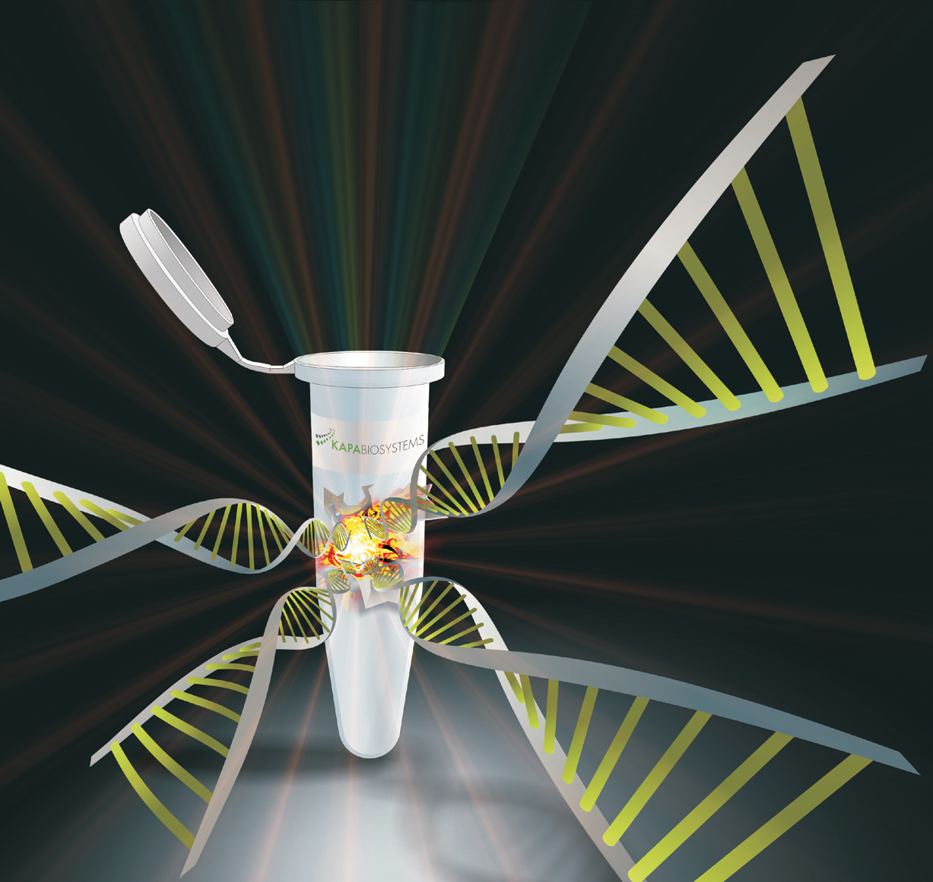
Association of functional polymorphisms of
Bax and Bcl2
genes with schizophrenia
Kristina Pirumya, PhD,
Laboratory of Human Genomics and Immunomics
Institute of Molecular Biology, National Academy of Sciences of the Republic of Armenia

Slide 2

Schizophrenia is one of the most severe and disabling among mental disorders affecting up to 1% of the world population and is characterized by cognitive impairments linked to behavioral changes.
It is considered a multifactorial disease, likely to be caused by alterations in genome, both acquired (originated during prenatal development) and inherent, combined with postnatal environmental factors.

Slide 3
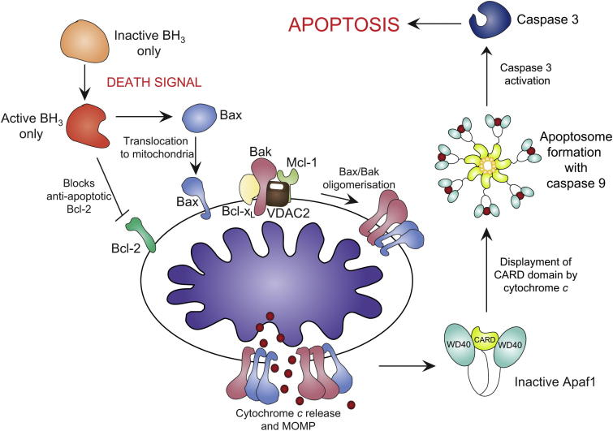
One of the contemporary hypotheses of etiology and pathogenesis of schizophrenia proposes that in schizophrenia apoptotic processes and their genetic regulation are altered starting from the early stages of neural development. It is proposed that both pre- and postnatal as well as genetically determined abnormalities of the apoptotic processes are among factors responsible for the development of schizophrenia.
Apoptosis is regulated by several protein families, including the upstream Bcl-2 family (antiapoptotic Bcl-2 and proapoptotic Bax) and the downstream caspase family (caspase-3). The proapoptotic Bax and antiapoptotic Bcl-2 are membrane-bound pore forming proteins that interact through heterodimerization.

Slide 4
The Aim of Study
The aim of this study was to investigate the possible association of single nucleotide polymorphisms (SNPs) rs1057369 and rs956572, rs1801018 of Bax and Bcl-2 encoding genes (BAX and BCL2, respectively) with schizophrenia in Armenian population.

Slide 5
Information about functionality of these SNPs was obtained from the databases of the International
Haplotype Map Project (HapMap; http://hapmap.ncbi.nlm. nih.gov/cgiperl/gbrowse/hapmap27_B36/) and the National Institute of Environmental Health Sciences (NIEHS; http://snpinfo.niehs.nih.gov/snpinfo/snpt ag.htm). This is a first study evaluating potential implication of BAX (chromosome 19, locus 19q13.33) and BCL2 (chromosome 18, locus 18q21.33) polymorphisms in etiopathomechanisms of schizophrenia.

Slide 6
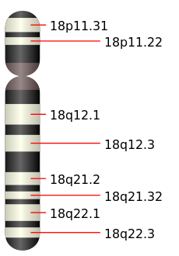
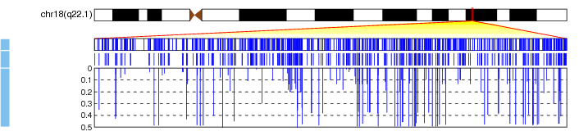
Localisation of Bcl2 gene on chromosome 18
SNPs
rs 1801018 MAF=0.276
rs 956572 MAF=0.377

Slide 7
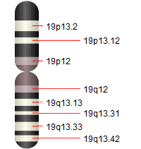
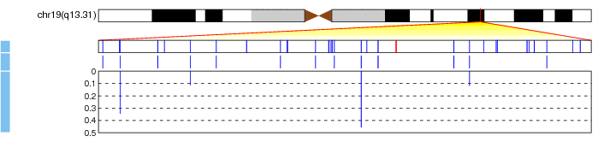
Localisation of Bax gene on chromosome 19
SNP
rs 1057369 MAF=0.368

Slide 8
Subjects and Methods Study Population
1. Collection of Blood Samples and Extraction of Genomic DNA
2. Genotyping of BAX Rs1057369 and BCL2 Rs956572, Rs1801018 SNPs
3. Statistical Analysis

Slide 9
Collection of Blood Samples and Extraction of Genomic DNA
About 5 ml of peripheral blood was collected from each study subject by venipuncture and transferred to EDTA-containing tubes. Genomic DNA samples were isolated from fresh blood according to a standard phenol-chloroform method and stored at -30°C until use.
2. Genotyping of BAX Rs1057369 and BCL2 Rs956572, Rs1801018 SNPs
Primer design
All primers for PCR-SSP were designed using the genomic sequences in the GenBank database (http://www.ncbi.nlm.nih.gov, Gene IDs: 581 and 596 for BAX and BCL2, respectively).

Slide 10
rs956572: allele A reverse 5'-AGAGGGAGTCATGACTGAATT allele G reverse 5'-AGAGGGAGTCATGACTGAATC constant forward 5'-CAGATCTGTGCTTGAACCTCA rs1801018: allele A reverse 5'-ATCTCCCGGTTATCGTACCCT allele G reverse 5'-ATCTCCCGGTTATCGTACCCC constant forward 5'-GATCCGAAAGGAATTGGAATA rs1057369: allele A reverse 5'- ATCTTCTTCCAGATGGTGAGT allele G reverse 5'-ATCTTCTTCCAGATGGTGAGC constant forward 5'-TTACAGGTGTGAGCCACCATG

Slide 11
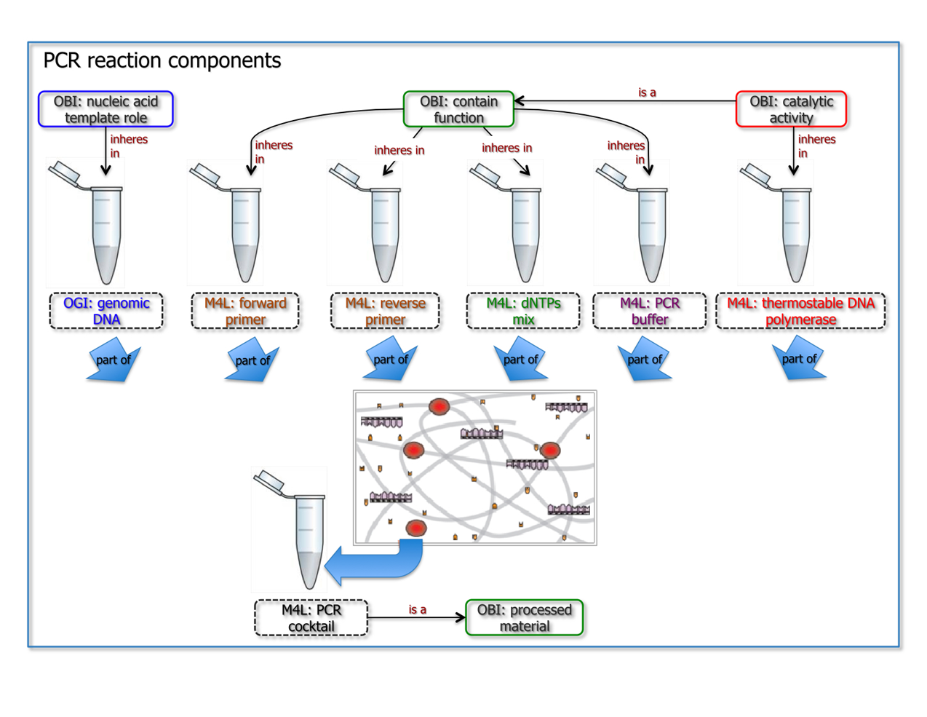
PCR-SSP

Slide 12
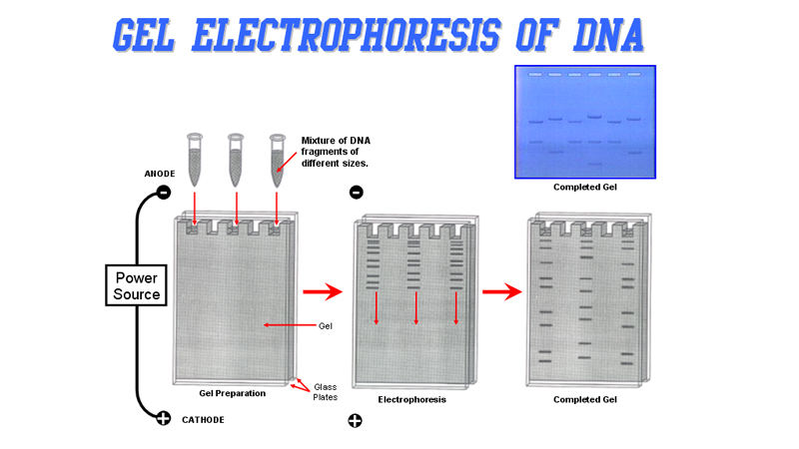
Gel electrophoresis

Slide 13
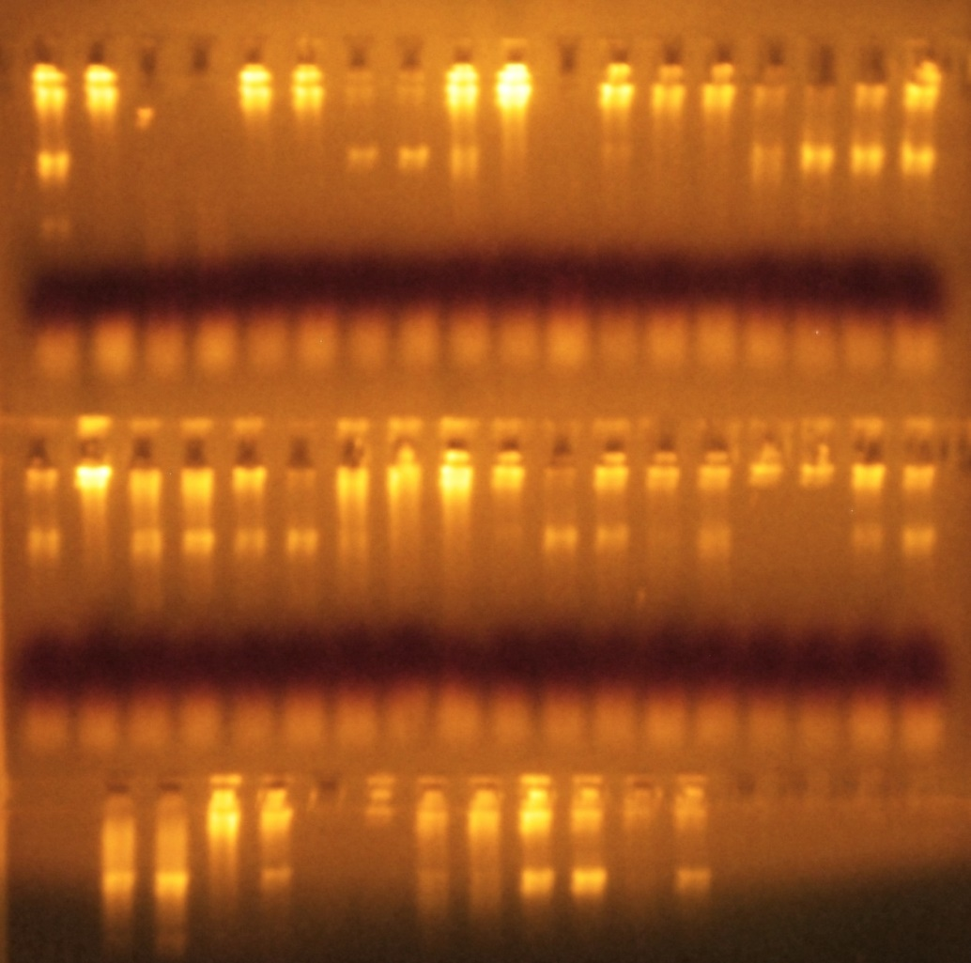
The presence/absence of allele-specific amplicons in the PCR products was visualized in 2% agarose gel stained with ethidium bromide fluorescent dye using DNA molecular weight markers as a reference.

Slide 14
Genotype and allele frequencies and minor allele carriage of BCL2 rs956572, rs1801018 SNPs in patients with schizophrenia (SCH) and controls.
Bcl2 (rs956572) Genotypes | SCH (n=135) | Controls (n=132) | P_{corrected}
TT | 15(11%) | 23(17%)
CT | 74(55%) | 59(45%)
CC | 46(34%) | 50(38%) | 1.08
Alleles
T | 104(39%) | 105(40%)
C | 166(61%) | 159(60%) | 2.0
Carriage
C | 120(89%) | 109(83%) | 0.1
Bcl2 (rs1801018) Genotypes
TT | 28(21%) | 26(20%)
CT | 67(50%) | 77(58%)
CC | 20(29%) | 29(22%) | 0.309
Alleles
T | 123(53%) | 129(49%)
C | 107(47%) | 135(51%) | 0.44
Carriage
C | 87(64%) | 106(80%) | 0.64

Slide 15
Genotype and allele frequencies and minor allele carriage of BAX rs1057369 SNPs in patients with schizophrenia (SCH) and controls.
Bax (rs1057369) Genotypes | SCH (n=135) | Controls (n=132) | P_{corrected}
TT | 21(16%) | 38(29%)
CT | 76(56%) | 74(56%)
CC | 35(28%) | 23(15%) | 0.0237
Alleles
T | 118(45%) | 150(55%)
C | 146(55%) | 120(45%) | 0.0012
Carriage
C | 111(82%) | 97(73%) | 0.002

Slide 16
CONCLUSIONS
Our study indicated no significant association between schizophrenia and rs956572, and rs1801018 polymorphisms of BCL2 gene encoding antiapoptotic bcl-2 proper protein.
For the first time, revealed significant negative association between schizophrenia and rs1057369 polymorphism of BAX gene encoding proapoptotic Bax protein. According to these results the rs1057369*G minor allele of BAX may have a protective effect relative to schizophrenia at least in Armenian population.
In addition, it was demonstrated that this effect is most pronounced in individuals with GG homozygous genotype.

Slide 17
A. Boyajyan, A. Stepanyan, D. Avetyan, H. Ghazaryan, S. Atshemyan, R. Zakharyan, K. Pirumyan, G. Tsakanova // Genetic variations associated with brain disorders: Focus on synaptic plasticity and apoptosis regulatory genes in schizophrenia, posttraumatic stress disorder and ischemic stroke. International Journal of Genetics and Genomics. 2014; 2(2): 19-29. K. Pirumyan, A. Boyajyan // Study of association between schizophrenia and functional polymorphisms of genes encoding Bcl-2 family proteins. International Journal of Biological Sciences and Applications. 2014; 1(1): 28-34. Boyajyan A., Pirumyan K., Zakharyan R., Chavushyan A., Stepanyan A., Gevorgyan A., Melkumova M., Torosyan S. Genetic polymorphisms of apoptosis regulatory proteins in schizophrenia disorder. Proceedings of the VIII All-Russia Research and Practical Conference with international participation "Molecular Diagnostics 2014", Moscow, Russia, March 18-20, 2014, vol.2, p.155-156.
PUBLICATIONS

Slide 18

Thank you for your attention

