Slide 1
The Future Role of Stem Cells
in Antimicrobial Therapies
KHALID AL-ANAZI
Dubai November 2015

Slide 2
Topics to be covered
1- Introduction to various types of stem cells.
2- Mesenchymal stem cells (MSCs):
- Sources & distinguishing features
- Evolving clinical indications
3- Complications of MSCs & existing challenges
4- Tracking of MSCs
5- final conclusions

Slide 3
Types of Stem Cells
(1) Totipotent stem cells: zygote + [2 to 4] cell embryo
- Capable of giving rise to the entire organism
(embryonic and non-embryonic tissues)
(2) Multipotent stem cells; adult stem cells:
** Mesenchymal stem cells
(3) Pluripotent stem cells: embryonic stem cells & embryonic germ cells:
* Can give rise to derivatives of all 3 germ layers
* There are 2 types of pluripotent stem cells (PSCs):
[a] Embryonic stem cells (ESCs):
- Derived from the inner cell mass of the mammalian blastocyte.
- Have the potential to form any cell type in the body.
[b] Induced pluripotent stem cells (iPSCs):
- Somatic cells reprogrammed to a pluripotent state
by exogenous expression of transcription factors.
- Liras A, et al. In-Tech 2013
- Arora N, et al. Cold Spring Harb Perspect Med 2012

Slide 4
Sources of MSCs
1- Bone marrow
2- Peripheral blood
3- Blood of umbilical cord, Wharton’s jelly of UC
4- Placenta & fetal membrane
4- Amniotic fluid & amniotic membrane
5- Synovial fluid
6- Dental tissues e.g. pulp
7- Palatal tonsil; salivary glands
8- Fallopian tubes; endometrium
9- Fat: adipose tissue
10- Parathyroid glands
11- Skin & foreskin
- Wang Y, et al. Stem Cell Int 2012 - Herberts CA, et al. J Transl Med 2011
- Ra JC, et al. Stem Cell Dev 2011 - Wong RSY, et al. J Biomed Biotechnol 2011
- Ullah I, et al Bioscience Rep 2015 [In Press] - Al-Anazi KA, et al. In-Tech 2015 [In Press

Slide 5
Distinguishing features of MSCs
(A) They must be plastic adherent
(B) They must be capable of differentiating into:
osteoblasts, adipocytes and chondrocytes
(C) Findings on flow cytometry:
[1] positive surface molecules:
- CD 105 - CD 29
- CD 73 - CD 44
- CD 90 - CD 166
[2] negative surface molecules:
- CD 45 - CD 34
- CD 14 - CD 11
- CD 19 - CD 79
- HLA – DR - CD 31
- Wang Y, et al. Stem Cell Int 2012 - Herberts CA, et al. J Transl Med 2011
- Ra JC, et al. Stem Cell Dev 2011 - Wong RSY, et al. J Biomed Biotechnol 2011
- Al-Anazi KA, et al. In-Tech 2015 [In Press] - Zomer HD et al Stem Cell Clon 2015

Slide 6
Clinical trials using MSCs

Slide 7
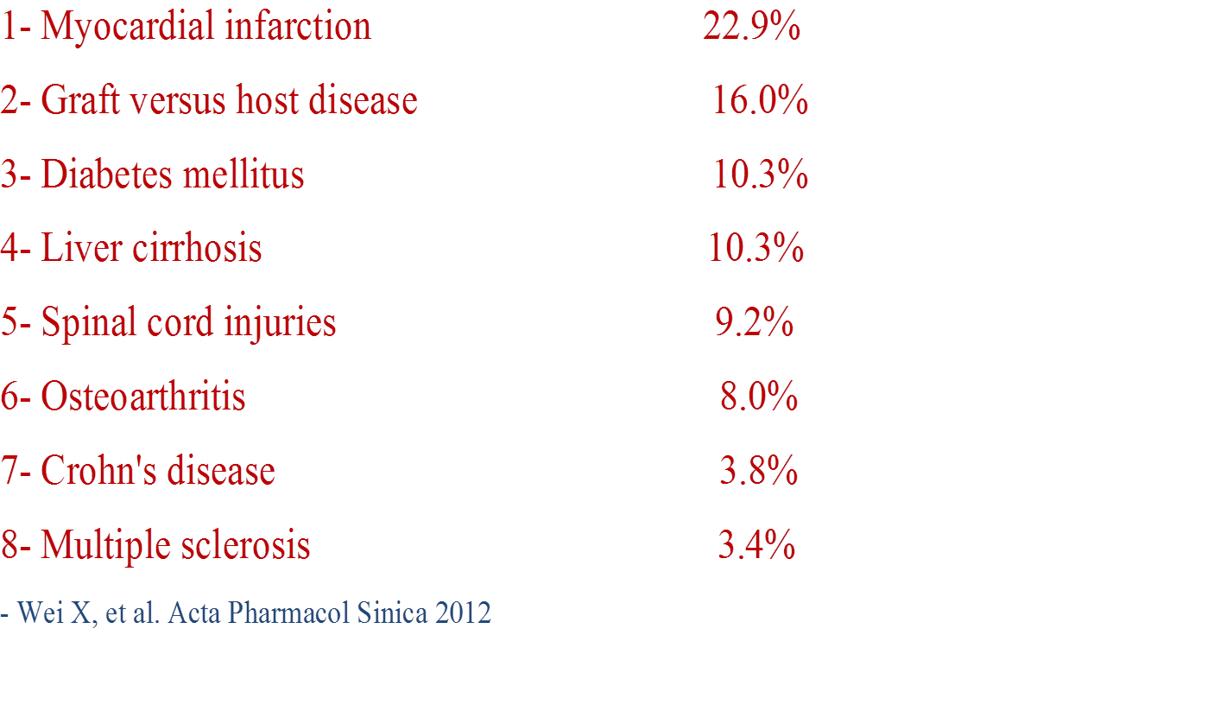
Clinical diseases treated by MSCs; 2012

Slide 8
Therapeutic indications of MSCs
1- In stem cell transplantation:
- Prevention & Rx of graft versus host disease
- Enhancement of engraftment
2- In cardiology; treatment of:
- Coronary artery disease
- Myocardial infarction
- Dilated cardiomyopathy
3- Critical limb ischemia
4- Repair of skeletal tissues
5- Non-healing chronic wounds
6- Chronic spinal cord injuries
7- Liver injury
8- Regenerative medicine
9- Osteogenesis imperfecta
10- Amyotrophic lateral sclerosis
11- Acute respiratory distress syndrome
12- Severe autoimmune disorders: SLE, RA, MS & systemic sclerosis
- Wang Y, et al. Stem Cell Int 2012 - Herberts CA, et al. J Transl Med 2011
- Ra JC, et al. Stem Cell Dev 2011 - Wong RSY, et al. J Biomed Biotechnol 2011
- Al-Anazi KA, et al. In-Tech 2015 [In Press]

Slide 9
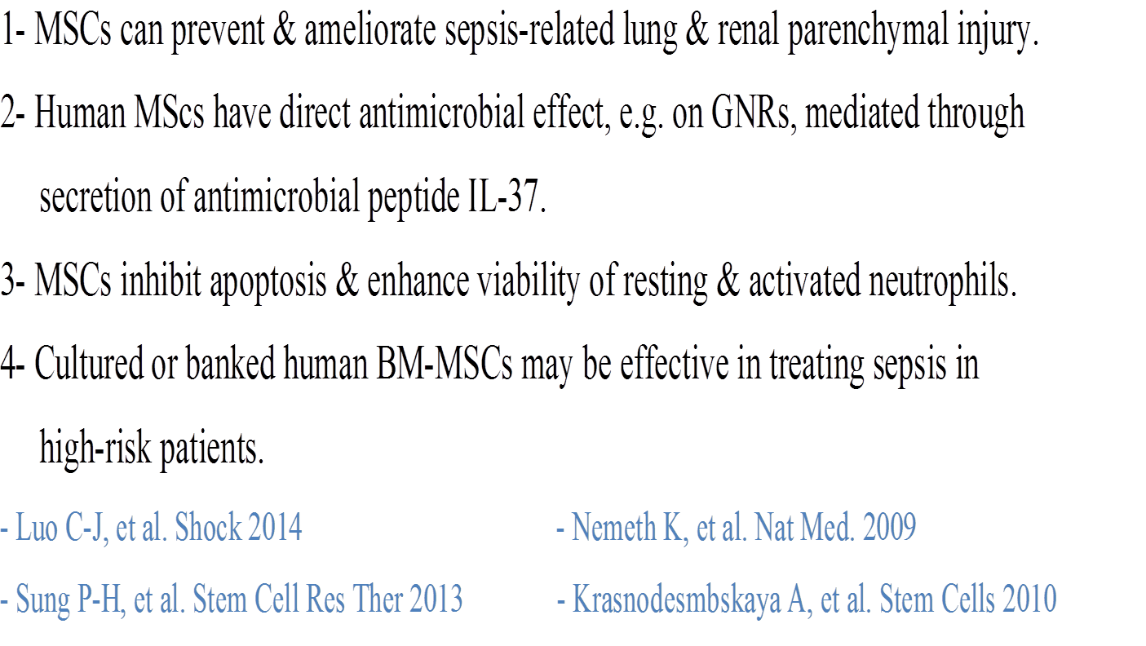
Conclusions from experimental sepsis models & human clinical trials

Slide 10
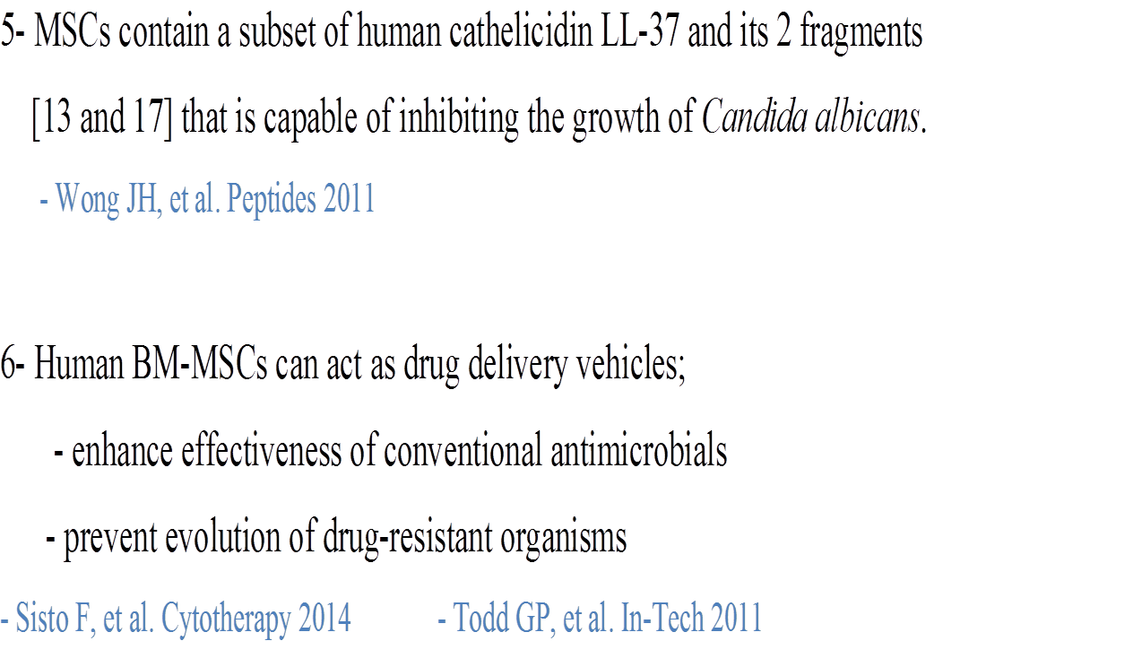
Conclusions continued

Slide 11
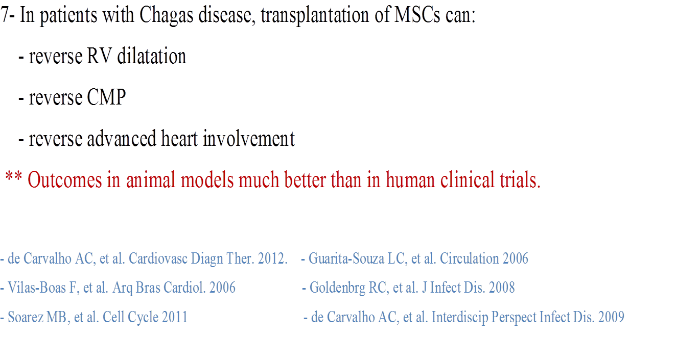
Conclusions continued

Slide 12
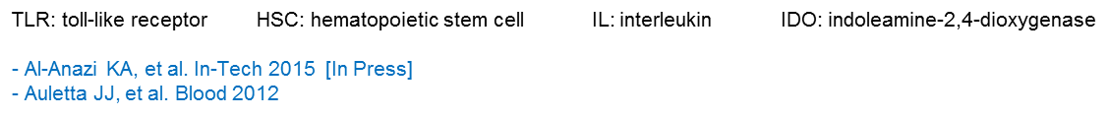
Accepted roles MSCs during infection
Details and explanations | Main effect / mechanism | Phase
- Engagement of TLR-mediated signaling pathways - Recruitment of MSCs at the sites of infection | Detection of pathogens and damage signals | 1
- Maintenance of quiescent HSC pool - BM emigration of activated HSCs - Mobilization and emigration of immune effector cells from BM. Thymic development to augment response of immune effector cells | Activation of host immune response | 2
- Production of microbiocidal soluble factors - Containment of infectious pathogen within micro-environment [ pathogen phagocytosis ] | Elimination of pathogens | 3
- Antioxidant soluble factor (HO-1) Antiinflammatory soluble factors such as: IDO, PGFZ, IL-10, TGF-B, TGF-6, HLA-G5 and Galectin-1 | Induction of pro-inflammatory gradients | 4
Activation of function, differentiation and migration of immune effector cells. - Augmentation of wound healing - Enhancement of revascularization - Inhibition of tissue toxicity - Modulation of inflammation and organ dysfunction. | Modulation of pro-inflammatory host immune response | 5

Slide 13
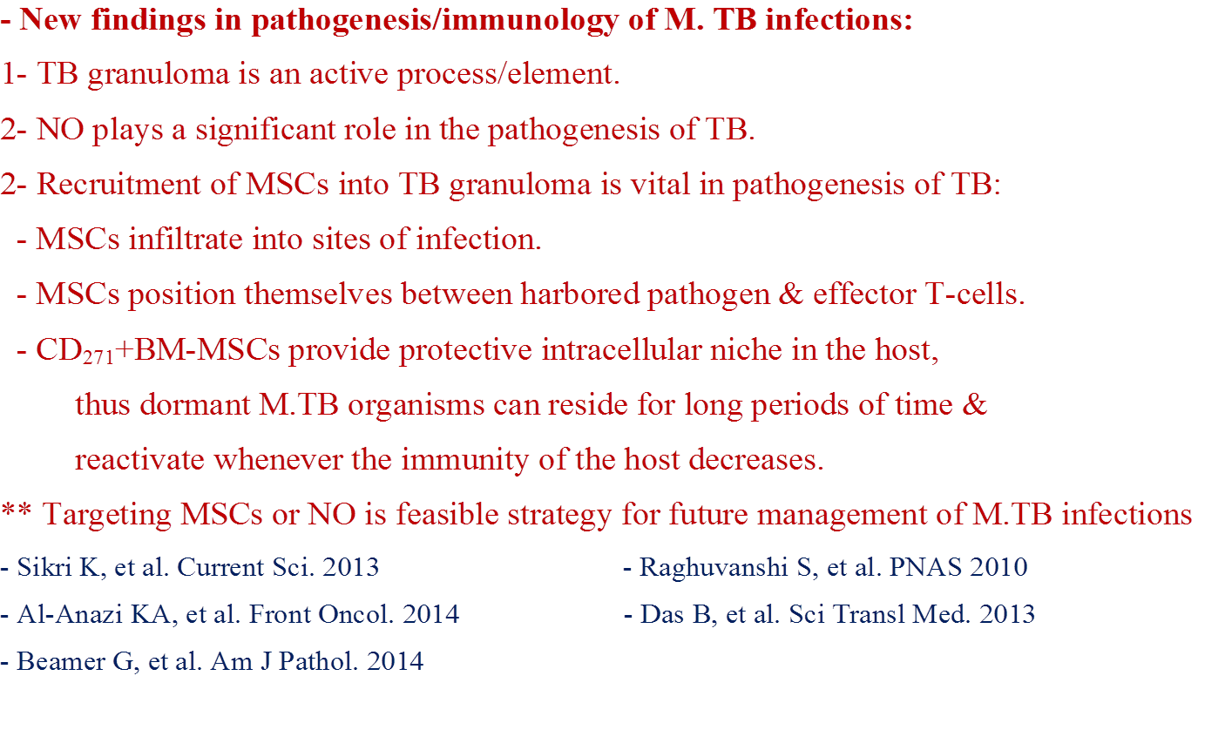
MSCs in M. TB Infections

Slide 14
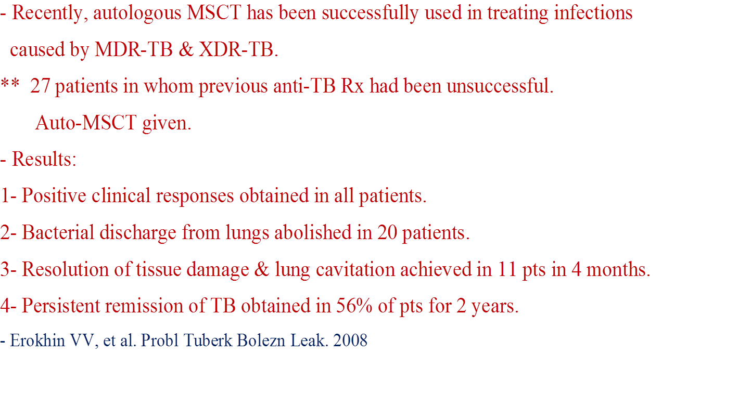
Auto-MSCT in TB

Slide 15
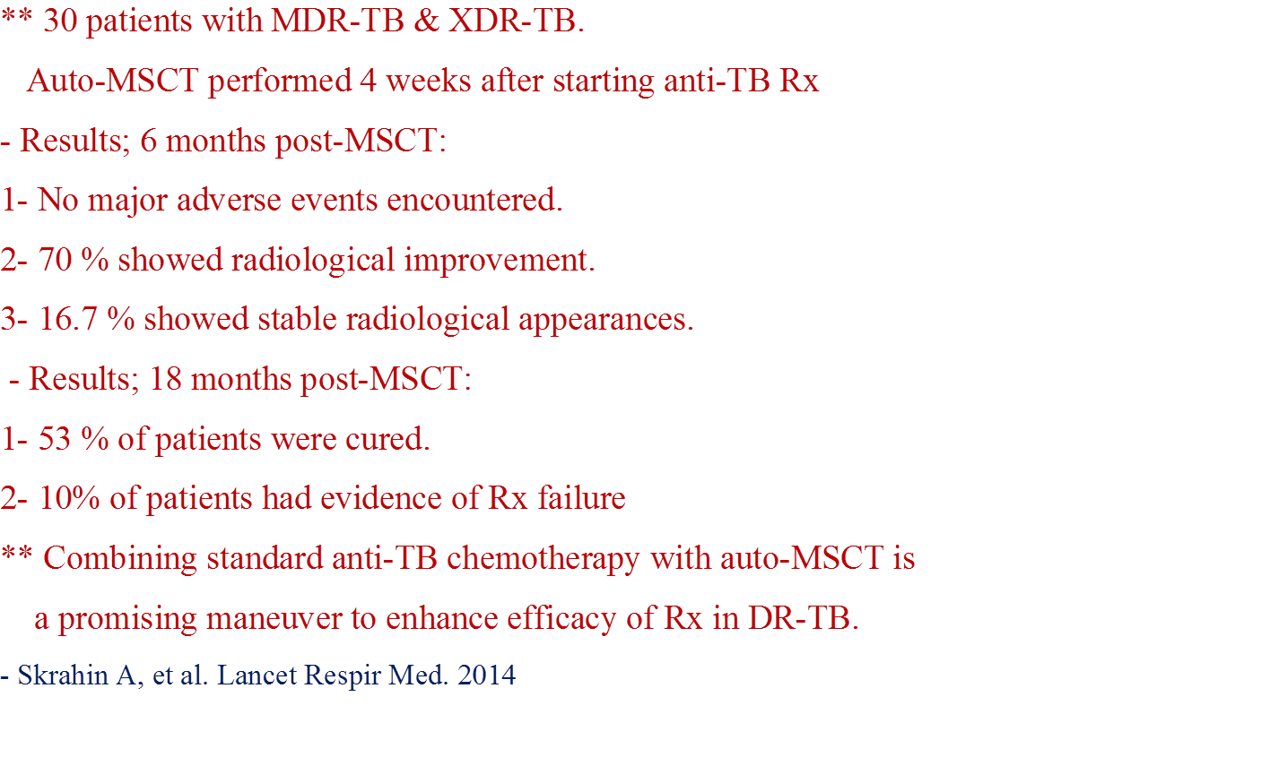
Auto-MSCT in TB continued

Slide 16
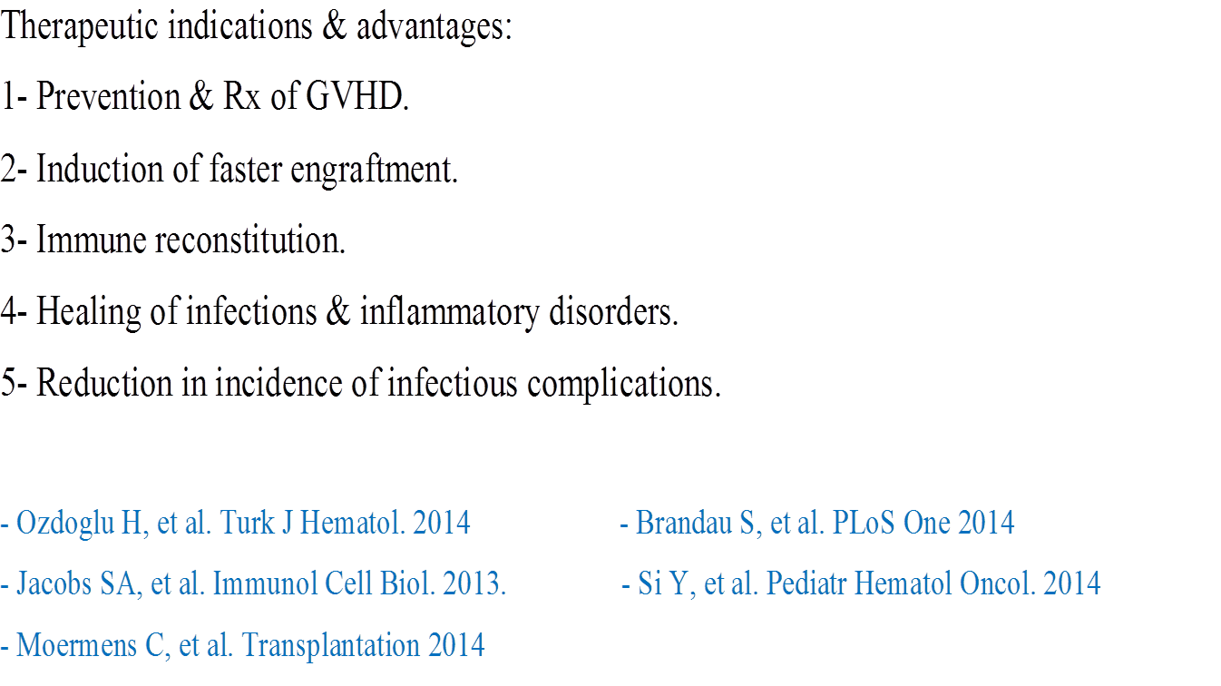
MSCs in HSCT

Slide 17
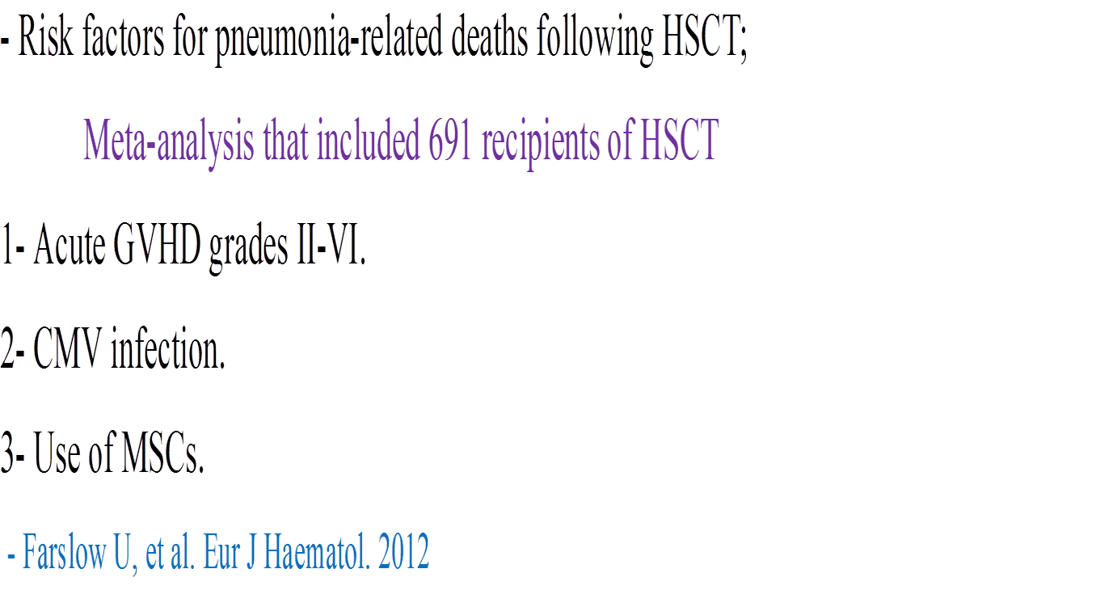
MSCs in HSCT continued

Slide 18
Other Studies on MSCs in HSCT
** 3 studies on the use of MSCs in Rx of
steroid-refractory GVHD &
2 studies on the use of MSCs in
GVHD prevention showed no increase in
the incidence of viral, bacterial or fungal infections.
Kurtzberg J et al Biol BMT 2013 - Baron F et al Biol BMT 2010
Fang B et al Transplant Proc 2007 - Ball LM et al Blood 2007
Lucchini G et al Stem Cell Int 2012

Slide 19
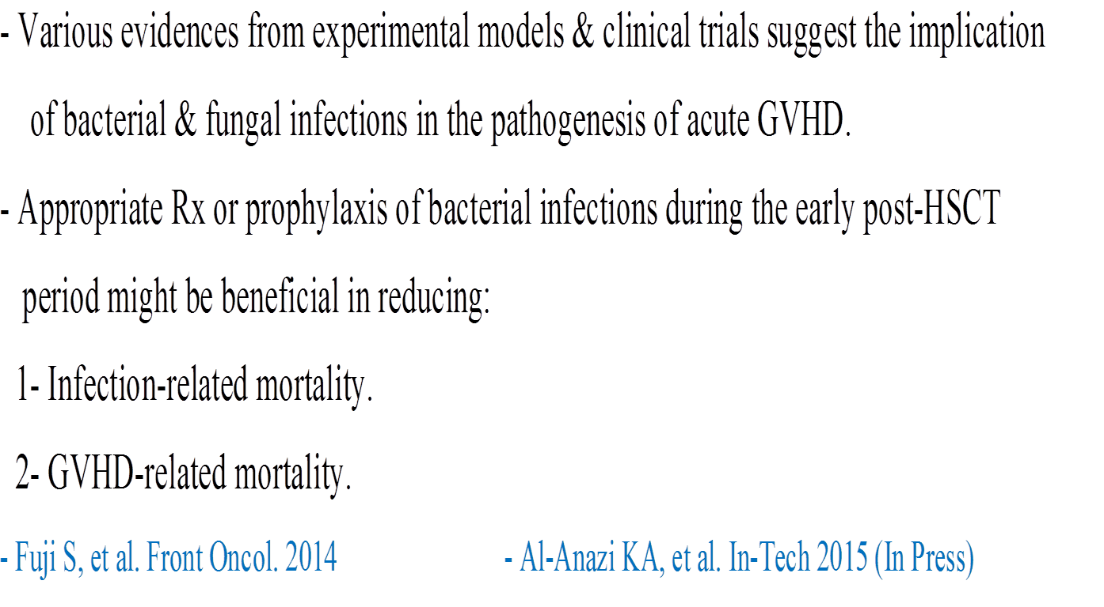
New data on GVHD

Slide 20
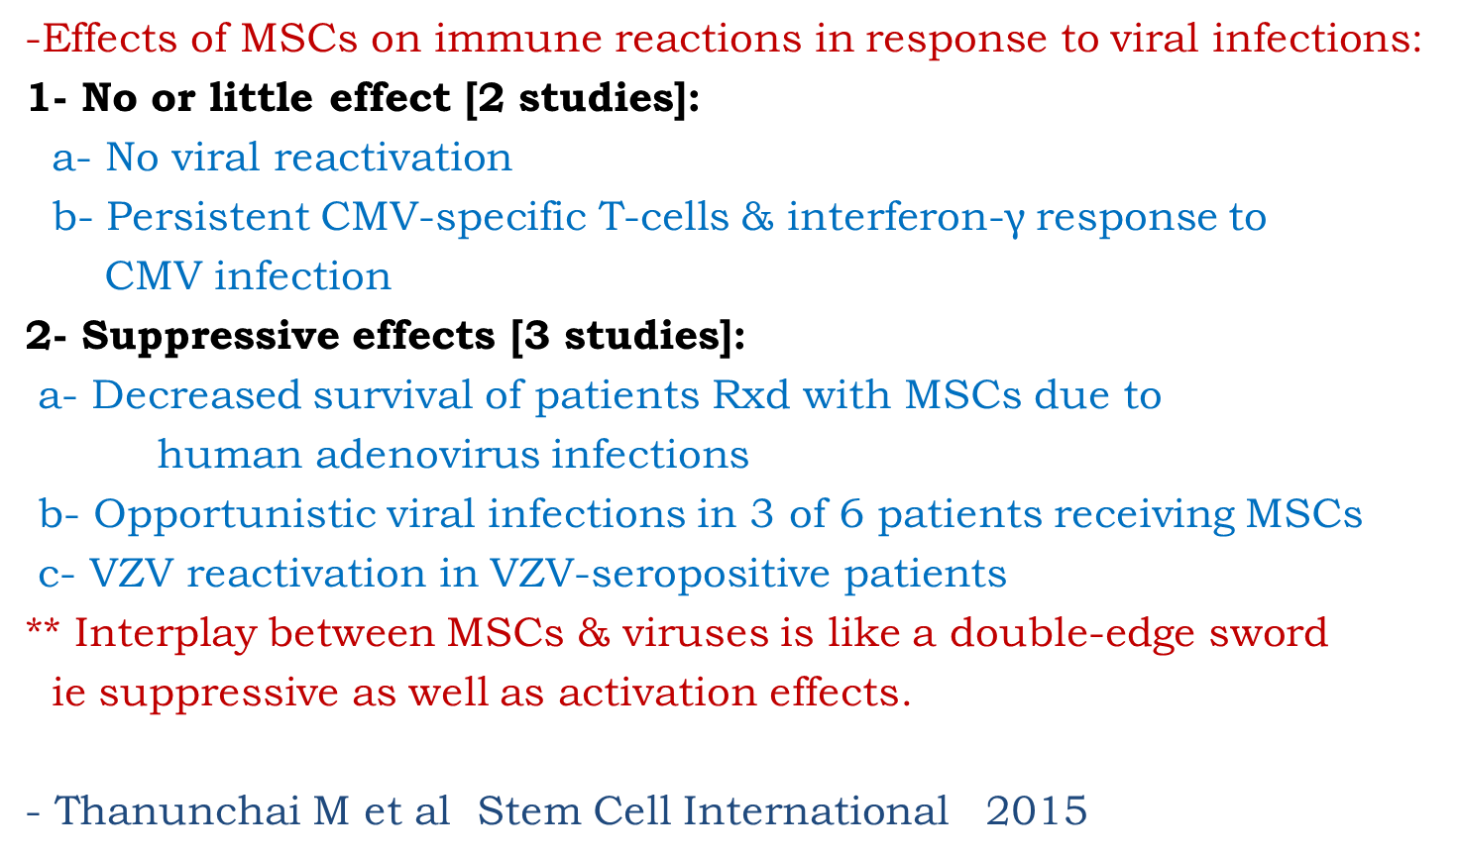
MSCs and Viral Infections

Slide 21
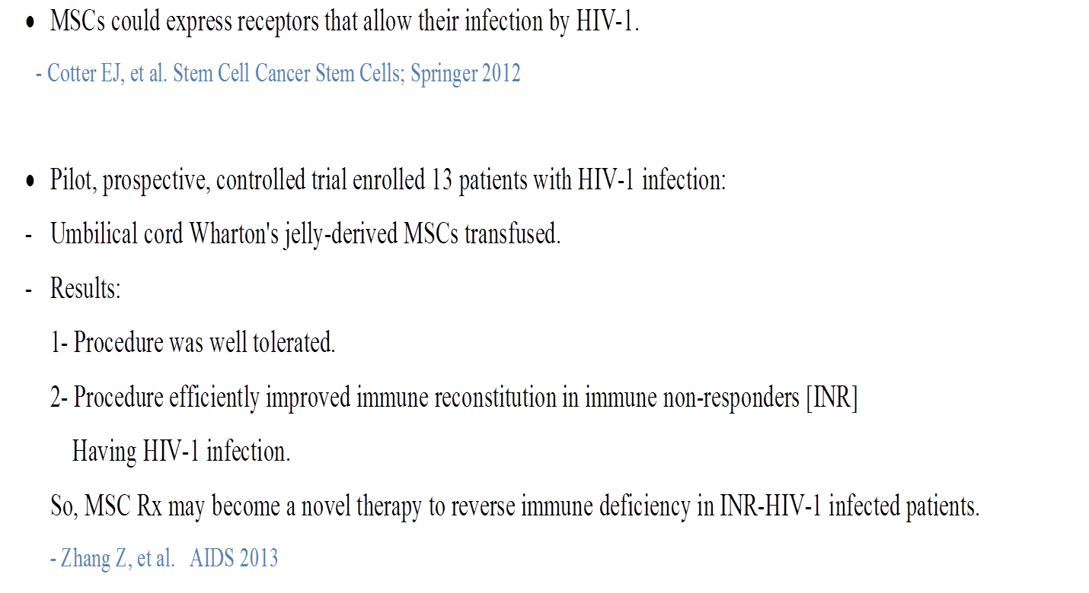
MSCs in HIV-1 infection

Slide 22
Auto-BM-MSCs in Liver Failure due to Hepatitis B

Slide 23
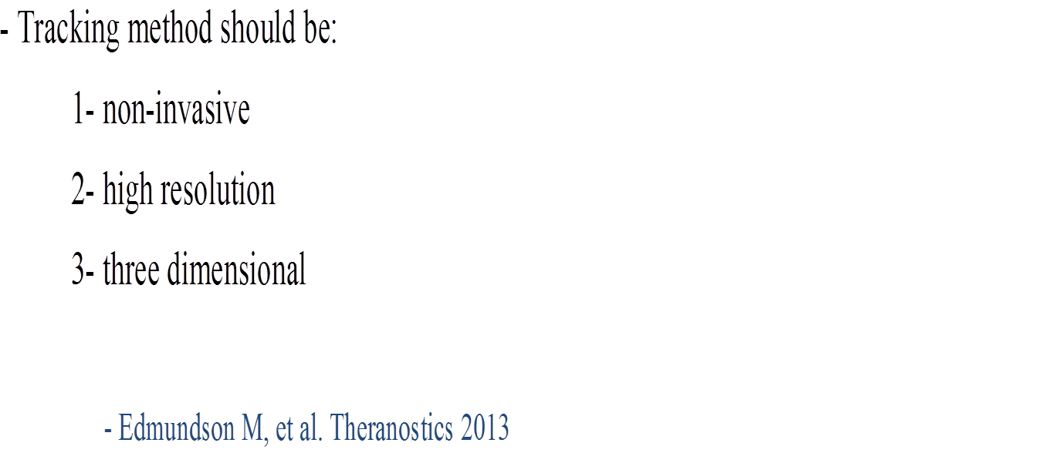
Tracking of Stem cells

Slide 24
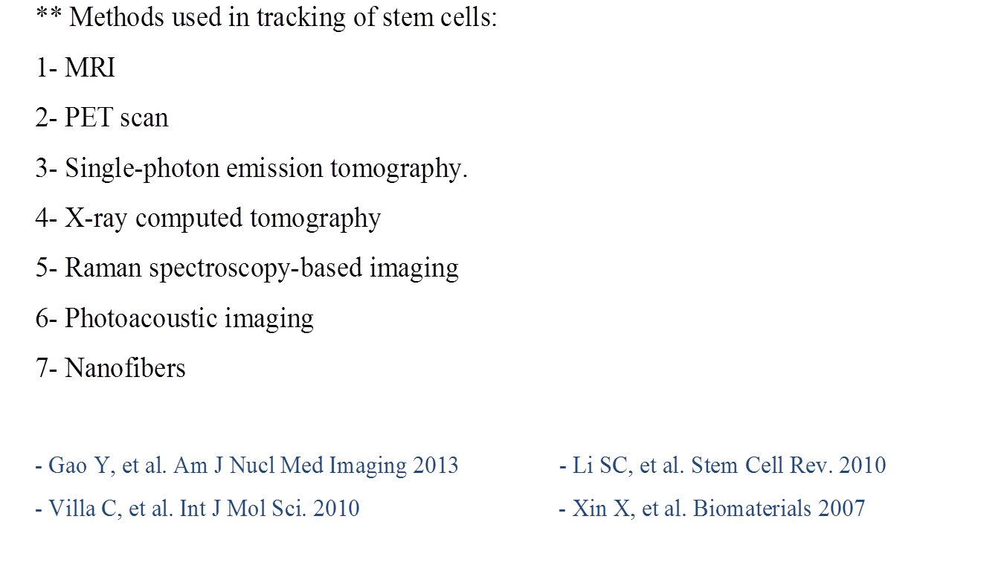
Tracking of stem cells continued

Slide 25
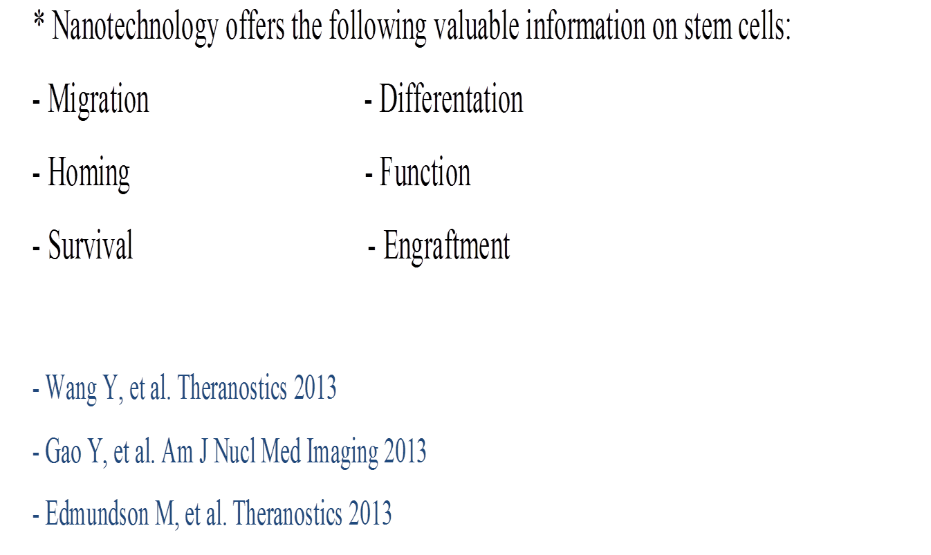
Tracking of stem cells continued

Slide 26
Conclusions

Slide 27


