Slide 1
About OMICS International
OMICS International is an amalgamation of Open Access Publications and worldwide international science conferences and events. Established in the year 2007 with the sole aim of making the information on Sciences and technology ‘Open Access’, OMICS Group publishes 500 online open access scholarly journals in all aspects of Science, Engineering, Management and Technology journals. OMICS Group has been instrumental in taking the knowledge on Science & technology to the doorsteps of ordinary men and women. Research Scholars, Students, Libraries, Educational Institutions, Research centers and the industry are main stakeholders that benefitted greatly from this knowledge dissemination. OMICS Group also organizes 500 International conferences annually across the globe, where knowledge transfer takes place through debates, round table discussions, poster presentations, workshops, symposia and exhibitions.

Slide 2
OMICS International Conferences
OMICS International is a pioneer and leading science event organizer, which publishes around 500 open access journals and conducts over 500 Medical, Clinical, Engineering, Life Sciences, Pharma scientific conferences all over the globe annually with the support of more than 1000 scientific associations and 30,000 editorial board members and 3.5 million followers to its credit.
OMICS Group has organized 500 conferences, workshops and national symposiums across the major cities including San Francisco, Las Vegas, San Antonio, Omaha, Orlando, Raleigh, Santa Clara, Chicago, Philadelphia, Baltimore, United Kingdom, Valencia, Dubai, Beijing, Hyderabad, Bengaluru and Mumbai.

Slide 3
Janssen Biotech v. Celltrion:
The Balance Between the BPCIA and Litigation
Presented by Kerisha A. Bowen, Ph.D.

Slide 4
The Biologics Price Competition and
Innovation Act of 2009 (BPCIA)
The BPCIA includes three major elements:
  The BPCIA creates a pathway for submitting an abbreviated biologics license application (aBLA) for approval of biosimilars
  The BPCIA creates a term of regulatory exclusivity for the applicant that is the first to demonstrate an interchangeable biosimilar
  The BPCIA creates a distinct patent dispute resolution procedure for use by brand name and biosimilar manufacturers.

Slide 5
BPCIA: The Varying Definitions of "SHALL"
42 U.S.C. § (I)(2)(A) Application Information: Not later than 20 days after the Secretary notifies the subsection (k) applicant that the application has been accepted for review, the subsection (k) applicant shall provide to the reference product sponsor a copy of the application submitted to the Secretary under subsection (k), and such other information that describes the process or processes used to manufacture the biological product that is the subject of such application; and
42 U.S.C. § (I)(8)(A) Notice of Commercial Marketing: The subsection (k) applicant shall provide notice to the reference product sponsor not later than 180 days before the date of the first commercial marketing of the biological product licensed under subsection (k).

Slide 6
BPCIA: The Varying Definitions of "SHALL"
42 U.S.C. § (I)(2)(A) Application Information: Not later than 20 days after the Secretary notifies the subsection (k) applicant that the application has been accepted for review, the subsection (k) applicant shall [MAY] provide to the reference product sponsor a copy of the application submitted to the Secretary under subsection (k), and such other information that describes the process or processes used to manufacture the biological product that is the subject of such application; and
42 U.S.C. § (I)(8)(A) Notice of Commercial Marketing: The subsection (k) applicant shall [MUST] provide notice to the reference product sponsor not later than 180 days before the date of the first commercial marketing of the biological product licensed under subsection (k).

Slide 7
Effect Notice of Commercial Marketing Under BPCIA
The Federal Circuit decided “shall” in this context is mandatory, and effective notice of commercial marketing may only occur after the product is licensed by the FDA.
In it's decision in Amgen Inc. v. Sandoz Inc. 794 F.3d 1347 (Fed. Cir. 2015) , the Federal Circuit stated that notice of commercial marketing prior to licensing by the FDA is premature and ineffective.

Slide 8
Janssen Biotech v. Celltrion: Timeline
Sep 1998 - U.S. Patent No. 5,807,715 issues (expired 15-Sep-2015)
  A method for producing a functional immunoglobin.
Sep 2001 - U.S. Patent No. 6,284,471 issues (expires 4-Sep-2018)
  A chimeric antibody comprising at least a part of human immunoglobin constant region and at least a part of a non-human immunoglobin variable region.
May 2007 - U.S. Patent No. 7,223,396 issued (expires 29-Jun-2016)
  A method for inhibiting TNFα in a human patient.
Mar 2013 - Celltrion files Complaint for Declaratory Judgement to invalidate the '715, '471, and '396 patents. (in the District Court for the District of Massachusetts)
Oct 2014 - the FDA accepts the application for review
Oct 2014 - Declaratory Judgment voluntary dismissed
Mar 2015 - Janssen files a complaint against Celltrion for not obeying BPCIA

Slide 9
Janssen Biotech v. Celltrion: Timeline
Sep 1998 - U.S. Patent No. 5,807,715 issues (expired 15-Sep-2015)
  A method for producing a functional immunoglobin.
Sep 2001 - U.S. Patent No. 6,284,471 issues (expires 4-Sep-2018)
  A chimeric antibody comprising at least a part of human immunoglobin constant region and at least a part of a non-human immunoglobin variable region.
May 2007 - U.S. Patent No. 7,223,396 issued (expires 29-Jun-2016)
  A method for inhibiting TNFα in a human patient.
Mar 2013 - Celltrion files Complaint for Declaratory Judgement to invalidate the '715, '471, and '396 patents. (in the District Court for the District of Massachusetts)
Oct 2014 - the FDA accepts the application for review
Oct 2014 - Declaratory Judgment voluntary dismissed
Mar 2015 - Janssen files a complaint against Celltrion for not obeying BPCIA

Slide 10
Janssen Biotech v. Celltrion: Timeline
Sep 1998 - U.S. Patent No. 5,807,715 issues (expired 15-Sep-2015)
  A method for producing a functional immunoglobin.
Sep 2001 - U.S. Patent No. 6,284,471 issues (expires 4-Sep-2018)
  A chimeric antibody comprising at least a part of human immunoglobin constant region and at least a part of a non-human immunoglobin variable region.
May 2007 - U.S. Patent No. 7,223,396 issued (expires 29-Jun-2016)
  A method for inhibiting TNFα in a human patient.
Mar 2013 - Celltrion files Complaint for Declaratory Judgement to invalidate the '715, '471, and '396 patents. (in the District Court for the District of Massachusetts)
Oct 2014 - the FDA accepts the application for review
Oct 2014 - Declaratory Judgment voluntary dismissed
Mar 2015 - Janssen files a complaint against Celltrion for not obeying BPCIA

Slide 11
Janssen Biotech v. Celltrion: Timeline
Sep 1998 - U.S. Patent No. 5,807,715 issues (expired 15-Sep-2015)
  A method for producing a functional immunoglobin.
Sep 2001 - U.S. Patent No. 6,284,471 issues (expires 4-Sep-2018)
  A chimeric antibody comprising at least a part of human immunoglobin constant region and at least a part of a non-human immunoglobin variable region.
May 2007 - U.S. Patent No. 7,223,396 issued (expires 29-Jun-2016)
  A method for inhibiting TNFα in a human patient.
Mar 2013 - Celltrion files Complaint for Declaratory Judgement to invalidate the '715, '471, and '396 patents. (in the District Court for the District of Massachusetts)
Oct 2014 - the FDA accepts the application for review
Oct 2014 - Declaratory Judgment voluntary dismissed
Mar 2015 - Janssen files a complaint against Celltrion for not obeying BPCIA

Slide 12
Janssen Biotech v. Celltrion: Update as of 28-Sep-2015
In light of Sandoz…
Defendants will not launch any biosimilar infliximab product in the United States until after September 15, 2015 (when the ‘715 patent expired).
All claims and defenses pending between Janssen and Celltrion related to alleged infringement of the ‘715 patent under 35 U.S.C. § 271(e)(2)(C)(i) are dismissed as moot.
All claims and defenses pending between the parties related to alleged infringement of the ‘056 patent under 35 U.S.C. § 271(e)(2)(C)(ii) are dismissed, and that dismissal is with prejudice only with respect to all claims and defenses related to the cell growth media described in the Cell Growth Media Spreadsheet.

Slide 13
The Take Home Message…
Do not file a notice of commercial marketing until AFTER the product is licensed by the FDA!!!

Slide 14
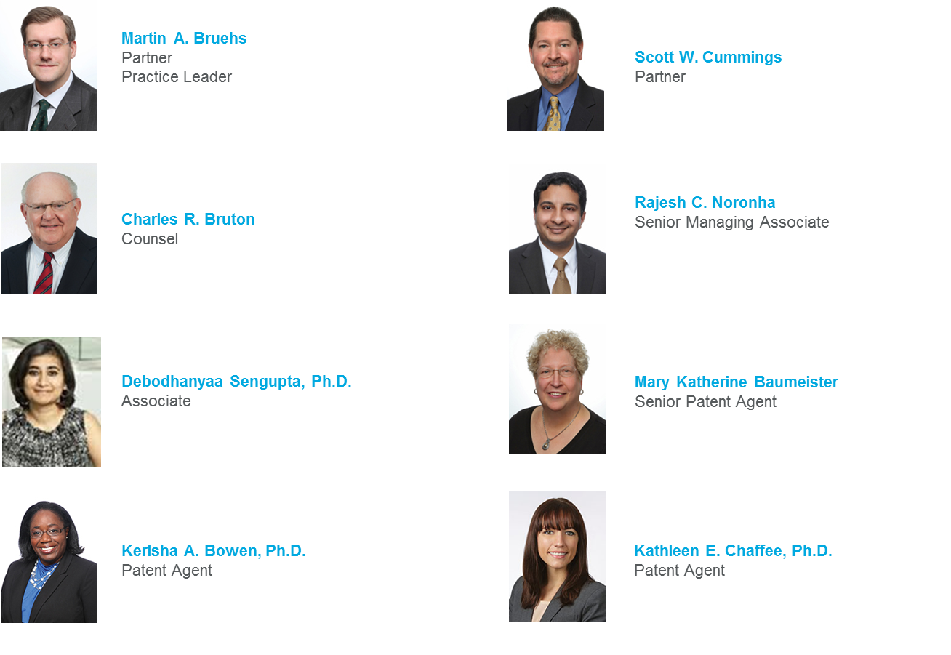
Dentons US LLC - Chemical Intellectual Property Team

Slide 16
Let us meet again..
We welcome you to our future conferences of OMICS International
5th European Biosimilars Congress
through
June 27-29, 2016 at Valencia, Spain
http://biosimilars-biologics.pharmaceuticalconferences.com/europe

Slide 17
Let us meet again..
We welcome you to our future conferences of OMICS International
5th European Biosimilars Congress
through
June 27-29, 2016 at Valencia, Spain
http://biosimilars-biologics.pharmaceuticalconferences.com/europe

