Slide 1





Identifying novel epigenetically induced synthetic lethality therapeutic combinations for high risk MDS/AML
Identifying novel epigenetically induced synthetic lethality therapeutic combinations for high risk MDS/ AML
Ken Mills
3rd International Conference on Hematology & Blood Disorders
Atlanta, USA: 1st November, 2015

Slide 2
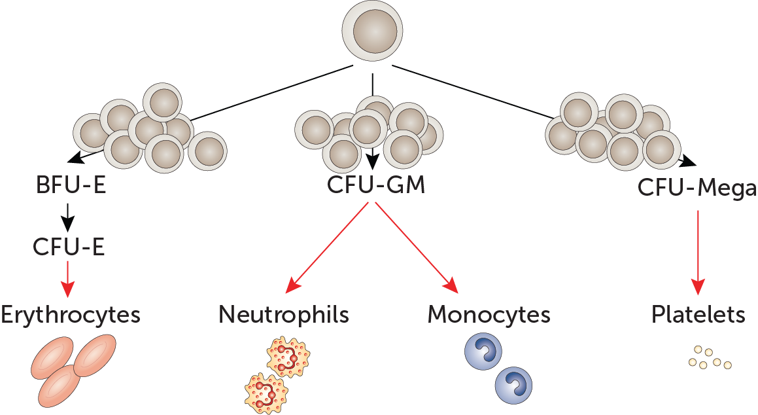
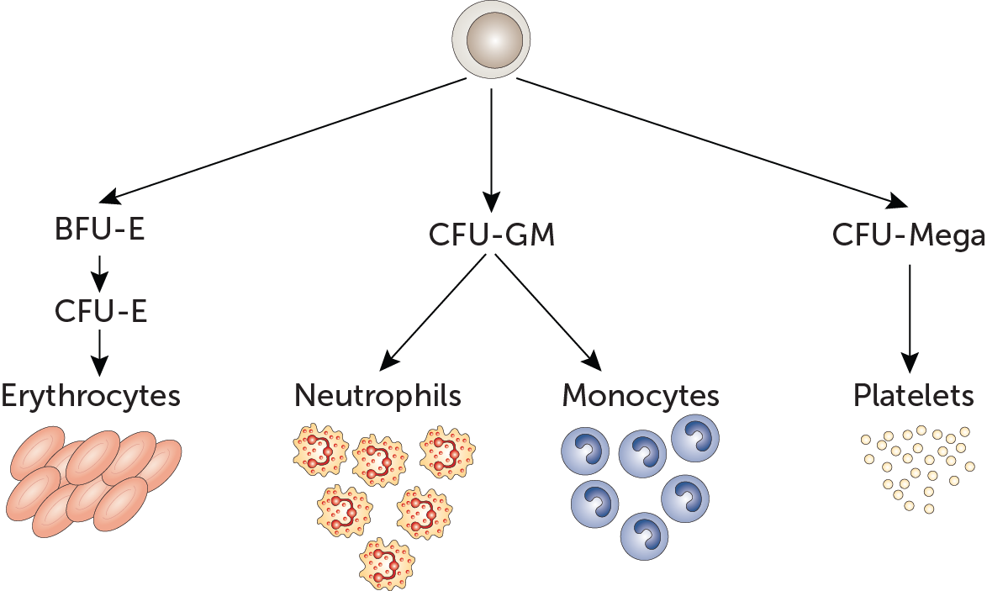
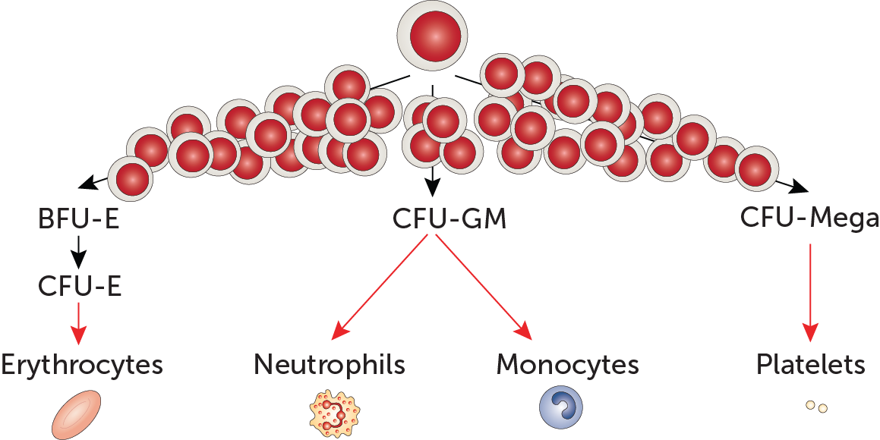
NBM → MDS → AML
Acute Myeloid Leukaemia (AML)
Normal Bone Marrow (NBM)
Myelodysplastic Syndrome (MDS)
~¹/₃ transform

Slide 3
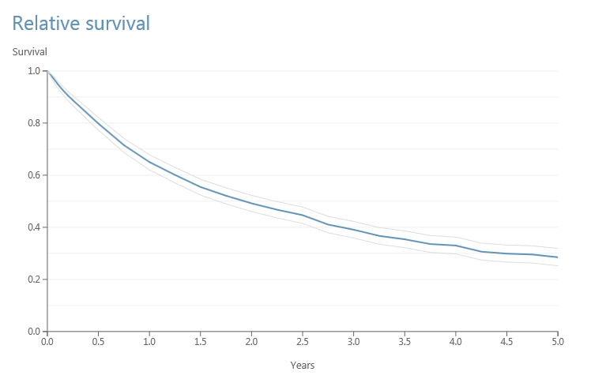
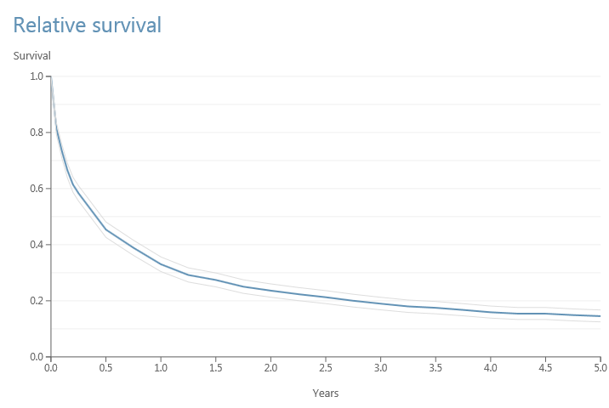
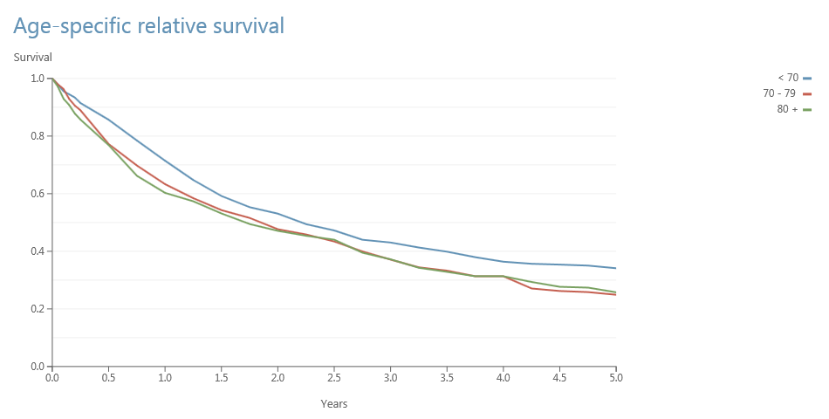
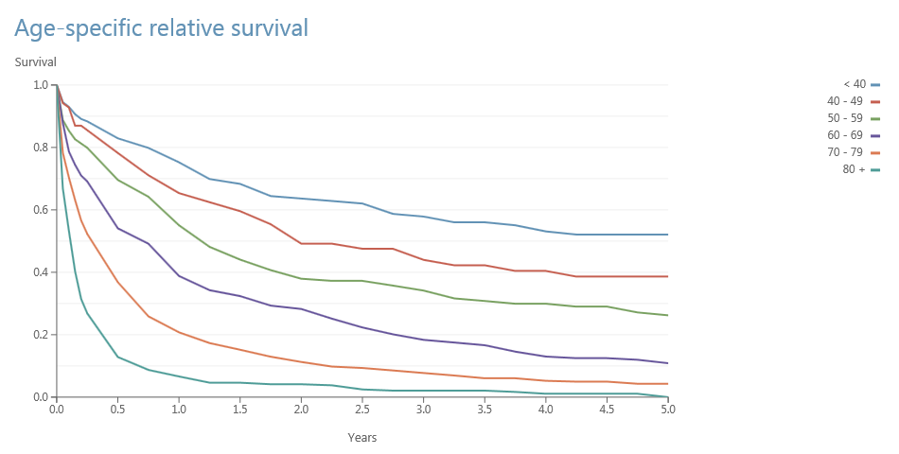
Overall and Age-Specific
Relative Survival
MDS
AML
HMRN 2015

Slide 4
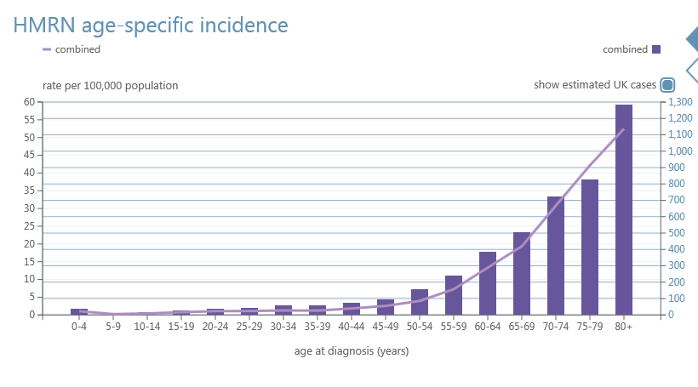
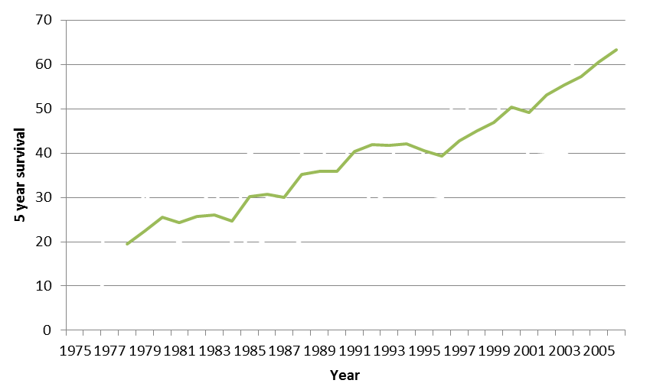
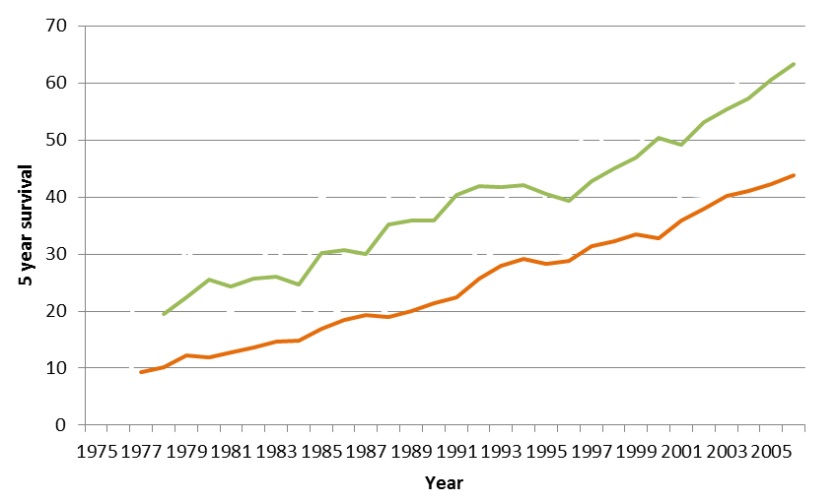
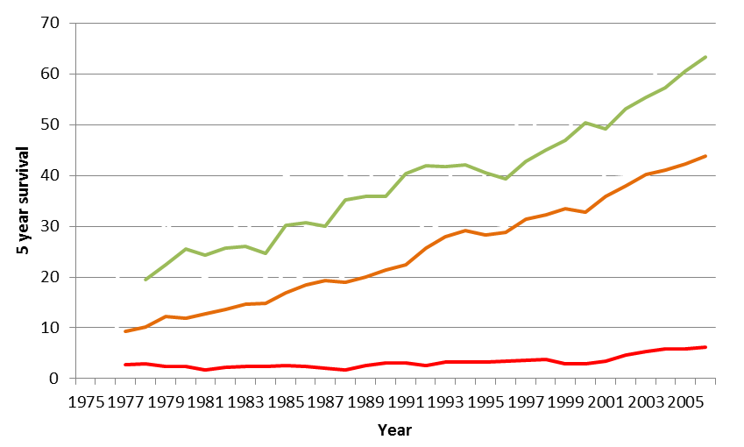

Novel therapies are needed for elderly AML / MDS
  Leukaemia is the most common cancer in children less than 20 years old
    The survival rate for children 0-14 years old has increased from ~10% at 1 year in the 1960’s to >90% at 10 years now
  Over 95% of cases of leukaemia occur in people over the age of 20 years old
    BUT survival rates for some types of leukaemia in patients over the age of 65 years old still remain poor
HMRN 2015
Elderly patients are unable to withstand harsh standard chemotherapy
Bleak outlook
Novel therapies required
<20 yrs
<65 yrs
Why has this person developed this disease?
How can I treat this more successfully?
How can I treat this patient without so much damage?
How can I treat the elderly?
>65 yrs
SEER, August 2014

Slide 5
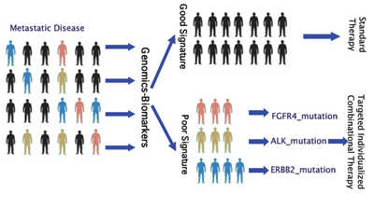
Personalised medicine
Favourable outcome
Standard Therapy
Molecular Analysis
Personalised Therapy
Adverse outcome
Mutation A: Therapy A
Mutation B: Therapy B
Mutation C: Therapy C

Slide 6
    Genes mutated in MDS & AML
BIRC3
BRAF
CDKN2A
CEBPA
CSF3R
ETV6
FBXW7
GATA2
GNAS
KDM6A
KRAS
MAP2K1
MLL
PTPN11
RAD21
RHOA
RUNX1
SETBP1
SMC1A
SMC3
SRSF2
U2AF1
XPO1
ZRSR2
ASXL1
PHF6
WT1
IDH2
NPM1
TET2
SF3B1
TP53
FLT3-ITD
FLT3-TKD
EZH2
JAK2
STAG2
MLL-PTD
CEBPA
RUNX1
IDH1
DNMT3A
NRAS
KIT
CBL
BCOR/BCORL1
1990
1992
1994
1996
1998
2000
2002
2004
2006
2008
2010
2012
NGS

Slide 7
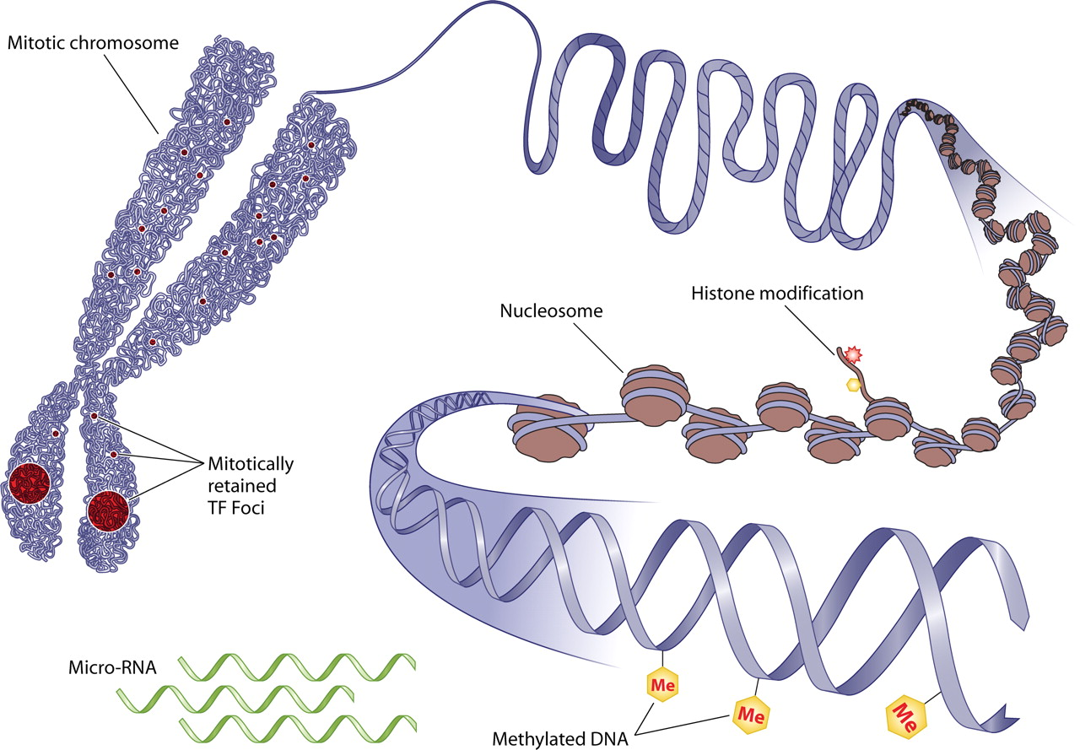
Epigenetics

Slide 8
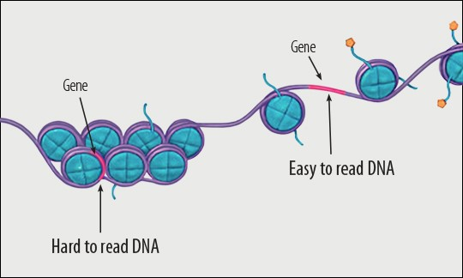
“Epigenetics is a layer of regulation over our genes that is key to how genes are turned on and off.”

Slide 9
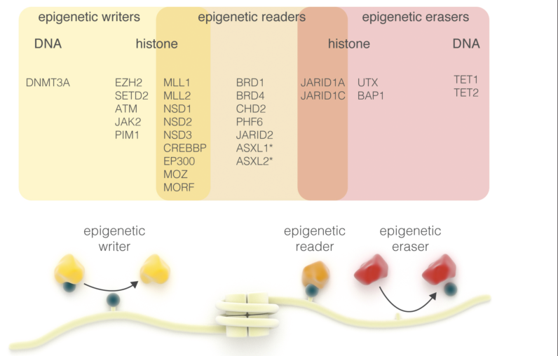
Common mutations in epigenetic readers, writers
and erasers in haematological malignancies.

Slide 10
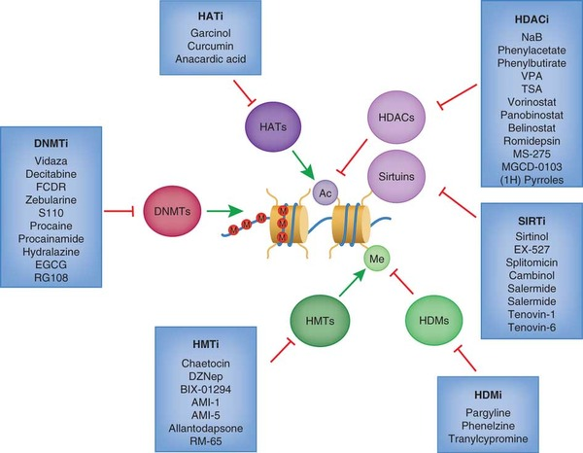
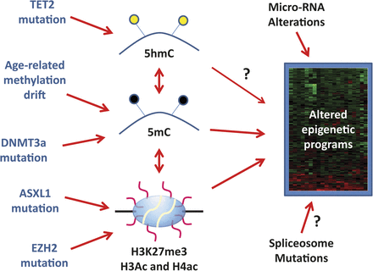
MDS – emergence as an epigenetic disease
Issa, Jean-Pierre J, Blood (2013)
Rodríguez-Paredes & Esteller, Nature (2011)

Slide 11
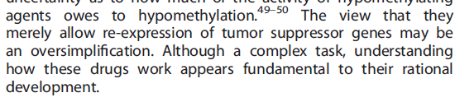

A need to identify rationally defined epigenetic therapeutic combinations
Estey, 2013. Leukaemia

Slide 12
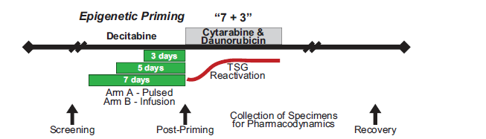
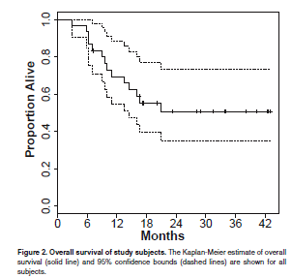
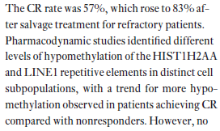

Phase I Epigenetic Priming Using Decitabine With Induction Chemotherapy in AML

Slide 13
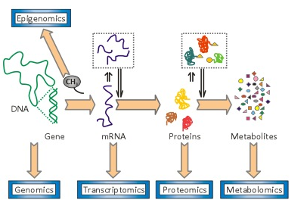
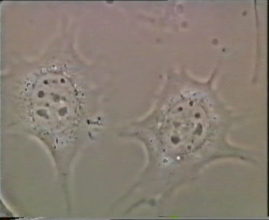
  An epigenetic therapeutic approach
Less toxic for unfit patients
Sensitises cells for other therapies
Mutation detection
DNA sequencing
Epigenetic profiling
Epigenetic Therapies
2nd
Therapy
Drug resistant
cells
Primed epi-sensitised cells

Slide 14
HDACi
DNMTi
HDMi
NGS mutation detection
DNA sequencing
Methylation profiling
Epigenetic Therapy
2nd Combination Therapy
Chemo-resistant
leukaemia
cells
Primed
leukaemia
cells

Slide 15
Re-purposed agents
Novel targets
Novel agents
2nd Combination Therapy
Primed
Leukaemia
cells
Cell death!

Slide 16
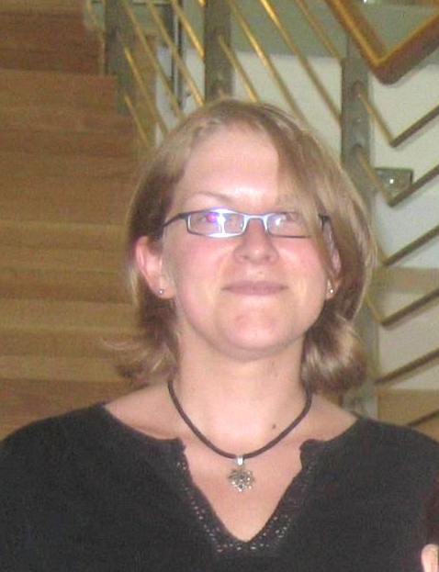



Integrated analysis of the molecular consequences of epigenetic therapies
DNMT inhibitors
  Decitabine
  Azacytidine
HDAC inhibitors
  Vorinostat
  Romidepsin
Combinations
  Decitabine ➔Vorinostat
Dr Hilary Colyer
Dr Jodie Hay
Kathryn Clarke
Dr Christine Young

Slide 17
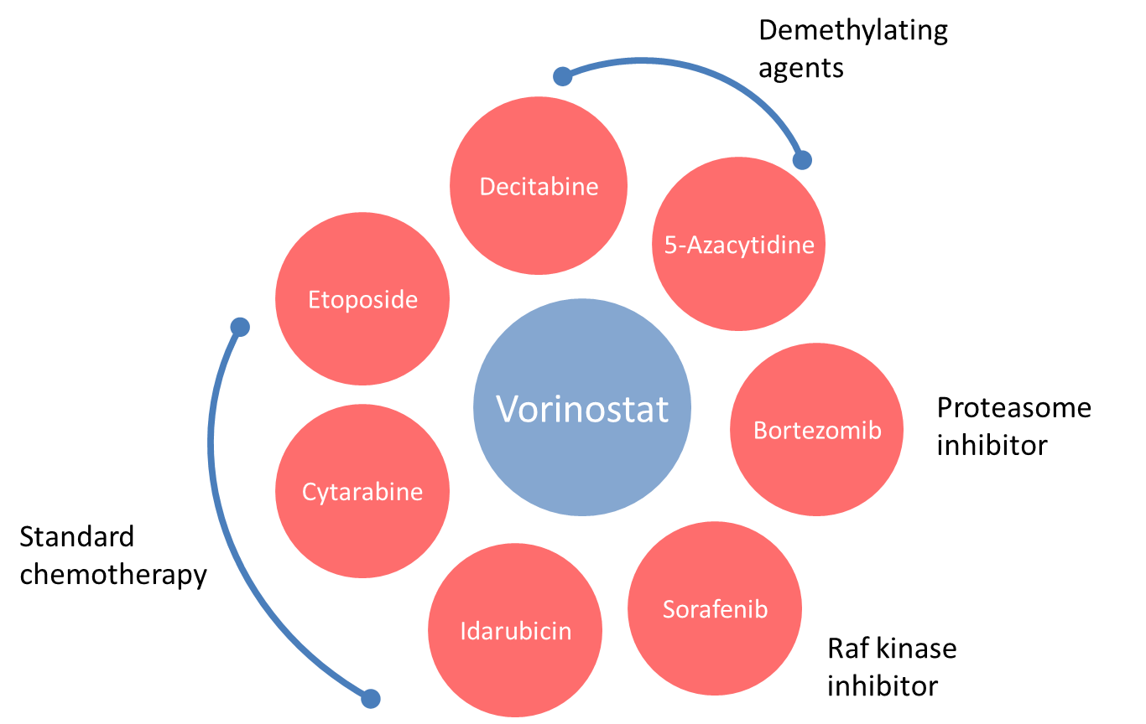
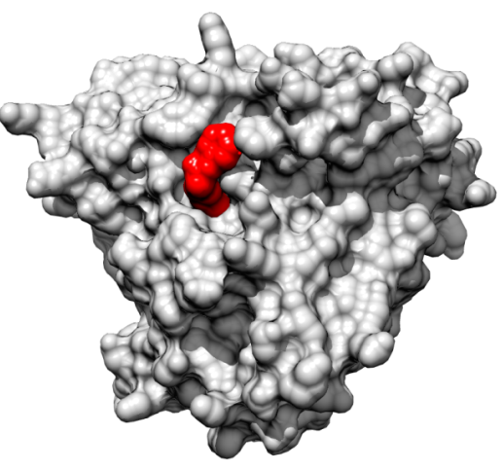
Vorinostat
Pan-HDAC inhibitor
  HDACs 1, 2, 3 and 6
Binds Zn²⁺ within enzyme pocket
FDA approved 2006 for CTCL treatment
Phase I and II clinical trials in haematological malignancies including AML
Vorinostat
(UCSF Chimera PDB 4LXZ)

Slide 18
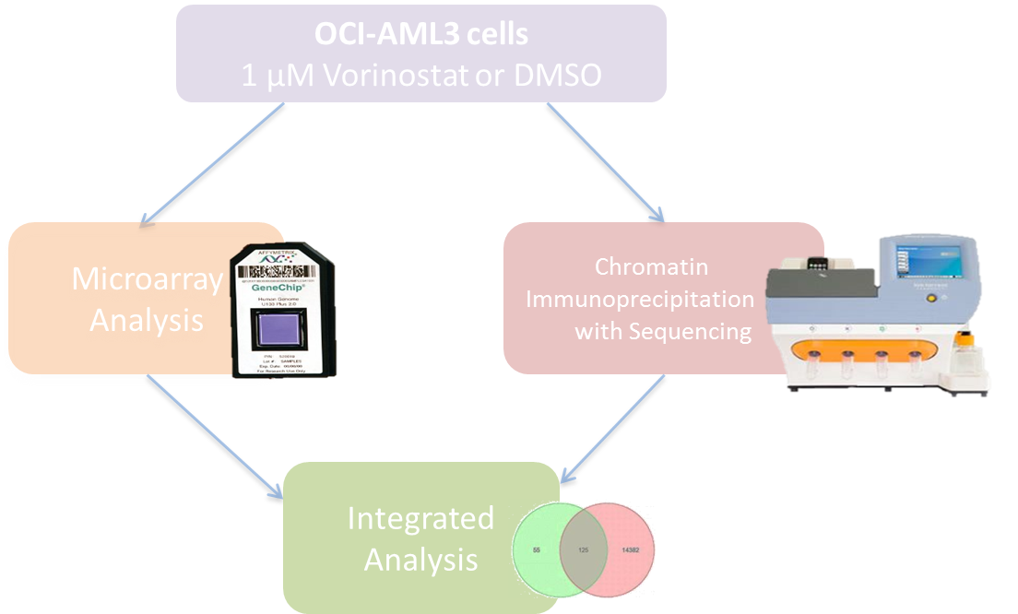
AML cells
1 μm Vorinostat or DMSO
Microarray
analysis
Chromatin-immuno-precipitation with sequencing
Integrated
analysis

Slide 19
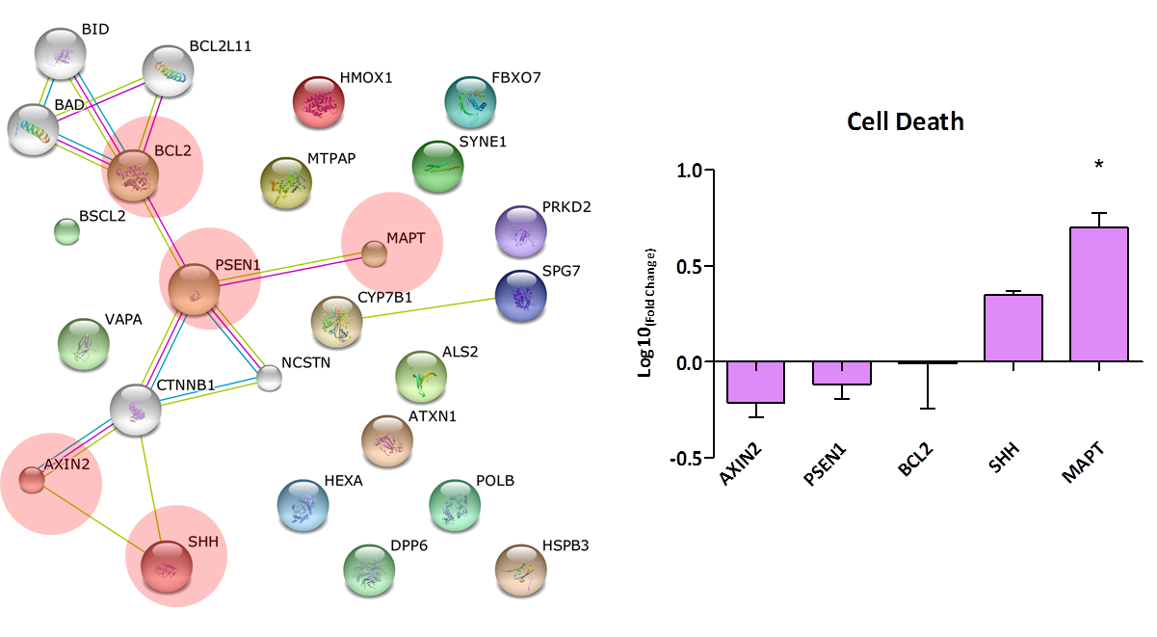
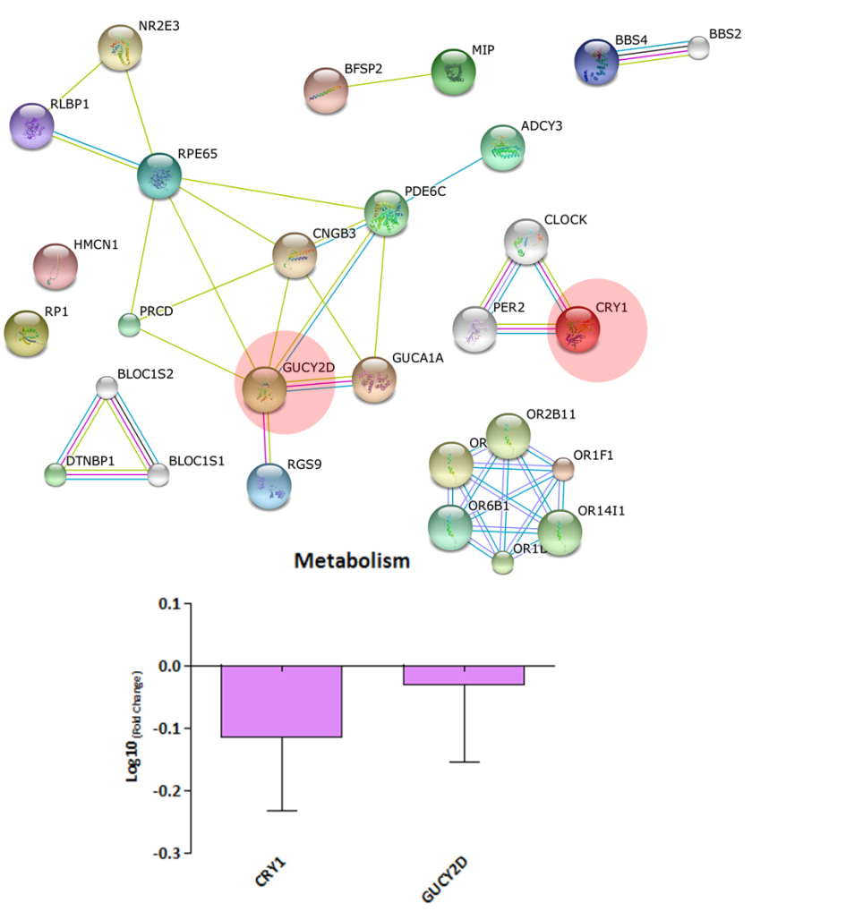
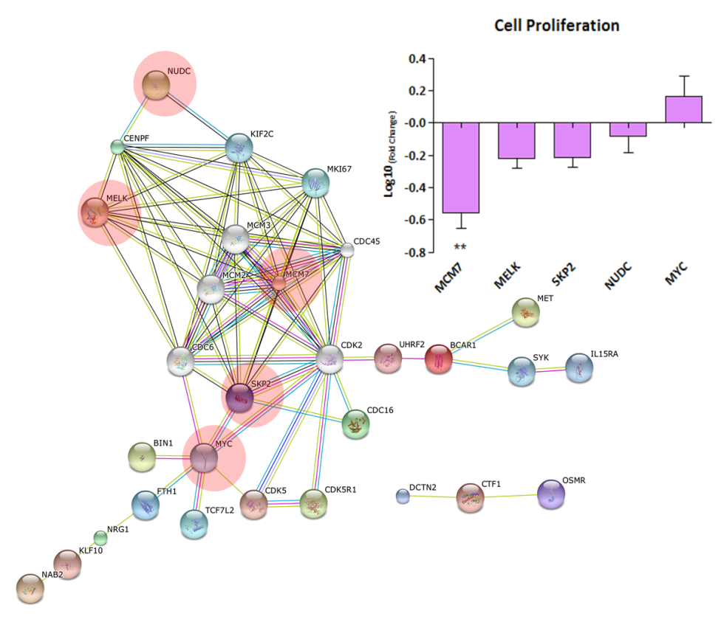
Gene networks associated with increased H3 acetylation

Slide 20
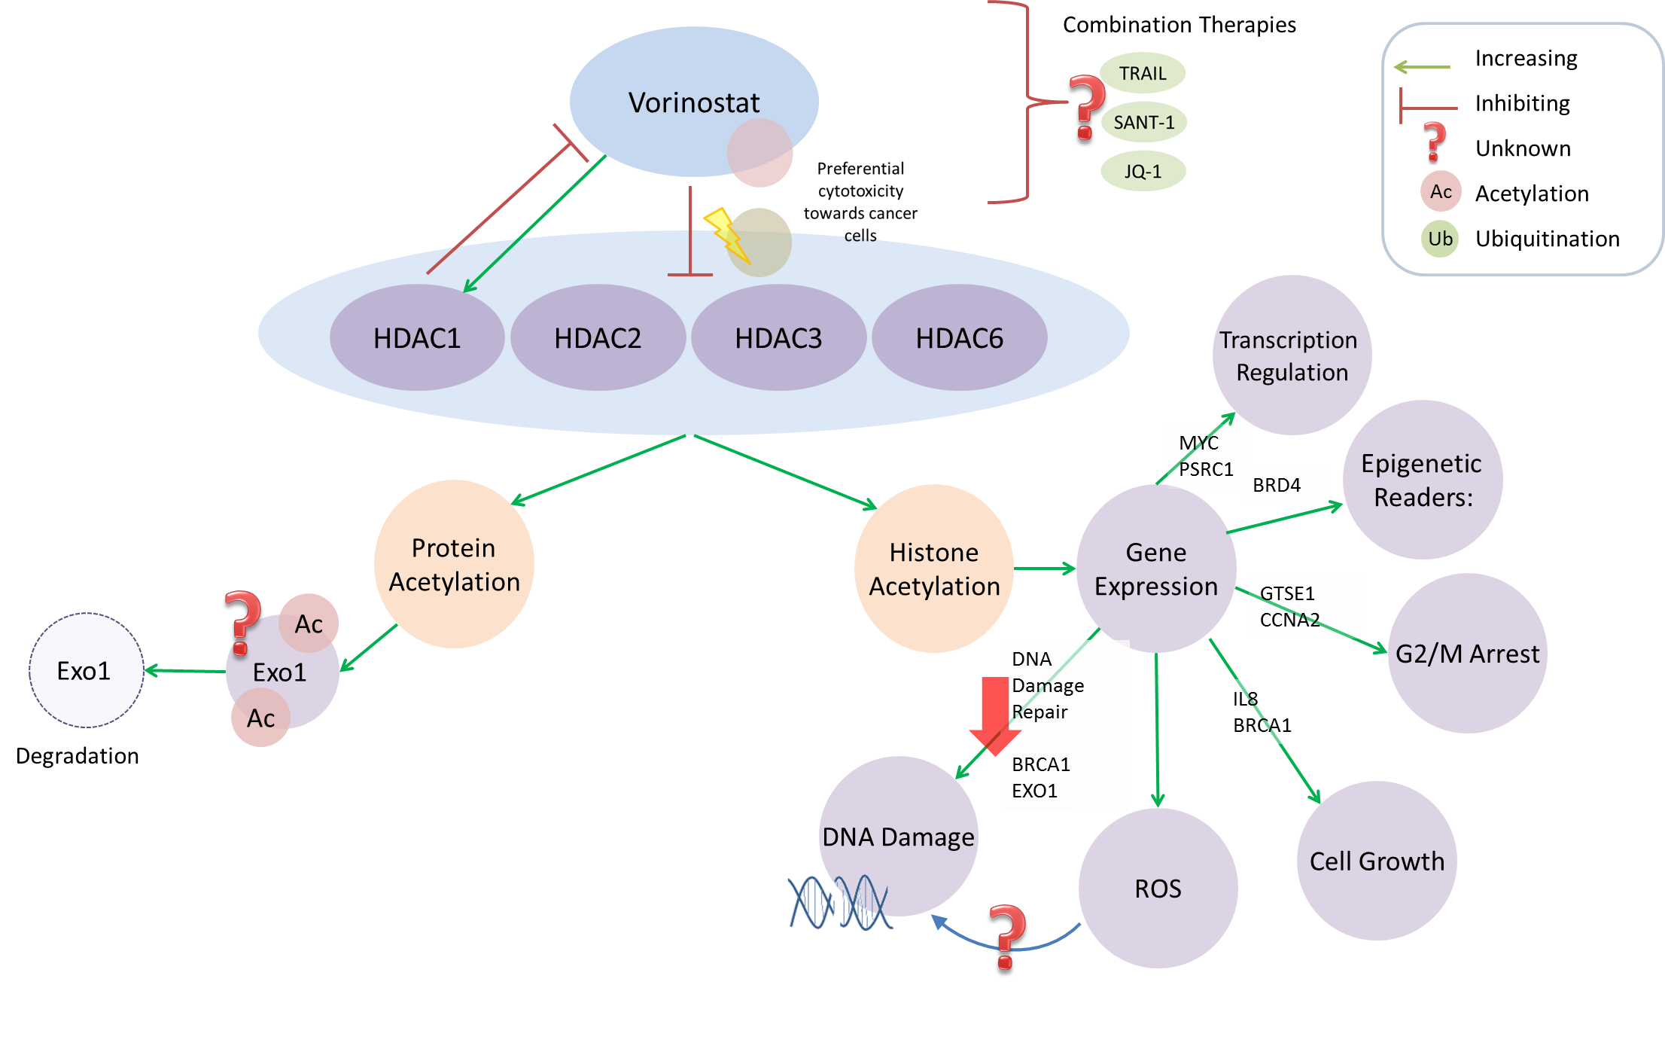
Combination therapy
targets
TRAIL
Hh
BRD4

Slide 21

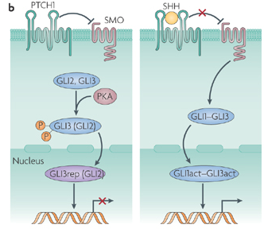
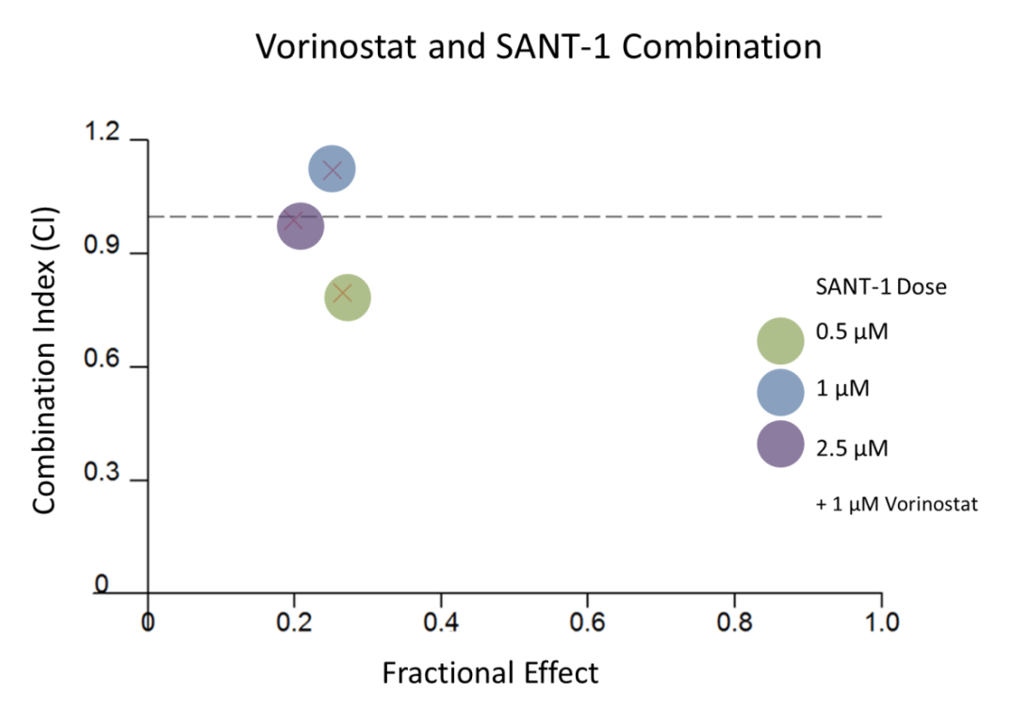
Targeting SHH
Hh inhibitor
Essential in embryonic development
Can control proliferation and activate the cell cycle
Aberrant activation linked to cancer
Regulates Bcl-2 expression
Hh inhibitor and Vorinostat are synergistic in pancreatic cancer
Crompton, 2007

Slide 22
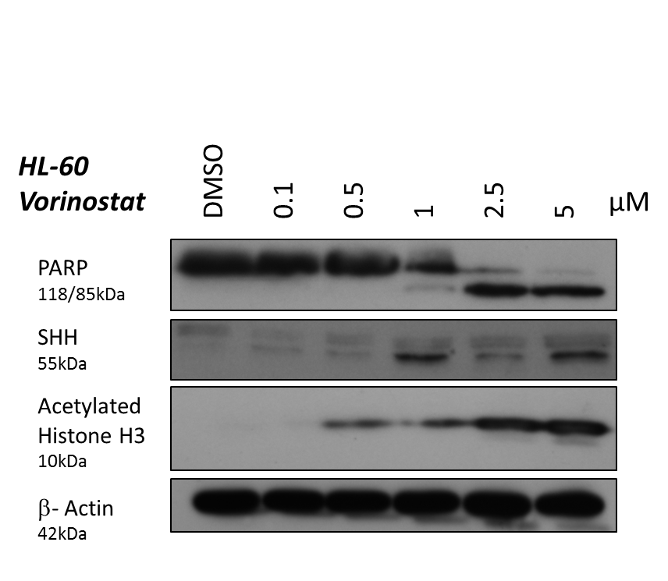
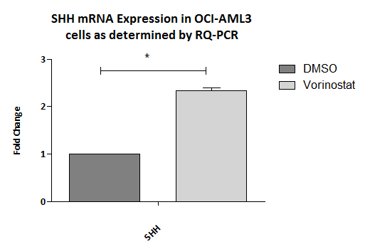
Vorinostat up-regulates Sonic Hedgehog Homolog (SHH)
Vorinostat up-regulates both SHH protein and mRNA
SHH stimulates cell cycle and induces proliferation
Inhibit SHH with Hh inhibitor (potent inhibitor of Shh signalling which inhibits SMO agonist effects with IC50 of 20nM

Slide 23
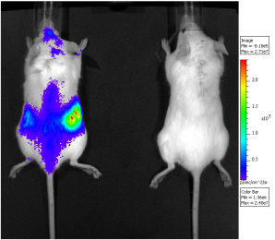
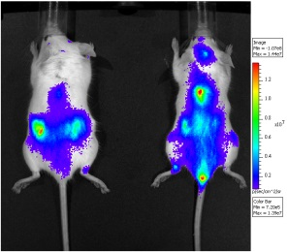
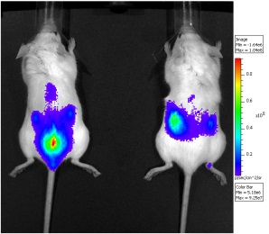
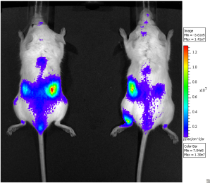
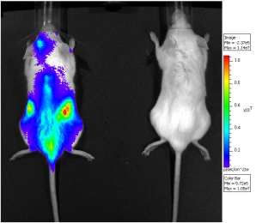
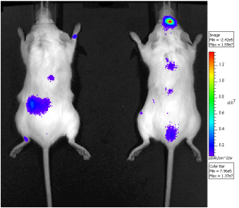
OCI-AML3 cells treated with drug combinations – Day 28 visualization
Untreated
DMSO
D31
D29.5
Decitabine
Vorinostat
Hh inhibitor
Modest extension of survival with single agents
Vorinostat + Hh inhibitor combination increases survival
D32
D30
D31
Vorinostat + Hh inhibitor
D36
1 x 10⁵
D39
2.5 x 10⁴
3 x 10⁵
1 x 10⁵
1.5 x 10⁶

Slide 24
Vorinostat + Hh combination: TRIAL DESIGN
PATIENTS | Dose ESCALATION | Dose EXPANSION
Patient Population | Acute Myeloid Leukaemia/High Risk MDS | Acute Myeloid Leukaemia/High Risk MDS
No. Patients (Total = 30 – 48) | 3+3 cohorts = 18 - 36 patients | 12 patients
Patient group | Relapsed and refractory AML/high risk MDS, not fit for intensive therapy | Relapsed and refractory AML/high risk MDS, not fit for intensive therapy
No. of Centres required | 5-6 | 5-6

Slide 25

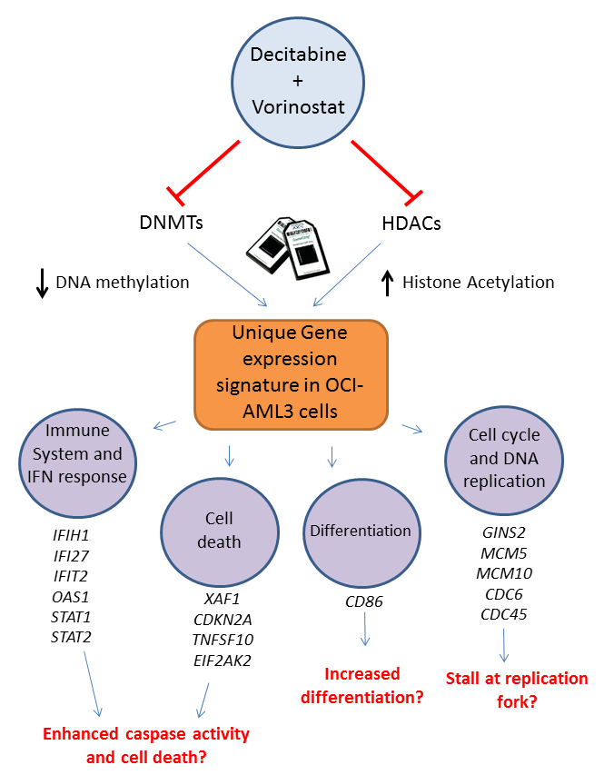
AXL
AXL
AXL
Notes:
So to summarise this chapter of work, I have shown that the combined action of Decitabine and vorinostat in oci-aml3 cells leading to the inhibition and dna methylation and increased histone acetylation produces a unique gene expression signature within these cells. Specific functions that were found to be enriched included those such as the immune and inf response and cell death and upon further investigation some of the genes altered were found to play a role in the induction if caspase activity which may provide a possible reason for the increase in caspase and apoptosis seen in the first chapter. Differentiation was also enriched and although this was not investigated directly in the human aml cell lines, treatments on murine cell lines suggested a role for these agents in the induction of differentiation. And finally, the cell cycle and dna replication related genes both of which were down regulated following combination treatment.

Slide 26
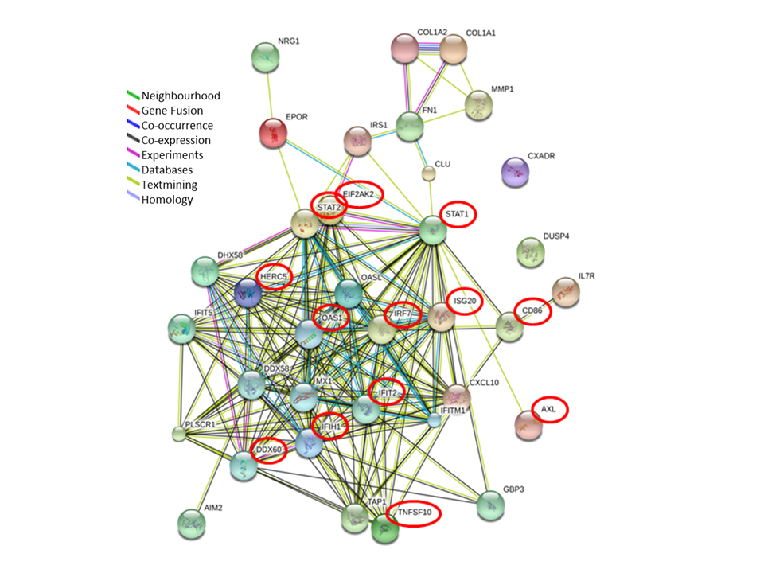
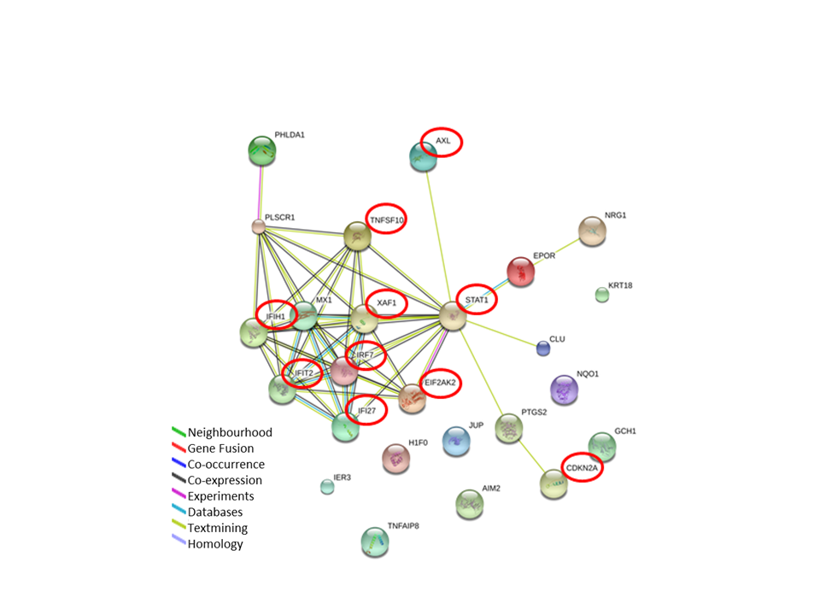
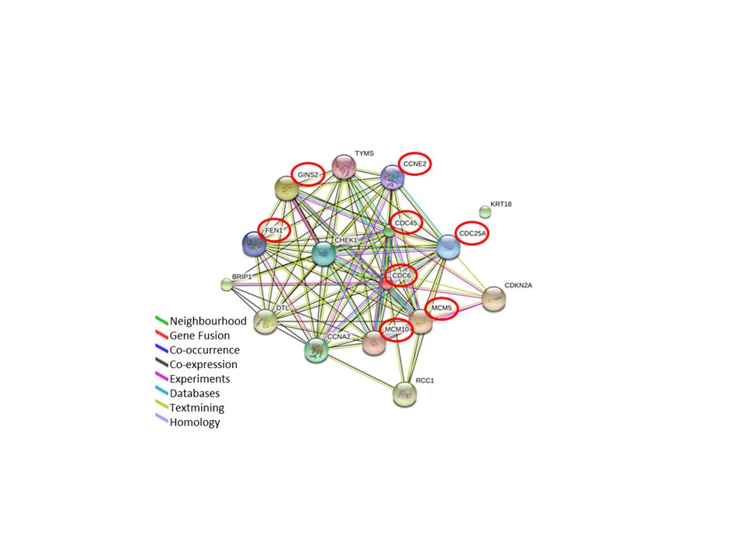
Identifying Protein-protein interactions
19 genes
8 genes
Notes:
So gene lists for each function were entered into string which maps known and predicted protein-protein interactions and creates these interaction netweorks . From these networks, 19 genes said to be upregulated and 8 genes said to be down regulated following combination treatment were chosen for validatuon by qPCR.

Slide 27
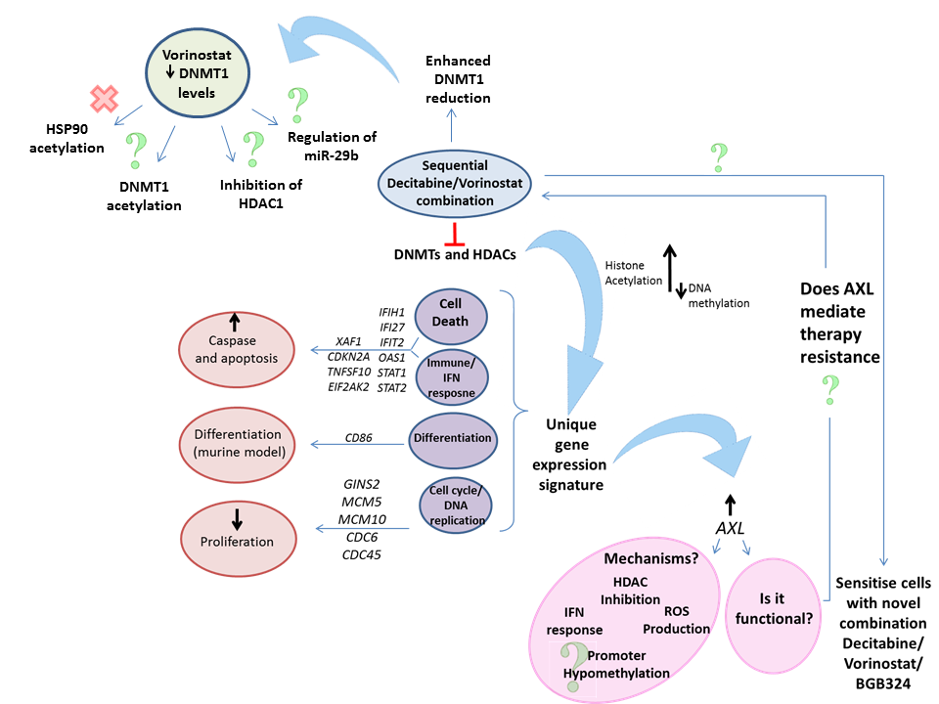
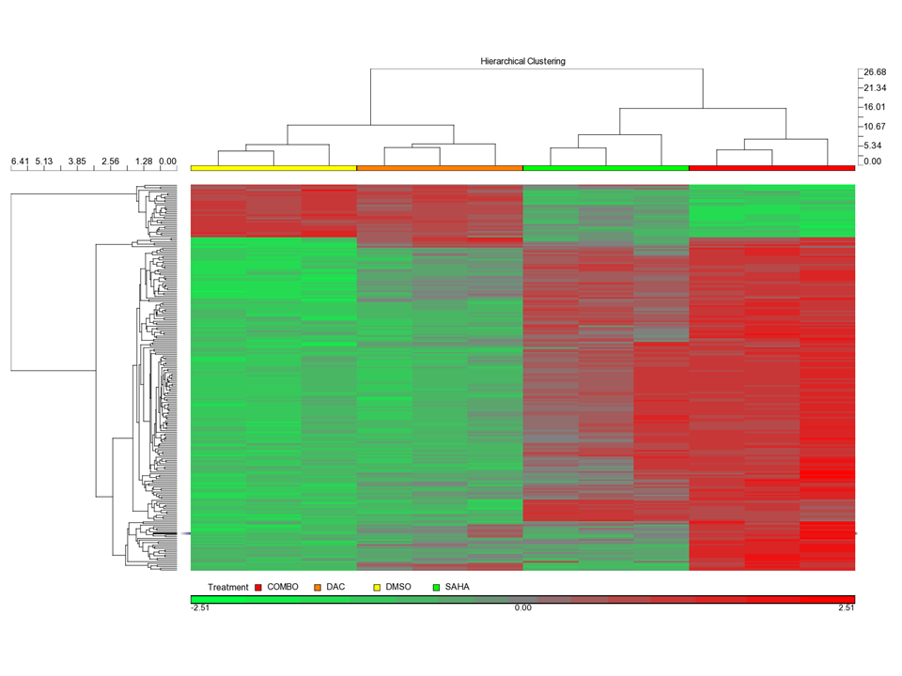
Hours
0 24 48 72
Decitabine
Vorinostat
Control
Decitabine
Vorinostat
Combination
AXL inhibitor

Slide 28
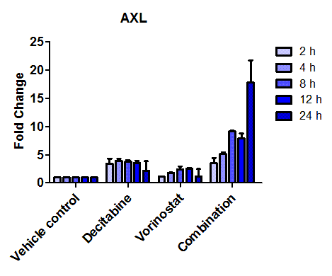
Hours
0 24 48 72
56
Decitabine
Vorinostat
Axl inhibitor
AXL inhibitor

Slide 29
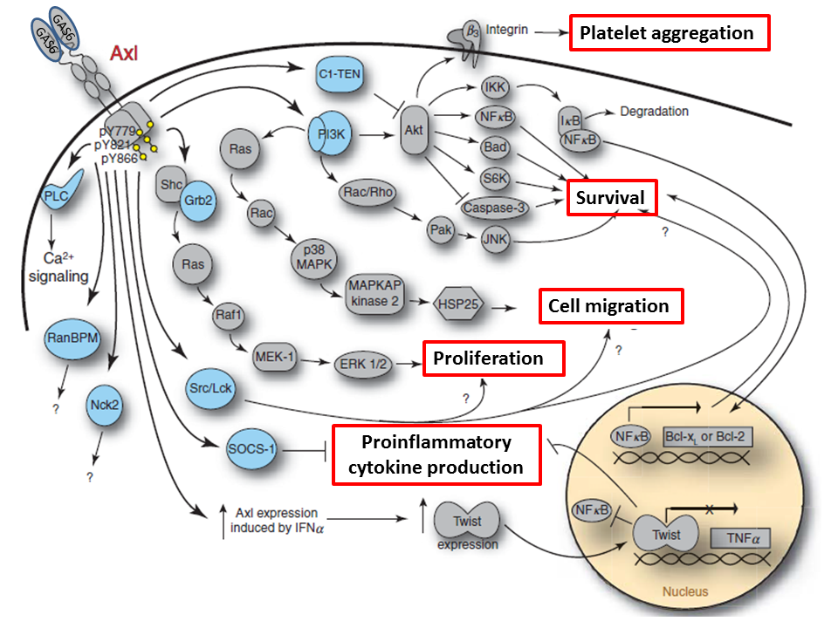
AXL-GAS6 signalling
GAS6 (ligand)
PI3K and MAPK signalling
Promotes cell proliferation and survival
Notes:
As I said axl is localised to the cell membrane and requires a binding of a ligand known as Growth arrest specific 6 which leads to the dimerisation and autophosphorylation of axl which activates downstream pathways such as the pi3k akt and mapk erk pathways which ultimatley lead to the survival and proliferation of cells

Slide 30
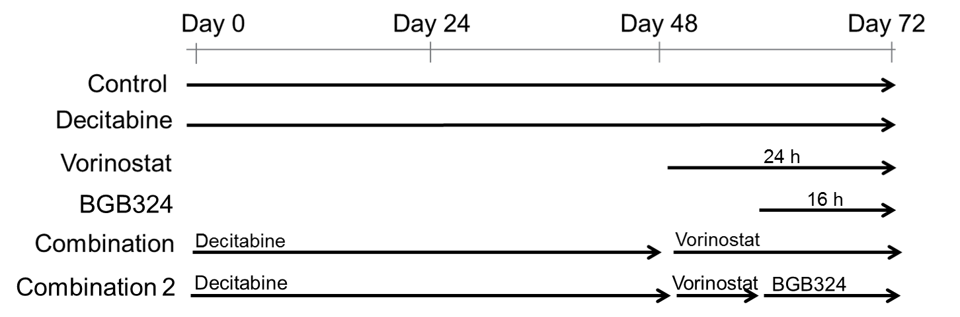
Triple combination:
Decitabine/Vorinostat/AXLi
0 h
24 h
48 h
72 h
AXL inhibitor
AXL inhibitor
Performed using OCI-AML3_Luciferase expressing cells
Transplanted into NSG mice
Mice imaged using IVIS bioimager 15 mins after D-luciferin injection on day 15, 21, 28 post injection
Notes:
So cells were treated as beofore wit the double combination and then treated with AXL inhibitor 8 hours post vorinostat addition as this is where I had previously shown axl to start to increase. So some preliminary viabilty assays again support the idea that axl may be signalling within these cells. So axl alone does not induce much of a change in cell viability even at 0.5 um however once axl is induced with the combination treatment we see a further 15% reducition in the viabilty of the cells when also treatmed with the axl inhibitor.

Slide 31




OCI-AML3 cells treated with drug combinations – Day 28 visualization
Untreated
DMSO
D31
D29.5
Decitabine
Vorinostat
Hh inhibitor
Axl inhibitor
D32
D30
D31
D29.5
Triple combination confers longest survival
Vorinostat + Hh inhibitor
Decitabine + Vorinostat
Decitabine + Axl inhibitor
Decitabine + Vorinostat + Axl inhibitor
D36
D35
D31
D36.5
1 x 10⁵
D39
2.5 x 10⁴
3 x 10⁵
1 x 10⁵
1.5 x 10⁶

Slide 32
In vivo
D0:
Cells injected
Decitabine / voronistat / AXL
Decitabine / vorinostat
Decitabine
D11:
Tumour load confirmed by imaging
Imaging

Slide 33
Conclusion
Integrated transcriptomics / epi-genomics analysis can identify novel and rational therapeutic targets for pre-clinical and phase I testing

Slide 34






Thank you!

