Slide 1

Green Chemistry and Global Access to Medicines: New Chemistry for Access to HIV, Malaria, and Hepatitis Medicines
Joseph M. Fortunak
Howard University
Washington, DC USA
jfortunak@comcast.net

Slide 2
Summary
Green Chemistry is increasing access to essential medicines in LMICs
Sustainability requires industrial development
NEEDED: Scientists to promote in this area:
Economic and human development
Stable, democratic governance

Slide 3
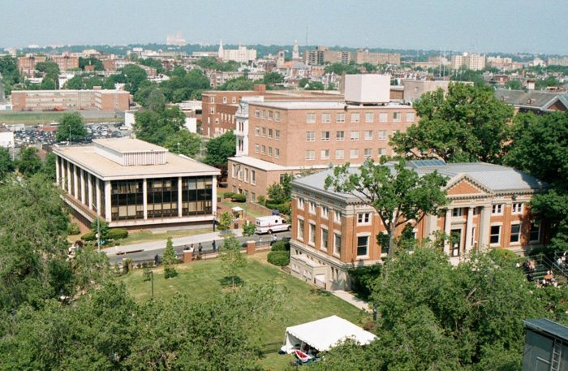
Howard University (HBCU)
Washington, D.C.

Slide 4
Impact of Medicines
US: Life expectancy 48.6 years (1900), 78.7 (2010)
Death rate from simple infections in 1900 exceeded rate from all causes in 2010
Nigeria: Life expectancy 48.6 years in 2003; 54.5 years in 2013
Absolute number and increase both correlate heavily with medicines access
The richest 15% of the world consumes 91% of medicines (UN MDG report: 2005)

Slide 5
Two Approaches to Increasing Access

Slide 6
1. Work with NGOs and producers:
Lowest sustainable prices for LMICs
===============================
2. Improve regional manufacturing and regulation:
Assure quality, increase supply, expand beyond AIDS, TB, malaria…
= End dependence,
Create jobs, economic development

Slide 8
Pricing (LMICs) for HIV/AIDS Medicines
2004: $569/PPPY
2012: $143/PPPY
2015: $117/PPPY
(API contents = about $64)

Slide 9
Examples of Green “Leap-frogging” Technologies
Organocatalysis
Reactions in water, C-H bond activation, PATs, (etc.)
Continuous (flow) processing
No single technology will revolutionize pharmaceutical manufacturing and regulation

Slide 10
Key Drugs for HIV/AIDS

Slide 11
Generic Pricing for ART APIs
Equivalent to $19 for TDF and $24 for EFV API costs / year

Slide 12
Efavirenz Synthesis

Slide 13
Efavirenz Through Four Generations
1st Generation – E-factor 55 ($900/kg)
2nd Generation – E-factor 35 ($450/kg)
3rd Generation – E-factor about 26 ($300/kg)
4th Generation – E-factor 12 ($106-$110/kg)
5 mol% inorganic zinc(II), new chiral catalyst
GWP reduced by 81%

Slide 14
Efavirenz – 4th Generation
Catalyst from chloramphenicol synthesis = cheap!

Slide 15
2nd Line ART – Protease Inhibitors

Slide 16
Current DRV and ATV

Slide 17
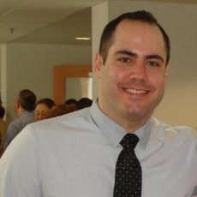

Dr. Fred Nytko, III
Tiffany Ellison

Slide 19
Same, cheap raw materials and reactions
to synthesize both atazanavir and darunavir

Slide 20
5 steps versus 8 and 10 steps for commercial
Syntheses of ATV and DRV:
Cheaper starting materials

Slide 21
Target: $400/kg

Slide 22
Universal Access = 35MM people on treatment

Slide 23
APIs – MT/A 2015 vs 35 MM
API | Daily Dose (mg) | 2015 Volumes MT | 35 MM Patients - MT
PI drugs | 1000 | 270 | 1300
NVP | 400 | 710 | 440
3TC/FTC | 300 | 1510 | 2890
AZT | 600 | 1085 | 650
EFV | 600 | 1989 | 6570
TDF | 300 | 997 | 3235
TOTAL |  | 6561 | 15085

Slide 24
The Future of ART for LMICs

Slide 25
The “Ultimate” 1st-line ART?
API | Daily Dose (mg) | MT/A to Treat 35MM People
DTG | 50 | 639
TAF/(RIL) | 25 | 320
FTC(?*) | 200 | 2555
Total | 280 (75) | 3514 (959)
*DTG / RIL for maintenance?

Slide 26
Dolutegravir (2nd Generation - GSK)

Slide 27
Dolutegravir… 3rd Generation

Slide 28
2. Promoting African Independence

Slide 29
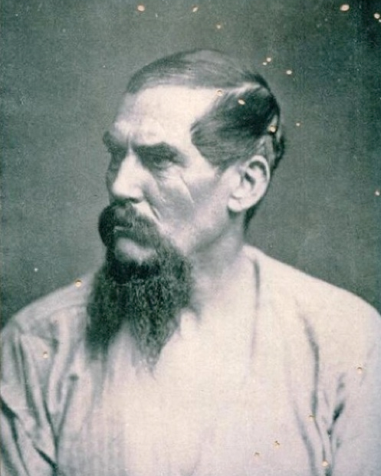
Sir Richard Frances Burton “First Footsteps in East Africa” (1856)

Slide 30
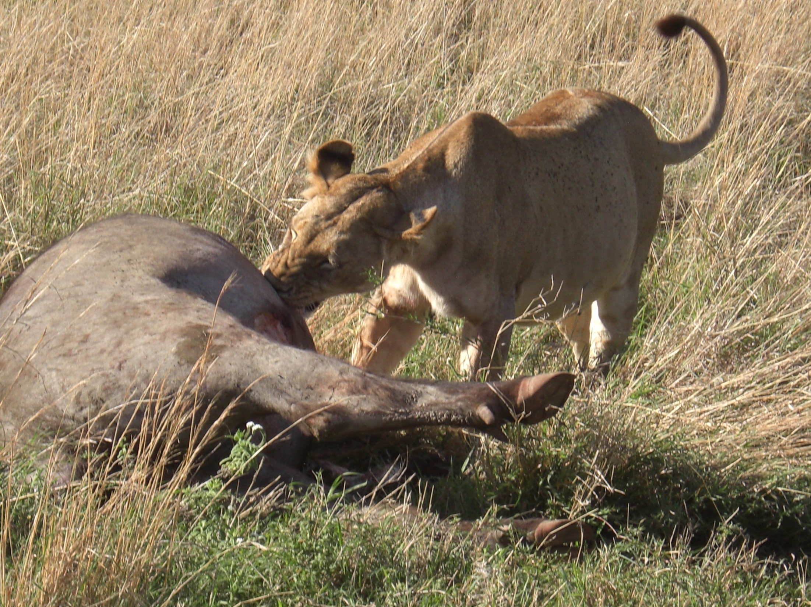

Slide 31
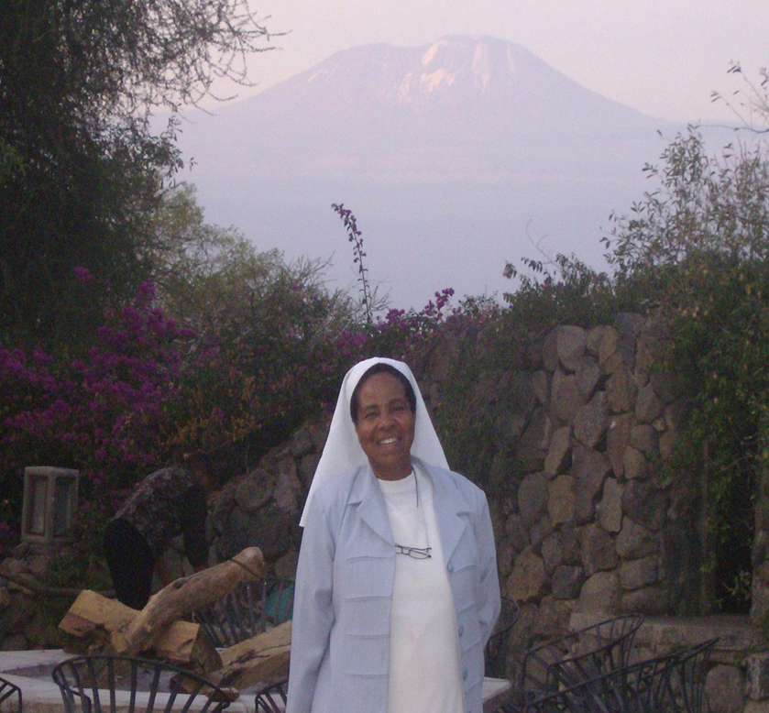

Slide 32
African Pharmaceutical Manufacturing
Kilimanjaro School of Pharmacy,
Ibadan University, School of Pharmacy
Z. Ekeocha, C. Babalola
W. Mlaki

Slide 33
Key Drugs for Malaria (ACTs)

Slide 34
DHAP = Fixed-dose combination ACT
Useful for pediatric, less-expensive, clears parasites from liver
(radical cure)

Slide 35
New, Green Chemistry

Slide 36
Piperaquine GC
Overall yield 93% on 5kg scale (vs. 55%)
E-factor reduced from 45 to 8
Pediatric and adult tablets in KSP Pilot Plant

Slide 37
St. Luke Foundation – Kilimanjaro School of Pharmacy

Slide 38
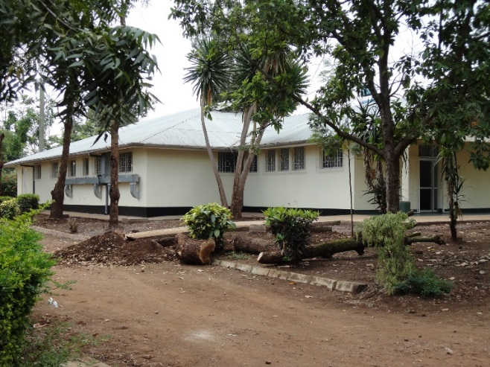
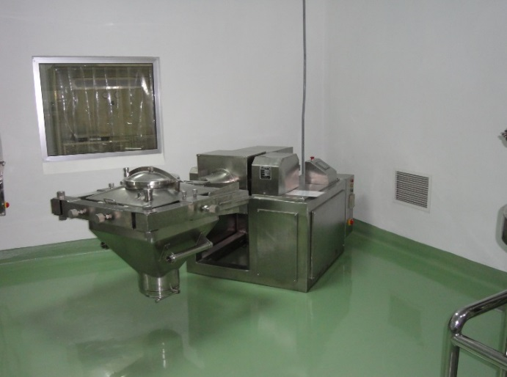
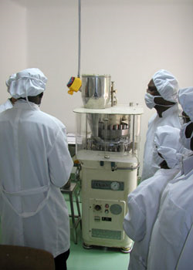
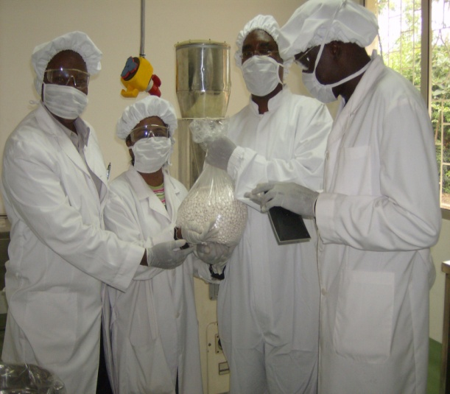
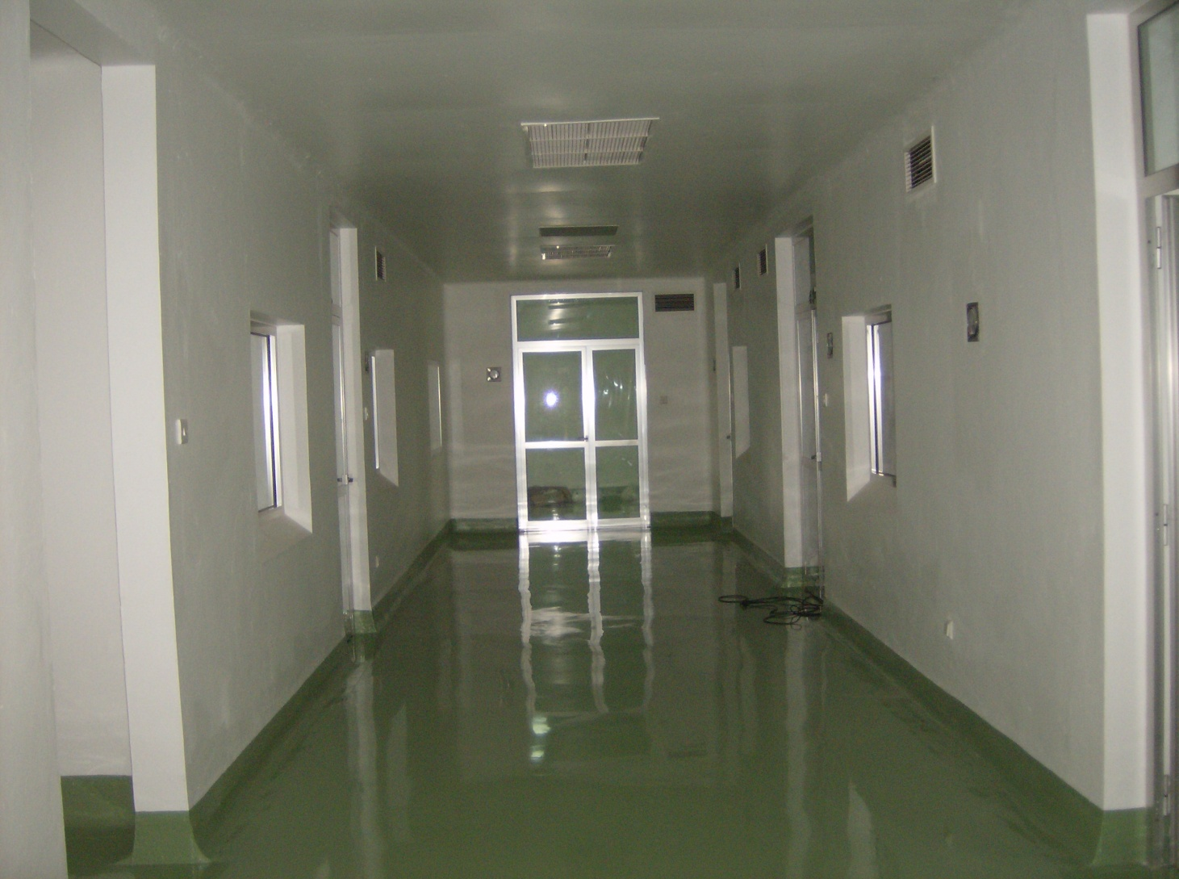
INDUSTRY
CLASSROOM
AND
LABORATORY
TRAINING
Regulatory
ACADEMIA

Slide 39
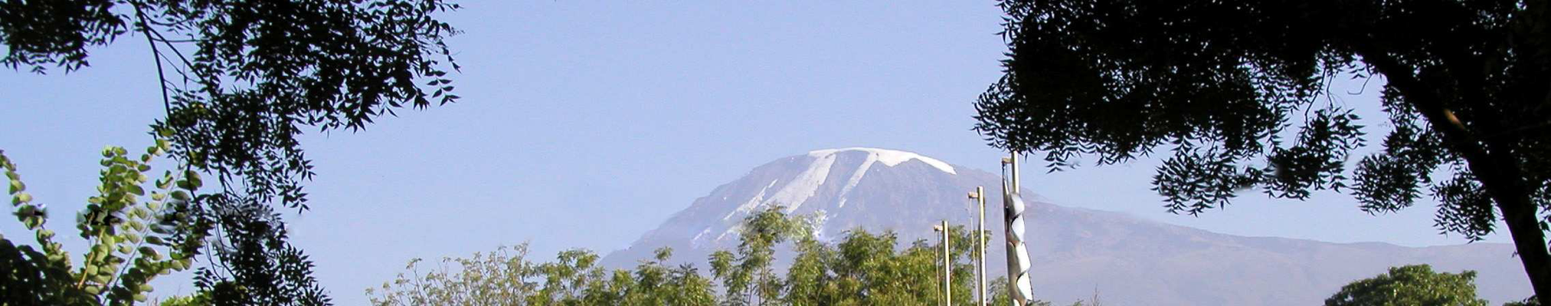
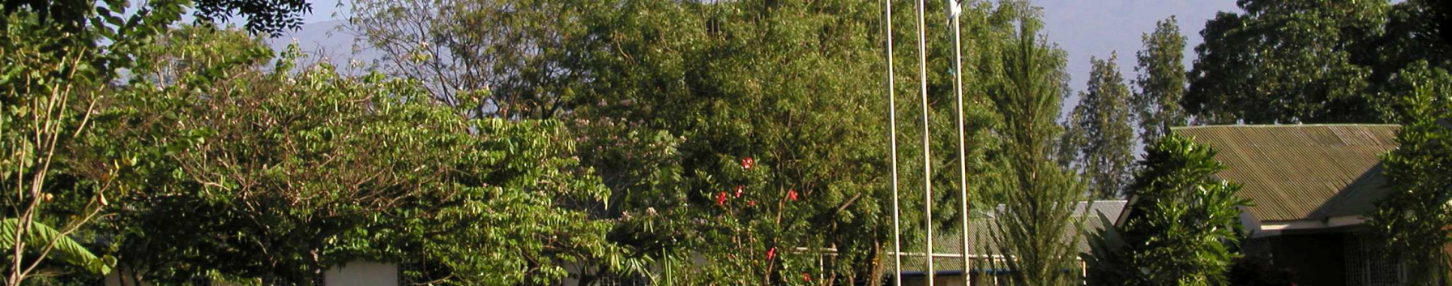

Slide 40
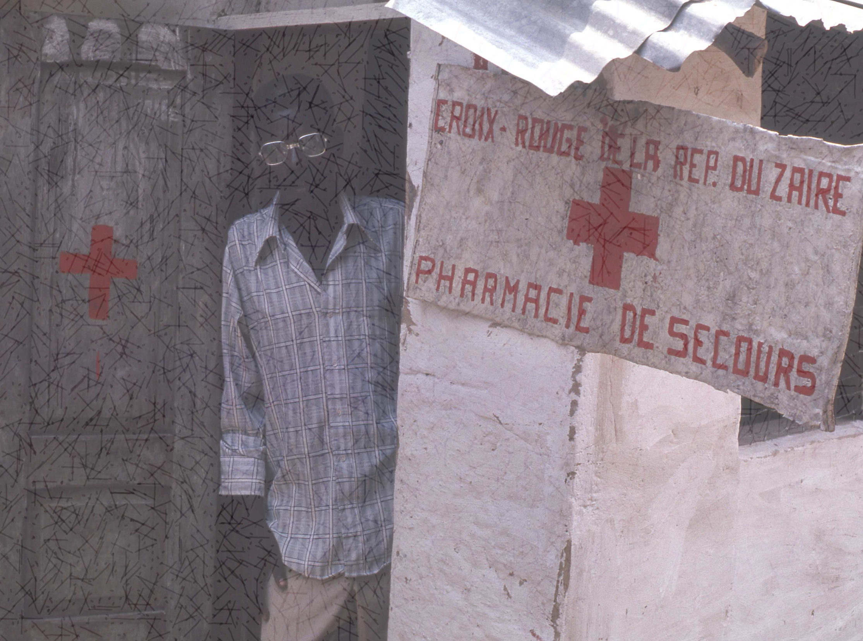
Universal access to HIV treatment is one of the
greatest success stories in medicine (>15 million treated).
This should not stand alone, but be repeated for
mass treatment of Hepatitis C – this time, more quickly

Slide 41
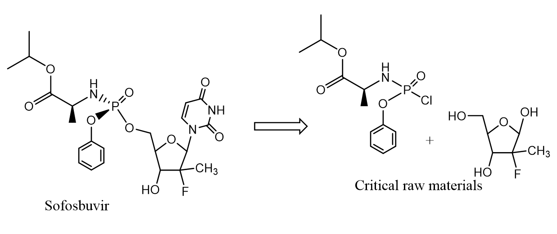
Hepatitis C
Sofosbuvir ($1,000/tab in US)
$84,000/treatment in US
$531/treatment in India
API is selling for $3,500/kg in India
Equal to $117/treatment in API cost
Roughly approximates $235/treatment for mass treatment programs (>1 MM patients)

Slide 42
Take-Home Message
Green Chemistry is helping millions in LMICs
Science can help shape policy for the good of humanity
More engagement by Global Pharma, individual scientists, and US is invited

Slide 43
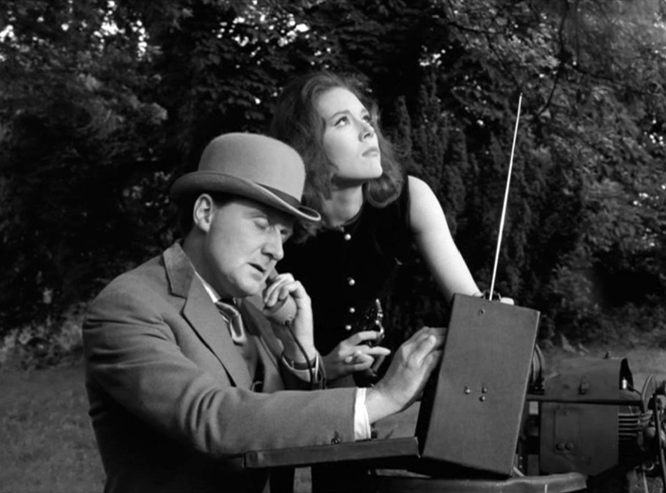
We’re Needed…

Slide 44
Contributors
Tiffany Ellison
Christopher King
Fred E. Nytko, III
Addebowale Ogunjirin
Endalkachew Tadesse
Frajovon Talley
Adrian Williams
Joseph Williams Jr.

Slide 45
Funding
American Chemical Society
United Nations Industrial Development Organization
UNITAID
William J. Clinton Healthcare Initiative

