Slide 1

The effect of numbers and duration between osteopathic treatments on Patients suffering from foot related pain; a dose-response study
Joachim Kaufmann
Osteopat MSc (GB)
Bergen, Norway

Slide 2
The aim of the study
To determine the combination of “number of treatments” and “interval between treatments” in order to optimize the effect of Osteopathic treatment of foot related pain

Slide 3
Material & Methods
32 female and 22 male patients
mean age of 42 years (SD =13.1)
BMI of 27.0 (SD =4.4)
suffered from foot injuries
patients reported the injured side
10 left side
17 right side
27 on both sides

Slide 4
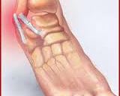
Twisted ankle
Footcaredirect.com

Slide 5
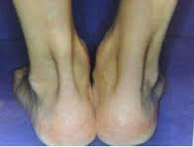
Achillestendinitis
Orthopaedicsurgeon.com

Slide 6
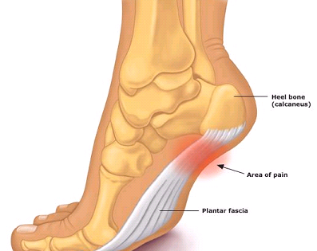
Plantarfasciitis
Newyork-footdictor.com

Slide 7
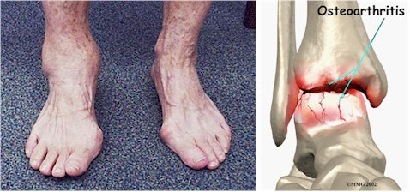
Ankle artritis
Atlsntisfootandankle.com

Slide 8
Material & Methods
Study
performed as observer blinded, randomised single centre trial with 3²-factorial design
The 2 factors: Number of treatments + Treatment intervals
Randomisation
The patients were allocated to treatment groups
nested block randomisation with a fixed block size of 18 and six
Notes:
3 4 5 treatments
7 10 14 days interval

Slide 9
3²-factorial design

Slide 10
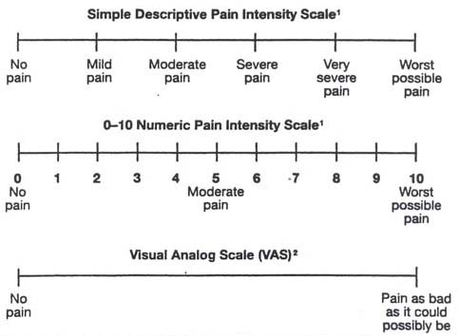
Material & Methods
Primary variables: “Pain at rest” + “Pain at load”
recorded on 10 cm Visual Analogue Scales (VAS)
before each treatment
one day after the last treatment
at four weeks follow-up
Additionally, the Ankle-Brachial Index (ABI) was obtained

Slide 11
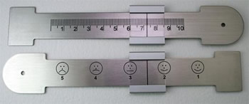
Visual analoge scale (VAS)
Pain Intensity scales
If used as a graphic rating scale, a 10cm baseline is recommended. A 10-cm baseline is recommended for VAS scales
Source: Acute Pain Management Guideline Panel, 1992

Slide 12

Ankle-Brachial Index
Boso ABI 100
Notes:
4 limbs measured simultaneous / systolic blood pressure is on the legs higher than the arms

Slide 13
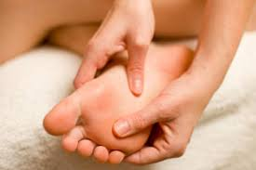
Treatment
Local treatment
General treatment
The whole body
Depending on where the areas of decreased movement are situated…
Patterns of restrictions
40 Minutes / Included documentation of all relevant findings ...

Slide 15
Results related to number of treatments
Pain at rest was significantly reduced (p < 0.01) in all three groups under the treatment (Fig. 2a).
Largest reduction -> three and four treatments: For three treatments the pain was reduced from 3.7 at baseline to 2.5 one day after final treatment four treatments: reduction from 3.3 to 1.7, five treatment group: from 3.0 to 1.8
Similar pattern was detected for pain at load with significantly (p < 0.01) reduction in all three groups (Fig. 2b).
Three treatment group: from 6.0 at baseline to 3.1 after, four treatment reduced from 5.7 to 3.1 and for five treatments from 5.6 to 3.6
For both pain at rest and at load, three and four treatments were found superior to five treatments (Fig. 2a & 2b).

Slide 16
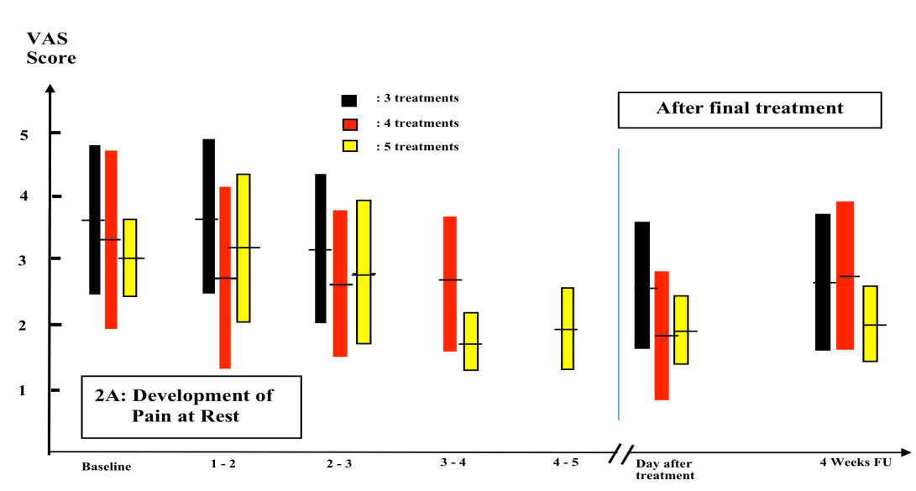
Development of Pain at Rest related to “Number of treatment”

Slide 17
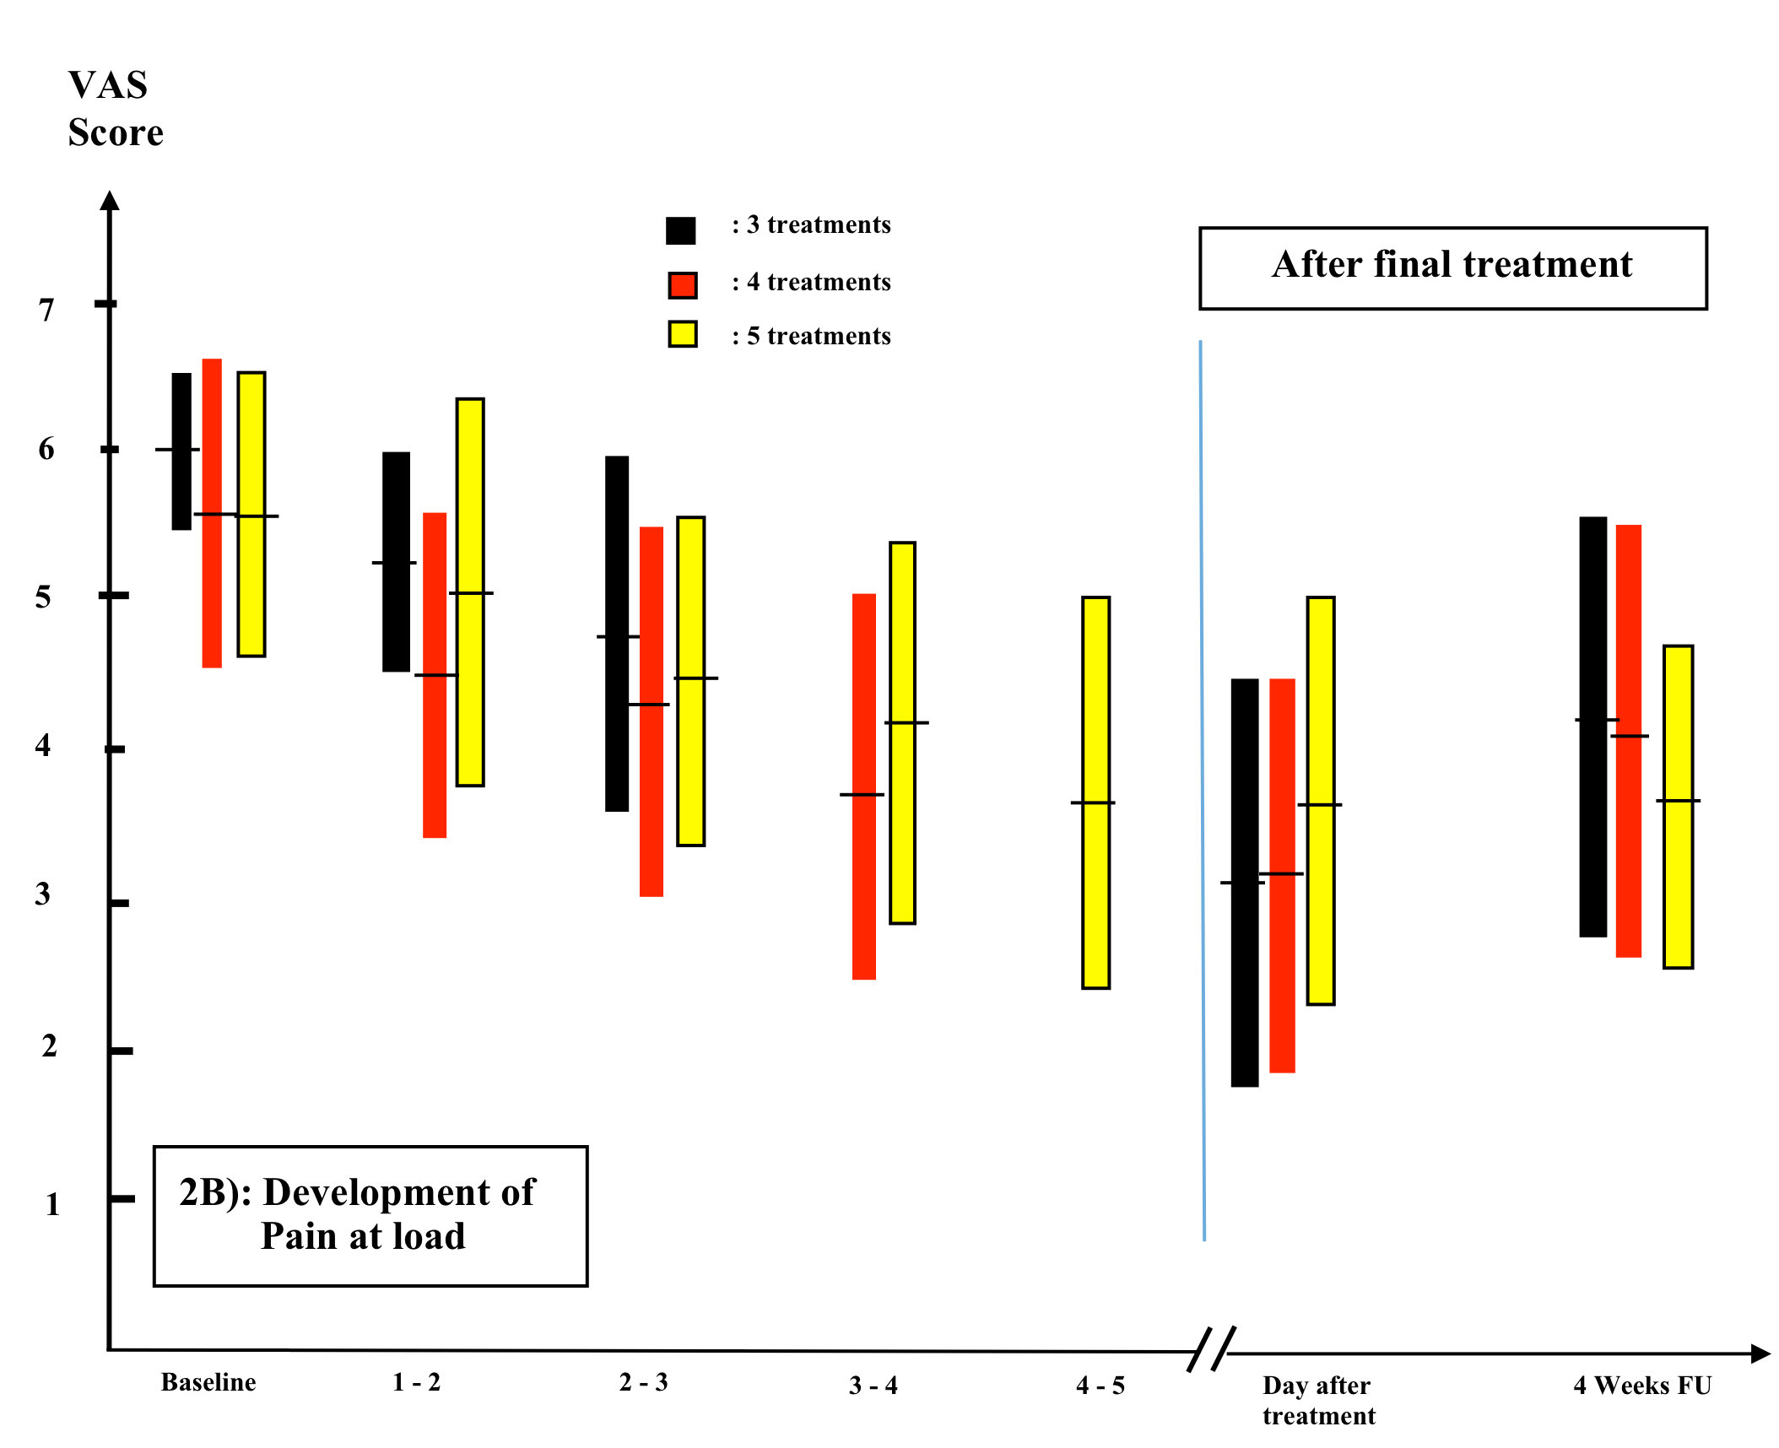
Development of Pain at Load related to “Number of treatment”

Slide 18
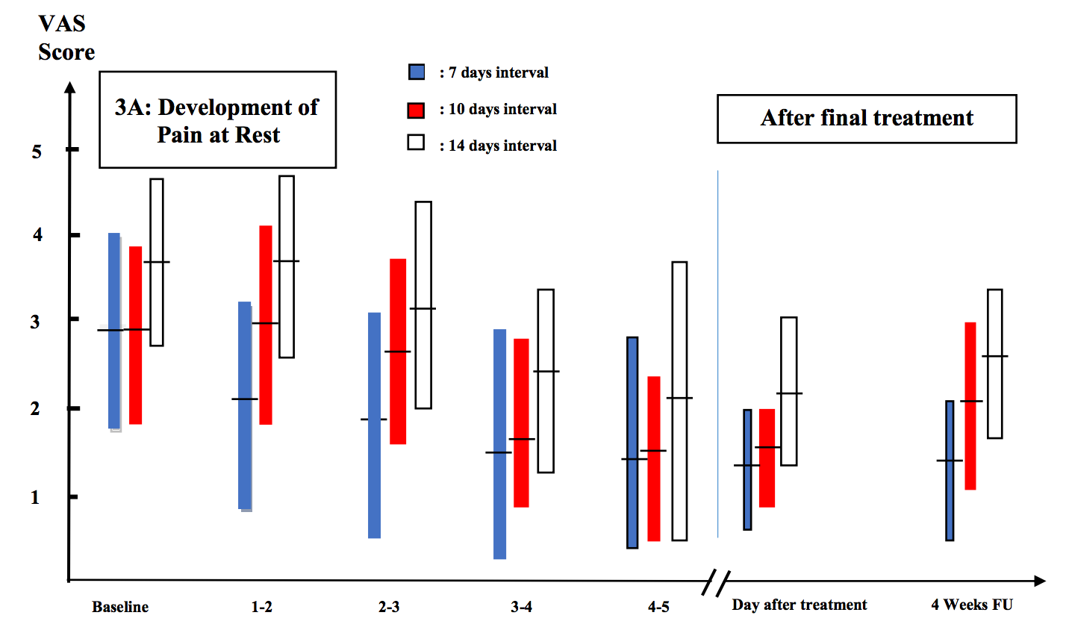
Results related to duration between treatments
Pain at rest was significantly reduced (p < 0.01) in all groups related to duration between treatments (Fig. 3a). In the group with 7 days treatment interval, pain at rest was reduced from 2.9 to 1.4 one day after final treatmen,10 days: from 2.9 to 1.7 and 14 days interval from 3.7 to 2.4. For pain at rest, seven days duration between treatments seems to be the superior choice.

Slide 19
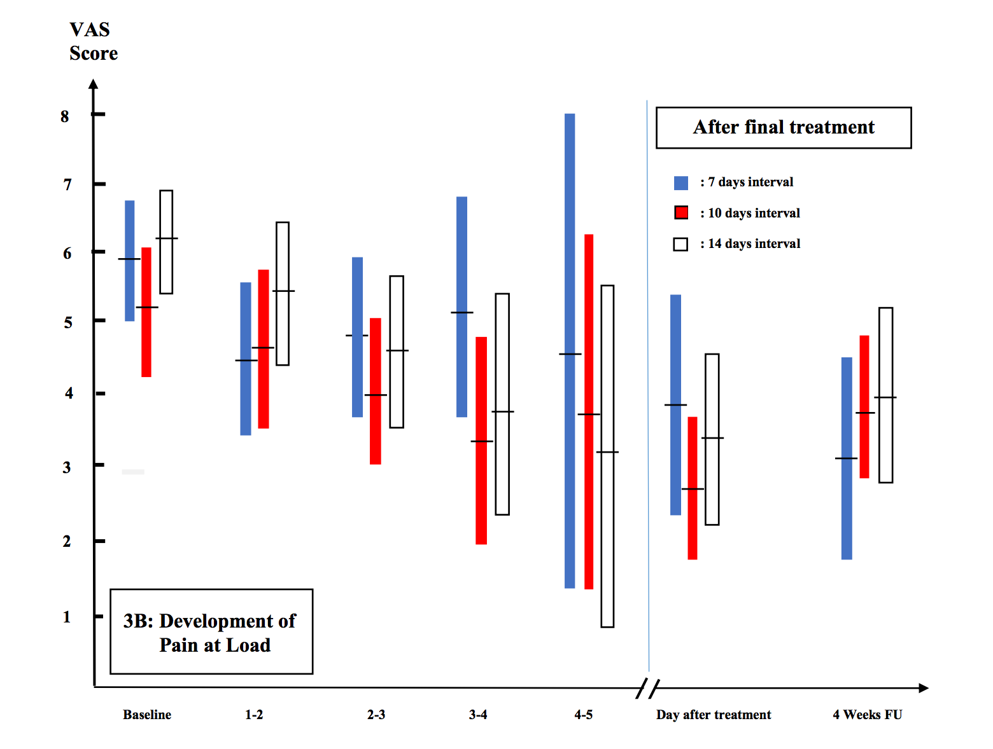
Results related to duration between treatments
Pain at load was significantly (p < 0.01) reduced in all the three groups (Fig. 3b). In the seven days treatment interval group, pain at load was reduced from 5.9 at baseline to 3.9 one day after the final treatment, 10 days: from 5.2 to 2.7, 14 days treatment interval resulted in a reduction was from 6.2 to 3.5. Ten and 14 days treatment interval was found superior to seven days regarding reduction in pain at load.

Slide 20
Development of Pain at Rest related to “Duration between treatment”

Slide 21
Development of Pain at Load related to “Duration between treatment”

Slide 22
Results: Interaction between numbers and duration between treatments
Reduction in pain at rest superior combination was
Four treatments with seven days treatment interval
Reduction in pain at rest
Four treatments gave significant (p<0.01) results
both for 7 and 10 days treatment intervals
but 10 days treatment intervals were found to be the optimal combination

Slide 23
Results: Interaction between numbers and duration between treatment
Number of treatments seems to be the dominant factor with regards to both reduction of pain at rest and at load
An increase in number of treatments, recommending increased duration between treatments in order to keep the significant reduction

Slide 24
Diskussion
Number of treatments
3 / not enough input?
4 / right amount…
5 / overload?
More patients – more exact results
Recovery time, fnding the optimal point of new dose…
Duration between treatments
Depending on:
VAS score?
Low score – shorter rythm
High score – longer rythm
Pain occurance?
Rest / 7 days best
Load / 10 days best

Slide 25
Conclusion
The combinations for obtaining the largest reduction in pain at rest and at load seem to be four treatments with 7 and 10 days treatment intervals, respectively

Slide 26
Thank you for your attention
Any questions?

