Slide 1
p53-dependent Regulation of Mitochondrial Energy Production by the RelA NF-κB Subunit.
Ini-Isabée Witzel^{1,2}, Renée Johnson^{1,3} and Neil Perkins¹
¹Institute for Cellular &Molecular Biosciences, Newcastle University, UK.
²New York University Abu Dhabi, Saadiyat Campus, Abu Dhabi, UAE.
³Victor Chang Cardiac Research Institute, Sydney, Australia.

Slide 2
NF-κB Family Members
Rel Homology Domain
(RHD)
(DNA binding and
dimerisation)
Transactivation
RelA (p65)
N
C
c-Rel
RelB
Ankyrin Repeats
NF-κB1 p105
Proteolysis
p50
NF- κB2 p100
Proteolysis
p52

Slide 3
NF-κB and Disease
NF-κB under control
(mainly cytoplasmic)
IIINFLAMMATORY DISEASES
Arthritis
Asthma
Atherosclerosis
Inflammatory bowel diseases
Renal diseases
Gut diseases
Skin diseases
Heart Failure
CANCER
All subunits have been implicated in cancer.
NF-kB aberrantly active (nuclear):
Leukemias
Lymphomas
Many solid tumours
Normal cells
Diabetes
(type I & II)
Out of control NF-κB
(aberrantly nuclear)
Ectodermal dysplasia
IIINFECTIONS
Alzheimer’s diseases
AIDS
Heliobacter pylori-associated gastritis
Incontinentia pigmenti
Diseased cells

Slide 4
Hallmarks of Cancer
Cancer Cells
Self-sufficiency in growth signals
Resistance to anti-growth signals
Evasion of apoptosis
Sustained angiogensis
Limitless reproductive potential
Tissue invasion and metatasis
Abnormal metabolic pathways
Immune system evasion
Inflammation
Unstable DNA and chromosome abnormality
Cell. 2011 Mar 4;144(5):646-74.

Slide 5
NF-κB and Cancer
Cancer-associated inducers of aberrant NF-κB activity
Genetic
alteration
(subunit expression,
IkB deletion)
Oncogene
activation
(Ras, Bcr-Abl)
Stress
ROI inducers
(hypoxia)
Carcinogens
Tumour promoters
(PMA, UV)
Cytokines
Infection
Cancer therapies
(chemotherapeutic agents
γ-irradiation)
Is NF-κB also involved in alteration of cellular metabolism in cancer cells?
IKK
NF-kB
Inflammation
(IL-1, TNF, chemokines)
Immortality
(telomerase)
Tumour promotion
(COX2, iNOS, MMP-9, uPA)
Angiogenesis
(VEGF, TNF, IL-1, IL-8)
Proliferation
(Cyclin D1, c-Myc)
Metastasis
(ICAM-1, VCAM-1,
ELAM-1)
Survival
(Bcl-xL, XIAP,
cIAP1 & 2)
Tumour promoting functions of NF-kB
Notes:
The NFκB subunits RelA and p50 have been identified in mitochondria ¹⁻⁴
RelA and p50 bind to mitochondrial DNA in vitro ^{2,3}
Expression of the IκB super repressor prevents the NFκB mediated decrease of mitochondrial genes following TNFα and TRAIL treatments ^{2,3}
However, it remains unclear if these are direct effects mediated through NF-κB binding to the mitochondrial genome.
Moreover, the mechanism and consequences of NF-κB mitochondrial localization on oxidative phosphorylation and ATP production, together with how these might contribute to the switch to glycolysis observed in cancer cells, have not been clearly defined.

Slide 6
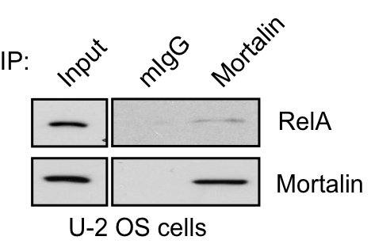
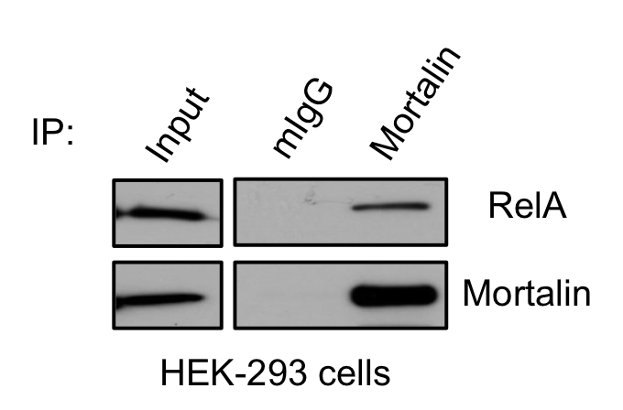
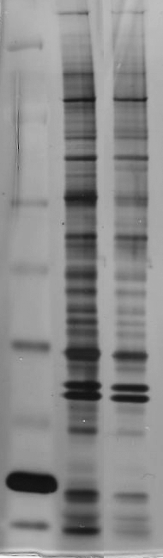
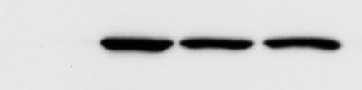



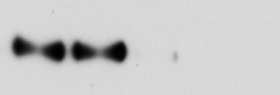
RelA interacts with mitochondrial HSP70, Mortalin
T505
P
RelA
(p65)
Rel Homology Domain
TA2
TA1
T505 Peptide
1
551
Scramble
19
301
428
521
kDa
191
97
64
51
39
28
19
14
RelA T505 Peptide (RelA):
TTEPMLMEYPEAITRLVTGAQRPC
Scramble Peptide (S):
LATRQETGPIRMPEVYTAETMPLC
Mortalin
Mortalin binds to endogenous RelA in
U-2 OS and 293 cells
IP:
IP Inputs:
Null
T505A
T505D
T505A
Mortalin
Mortalin
Mortalin
Mortalin
Null
RelA
T505D
mIgG
mIgG
mIgG
mIgG
WB:
RelA
Mortalin
HeLa cells
T505 Peptide
Scramble
RelA reconstituted MEF cells
Fr 3-4
Fr 5-6
Fr 3-4
Fr 5-6
Mutation of RelA at T505 impairs binding of RelA to Mortalin
WB:
Mortalin
HeLa cells
Mortalin (mtHSP70) binds to the RelA T505 region

Slide 7


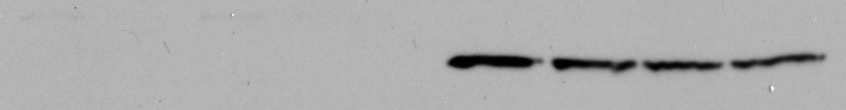
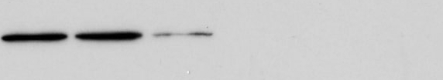




RelA mitochondrial import is Mortalin dependent
Cytoplasm
Mitochondria
Mitochondria
Cytoplasm
siRNA
siRNA
T505D
T505D
WB:
RelA
Mortalin
VDAC
α-tubulin
BiP
T505A
T505A
Null
RelA
Null
RelA
U-2 OS
Mortalin
Mortalin
Control
U-2 OS
Control
WB:
RelA
Mortalin
VDAC
α-tubulin
BiP
RelA reconstituted MEF cells
U-2 OS cells
RelA import into mitochondria is facilitated by an interaction with mortalin that is impaired by mutation of RelA at T505.

Slide 8
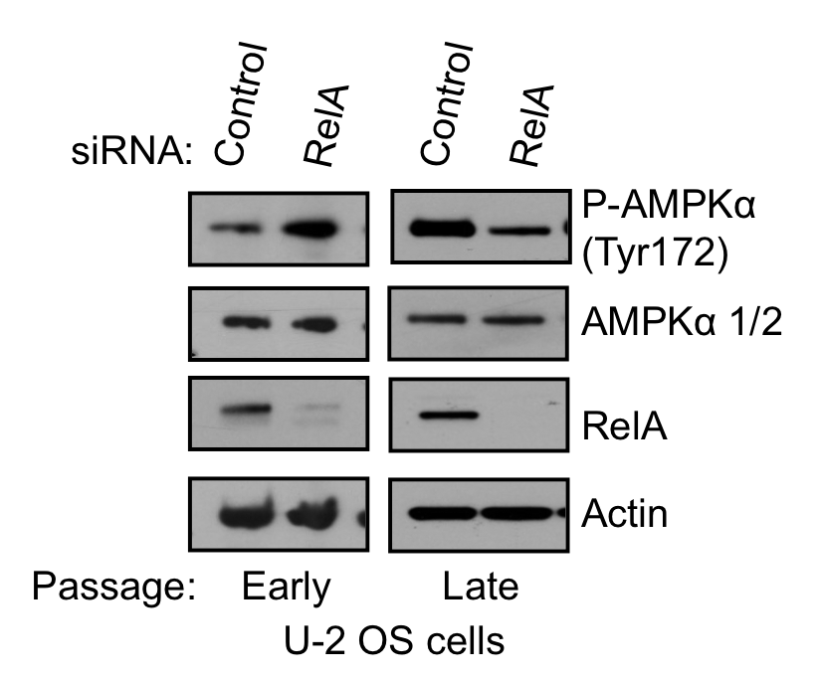
RelA regulates cellular energy production
U-2 OS cells
Late Passage U-2 OS cells
***
1.5
1.5
1.6
***
**
**
***
1
1
O₂
consumption
(average
NRF)
1.2
O₂
consumption
(average
NRF)
0.8
0.5
0.5
0.4
0
0
0
siRNA: Control
RelA
Control
RelA
siRNA: Control RelA Control RelA
Passage: Early Late
Treatment: Control Oligomycin
Late Passage U-2 OS cells
Late Passage
U-2 OS cells
RelA-induced changes in ATP production have a physiological effect on the cells as indicated by phosphorylation of the energy sensing protein, AMPK.
1.8
**
**
3
1.2
Glucose
consumption
(μg/min
/50 000
cells)
ATP
levels
(average
RLU /
cell)
2
0.6
1
0
0
siRNA: Control RelA Control RelA
siRNA: Control RelA
Treatment: Control Oligomycin
Notes:
RelA regulates oxygen consumption in U-2 OS cells. Increasing time in culture results in a switch in RelA regulation of oxygen consumption that is inhibited by oligomycin, an inhibitor of mitochondrial ATP synthase.
RelA regulation of oxygen consumption results in altered ATP production in U-2 OS cells that is independent of changes in glucose consumption. U-2 OS cells generate the majority of their ATP through glycolysis, however in the absence of RelA there is and increase in ATP produced through oxidative phosphorylation

Slide 9
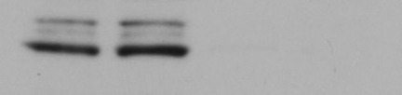

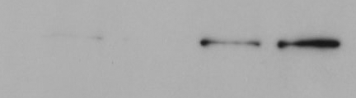
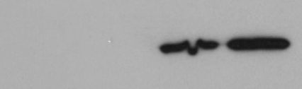
RelA regulates mitochondrial gene expression
D-loop
*
12
U-2 OS Cells
3
3
Cytoplasm Mitochondria
p12
p20
p12
p20
8
Relative
Enrichment
(ChIP
Assay)
Relative
Enrichment
(ChIP
Assay)
2
2
*
RelA
1
1
4
VDAC
0
0
0
Mot
Antibody: Control RelA Control RelA
siRNA: Control RelA Control RelA
Gene: D-loop
Antibody: POLRMT
Passage: Early Late
α-tubulin
Passage: Early Late
**
0.08
*
Late Passage U-2 OS cells
0.12
0.06
**
*
Average
mRNA
Abundance
Relative
Cytochrome
C Oxidase
I mRNA
Level
0.08
0.04
0.02
0.04
0
0
siRNA: Control RelA Control RelA
siRNA: Control RelA
Gene: Cytochrome B
Passage: Early Late

Slide 10
p53, RelA and Energy Production
Loss of p53:
  Results in reduced oxygen consumption and increased glycolysis¹
  Reduced SCO2 and TIGAR and increased PGM and GLUT3^{1,2}
  Enhances activation of NF-κB²
Increased glycolysis in the absence of p53 via up-regulation of GLUT3 is RelA dependent²
1. S. Matoba et al., Science 312, 1650 (Jun 16,2006).
2. K. Kawauchi, K. Araki, K. Tobiume, N. Tanaka, Nat Cell Biol 10, 611 (May, 2008)

Slide 11





RelA regulation of mitochondrial energy production is p53 dependent
Passage Number
Cytochrome B
α-RelA
4
Phospho-RelA Thr505
RelA
3
Relative
enrichment
(ChIP
assay)
Induction of p53 reduces RelA binding to the mitochondrial genome
Phospho-p53 Ser15
2
*
p53
1
Actin
0
Treatment: Control IPTG
U-2 OS cells
H1299^{wtp53} cells
**
4
*
1.2
*
**
*
*
3
O₂
consumption
(average
NRF)
ATP
levels
(average
RLU
/cell)
0.8
2
1
0.4
0
0
siRNA: Control RelA Control RelA
siRNA: Control RelA Control RelA
Treatment: Control IPTG
Wild Type
p53 -/-
H1299^{wtp53} cells
MEF cells
p53 mediates the switch in RelA regulation of cellular energy production

Slide 12
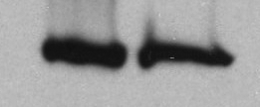




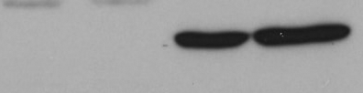
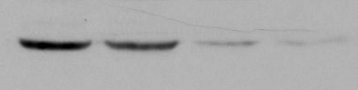
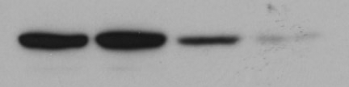
RelA regulation of mitochondrial energy production is p53 dependent
Cytoplasm Mitochondria
P53-RSV
P53-RSV
RSV
RSV
WB:
RelA
Mortalin
VDAC
α-tubulin
H1299 cells
IP:
Inputs
Control
IPTG
Control
IPTG
mIgG
Mortalin
mIgG
Mortalin
WB:
RelA
Mortalin
H1299^{wtp53} cells
p53 prevents RelA import into mitochondria by disrupting the interaction of RelA with mortalin

Slide 13
Conclusions
Early Passage (+p53)
Late Passage (-p53)
p53
RelA
Nucleus
Glycolysis
Notes:
Loss of p53 allows RelA to interact with Mortalin and be imported into the mitochondria where it reduces binding of POLRMT to the genome resulting in a reduction in mitochondrial gene expression. This results in a reduction in oxidative phosphorylation and cellular ATP production. We propose that this contributes to the switch from ATP production through oxidative phosphorylation to glycolysis seen in cancer cells.

Slide 14





Acknowledgements
Neil Perkins
Renée Johnson
Members of the Perkins Laboratory
Members of CTP at NYUAD
CRUK for funding our work!

