Slide 1
MACROPHAGES WITH THE M3 SWITCH PHENOTYPE AND HOW WE CAN USE THESE MACROPHAGES IN IMMUNOTHERAPY FOR CANCER
Malyshev Igor
Moscow State University of
Medicine and Dentistry
Moscow, Russia

Slide 2
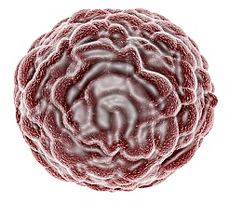

PRO-TUMOR TRANSFORMATION OF THE IMMUNE RESPONSE
Macrophages play the key role in the immune disorders in carcinogenesis
a lot of and PI-cytokines and ROS
contributes to destruction of tumor
M1
TGF-β, IL-4, IL-5, IL-10 and IL-13
reprograming anti-tumor М1 phenotype into pro-tumor M2 phenotype
M0
TUMOR
small amounts of
PI-cytokines and ROS, but a lot of AI-cytokines
contributes to
suppression of anti-tumor immunity and promotes the tumor growth
M2

Slide 3

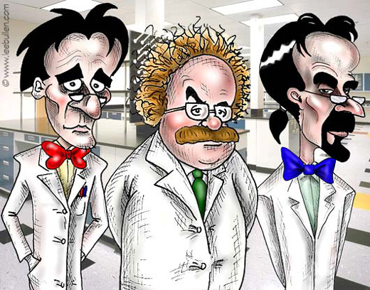
HYPOTHESES:
the problem of pro-tumor macrophage reprogramming could be solved by a specific M3 switch phenotype
by increasing production of PI-cytokines to retain thereby its
anti-tumor
properties
The M3
phenotype, in contrast to the M1 phenotype, should respond to AI-cytokines
RESEARCHERS

Slide 4
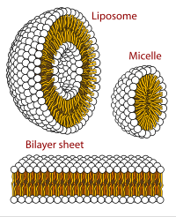
WE HAVE THEORETICALLY SUBSTANTIATED A POSSIBILITY OF PROGRAMMING THE M3 PHENOTYPE
many reprogramming pathways branch to form the M1 or the M2 phenotype
Anti-inflammatory cytokine
IL-13
JAK
N
STAT1
STAT3/6
proinflammatory cytokines
anti-inflammatory cytokines
ANTITUMOR M3 PHENOTYPE
PROTUMOR M2 PHENOTYPE

Slide 5
THE AIM OF THE STUDY
was to verify this hypothesis
OBJECTIVES OF THE STUDY WERE
to form a M3 switch phenotype,
to evaluate the effect of M3 macrophages on growth of tumor cells, and
to evaluate the mechanism of the antitumor effect of M3 macrophages.

Slide 6
METHODS
The M1 phenotype was reprogrammed in vitro by IFN-γ, and the M3 - by additional inhibition of STAT3 and STAT6.
The tumor microenvironment was created by addition of ascetic fluid from mice with Ehrlich carcinoma to cultured macrophages.

Slide 7
THE EFFECT OF TUMOR MICROENVIRONMENT ON ACTIVITIES OF
M1 MACROPHAGES AND M1 MACROPHAGES WITH INHIBITED TRANSCRIPTION FACTORS STAT3/6
These changes reflect strengthening of PI-, anti-tumor properties of the macrophages with inhibited Stat3/6 in the tumor microenvironment
These changes reflect the reprogramming of M1 phenotype towards the protumor M2 phenotype

Slide 8
CONCLUSION 1
Stat3/6 inhibition
changed the response of M1 macs
in the TM from reprogramming of the PT-phenotype to reprogramming of the AT-phenotype
Such reaction of macs with inhibited Stat3/6 is consistent with characteristics of the
M3 switch phenotype.
In the tumor microenvironment (TM)
JAK
STAT1
N
STAT3/6
proinflammatory cytokines
anti-inflammatory cytokines
ANTITUMOR M3 PHENOTYPE
PROTUMOR M2 PHENOTYPE

Slide 9
THE ANTITUMOR EFFECT OF M3 PHENOTYPE
This effect reflects the phenomenon of pro-tumor macrophage transformation
M0 phenotype
M1 phenotype
M3 phenotype

Slide 10
CONCLUSION 2
M3 macrophages
exerted a direct anti-tumor effect, which was not inferior to the effect of cisplatin and superior to antitumor effects of M1 macrophages

Slide 11
THE QUESTION: WHETHER THE ANTI-TUMOR EFFECT OF M3 MACROPHAGES WAS DUE TO REDUCED RATE OF DIVISION OR DEATH OF THE TUMOR CELLS

Slide 12
CONCLUSION 3
The antitumor effect
of M3 macrophages was due to an anti-proliferative rather than a cytotoxic effect

Slide 13
THE MAIN CONCLUSIONS OF OUR WORK
1. Inhibition of M2 phenotype transcription factors in macrophages resulted in formation of the M3 switch phenotype. In the tumor microenvironment, the M3 phenotype increased production of anti-tumor cytokines and was resistant to reprogramming towards the pro-tumor phenotype;
2. The M3 phenotype exerts a strong anti-tumor, anti-proliferative effect. This effect of M3 phenotype is significantly stronger than effects of M1 and M0 phenotypes;
3. Using M3 macrophages may appear very promising and effective with respect of restriction of tumor growth.

Slide 14
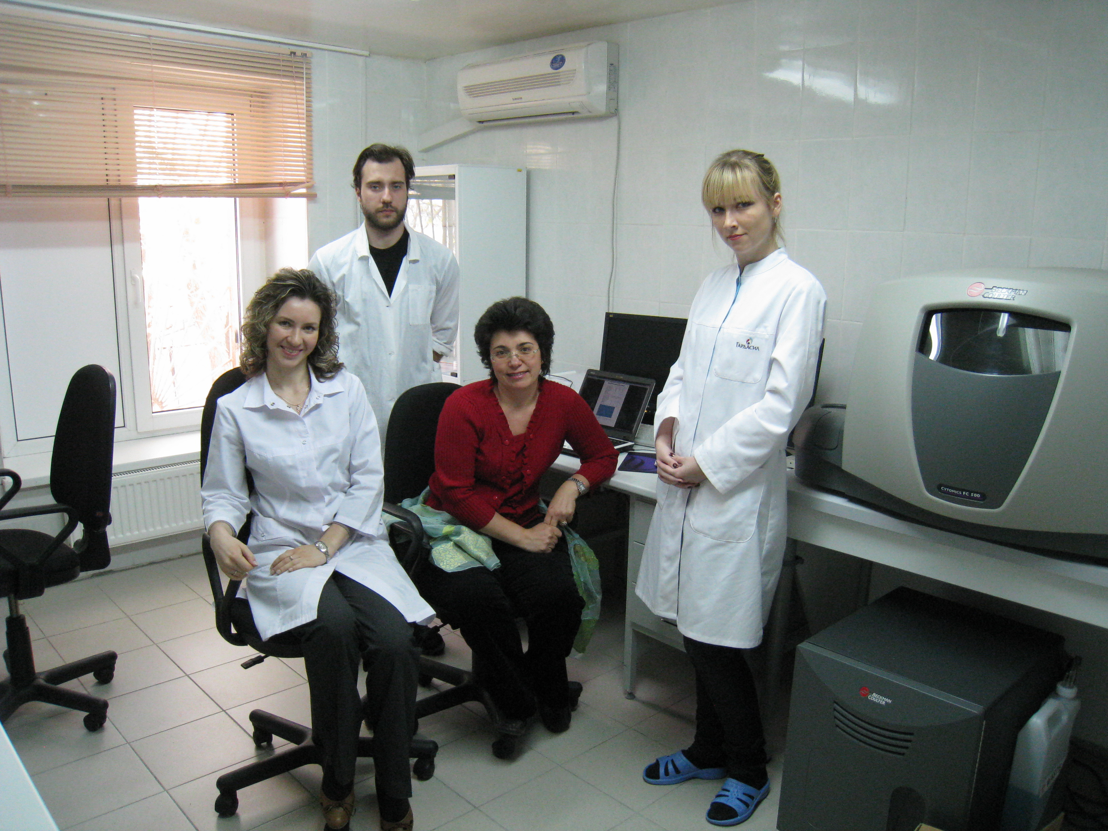
I appreciate deeply:
my colleagues from my Lab, doctors Lyamina and Kalish and students from department of Pathophysiology for cooperation in this research.
the Ministry of Science and Education of Russia for financial support. Agreement №14.604.21.0020, Unique identifier applied research RFMEFI60414X0020

Slide 15
Thank you for your attention

