Slide 1
OMICS 2015: Green Chemistry
Improvements to the Biorefinery Model Through Lignin Valorization
Ian Klein, Ph.D
Spero Energy, Inc.

Slide 2
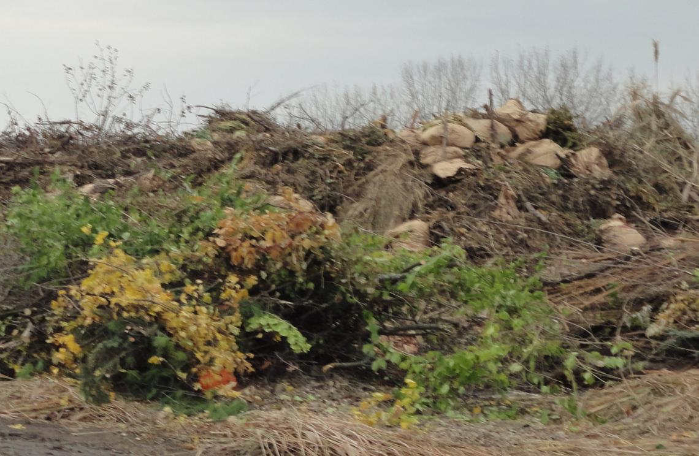
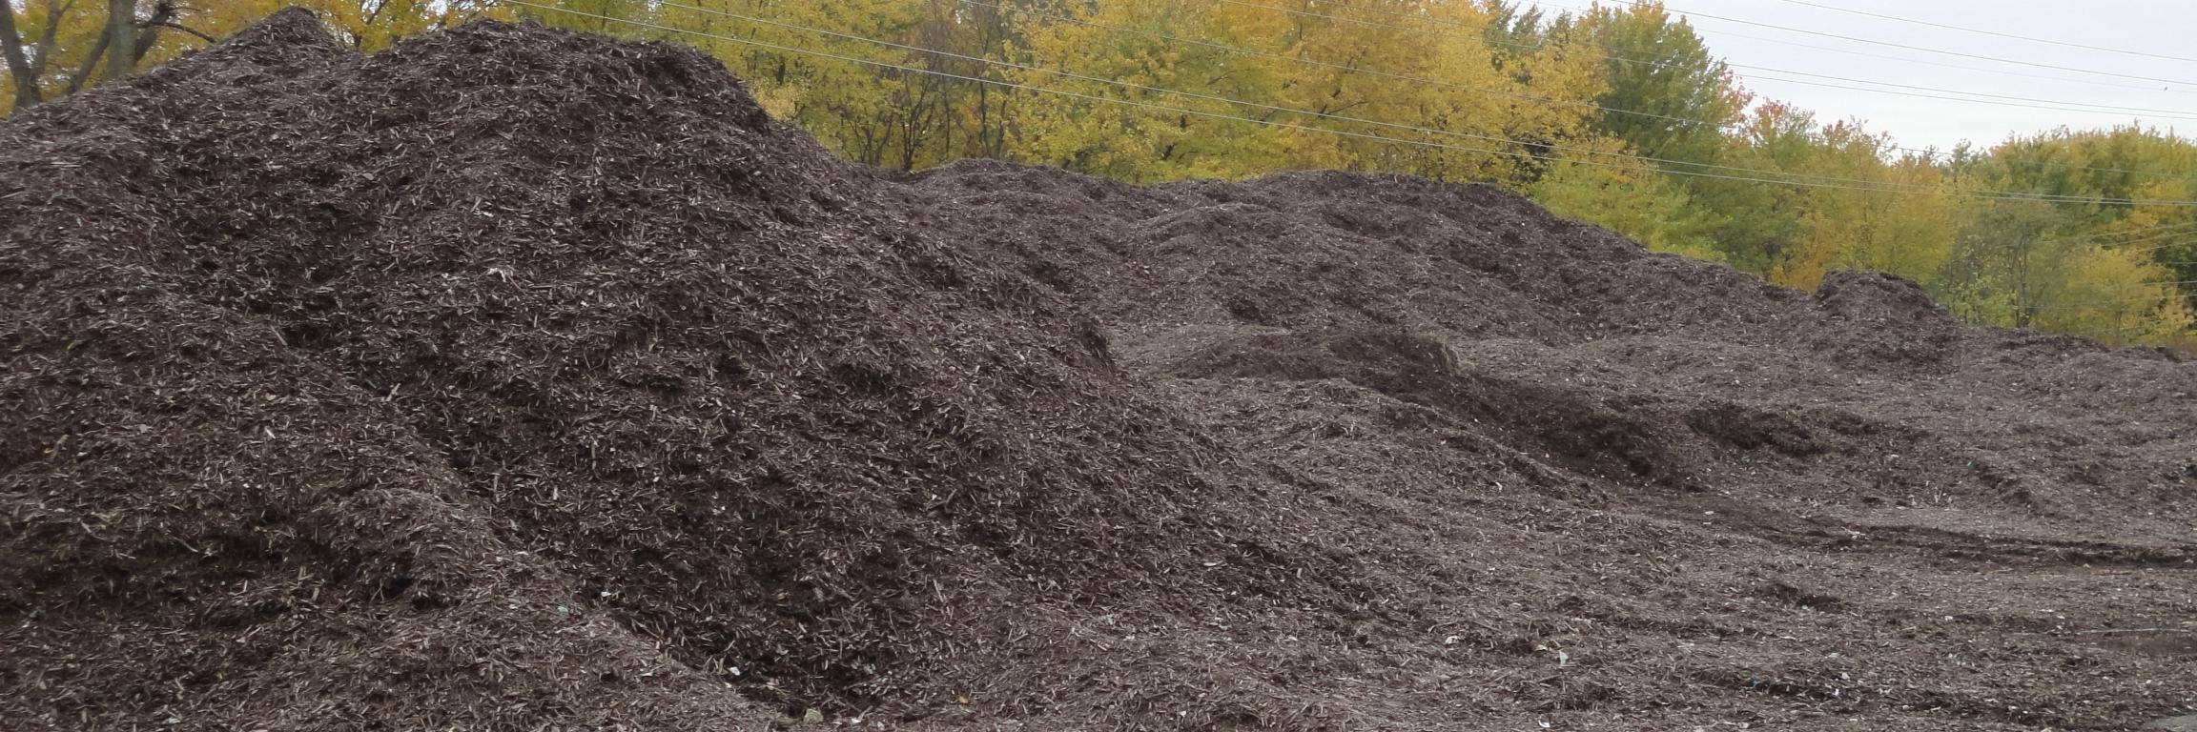
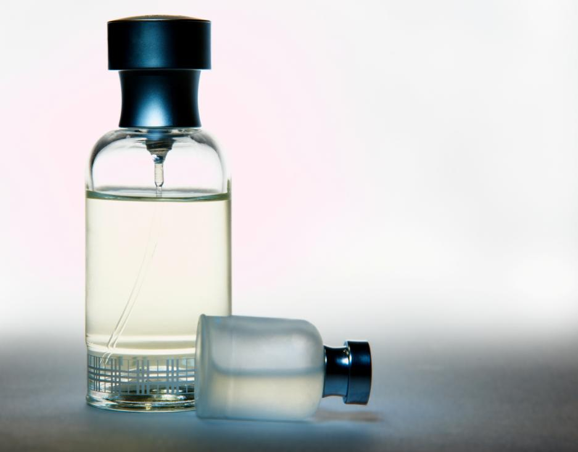
Spero Energy, Inc.
Initiated Operations in 2013
Advantage Sourced Raw Materials
Sustainable Catalysis
High Value Chemical Production

Slide 3
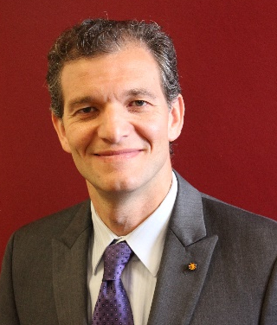
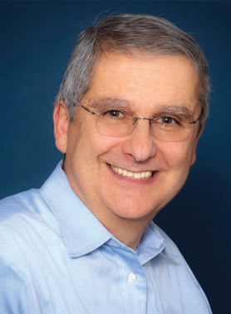
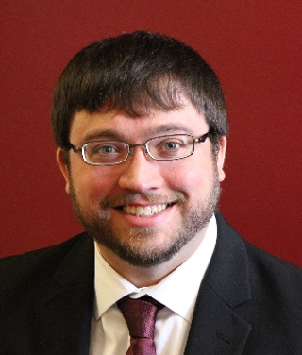


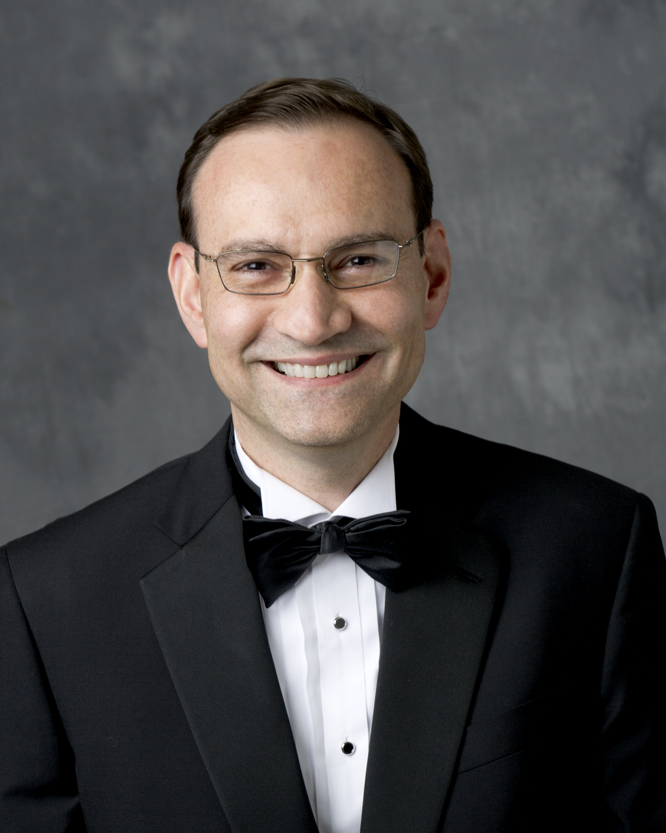
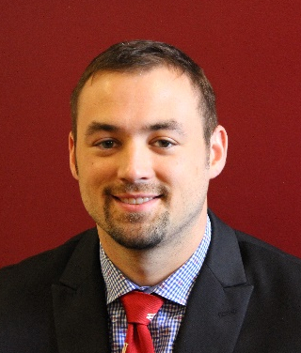
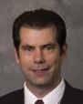
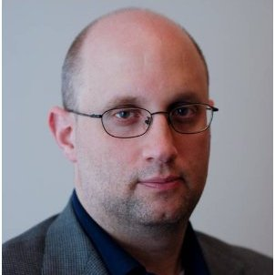
Team Spero & Advisory Board
Robert Bedoukian, Ph.D.
President, Bedoukian Research Inc.
Research Institute for Fragrance Materials
Product validation & Development
Mahdi Abu-Omar, Ph.D.
Founder and President
Trenton Parsell, Ph.D.
Senior Scientist
William Ludlum
Managing Director, Hexagon Agency LLC
Commercial relationships & Product Development
Ian Klein, Ph.D
Senior Scientist
Fabio Ribeiro, Ph.D.
Professor of Chemical Engineering, Purdue University
Process Development & Reaction Engineering
Barron Hewetson
Engineer
Nathan Mosier, Ph.D.
Scale-up, bioprocess engineering
Eyal Barash, JD
Barash Law
Legal Counsel

Slide 4

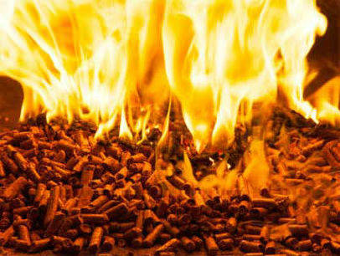
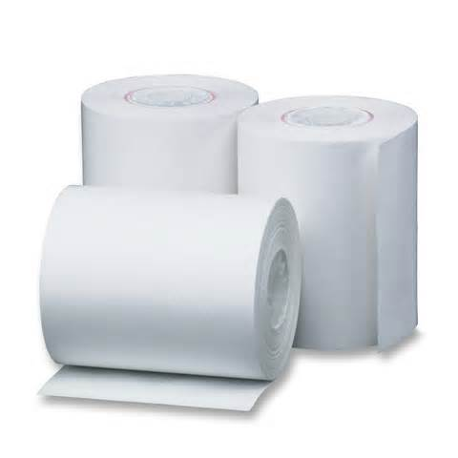
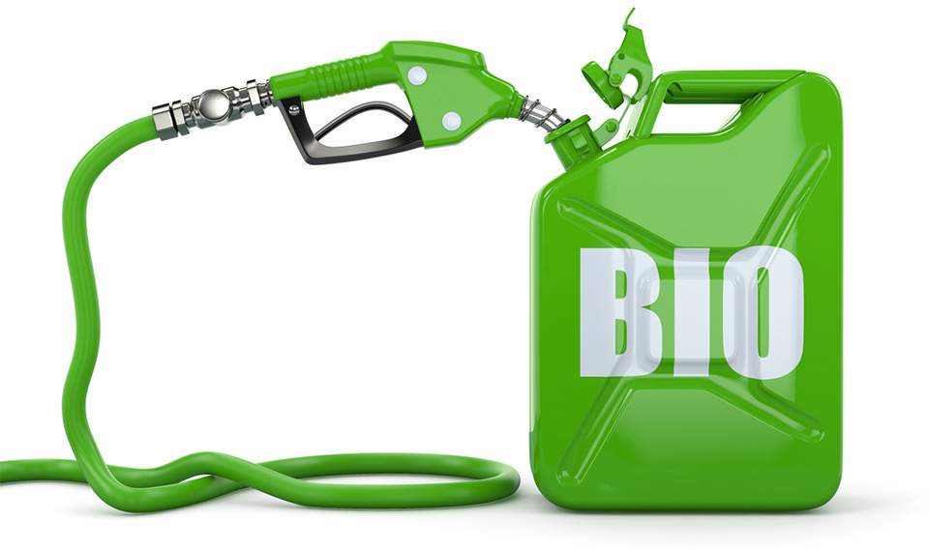
Wasted Carbon Value
$40 per ton
$40,000 per ton
Lignin
Biomass2energy.com
Carbohydrates
Petrixo.com
Notes:
The plant component lignin is underutilized
Lignin must be removed in biorefiniery and paper pulp industries
Millions of tons of lignin are burned annually for low value energy
Low carbon efficiency of operations

Slide 5
Complex Structure & Low Selectivity
Linkage Types
β-O-4
5-5
α-O-4
β-5
8-8

Slide 6

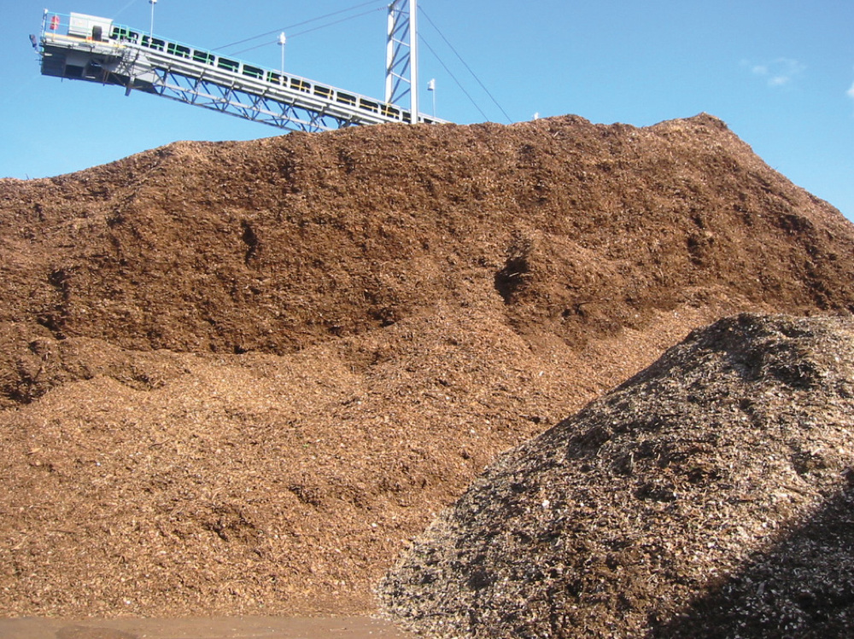
SPERLU_{TM} Technology
Selective Process for Efficient Removal of Lignin and Upgrading
Liquid stream
xylose
soluble lignin
SPERLU_{TM}
cellulose
Solid Phase
unknown

Slide 7
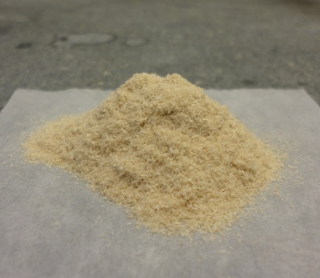
SPERLU_{TM} Yields
Catalyst
Alcohol solvent
35 bar H₂, 225º C,
Milled wood
DHE
DMPP
Biomass Type | % Lignin Content |  |  | % Yield
Poplar WT-717 | 18.5 | 31 | 69 | 40
Poplar 717-0998 (High G Poplar) | 18.7 | 90 | 10 | 27
Poplar 717-F5H (High S Poplar) | 20.2 | 17 | 83 | 37
Biomass Type | % Lignin Content |  |  | % Yield
Poplar WT-LORRE | 19.2 | 45 | 55 | 54
WT-Lodgepole Pine | 30.5 | 100 | NA | 19
WT-White Birch | 15.8 | 31 | 69 | 52
Eucalyptus | 23.6 | 30 | 70 | 56
Selectivity

Slide 8
Hydrolysis of SPERLU_{TM} Residue
Conditions:
200 mg glucan
citrate buffer, pH 4.8
CTEC-3 cellulase (50fpu)
50ºC, 72 hours
Cellulose is not destroyed during HDO process
Cellulose residue amenable to hydrolysis
  Lignin inhibits enzymatic hydrolysis

Slide 9
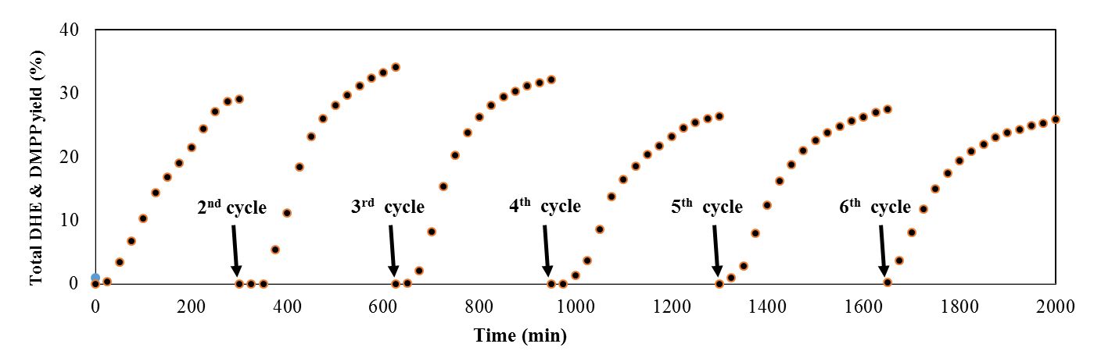
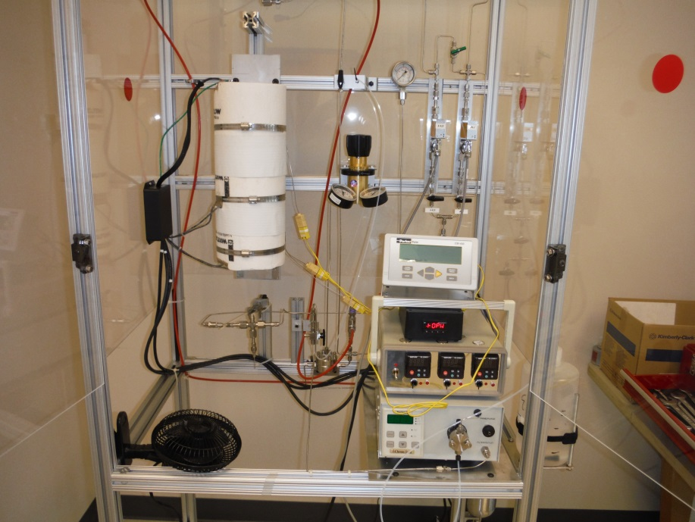
SPERLU_{TM} Advantages
Natural and renewable feedstock
Earth-abundant and recyclable catalyst
Easily separable product stream of aroma chemicals
Digestible carbohydrate co-product
Cost competitive

Slide 10
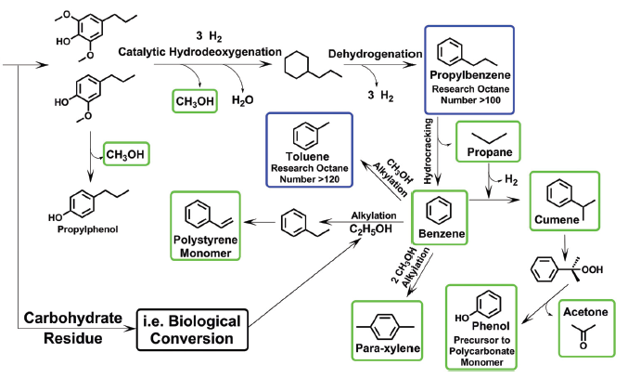
Biorefinery Vision
T. Parsell, et al. Green Chem., 2015, 17, 1492-1499

Slide 11
Business Opportunity
Flavor & Fragrance
Fragrance $10 B
  4.3% growth
Flavor $10.6 B
  6% growth
  Natural flavors 12%
Eugenol Family
$443M
DMP $375 M
Vanillin $300 M
$1.1 Billion Market
Notes:
High Value Renewable Specialty Chemical Production
HVCs from wood waste
HVCs used in flavor & fragrance industry
Spero HVCs and derivatives
$400 M
Spero has inherently lower cost base

Slide 12
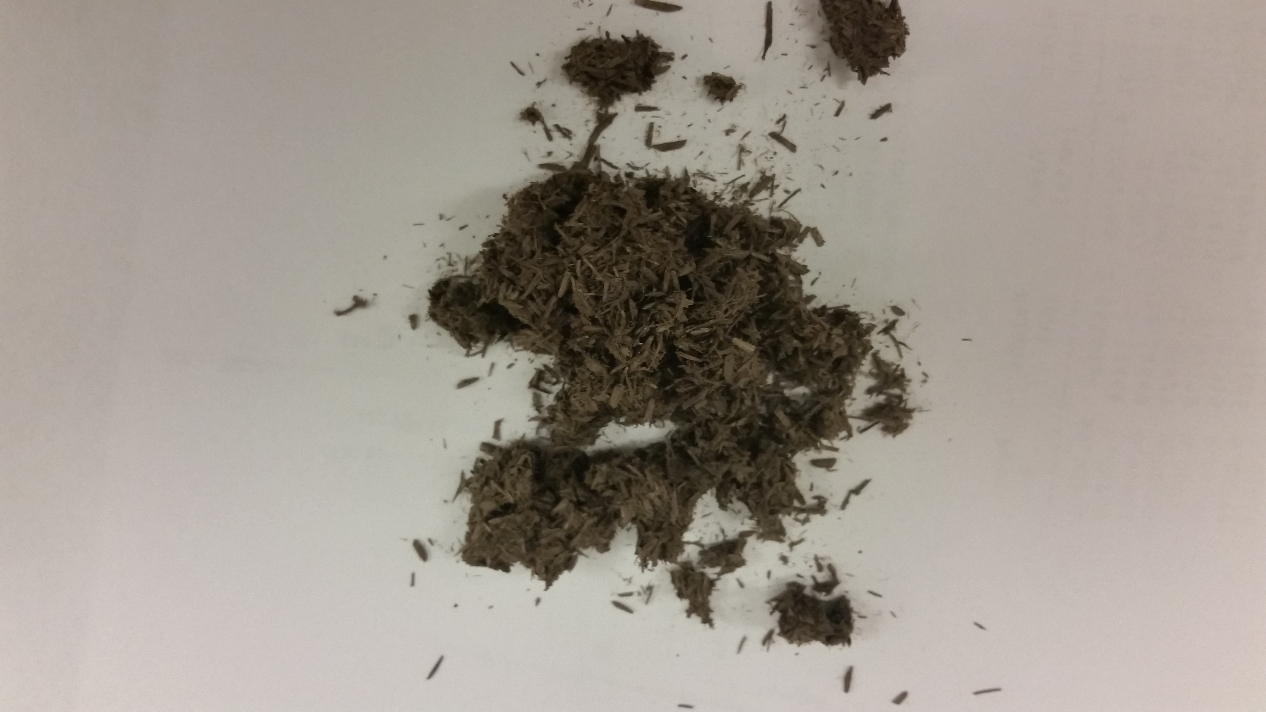
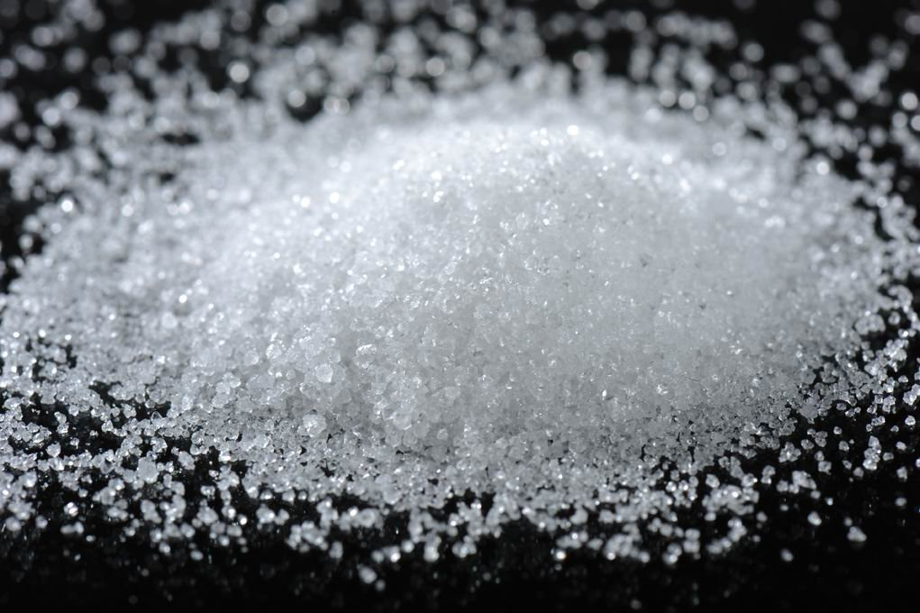
Production Cost vs Product Value: DHE/DMPP
1000 Kg Biomass
100 Kg DHE/DMPP
$2000
400 Kg Cellulose
$80
Materials &
Process: $519
200 Kg Xylose
$100
Total Product Value = $2180

Slide 13
Summary
High value products from Lignin
Enhanced digestibility of cellulose
Abundant, recyclable catalyst
Dedicated and Qualified Team
  Scientific and business acumen

Slide 14




Acknowledgements
Questions?
SBIR Phase II DOE (04/2015)
SBIR Phase I DOE (02/2014)
  Indiana matching grant (10/2014)
SBIR Phase I NSF (07/2014)
  Indiana matching grant (10/2014)
Phase IB NSF (12/2014)
BDM Business Plan Competition (02/2015)
Indiana BioCrossroads Prize (11/2014)
Clean Energy Trust : Midwest Clean Energy Challenge
  Indiana Clean Energy Challenge Winner (02/2014)
  Aviation Energy Prize Winner (05/2014)
Notes:
INVESTMENT

