Slide 1
Molecular classification of breast cancer using a Multiplex assay
Dr. Godfrey Grech

Slide 2
Molecular classification of breast cancer using a Multiplex assay
Background
Introduction to current research objectives
Project overview and Infrastructure
Quantigene 2.0 assay
Criteria for Biomarker Selection
Results – Classification of Breast cancer and biomarker discovery

Slide 3
Molecular classification of breast cancer using a Multiplex assay
Background
Introduction to current research objectives
Project overview and Infrastructure
Quantigene 2.0
Criteria for Biomarker Selection
Results – Classification of Breast cancer and biomarker discovery

Slide 4

Background
Hybridise
polysome bound RNA
SCF
Epo+SCF
SCF
Epo
Epo
deprived
Novel list of transcripts that are recruited to polysomes by Growth Factor Signaling
ANOVA
Gene List
Hybridise
Total RNA
Epo+SCF
deprived
Affymetrix
Data Analysis
Notes:
Project started at the Haematology Department in the EMC as part of the doctoral studies of Dr. Grech in 2005.
Differentiation-proliferation mechanisms were studied in haematopoietic progenitor cells specifically in erythroblasts.
Signal Transduction alters gene transcription but also translation through polysome recruitment.
Microarray assays (provided by Affymetrix) on total RNA and polysome-bound RNA. The ratio between the two revealed 8 transcripts of interest that are recruited onto polysomes by GF signaling.

Slide 5
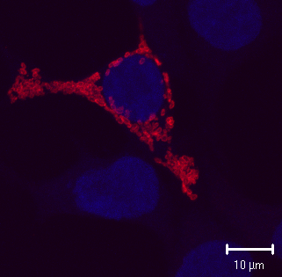
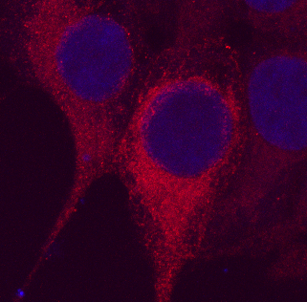
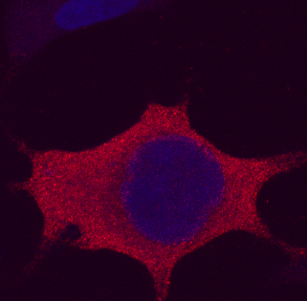
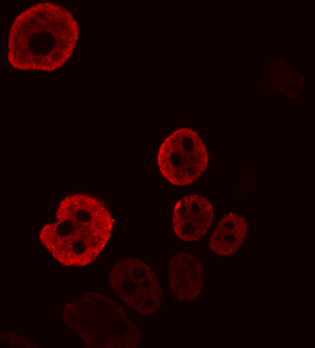
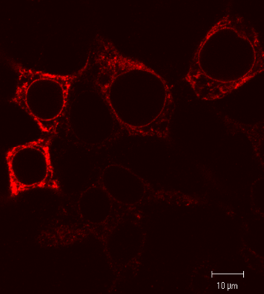
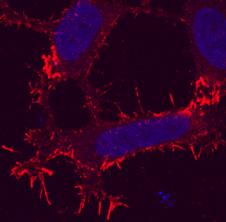
Background
5730466P16Rik
mEd2
α4
5730466P16Rik
mEd2
Igbp1
Constitutive expression of α4 blocks differentiation in the erythroid model.
hnrpa1
Kist
Cnih
hnrpa1
Kist
Cnih
α4
Notes:
The 8 transcripts were transduced into a cellular model
Cells were not supplemented with any growth signals to initiate differentiation into erythrocytes as seen in the empty vector model.
When alpha4 was transduced, differentiation was blocked and proliferation maintained.

Slide 6
Background
Nutrients / Growth Factors
α 4
α 4
α 4
mTOR
PP2A
pS6K
eV
TGF-β rescues block of differentiation.
4EBP-P
S6K-P
PP2A
S6K
pS6K
α 4
FTY720 activates pp2a resulting in the release of differentiation block by Stem Cell Factor.
TGF-β inhibits p⁷⁰S6K by activation of PP2A
S6K
Translation
Initiation
Petritsch, et al. (2000)
Grech, G., et al. (2008)
Blood Oct 1;112(7):2750-60.
Suppressed PP2A activity maintains mTOR signals resulting in enhanced proliferation and block of differentiation.
Notes:
(Transforming Growth factor Beta) TGF-β can restore the differentiation block induced by transduction of α4. Both proteins act on a common feedback complex – the PP2A complex which inactivates proliferative signals mediated by 4EBP-P and S6K-P hence releasing the block on differentiation.
FTY720, a chemical that induces PP2A activity, also restores the differentiation block mediated by SCF confirming the role of PP2A in mediating differentiation as opposed to proliferative signaling.

Slide 7
Molecular classification of breast cancer using a Multiplex assay
Background
Introduction to current research objectives
Project overview and Infrastructure
Quantigene 2.0
Criteria for Biomarker Selection
Results – Classification of Breast cancer and biomarker discovery

Slide 8
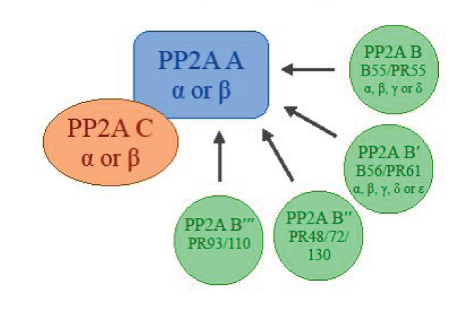
PP2A Mechanism – Breast Cancer
PP2A is a versatile complex.
Binding subunits regulate target specificity and activity.
Notes:
Structure of PP2A and regulatory subunits define target specificity and activity

Slide 9



PP2A Mechanism – Breast Cancer
Oestrogen
Cytoplasmic
membrane
High p-AKT is a common event in Triple Negative breast cancer.
Activation of the PI3K/AKT can be blocked by the PP2A activator,FTY720 (Borg et al., 2014)
TK
Nuclear
membrane
IGFR
ER
P
AKT
mTOR
P
P
BRCA1
S6K
P
Dephosphorylation
PP2A Complex
B
C
Proliferation
Differentiation Block
Survival
A
Nigel Borg, Shawn Baldacchino, Christian Saliba, Sharon Falzon, James DeGaetano, Christian Scerri, Godfrey Grech: Phospho-Akt expression is high in a subset of Triple Negative breast Cancer Patients. Xjenza. 03/2014
Notes:
Xiang, 2008 – inhibition of BRCA1 leads to the phosphorylation of AKT
Xiang, 2011; - ki67 was significantly higher in p-Akt positive tumours and in BRCA1-negative tumours
Nigel et al, 2011
The reduction in PP2A activity was comparable to that caused by okaidic acid, a selective inhibitor of PP2A. Okadaic acid and siRNA against BRCA1 were both found to induce phosphorylation of Akt at S473, further supporting that in this case BRCA1 acts through PP2A. BRCA1 overexpression results in an increase PP2A activity further supporting that dephosphorylation of p-Akt by BRCA1 occurs through PP2A (Ma, et al., 2007).
Interestingly both PP2A and BRCA1 activities induce or preserve ER mRNA expression (Keen, et al., 2005; Ma, et al., 2007). BRCA1 then acts as a negative feedback on ER signalling (Ma, et al., 2007). This leads to the hypothesis that breast cancers with low BRCA1 expression/activity through mutation or through ER down-regulation are eligible to phosphatase treatment. This will be investigated by determining the expression levels of ER and BRCA1 and also the downstream targets of PP2A, p-Akt and p-S6K.
From previous studies, we showed described a potential subset of TNBC patients with elevated p-Akt which was further supported by evidence showing that BRCA1 negatively regulates the phosphorylation status of Akt (Xiang et al., 2008). High levels of p-Akt are described in 20-80% of breast tumours and in human breast cell lines. These findings were accompanied and correlated with a low expression of the BRCA1 protein (Al-Bazz, Underwood, Brown, & Dobson, 2009; Stål, et al., 2003; Xiang, et al., 2011). We suspect that Akt activation by BRCA1 is PP2A mediated or accompanied by PP2A downregulation that allows p-Akt overexpression. Moreover, studies on breast cancer cell lines show an increased sensitivity of TNBC and BRCA1-deficient cancers to mTOR inhibitors (Noh et al., 2004; Xiang, et al., 2011). This suggests that deregulation of the mTOR effectors and/or regulators plays an important role in the pathology of triple-negative breast cancers.
Increased expression of a mutant PP2A-C at the phosphorylation site Y307 has also been described in HER2-enriched breast tumours. This mutation significantly correlates with disease progression and loss of PP2A activity. Upon reactivation of PP2A activity, cells went into apoptosis (Stebbing, et al., 2013).
Treatment of TNBC with a CIP2A inhibitor Bortezomib also led to a reduction in p-Akt affirming CIP2A inhibitory effect on PP2A (Tseng, et al., 2012). The relation of CIP2A to p53 and BRCA and the common overexpression of p-Akt in breast cancer patients provides promising evidence that PP2A is heavily involved in this malignancy. These selected patients may potentially benefit from broad effect of PP2A activating therapy.
FTY720 activates PP2A, and causes dephosphorylation of Akt at both S473 and T308 phosphorylation sites and also dephosphorylation of S6K at T389 in leukaemic cellular models. This was confirmed as total protein levels of these two kinases were identical with or without FTY720 treatment (Matsuoka, et al., 2003).
Notes our data (local pts only):
ESR negatively correlates to KIAA1524 (p-value = 0.025) and SETBP1 expression (pvalue = 0.000);
ESR1 does not correlate with BRCA1 expression (p-value = 0.4)

Slide 10
PP2A Mechanism – Breast Cancer
Cytoplasmic
membrane
Oestrogen
PP2A inhibitory subunits, a potential list of cancer biomarkers.
PP2A Regulators
IGFR
TK
Nuclear
membrane
ER
P
cip2a
AKT
mTOR
P
P
BRCA1
ANP32A
S6K
P
SETBP1
SET
Dephosphorylation
PP2A Complex
B
C
A
α4
Proliferation
Differentiation Block
Survival

Slide 11
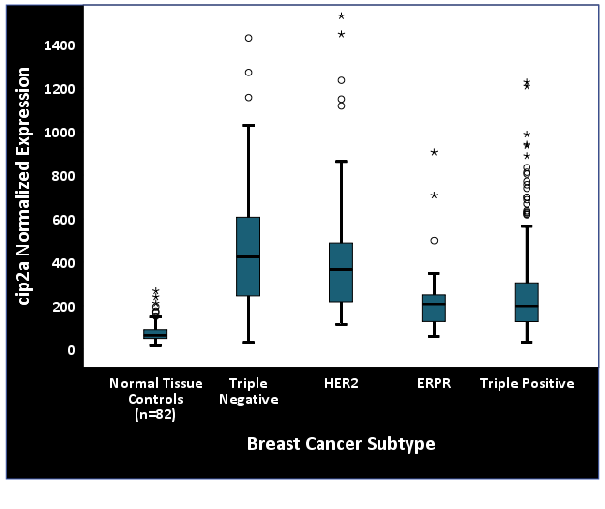


PP2A deregulation is a common event
CIP2A expression is upregulated in TNBC and Her2-enriched samples.

Slide 12
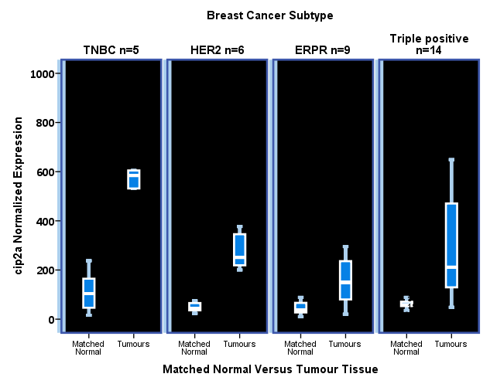
PP2A deregulation is a common event
High expression of Cip2a in tumour tissue when compared to matched normal.

Slide 13
PP2A deregulation is a common event
PP2A Deregulation Criteria | Triple Negative (N=84) | ERPR (N=308) | HER2 (N=26) | Triple Positive (N=59) | Total (N=477)
PPP2CA HOMDEL EXP <-2 | 17% | 2% | 4% | 0% | 4%
PPP2CB HOMDEL EXP <-2 | 24% | 16% | 31% | 19% | 19%
PPP2R2A HOMDEL EXP <-2 | 24% | 15% | 46% | 19% | 18%
PPP2R2B HOMDEL EXP <-2 | 1% | 0% | 0% | 0% | 0%
CIP2A AMP EXP>2 | 18% | 5% | 12% | 10% | 8%
SETBP1 AMP EXP>2 | 2% | 7% | 8% | 2% | 6%
SET AMP EXP>2 | 15% | 5% | 31% | 2% | 8%
α4 AMP EXP>2 | 2% | 6% | 4% | 2% | 5%
Total PP2A deregulation | 67% | 38% | 74% | 36% | 45%
Baldacchino S, Saliba C, Petroni V, Fenech AG, Borg N, Grech G: Deregulation of the phosphatase, PP2A is a common event in breast cancer, predicting sensitivity to FTY720. The EPMA Journal 2014 Jan 25; 5(1):3
Notes:
67% of TNBC breast tumours, have low expression of the catalytic subunit, PPP2CA and an overexpression of the inhibitory subunits – driven mainly by SET CIP2A and PPP2CA, whereas in HER2 it is driven mainly by the other PP2A subunits and by SET

Slide 14
Aims and Relevance of Study
Generate a predictive gene set to classify patients with low PP2A activity
Define actionable biomarkers providing knowledge on the application of PP2A activators in specific therapeutic groups.

Slide 15
Molecular classification of breast cancer using a Multiplex assay
Background
Introduction to current research objectives
Project overview and Infrastructure
Quantigene 2.0
Criteria for Biomarker Selection
Results – Classification of Breast cancer and biomarker discovery

Slide 16



Project Outline
Sample Processing
Data Access
Diagnostic and Therapeutic
Biobanking
Research
Cellular Models
Cell lines and primary cells
Patient Material
Fresh tissue: pbRNA isolation
RNA isolation
DNA isolation
Cancer stem cells
FFPE tissue: Microdissection of tissues
Expression analysis
Sensitivity to drugs
Functional assays
expression profiling
Exome sequencing
Cellular models
Predictive Biomarkers

Slide 17
Molecular classification of breast cancer using a Multiplex assay
Background
Introduction to current research objectives
Project overview and Infrastructure
Quantigene 2.0
Criteria for Biomarker Selection
Results – Classification of Breast cancer and biomarker discovery

Slide 18
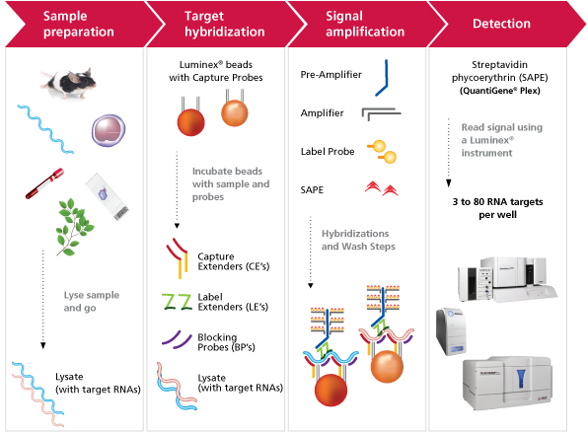
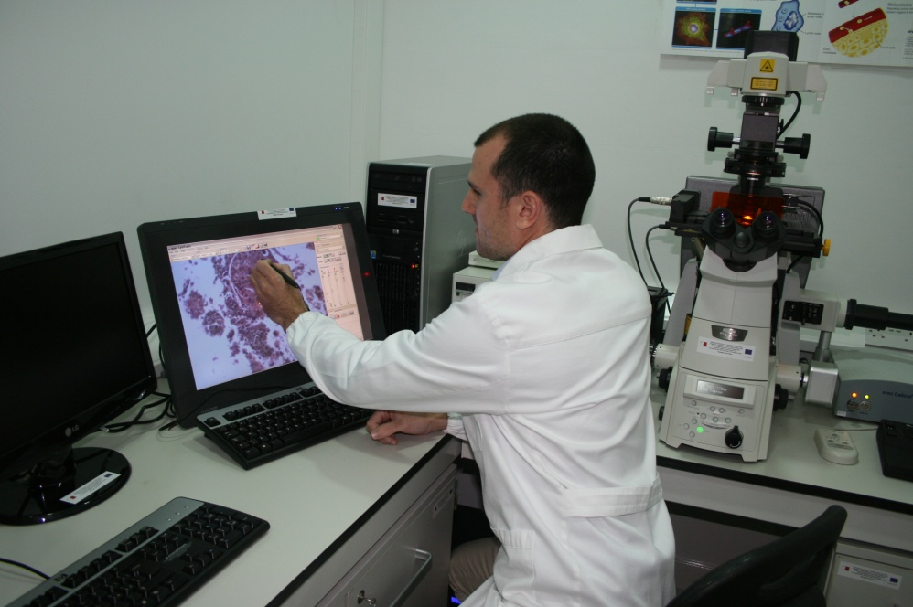
Quantigene 2.0 - Affymetrix Technology
Laser microdissection
Notes:
Allows us to use FFPE material
No amplification step
Can probe for up to 100 genes
Relatively straightforward methodology
?Drawbacks – requires 2.5mm3 of tissue – difficult to lmd scanty tumours?

Slide 19
Quality Control
No significant difference between replicates
And no significant effect when stained or unstained
Notes:
Stained section definition of morphology – accurate LMD!

Slide 20
Molecular classification of breast cancer using a Multiplex assay
Background
Introduction to current research objectives
Project overview and Infrastructure
Quantigene 2.0
Criteria for Biomarker Selection
Results – Classification of Breast cancer and biomarker discovery

Slide 21
Biomarker selection
40-GenePlex
Basal vs Luminal Classifiers
Epithelial Mesenchymal Transition
PP2A activity regulators
PP2A activity Biomarkers
A panel of genes was selected to identify:
Molecular classification
Epithelial or Mesenchymal phenotype (EMT)
PP2A deregulation
Potential biomarkers for PP2A activity

Slide 22
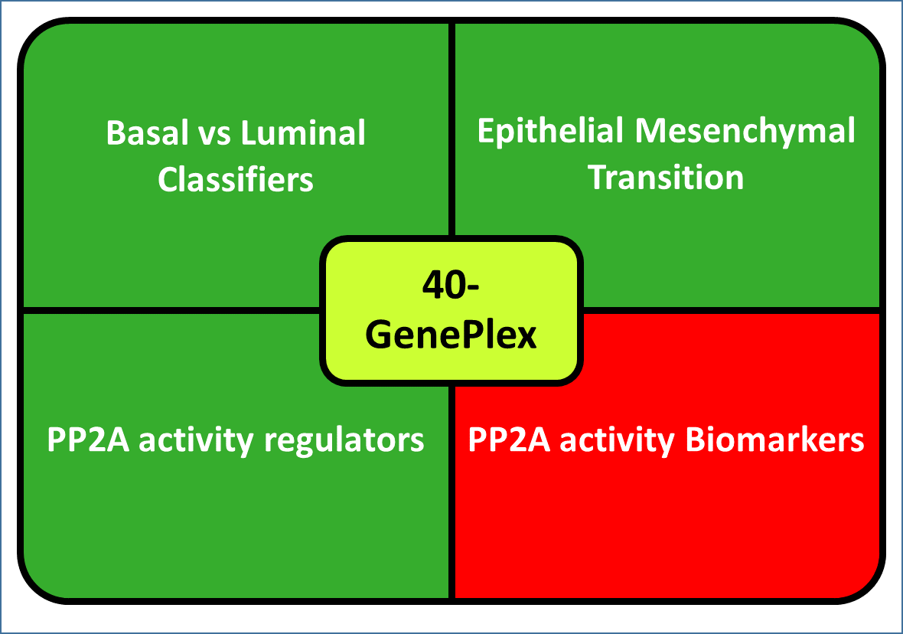
PP2A Activity Biomarker Selection
List of Genes of Interest
Use criteria to group patients into suppressed or normal PP2A activity
Selection of five (5) biomarker genes associated with low PP2A activity
Notes:
2) Includes genes related with grade, histological type
Zhang 2013 – in category 4 - including genes derived from comparing normal cell line and breast cancer cell line expression
Ma 2013 – patient data – patient matched normal vs tumours

Slide 23
PP2A Activity Biomarker Selection
List of Genes of Interest
Use criteria to group patients into suppressed or normal PP2A activity
Selection of five (5) biomarker genes associated with low PP2A activity
Notes:
2) Includes genes related with grade, histological type
Zhang 2013 – in category 4 - including genes derived from comparing normal cell line and breast cancer cell line expression
Ma 2013 – patient data – patient matched normal vs tumours

Slide 24
PP2A Activity Biomarker Selection
Used publicly available gene sets from genome-wide expression patterns that:
predict clinical outcome or survival in breast cancer
define Molecular and Novel tumour subclasses
persist in distant tumour metastasis
are differentially expressed in Breast Cancer
cip2a expression signature in breast cancer
proteins interacting with PP2A complex
(Van ‘t Veer et al., 2001)
(Sotiriou et al., 2003)
(Cobleigh et al., 2005)
(Paik et al., 2007)
(Lyng et al., 2013)
(Hedenfalk et al., 2001)
(Sotiriou et al., 2003)
(Ma et al., 2003)
(Sotiriou et al., 2006)
(Wang et al., 2005)
(Zhang et al., 2013)
(Ma et al., 2003)
(Niemela et al., 2012)
Ingenuity, IPA
Notes:
2) Includes genes related with grade, histological type
Zhang 2013 – in category 4 - including genes derived from comparing normal cell line and breast cancer cell line expression
Ma 2013 – patient data – patient matched normal vs tumours

Slide 25
PP2A Activity Biomarker Selection
List of Genes of Interest
Use criteria to group patients into suppressed or normal PP2A activity
Selection of five (5) biomarker genes associated with low PP2A activity
Notes:
2) Includes genes related with grade, histological type
Zhang 2013 – in category 4 - including genes derived from comparing normal cell line and breast cancer cell line expression
Ma 2013 – patient data – patient matched normal vs tumours

Slide 26
PP2A Activity Biomarker Selection
Criteria defining PP2A Deregulation
PPP2CA | HOMOZYGOUS DELETION OR EXPRESSION < -2 RNASeq (z-score)
PPP2CB
PPP2R2A
PPP2R2B
CIP2A | AMPLIFICATION OR EXPRESSION > 2 RNASeq (z-score)
SETBP1
SET
α4
Notes:
Genes had to have coherent aberrations hence recurrently overexpressed and in very low instance or never under expressed in the same cohort of patients (PP2A dereg)
TOP 75 genes were obtained
Genes aberrations were subdivided into the classical luminal basal classes. The Basal subtype showed the highest rate of aberrations in these genes with Luminal A having the least aberrant cases.
A set of a handful of genes was then selected depending on the evidence found in literature implicating the genes with the PP2A pathway or is associated with tumour formation, prognosis or tumorigenesis.

Slide 27
PP2A Activity Biomarker Selection
List of Genes of Interest
Use criteria to group patients into suppressed or normal PP2A activity
Selection of five (5) biomarker genes associated with low PP2A activity
Prioritisation based on:
Ingenuity Pathway Analysis (IPA)
Function and implications in tumours (Literature)
Possible relation with the PP2A pathway
Notes:
2) Includes genes related with grade, histological type
Zhang 2013 – in category 4 - including genes derived from comparing normal cell line and breast cancer cell line expression
Ma 2013 – patient data – patient matched normal vs tumours

Slide 28
Molecular classification of breast cancer using a Multiplex assay
Background
Introduction to current research objectives
Project overview and Infrastructure
Quantigene 2.0
Criteria for Biomarker Selection
Results – Classification of Breast cancer and biomarker discovery

Slide 29

Dataset and Data Analysis
Dataset
Annotated cell lines
(Quantigene results)
[N=10]
Patient cases (FFPE)
(Quantigene results)
[N=44]
TCGA annotated dataset (RNASeq data)
[N=835 Tumours and N=82 Normal]
Statistical Analysis
z-score weighting
Principal Component Analysis (PCA)
Algorithm Training
Decision Tree
Random Forests
Rule Model
Support Vector Machine (SVM)
Neural Networks
Notes:
Most of the genes had a normal distribution hence we used z-score weighting to eliminate the magnitude weight across genes.
In the case of the HER2 gene we had the FISH and IHC HER2 results. Using this data we could set a clear threshold to define positive and negative cases for HER2 expression.
ESR1 expression data also correlated well with ER IHC, only 1 out of 44 cases was considered as HER2-enriched by the Quantigene but determined as triple positive by IHC.
Principal Component Analysis – definition? (Components are not correlated within eachother)
To train algorithms a large training dataset that is annotated is required.

Slide 30
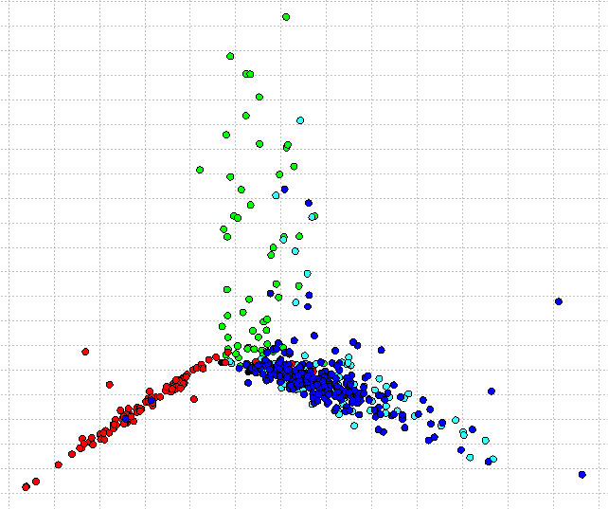
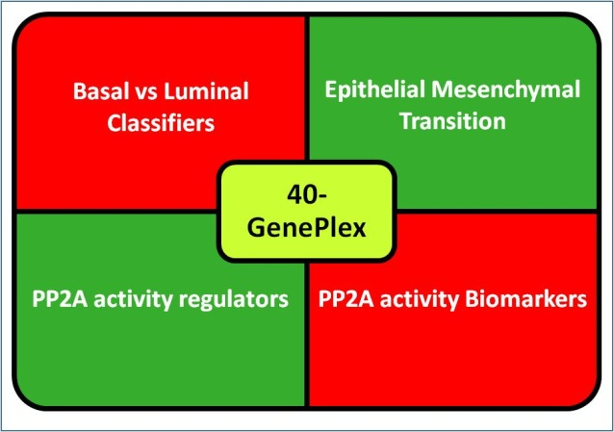
Data Processing
The Cancer Genome Atlas Breast Cancer RNASeq Data
Quantigene 2.0
RNA expression data
Data Normalisation against Housekeeping Gene Expression Set
z-score weighting
PAM50 Annotation
Basal vs Luminal Prediction
PCA Analysis
Notes:
Algorithm (threshold) trained on cell lines

Slide 31
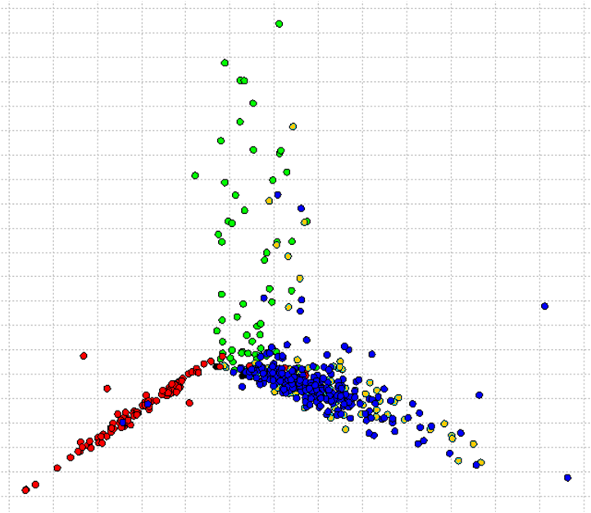
Results – Dataset and Data Analysis
Class: Luminal A Luminal B Basal HER2- enriched
Analysis:
Principal Component Analysis (PCA) using the
Basal vs Luminal Classifier gene set and ERBB2.
Sample:
TCGA patients annotated with PAM50 annotation
N = 520
98.2% overlap between molecular classification of Quantigene 2.0 and PAM50.
Component 2
Component 1
Notes:
The Basal vs Luminal Classifier genes do not overlap with the PAM50 genes with very exceptions. Using our gene set and normalisation method used for Quantigene 2.0 data we could define Basal, Luminal and HER2 groups with almost complete concordance with the PAM50 classification.

Slide 32
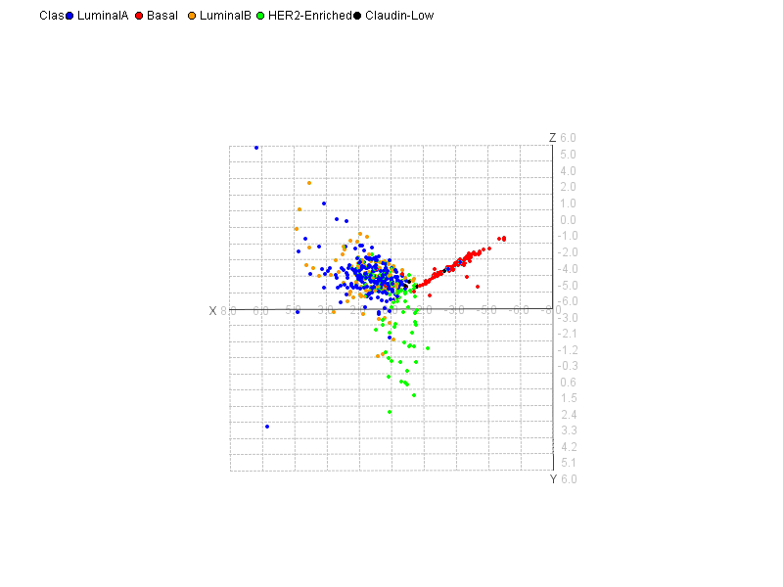
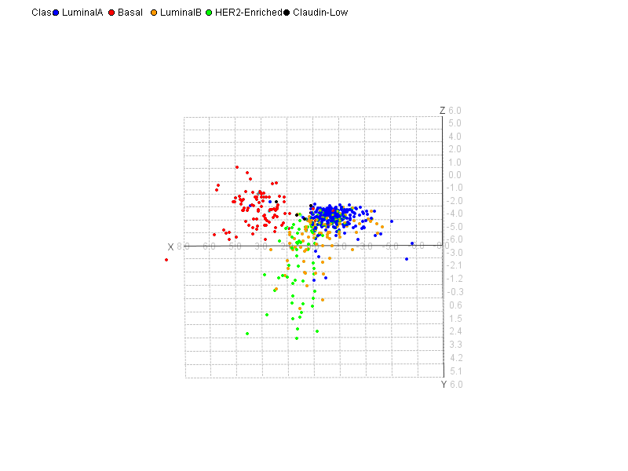
Our Vision - Classifiers
PCA Analysis:
A: Basal vs Luminal Classifiers ERBB2
B: Basal vs Luminal Classifiers ERBB2
PP2A activity Biomarkers
Sample:
TCGA patients annotated with PAM50 annotation
N = 520
Class: Luminal A Luminal B Basal HER2- enriched
A
B

Slide 33
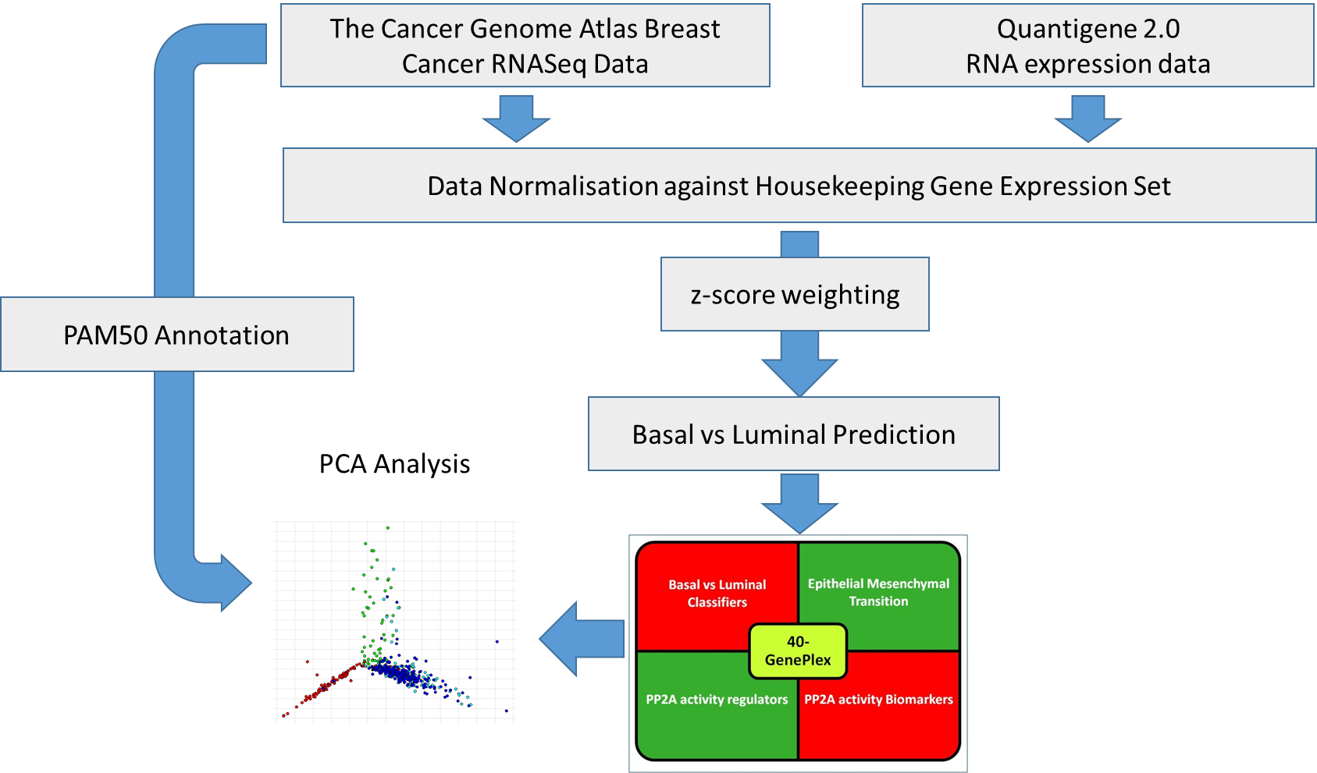
Data Processing
Immunohistochemistry (IHC)
Validation
PP2A Activity
(pS6K)
Annotation
PP2A complex regulation
Notes:
Algorithm (threshold) trained on cell lines

Slide 34
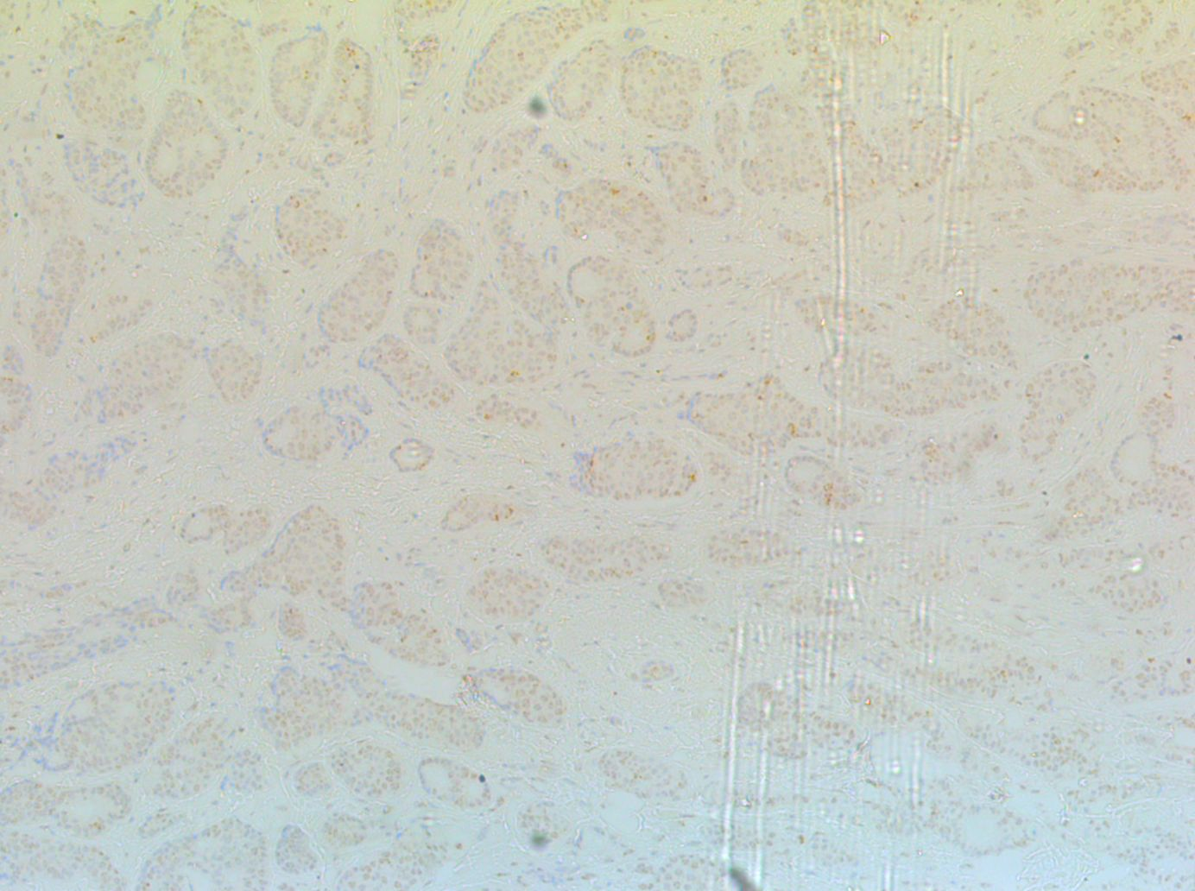
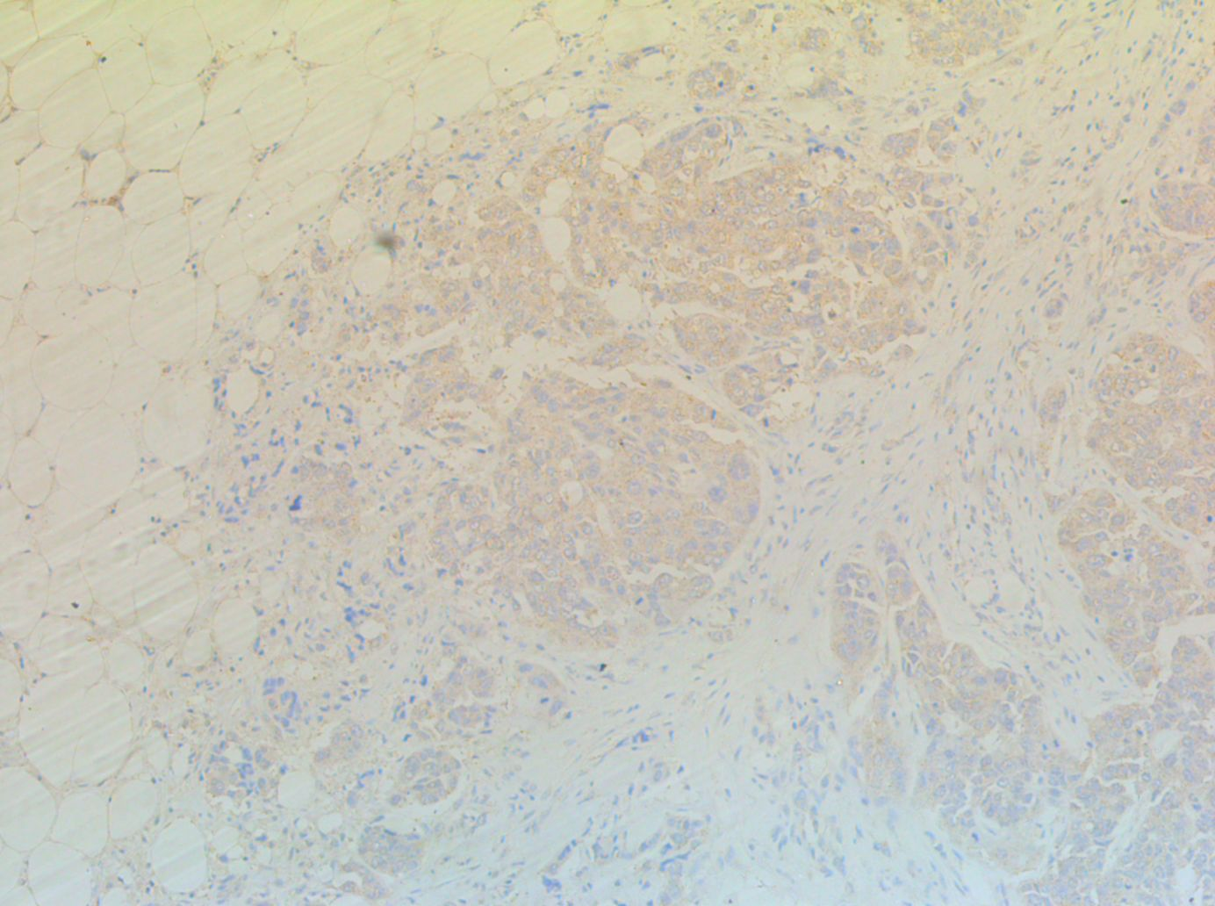
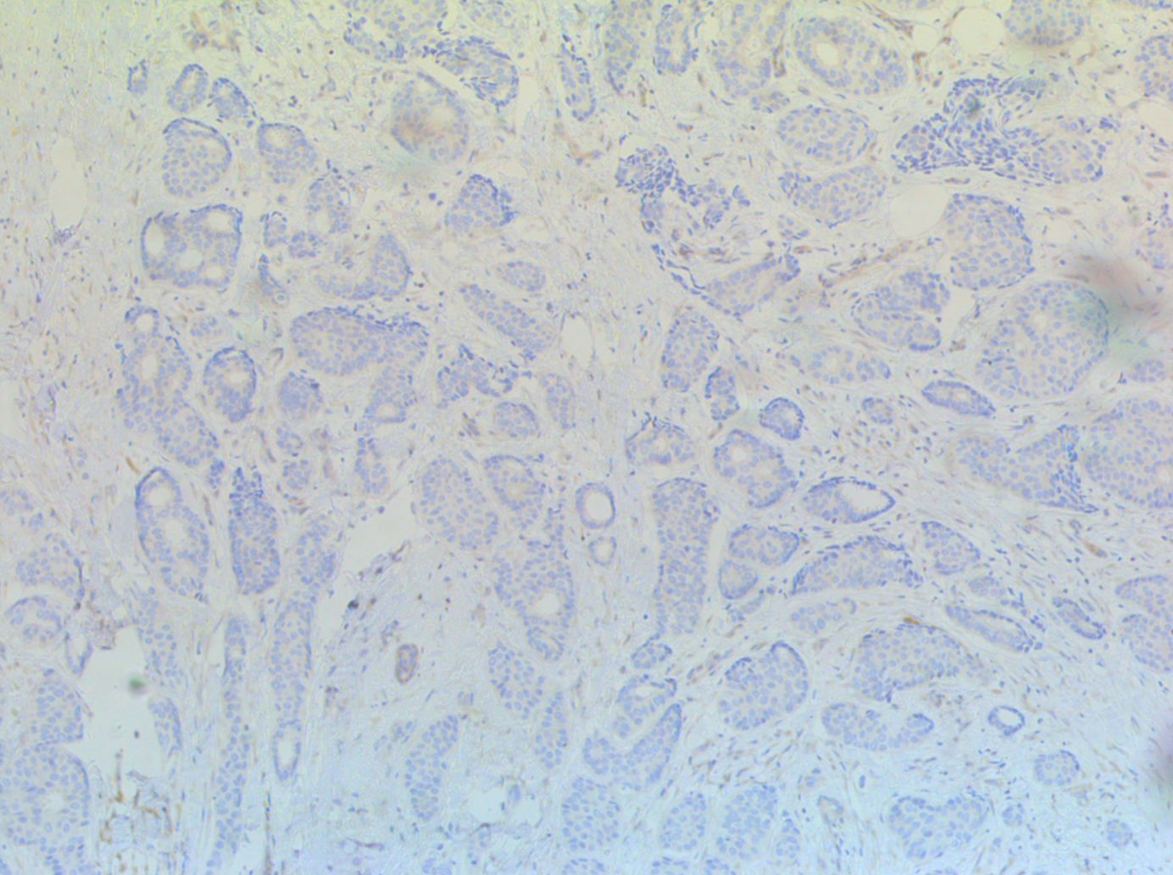
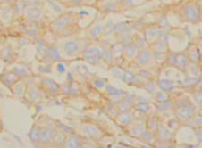
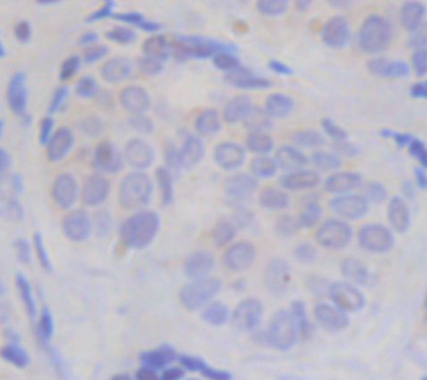
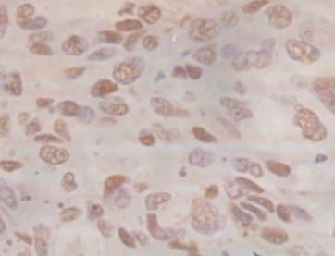
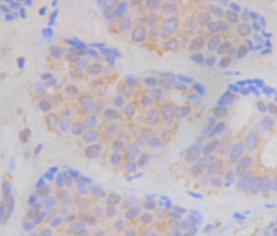
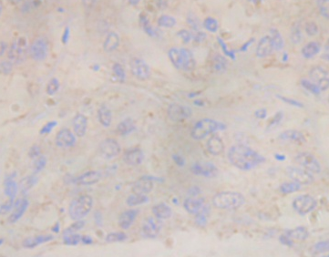
Biomarker Validation
Concordance | ER Positive | TNBC
Z-score Algorithm | 99.4% Luminal | 95% Basal
IHC Validation:
PP2A activity using pS6K
IHC Annotation:
PP2A complex regulators
Sample:
FFPE material
N = 40
p-S6K
cip2a
SET
α4

Slide 35

Potential Biomarkers to define a new Therapeutic Subtype
Out of 11 Breast cancer cell lines, 3 TNBC cell lines are sensitive to FTY720.
(Baldacchino et al., 2014)

Slide 36
Ongoing Studies
IGFR
mTOR
PI3K
P
P
P
P
Akt
S6K
P85/p70
ER
BRCA1
P
P
S6K
p70
B
C
P
A
Akt
EMT
P
Proliferation
B
B
C
A
Apoptosis
CIP2A
CIP2A
α4
SET

Slide 37
Conclusions
Quantigene results classified datasets into Luminal and Basal subtypes with high accuracy.
Quantigene results provided evidence for a novel Basal subtype.
The quantigene assay provides the technology to utilise FFPE material for gene expression studies
The novel subtype based on PP2A activity biomarkers, is potentially sensitive to the PP2A activator, FTY720.

Slide 38

Acknowledgments
PostDoc Position: Dr Christian Saliba
PhD Students: Mr Shawn Baldacchino; Dr Elaine Borg, Ms Maria Pia Grixti, Dr Ritienne Debono; Ms Vanessa Petroni.
MSc Students: Dr Keith Sacco; Mr Robert Gauci

