Slide 1

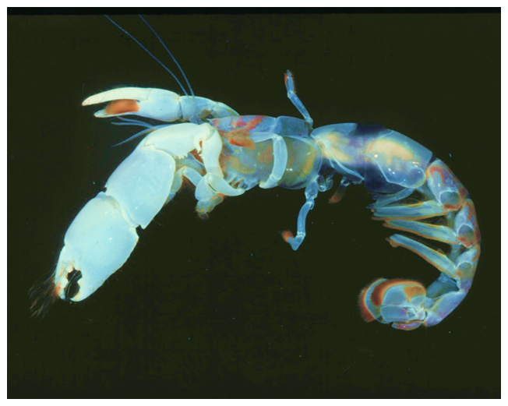
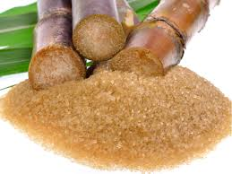
Comparing the Effect of Ecofriendly Adsorbents and Bioturbators on the Concentration of Pyrene
Febee Louka
Department of Chemistry
University of Louisiana at Lafaytte

Slide 2
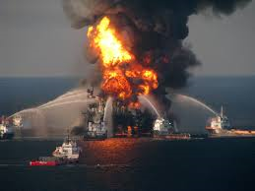
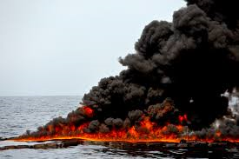
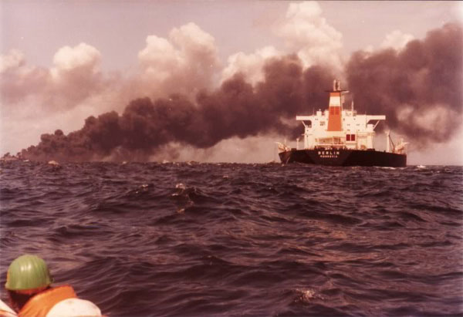
Oil Spills:
BP oil spill
Gulf of Mexico
Atlantic Empress
http://nypost.com/2014/10/27/bp-oil-spill-left-big-bathtub-ring-on-sea-floor/

Slide 3
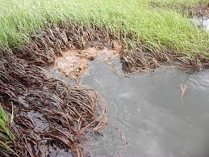
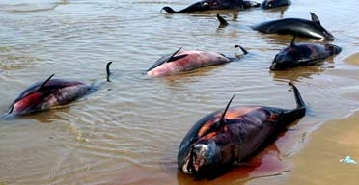
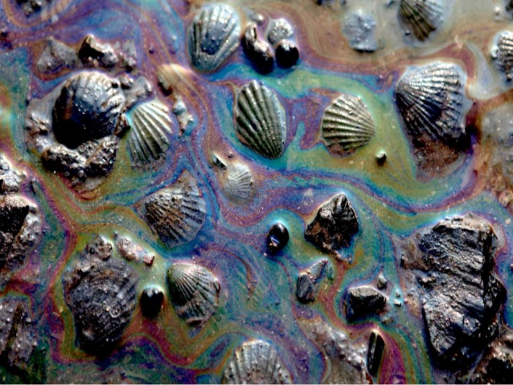
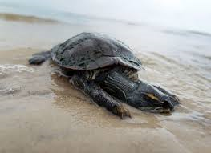
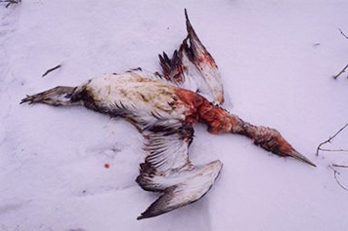
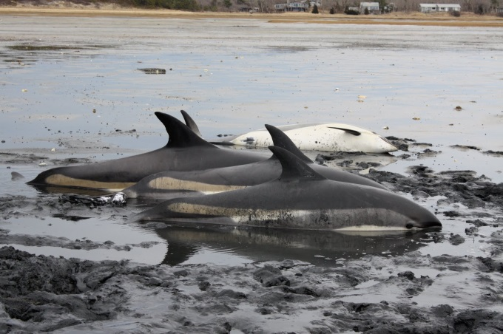
Effect of oil spills:

Slide 4
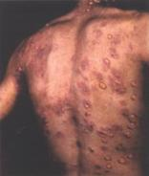
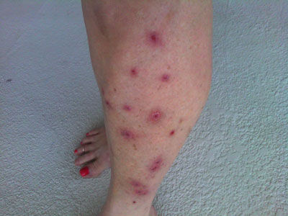
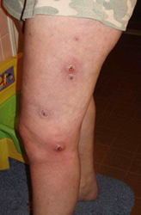
Oil spill treatment:
The most common treatment of oil spills is using dispersants such as Corexit
Corexit 9500 was found to be lethal for silver fish which is used as a bench mark in toxicity testing.
The skin becomes red, swollen, and sore, sometimes with small blisters.
Super bug causing MRSA like infection
Dermatitis
http://www.floridaoilspilllaw.com/toxicologist-oil-eating-microbes-genetically-modified-mrsa-like-infection/

Slide 5
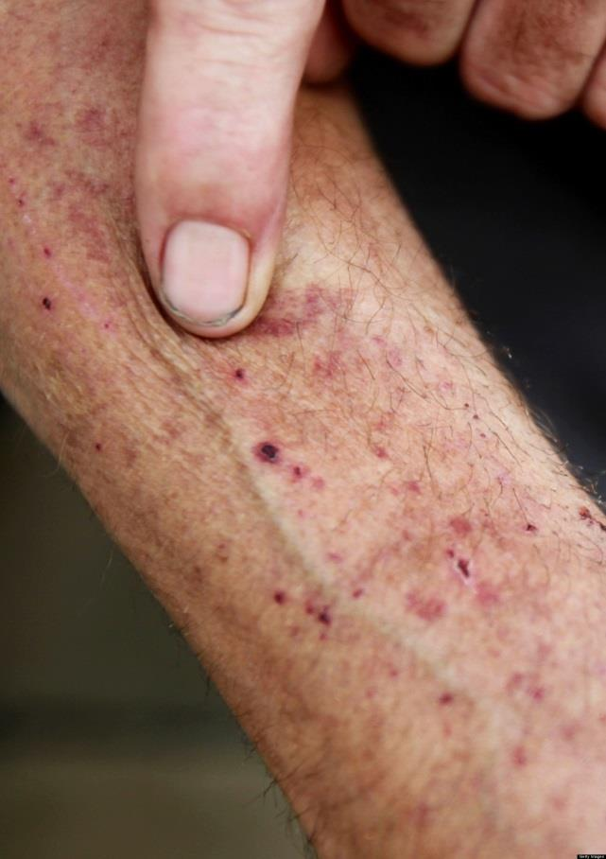
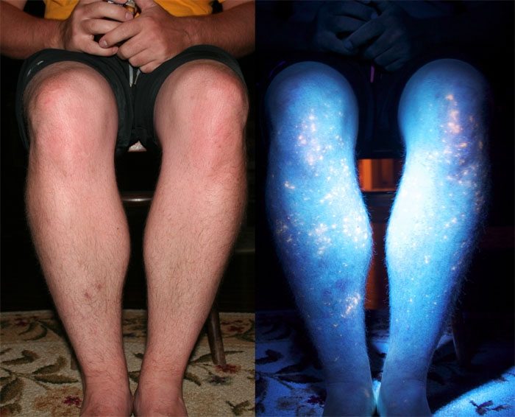
Another type of unknown rash appears in the form of bumps. Then a raw, irritating redness sets in before the skin peels away in patches. Accompanied with other symptoms, such as dizziness, nausea, diarrhea and bloody stools
Corexit oil residue promotes the absorption of toxins into the skin. The contamination into the skin are not visible under normal light, but show appear as fluorescent spots under UV light
http://news.discovery.com/earth/corexit-bp-120419.htm

Slide 6
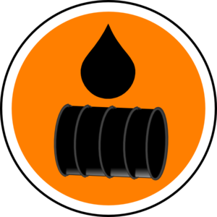
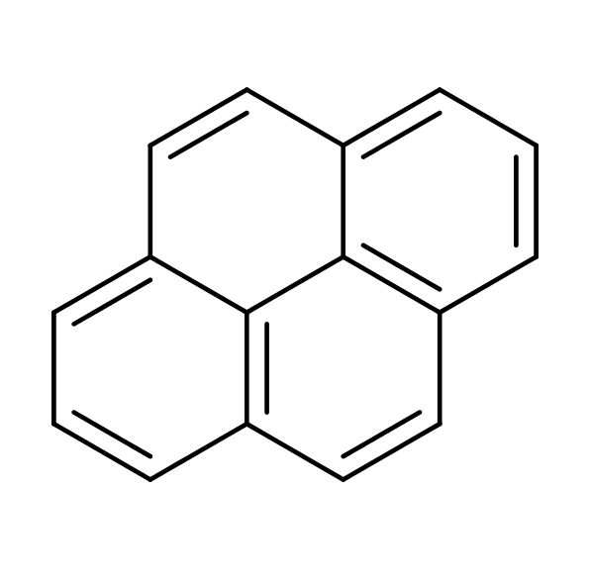
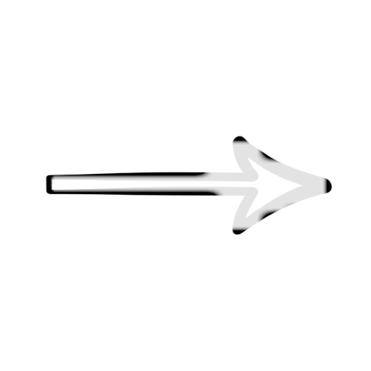
Oil Spills and Polycyclic Aromatic Hydrocarbons (PAHs)
Oils
PAHs
The most used energy in the world
Causes many problems like global warming and oil spill
Oil spills cause some damages and pollution
16 of them are considered as priority pollutants by USEPA
They form DNA adducts in living organisms which can induce mutations
Deadly for marine animals and human due to bioaccumulation

Slide 7
Bioturbators
Biological Treatment

Slide 8
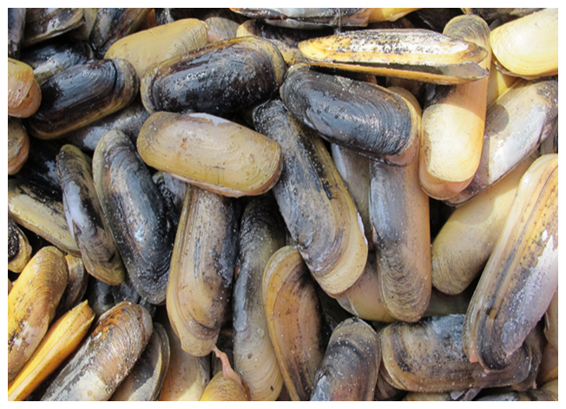
What are Bioturbators?
The ghost shrimp Lepidophthalmus louisianensis is one of the most-abundant bioturbators on the Gulf Coast, they move up to 3500 g sediment/m²/day and they make burrows up to 3 m deep.
The other bioturbator is the bivalve Tagelus plebeius (razor clam) which is present along the Gulf Coast. These clams also have the potential to affect contaminant distribution and biodegradation

Slide 9
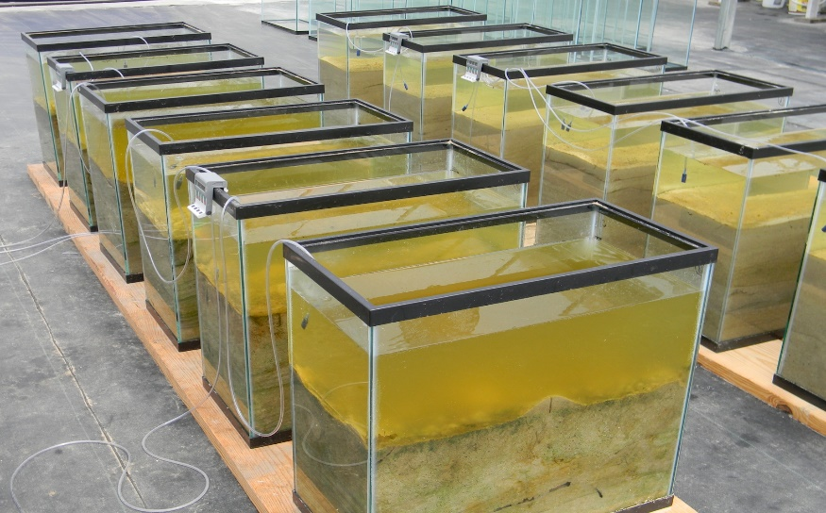
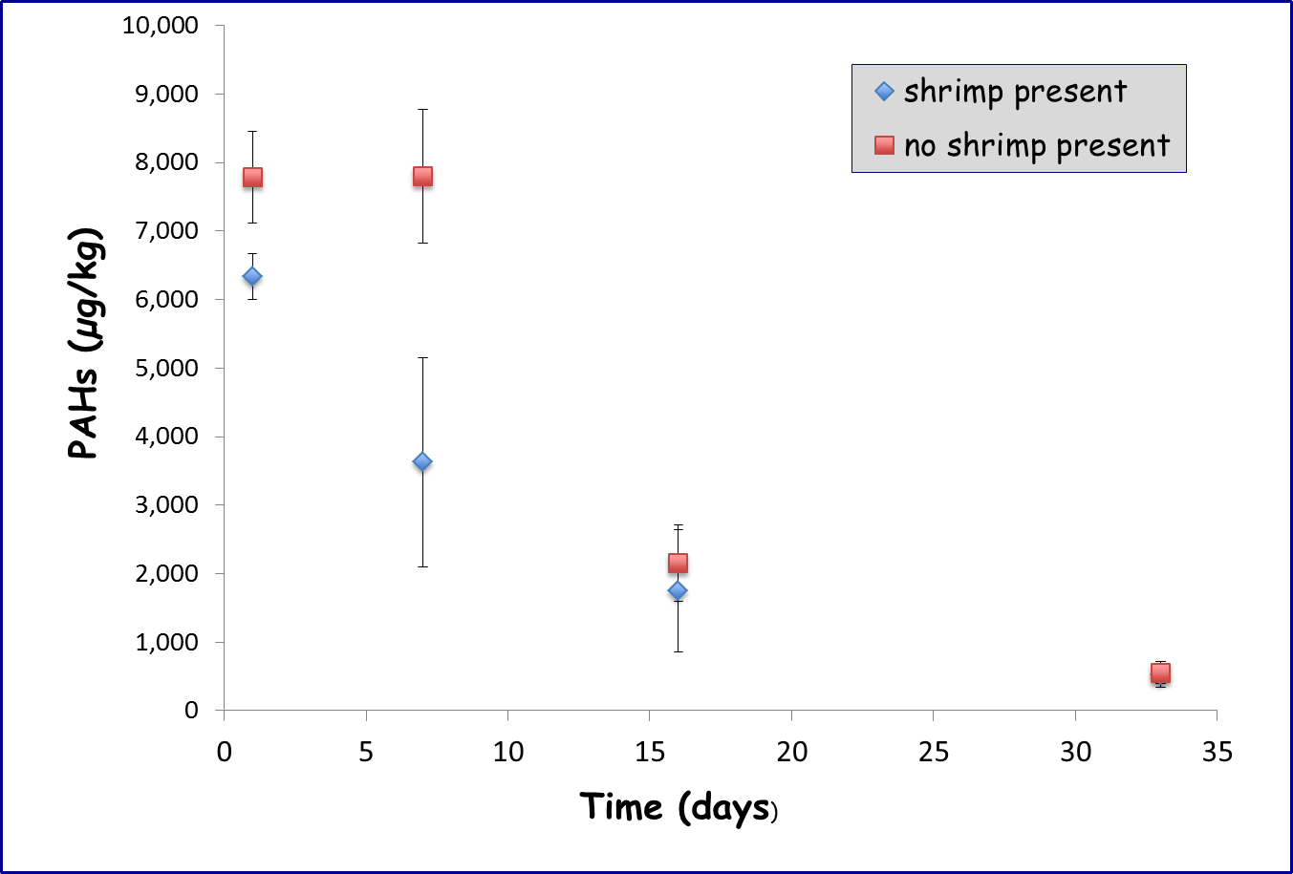
Determination of Pyrene in Presence of Bioturbators:
In this the study, research was conducted in laboratory greenhouse mesocosms containing field-collected clean water and sediment.
To determine the optimum duration and conditions for performing the experiment, An experiment was conducted over a time span of 33 days, in the presence and absence of ghost shrimp.

Slide 10
Samples Analysis:
Water Samples Analyses
Liquid-liquid extraction (LLE) using (CH₂Cl₂).
After evaporation, the residue was dissolved in hexane.
Excess hexane was evaporated under N₂ to 1.00 mL.
Sediment Samples Analyses
Dry Sediment + CH₂Cl₂

Slide 11
Microwave extraction using the US EPA 3546 method.
GC
Excess hexane evaporated under N₂ to 1.00 mL.
Filtration
Rinsing
Evaporation
An Aliquot injected
The residue was dissolved in hexane

Slide 12
Biological Treatment
Results & Discussion

Slide 13
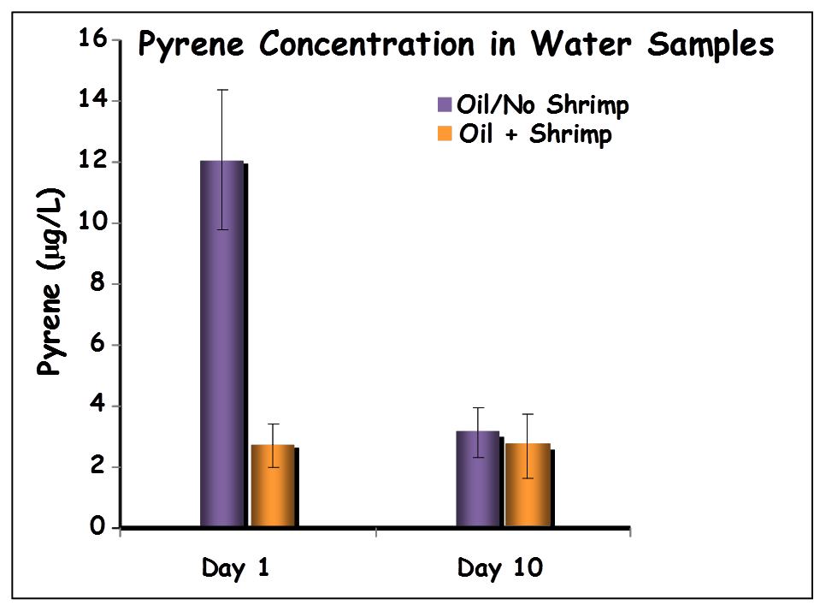
Determination of Pyrene in Presence of Bioturbators
Water Samples In Abscence of Shrimp
Decrease in pyrene concentration from 12.07 to 3.15 μg/L after 10 days
Evaporation of pyrene due to high temperature

Slide 14
Determination of Pyrene in Presence of Bioturbators
Water Samples In Presence of Shrimp
Shrimp
After 1 day concentration dropped to 2.72 μg/L
Ghost Shrimp that move up 3500 g sediment/m²/day
Evaporation of pyrene due to high temperature
The pyrene evaporating is replaced by pyrene transported by shrimp to sediment
After 10 days concentration determined was 2.68 μg/L

Slide 15
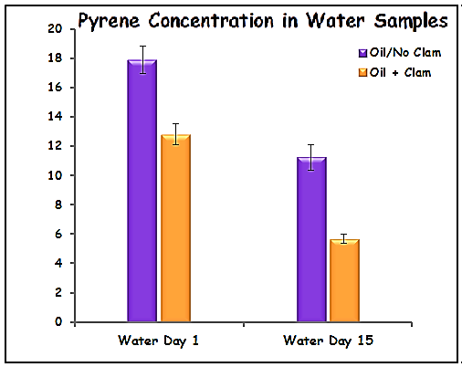
Water Samples In Abscence of Razor Clams
Decrease in pyrene concentration from 17.88 to 11.25 μg/L after 10 days
Pyrene (μg/L)
Evaporation of pyrene due to high temperature
Water Day 10

Slide 16

Water Samples In Presence of Razor Clams
Decrease in pyrene concentration from 12.8 to 5.7 μg/L after 10 days
Pyrene (μg/L)
Presence of clams
Evaporation of pyrene due to high temperature

Slide 17
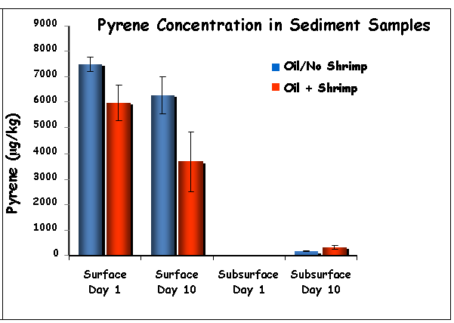
Sediment Samples In Abscence of Shrimp
For surface sediment, there difference in pyrene concentration is not significate different between day 1 and day 10
Evaporation due to high temperature
Very low transportation of Pyrene from surface sediment to subsurface sediment by the action of water movement
As for subsurface sediment the pyrene concentration parley increased between day 1 and day 10

Slide 18
Sediment Samples In presence of Shrimp
Significant difference between day 1 and day 10 for surface sediment
Ingestion by the ghost shrimps
Adsorption on the surface of the shrimp
Degradation of pyrene by the shrimp
Increasing of pyrene concentration in subsurface between day 1 and day 10
Pyrene transportation from surface sediment to subsurface sediment by the action of shrimp

Slide 19
Ecofriendly Treatment

Slide 20
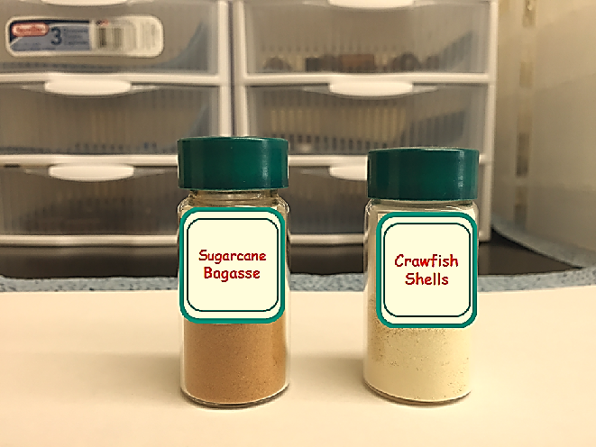
Effect of Exposure to Sugarcane Bagasse and Crawfish Shells:
The water samples were dosed with a known concentration of pyrene, and were treated with sugarcane “Saccharum officinarum” bagasse and crawfish “Cambarus robustus“ shells to examine their effects as adsorbents to remove oil pollutants from water samples.

Slide 21
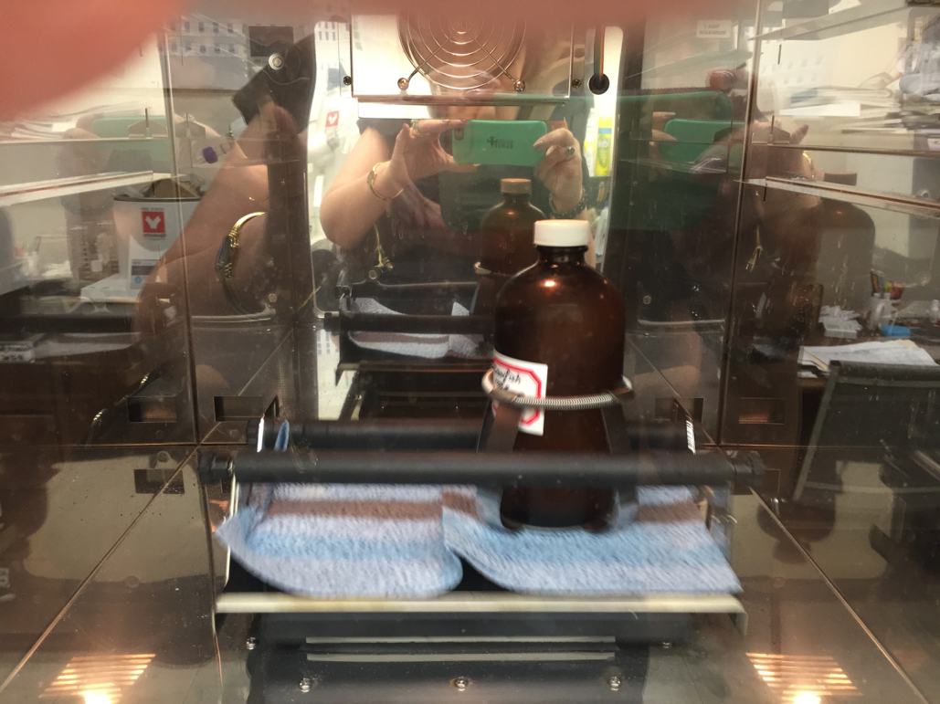
Effect of Time of Exposure on Pyrene Concentration:
Half a gram of sugarcane bagasse or one gram of crawfish shells were added to different containers with 400 mL of dosed pyrene solution.
Samples were shacked (250 R/M)
In case of sugarcane bagasse, the concentration of pyrene was determined after different intervals of time (0.5 hour, 1 hour, 2 hours, and 24 hours)
In case of crawfish shells, the concentration of pyrene was determined certain periods of time (12 hour, 1 day, 4 days, and 7 days)

Slide 22
Ecofriendly Treatment
Results & Discussion

Slide 23
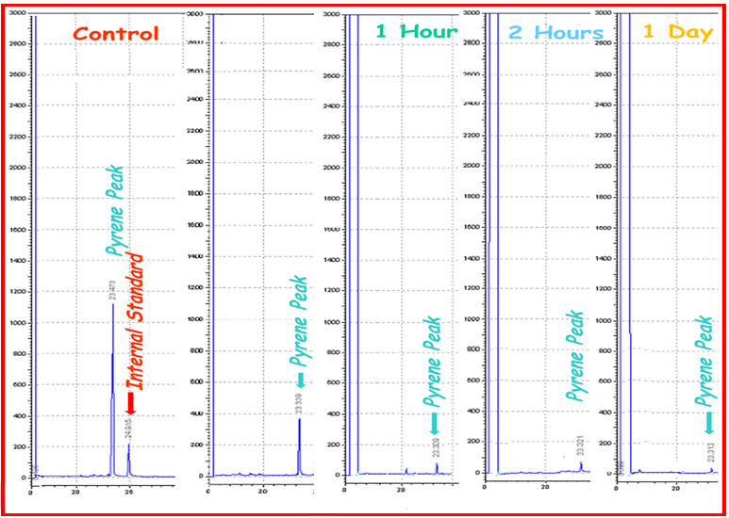
Time of Exposure to Sugarcane Bagasse
Minutes

Slide 24
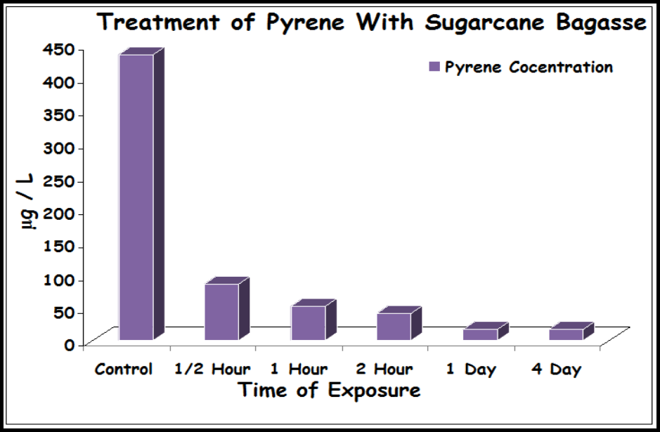
Effect of Time of Exposure to Sugarcane Bagasse
Pyrene concentration decreased a lot in presence of sugarcane bagasse, due to it’s adsorption on the surface of the bagasse particles
By day 1: the concentration of pyrene droped to 16.8 μg/L compared to 434.3 μg/L at the beginning of the experiment (26 times less)

Slide 25
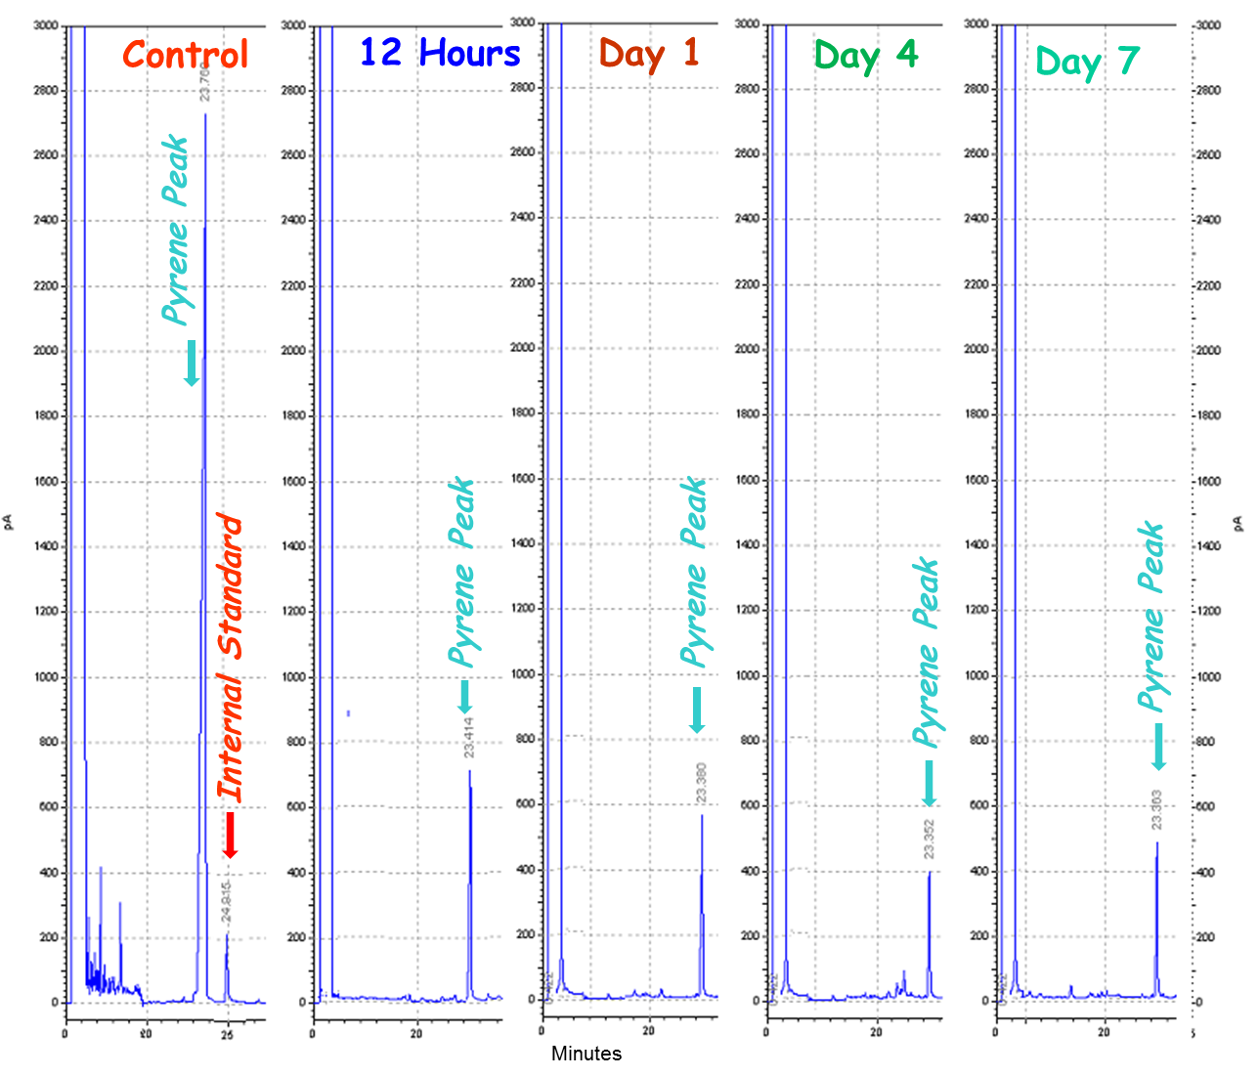
Time of Exposure to Crawfish Shells
Minutes

Slide 26
Effect of Time of Exposure to Crawfish Shells
Pyrene concentration decreased in presence of Crawfish Shells, due to it’s adsorption on the shells particles
On day 7, crawfish shells particles started to release part of the adsorbed pyrene

Slide 27
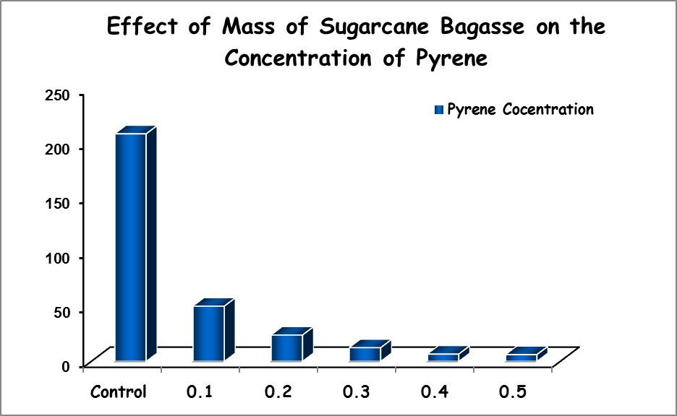
Effect of Mass of Adsorbant on Pyrene Concentration:
Different masses of sugarcane bagasse or crawfish shells were added to different containers with 400 mL of dosed pyrene solution.
Samples were incubated
with sugarcane bagasse
for 1 day and for 2 days
in case of crawfish shells
at room temperature.
μg pyrene/L
When 0.5 g of sugar-cane bagasse was used almost all pyrene was
Mass of sugarcane bagasse (g)
adsorbed by this amount.

Slide 28
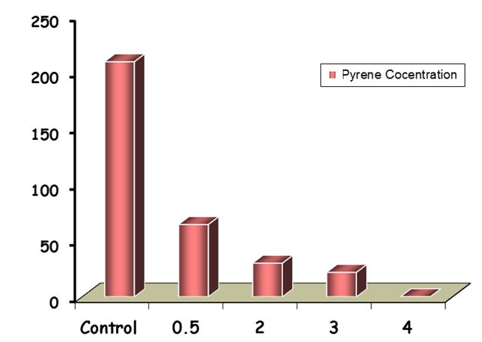
Effect of Different Masses of Crawfish Shells
Effect of Mass of Crawfish Shells on Pyrene Concentration
It took two days and 4 g of crawfish shells to almost remove (adsorb) all the pyrene from the water sample, leaving only traces
μg pyrene/L
Mass of crawfish shells (g)

Slide 29
Conclusions:
Biological and ecofriendly adsorbents are much safer than dispersants as a solution for oil spills.
Ecofriendly adsorbents are very promising method to remove PAHs.
Sugarcane bagasse is more efficient than crawfish shells, and both of them are very safe for the environment, animals and human.
Crawfish shells will start releasing the adsorbed pyrene after the 4th day of incubation.
The efficiency of the ecofriendly adsorbents should be tried with other PAHs.

Slide 30
Acknowledgements
The grant from BP/The Gulf of Mexico Research Initiative
Dr. Paul Klerks
The Department of Chemistry at ULL
The Department of Biology at ULL
All my students

Slide 31




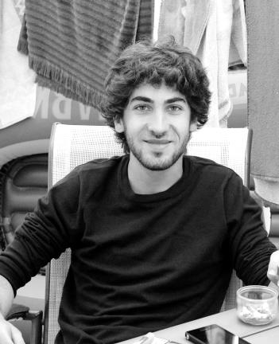




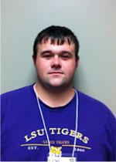

Paul
Marie
Jill
Ashley
Guénaëlle
Jeanne
Chase
Gerard
Mark
Raven
Jullian
Yasser

Slide 32



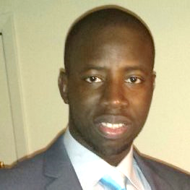



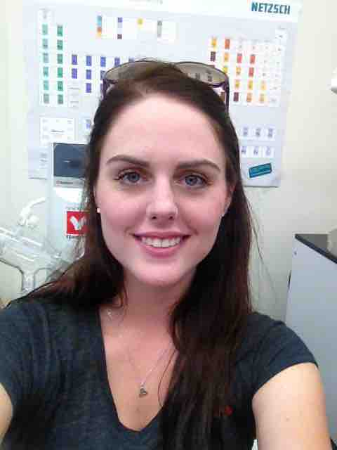
April
Mohamed
Fatima
Eric
Alpha
Dominique
Amalia
Jodie
Kru
Raven
Jorden
Ashley

Slide 33


Thank you for your Attention
Questions

