Slide 1
Emphasizing Reproductive Health Issues, HIV and AIDS Prevention to Youths from a Religious Perspective in Abia State
E. E. Enwereji and R. A. Eke
September 2013

Slide 2
Introduction
Religion shapes everyday beliefs and activities of individuals including that of youths.
Most times, some religious groups do not want their members to be associated with HIV prevention.

Slide 3
The Need
The need to use religious beliefs to enhance prevention of HIV and other sexually transmitted infections among youths in the Church can not be overemphasized.
In this study, the roles of religion in encouraging HIV prevention, discouraging HIV-related issues like stigma, discrimination and others were highlighted.
Awareness was created on how to integrate religious beliefs with HIV prevention to ensure compliance to HIV/AIDS interventions.

Slide 4
Objectives
To explain the importance of HIV/STI prevention among youth to church stakeholders.
Specific:
To encourage activities that will ensure care and support for HIV positive youths in Seventh-day Adventist church.
To empower youths through training on how to minimize risks of HIV/STIs.
To reduce the barriers that discourage Seventh-day Adventist youths from obtaining correct information on HIV/STIs prevention.
To increase knowledge of sexuality from Biblical points of view.

Slide 5
Methodology
This was an intervention study. Interactive seminars using both English and local languages for 538 youths were done.
Pictures of types of STIs were used to practically acquaint youth of the risks .
Bible passages were used to explain sexuality, care and support from the Christian perspective.
Questions and answers were used to elicit needed responses on knowledge of HIV and AIDS prevention

Slide 6
-
Semi-structured questionnaire, interview, story telling, checklist and systematic observation were used.
Training needs assessment was done
Pre-test and post-test were conducted
Analyses were done with SPSS using descriptive statistics

Slide 7
Major Activities
Produced IEC materials for training.
Carried out advocacy visits to church leaders.
Mobilized youths to attend HIV/STI prevention seminar.
Conducted needs assessment.
Conducted training workshop using questionnaire, storytelling, lectures, questions and answers.
Carried out systematic observation after the training to note the extent to which youths are likely to adopt the desired behavior change .

Slide 8
Ethical Consideration
Consent was got from church and youth leaders
University ethical committee approved the project

Slide 9
Problem Tree
Higher effect
Discrimination and stigmatization
Increased new Infections
Likely death of those infected
Direct effect
Non/late disclosure of status
Poor knowledge of HIV prevention programs
Focal problem
Wrong perception of HIV infection
Non-participation in HIV prevention programs
lack of relevant information on HIV infection
Immediate and direct causes
Negative attitude of church leaders on HIV positive youth
Denial that Christians can be infected
Lack of advocacy
Lack of care and support
low literacy among youths
lack of HIV enlightenment campaigns

Slide 10
Non discrimination and stigmatization
decreased new Infections
Unlikely death of those infected
Early disclosure of status
increase knowledge of HIV mode of prevention
Objective Tree
Correct perception of HIV infection
Increase participation in HIV prevention programs
accessible and relevant information on HIV infection
Positive Attitude Of Church Leaders On HIV Positive Youth
Acceptance that Christians can be infected
increase advocacy
high literacy among youths
increase HIV enlightenment campaigns
Activities to increase care and support

Slide 11
Logical framework LFM
 | Intervention logic | Objectively verifiable indicator | Means of verification | Assumption
Overall objective | 1.2.1.To increase the proportion of youths with correct knowledge of HIV mode of transmission by four months. | 1.2.1. ability to correctly mention at least two modes of HIV transmission 1.2.2.proportion of youths with no risk behavior | 1.3.1.Proportion of youths aware of correct modes of HIV transmission 1.3.2.Number of youths successfully trained 1.3.2.Pictures taken. 1.3.3.Attendance sheet | 1.4 If the youths are encouraged to attend the HIV prevention training
Project purpose | 2.1.reduce the risk of HIV transmission among youths | 2.2.1 proportion of youths with the correct HIV knowledge | 2.3.1 proportion of youths that completed the training | 2.4.1.Risk: church elders could threaten to excommunicate youths who wish to attend the training seminar

Slide 12
Result (output) | 3.1.1.70% of the youths trained correctly mention two modes of HIV transmission 3.1.2. 40% of youths after training begin to test for HIV | 3.2. 1. number of youths who are able to mention at least two mode of HIV transmission 3.2. 2 number of youths who successfully completed the training 3.2.3 number of youths attending HTC |  | 3.4.1.Assuming those trained adopt the preventive measures
Activities (process) | 4.1.1. produce IEC materials for training , 4.1.2. carry out advocacy visits to church leaders , and mobilization of youths to attend the training 4.1.3. conduct training workshop, using story telling, lectures, questions and answers, questionnaire, IEC materials 4.1.4.Conduct pre- and post-test 4.1.4.5 after the training, systematic observation using check-list will be carried out to note the extent to which youths are likely to adopt the desired behavior change | 4.2;1. number of advocacy visits successfully conducted, 4.2.2.Production of good quality IEC
If the stakeholders approve the training

Slide 13
Resource Planning
Means | Budget $= N160
Human resources( consultants and facilitators to prepare IEC materials,) | Consultant for IEC production N64,000 =$400, 2 Facilitators during the training N120,000 =$ 750 , Consultant for computer processing of data N70,000=$437.5
Material resources( training materials –paper, pen, bag, pencil, eraser) | Paper for 100 participants at N50 =$.31 x 100 =50000= $30
Venue for training | hired accommodation at N 20,000 per day for 5 days =$375
Feeding for participants | Snacks for 100 participants at N100 each for 3 days=$187.5, lunch at N300 for 3days for 100 participants $562.5.
Paper for report writing | three reams of paper at N500 each =$9.375 Total =$3929.375 orN 628,700.

Slide 14
Monitoring Plan
Parameters | Measures To Monitor
Information needed | proportion 0f youths with correct knowledge of modes of HIV transmission percentage of youths without risky behaviors Frequency of sensitization seminars organized for youths Types of IEC materials used for illustration during trainings Proportion of participants who consistently attended the training
Intended use | 1. create awareness on the correct modes of HIV infection 2. increase acceptance of people living positively with HIV among religious groups 3. increase awareness for HTC among Christian youths 4. Sensitization of stakeholders on the need for care and support for youths
Main users | target groups , church stakeholders , and beneficiaries (youths) in the church
Who collects the data | research team (facilitators)
Sources of data | Questionnaire, Semi-structured Interviews and Systematic Observation using check-list to note the extent to which the intervention has effect.
How the information will be collected from sources | combination of data collection methods were used, tape recording of formal and informal conversation with stakeholders and participants, documentation of reviewed records ,storytelling, lectures, question and answers.

Slide 15
Parameters | Measures To Monitor
When | June-August
Cost of data collection | Total =$39,294 or 62,870
How the researchers made sure that the monitoring data and lessons learned were fed into future planning . | The researchers organized three project monitoring meetings with the stakeholders of the Church. The meetings enabled the researchers to reflect on certain identified problems that affected the youth. Lessons learned were also discussed during the meeting. Thereafter, the reports were compiled. The project support team and stakeholders got the report. The project report was then reviewed during Church Board meeting.

Slide 16
Evaluation: Terms of Reference
An external evaluator was used for the desk review of relevant documents.
The evaluator conducted interviews with church stakeholders and effectively held meetings with them. He had solid expertise and impeccable experience in monitoring and evaluation on HIV and AIDS for more than 5 years.
He had proven knowledge of impact assessments, and at the same time was proficient in English both written and oral. He also had strong report writing skills.

Slide 17
Terms the Evaluator was paid
Three payments were made:
20% upon signing of contract
30% upon presentation of findings
50% upon submission of final report

Slide 18
Time frame for the Evaluator’s Work
S/N | Activity | Duration
1 | Communication and designing Evaluation process | 3 Days
2 | Data Collection | 10 Days
3 | Data Analysis, Presentation and Report Writing | 6 Days
Notes:
Total days evaluator worked 21 days and 9 days delay basis were allowed for fast decision-making.

Slide 19
Work plan
Objective | Activity | Indicator | Period |  |  |  |  | Responsible | Budget (N)
 |  |  | May | June | July | Aug | Sept
To increase the proportion of youths with correct knowledge of HIV mode of transmission | 1.Advocacy visits to Stakeholders in the church | Proportion of youths who are allowed to attend the seminar. | X |  |  |  |  | Project Manager | 60,000
 |  | Number of youths with correct information on HIV mode of transmission
 |  | Adequate materials available for the seminar
 | 2.Procurement of seminar materials (pen, paper, bags, etc) | Good quality training materials available | X |  |  |  |  | Project Manager | 70,000
 | 3.Produce IEC materials for training |  | X | X |  |  |  | Consultant
 | 4. Construction , production and pre-testing of questionnaire |  | X |  |  |  |  |  | 60,000

Slide 20
To increase the number of youths willing to undergo HIV testing | Conduct training workshop and counseling | Number of participant successfully trained and counseled |  | X |  |  |  | Project Manager | 100,000
 | Evalute the outcome of Training/Workshop | Number of youths undergoing regular testing |  | X | X | X
Report writing |  |  |  |  |  | X | X | Project Manager

Slide 21
RESULTS
The result of the pre-test showed that 21.45% of the respondents were aware of HIV mode of transmission and only 13.9% had knowledge of the risk factors of HIV. Result of post-test showed that 64.4% of the respondents had improved knowledge of HIV mode of transmission (taking into consideration confounding factors).

Slide 22
-
The respondents’ socio-demographic variables were varied.
The greater number of the respondents 372(69.1%) were between the ages 20-30 years.
They were essentially students 245(45.6%) in both secondary and tertiary education.

Slide 23
Table 2: Respondents Knowledge on Causes of HIV Before Training

Slide 24
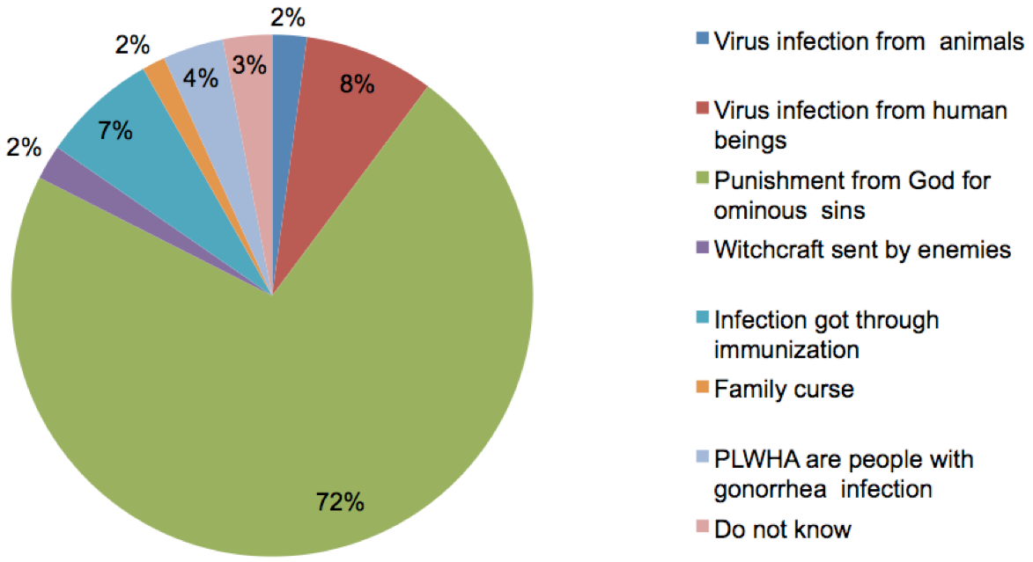

Slide 25
Table 3: Respondents Knowledge on Causes of HIV After Training

Slide 26
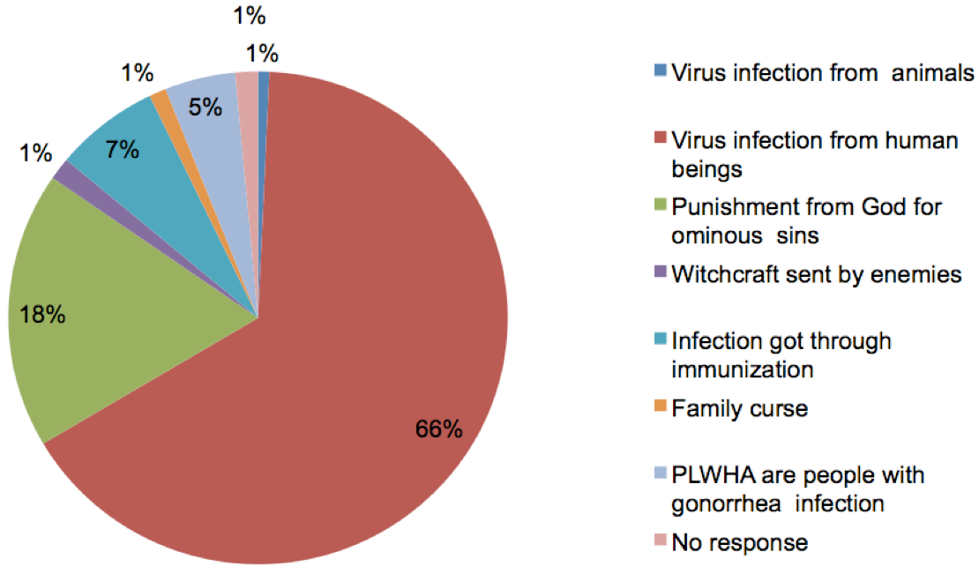

Slide 27
Table 4: Perception of Respondents about PLWHA Before Training

Slide 28
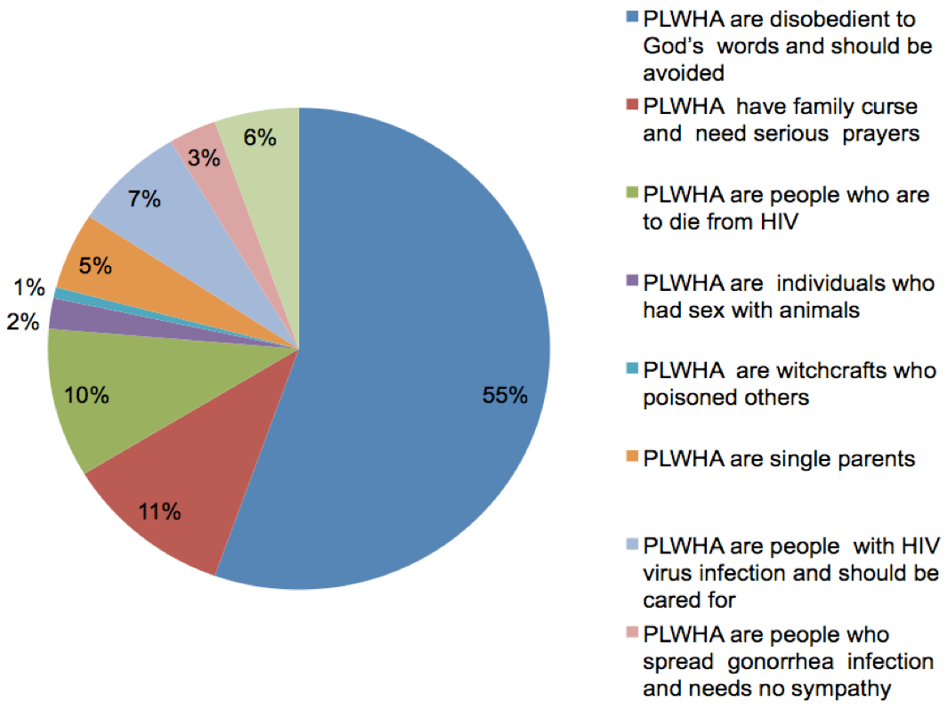

Slide 29
Table 5: Perception of Respondents about PLWHA After Training

Slide 31
Table 6: Respondents and Preparedness to Disclose their Sero-Status to Others Before Training

Slide 32
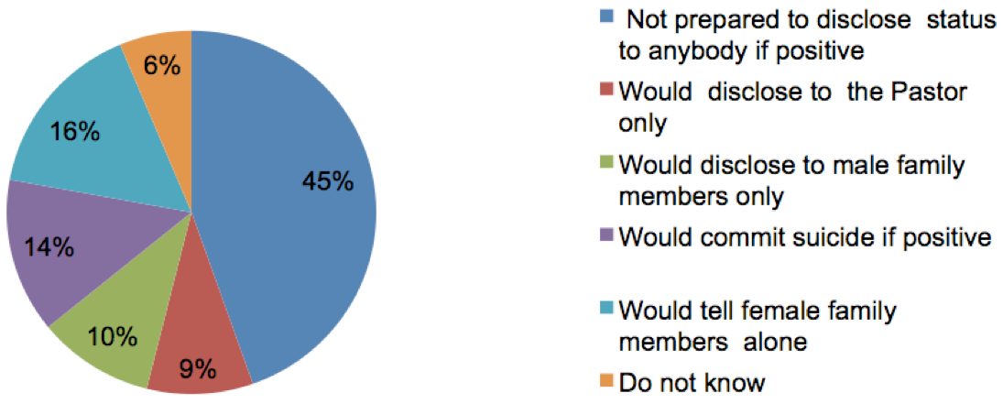

Slide 33
Table 7: Respondents and Preparedness to Disclose their Sero-Status to Others After Training
Preparedness to disclose HIV status | Response category N=538
Not prepared to disclose status to anybody if positive | 34(6.3%)
Would disclose to the Pastor only | 110(20.4%)
Would disclose to male family members only | 185(34.4%)
Would commit suicide if positive | 55(10.2%)
Would tell female family members alone | 140(26%)
No response | 14(2.6%)

Slide 34
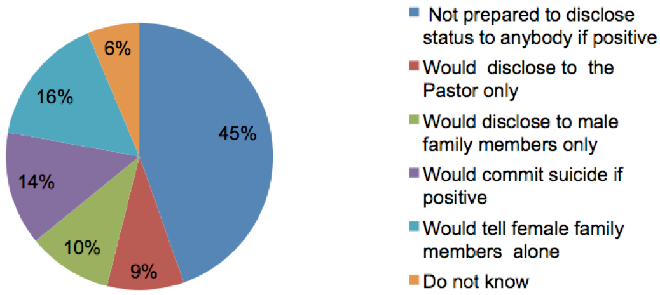

Slide 35
DISCUSSION/FINDINGS
There was poor knowledge of sexually transmitted infections including HIV and AIDS before training and after training a remarkable increase in knowledge was noted.
Popular opinion was that people living with HIV and AIDS (PLWHA) should be avoided. They are individuals God has punished because of their sins.
After training, a good number of the youths were willing to disclose their sero-status unlike what it was before training.

Slide 36
LESSONS LEARNT
achieving sustainability in HIV prevention requires a multipronged approach which involves working with church leaders and engaging them actively in prevention programmes.
Gracefulness in which PLWHA were seen made more church members to give care and support.
Involvement of church board members in HIV prevention encouraged some youths to undergo HIV testing as they tended to confine in the members.
Rigorous systematic observation of the project allowed for effective learning and provided a basis for course correction as well as a design for addressing critical issues that emerged during study.

Slide 37
CONSTRAINTS
Unwillingness of some youths to view pictures of STIs used during the study.
Denial that HIV infection is not for Christians helped to decreased knowledge of HIV mode of infection among the youth.
Some stakeholders viewed the seminar on HIV prevention as unnecessary for Christians and tended to disassociate themselves from it.

Slide 38
RECOMMENDATION
Based on the poor knowledge of HIV mode of infection among youths in this church, there is need to extend HIV seminar to youths in other churches.

Slide 39
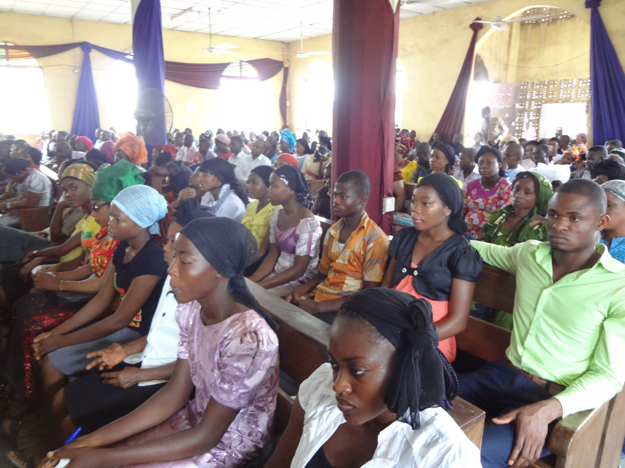

Slide 40
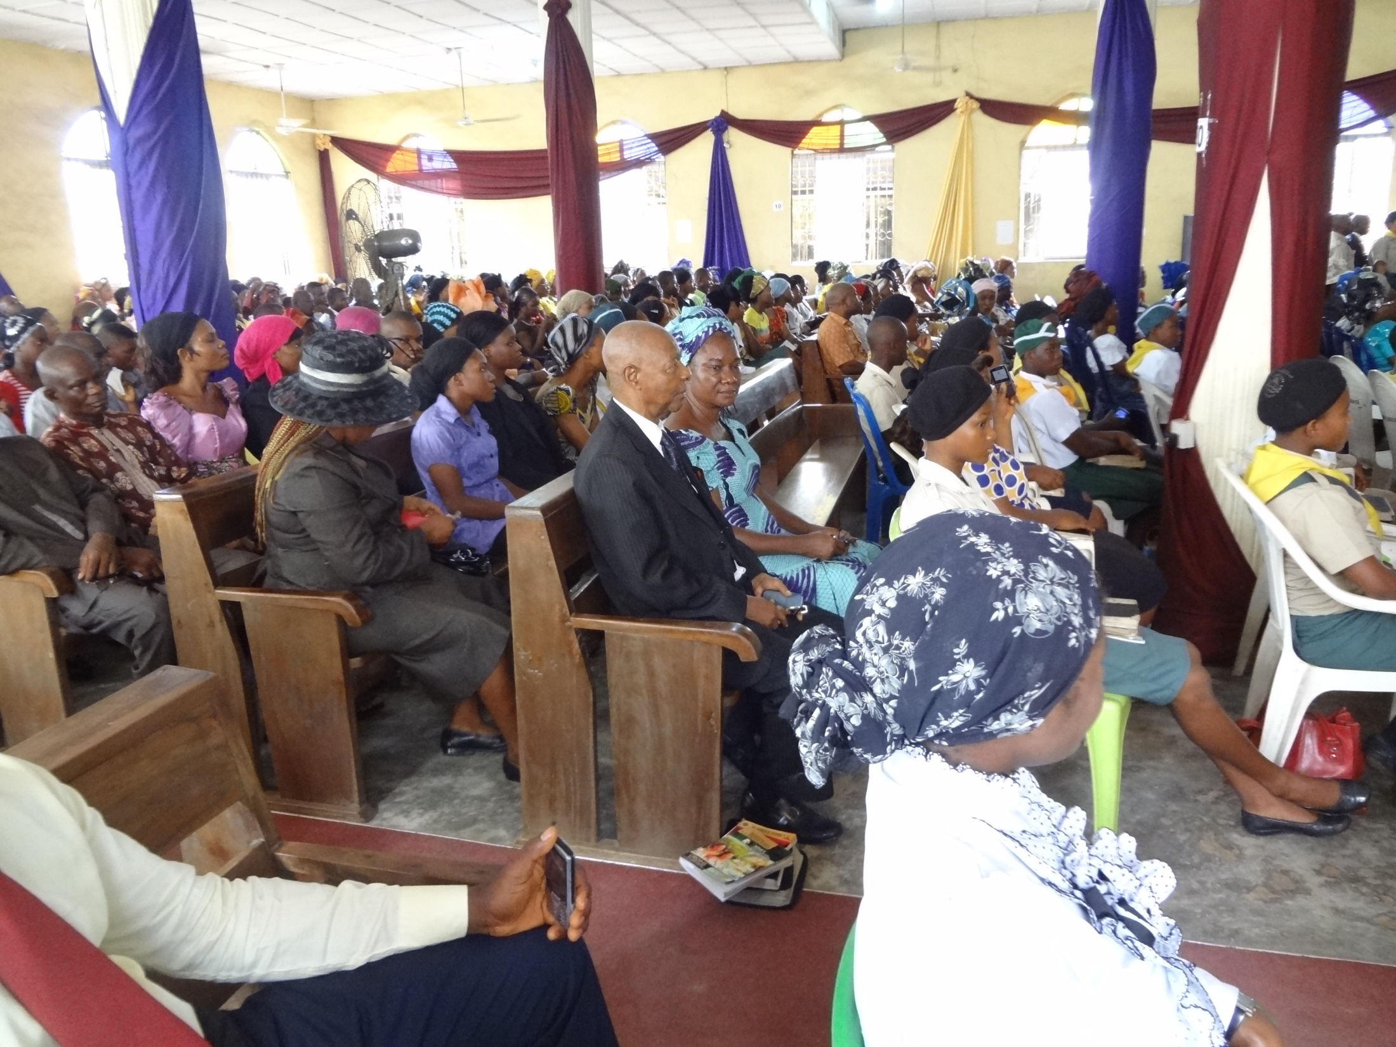

Slide 41
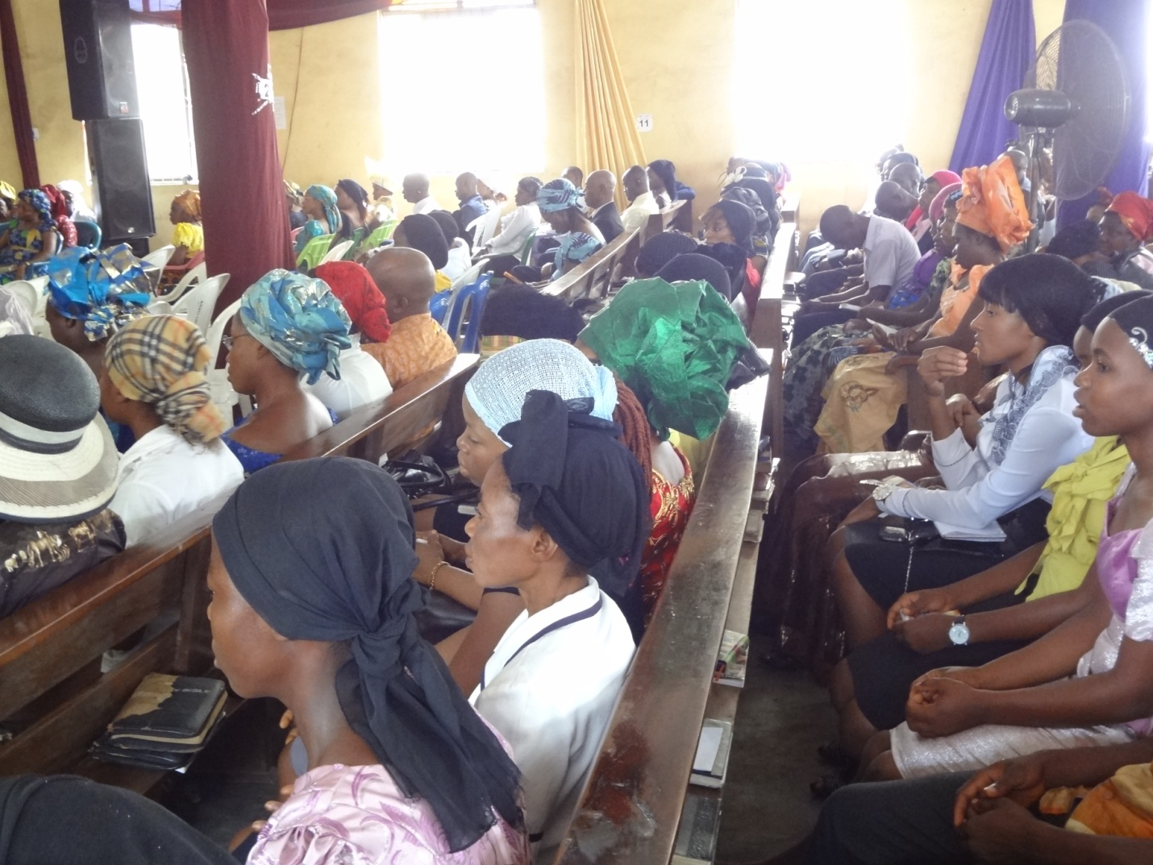

Slide 42
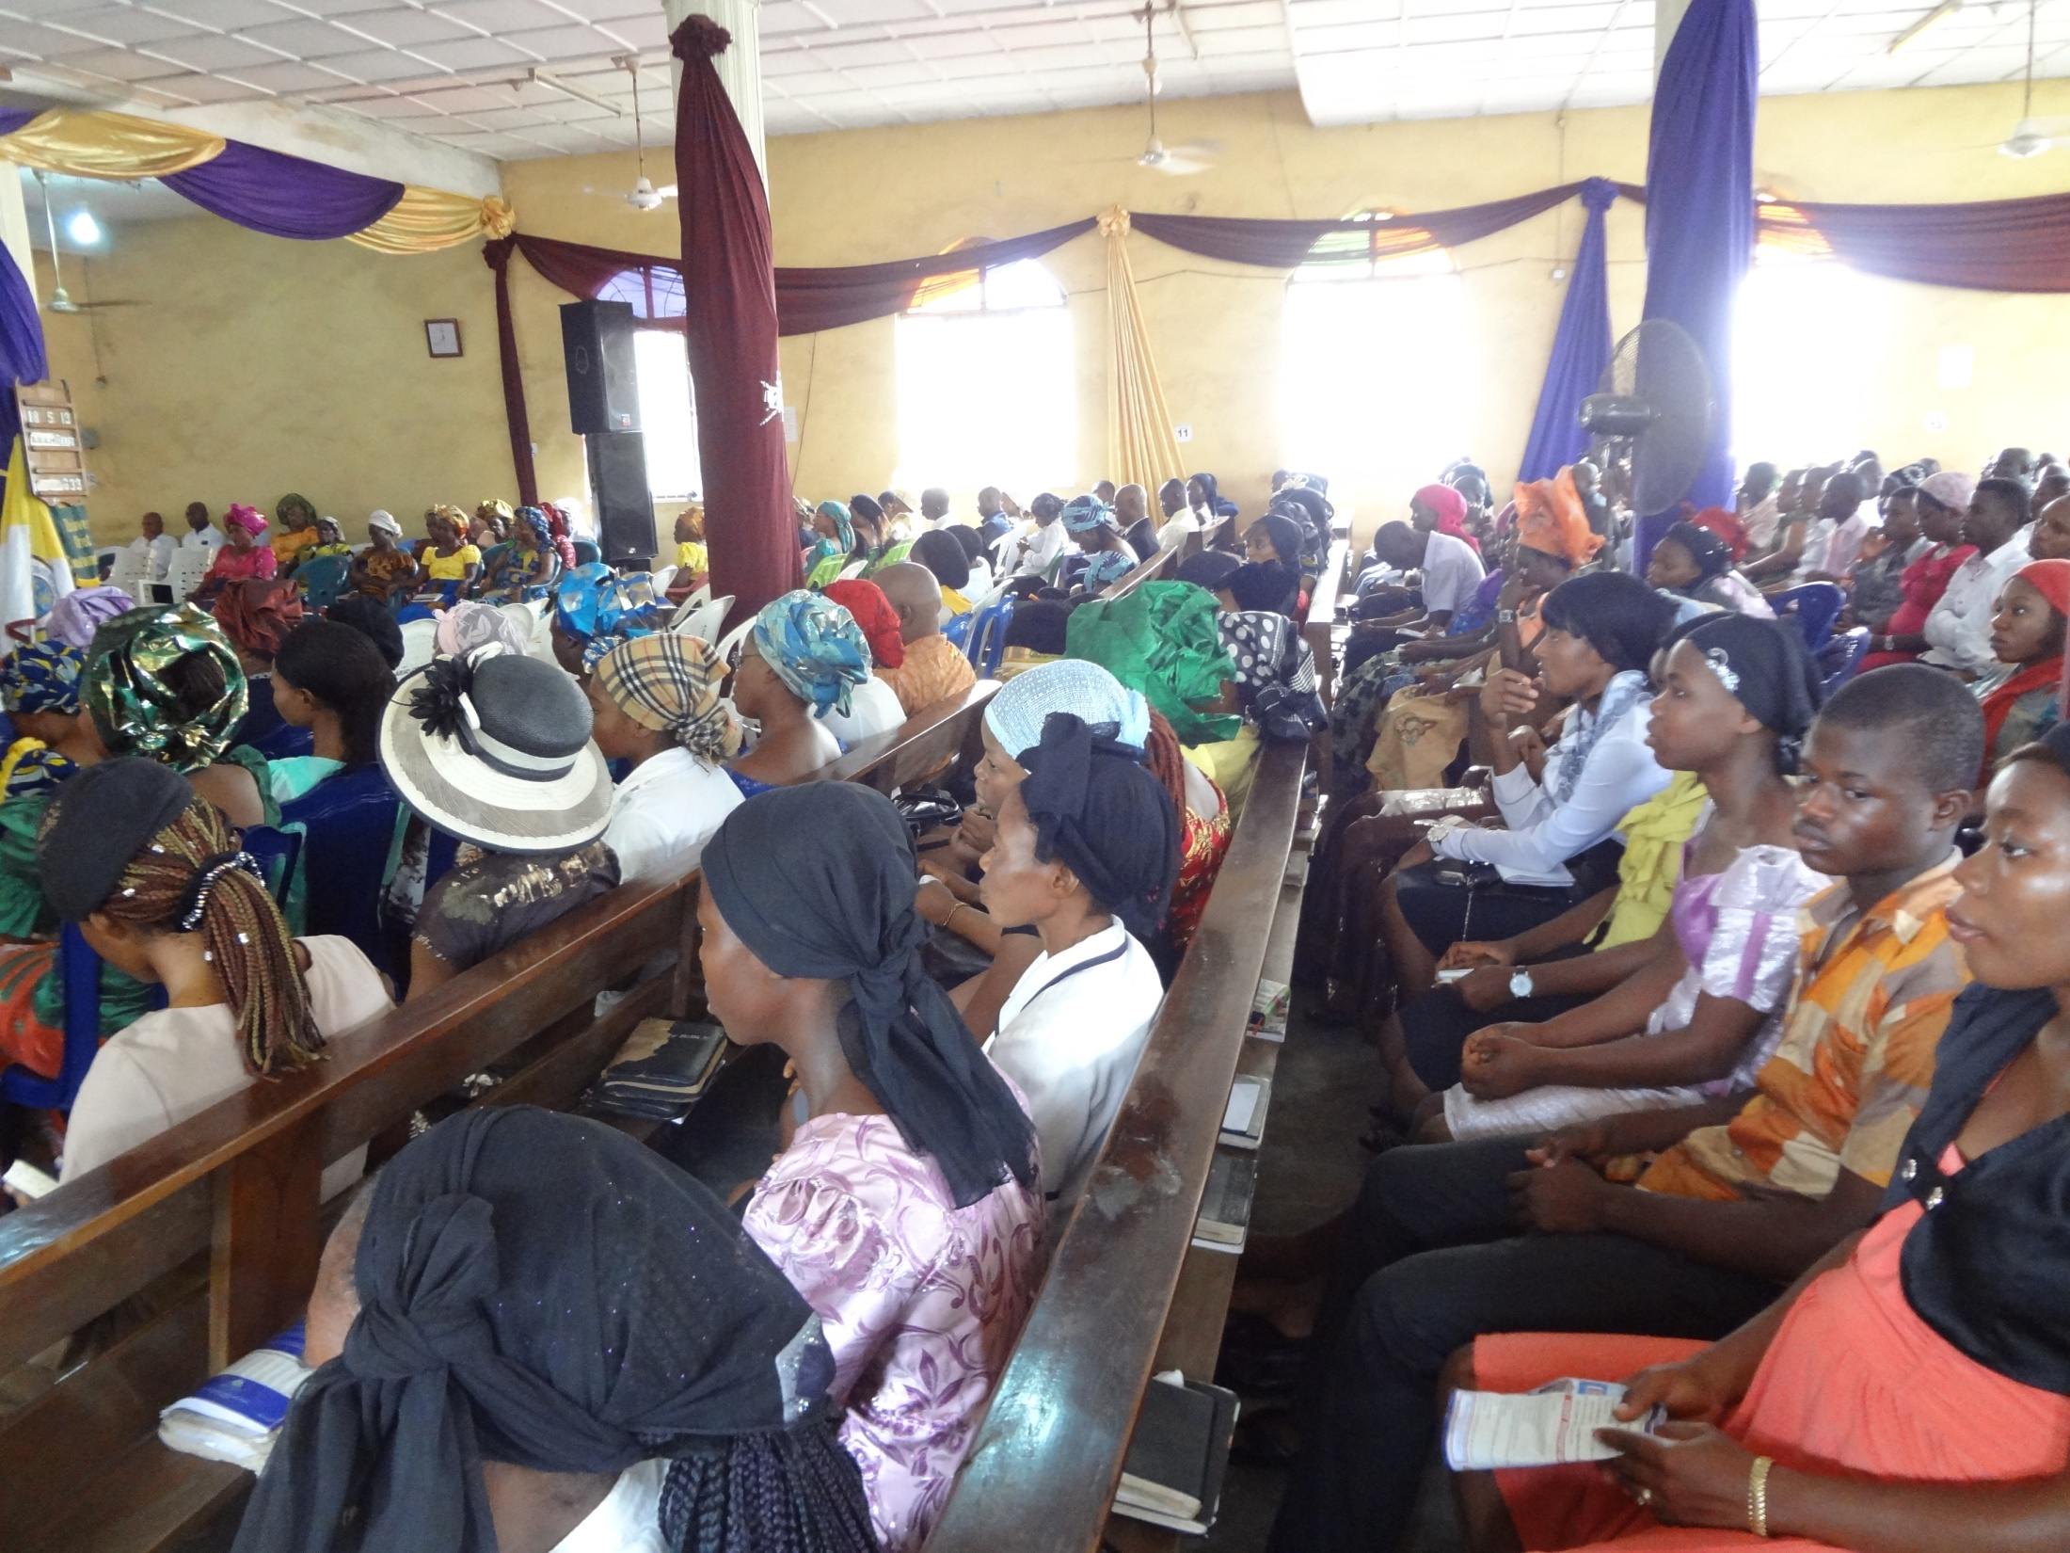

Slide 43
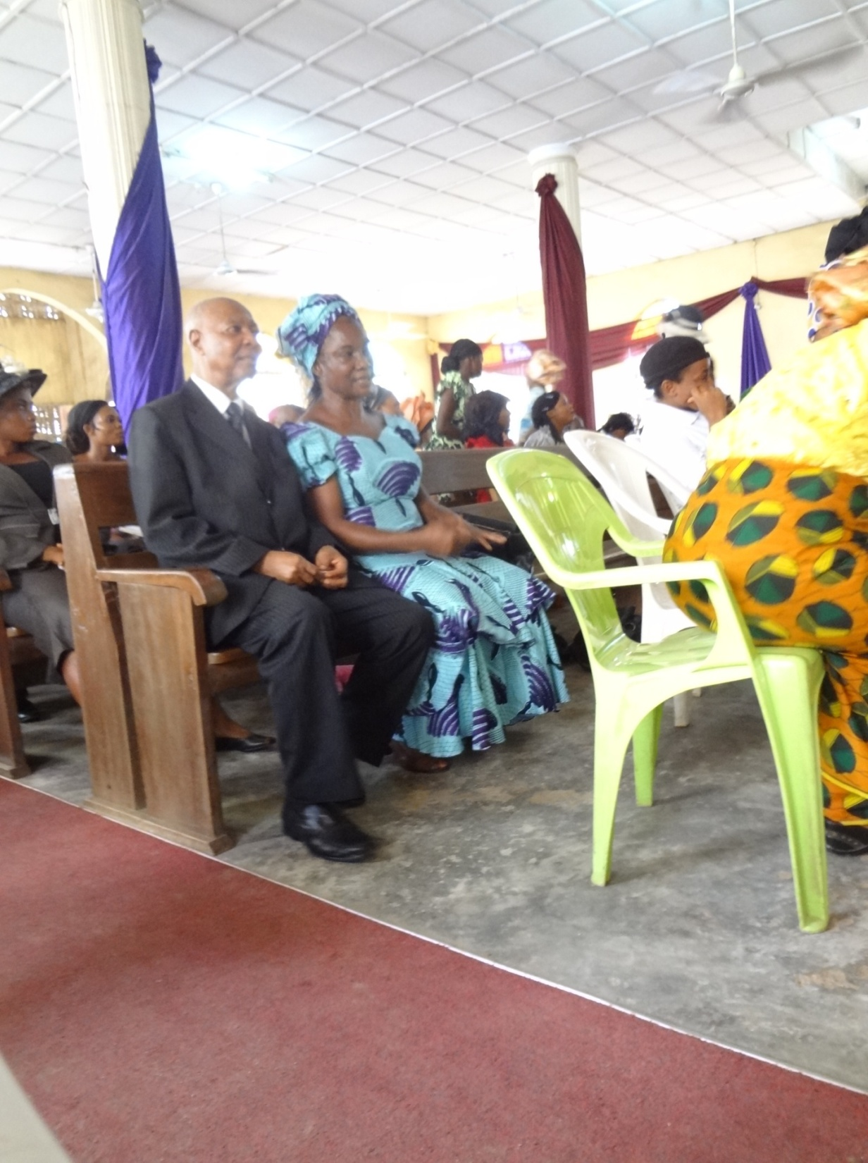

Slide 44
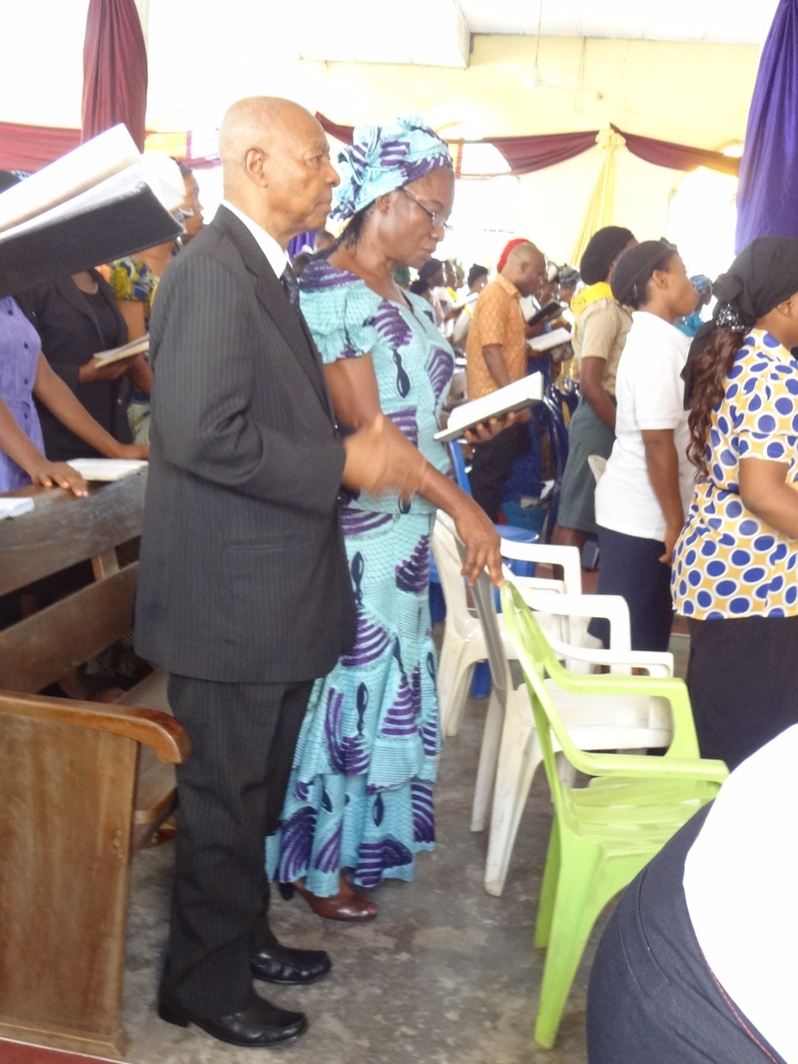

Slide 45
THANK YOU

