Slide 1


Alternative Ionic Liquid-based Lignocellulosic Biomass
Pre-treatment and Fractionation towards Progress in Biorefinery
Ewa Bogel-Łukasik
Universidade Nova de Lisboa,
Foundation for Science and Technology (FCT), LAQV/REQUIMTE, Associated Laboratory for Green Chemistry, Portugal
ADVANCED FLUIDS in TAILOR-MADE BIOFUEL and BIO-BASED PRODUCT PROCESSING
e-mail: ewa.lukasik@fct.unl.pt

Slide 2
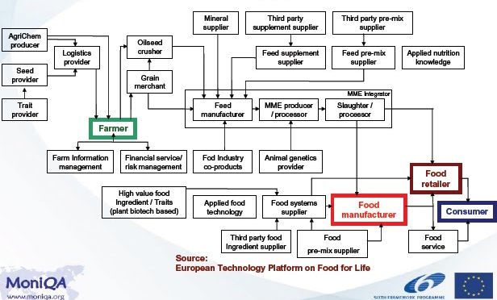
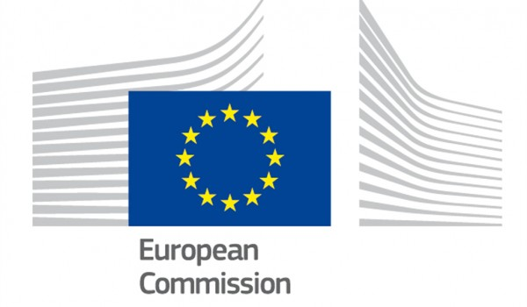
Where are we in an European Technology Platform supply chain (2015-2020 and beyond)?
2

Slide 3
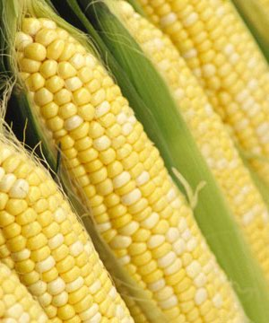
Why biomass is significant?
Supply energy for all kind of activities
Regulate essential activities of human systems
Fundamental chemicals in the plant kingdom

Slide 4
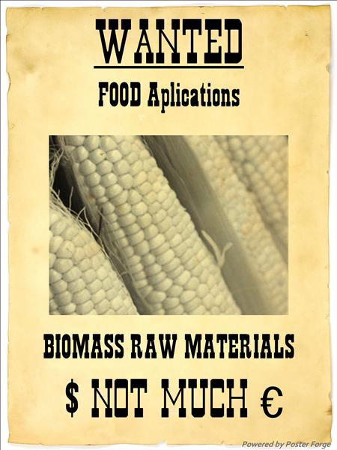
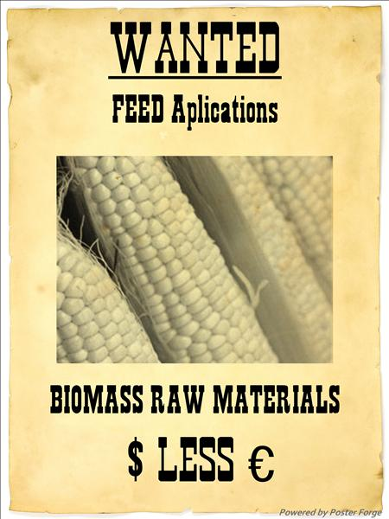
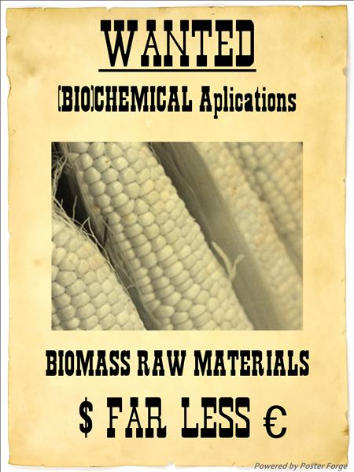
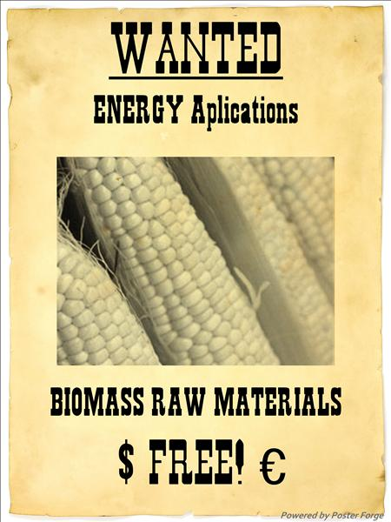


Need of biomass raw materials
Many sectors want biomass raw materials
Best guaranted price
Best guaranted price
FREE!
Transport/ biofuels compete with food and feed production regarding AGRICULTURAL CROPS

Slide 5

Biorefinery
Future
Today
www.processum.se

Slide 6
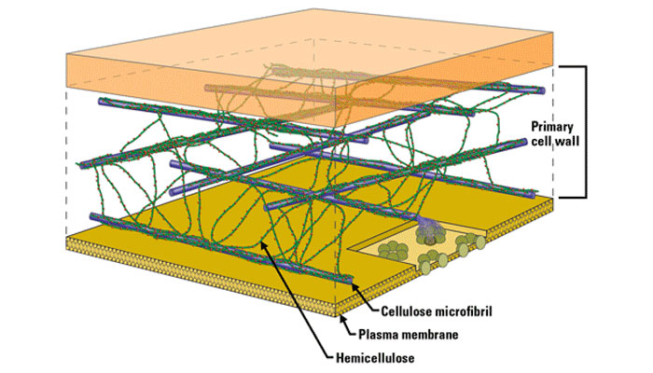
Lignocellulosic biomass
A complex biopolymer
Cellulose
is like an iron frame to keep the structure of plants
Hemicellulose
is like a string to bind the cellulose fibers
Lignin
is like cement to harden the structure
United States Department of Energy Genome Programs/genomics.energy.gov
Cellulose: 30-50% - crystalline homopolymer of glucose (cellobiose); difficult to chemically hydrolyse, susceptible to enzymatic attack by cellulases
Hemicellulose: 15-30% - heteropolymer made up of a variety of sugar units including glucose, xylose, galactose, arabinose and mannose; much easier depolymerised
Lignin: 10-25% - complex aromatic structure of cross-linked polymers of phenolic monomers; resistant to biochemical conversion; different depolymerisation chemistry

Slide 7
Formation of micro- and macrofibrils (fibres) of cellulose and their position in the wall
P.F.H. Harmsen, W.J.J. Huijen, L.M. Bermudez Lopez, R.R.C. Bakker, Literature review of Physical and Chemical Processes
for Lignocellulosic Biomass, ECN-E-10-013, 2010

Slide 8
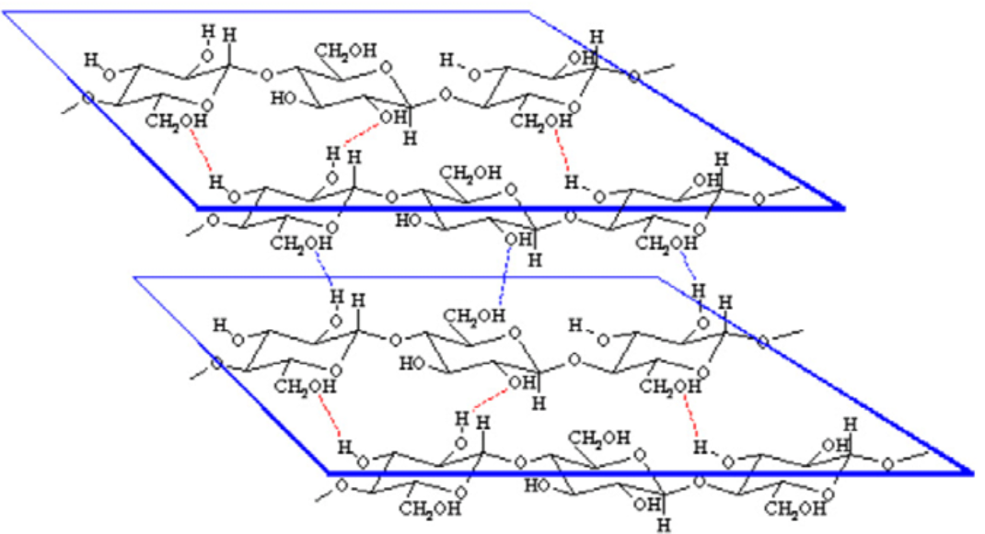
Demonstration of the hydrogen bonding that allows the parallel arrangement of the cellulose polymer chains
P.F.H. Harmsen, W.J.J. Huijen, L.M. Bermudez Lopez, R.R.C. Bakker, Literature review of Physical and Chemical Processes
for Lignocellulosic Biomass, ECN-E-10-013, 2010

Slide 9
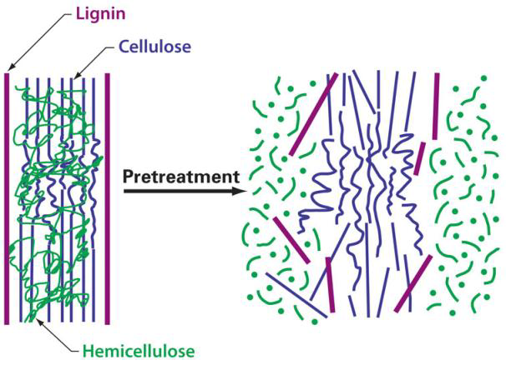
Pre-treatment of lignocellulosic biomass
Essential to disrupt the complex structure of lignocellulosic biomass
↑ Extraction of lignin
↓ Crystallinity of cellulose
Pre-treatments
↑ Surface area for enzyme binding and microbial attack
Types of pre-treatments:
Physical treatment (milling, gridding);
Chemical pre-treatments (alkali and acid hydrolysis);
Physico-chemical pre-treatments (steam explosion);
Biological pre-treatments.
Carvalheiro, F. et al., Appl. Biochem. Biotechnol., 2009, 153, 84-93; Yoon, L.W. et al., J. Chem. Technol. Biotechnol., 2011, 86, 1342-1348 http://genomicsgtl.energy.gov/biofuels/.

Slide 10
Biorefinery and Green Chemistry complex role
Green Chemi-stry
Prevention
Atom Economy
Inherently Safer Chemistry for Accident Prevention
Less Hazardous Chemical Syntheses
Designing Safer Chemicals
Safer Solvents and Auxiliaries
Design for Energy Efficiency
Use of Renewable Feedstocks
Reduce Derivatives
Catalysis
Real-Time Analysis for Pollution Prevention
Design for Degradation
Increased Value
Chemicals
Materials
Fuel Energy
Energy
Biorefinery
Chemicals
Biomass
P.T. Anastas and J.C. Warner, Green Chemistry: Theory and Practice, Oxford University Press, New York, 1998.
SIADEB www.siadeb.org 2014

Slide 11
Common methods of biomass pretreatment
Autohydrolysis
Dilute acid hydrolysis
Acetosolv/Organosolv
Alkaline
Ionic liquids

Slide 12
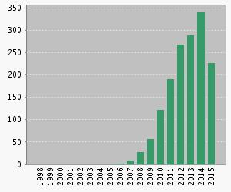
ISI Web of Science report by THOMSON REUTERS
 | TOPIC:
 | 28/08/2015
"ionic liquid*" |  |  | 101145
"ionic liquid*" and "biomass" |  |  | 1544
Published Items in Each Year

Slide 13
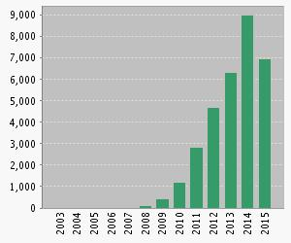
ISI Web of Science report by THOMSON REUTERS
The latest 20 years are displayed.
Results found: | 1544
Sum of the Times Cited: | 31564
Sum of Times Cited without self-citations: | 20891
Citing Articles: | 13344
Citing Articles without self-citations: | 12050
Average Citations per Item: | 20.44
h-index: | 80
Citations in Each Year

Slide 14
Pre-treatment of lignocellulosic biomass
Possible solution
ionic liquids
Why?

Slide 15
Ionic liquids &biomass
Solubility
Efficient pre-treatment
Conversion of biomass carbohydrates into Value Added Products
Solubility & pre-treatment of biomass with ILs
Ability of an anion and a cation to interact with carbohydrates
Water content
Mutual interactions in raw biomass

Slide 16
Ionic liquids
10¹⁸
Anions
Cations

Slide 17
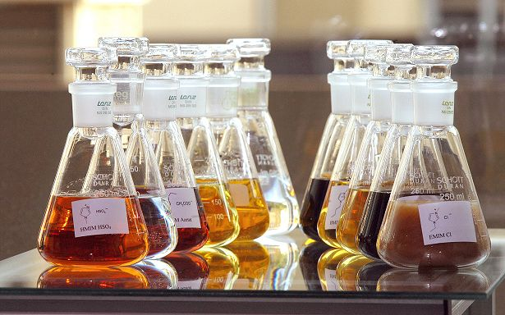
Ionic liquid properties
High polarity
Negligible volatility
Thermal stability
High conductivity
Large electrochemical window
Solvent power
Tunable solvation
Properties of ILs can be tailored:
Density and Viscosity
Solubility
Lipophilicity and polarity
The toxicity and biodegradability of ionic liquids are an important issue

Slide 18

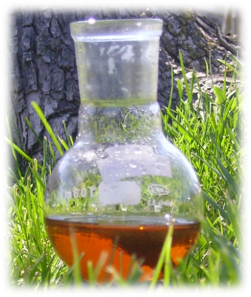
Role of Pre-treatment of raw feedstock with ILs
Alter the physicochemical properties of the biomass macromolecular components
Extract a specific macromolecular fraction
Perform different fractionation approaches after dissolution
Benefits:
↓ Cellulose crystallinity
↑ Extraction of lignin
Lower degradation of monosaccharides
Sustainable aspect due to the IL reuse and recycle possibility

Slide 19
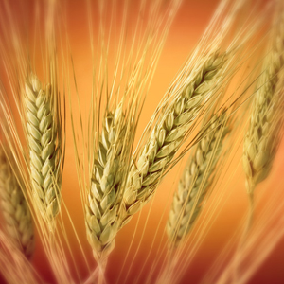
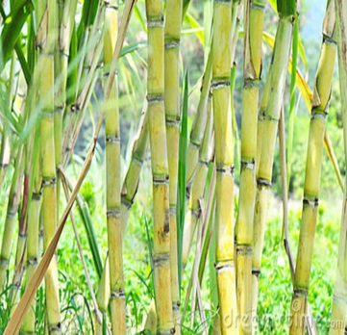

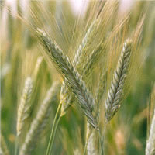
Pre-treatment of biomass with ILs
Biomass
Ionic liquids
[emim]+
[bmim]+
Wheat straw
Sugarcane bagasse
[SCN]-
[CH₃COO]-
[N(CN)₂]-
Rice straw
Triticale straw
[HSO₄]-

Slide 20
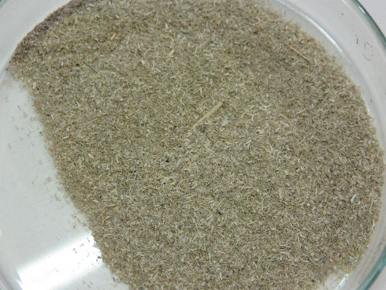
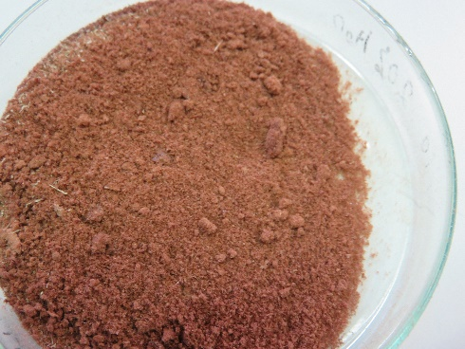
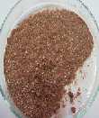
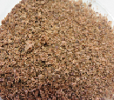
Pre-treatment of biomass with ILs
Raw Biomass
Milled biomass
Wheat straw
Sugarcane bagasse
Wheat straw
Sugarcane bagasse
Rice straw
Triticale straw
Rice straw
Triticale straw

Slide 21
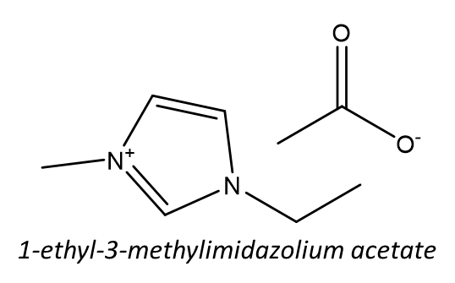
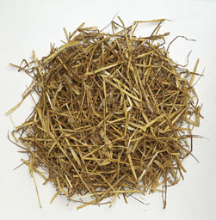

Methodology
A method
+
B method
Wheat straw
[emim][CH₃COO]
Ionic liquid recovery
93 % (initial)
Ionic liquid recovery
73 % (initial)
110 ºC, 4 h, 2 % (w/w)
120 ºC, 6 h, 5 % (w/w)
NaOH (0.1 M)
Fractionation & recovery
Acetone/Water (9:1,( v/v))
Cellulose
Carbohydrates
Liquid Fraction
NaOH (3 %)
HCl
Filtrate
Lignin
EtOH
HCl
Hemicellulose
Residual lignin
A. M. da Costa Lopes, K. João, D. Rubik, E. Bogel-Lukasik, L. C. Duarte, J. Andreaus and R. Bogel-Lukasik, Bioresource Technol., 2013, 142, 198-208
21

Slide 22
Methodology
C method
+
Wheat straw
[emim][CH₃COO]
120 ºC, 6 h, 5 % (w/w)
Ionic liquid recovery
86 % (initial)
NaOH (0.1 M)
Fractionation & recovery
Cellulose
Carbohydrates
Liquid Fraction
NaOH (3 %)
EtOH
HCl
Filtrate
Lignin
Residual hemicellulose
EtOH
HCl
Hemicellulose
Residual lignin
A. M. da Costa Lopes, K. João, D. Rubik, E. Bogel-Lukasik, L. C. Duarte, J. Andreaus and R. Bogel-Lukasik, Bioresource Technol., 2013, 142, 198-208

Slide 23
FTIR spectra of carbohydrate samples
Wheat straw
Hemicellulose-rich
Cellulose-rich
xylan C-O-C contribution
1042
Cellulose MN 300 (standard)
Ester linkage vibration
Lignin aromatic vibration
arabinosyl side chain vibration
C-O-C skeletal vibration
989
1508
1060
1734
1034
C-O stretching vibration
C-OH skeletal vibration
A
1112
C-O
asymmetric bending
1161
β-glycosidic
C-H deformation
898
1800
1600
1400
1200
1000
800
Wavenumbers (cm⁻¹)

Slide 24
FTIR spectra of lignin samples
1127
C-H plane deformation in syringyl units
Aromatic skeletal vibrations
C-O vibrations
1596
1508
1225
1458
1263
1420
Aromatic C-H
plane deformation
1032
A
C-H out-of-plane deformation
840
1800
1600
1400
1200
1000
800
Wavenumbers (cm⁻¹)

Slide 25
Advantages of the C method
Method | A | B | C
% Purity cellulose | ↓ | ↓ | ↑
% Purity hemicellulose | ↓ | ↓ | ↑
% Loss carbohydrates | ↑ | ↑ | ↓
% Loss lignin | ↓ | ↓ | ↑
C method was chosen

Slide 26
Results with various ILs
ILs
Cellulose
Hemicellulose
Lignin
Wheat straw
[emim][CH₃COO]
[bmim][SCN]
Carbohydrates
Lignin
[bmim][N(CN)₂]
Others
Not quantified
NQ
A. M. da Costa Lopes, K. João, E. Bogel-Lukasik, L. B. Roseiro, R. Bogel-Lukasik, J. Agric. Food Chem., 2013, 61, 7874.
[bmim][HSO₄]

Slide 27
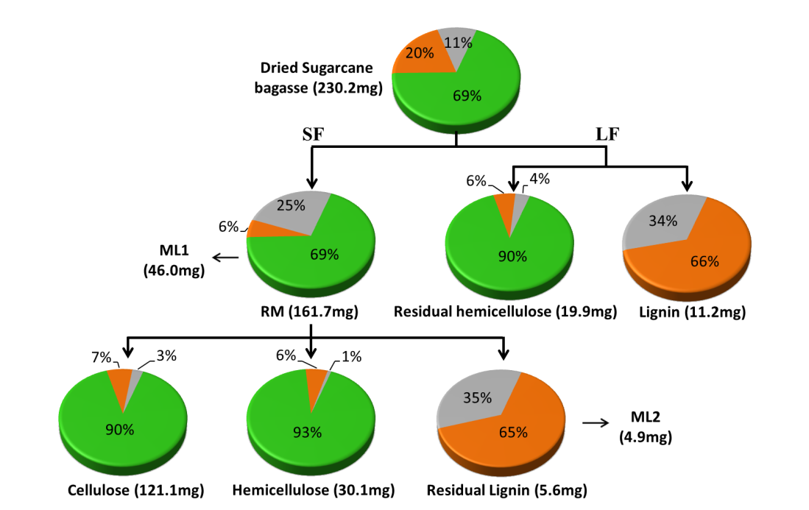
Quantitative FTIR results for fractionation of sugarcane bagasse with [emim][CH3COO]
Carbohydrates
Lignin
Others
SF, LF: solid or liquid fraction
ML: material lost
RM: regernerated fraction
K. João, A. M. da Costa Lopes, E. Bogel- Łukasik L. C. Duarte and R. Bogel-Lukasik, 2015, in preparation.

Slide 28
Results with other types of biomass
Biomass
Cellulose
Hemicellulose
Lignin
Wheat straw
Carbohydrates
Lignin
Others
Sugarcane bagasse
Not quantified
NQ
Rice straw
K. João, A. M. da Costa Lopes, E. Bogel- Łukasik L. C. Duarte and R. Bogel-Lukasik, 2015, in preparation.
Triticale straw

Slide 29
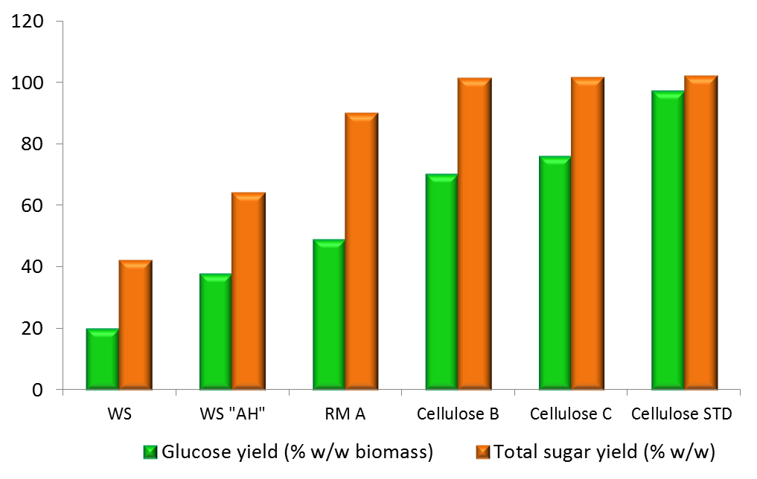
Enzymatic Hydrolysis: A,B, C methods
Enzymes:
Conditions:
Celluclast® 1.5L
50ºC, 72h, 150rpm
Novozym 188
%
WS – wheat straw; AH – acid hydrolysed; RM – regenerated material; STD - standard
A. M. da Costa Lopes, K. João, D. Rubik, E. Bogel-Lukasik, L. C. Duarte, J. Andreaus and R. Bogel-Lukasik, Bioresource Technol., 2013, 142, 198-208

Slide 30
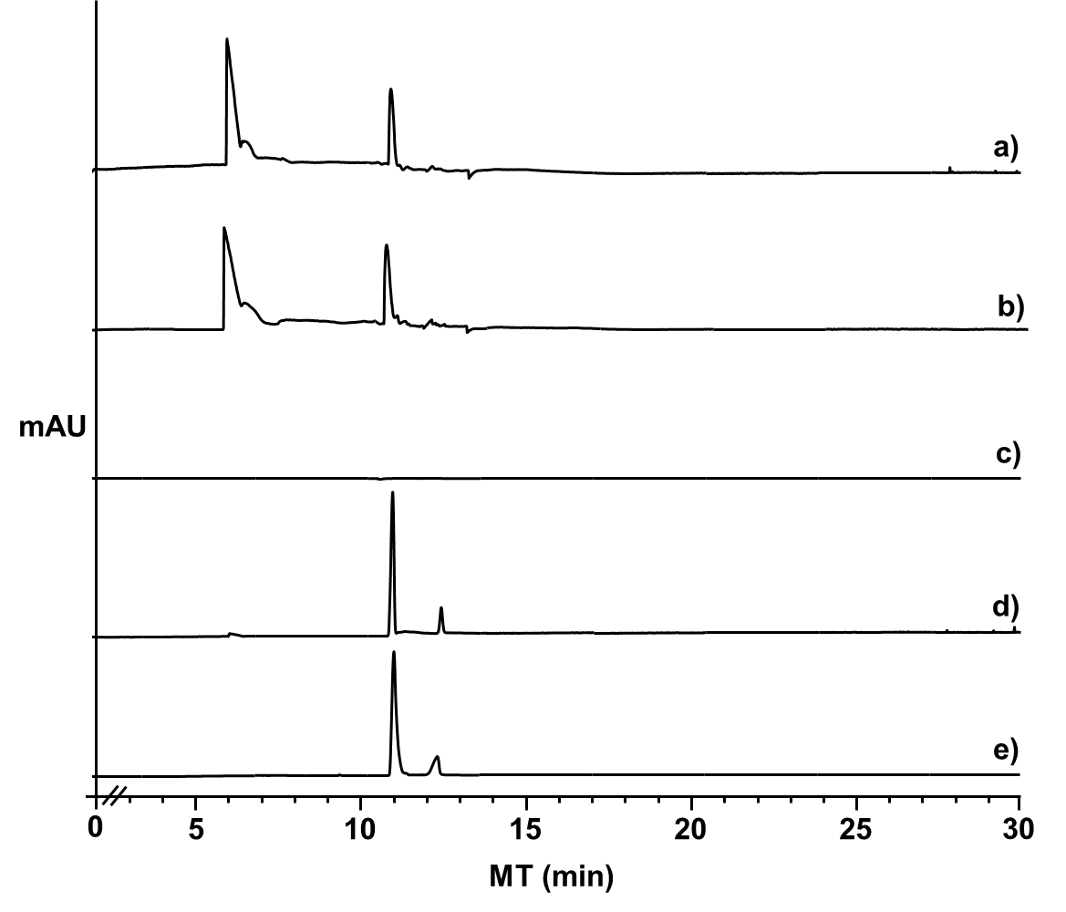
Hemicellulose Hydrolysis of the biomass pre-treated with [bmim][HSO4]
Electropherograms showing the profile for a) diluted pure [bmim][HSO₄] (1/5) at 210 nm, b) sample of the filtrate 1 from process with [bmim][HSO₄] at 210 nm; c) diluted pure [bmim][HSO₄] (1/5) at 270 nm; d) furfural and HMF identified in the sample at 270 nm; and e) furfural and HMF standard solutions at wavelengths at 270 nm.

Slide 31
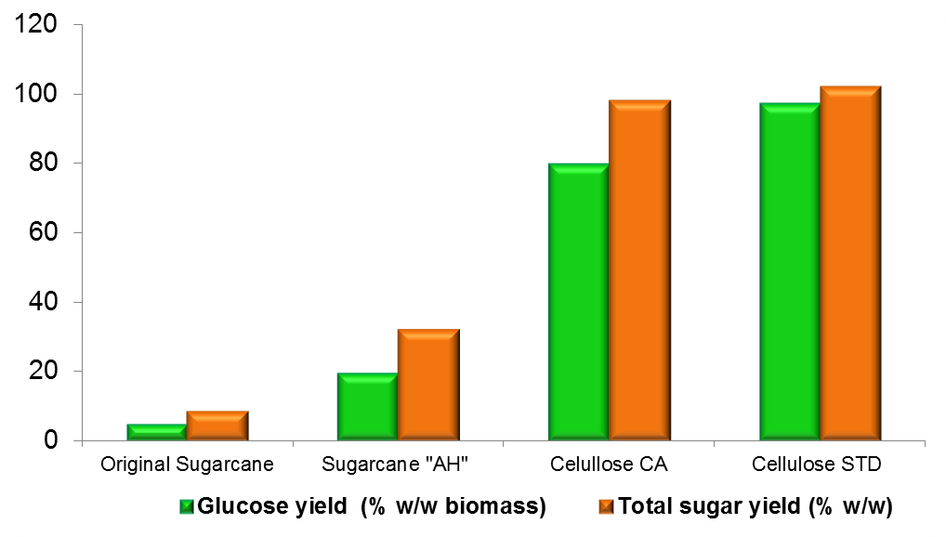
Enzymatic Hydrolysis: Sugarcane bagasse
Enzymes:
Conditions:
Celluclast® 1.5L
50ºC, 72h, 150rpm
Novozym 188
%
AH – acid hydrolysed; Cellulose CA – cellulose obtained from sugarcane bagasse pre-treatment; STD - standard
K. João, A. M. da Costa Lopes, E. Bogel- Łukasik L. C. Duarte, R. Bogel-Lukasik, 2015, in preparation.

Slide 32
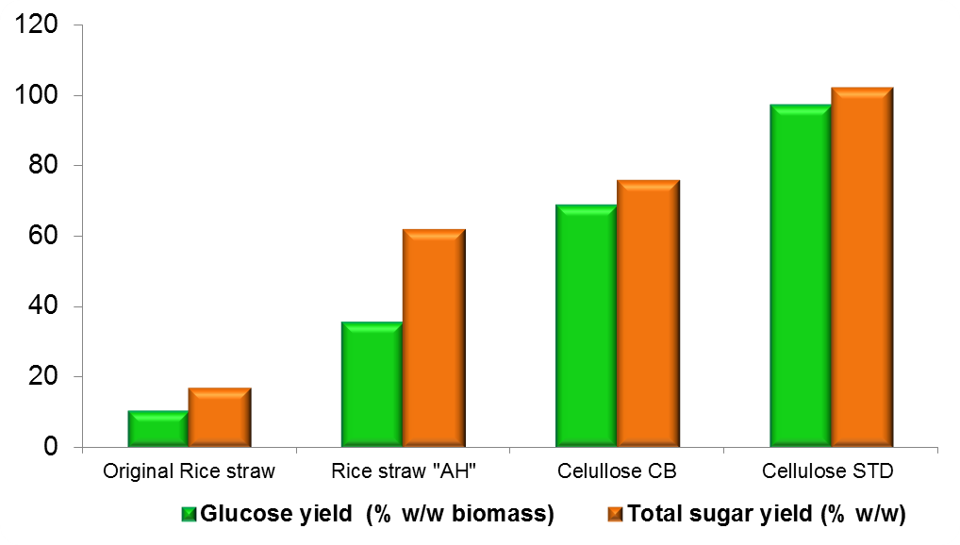
Enzymatic Hydrolysis: Rice straw
Enzymes:
Conditions:
Celluclast® 1.5L
50ºC, 72h, 150rpm
Novozym 188
%
AH – acid hydrolysed; Cellulose CB – cellulose obtained from rice straw pre-treatment; STD - standard
K. João, A. M. da Costa Lopes, E. Bogel- Łukasik L. C. Duarte, R. Bogel-Lukasik, 2015, in preparation.

Slide 33
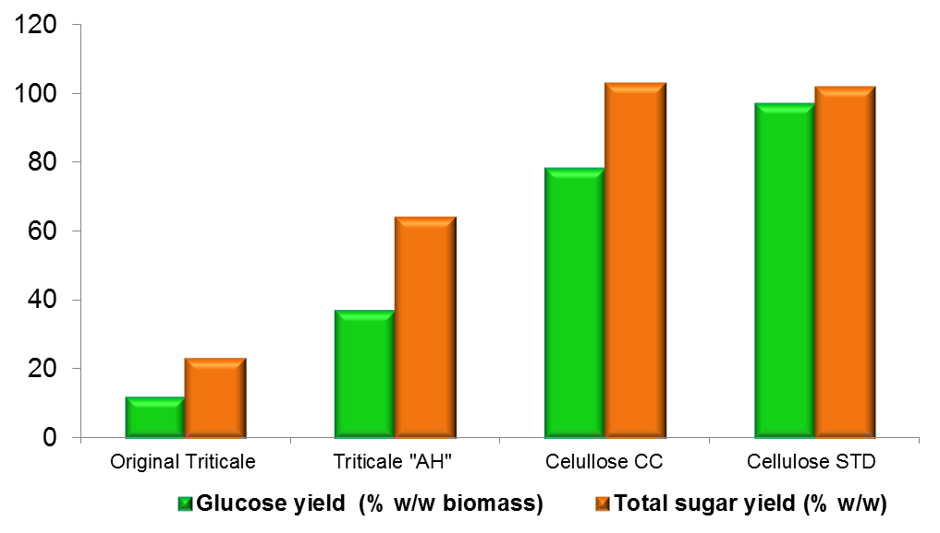
Enzymatic Hydrolysis: Triticale straw
Enzymes:
Conditions:
Celluclast® 1.5L
50ºC, 72h, 150rpm
Novozym 188
%
AH – acid hydrolysed; Cellulose CC – cellulose obtained from triticale straw pre-treatment; STD - standard
K. João, A. M. da Costa Lopes, E. Bogel- Łukasik L. C. Duarte, R. Bogel-Lukasik, 2015, in preparation.

Slide 34

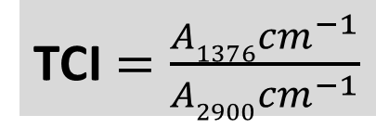
Crystallinity indexes
Sample | LOI | TCI
WS | 1.74 | 1.13
SB | 1.57 | 1.18
RS | 1.76 | 1.15
TS | 1.74 | 1.14
WS AH | 1.68 | 1.07
SB AH | 1.58 | 1.05
RS AH | 1.60 | 1.10
TS AH | 1.81 | 1.01
RM WS | 1.36 | 1.02
RM SB | 1.27 | 1.04
RM RS | 1.45 | 1.10
RM TS | 1.55 | 1.08
Sample | LOI | TCI
STD cellulose | 1.69 | 1.12
Cellulose WS | 1.34 | 1.02
Cellulose SB | 1.31 | 1.07
Cellulose RS | 1.46 | 1.11
Cellulose TS | 1.59 | 1.10
+
+
-
LOI $=\frac{A1437{cm}^{−1}}{A898{cm}^{−1}}$
Lignin/hemicellulose content also affects cellulose accessibility in enzymatic hydrolysis
TCI $=\frac{A1376{cm}^{−1}}{A2900{cm}^{−1}}$
Nelson, M.L. et al., J. Appl. Polym. Sci. , 2003, 8 (3), 1325–1341
Hurtubise, F.G. et al., Anal. Chem.,1960, 32 (2), 177–1810
-
WS – wheat straw; SB – sugarcane bagasse; RS – rice straw; T – triticale straw; AH – acid hydrolysed; RM– regenerated material; STD - standard ; LOI – lateral order index ; TCI – total crystallinity index 34

Slide 35
[emim][CH3COO]IL recyclability in an efficient Pre-treatment of Wheat Straw
good recyclability of ILs
A. M. da Costa Lopes, K. João, D. Rubik, E. Bogel-Lukasik, L. C. Duarte, J. Andreaus and R. Bogel-Lukasik, Bioresource Technol., 2013, 142, 198-208

Slide 36
Are other ILs recovery in pre-treatment of Wheat straw is also sufficient?
ª WS, wheat straw; ^{b} SF, solid fraction; ^{c} LF, liquid fraction; ^{d} RY, regeneration yield; ^{e} residual.
A. M. da Costa Lopes, K. João, E. Bogel-Lukasik, L. B. Roseiro and R. Bogel-Lukasik, J. Agric. Food Chem., 2013, 61, 7874.

Slide 37
Conclusions
A 3-step optimised fractionation using [emim][CH₃COO] for 4 types of biomass was tuned to obtain separately cellulose, hemicellulose and lignin as high purity samples
[bmim][HSO₄] posses a capability to dissolve wheat straw completely
and hydrolyse hemicellulose selectively to produce furfural and hydroxymethylfurfural confirming extended hydrolyses of sugars
Pre-treatment of wheat straw using [bmim][SCN] gives lignin-rich materials with a high purity of lignin (no carbohydrates)
Importance to fractionate the liquid stream after the regeneration process within pre-treatment of biomass with IL to recover remaining significant amount of hemicellulose and lignin
Combined method allowed to produce carbohydrate-rich material and a carbohydrate-free lignin more efficiently and can suit as a direction in development of an industrially feasible pre-treatment and fractionation of biomass

Slide 38
Conclusions
The partial delignification of biomass enables to achieve complete hydrolysis into reducing sugars. IL pre-treatment is more efficient than the conventional acid hydrolysis pre-treatment.
Easy digestible material was regenerated from all 4 types of biomass pre-treated with the IL.
LOI decrease of biomass pre-treated with ILs might indicate restruction of crystalline structure of cellulose rich materials into amorphous forms
Reduction in cellulose crystallinity (LOI) implies that treated with the IL cellulose material has a cellulose surface accessibility increased that what confirmed by efficiency of hydrolysis
IL recyclability 7 times without losses in biomass pre-treatment efficiency for WS (up to 95% for [emim][CH₃COO] ) , for other biomass up to 97% ([bmim][N(CN)2] ).

Slide 39
Acknowledgments
Fundação para a Ciência e a Tecnologia, Portugal
IF/01643/2013/CP1161/CT004
SFRH/BPD/26356/2006
PEst-C/EQB/LA0006/2011
Programme Ciência 2008
UID/QUI/50006/2013
SFRH/BD/90282/2012
IF/01643/2013
LAQV/REQUIMTE
National NMR Facility (RECI/BBBBQB/0230/2012)

Slide 40
Acknowledgments
FPS COST Action FP1306: Valorisation of lignocellulosic biomass side streams for
sustainable production of chemicals, materials & fuels using low environmental impact technologies
COST Actions: CM 1304 Emergence and Evolution of Complex Chemical Systems
LNEG
ERA-IB project Products from lignocelluloses
PROETHANOL2G Project (FP7-ENERGY-2009-BRAZIL;Grant agreement: 251151)
Brazilian National Council of Scientific and Technological Development

Slide 41










Acknowledgments
André da Costa Lopes
Karen G. João
Ewa Bogel-Łukasik
Luísa B. Roseiro
Rafał Bogel-Łukasik
Luis C. Duarte
Djonatam Rubik
Jürgen Andreaus
Florbela Carvalheiro
Maria do Céu Penedo
Luísa Ferreira
Thank you!

