Slide 1

High prevalence rate of Trichomoniasis Vaginalis in an urban HIV clinic
Debbie Mohammed, DrPH, MS, MPH, AACRN
Prerak Shukla, MBBS
Maria Szabela, MD
Jihad Slim, MD
Saint Michaels Medical Center
Newark, New Jersey
debbiemoha@aol.com
3rd International Conference on HIV/AIDS,STDs & STIs, November 30-December 02, 2015, Hilton Atlanta Airport, Atlanta, USA

Slide 2
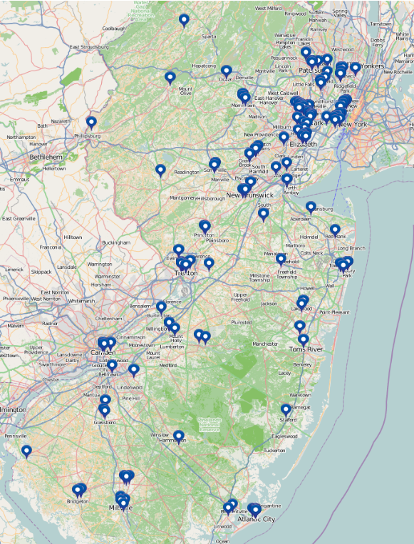
Overview of New Jersey
Geographic location
Racial/cultural/ethnic diversity
Almost 9 million residents in 8,721 square miles
38,000 PLWHA, 427.8/100,000
79% are > 40 years of age
65% male
78% minorities (Black, Hispanic)
IDU – 20%
MSM – 24%
Map credit: www.njhiv1.org
Accessed September 15th 2015
Notes:
As of July 2015 – Map on left shows the distribution of Rapid test sites in NJ

Slide 3
Background
Sexually transmitted infections (STI) facilitate the transmission of HIV from positive to negative persons.
Routine screening for gonorrhea and chlamydia in both HIV + males and females is recommended¹
Trichomoniasis screening in HIV+ females only²
The objective of this study is to compare the prevalence of gonorrhea, chlamydia and Trichomoniasis vaginalis in an urban HIV clinic from 4/1/2014-3/30/2015
¹HRSA ²STD guidelines

Slide 4
Methods
Retrospective chart review: to determine screening results for chlamydia, gonorrhea and trichomoniasis in an urban HIV clinic from 4/1/2014-3/30/2015.
Women: screened using the APTIMA® Unisex Swab Specimen Collection Kit for Endocervical Specimens
Men: screened by urine NAAT testing with APTIMA®

Slide 5
Methods: Statistical Analysis
Compare baseline demographics of patients
Compare prevalence rates of gonorrhea, chlamydia and Trichomoniasis from 4/1/2014-3/30/2015

Slide 6
Results: Study Population
 | Total Patients 1,184 N (%) | Screened N (%) 765 (65%)
Gender
Males | 731 (62) | 492 (64)
Females | 453 (38) | 273 (36)
Age
18-34 | 160 (13) | 102 (13)
35-49 | 408 (35) | 266 (35)
>50 | 616 (52) | 397 (52)
Race
Black | 834 (70) | 550 (72)
Other | 350 (30) | 215 (28)
Insurance
Ryan White | 176 (15) | 112 (15)
Medicaid | 536 (45) | 353 (46)
Medicare | 313 (26) | 193 (25)
Private | 159 (14) | 107 (14)
Of 1,184 HIV positive patients, 765 (65%) were screened for at least one STI from 4/1/2014-3/31/2015
Baseline characteristics were similar between those receiving STI screening and those who did not.

Slide 7
Prevalence of STI, by gender (per 100 patients screened)
Notes:
Of 765 patients screened for STI, 492 (64%) were males 273 (36%) were females.
STI infection prevalence rate was at least 6 times higher among women 12.8/100 women screened vs 2/100 men screened
Trichomoniasis was the most prevalent STI for both males and females and was 14 times higher

Slide 8
Results: Prevalence of STI, by Age (per 100/patients screened)
Notes:
Patients aged 35-49 had higher prevalence rates of STI overall.
Gonorrhea and chlamydia was more prevalent among those 18-34 and 35-49 years.
However, Trichomoniasis was the most prevalent STI regardless of age.

Slide 9
Prevalence of STI, by Race (per 100/patients screened)
Notes:
Blacks were disproportionately affected by STI and rates were about 3 times higher in this group
And Trichomoniasis was the most prevalent STI for this group

Slide 10
Prevalence of STI, by Insurance Type (per 100 patients screened )
Notes:
Patients with Medicaid insurance were positive for STIs about 2-3 times higher than those with other insurance types. Trichomoniasis was most common STI among these patients

Slide 11
Conclusions
Testing and treating trichomoniasis vaginalis in addition to gonorrhea and chlamydia is important for HIV + males and females to prevent the transmission of HIV.
Trichomoniasis vaginalis was the most prevalent STI regardless of age, race and insurance status
This STI may be an important mediating factor in the transmission of disease for this population.
The cell sizes were small for most of the measures and results may become more robust with increased screening.
Results may not be generalizable to other HIV clinics or other areas of the world

