Slide 1
Green Fuel: Selective and Water Compatible Catalysts for Solar Fuel Production
Hongjin Lv, Ben Yin, Yurii V. Geletii, James W. Vickers, Sarah M. Lauinger, Tianquan Lian, Djamaladdin G. Musaev, John Bacsa, Paul Kögerler, Craig L. Hill
Department of Chemistry
Emory University, Atlanta, GA, USA
Funding:
U.S. DOE, Basic Energy Sciences & NSF

Slide 2
Challenges for Solar Fuels Catalysts
• Photoelectrode – catalyst interface
immobilization techniques for molecular catalysts
effective spectroscopic and diffraction probes of monolayer coverages
• Rate
• Stability (particularly WOCs)
• Selectivity (WOCs, CO₂ reduction catalysts)
• Catalyst behavior: solution vs. immobilized
• Inhibit photocorrosion
• WOCs (OECs) effective at very low pH
• Earth abundant elements; facile and green processing
• Catalyst counterions impact all the above.

Slide 3
Multi-electron catalysts (WOCs, WRCs, CO₂-RCs)
Heterogeneous (NPs, films, etc.)
Homogeneous / molecular
More stable, lower cost, manufacturable at scale
Can be studied experimentally and theoretically, thus optimized and formulated
Progress toward viable catalysts
BUT !
Extremely hard to study and understand at molecular level
BUT !
Unstable (hydrolytically, oxidatively and thermally)
• Two communities – little overlap; need to converge
• Idea: -- use POMs as catalysts (first, WOCs): they combine the advantanges of both without the disadvantages of both.

Slide 4
Polyoxometalates (POMs):
early-transition-metal oxygen anion clusters
H⁺
H⁺
n [WO₄]²⁻ [W_{x}O_{y}]^{n-} + nH₂O WO₃ + nH₂O
OH⁻
OH⁻
metal oxide
polyoxometalates
readily alter:
• elemental compositions
• potentials
• acidities
• solubilities
• shape, size, charge
• others
• counterions
• stable (O₂, H₂O)
• accessible
• scalable
• nontoxic
• inexpensive
[AlW₁₂O₄₀]⁶⁻ (Keggin)
Al, purple; W, gray, O, red
Excellent oxidation catalysts AND corrosion inhibitors

Slide 5
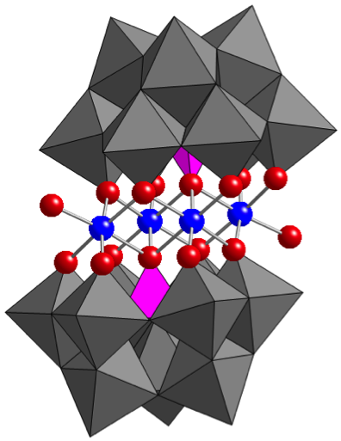
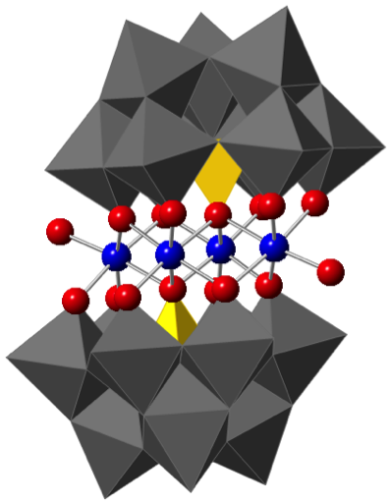
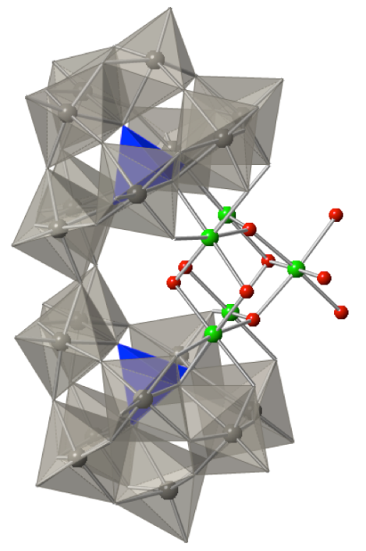
Polyoxometalate (POM) Water Oxidation Catalysts (WOCs)
[{Ru₄O₄(-XW₁₀O₃₆)₂]10-
Ru₄POM, X = Si or P
[Co₄(α-PW₉O₃₄)₂]10-
Co₄P₂
[Ni₅(Si₂W₁₈O₆₆)]10-
Ni₅POM
[Co₄(α-VW₉O₃₄)₂]10-
Co₄V₂
ACIE 2008, 47, 3896
JACS, 2009, etc.
Science, 2010, 328, 342;
JACS, 2011, etc.
Dalton, 2012,
41, 13043
JACS, 2014, 136, 9268
TOF ~ 1 sec-1
~ 6 sec-1
~ 10 sec-1
~ 1000 sec-1
TOFs depend on many parameters. Reporting TOFs for light-driven WOCs can be tricky.

Slide 6
Multielectron catalysts in H₂O –
homogeneous or heterogeneous?
Clarification of initial reports:
Co₄P₂ Hill group (Science, 2010), then challenged by Finke, Scandola-Bonchio, but confirmed homogeneous catalyst by H. Dau, J.R. Galán-Mascarós, R. Finke, M. Nyman (just published).
Mn₄O₄(L)₄ Original work (homo cat) clarified as heterogeneous catalyst precursor -- Spiccia et al. Nature Chem, 2011
Co₄O₄(OAc)₄(pyr)₄ Original work (homogeneous cluster) clarified as Co²⁺ -- Nocera et al. JACS, 2014.
NiOOH Original work (heterogeneous WOC) but Fe impurities are critical to activity – Boettcher et al. JACS, 2014.
Others

Slide 7
Homogeneous vs. heterogeneous catalyst(s) in H₂O?
Many methods:
spectra (IR, NMR, etc. before and after catalysis)
rate laws (pH dependence)
DLS
SAXS
controls (e.g. activity of CoO_{x})
recovery/reuse (initial kinetics for H₂O oxidation)
electro-catalytic activity (e.g. [Ru(bpy)₃]²⁺ oxidation)
bpy present scavenges all Co²⁺ and prevents CoO_{x}.
electrochemical quartz crystal nanobalance -- Crabtree, Brudvig
extraction of POM (not Co²⁺ or CoO_{x}) into organic solvent
Vickers, J. W.; Lv, H.; Sumliner, J. M.; Zhu, G.; Luo, Z.; Musaev, D. G.; Geletii, Y. V.; Hill, C. L. J. Am. Chem. Soc., 2013, 135, 14110.

Slide 8
Quantification of catalytic water oxidation by:
Co₄P₂ vs. Co²⁺(aq) vs. CoO_{x}
POM (red) extracts 100% from H₂O into
toluene phase containing R₄N⁺
toluene
Co²⁺, CoO_{x} extract 0%
NaP_{i}
NaB
CAdSV
0.54 ± 0.04 µM
0.07 ± 0.01 µM
ICP-MS
0.44± 0.02 µM
0.07 ± 0.01 µM
H₂O
Should be general method for assessing soluble and insoluble WOCs
Vickers, J.W. et al. J. Am. Chem. Soc., 2013, 135, 14110−14118

Slide 9
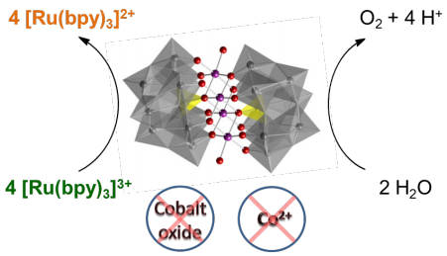
Comprehensive study of Co₄P₂:
reactivity and stability
Vickers, J. W.; Lv, H.; Sumliner, J. M.; Zhu, G.; Luo, Z.; Musaev, D. G.; Geletii, Y. V.; Hill, C. L. J. Am. Chem. Soc., 2013, 135, 14110.

Slide 10
Photocatalytic Water Splitting Cells – Catalysts Immobilized
Immobilization of POMs on photoelectrode surfaces
3 ways:
• electrostatic (usually easy and effective)
• hydrophobic (usually easy; POM hydrolytically stabilized
but organic groups can oxidize)
• covalent (easy for many types of POMs, but not yet for
POM WOCs, WRCs, etc.)

Slide 11
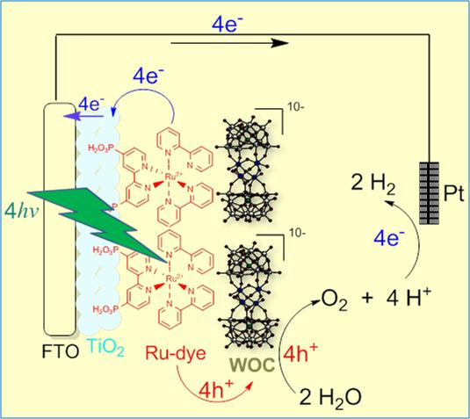
TiO₂-P2-Ru₄POM Triadic Photonodes
Conditions:
Ref. electrode: Ag/AgCl,
3 M NaCl
Electrolyte: 3~5 mM
Na₂SiF₆-NaHCO₃
pH 5.8
0 V (vs Ag/AgCl), +0.56 V (RHE)
Illumination: 420 to 470 nm
F. Scandola, M. Bonchio et al., Chem. Commun. 2010, 46, 3152
Our group: X. Xiang, J. Fielden et al. J. Phys. Chem. C 2013, 117, 918−926

Slide 12
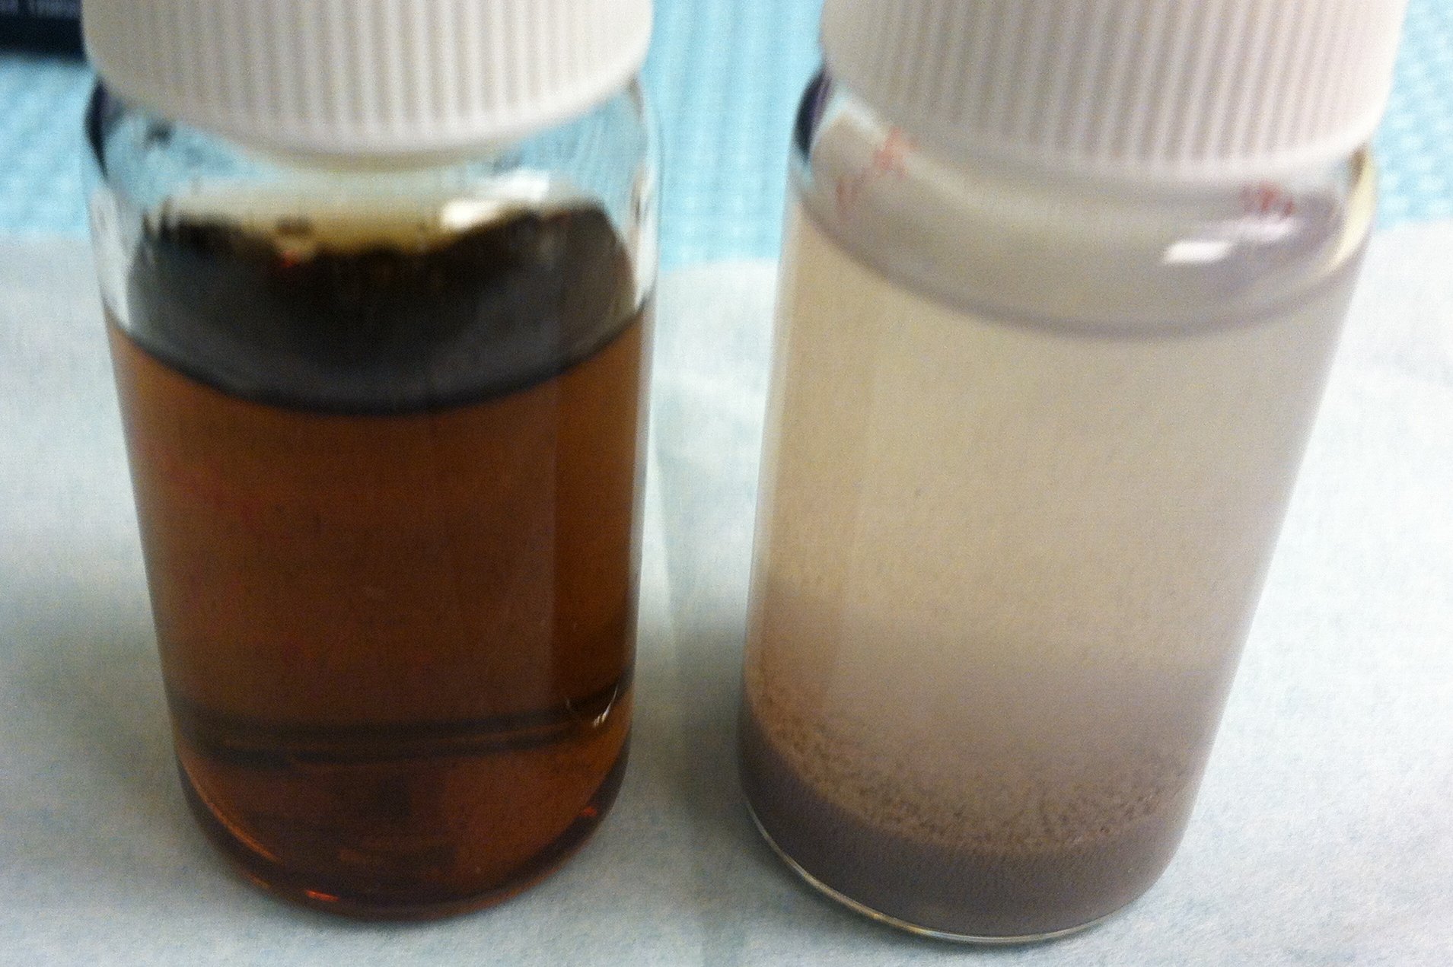
Electrostatic POM immobilization can be improved by metal oxide (MO_{x}) silylation with cation
MO_{x}
rt
MO_{x}
toluene
pH < 10
NH₃⁺
3-aminopropyltrimethoxysilane
(APS)
TiO₂, BiVO₄
rt
aqueous
POM
-
-
-
+
-
~ 1 - 1.5 nm
-
POM
-
-
+
-
-
-
MO_{x}
-
+
-
-
-
-
POM
+
-
-
Ru₄POM Ru₄POM-TiO₂-APS
-
-
-
Sarah Lauinger
Idea: have enough catalyst on surface in monolayer to quantify it.
Notes:
First, the methoxy groups of the silane coupling reagent reacted cleanly with the hydroxyl groups of TiO₂ to eliminate MeOH resulting in the formation of isolated surface species.
pKa RNH₃⁺=10.66
The grafted PMoV can be removed by the addition of tetrabutylammonium bromide (TBABr) to form TBA4[PMo11VVO40], suggesting that there is no covalent bonding between the vanadium site and the ammonium groups.

Slide 13
Hydrophobic R₄N⁺ immobilizes and stabilizes POMs in carbon paste electrodes
I-V curve
Electrocatalytic curve where λ and γ are high;
λ = (RT/nF)/(k_{e}C_{P}⁰/ν)
γ = (C_{A}⁰/C_{P}⁰)
i.e. where there is competition between rate-limiting substrate (H₂O) consumption and diffusion.
Conditions: 20 wt % TBA-Co₄V₂ in carbon paste, 80 mM pH 8.0 NaBi buffer, 0.2 M NaClO₄ as supporting electrolyte, 100 mV/s.

Slide 14
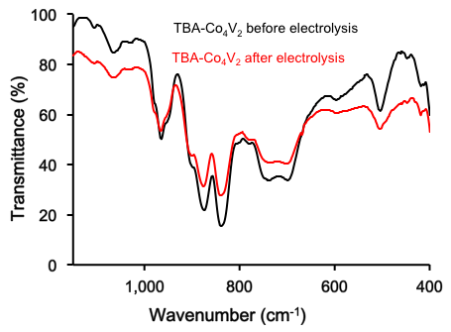
Hydrophobic R₄N⁺ immobilizes and stabilizes POMs in carbon paste electrodes
I-V curve
FTIR of TBA-Co₂V₂
Conditions: 20 wt % TBA-Co₄V₂ in carbon paste, 80 mM pH 8.0 NaBi buffer, 0.2 M NaClO₄ as supporting electrolyte, 100 mV/s.
Hongjin Lv

Slide 15
Hydrophobic R₄N⁺ immobilizes and stabilizes POMs in carbon paste electrodes
I-V curve
FTIR of TBA-Co₂V₂
O₂ also now quantified. See system for fast monitoring of spectra and O₂: Vickers, Sumliner, Lv, Morris, Geletii, Hill, PCCP, 2014, 16, 11942.

Slide 16
TiO₂-P2-Ru₄POM Triadic Anodes: Catalytic photocurrent
Near 100% photocurrent enhancement
No photocurrent increase in MeCN, nor with catalytically inactive Zn₄POM
Over 20 minutes: 40% loss of dye/catalyst absorbance for P2 system, due to desorption (not WOC damage)
J. Phys. Chem. C 2013, 117, 918

Slide 17
TiO₂-P2-Ru₄POM Triadic Anodes:
Comparison of different oxides
Ru₄POM transfers electron to photogenerated Ru^{III}P2 hole
J. Phys. Chem. C 2013, 117, 918
Chem. Science 2015, in press

Slide 18
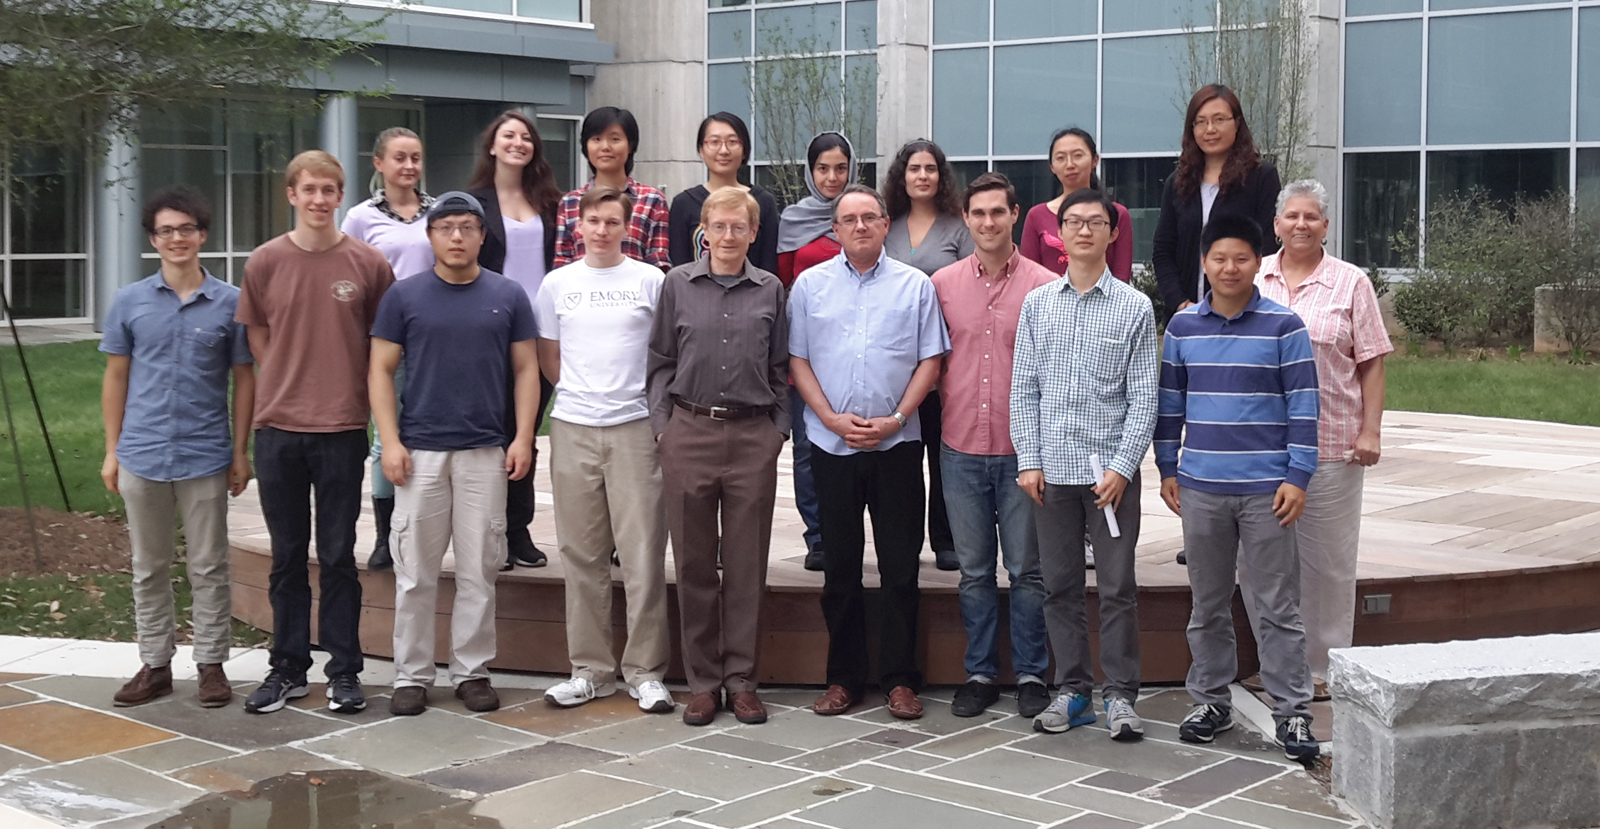
Hill group (April, 2015)
Sarah Lauinger
Marika Wieliczko
James
Vickers
Ben Yin
Yurii
Geletii
Hongjin
Lv
Missing: Emory collaborators: Jamal Musaev, Tim Lian, Paul Kögerler, Anil Mehta, Brian Dyer. Also John Fielden (now UEA).

Slide 19
TiO₂-P2-Ru₄POM Triadic Anodes: Comparison with IrO₂
Mallouk, Moore, Gust et al.
J. Am. Chem. Soc. 2009, 131, 926
Our work: J. Phys. Chem. C 2013, 117, 918
Ru₄POM to dye electron transfer much faster than IrO₂ to dye
Able to outcompete recombination
Computational modeling

Slide 20
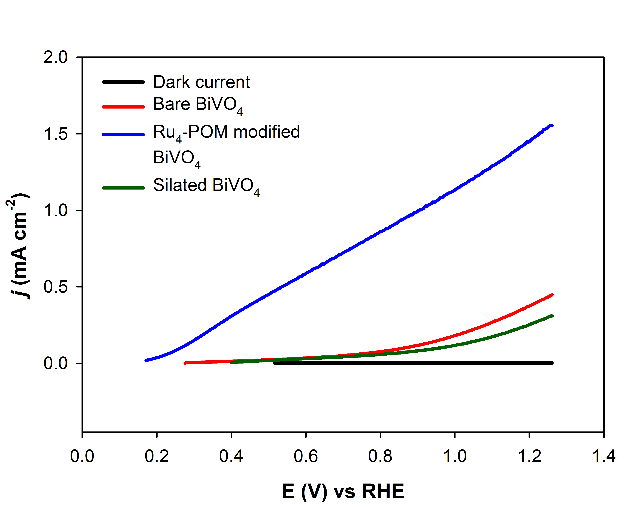
Photoelectrocatalytic H₂O Oxidation by BiVO₄-Ru₄POM
Conditions
0.2 M pH 7.2 phosphate buffer
Xenon lamp (λ > 400 nm) at 80 mW/cm²
10 mV/s scan rate
Ref. vs Ag/AgCl in 1M KCl
Ben Yin

Slide 21
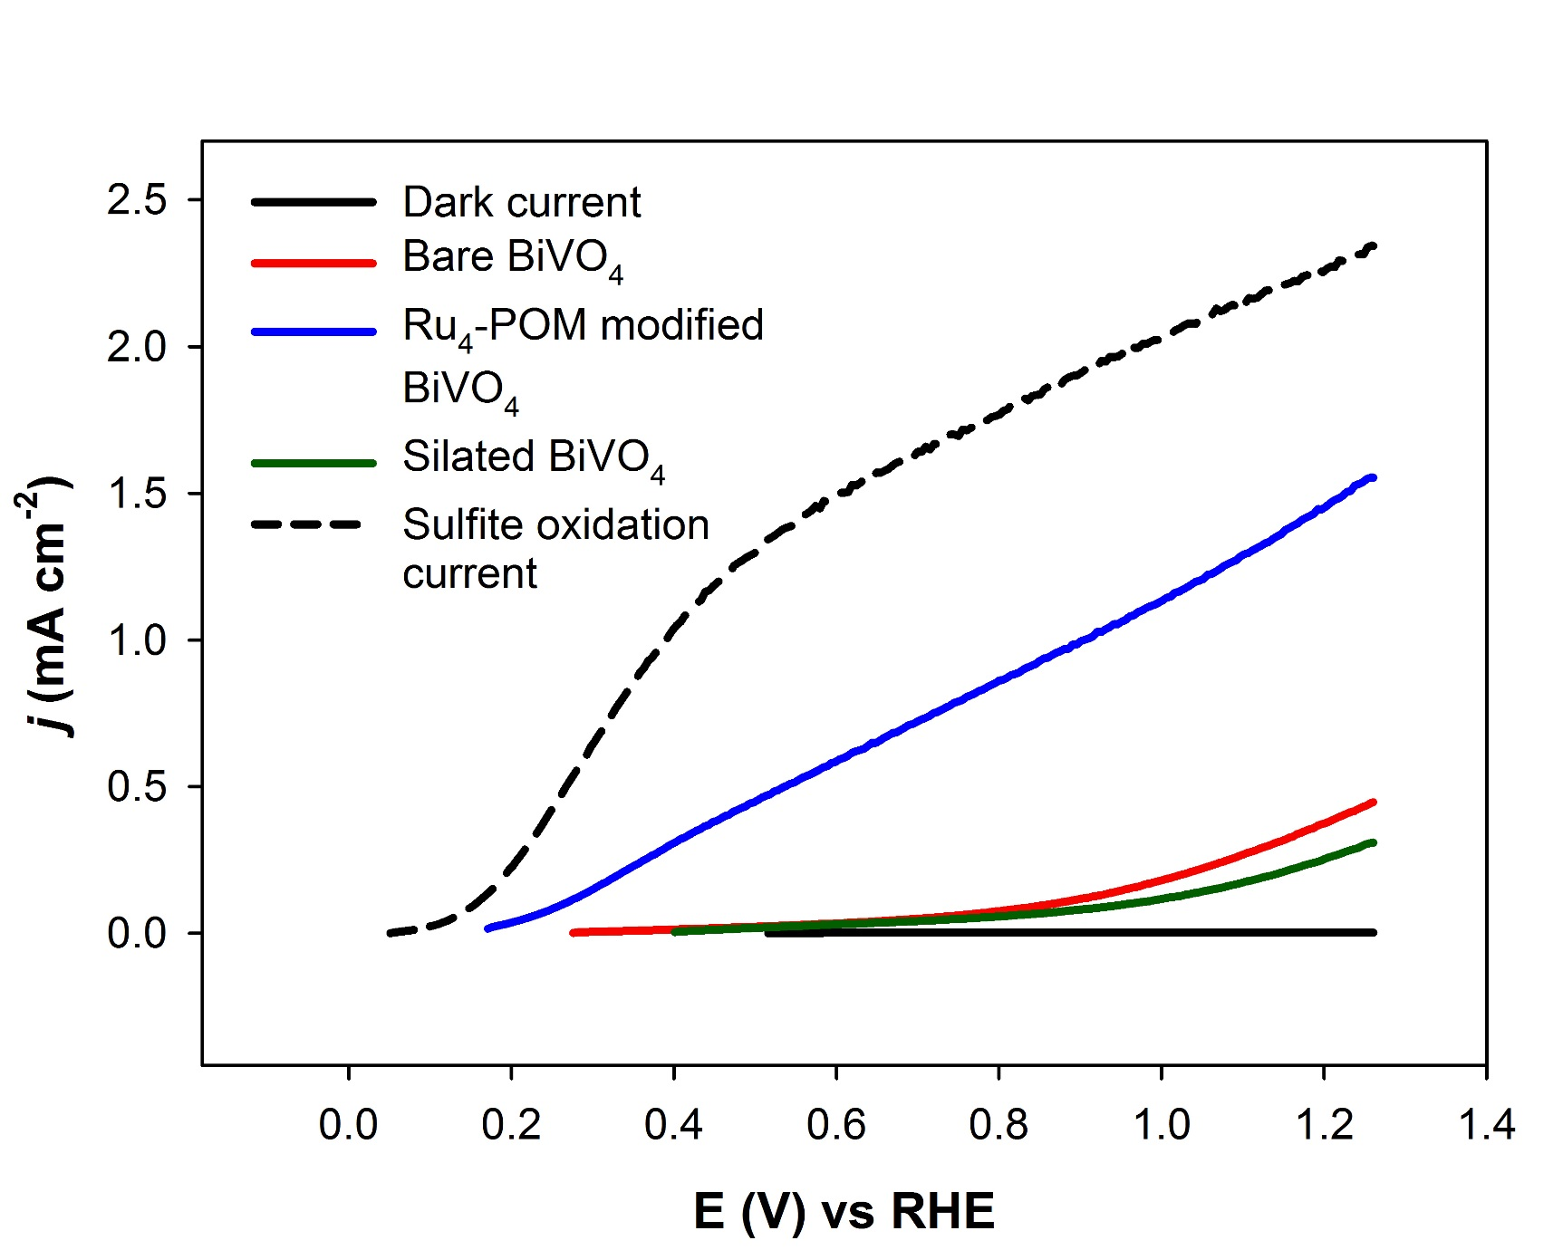
Photoelectrocatalytic BiVO₄-Ru₄POM oxidation:
Sulfite versus H₂O
Conditions
0.2 M pH 7.2 phosphate buffer
Xenon lamp (λ > 400 nm) at 80 mW/cm²
10 mV/s scan rate
Ref. vs Ag/AgCl in 1M KCl

Slide 22
Photoelectrocatalytic BiVO₄-Ru₄POM oxidation:
Sulfite versus H₂O
Conditions
0.2 M pH 7.2 phosphate buffer
Xenon lamp (λ > 400 nm) at 80 mW/cm²
10 mV/s scan rate
Ref. vs Ag/AgCl in 1M KCl
O₂ also now measured.
See Vickers, Sumliner, Lv, Morris, Geletii, Hill, PCCP, 2014, 16, 11942.

Slide 23
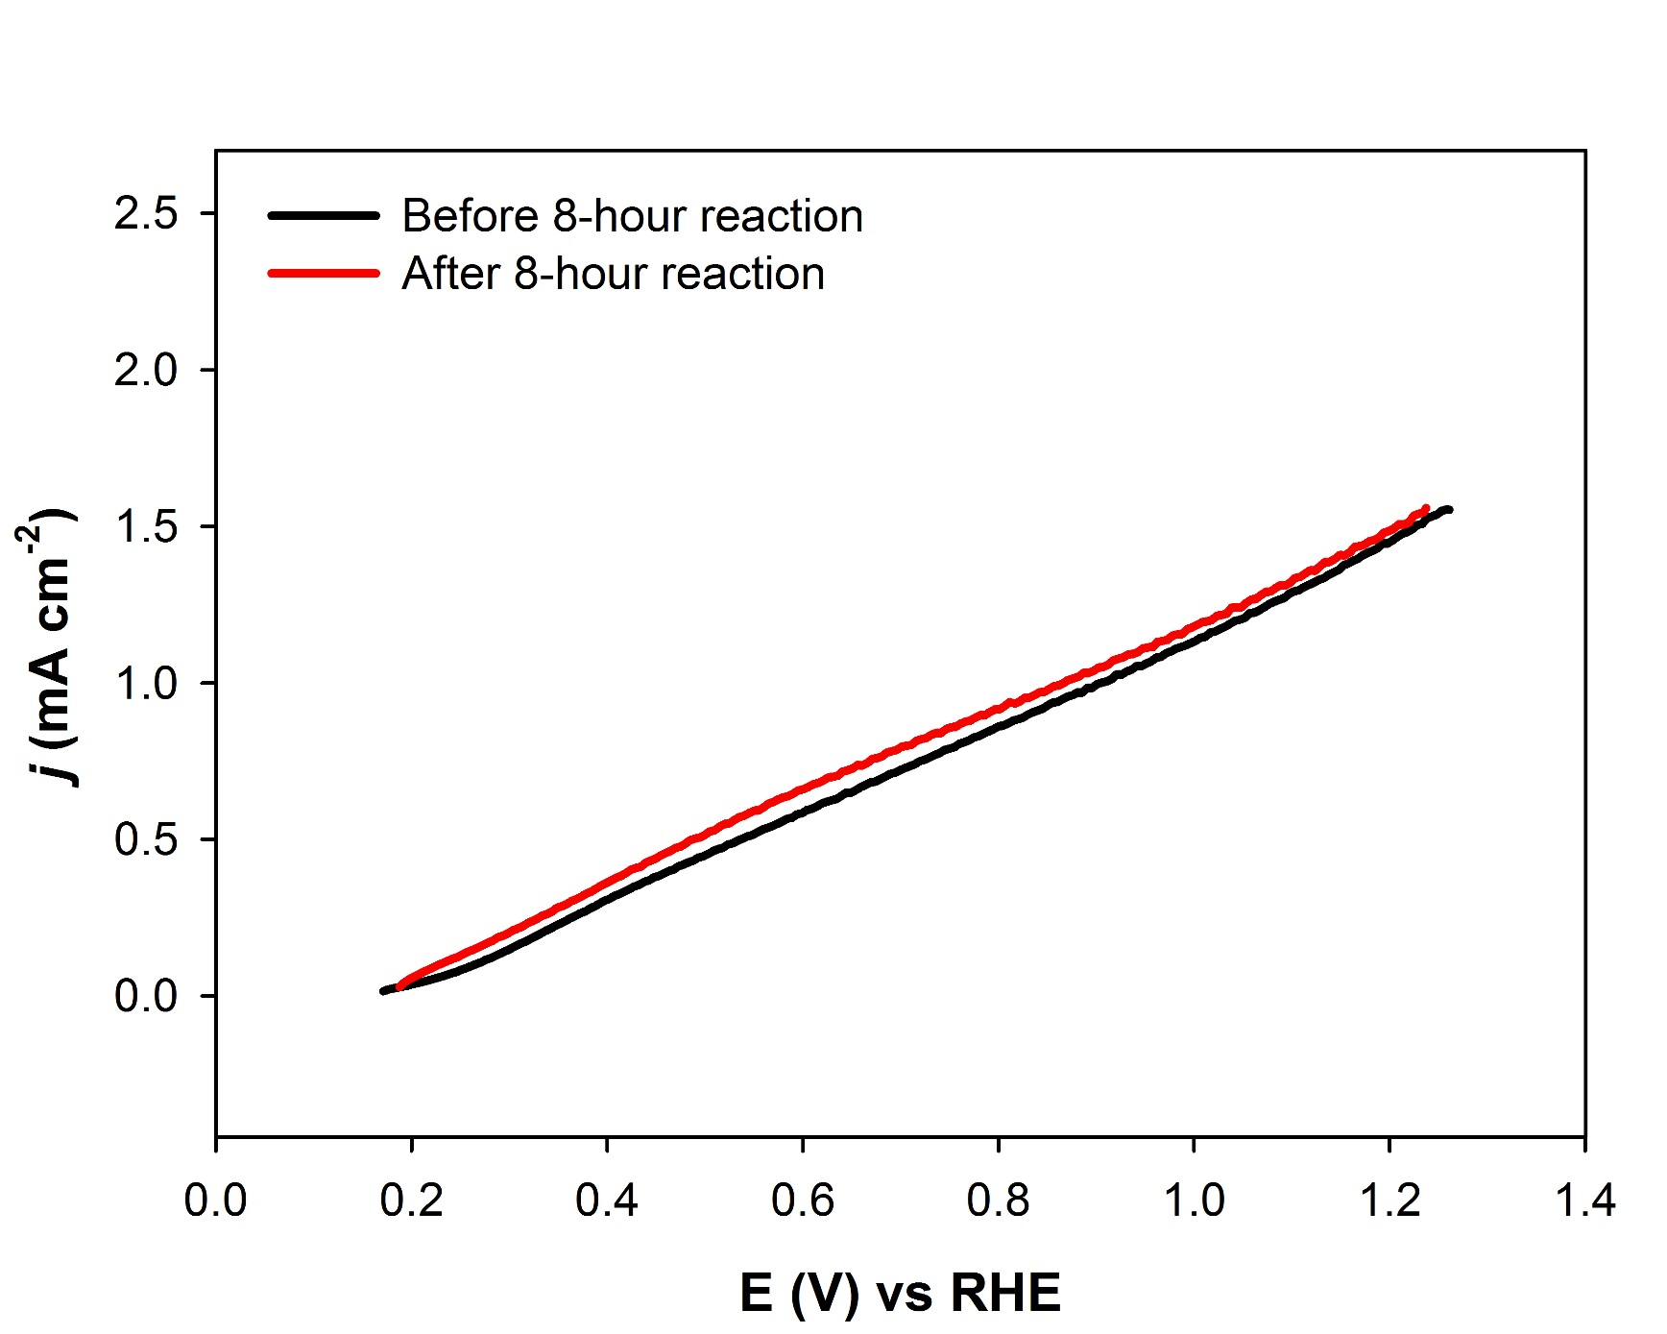
Stability:
Photoelectrocatalytic H₂O oxidation by BiVO₄-Ru₄POM
Conditions
0.2 M pH 7.2 phosphate buffer
Pt counter electrode
Xenon lamp (λ > 400 nm) at 80 mW/cm²
8 hours electrolysis at 0.66 V vs. RHE
Ref. vs Ag/AgCl in 1M KCl

Slide 24
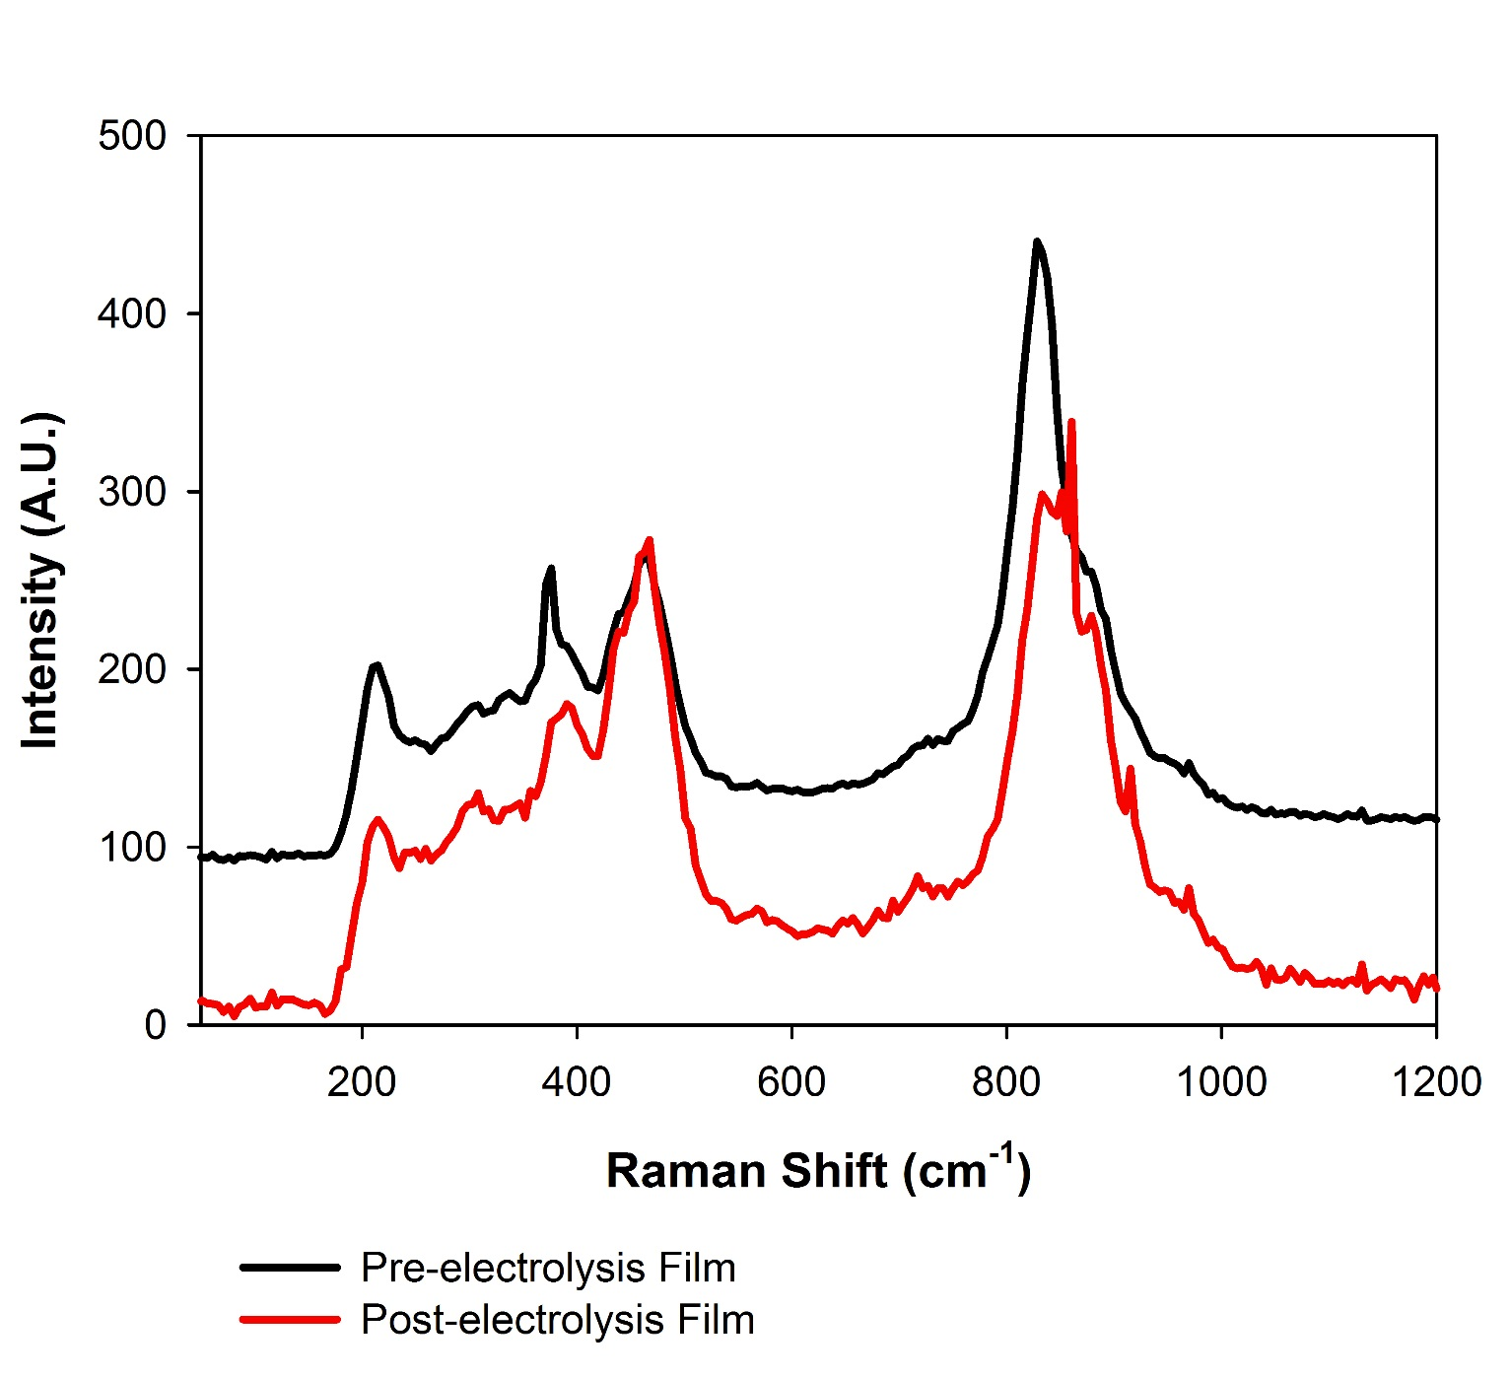
Stability of BiVO₄-Ru₄-POM by Confocal Raman
Conditions
0.2 M pH 7.2 phosphate buffer
Pt counter electrode
Xenon lamp (λ > 400 nm) at 80 mW/cm²
Before and after 8 hours electrolysis at 0.66 V vs. RHE
Ref. vs Ag/AgCl in 1M KCl

Slide 25
Ru₄POM potentials (PCET, CCET events) easily quantified
DC CVs of 0.7 mM Rb₈K₂Ru₄POM in 0.1 M aqueous HCl with (red) and without (black) 0.5 M KCl
J. Zhang, S-X Guo, J. Zhang, A. Bond, Y. Geletii, Inorg. Chem. 2012, 51, 11521 and Inorg. Chem. 2013, 52, 11986

Slide 26
Ru₄POM potentials (PCET, CCET) easily quantified
FT ac cyclic voltammetric fundamental (a) to eighth (h) harmonic components for Ru^{IV/V} oxidation (A/A´, B/B´) and Ru^{IV/III} reduction (C/C´, D/D´, E/E´, F/F´). WE = GC, 0.7 mM Rb₈K₂Ru₄POM in 0.1 M aqueous HCl with and w/o 0.5 M KCl. Red = simulations
J. Zhang, S-X Guo, J. Zhang, A. Bond, Y. Geletii, Inorg. Chem. 2012, 51, 11521 and Inorg. Chem. 2013, 52, 11986

Slide 27
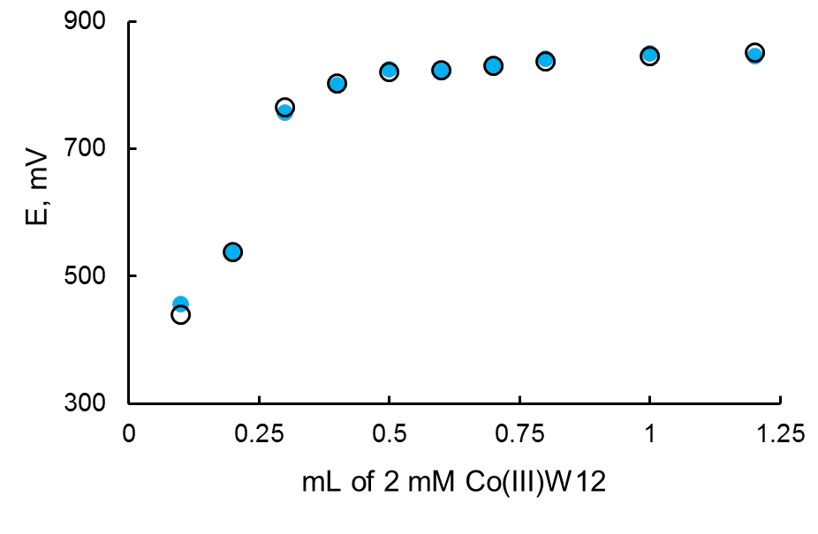
In contrast:
potentials of 3d-metal POMs not easily measured.
Co₄P₂ & Co₄V₂ unstable at high anode potentials. Oxidation potentials not
accessible by CV.
Method that works: potentiometric titration of Co₄P₂ with [Co^{III}W₁₂O₄₀]
1 mL of 2 mM [Co^{III}W₁₂O₄₀] was titrated by 2 mM Co₄P₂ in 80 mM sodium borate buffer pH 8.0.
E₁º and E₂º both ~ 1.1 V where E₁º = [Co₄P₂(I)] / [Co₄P₂(0)]
E₃º and E₄º both ~ 1.2 V vs. Ag/AgCl
Yurii Gueletii (Geletii)

Slide 28
Counter cation effects on POM properties, catalysis and electrode surface immobilization
Largely ignored to date, but important in H₂O ox, H₂O red, CO₂ red, and chemistry of the interface
First experiments: alkali metal salts of Ru₄POM (10-)
(5 experiments quantify differences in Na⁺, Li⁺ versus K⁺)
Yurii Gueletii (Geletii)

Slide 29
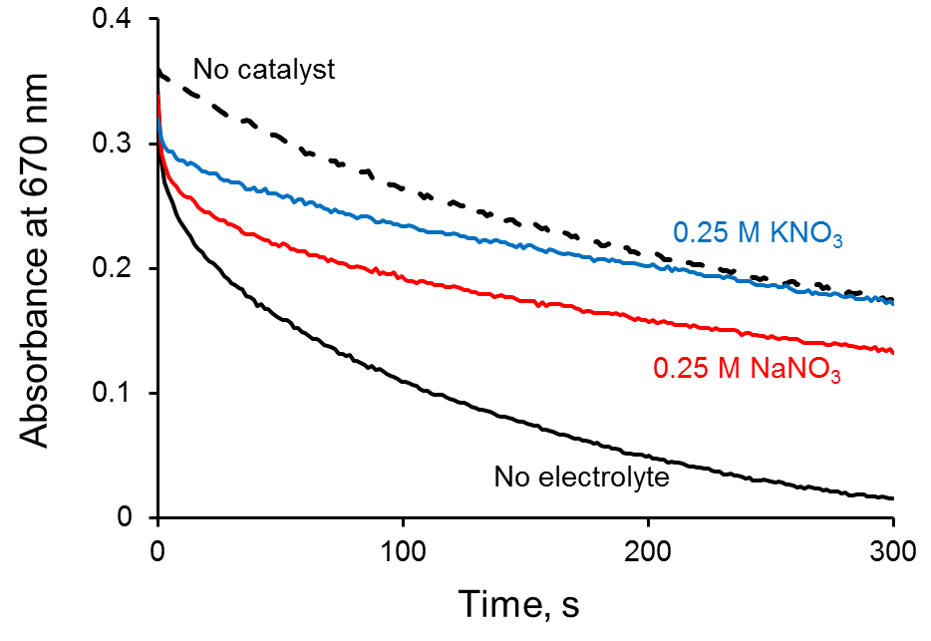
Counter cation effect #1: Kinetics of Ru₄POM oxidation
by [Ru(bpy)₃]³⁺ (stopped flow)
~1.0 mM [Ru(bpy)₃]³⁺, 5 μM Ru₄POM, 80 mM NaPi buffer, pH 7.0

Slide 30
Counter cation effect #2: Impact on POM potentials
Effect of cations on the reversible potential (E⁰') for the Ru₄POM (4445)/(4444) couple. 1M KNO₃, NaNO₃, LiNO₃, 10 mM of Ca(NO₃)₂, 1M Mg(NO₃)₂, MgSO₄ or Na₂SO₄. Britton-Robinson buffer (phosphate/acetate/borate)

Slide 31
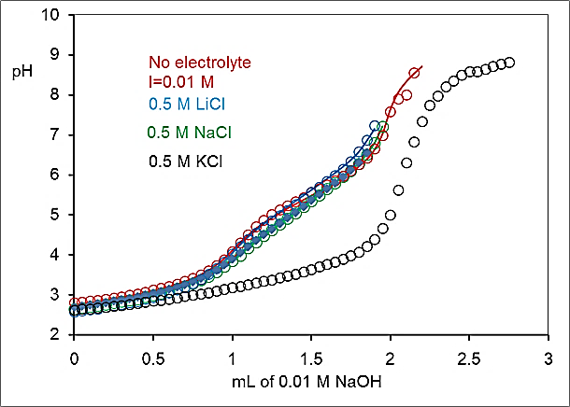
Counter cation effect #3: pK_{a} values
Titration curves of Ru₄POM (oxidation state: 4444) in the presence of different electrolytes

Slide 32
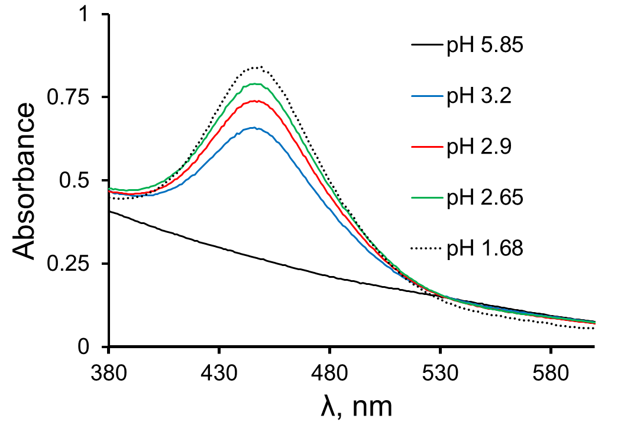
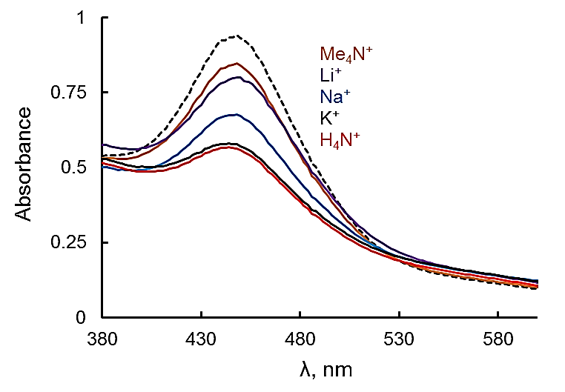
Counter cation effect #4: Impact on UV-vis spectra
Effects of pH and cations (at pH 2.0) on UV-vis spectra of Ru₄POM
Ru₄POM + H⁺ = Ru₄POMH⁺ pK_{a}
Ru₄POM + K⁺ = Ru₄POMK⁺ pK_{K}
Ru₄POMK⁺ + H⁺ = Ru₄POMK⁺H⁺ pK_{aK}

Slide 33
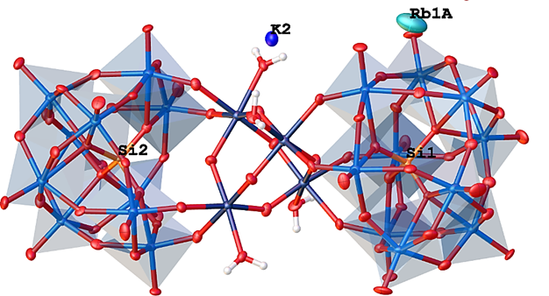
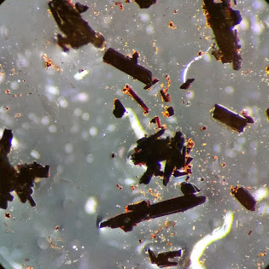
Counter cation effect #5: X-ray crystal structures
(cation—O(POM distances) & K₂Rb₈ counterions located
Unusual interaction of K⁺ ion observed: K⁺ (“K2”) interacts directly with terminal aqua ligand on Ru.
Guibo Zhu, John Bacsa, Marika Wieliczko

Slide 34
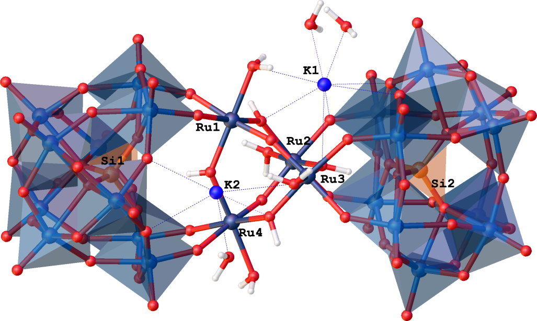
K₂Rb₈ versus K₁₀{Ru₄POM} crystal structures
Ru oxidation state confirmed by valence bond sum calculation + titration with [Ce(IV)]
Marika Wieliczko
Notes:
In other words, O2 evolution via a RuV-toRuIII redox process does not appear to be feasible, but it does appear to be so via a RuVI-to-RuIV redox process in this Ru2 “monomer”, [{RuIII2(OH)2(H2O)2}(g-SiW10O36)]4- (which is half of 1) and 1 itself

Slide 35
Findings
• Polyoxometalate (POM) catalysts: address rate, stability, selectivity + control of interface (PCET). Photocorrosion inhibition?
• POM WOC stability and reactivity better understood
• Quantifying homogeneous vs. heterogeneous catalysts simultaneously
• Photocatalytic POM-based dyads, triads
POM immobilization;
Many processes, understandable at molecular level, can be probed.
• POM-based chromophores and photosensitizers (PS)
• POM H₂O, CO₂ reduction catalysts (noble-metal-free and
water compatible, molecular -- J. Am. Chem. Soc. 2014, 136, 14015)
• pH 14-compatible POM WOCs
• Counter cation effects on POM physicochemical properties, catalysis, immobilization, interface dynamics

Slide 36
End

Slide 37

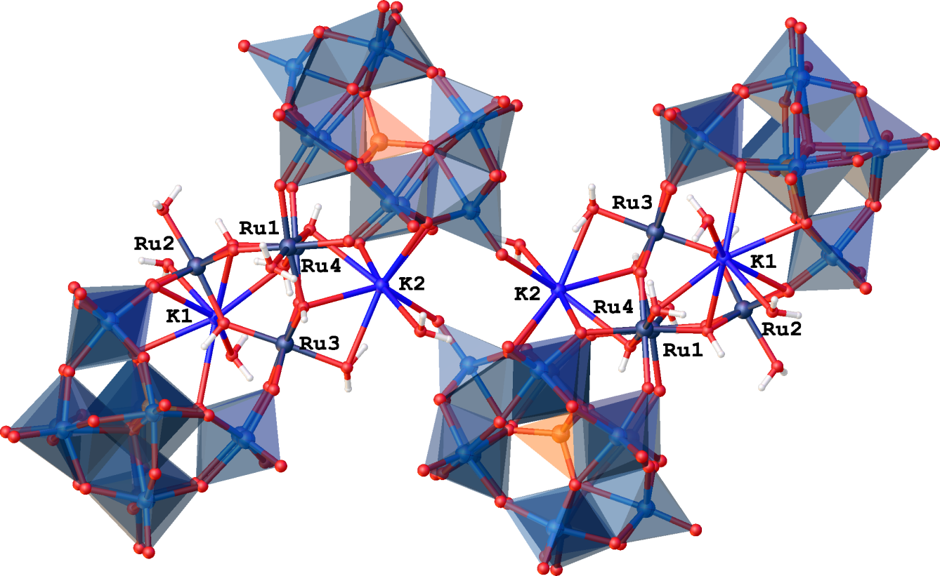
Potassium: Non-innocent Cation Interactions

Slide 38
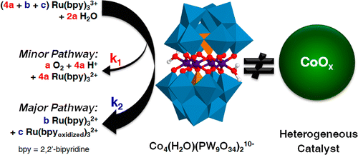
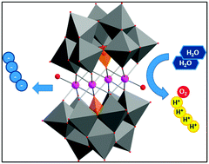
Three other research groups confirm our work: Co₄P₂ is the dominant WOC
XAS: Co₄P₂ intact and
No catalytic cobalt oxide forms
Stracke, Finke ACS Catal., 2014, 4, 79
Limberg, Dau et al. Chem. Commun., 2014, 50, 100.
Galan-Mascaros et al: 2 recent thorough papers:
Inorg. Chem. 2012, 51, 11707
Inorg. Chem. 2013, 52, 4753

Slide 39
Ultimately need:
Sunlight for energy
(hydroelectric, wind, tides, biofuel, geothermal, etc. aren’t sufficient)
Water as electron source
High density energy, hence “solar fuels”
2 H₂O + hν (sun) → O₂ + 2 H₂
CO₂ + 2 H₂O + hν (sun) → CH₃OH + O₂
Need breakthroughs in fundamental science (not just engineering)

Slide 40
Approaches to solar fuels
Electron-donor-acceptor (EDA) and photoelectrochemical (PEC) systems
All systems:
(1) light absorption – charge separation
(2) catalytic H₂O or CO₂ reduction
(3) catalytic water oxidation
(4) All 3 units work together (good control of interface dynamics)
sunlight
antenna
e-
- +
e-
H₂O, CO₂
2 H₂O
reduction catalyst(s)
A D
water oxidation catalyst (WOC)
H₂, CH₃OH
O₂ + 4H+

Slide 41
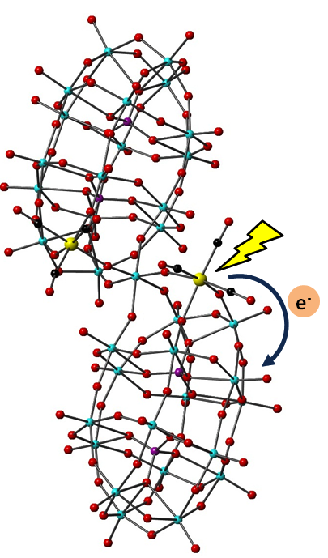
Need more robust photosensitizers (PS).
Thus POM-based MPCT and MMCT chromophores
Requirements for viable PS:
Absorbs sunlight intensely and broadly
Charge-separated excited state (exciton)
Long-lived charge-separated excited state
Metal-to-Polyoxometalate (MPCT)
Chromophores.
J. Am. Chem. Soc. 2011, 133, 20134–2013

Slide 42
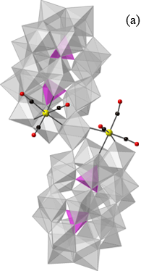
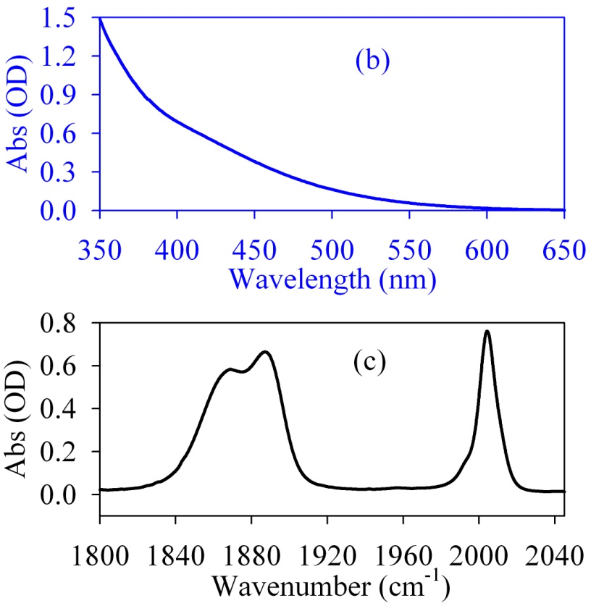
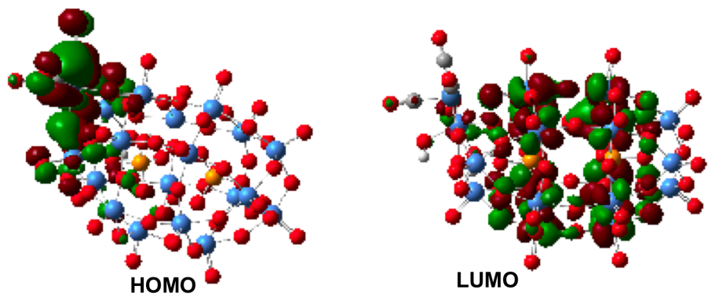
New class of photosentizer (metal-to-POM CT)
(a) X-ray structure of [P₄W₃₅O₁₂₄{Re(CO)₃}₂]^{16–} in combined polyhedral and ball-and-stick notation. Re: yellow; O: red; C: black; WO₆ octahedra: gray; PO₄ tetrahedra: purple. (b) UV–Vis and (c) FTIR spectra of in CH₂Cl₂.
The calculated HOMO and LUMO of the model complex [{P₂W₁₈O₆₃[Re(CO)₃]}(H₂O)(OH)]⁸⁻.
J. Am. Chem. Soc. 2011, 133, 20134

Slide 43
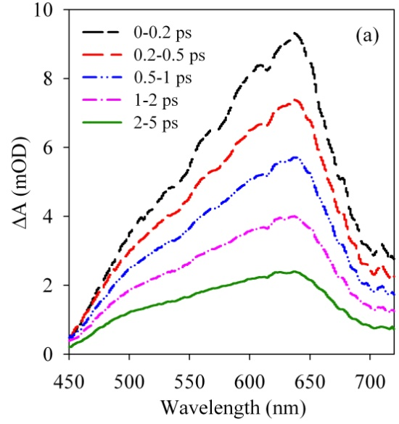
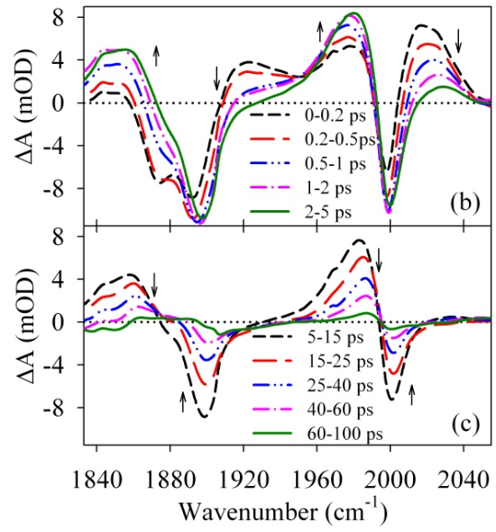
Time-resolved spectroscopic studies
EXCITATION:
New bands: 1925, 2020 cm-1: blue-shifted (electron density on Re is decreased)
reduced POM unit
DECAY:
New Bands: 1850, 1980 cm-1: red-shifted
(hot ground state; vibrational cooling process)
Average transient visible (a), and mid-IR (b, 0~5 ps; c, 5~100 ps) absorption spectra in CH₂Cl₂ at indicated delay time windows after 400 nm excitation.
Arrows in (b) and (c) indicate the directions of amplitude changes.

Slide 44
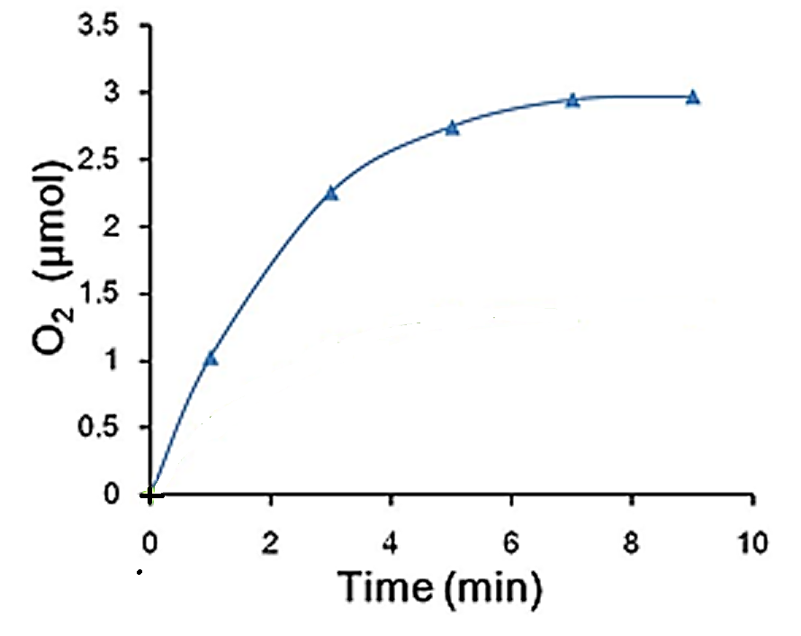
Co₂V₂-POM: Light driven O₂ evolution
Experiment:
d[O₂]/dt ~ 3.3x10⁻⁷ M/s
Y = 4[O₂]/[Ru(bpy)₃³⁺]_{o} ~ 0.7 for Co₄V₂
d[Ru(bpy)₃]³⁺/dt ~ 2.0x10⁻⁶ M/s
Kinetics of O₂ formation with 2 μM Co₄V₂ in light-driven reaction
1.0 mM [Ru(bpy)₃]²⁺, 5.0 mM Na₂S₂O₈, 80 mM borate buffers, pH 9
Expected (d[O₂]/dt)/(d[Ru(bpy)₃]³⁺/dt) = (Y/4) = 0.175 Determined 0.165
Light driven O₂ evolution rate is limited by oxidant generation

Slide 45
Hydrophobic immobilization and stabilization of POMs on semiconductor photoanodes (POM dyads)
(heptyl)₄N⁺ immobilzes and stabilizes Ru₄POM and Co₄P₂-POM on photoelectrodes (Fe₂O₃ and TiO₂ )
1): α-Fe₂O₃
2): 1) + Co₄P₂-POM
3): 2) + toluene wash
4): 3) + Co₄P₂-POM
4)
2)
3)
1)
dark
Film preparation:
drop-cast Co₄P₂-POM:THpA toluene solution on α-Fe₂O₃ films
dry in air
wash with 1M NaOH
Control: Films prepared with Co(NO₃)₂ or Co₄P₂-POM (without THpA) forms CoO_{x} on electrodes. Photocurrent remains after toluene wash

Slide 46
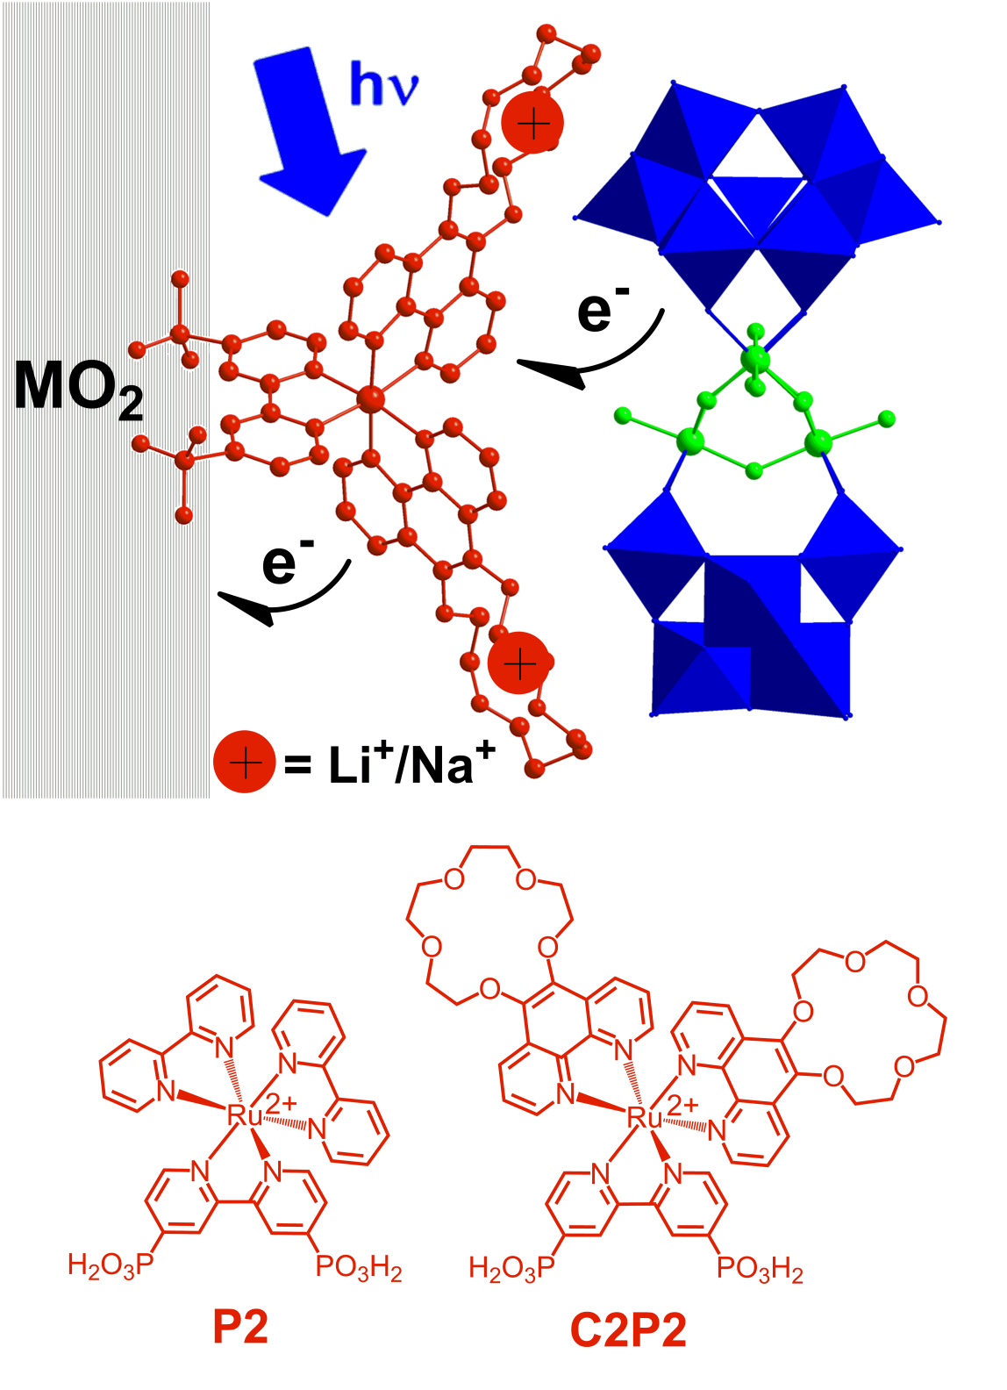
CT and water oxidation in POM-containing nanotriads
Semiconductor–PS-POM WOC Interfaces: Water-Oxidizing Photoelectrodes.
• Triad preparation
• Triad structure (including atomistic knowledge of the metal oxide surface)
• Photocurrent (H₂O ➔ O₂)
• Charge transfer dynamics (experimental and computational)
John Fielden

Slide 47
Evaluation of water oxidation catalytic activity
Water Oxidation (dark)
4 [Ru(bpy)₃]³⁺ + 2 H₂O → 4 [Ru(bpy)₃]²⁺ + O₂ + 4 H⁺
Light-Driven Water Oxidation by Sacrificial Electron Acceptor
2 S₂O₈ ²⁻ + 2 H₂O + 2 hν → 4 SO₄ ²⁻ + O₂ + 4 H⁺
POM WOC
Photoelectrochemical cells: H₂O + 4 hν → H₂ + ½ O₂

Slide 48
Hill group POM WOCs (X-ray structures)
O
Ru
Co
Ni
Ir
Cl;
PO₄/SiO₄/GeO₄
ZnO₄/ZnO₆
WO₆
MoO₆
Chem. Soc. Rev. 2012,
41, 7572–7589.

Slide 49
Hill group POM WOCs (X-ray structures)
O
Ru
Co
Ni
Ir
Cl;
PO₄/SiO₄/GeO₄
ZnO₄/ZnO₆
WO₆
MoO₆
Chem. Soc. Rev. 2012,
41, 7572–7589.

Slide 50
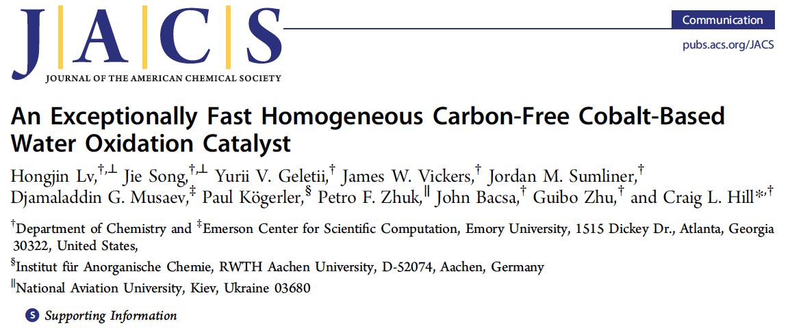
[Co₄(H₂O)₂(VW₉O₃₄)₂]¹⁰⁻ (Co₄V₂-POM)
X-ray structure (R = 2.45%) Co, O, VO₄, WO₆
Just published:
J. Am. Chem. Soc. 2014, 136, 9268
doi.org/10.1021/ja5045488
Lixin Wu

Slide 51
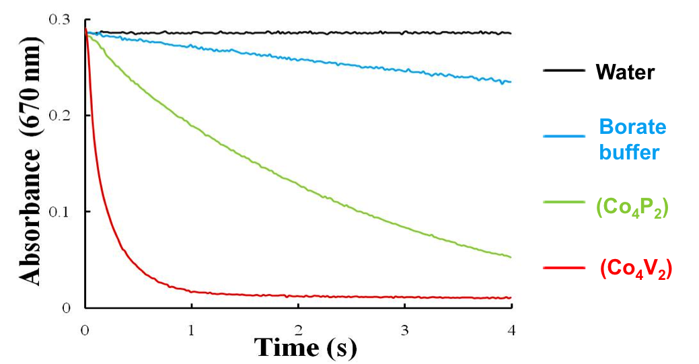
Co₂V₂-POM: extremely fast WOC (TOF > 1000 sec⁻¹)
4 [Ru(bpy)₃]³⁺ + 2 H₂O → 4 [Ru(bpy)₃]²⁺ + O₂ + 4 H⁺
Reduction of [Ru(bpy)₃]3+ to [Ru(bpy)₃]2+ followed at 670 nm with stopped-flow system. Conditions: 1.0 mM [Ru(bpy)₃]3+, 1 µM catalyst, 40 mM borate buffer pH = 8.0.

Slide 52
Catalytic Water Oxidation.
Potentiometric Titration of Co₄P₂ with Co(III)W₁₂
Co(III)W12 + Co4P2(i) =
Co(II)W12 + Co4P2(i+1)
i = 0-2
1 mL of 2 mM Co(III)W12 was titrated by 2 mM Co4P2 in 80 mM sodium borate buffer pH 8.0.
Eº(Co(III)W12)/(Co(II)W12) = 1.05 V (NHEl)
Estimated potentials versus Ag/AgCl:
E₁º(Co4P2(I))/(Co4P2(0)) = (1.1±0.02) V
E₂º(Co4P2(II))/(Co4P2(I)) = (1.07±0.02) V

Slide 53
Co₄P₂ not stable under electrocatalytic conditions
Stracke, Finke, J. Am. Chem. Soc., 2011, 133 , 14872:
500 μM Co₄P₂, electrocatalytic water oxidation at high bias.
4 experiments show Co₄P₂ ➔➔ CoO_{x}
O₂ not measured, TON not addressed.
Scandola, Bonchio et al. Chem. Commun., 2012, 48, 8808:
50 μM Co₄P₂ rate of photogenerated [Ru(bpy)₃]³⁺ reduction by Co₄POM.

Slide 54

Catalytic Water Oxidation.
Potentiometric Titration of Co4P2 with [Ru(bpy)₃]³⁺
[Ru(bpy)₃]³⁺ + Co4P2(i) = [Ru(bpy)₃]²⁺ + Co4P2(i+1), i = 0-4
50 μM Co₄P₂, 80 mM sodium borate buffer pH 8.0. The reaction was followed by formation of [Ru(bpy)₃]²⁺ using a stopped flow instrument
Estimated potentials versus NHE:
E₃º(Co4P2(II))/(Co4P2(III)) = (1.25 ± 0.02) V
E₄º(Co4P2(III))/(Co4P2(IV)) = (1.23 ± 0.02) V E₃º > E₄º

Slide 55
Ongoing work
• polyoxometalate (POM) water oxidation catalysts (WOCs)
• POM WOC stability and reactivity
• photocatalytic POM-based dyads, triads
POM immobilization
• POM-based chromophores and photosensitizers (PS)
• POM H₂O, CO₂ reduction catalysts (noble-metal-free and
water compatible, molecular -- J. Am. Chem. Soc. 2014, 136, 14015)
• pH 14-compatible POM WOCs
• Counter cation effects on POM catalysis, immobilization
(molecular models for MOS electrode surfaces)

Slide 56
Ongoing work
• polyoxometalate (POM) water oxidation catalysts (WOCs)
• POM WOC stability and reactivity
• photocatalytic POM-based dyads, triads
POM immobilization
• POM-based chromophores and photosensitizers (PS)
• POM H₂O, CO₂ reduction catalysts (noble-metal-free and
water compatible, molecular -- J. Am. Chem. Soc. 2014, 136, 14015)
• pH 14-compatible POM WOCs
• Counter cation effects on POM catalysis, immobilization
(molecular models for MOS electrode surfaces)

Slide 57
POMs can address the many challenges for WOCs,
HO•
1e
• fast and selective
H₂O₂
volts
2e
O₂•
• stable
(air, water, heat)
3e
O₂
4e
H₂O
electrons removed
• homogeneous
--experimentally and computationally study molecular level; optimize
--interface with photosensitizer (PS) more controllable
• nontoxic and can mass produce
• inexpensive (earth-abundant metals)
Notes:
57

Slide 58
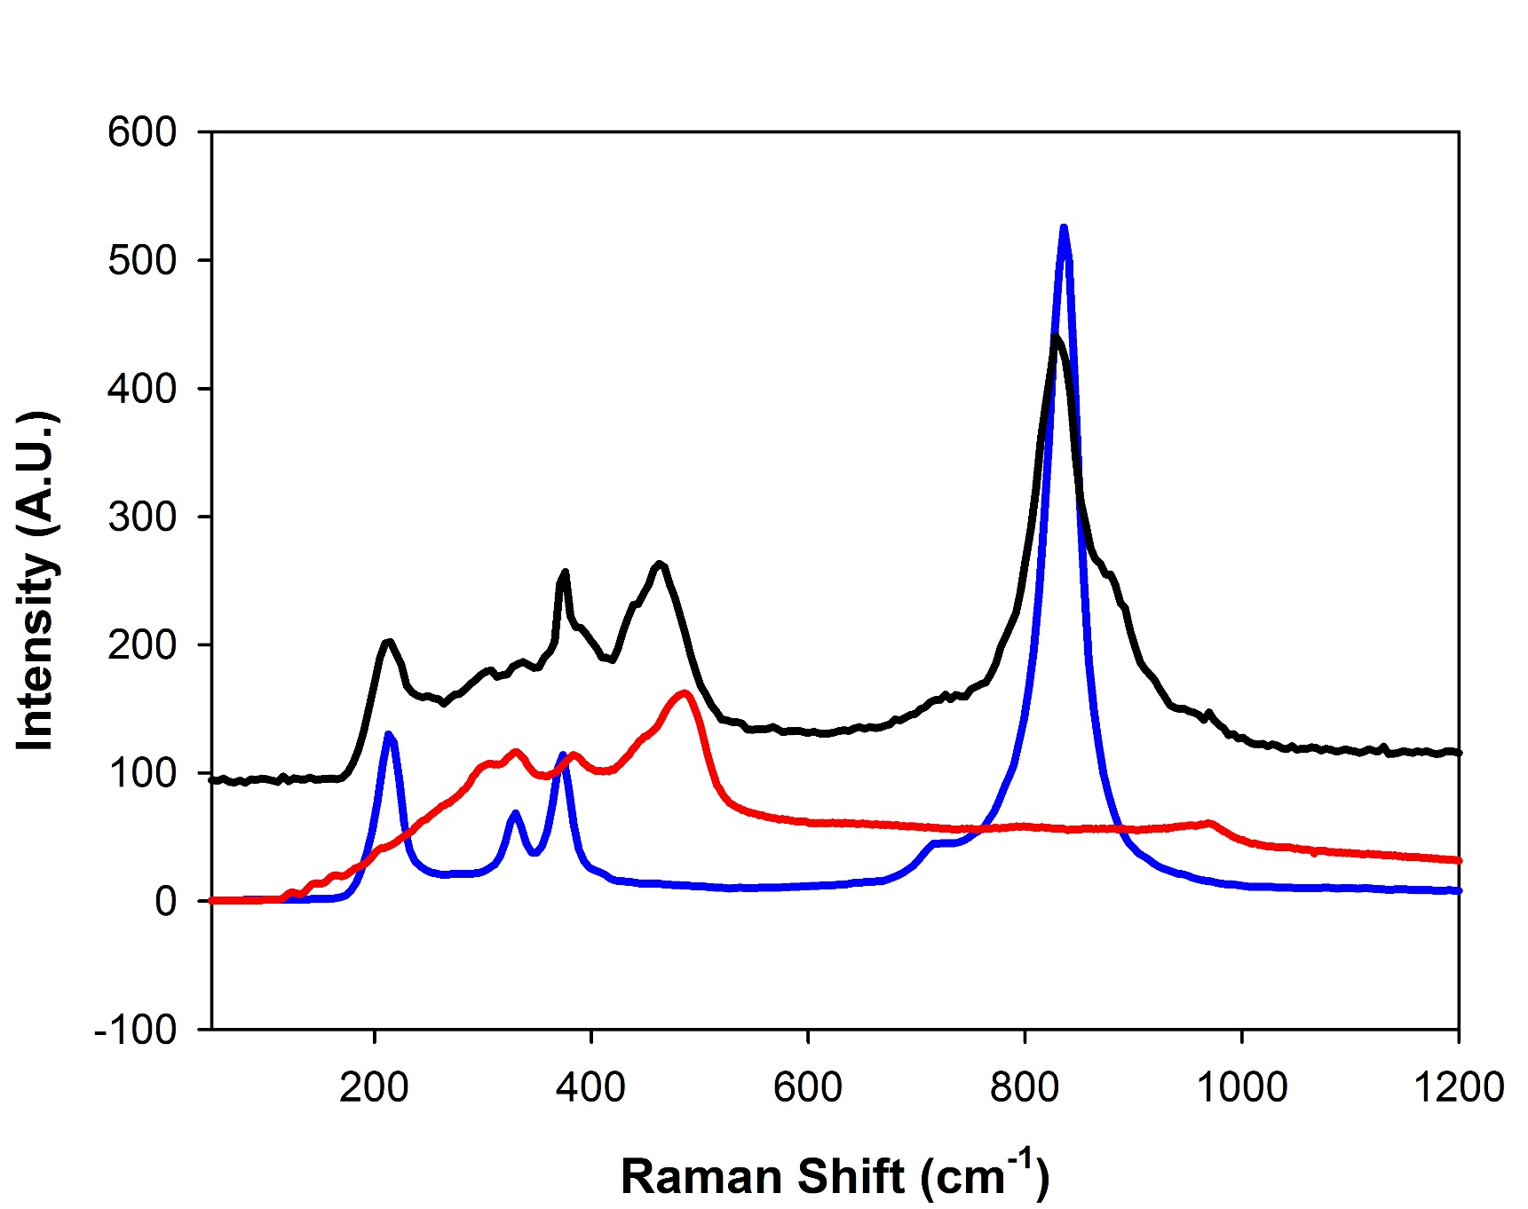
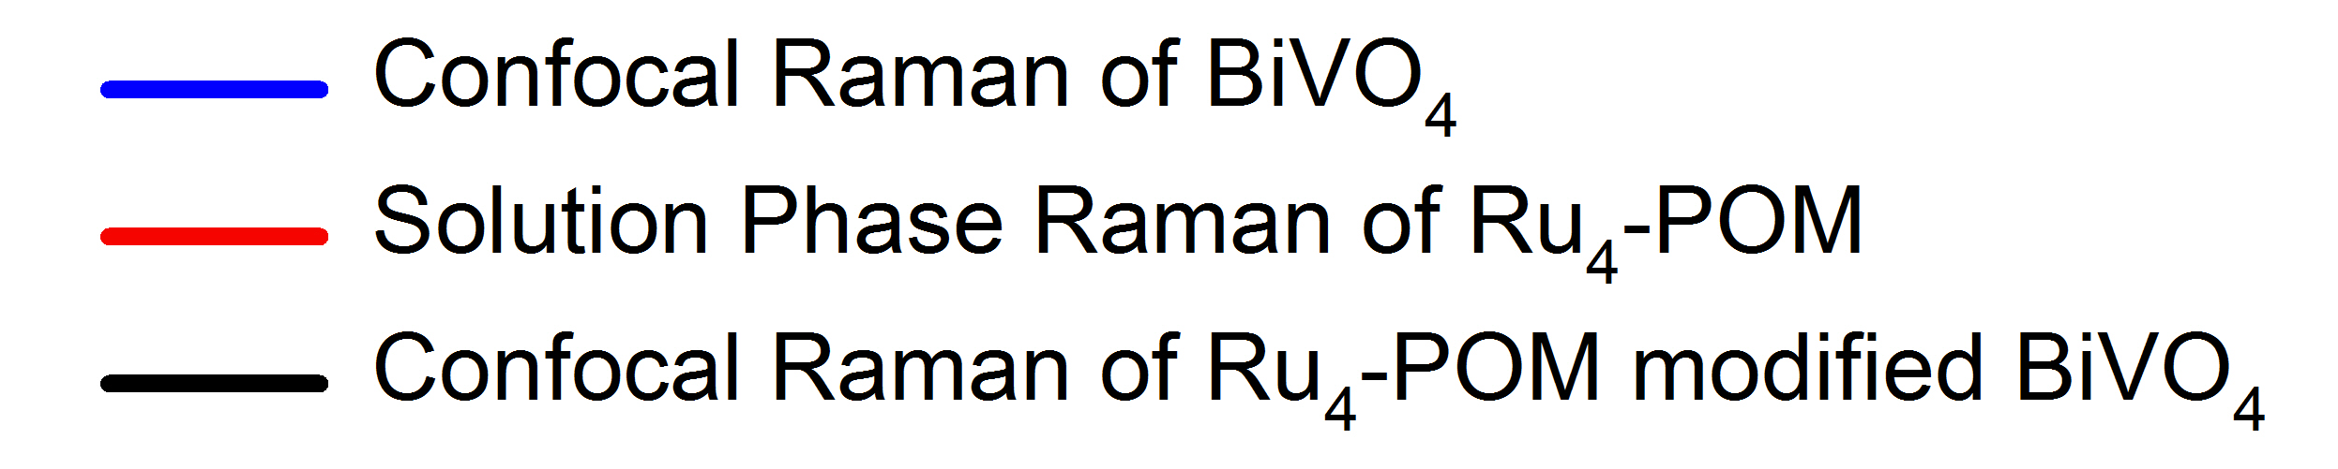
Confocal Raman Characterization of BiVO₄-Ru₄-POM
Conditions
Typical electrodes fabricated for PEC study
Electrode surface was rinsed with IPA and water
514 nm laser
~400 nm spot size
Ben Yin and Sarah Lauinger

