Slide 1

A PRESENTATION ON
“In Ovo Mefloquine and 4-Aminopyridine administration inhibits chorioallantoic membrane (CAM) angiogenesis in chicken embryos through ion-channel modulation.”
Presented by:
CHANDANA KAMILI,
M-Pharmacy(Pharmacology),(Ph.D)
Assistant Professor,
CMR College of Pharmacy, Hyderabad-501401

Slide 2
PRESENTATION OUTLINE
INTRODUCTION
OBJECTIVES FOR THE STUDY
RATIONALE FOR THE STUDY
MATERIALS AND METHODS
RESULTS
DISCUSSION & PROPOSED MECHANISMS
FUTURE PROSPECTIVE
REFERENCES

Slide 3
INTRODUCTION
Angiogenesis is the generation of new blood vessels from pre-existing vasculature.
Angiogenesis has two faces, it plays vital role in maintenance of both health and diseases. Vessel growth could benefit in case of baldness, neurodegenerative ills, heart attack and could be helpful to bypass the clots in blood vessels (occlusion) as well as in tissue repair.
Abundant ion channels are located on the endothelial cell surface. Ion channels have significant role in cell proliferation and thus in angiogenesis
.

Slide 4
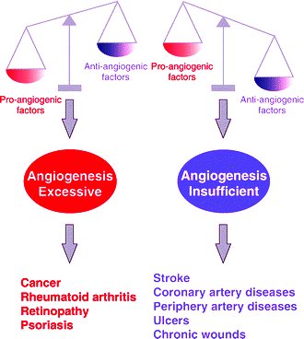
DISEASES INVOLVED IN ANGIOGENIC IMBALANCE

Slide 5
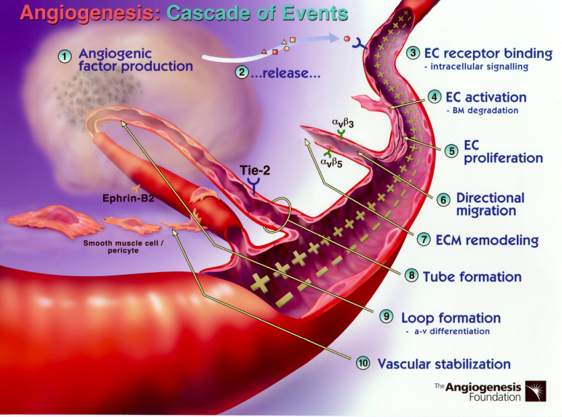
MECHANISM OF ANGIOGENESIS

Slide 6
OBJECTIVES OF THE WORK
The study aimed to investigate the effects of Mefloquine (Cl⁻ channel blocker) and 4-Aminopyridine (K⁺ channel blocker) on angiogenesis
At what concentration of the test drugs show maximum percentage inhibition of neovascularization..
The number of branches formed in test drug treated groups in CAM assay and to compare with the control group.

Slide 7
RATIONALE BEHIND THE STUDY
Excess
insufficient
Angiogenesis
Ion channel modulators
Cancer
Rheumatoid Arthritis
Retinopathy
Obesity
psoriasis
Stroke
Coronary artery diseases
Chronic wounds
Ulcers
Mefloquine
4-Aminopyridine
Ion channels
Cell proliferation
Endithelial cells contain ion channels

Slide 9
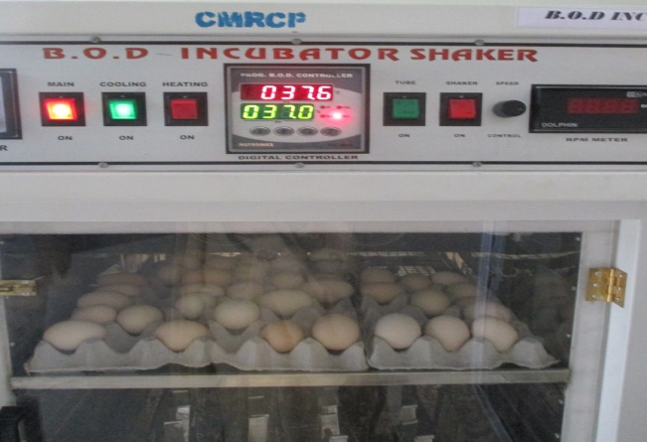
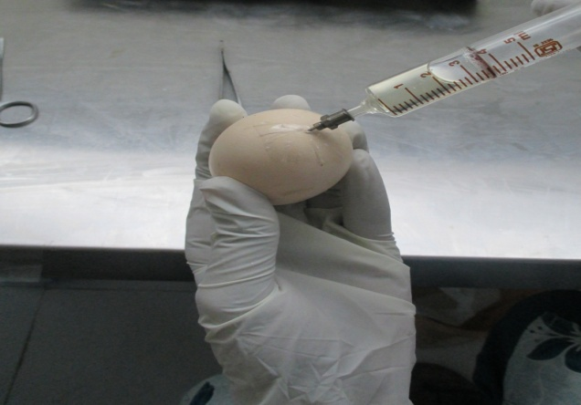
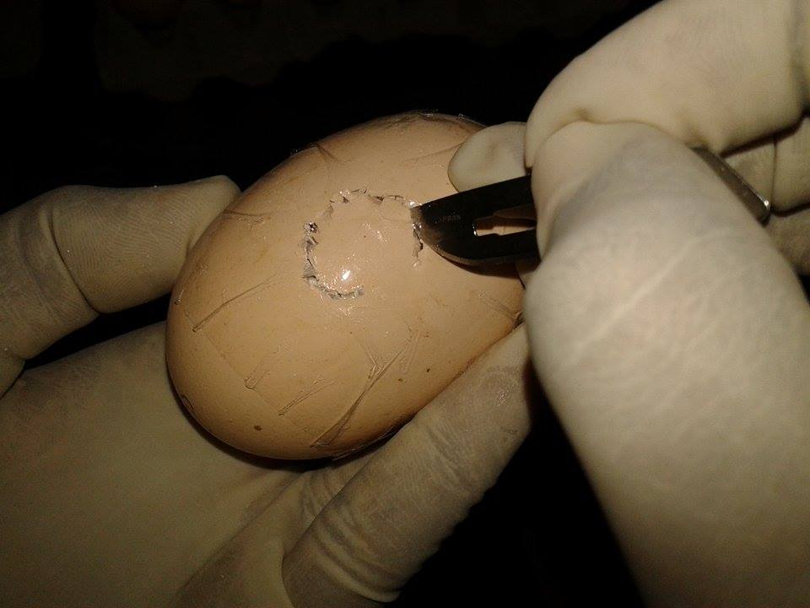
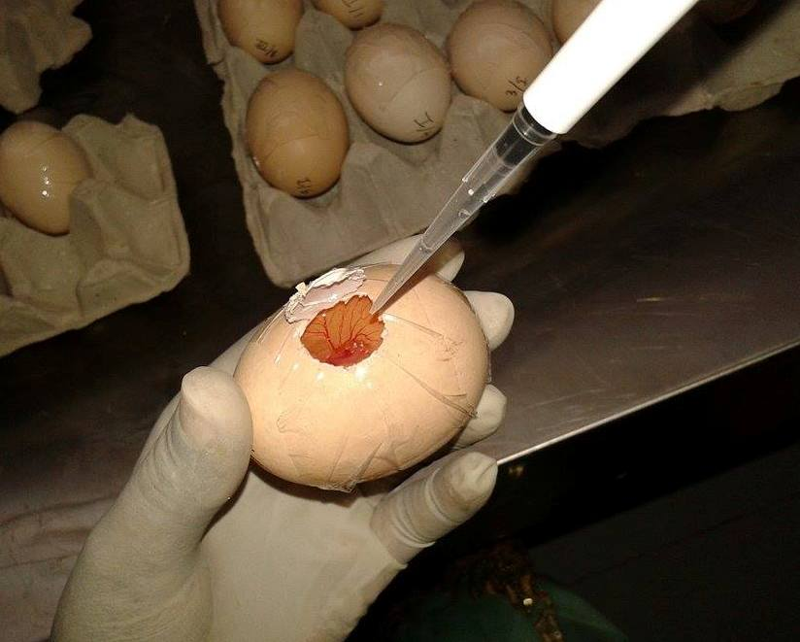
CAM assay

Slide 10
Chick choreoallantoic membrane assay:
Fertilized, white leghorn chicken eggs
(on 0 day of incubation)
Incubated at 37⁰C
3rd day
Narrow end was drilled to withdraw albumin
7th day
Small square window was opened to implant drugs
Resealed and reincubated
On 15th day number of branching points were quantified

Slide 11
Dosing schedule:
GROUP NO. | TREATMENT (CAM Assay) | Dose (μg/egg)
I | - | -
II | Mefloquine | 10
III | Mefloquine | 50
IV | Mefloquine | 100
V | 4-Aminopyridine | 100
VI | 4-Aminopyridine | 250
VII | 4-Aminopyridine | 500

Slide 12
Statistics
The data was analyzed by one-way ANOVA followed by Dunnett test using Graph pad prism5.0 software. Values are significant at * p<0.05. Comparison of the test groups were done with disease control group. Values are expressed as mean ± SEM

Slide 13
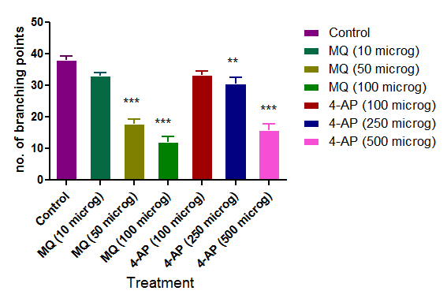
Results
CAM Assay
Number of branching points
Group No | Treatment (dose/egg) | No. of branching points
1. | Control | 38.16±1.138
2. | Mefloquine (10 μg) | 33.16±0.792
3. | Mefloquine (50 μg) | 18±1.414 ***
4. | Mefloquine (100 μg) | 12.33±1.542 ***
5. | 4-AP (100μg) | 33.5±0.991
6. | 4-AP (250μg) | 30.83±1.662 **
7. | 4-AP (500μg) | 16±1.862 ***

Slide 14
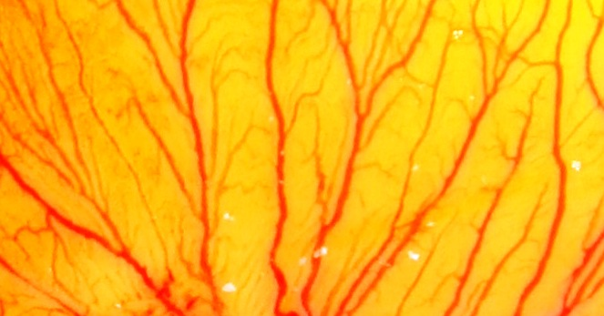
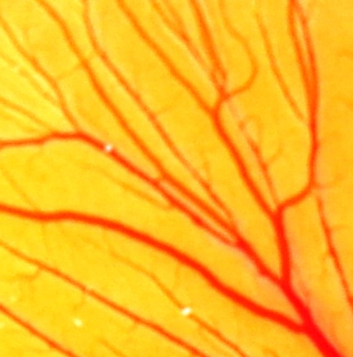
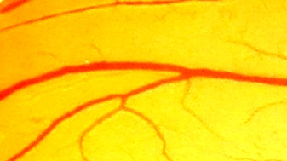
Results
CAM Assay
Images were captured from Trinocular Microscope at magnification of 40X.
Control Mefloquine (10 μg) Mefloquine (50 μg)

Slide 15
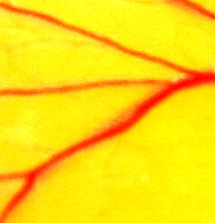
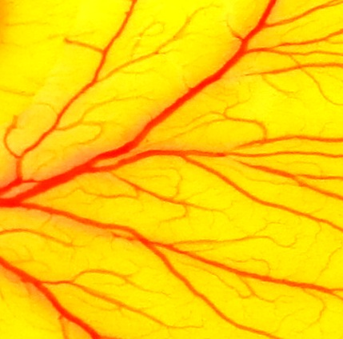
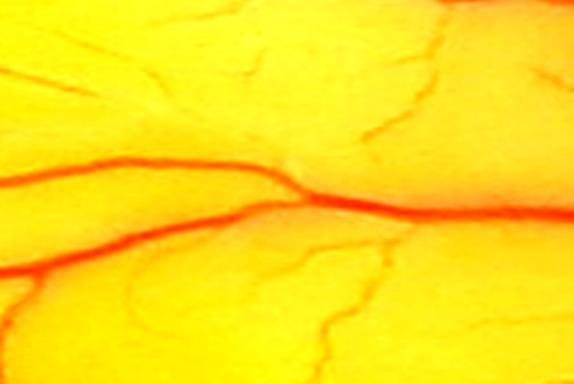
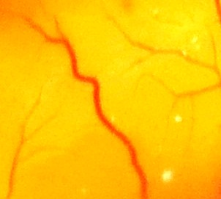
Results
CAM Assay
Mefloquine (100μg) 4-AP (100 μg) 4-AP (250 μg)
4-AP (500 μM)

Slide 16
Results
CAM Assay
Angiogenesis score
No. of branching points | Angiogenesis score
≥35 | 4
25-34 | 3
15-24 | 2
<15 | 1

Slide 17
Significance values of the results obtained
S.No. | Experimental method | Parameter | Treatment | Significance
 |  |  |  | Low dose | Medium dose | High dose
1. | CAM Assay | Number of branches | Mefloquine | NS | *** | ***
 |  |  | 4-AP | NS | ** | ***
 |  | Angiogenesis score | Mefloquine | - | - | -
 |  |  | 4-AP | - | - | -

Slide 18
Discussion
Angiogenesis
Blood vessels
Ion channels
Potassium channels
Volume regulated anion channels
Sodium channels
Calcium channels
Ion channels
Cell proliferation
Migration
-
Blockers

Slide 19
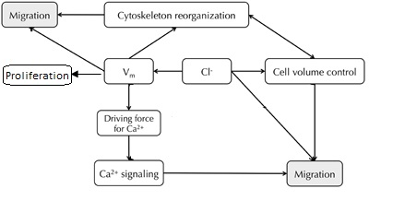
Mechanisms
Mefloquine
Maintains membrane potential
Regulation of the driving force for Ca²⁺
that regulates
secondary messengers
for cell proliferation

Slide 20
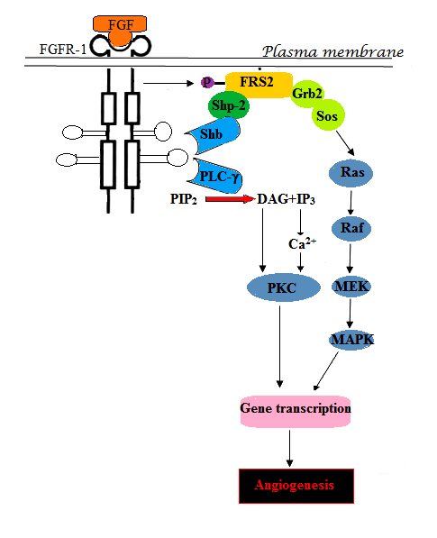
Mechanisms
Mefloquine
Chloride is needed for the expression of Ras
(a small G-protein molecule)
that regulates
a large number of intracellular signaling pathways
affecting cell proliferation and motility.

Slide 21
Mechanisms
4-Aminopyridine
K⁺ channels activation
hyperpolarisation
Ca²⁺ influx
Calcium signaling
Ca²⁺-dependent transcriptional factors activation
progression through
G1, the G1/S transition, and G2/M
Expression of cell cycle regulatory proteins
cyclins, CDKs

Slide 22
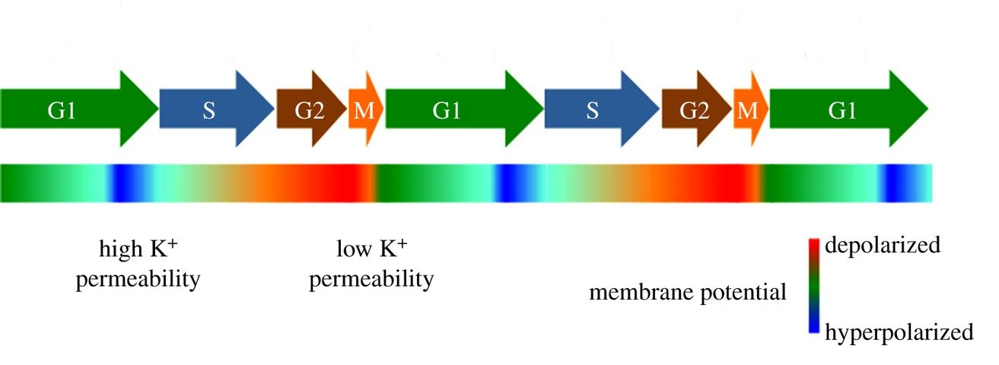
Mechanisms
4-Aminopyridine

Slide 23
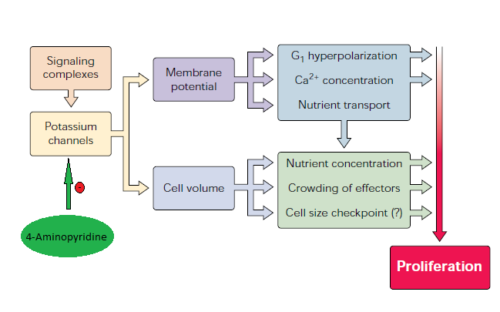
Mechanisms
4-Aminopyridine

Slide 24
Conclusion
We report here that VRAC blocker, Mefloquine and volume regulated K⁺ channel blocker, 4-AP inhibit new vessel formation in all three models. These results suggest that Mefloquine and 4-AP may be useful in the therapy of angiogenesis-dependent tumor growth and other angiogenesis-dependent diseases

