Slide 1


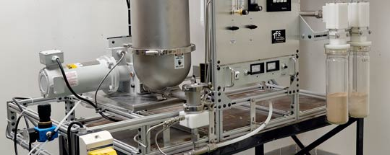
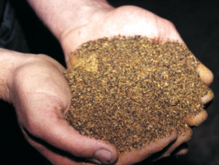
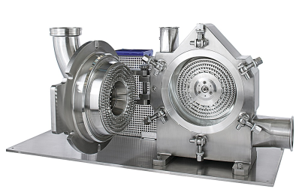
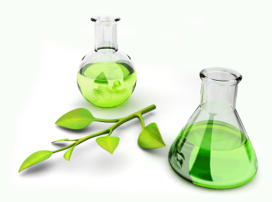

Thermo-chemical pretreatments for the combined recovery of extractives and bioethanol production from softwood bark C. Sambusiti, Chloé Navas, Eric Dubreucq, Abdellatif Barakat
Past and Present Research Systems of Green Chemistry
September 14-16/2015 Orlando (USA)

Slide 2
Introduction – Lignocellulosic biorefinery (2° generation)
Anaerobic digestion
Dark fermentation
Bioethanol fermentation
Oil extraction
Biological platforms
BioEtOH
Bio-diesel
Renewable energies
(CHP system)
VFA
BIOMASS
Fuels, chemicals & materials
BioCH4
Thermochemical platforms
BioH2
Combustion
Pyrolysis
Gasification
HTC & HTL

Slide 3
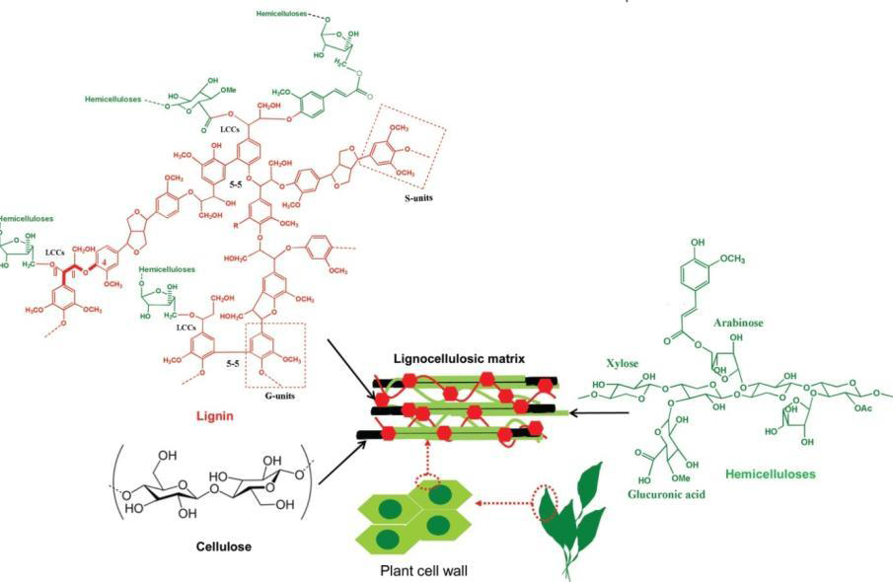
Lignocellulosic biomass – structure/composition
Cellulose : 10-60%
Hemicelluloses: 10-40%
Lignin: 5-60%
Cellulosic structures are interconnected by a network of hemicelluloses embedded by lignin.
Scheme of composition of plant cell walls in a lignocellulosic matrix. (adapted from Monlau et al., 2012).

Slide 4
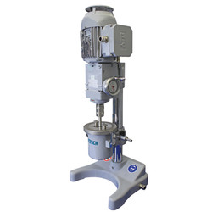
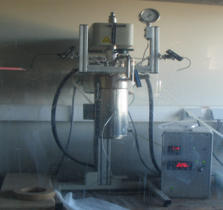
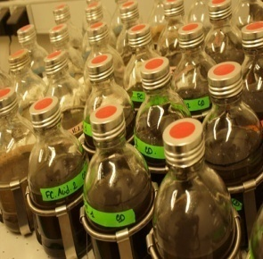
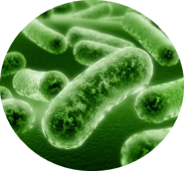
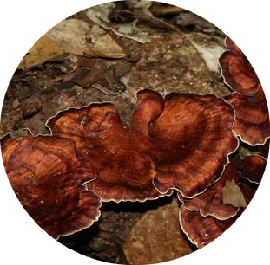

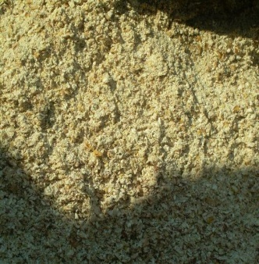
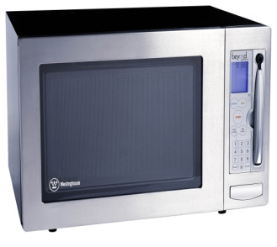
Lignocellulosic pretreatments - categories
Physical
Chemical
Biological
Mechanical (i.e. chipping, grinding, milling, …)
Enzymes or fungi
Steam explosion, Liquid Hot Water
Oxidative, alkaline, dilute-acid, ionic liquids, wet oxidation and inorganic salts pretreatments
Ensiling
Microwaves,
Ultrasound
 | Pretreatments | Mechanical | Chemical | Physicochemical | Biological
Physico-chemical properties | Particles size | ●●● | ○ | ○ | ○
 | Specific surface area (SA) | ●●● | ●● | ● | ●
 | Polymerization degree | ●● | ●●● | ●● | ●●●
 | Pore volume | ●● | ●● | ● | ●
 | Crystallinity (CrI) | ●●● | ●● | ● | ○
 | Lignin solubilisation (LiG) | ○ | ●● | ● | ●●
 | Hemicelluloses solubilisation | ○ | ●●● | ●● | ●●
 | LCCs degradation | nd | ●● | nd | nd
 | Cellulose solubilisation | ○ | ●● | ● | ●●
●●● major positive effect, ● minor positive effect, ○ No effect

Slide 5
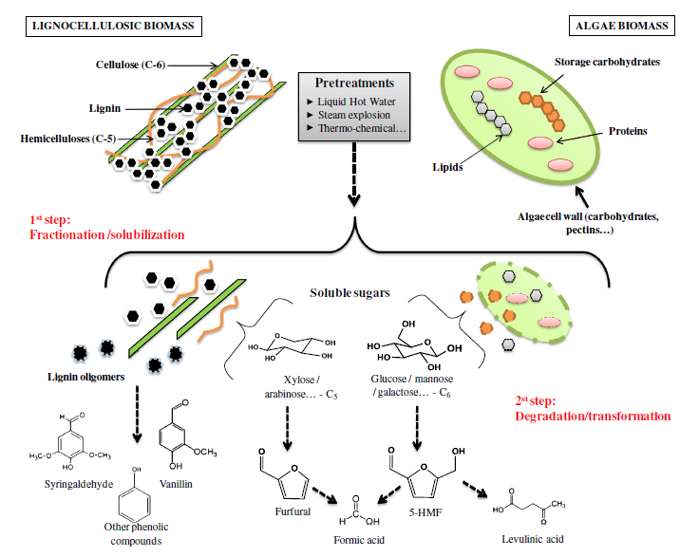
Lignocellulosic pretreatments - drawbacks
F. Monlau , C. Sambusiti, A. Barakat, M. Quéméneur, E. Trably, J.-P. Steyer, H. Carrère (2014). Do furanic and phenolic compounds of lignocellulosic and algae biomass hydrolyzate inhibit anaerobic mixed cultures? A comprehensive review. Biotechnology Advance.

Slide 6
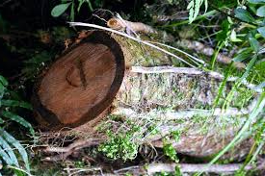
Introduction – Softwood-to-ethanol process scheme
Barked
De-barked
Pretreatments:
Mechanical (chipping, milling,....)
Physico-chemical (steam explosion,...)
SSF
Enzymatic hydrolysis
Fermentation
SHF
Ethanol

Slide 7
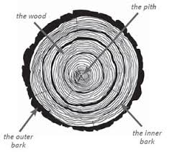
Introduction – Chemical composition of softwoods
BARK
(INNER AND OUTER)
WOOD
≈ 12% of the total weight of a tree
 | Wood | Bark
Lignin (%)* | 25-30 | 40-55
Polysaccharides (i.e. glucan, mannan, xylan, galactan, arabinan) (%)* | 66-72 | 30-48
Extractives (%) | 2-9 | 2-25
Ash (%)* | 0.2-0.6 | Up to 20
* Based on extractives free material (USDA et al., 1971)
N.B. Chemical composition varies according to plant type, plant varieties, plant part and maturity

Slide 8
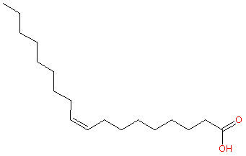
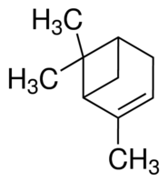
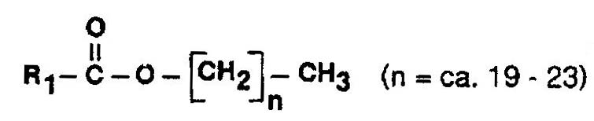
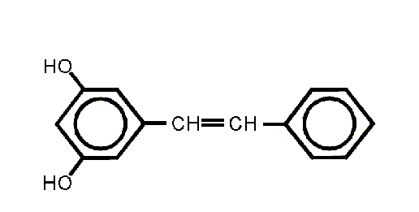
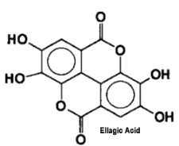

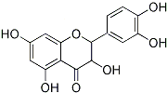
Introduction – Extractives
Fatty acids
Oleoresins (i.e. monoterpenoids and diterpenoids)
Group of non-structural components in wood
They consist of both hydrophilic and lipophilic compounds
Dissolves in either water or organic solvents
Protects the tree from microbic and insect attacks
Different amounts and distribution of extractives, dependent on: - wood species - growing site (latitude, altitude, wind exposure etc) - position within the tree - genetic factors
Waxes
R1= fatty acid chain
Phenolic compounds
1. Stilbenes
2. Tannins
4. Flavanoids
3. Lignans

Slide 9
Objectives of this work
Evaluation of the effect of organosolv/diluted acid pretreatment on chemical composition of softwood bark
Evaluate the feasibility of ethanol production from softwood bark and the influence of residual extractives on ethanol fermentation

Slide 10
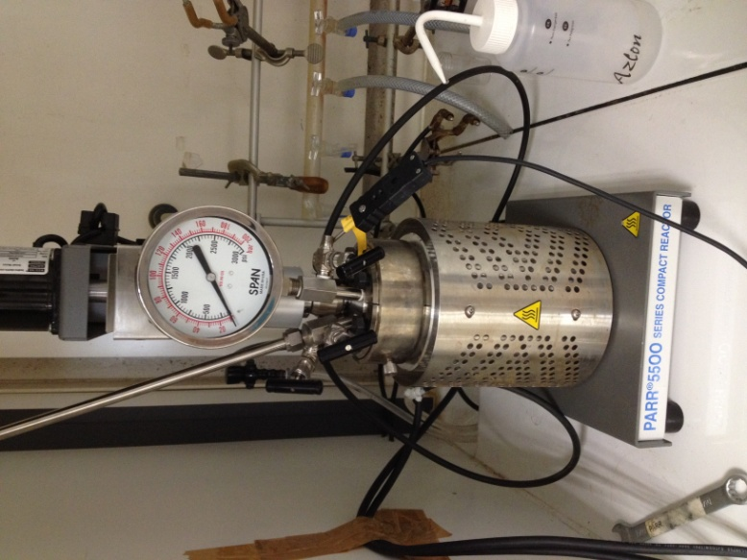
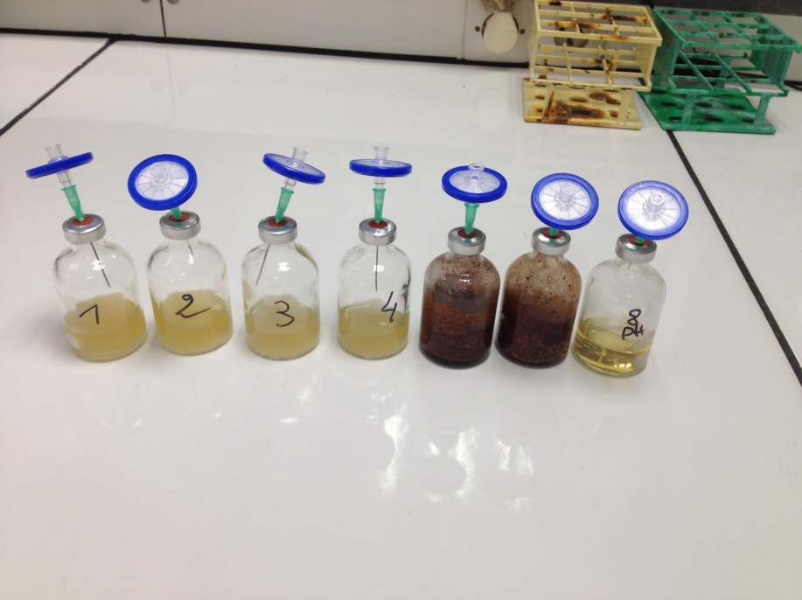
Materials and methods – experimental procedure
Softwood bark
Liquid fraction
Solid fraction
Cutting milling
(2 mm screen size)
Organosolv/diluted acid
pretreatment
Simultaneous Saccharification and Fermentation (SSF)
Extractives

Slide 11
Materials and methods – pretreatment conditions
 | Organosolv | Diluted acid | Diluted acid-Organosolv
Solid loading (gTS.L⁻¹) | 100 | 100 | 100
H₂SO₄ dosage (mM) | - | 8 | 8
Ethanol dosage (% v/v) | 65 | - | 65
Temperature (°C) | 150-180 | 150-180 | 150-180
Time (h) | 1 | 1 | 1

Slide 12
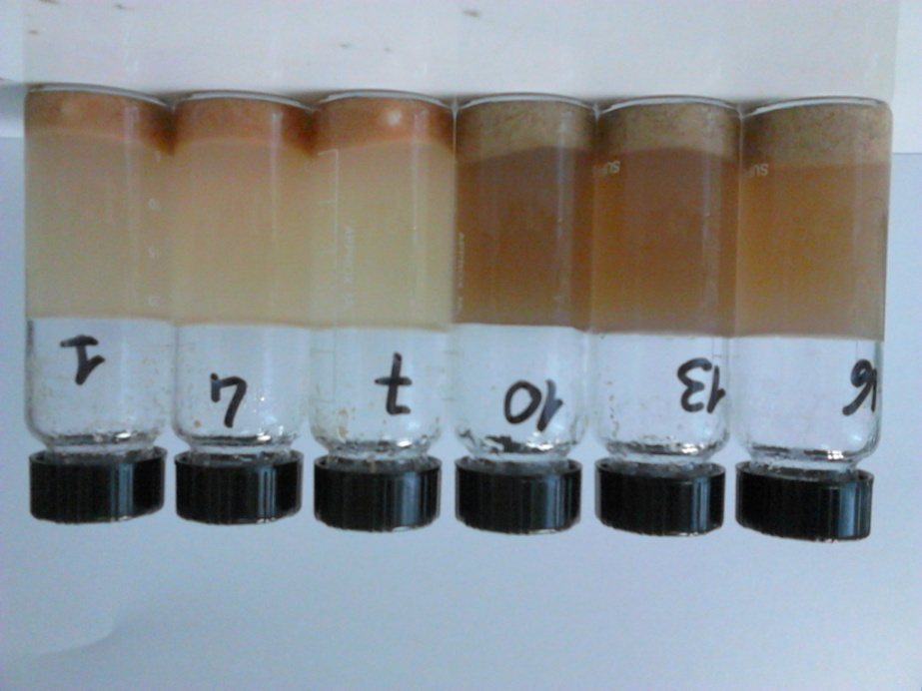
Materials and methods – Ethanol fermentation
Test preparation:
Solid loading: 60 gTS/L
Enzymatic cocktail: xylanase (33.15 IU/gTS), endoglucanase (261 IU/gTS), exoglucanase (1.14 IU/gTS) and beta-glucosidase (4785 IU/gTS)
Nutritive solution: acetate buffer (50 mM, pH=5); yeast extract (5 g/kg); urea (0.4 g/kg); 50 ppm chloramphenicol)
Yeast: S. cerevisiae for C6 conversion, produced by our team (1.5 g/kg)
Operational conditions:
T° = 40°C,
Time = 72 h
pH = 5
Stirring: 500 rpm
Monomeric sugars and ethanol analysed by HPLC

Slide 13
Results – chemical composition
Untreated softwood bark
Parameter | Mean±S.D.
TS (gTS.100g⁻¹_{fresh matter}) | 94.6 ± 0.0
VS (gVS.100g⁻¹TS) | 97.7 ± 0.1
Ash (g.100g⁻¹TS) | 2.1 ± 0.2
Cellulose (g.100g⁻¹TS) | 14.9± 2.3
Hemicelluloses (g.100g⁻¹TS)* | 10.3 ± 1.7
Klason lignin (g.100g⁻¹TS)** | 60.4 ± 2.1
DCM extractives (g.100g⁻¹TS) | 9.8 ± 1.5
Proteins (g.100g⁻¹TS) | 2.4 ± 0.3
* Xylose/mannose/galactose/arabinose monomers
**Calculated after extraction with DCM

Slide 14
Results – chemical composition
Untreated softwood bark
Molecule Structure | Chemical formula | Extract DCM mg/gTS
Polyols
(Z)-4-methyl-pent-2-ene-2,4-diol | C₆H₁₂O₂ | 45.81
Fatty acids and other carboxylic acids
palmitic acid | C₁₆H₃₂O₂ | 21.02
oleic acid | C₁₈H₃₄O₂ | 5.78
Aromatic compounds
2-(3,4-dihydroxyphenyl)chroman-3,5,7-triol | C₁₄H₈O₄ | 6.69
Resin acids
isopimaric acid | C₂₀H₃₀O₂ | 4.46
dehydroabietic acid | C₂₀H₂₈O₂ | 12.87
Alkaloids
agroclavine | C₁₆H₁₈N₂ | 2.74

Slide 15
Results – chemical composition
Pretreated softwood bark (solid separated residues)

Slide 16
Results – chemical composition
Exctractives recovery after pretreatment (liquid fractions)
 | Organosolv |  | Diluted acid |  | Diluted acid-organosolv
 | 150 °C | 180 °C | 150 °C | 180 °C | 150 °C | 180 °C
 | mg g⁻¹TSin
Polyols | 11.1 | 4.2 | 0.4 | 0.4 | 6.2 | 5.6
Fatty acids and other carboxylic acids | 7.3 | 6.1 | 0.2 | 0.6 | 3.5 | 2.7
Sugar derivatives | 5.3 | 11.7 | 0.1 | n.d. | 4.5 | 12.9
Aromatic compounds | 8.6 | 7.3 | 0.2 | 0.8 | 11.6 | 5.4
Resin acids | 7.6 | 4.2 | n.d. | n.d. | 3.6 | 2.8
Total | 39.9 | 33.6 | 0.9 | 1.8 | 29.3 | 29.3

Slide 17
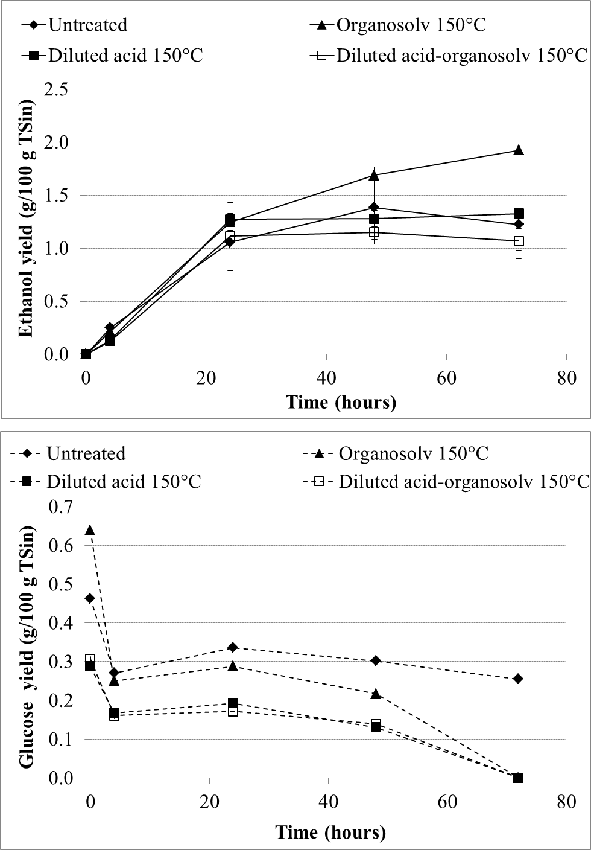
Results – Simultaneous saccharification and fermentation
yeast quickly consumed free glucose after inoculation and more than 90% of the ethanol was produced during the first 48h in all fermentations.
Fermentation of untreated bark produced 12 g/kgTS (16% of the theoretical conversion of glucose).
Organosolv pretreatment performed at 150°C led to the highest increase of ethanol yield (up to 20 g/kgTS), corresponding to 18% of the theoretical conversion of glucose.
Ethanol yields are very low confirming that during SSF enzymatic hydrolysis of cellulose is the limiting step.

Slide 18
Conclusions
In terms of chemical composition:
All pretreatments led to a solubilization of lignin, tannins and suberin
Cellulose was not solubilized by the pretreatment, while a slight solubilization of hemicelluloses seemed to occur also during organosolv and diluted acid pretreatments, especially at 180°C.
The amount of extractives originally present in the untreated bark, were not totally solubilized by the pretreatments. However, organosolv and diluted-acid organosolv pretreatments led to a high release of extractives (up to 40% w/w) if compared to those originally present in the bark sample.
According to fermentation results:
In all cases the yeast quickly consumed free glucose after inoculation during the first 48h in all fermentations. These results suggest that no inhibition of fermentation occurred during SSF
Experimental ethanol yields are very low compared to the expected, so enzymatic hydrolysis of cellulose remains the limiting step.

Slide 19
Acknowledgment
This research study has been supported by FUTUROL project , which is gratefully acknowledged.
The authors are also grateful to BPI-France for the financial support to the project.

Slide 20

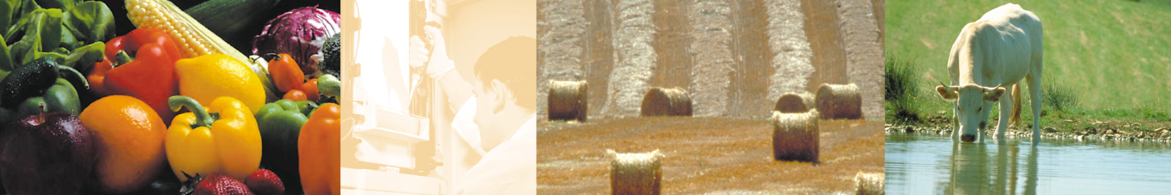
Thanks for your attention!

