Slide 1
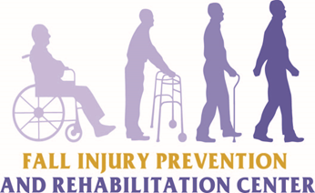
Fall Injury Prevention & Rehabilitation Services LLC
Dr. Cassandra Warner FriesoN, DNP, CRNP
Founder & President

Slide 2
Disclaimer
The information provided in this presentation is based on best practice interventions from research findings that reveal the most recent evidence for fall prevention and management in community-dwelling elderly. The presenter does not develop or endorse the evidence-based interventions. The information provided is for educational purposes only and may serve as a guide to clinical practice. The presenter assumes no liability for the content of information, or the clinical effectiveness of the best practices interventions and related materials.

Slide 3

OBJECTIVES
Increase awareness of the growing national public health concern of falls in older adults
Discuss the screening, assessment, and referral process for fall prevention as identified in the FIPAR Fall Risk Assessment Model
Apply FIPAR’s evidence-based fall prevention services in the clinical, academic, and research communities to prevent injurious falls in the elderly

Slide 4
DEFINITION OF A FALL
“Inadvertently coming to rest on the ground, floor or other lower level, excluding intentional change in position to rest in furniture, wall or other objects”.
World Health Organization, 2007

Slide 5
SIGNIFICANCE
Every 20 minutes an older adult dies as a result of a fall
One out of every three adults >65 years of age falls each year
Falls are the #1 cause of injury and #6 cause of death in the elderly
Falls account for 80-95% of hip fractures
Financial toll: Expected to reach $67.7 billion by the year 2020
(National Council on Aging, 2015; CDC, 2014)

Slide 6
Lloyd B. Minor, M.D.
“. . . Recent government reports estimate that fatal falls in the elderly cost the U.S. Medicare program nearly $1 billion in hospital charges, and those injured with broken bones cost an additional $19 billion.”
Andelot Professor and director of otolaryngology – head and neck surgery at the Johns Hopkins University School of Medicine

Slide 7
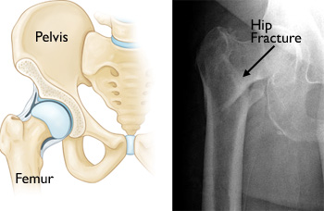
Hip Fractures:
1/2 hospitalized do not regain their former level of mobility
5-20% overall reduction in life expectancy
20% will die within a year
Johns Hopkins Survey, 2009
American Academy Of Orthopaedic Surgeons (AAOS), 2013

Slide 8
FALL INJURY OUTCOMES
Increased risk of premature death
Disability
Reduced social interactions
Premature nursing home placement

Slide 9
Evidence-based Components
Nursing Home Setting:
Morse Fall Scale
Tai Chi Exercises
Vitamin D Screening and Supplementation
Pharmacy Medication Review and Consultation
Interdisciplinary Fall Prevention Team

Slide 10
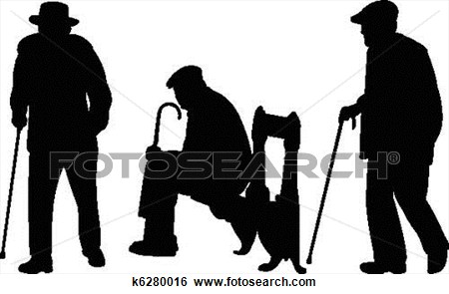
RESULTS
NO SIGNIFICANT CHANGE IN OVERALL FALL RATES

Slide 11
Why Target Community-Dwelling Elderly?
Fact: Sixty percent of falls among older adults occur in the home environment
Goals:
Prevent injurious falls among community-dwelling elderly
Maintain safety in the home
Avoid disability, premature nursing home placement, and even subsequent death

Slide 12
FALL INJURY PREVENTION AND REHAB CENTER
VISION: To promote an injurious falls-free community for older Americans through clinical practice, administration, education, and research
MISSION: To improve the safety of older Americans and the efficiency of community-based fall prevention services for the elderly
GOALS: Decrease injurious falls and overall falls 12-month no fall outcome

Slide 13
Interdisciplinary Fall Team Members
Certified Registered Nurse Practitioner
Collaborative Physician
Certified Tai Chi Instructor
Occupational Therapist
Community Social Worker
Audiologist

Slide 14
Why Perform Vestibular Testing?
1/3 of American adults or 69 million men and women over age 40 are 12x more likely to have a serious fall due to vestibular dysfunctions
1/3 of this group or more than 22 million have vestibular dysfunctions but have not been identified as a fall risk due to no prior incidents of disequilibrium or sudden onset of falls
These asymptomatic people were 6 times more likely to suffer a fall that was potentially fatal as compared to individuals with healthy balance
Johns Hopkins Survey, Archives of Internal Medicine, 2009

Slide 15
Lloyd B. Minor, M.D.
“Vestibular imbalances need to be taken seriously because falls can be fatal and injuries can be painful, lead to long hospital stays and result in significant loss in quality of life.”
Andelot Professor and director of otolaryngology – head and neck surgery at the Johns Hopkins University School of Medicine

Slide 18
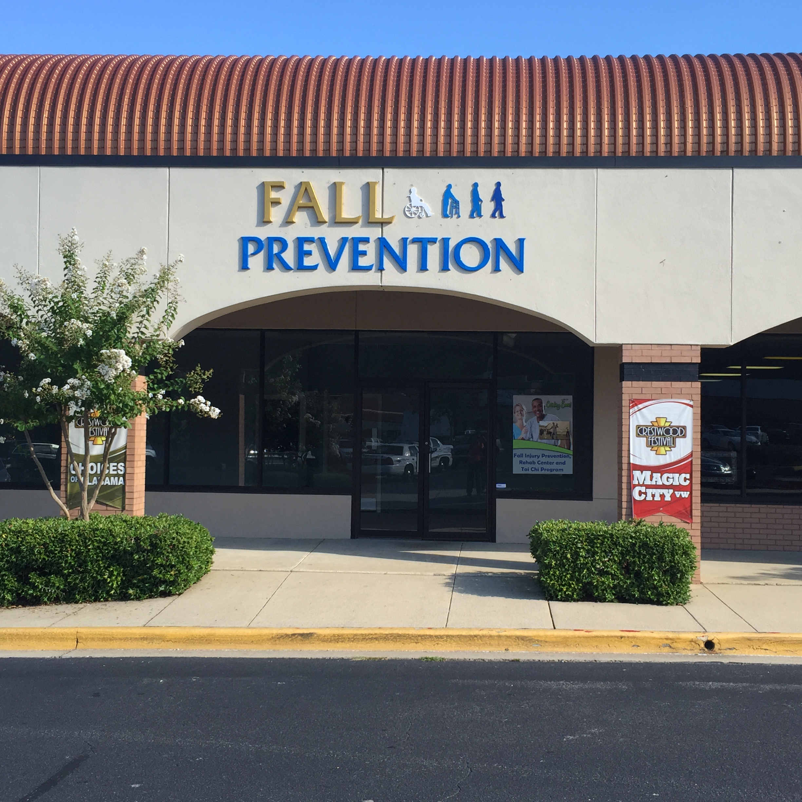
Fall Injury Prevention & Rehabilitation Center
FIPAR Center Opened June 2015
Office hours: Monday thru Friday 9am - 5pm
Evidence-based, Multi-factorial Program
Centralized location for a community ambulatory health care center
Located in a suburban area near senior residences, assisted living facilities, and nursing homes
“One-stop” community center for fall prevention education, medical diagnostic testing and comprehensive Tai Chi Program

Slide 19
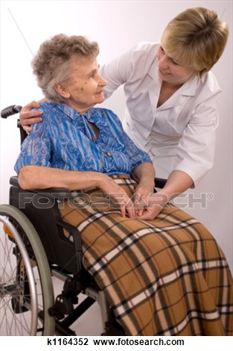
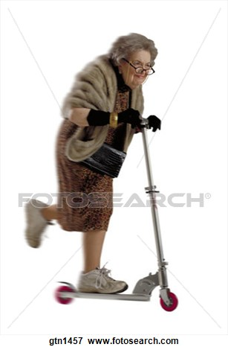
Individualized Goal Setting is Realistic

Slide 20
Research Priorities
Seek Funding Opportunities
Engage in future research
Support on-going community fall prevention initiatives

Slide 21
References
American Academy of Orthopaedic Surgeons. (2007). Falls and hip fractures. Retrieved from http://orthoinfo.aaos.org/topic.cfm?topic=A00121
Brians, L. K., Alexander, K., Grota, P., Chen, R. W., & Dumas, V. (1991, March-April). The development of the RISK tool for fall prevention. Rehabilitation Nursing, 16(2), 67-69.
Broe, K. E., Chen, T. C., Weinberg, J., Bischoff-Ferrari, H. A., Holick, M. F., & Kiel, D. P. (2007, February). A higher dose of vitamin D reduces the risk of falls in nursing home residents: A randomized, multiple-dose study. Journal of the American Geriatrics Society, 55(2), 234-239.
Cameron, I. D., Murray, G. R., Gillespie, L. D., Robertson, M. C., Hill, K. D., Cumming, R. G., & Kerse, N. (2010). Interventions for preventing falls in older people in nursing care facilities and hospitals (Review). Retrieved February 8, 2010, from http://www.thecochranelibrary.com
Centers for Disease Control and Prevention (2010). Costs of falls among older adults. Retrieved April 11, 2010, from
http://www.cdc.gov/HomeandRecreationalSafety/Falls/fallcost.html/
Centers for Disease Control and Prevention. (2010). Hip fractures among older adults. Retrieved from
http://www.cdc.gov/HomeandRecreationalSafety/Falls/adulthipfx.html
Centers for Disease Control and Prevention. (2009). Falls in nursing homes. Retrieved February 8, 2010, from
http://www.cdc.gov/HomeandRecreationalSafety/Falls/nursing.html
Centers for Medicare & Medicaid Services. (2011). Nursing Home Quality Initiatives: MDS 3.0 Training Material. Retrieved from https://www.cms.gov/NursingHomeQualityInits/30_NHQIMDS30TechnicalInformation.asp
Chang, J. T., Morton, S. C., Rubenstein, L. Z., Mojica, W. A., Maglione, M., Suttorp, M. J., . . . Shekelle, P.G. (2004, Mar 20). Interventions for the prevention of falls in older adults: systematic review and meta-analysis of randomised clinical trials. British Medical Journal, 328(7441), 680. doi: 10.1136/bmj.328.7441.680
Choi, J. H., Moon, J., & Song, R. (2005, July). Effects of Sun-style Tai Chi exercise on physical fitness and fall prevention in fall-prone older adults. Journal of Advanced Nursing, 51(2), 150-157.
Finkelstein, E. A.., Chen, H., Miller, T. R., Corso, P. S., & Stevens, J. A. (2005, November). A comparison of the case-control and case-crossover designs for estimating medical costs of nonfatal fall-related injuries among older Americans. Medical Care, 43(11), 1087-1091.
Frieson CW, Foote DG, Frith KH,Wagner III JH (2012) Utilizing Change Theory to Implement a Quality Improvement, Evidence-based Fall Prevention Model in Long-term Care. J Gerontol Geriat Res S1:001. doi:10.4172/2167-7182.S1-001. http://www.researchgate.net/publication/236577392_Utilizing_Change_Theory_to_Implement_a_Quality_Improvement_Evidencebased_Fall_Prevention_Model_in_Long-term_Car
Kehinde, J. O. (2009, October). Instruments for measuring fall risk in older adults living in long-term care facilities: An integrative review. Journal of Gerontological Nursing, 35(10), 46-54.
Kerse, N., Peri, K., Robinson, E., Wilkinson, T., Von Randow, M., Kiata, L., Parsons, J., ... Arroll, B. (2008, October). Does a functional activity programme improve function, quality of life, and falls for residents in long term care? Cluster randomised controlled trial. British Medical Journal, 337(7675), 1-7. doi: 10.1136/bmj.a1445
Kotter, J. P., & Cohen, D. S. (2002). The heart of change. Real-life stories of how people change their organizations. Boston: Harvard Business School Press.
Law, M., Withers, H., Morris, J., & Anderson, F. (2006, September). Vitamin D supplementation and the prevention of fractures and falls: Results of a randomised trial in elderly people in residential accommodation. Age & Ageing, 35(5), 482-486.
Morse, J. M. (2009). Preventing patient falls (2nd ed.). New York: Springer Publishing Company.
Neyens, J., Dijcks, B., Twisk, J., Schols, J., Van Haastregt, J., Van den Heuvel, W., & De Witte, L. (2009, March). A multifactorial intervention for the prevention of falls in psychogeriatric nursing home patients, a randomised controlled trial (RCT). Age & Ageing, 38(2), 194-199.
Shubert, Tiffany E. (2011, July-Sept). Evidence-Based Exercise Prescription for Balance and Falls Prevention: A Current Review of the Literature. Journal of Geriatric Physical Therapy, 34(3), 100-108. doi: 10.1519/JPT.0b013e31822938ac

Slide 22
Web Resources
American Physical Therapy Association (APTA), 2015. Balance and Falls. Retrieved from
http://www.apta.org/BalanceFalls/
Centers for Disease Control and Prevention (CDC), 2015. Home and Recreational Safety: Important Facts about Falls. Retrieved from
http://www.cdc.gov/homeandrecreationalsafety/falls/adultfalls.html
Cochrane, 2012 (Sept 12). Interventions for preventing falls in older people living in the community. Retrieved from
http://www.cochrane.org/CD007146/MUSKINJ_interventions-for-preventing-falls-in-older-people-living-in-the-community
Fall Prevention Center of Excellence, 2015. Information for Service Providers, Individuals & Families, and Researchers & Educators. Retrieved from http://stopfalls.org/
Johns Hopkins Medicine, 2009. Survey Suggests Higher Risk of Falls Due to Dizziness in Middle-Aged and Older Americans. Retrieved from
http://www.hopkinsmedicine.org/news/media/releases/Survey_Suggests_Higher_Risk_of_Falls_Due_to_Dizziness_in_MiddleAged_and_Older_Americans_
Merck Manuals Consumer and Professional Versions, 2015. Falls in the Elderly. Retrieved from
http://www.merckmanuals.com/home/older-people-s-health-issues/falls/falls-in-the-elderly#v836736
Michigan Public Health Institute, 2005 (Sept.) Comprehensive Fall Prevention For Community-Dwelling Older Adults. Retrieved from https://www.michigan.gov/documents/fallpreventionmanual_167797_7.pdf
Montana Geriatric Education Center, 2014. Fall Prevention for Community Dwelling Older Adults Module. Retrieved from
http://health.umt.edu/mtgec/documents/Fall%20Prevention%202014%20IPHARM.pdf
National Center for Injury Prevention and Control, 2010. A CDC Compendium of Effective Fall Interventions: What Works for Community-Dwelling Older Adults, 2nd edition. Retrieved from
http://www.cdc.gov/HomeandRecreationalSafety/pdf/CDC_Falls_Compendium_lowres.pdf
National Council on Aging (NCOA), 2015. Falls Prevention Facts. Retrieved from
https://www.ncoa.org/news/resources-for-reporters/get-the-facts/falls-prevention-facts/
National Council on Aging (NCOA), 2015. Falls Prevention: Keeping older adults safe and active. Retrieved from https://www.ncoa.org/healthy-aging/falls-prevention/
National Institute on Aging, 2013. NIH Senior Health: Falls and Older Adults. Retrieved from
http://nihseniorhealth.gov/falls/aboutfalls/01.html
World Health Organization., 2007. WHO Global Report on Falls Prevention in Older Age. Retrieved from http://www.who.int/ageing/publications/Falls_prevention7March.pdf

