Slide 1
OSTEOPATHY
A drug-free non-invasive manual
medicine that focuses on total body
health by influencing the musculoskeletal
framework, including joints, muscles,
internal organs and the nerverous system.
Its aim is to look at the body as a unit and
positively affect the all he regulatory systems.

Slide 2
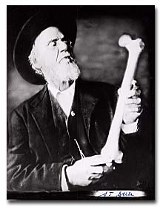
Dr. Andrew Taylor Still
Founder of Osteopathy,
A.T.STILL
with the aim of using manual 'hands on' techniques to improve circulation and correct altered biomechanics, without the use of drugs.

Slide 3
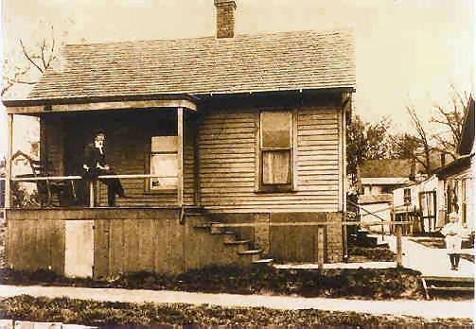
The American School of Osteopathy
On November 1, 1892, Still opened the American School of Osteopathy (ASO), now called A. T. Still University, and began teaching osteopathy.
Unlike many medical schools at the time, he permitted both women and African Americans to enroll in classes.

Slide 4
Osteopathy in Europa
United Kingdom: The first school of osteopathy was established in London in 1917 by John Martin Littlejohn a pupil of A.T. Still.
France: Osteopathy is a governmentally recognized profession and has title protection, autorisation d'utiliser le titre d'ostéopathe
Germany: Germany has both osteopathy and osteopathic medicine. There is a difference in the osteopathic education between non-physician osteopaths, physiotherapists, and medical physicians
Finland: The professional training of an osteopath in Finland refers to training of at least four consecutive years approved by the National Authority for Medicolegal Affairs.
Norway: Norwegian University College of Health Science Institute of Osteopathy
Portugal, Italy,Austria, Belgium, Netherland, Sweden.

Slide 5
OMT IN CLINICAL RESEARCH IN EUROPE
The National Council of Osteopathic Research (NCOR). UK.
Britisch School of Osteopathy. UK
Wiener Schule für Osteopathie. Austria.
Akademia für Osteopathie. Germany.
Escola dÒsteopatia de Barcelona (EOB).Spain.
Nordic Osteopathic Research Institute.(NORI).Norway.

Slide 6
Nordic Osteopathic Research Institute
Development of a Database
Research projects.
Multicenter studies
Norwegian osteopathic researchers
Seminars i Norway, Germany, Poland.

Slide 7
NORI PROJECTS/CLINICAL TRIALS
Dose-response of foot dysfunctions .
Relability, validity and stability of the
technological instrument Saccadio.
Dose-response study of Low-back pain.
OMT in treatment of gastro esophageal reflux
disease.
Effect og OMT techniques on patients suffering from GERD
Anatomical consideration to the Anatomy of Lower Esophgeal Sphincter.

Slide 8
THANK YOU FOR YOUT ATTENTION !

