Slide 1

3rd World Congress on Petrochemistry and Chemical Engineering
Nov. 30 – Dec. 02, 2015
Atlanta, GA
A Robust Image Analysis Approach for High Void-Fraction Gas-Liquid Flows
Ashish Karn, Roger E A Arndt, Jiarong Hong
Department of Mechanical Engineering &
Saint Anthony Falls Laboratory
University of Minnesota Twin Cities, Minneapolis, MN

Slide 2
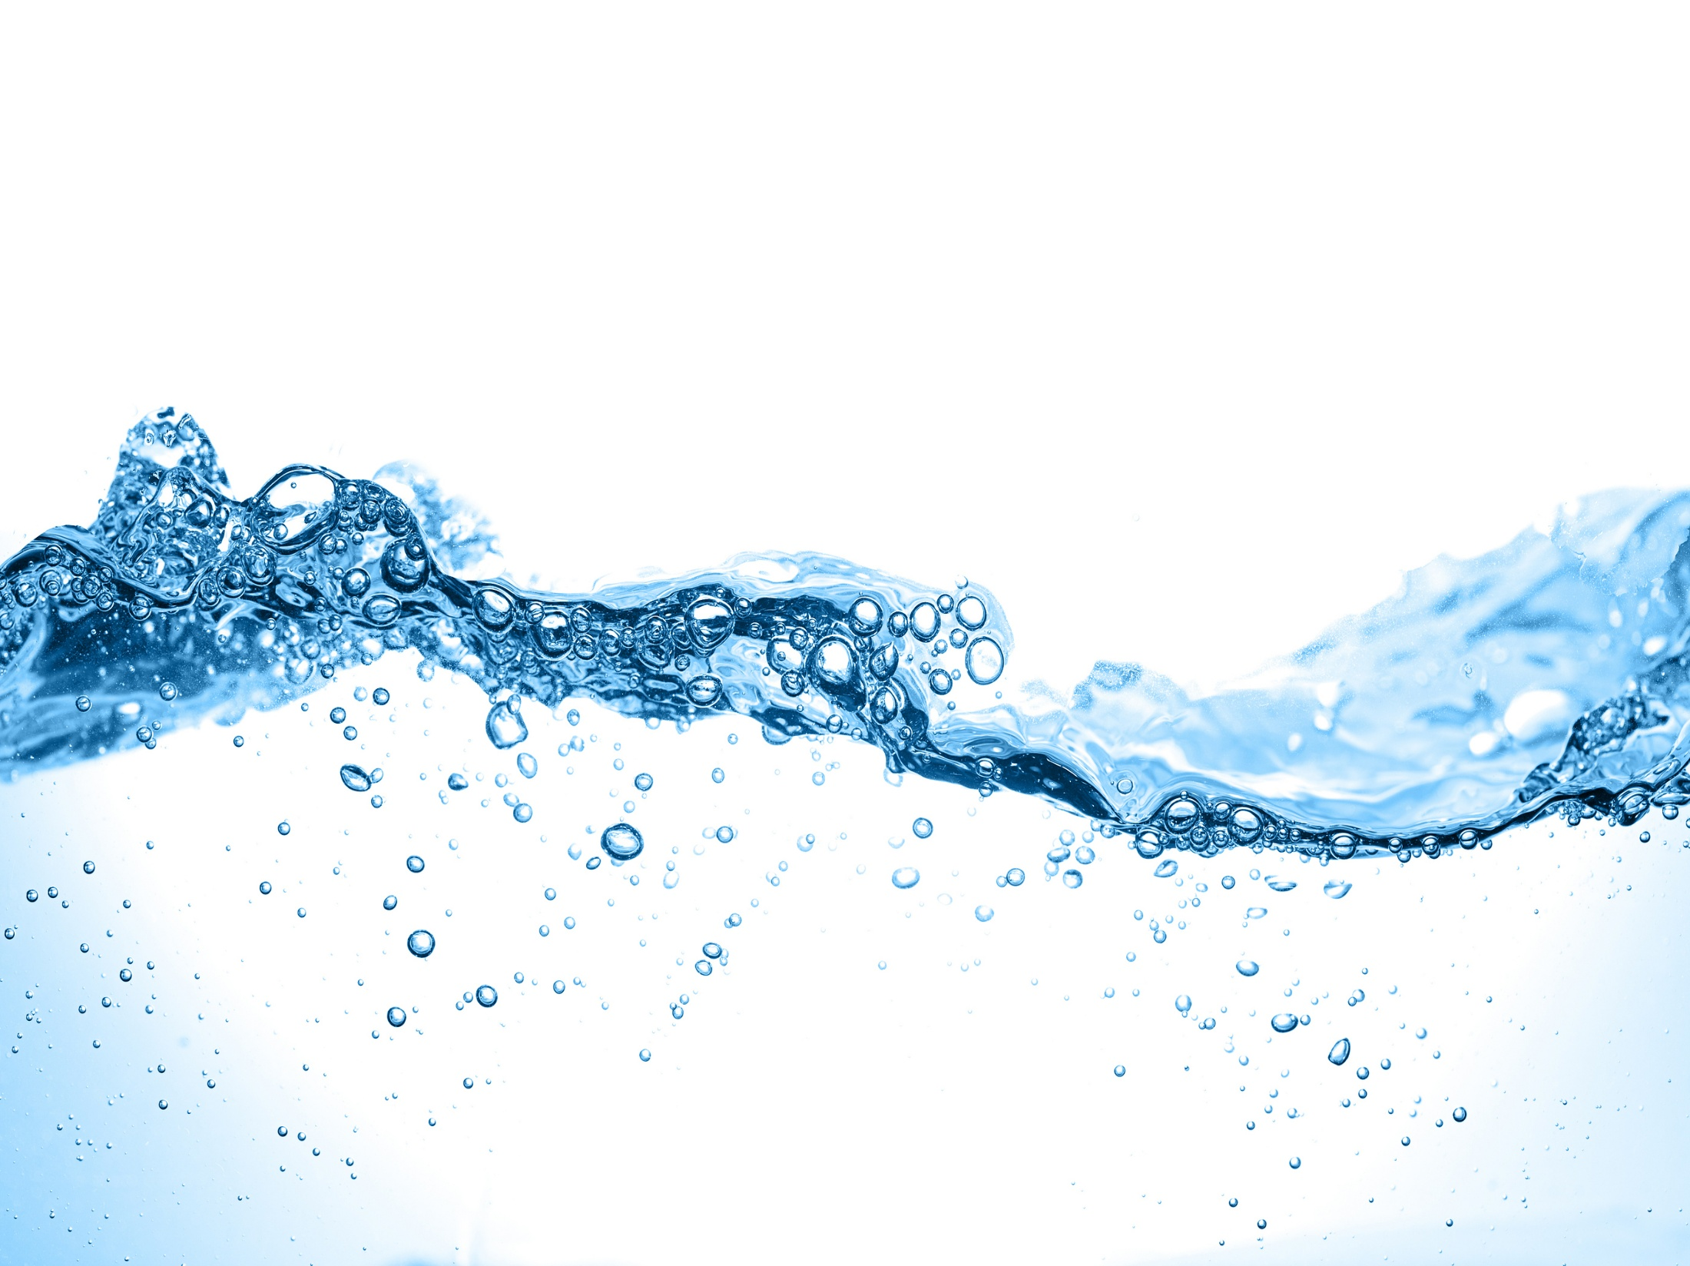
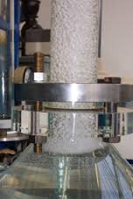
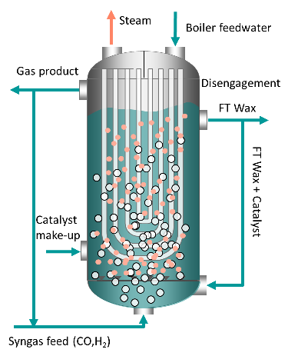
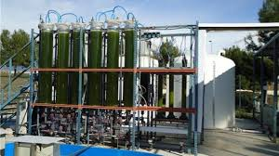
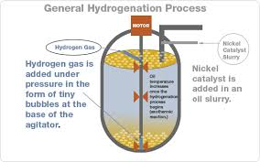

Bubbly Flows
Bubbly flows occur frequently in natural systems.
Bubbly flows occur frequently in natural systems.
Used in petroleum, energy-producing and chemical industries.
Employed in a variety of chemical and biochemical processes.
Fischer-Tropsch process for hydrocarbon synthesis
Hydrogenation of unsaturated oil
Coal liquefaction
Fermentation
Wastewater treatment
3rd World Congress on Petrochemistry and Chemical Engineering
Nov. 30 – Dec. 02, 2015
Atlanta, GA

Slide 3
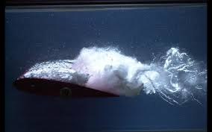
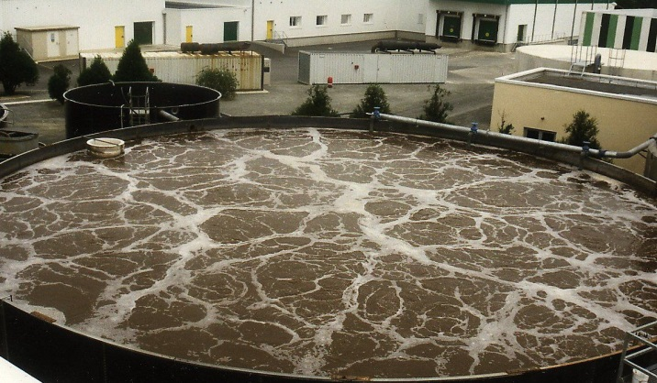
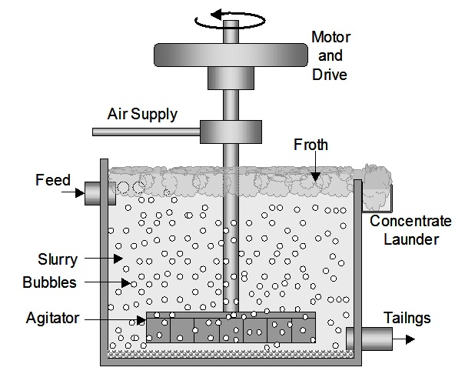
Bubbly Flows
Used in petroleum, energy-producing and chemical industries.
Bubble Columns
Floatation cells
3rd World Congress on Petrochemistry and Chemical Engineering
Nov. 30 – Dec. 02, 2015
Atlanta, GA

Slide 4
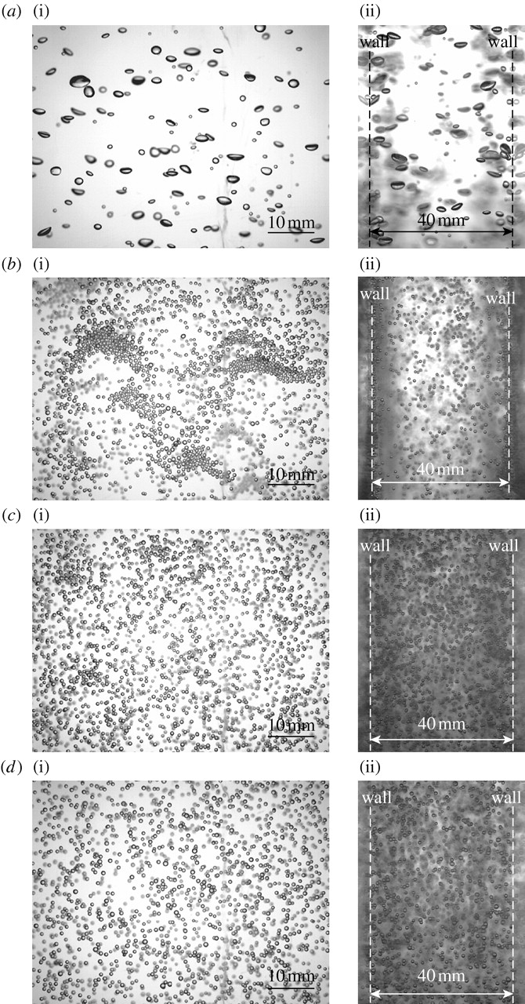
Measuring Bubble Size Distribution
Employed in a variety of chemical/biochemical processes:
Fischer-Tropsch process for hydrocarbon synthesis
Hydrogenation of unsaturated oil
Coal liquefaction
Fermentation
Wastewater treatment
The concentration distribution and morphology of the bubbles affects:
Interfacial area available for chemical reactions,
Pressure drop,
Heat and mass transfer
3rd World Congress on Petrochemistry and Chemical Engineering
Nov. 30 – Dec. 02, 2015
Atlanta, GA

Slide 5
Measurement Techniques
Intrusive
Non-intrusive
Capillary suction probes
Conductivity Probes
Optical Fiber Probes
Wire-mesh sensors
Interferometric Particle Imaging
Laser Doppler Velocimetry
Phase Doppler Velocimetry
Digital Image Analysis
3rd World Congress on Petrochemistry and Chemical Engineering
Nov. 30 – Dec. 02, 2015
Atlanta, GA

Slide 6
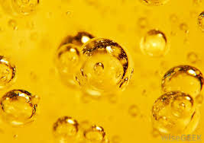
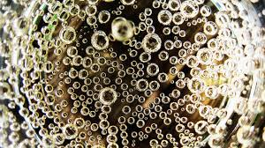
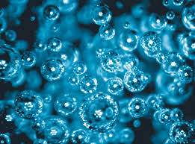
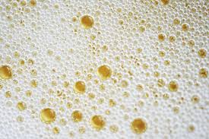
Digital Image Analysis
Advantages
Flexibility
Insensitivity to the optical properties of the dispersed phase
Easier optics alignment
Simultaneous information on velocity and size of the dispersed phase
Challenges
Computational Speed for real-time image processing
Ability to cope up with the poor quality of images
Robustness – capability to resolve overlapped clusters
3rd World Congress on Petrochemistry and Chemical Engineering
Nov. 30 – Dec. 02, 2015
Atlanta, GA

Slide 7
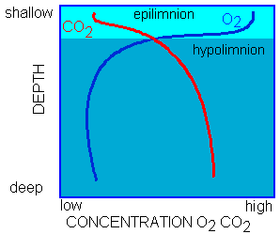
Relevance of the current research
Develop aeration technology for hydroturbines to minimize environmental impact.
Req’d DO
3rd World Congress on Petrochemistry and Chemical Engineering
Nov. 30 – Dec. 02, 2015
Atlanta, GA

Slide 8
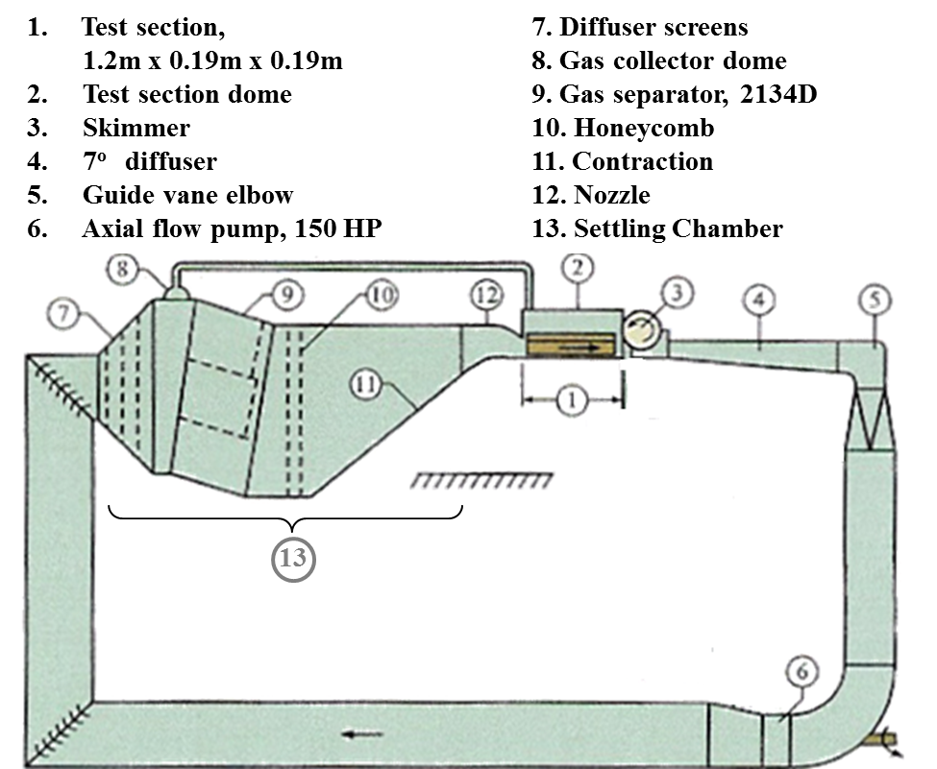
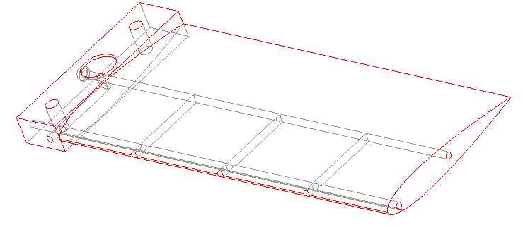
Experimental Facility
190 mm x 190mm
cross-section
Ventilated hydrofoil
(Turbine blade)
SAFL High Speed Water Tunnel
A vented turbine blade was mounted in a High speed water tunnel, and bubble data was recorded in its wake.
3rd World Congress on Petrochemistry and Chemical Engineering
Nov. 30 – Dec. 02, 2015
Atlanta, GA

Slide 9
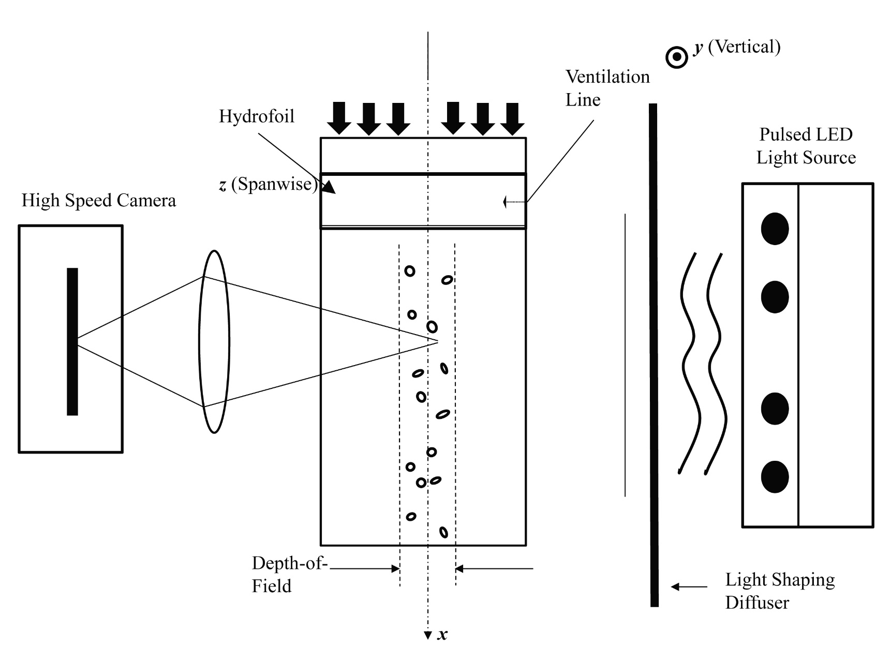
Experimental Methodology
Shadow Image Velocimetry Set up (Karn et al. Chem. Eng. Sci. 2015a)
3rd World Congress on Petrochemistry and Chemical Engineering
Nov. 30 – Dec. 02, 2015
Atlanta, GA

Slide 10
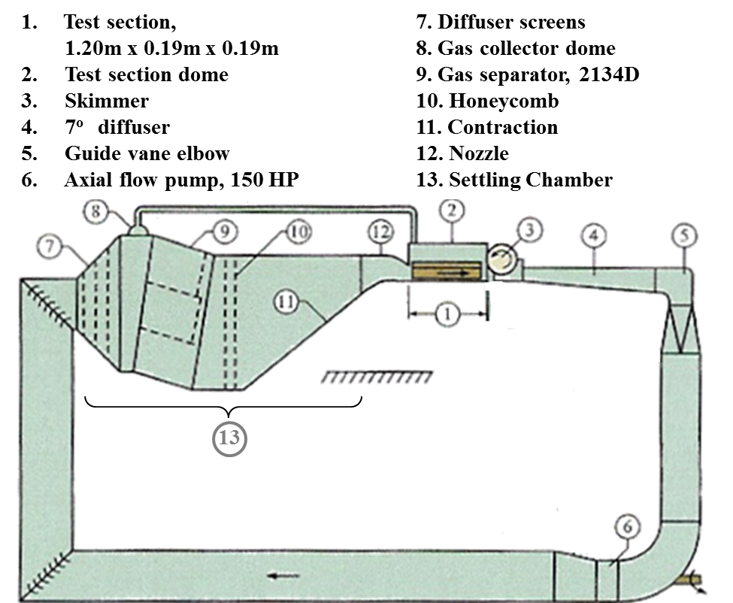
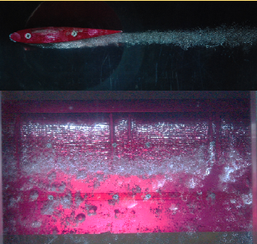
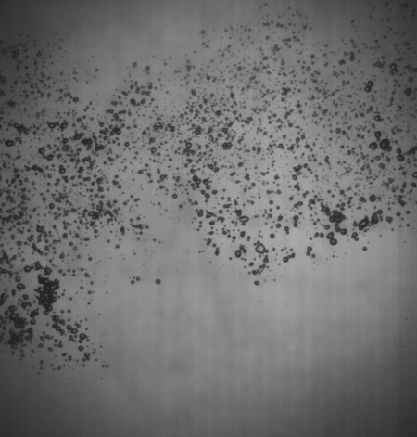

Experiments and Data Acquisition
Schematic of SAFL water tunnel
Testing with leading edge aeration
Sample Bubble image
y
x
60 mm
z
x/c = 1.3
60
mm
x/c = 2.1
x/c = 3
x/c = 4.7
3rd World Congress on Petrochemistry and Chemical Engineering
Nov. 30 – Dec. 02, 2015
Atlanta, GA

Slide 11
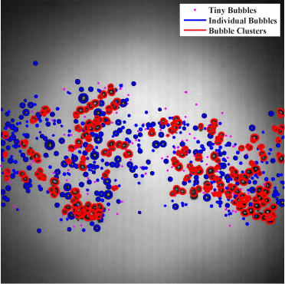
Image Analysis Technique
Image analysis technique resolves bubbles from clusters.
Size and shape information of both in-focus/out-of-focus bubbles are obtained.
3rd World Congress on Petrochemistry and Chemical Engineering
Nov. 30 – Dec. 02, 2015
Atlanta, GA

Slide 12
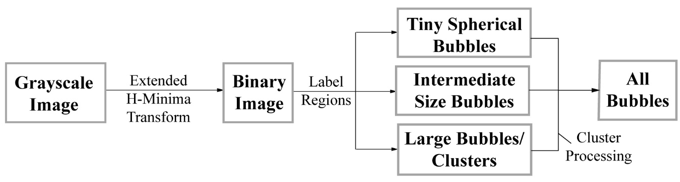
Image Analysis Technique
Image
binarization
Bubble
categorization
Bubble information
extraction
Overview of the Image analysis technique
3rd World Congress on Petrochemistry and Chemical Engineering
Nov. 30 – Dec. 02, 2015
Atlanta, GA

Slide 13
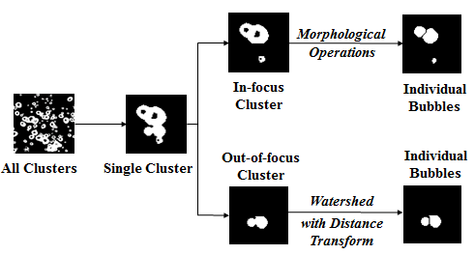
Cluster Processing
3rd World Congress on Petrochemistry and Chemical Engineering
Nov. 30 – Dec. 02, 2015
Atlanta, GA

Slide 14
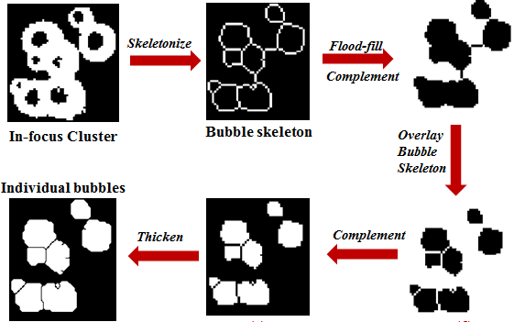
Morphological operations : In-focus Cluster Processing
3rd World Congress on Petrochemistry and Chemical Engineering
Nov. 30 – Dec. 02, 2015
Atlanta, GA

Slide 15
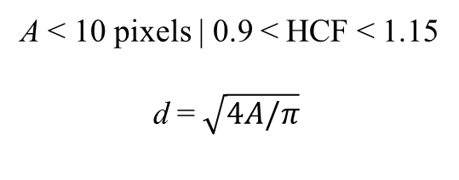
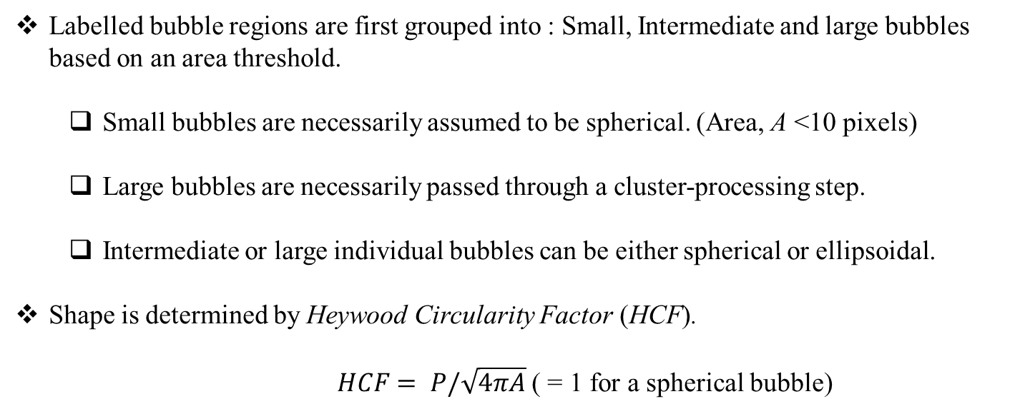
Bubble size and shape measurements
Labelled bubble regions are first grouped into : Small, Intermediate and large bubbles based on an area threshold.
Small bubbles are necessarily assumed to be spherical. (Area, A <10 pixels)
Large bubbles are necessarily passed through a cluster-processing step.
Intermediate or large individual bubbles can be either spherical or ellipsoidal.
Shape is determined by Heywood Circularity Factor (HCF).
$HCF= P/\sqrt{4πA}$ ( = 1 for a spherical bubble)
A < 10 pixels | 0.9 < HCF < 1.15
d =$\sqrt{4A/π}$
HCF < 0.9 | HCF > 1.15
Use ellipsoidal fitting
3rd World Congress on Petrochemistry and Chemical Engineering
Nov. 30 – Dec. 02, 2015
Atlanta, GA

Slide 16
Technique Validation
Simulation of synthetic bubble images
Single Bubble Measurement
Polydisperse Bubble Size Distribution Measurement
Experimental Validation
3rd World Congress on Petrochemistry and Chemical Engineering
Nov. 30 – Dec. 02, 2015
Atlanta, GA

Slide 17
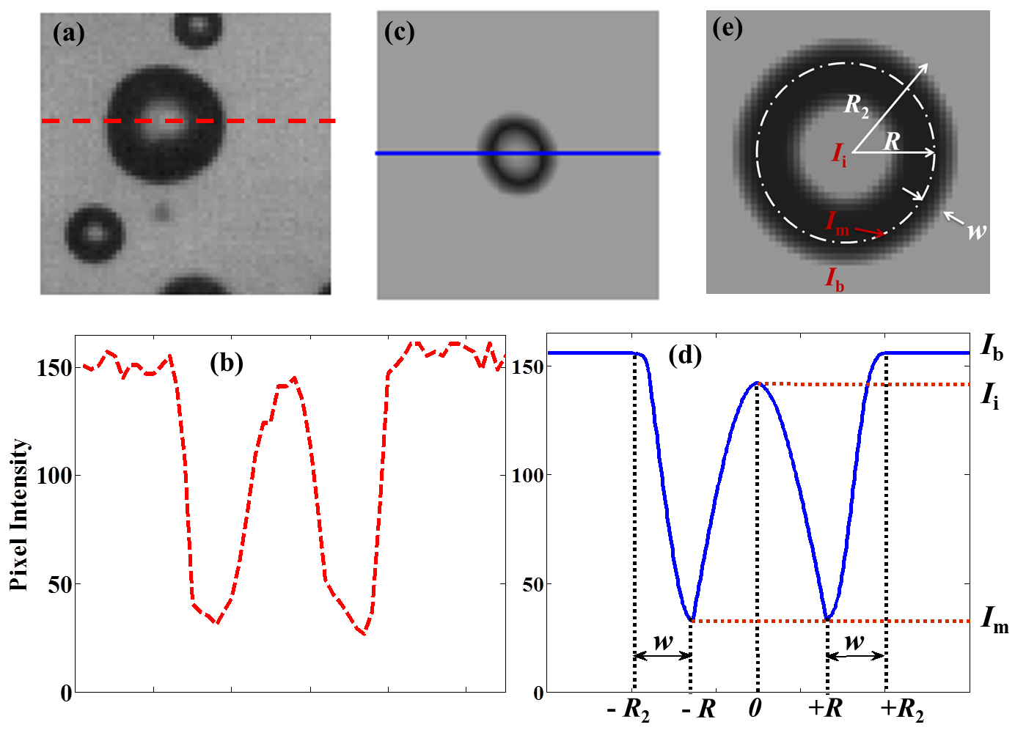
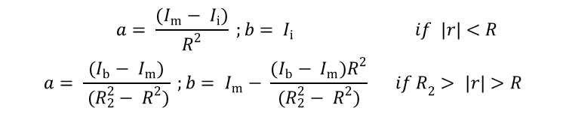

Validation through Simulation
Synthetic Bubble Generation Procedure
$$I=ar^{2 }+b$$
$$\begin{matrix}a= \frac{(I_{m}− I_{i})}{R^{2}} ;b= I_{i} & if \left|r\right|<R \\ a= \frac{(I_{b}− I_{m})}{ (R_{2}^{2}− R^{2})} ;b= I_{m}− \frac{(I_{b}− I_{m})R^{2}}{(R_{2}^{2}− R^{2})} & {if R}_{2}> \left|r\right|>R\end{matrix}$$
3rd World Congress on Petrochemistry and Chemical Engineering
Nov. 30 – Dec. 02, 2015
Atlanta, GA

Slide 18
Single Bubble Measurement
A bubble is drawn with a specific radius with its centroid placed in the middle of a pixel.
50 similar new bubbles are generated with centroid translated with steps of 0.01 pixels.
3rd World Congress on Petrochemistry and Chemical Engineering
Nov. 30 – Dec. 02, 2015
Atlanta, GA

Slide 19
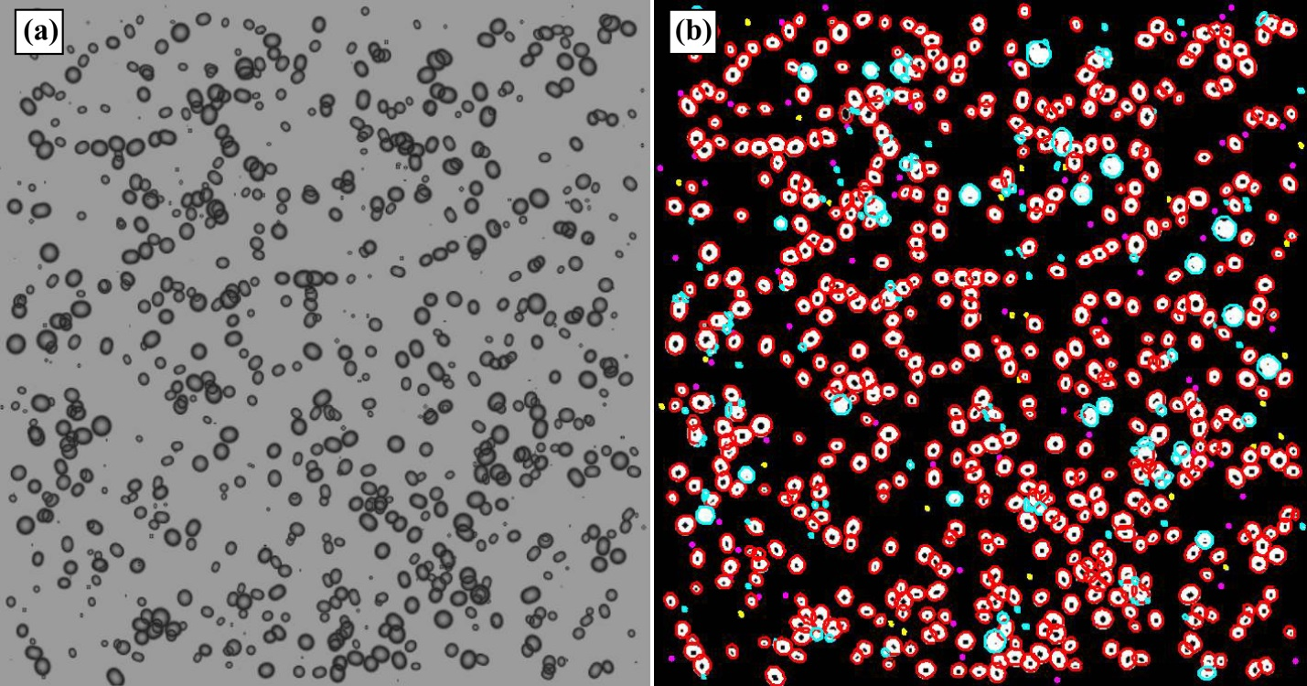
Polydisperse Bubble Size Distribution Measurement
Bubble images were generated with void fraction ranging from 0.1 - 0.7, with bubble eccentricity randomly chosen between 0 – 0.9.
Figure above shows a bubble image with 900 bubbles.
3rd World Congress on Petrochemistry and Chemical Engineering
Nov. 30 – Dec. 02, 2015
Atlanta, GA

Slide 20
Polydisperse Bubble Size Distribution Measurement
The image-processing algorithm captures the bimodal distribution quite well and the magnitudes in the PDFs are in good agreement.
The measured SMD is in good agreement with the input results with errors staying within 6-8% (limitation in accurately resolving highly overlapping bubble clusters).
3rd World Congress on Petrochemistry and Chemical Engineering
Nov. 30 – Dec. 02, 2015
Atlanta, GA

Slide 21
Experimental Validation
Extract 2D bubble size information,
Obtain the volume and velocity of individual bubbles, and
Calculate the volume flow rate from the volume and velocity information
Bubble Velocity Field
3rd World Congress on Petrochemistry and Chemical Engineering
Nov. 30 – Dec. 02, 2015
Atlanta, GA

Slide 22

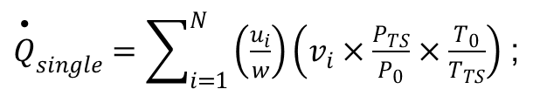
Experimental Validation
${\overset{•}{Q}}_{single}=\sum_{i=1}^{N}{\left(\frac{u_{i}}{w}\right)}\left(v_{i}×\frac{P_{TS}}{P_{0}}×\frac{T_{0}}{T_{TS}}\right)$ ;
$$ν_{i}=(4π/3)a_{i}b_{i}^{2}$$
Volume flow rates thus obtained are averaged over 1000 images to estimate an averaged volume flow rate.
3rd World Congress on Petrochemistry and Chemical Engineering
Nov. 30 – Dec. 02, 2015
Atlanta, GA

Slide 23
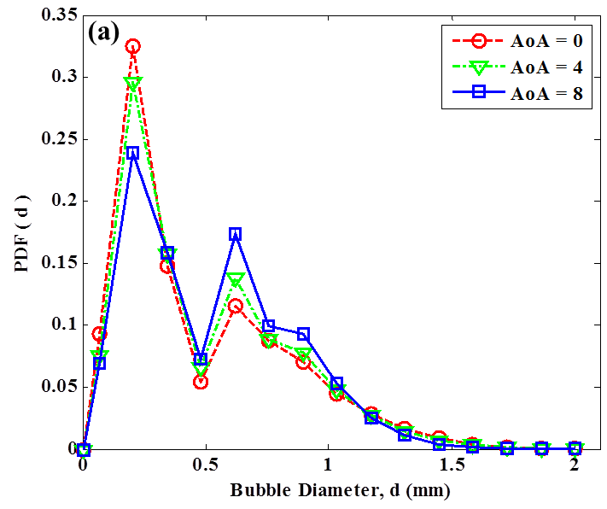
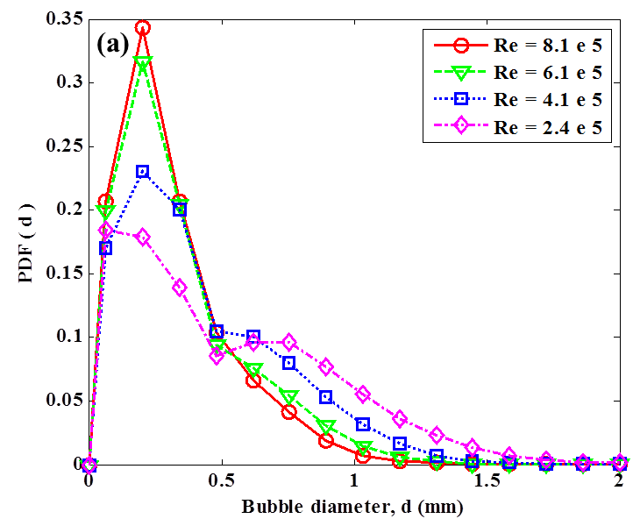
Bubble Size Characterization
A bimodal bubble size distribution is obtained with two modes at 0.2 and 0.6 mm.
An excess of tiny bubbles (~0.2 mm) are observed.
Some extremely large size bubbles (>2 mm) are observed even far downstream.
Karn et al., Exp. Therm. Fluid Sci. 2015b
3rd World Congress on Petrochemistry and Chemical Engineering
Nov. 30 – Dec. 02, 2015
Atlanta, GA

Slide 24
The effect of increased ventilation
V (m/s) | Q (LPM) | ɸ | N/(1e6) | D_{99.8} | SMD
10 | 1.50 | 0.091 | 2.382 | 0.95 | 0.54
10 | 0.50 | 0.047 | 1.805 | 0.78 | 0.43
7.5 | 1.13 | 0.059 | 1.325 | 1.03 | 0.60
7.5 | 0.50 | 0.036 | 1.068 | 0.89 | 0.51
5 | 1.50 | 0.065 | 0.782 | 1.38 | 0.81
5 | 1.25 | 0.057 | 0.723 | 1.35 | 0.79
5 | 1.00 | 0.050 | 0.677 | 1.31 | 0.77
5 | 0.75 | 0.042 | 0.645 | 1.24 | 0.73
5 | 0.50 | 0.032 | 0.573 | 1.16 | 0.68
3 | 0.50 | 0.028 | 0.242 | 1.62 | 0.97
The increase in ventilation ( or the void fraction) leads to greater d₃₂ and greater number of large sized bubbles.
This happens because of increased coalescence events in the wake.
3rd World Congress on Petrochemistry and Chemical Engineering
Nov. 30 – Dec. 02, 2015
Atlanta, GA

Slide 25
Insight into Bubble Coalescence/ Splitting
Total Number of Bubbles (NOB) passing through each section
x = 0 – 170 mm :
Break-up dominant regime
x > 170 mm :
Coalescence-dominant regime
3rd World Congress on Petrochemistry and Chemical Engineering
Nov. 30 – Dec. 02, 2015
Atlanta, GA

Slide 26
Bubble size distribution in the breakup-dominant regime
breakup
Larger bubbles breakup to give smaller bubbles in the region between X = 109 mm and X = 243 mm.
3rd World Congress on Petrochemistry and Chemical Engineering
Nov. 30 – Dec. 02, 2015
Atlanta, GA

Slide 27
Bubble size distribution in the coalescence-dominant regime
Coalescence
Smaller bubbles coalesce to give larger bubbles in the region between X = 170 mm and X = 243 mm.
3rd World Congress on Petrochemistry and Chemical Engineering
Nov. 30 – Dec. 02, 2015
Atlanta, GA

Slide 28









Observations on Bubble Breakup
The observed bubble breakup events are always binary.
No generation of small bubbles (0.2mm) during binary break up
The initial bubble sizes are always greater than 1.5 mm in all cases.
Where do these small bubbles come from ?
1 mm
3rd World Congress on Petrochemistry and Chemical Engineering
Nov. 30 – Dec. 02, 2015
Atlanta, GA

Slide 29






Mechanism I: Bubble Tearing
Leading
Trailing
1 mm
Wake acceleration of a trailing bubble and collision with a leading bubble leads to bubble tearing and small bubble generation.
3rd World Congress on Petrochemistry and Chemical Engineering
Nov. 30 – Dec. 02, 2015
Atlanta, GA

Slide 30









Mechanism II: Bubble generation during Coalescence.
1 mm
Careful observation of coalescence events shows that after a coalescence event, the bubbles undergo severe shape oscillations, and sometimes form tiny bubbles.
3rd World Congress on Petrochemistry and Chemical Engineering
Nov. 30 – Dec. 02, 2015
Atlanta, GA

Slide 31
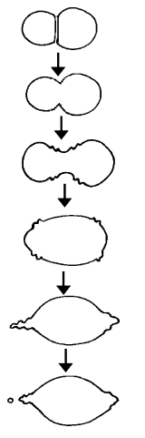





Coalescence-mediated Breakup
Tse et al. (2000)
An ellipsoidal bubble forms two lobes at the end which may be separated by Rayleigh instability (Ohnishi 1981).
After the lobe separation, the ellipsoidal bubble contracts and transitions into a spherical cap bubble before returning to a spherical bubble.
1 mm
Daughter bubble generation
3rd World Congress on Petrochemistry and Chemical Engineering
Nov. 30 – Dec. 02, 2015
Atlanta, GA

Slide 32


















Large Bubble Generation I: Successive Coalescence Events
1
2
3
In general, successive coalescence events lead to larger size bubbles.
However, within a small of observation, successive binary coalescence events will not lead to bubbles with sizes greater than 3 mm.
3rd World Congress on Petrochemistry and Chemical Engineering
Nov. 30 – Dec. 02, 2015
Atlanta, GA

Slide 33




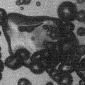




Large Bubble Generation II: Cluster Coalescence
1 mm
Usually, the coalescence events are binary. However, sometimes exceptions involving multiple bubbles are also possible.
The presence of extremely large bubbles far down in the wake can be explained by the phenomenon of ‘cluster coalescence’.
3rd World Congress on Petrochemistry and Chemical Engineering
Nov. 30 – Dec. 02, 2015
Atlanta, GA

Slide 34
Conclusions
A robust image analysis technique was developed to extract bubble size and shape information in a dense bubbly flow over a wide size range.
The developed technique was validated through both bubble simulation and experimental measurements.
The image analysis technique showed the occurrence of distinct breakup and coalescence regimes in the wake.
The occurrence of breakup and coalescence was actually confirmed by high-speed observations.
3rd World Congress on Petrochemistry and Chemical Engineering
Nov. 30 – Dec. 02, 2015
Atlanta, GA

Slide 35


Acknowledgements
This project is supported by grants from
DOE EERE Wind & Water Power Program
Dr. Jose Zayas, Program Manager
ONR, Dr. Ron Joslin, Program Manager.
Alstom Énergie & Transport Canada Inc.
Mr. Michel Sabourin, Program Manager

Slide 36
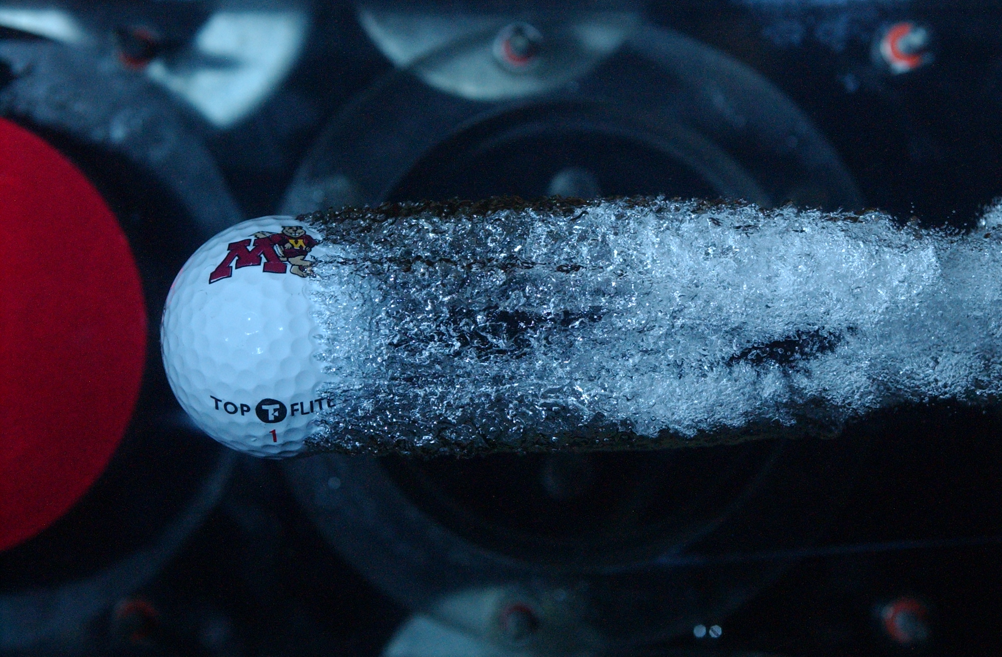
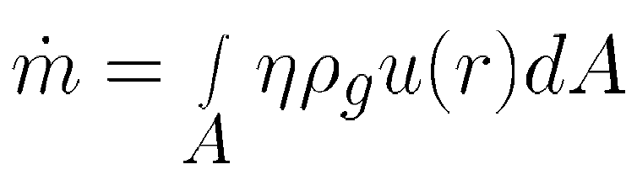
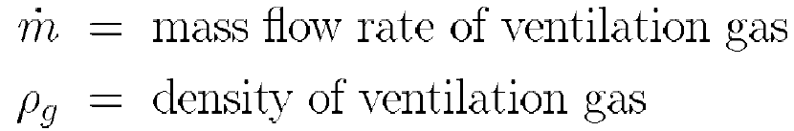
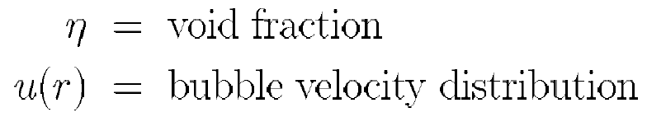
Void Fraction Measurements
A new technique to measure void fraction in the bubbly wake of a ventilated cavity
Utilizes grayscale data of PIV images along with velocity data generated by PIV
Void fraction determined using:
Thank you !
Assumption: Intensity of bubble reflections proportional to void fraction (Wosnik and Arndt, 2013)
Qualitative shape of void fraction curve η determined using grayscale level of PIV images of bubble reflections
Questions or Comments?
http://umn.edu/~karn

