Slide 1

The contribution of photochemistry and photocatalysis to Green Chemistry
2° Green Chemistry Conference, Orlando, September 14, 2015
Angelo Albini, PhotoGreen Lab, University of Pavia, Italy

Slide 2
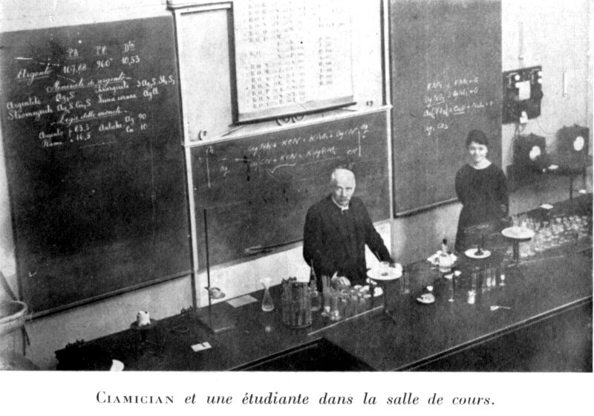

Photochemical generation of chemical intermediates
Adapted from http://www.chimica.unibo.it/it/dipartimento

Slide 3
It has often been a reproach to the great successes of modern
organic chemistry that victory has been obtained with too great a
show of strength.
Indeed, one has to admit that such an objection is
not deprived of some ground. Using aggressive reagents and high
temperatures is almost always unavoidable when carrying out an
organic synthesis in the laboratory.
Deploying energy would, on the
other hand, not be so frustrating for modern organic chemistry,
were it not that the living world, in particular plants, gives us the
marvelous example of great results obtained, at least from what
appears, by using minimal means
Giacomo Ciamician (Bologna)
French Chem Soc, Paris, 1908

Slide 4
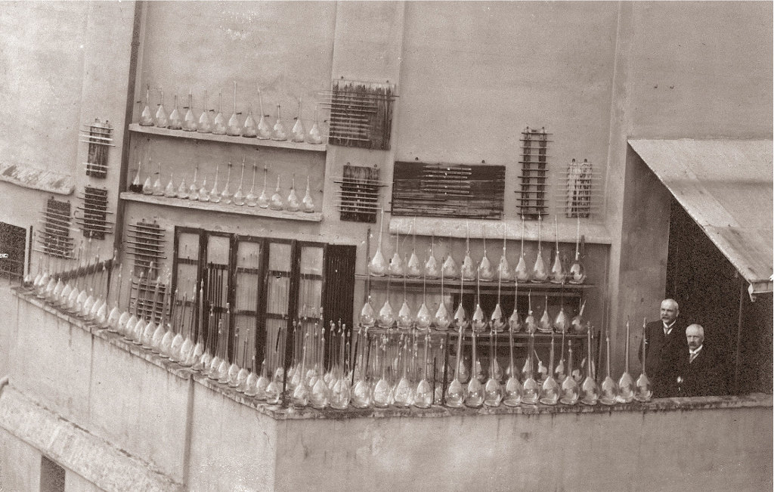
Adapted from http://www.chimica.unibo.it/it/dipartimento

Slide 5
No chemical added

Slide 6
Photochemistry and green chemistry
9 Catalysis
1 Prevention of waste
formation
No chemical added
Electronically excited states, very high energy
2 Atom economy
8 Reduce derivatives
Independent on temperature
3 Less hazardous chemical synthesis
6 Design for energy efficiency
5 Safer solvents and auxiliaries

Slide 7
Photochemistry and green chemistry
9 Catalysis
1 Prevention of waste
formation
Electronically excited states, very high energy
No chemical added
2 Atom economy
8 Reduce derivatives
Independent on temperature
3 Less hazardous chemical synthesis
6 Design for energy efficiency
5 Safer solvents and auxiliaries

Slide 8
Photochemistry and green chemistry
9 Catalysis
1 Prevention of waste
formation
Electronically excited states, very high energy
No chemical added
2 Atom economy
8 Reduce derivatives
Independent on temperature
3 Less hazardous chemical synthesis
6 Design for energy efficiency
5 Safer solvents and auxiliaries

Slide 9
Light activation is different from catalysis
Excited state
surface
Catalyst
Ground state
surface

Slide 10
Light activation is different from catalysis:
a mixed blessing
Excited state
surface
Excited
state
Excited state
Reagent complex
Catalyst
Ground state
surface

Slide 11
Difficult accessed intermediates
S_{N}1
¿S_{N}Ar1?
Phenyl Cation
Clayden, Greeves, Warren, Wothers, Organic Chemistry, Oxford Press

Slide 12
Metal catalysis vs photochemistry
Unusual intermediates, high atom economy

Slide 14
Metal catalysis vs photochemistry

Slide 15
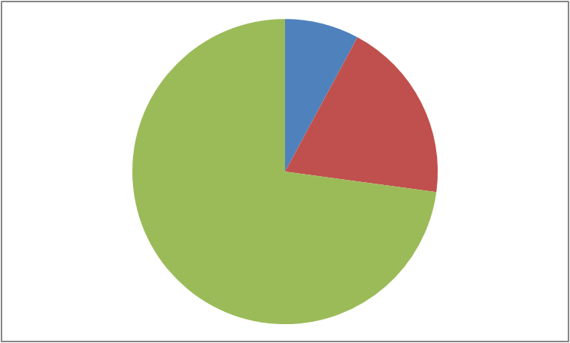
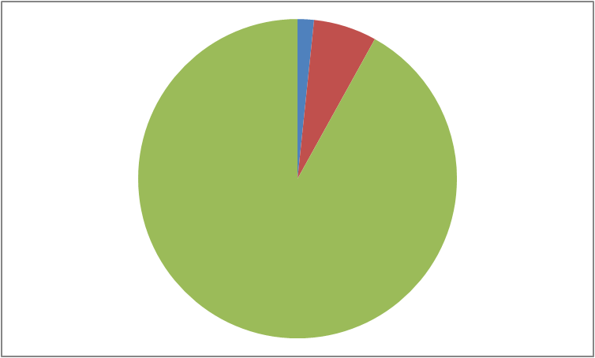
Solvent
Solvent

Slide 16
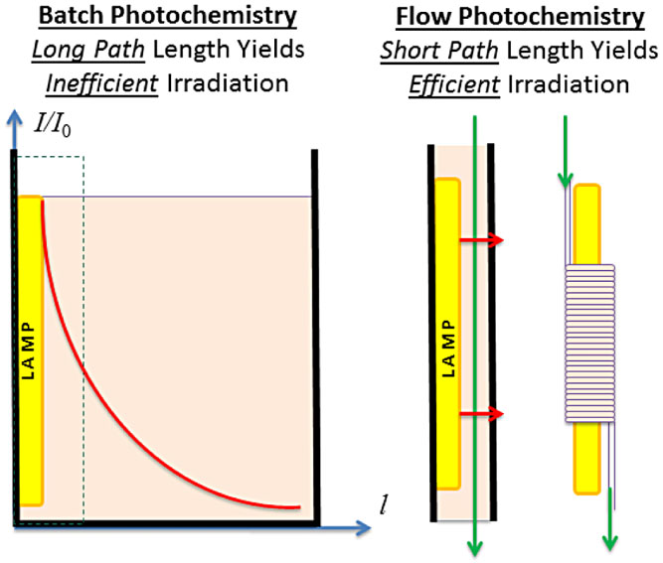
Photochemistry EATOS Assessment
unpublished
Lambert-Beer Law. A = ε∗b*c
HIGHLY DILUTE CONDITIONS

Slide 17
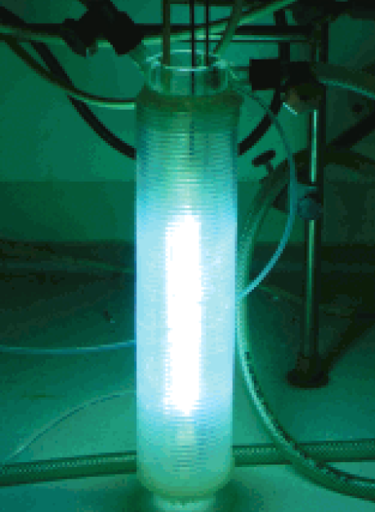
Batch
Flow

Slide 18
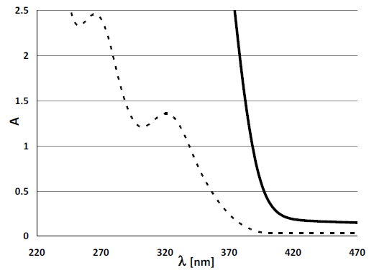
Photocatalysis
Reagents
PhCat

Slide 19
Photocatalysis: a green approach to organic synthesis?
PhCat = W₁₀O₃₂⁴⁻

Slide 22
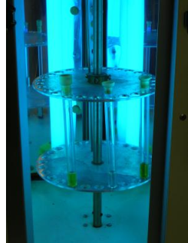
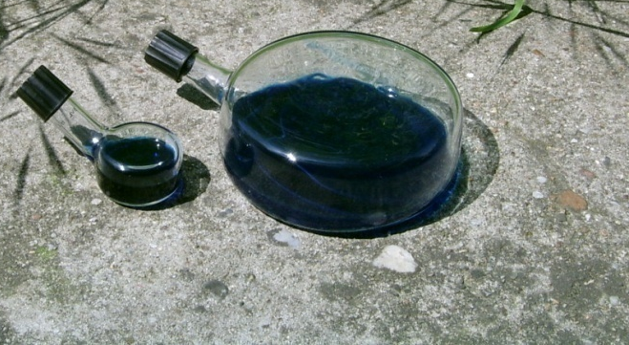
Batch, solar
Flow

Slide 23
The photon is an excellent candidate for the ideal green reagent
S. Protti, A. Albini,
Paradigms in Green Chemistry and Technology, Springerbriefs, 2015
Thank you

