Slide 1

Immunization with recombinant fusion protein rVE induces CD4+ and CD8+ T-cell mediated memory immune protection against Yersinia enterocolitica O:8 infection in mouse model
Presenting By Supervisor/ Guide
Amit Kumar Singh Dr. Joseph J. Kingston, Sc D
Ph.D. Scholar Head of Department,
Microbiology Division,
DFRL, DRDO, Mysore

Slide 2
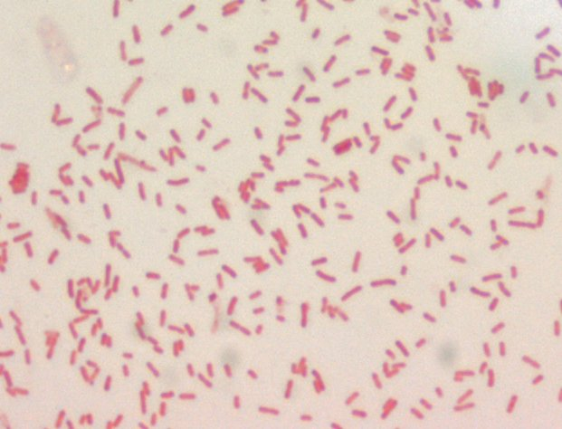
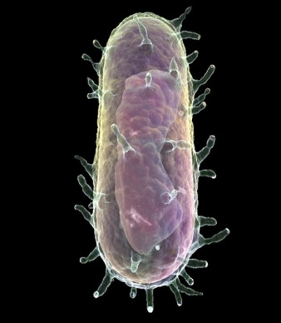
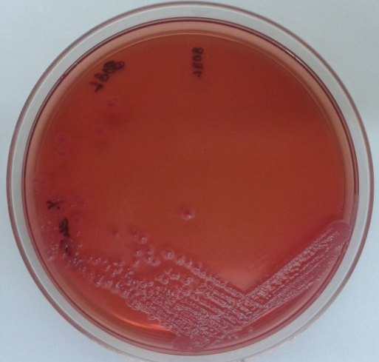
Introduction
Yesinia pestis
Gram –ve, facultative anaerobic bacteria.
Discovered by Alexandre Yersin (1894).
Family- Enterobacteriaceae.
Grows at temperatures of 4°C - 40°C (optimum 26°C).
Zoonotic disease occurs with the bite of infected flea.
Disease caused:
Bubonic plague
Septicemic plague
Pneumonic Plague

Slide 3
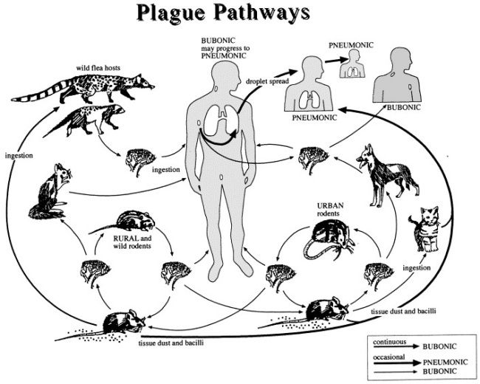
Introduction

Slide 4
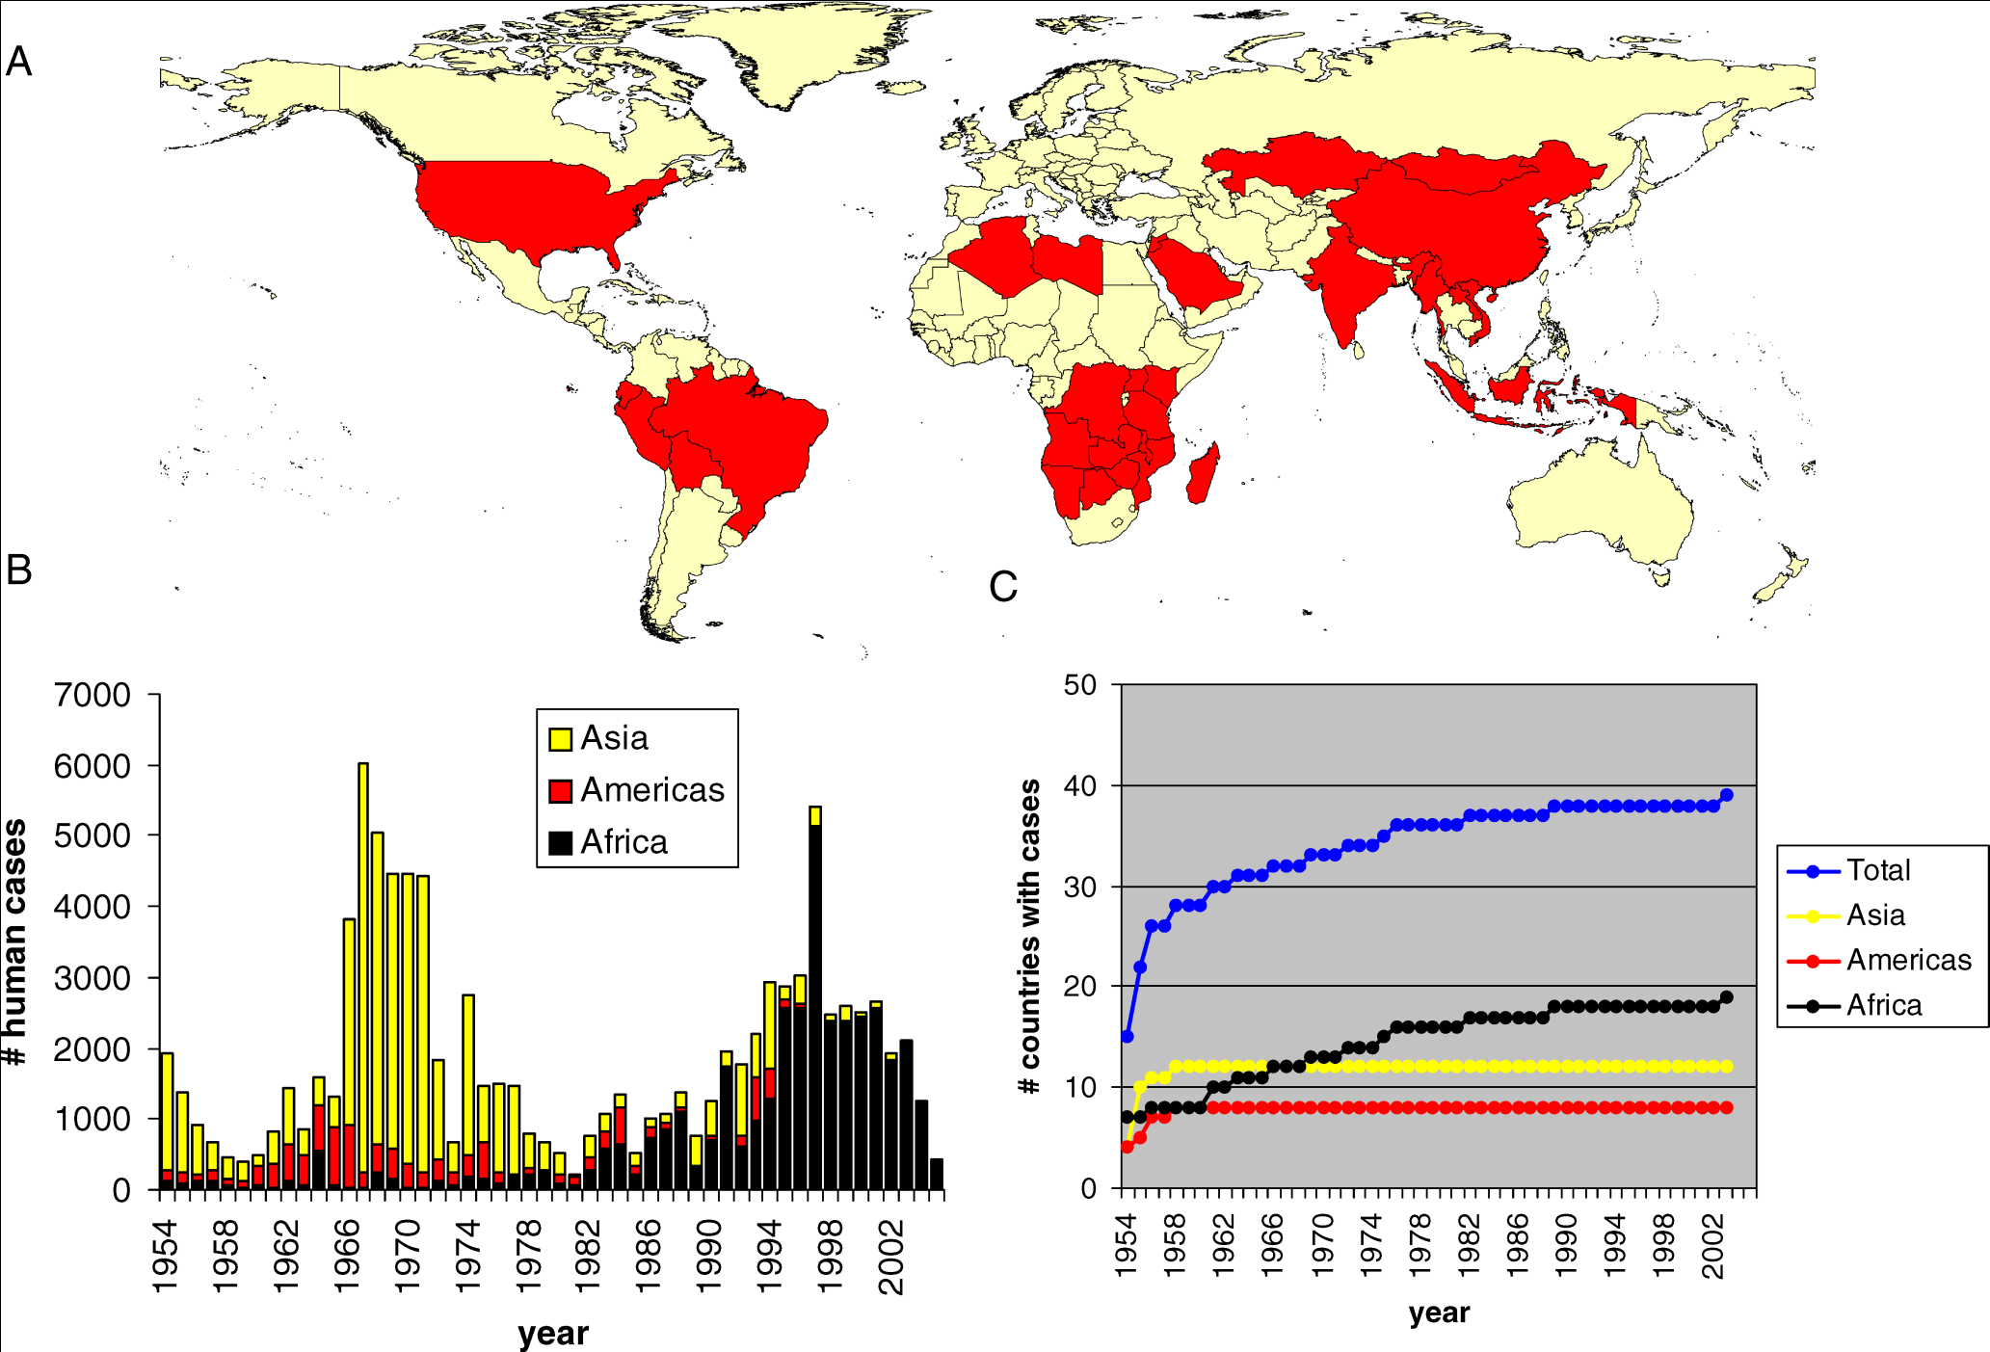
Introduction
Global occurrence of plague outbreaks

Slide 5
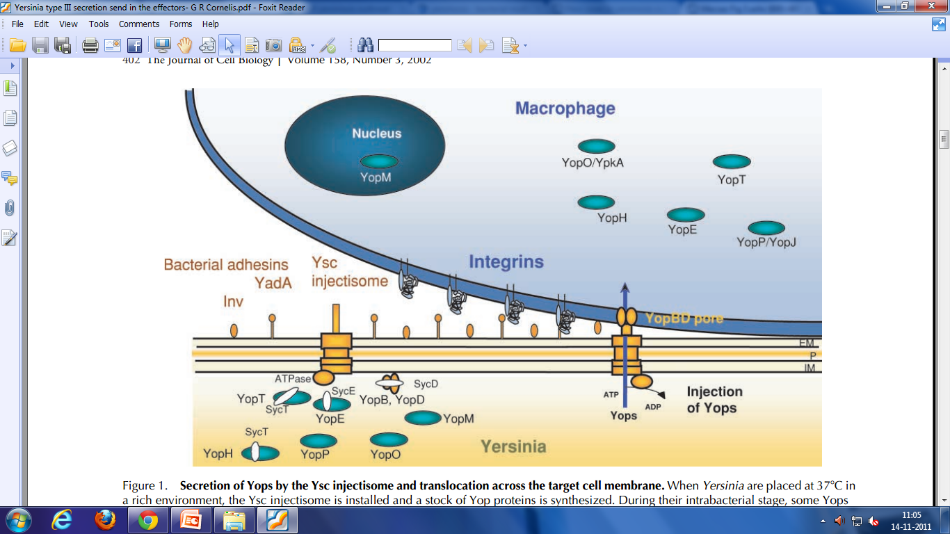
Introduction
C
LcrV dependent translocation of effectors in Yersinia Type III Secretion system
Cornalis et. al,. 2002

Slide 6
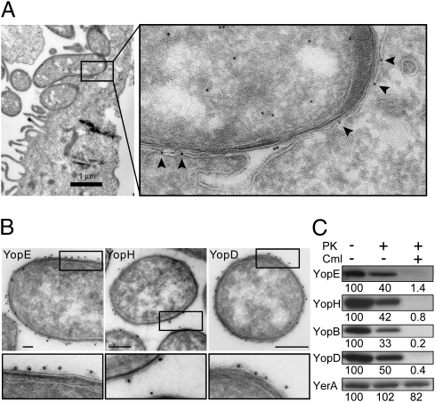
Introduction
LcrV independent translocation of effectors
Akopyan et. al., 2011

Slide 7
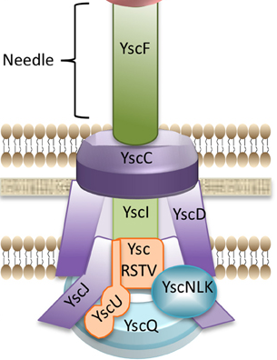

Introduction
host cell membrane
LcrV
Needle
Bacterial cell membrane
effectors

Slide 8
Introduction
S. No. | Molecule | Mol. wt. | Suspected Function
1 | YadA | 45kDa | Surface adhesion molecule, helps in attachment with host cell membrane.
2 | YopC | 49.6kDa | Form outer membrane ring of TTSS.
3 | YopD | 27.36kDa | Form inner membrane ring together with YscJ. Along with YopB it help in pore formation.
4 | YopE | 29 kDa | Molecule recognize most by CD8 immune response upon infection. Destabilizing cell cytoskeleton by degrading actin microfilament.
5 | YscF | 9kDa | ~ 150 copies of YscF assemble to form hollow needle.
6 | YopH | 51kDa | Most phosphorylated effector molecule. Initiate apoptotic like changes in host cell. Prevent cell from being phagocytosis by inhibiting immune response.
7 | YopM | 51.7kDa | Function remains unknown
8 | YopN | 32kDa | Prevent premature secretion of effector molecules
9 | YopP/ YopJ | 32.2kDa | Effector molecule which control length of injectisome. Inside host cell it trigger apoptotic reaction.
10 | LcrV | 37 kDa | Forming the tip of needle in TTSS. Help in docking on the host cell membrane
11 | Syc | 29kDa/ dimer | Molecular chaperon, help in secretion of effector molecules. Binds with specific molecules and maintain them into partial unfolded condition

Slide 9
Introduction
Immuno-dominant region of LcrV and YopE
LcrV
YopE

Slide 10
Plan of work
Y. pestis
Design & construction of chimera
YopE
LcrV
Cloning and expression in E. coli
Immuno-dominant regions of YopE (rE)
Immuno-dominant regions monomeric LcrV (rV)
Immunization of BALB/c mice,
Antigenicity vs Immunogenicity
Active challenge studies
Passive challenge studies
T cell responses

Slide 11
Results
In-silico structure prediction of Y. pestis LcrV and YopE

Slide 12
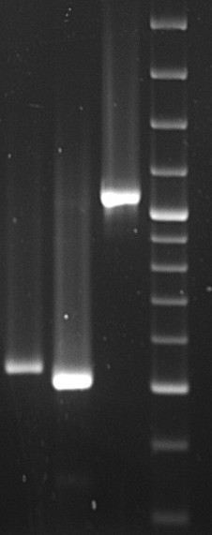
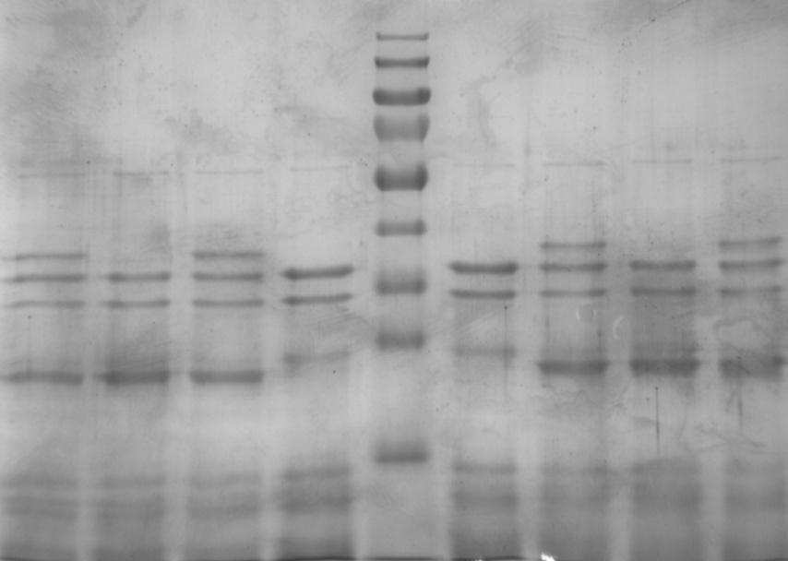
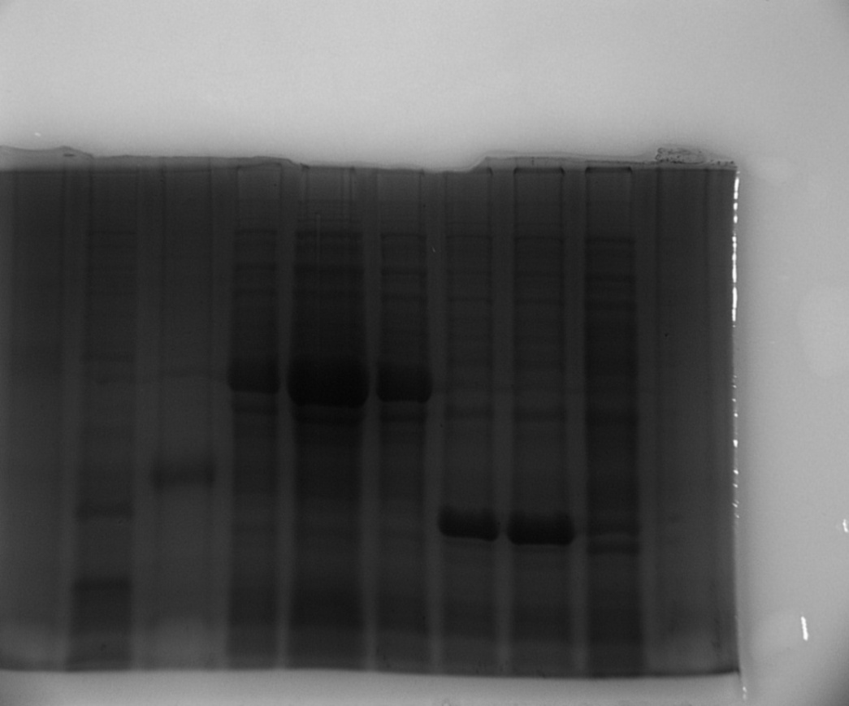
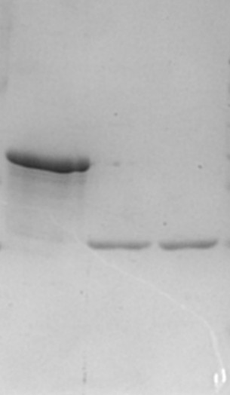
Results
Construction, Cloning, expression and purification of rV, rE and rVE
M 1 2 3
M 1 2 3 4 5 6 7
VE (1047 bp)
40 kDa
25 kDa
rV (513 bp)
rE (489 bp)
Construction of chimeric gene rVE
M: Protein ladder 1: Induced rVE clone
2: Induced rE clone 3: Induced rV clone
4: Un-induced rVE 5: Purified rVE protein
6: Purified rE protein 7: Purified rV protein

Slide 13
Results
Humoral Immune responses
Antibody titer after 42nd day immunization
Immuno-competitive assay

Slide 14
Results
Antibody Isotype profile
(A)
(B)
(A) Antibody isotypes induced by individual recombinant proteins (rV, rE), their cocktail mixture (rV+rE) and fusion construct (rVE) in BALB/c mice.
(B) Immuno-competitive assay with anti-rV+rE sera.
(C) Immuno-competitive assay with anti-rVE sera.
(C)

Slide 15
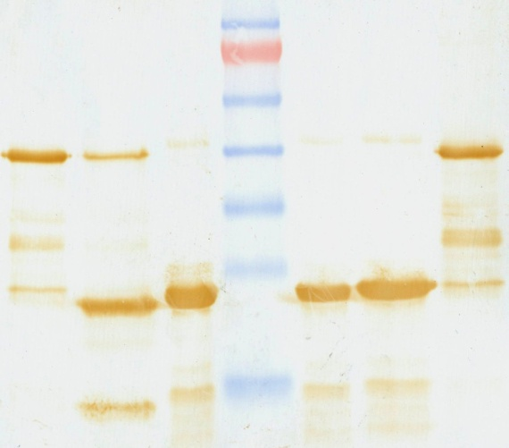
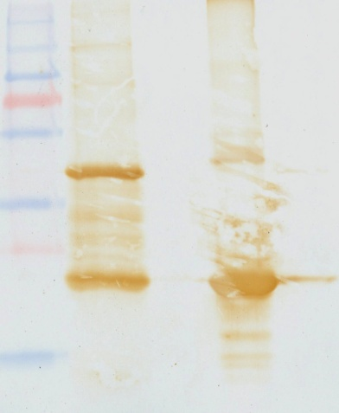
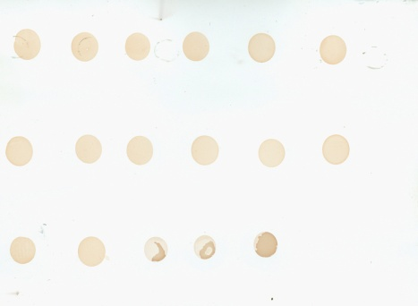
Results
Dot Immunoblot and Western blot analysis
M 1 2 3 4
1 2 3 4 5 6
A
B
40 kDa
Native
LcrV(37kDa)
25 kDa
Native
YopE(23kDa)
Dot immunoassay analysis to assess binding efficacy of poly-sera raised against VE fusion protein. Lane1 A1-A6: Y. enterocolitica O:3, O:5, O:8, O:9 O:13 and O:21 respectively. Lane B1-B6: Y. enterocolitica ATCC 23715, Y. pseudotuberculosis, rV, rE, rVE and –ve, respectively.
Western blot analysis using anti-VE polysera (1:1000) dilution. Lane M: Prestained Protein marker, Lane 1, 2 and 3: whole cell lysate of E. coli BL21DE3 recombinant rV, rE and rVE clones. Lane 4: Y. enterocolitica O:8 whole cell lysate showing binding efficacy of anti-rVE polysera with native LcrV and YopE proteins.

Slide 16
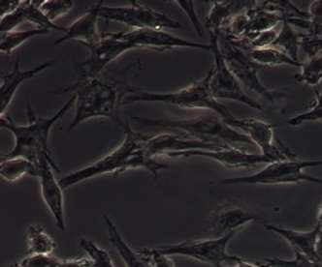
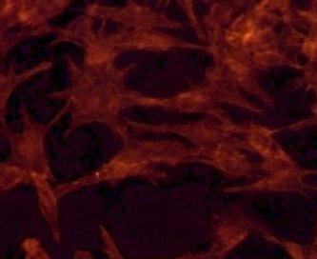
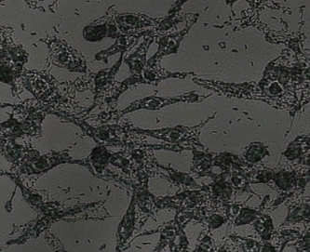
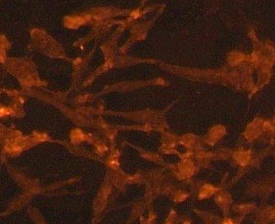
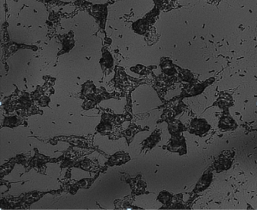
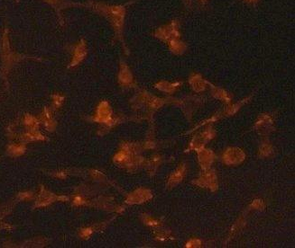
Results
Phase contrast
Rhodamine phalloidin
In-vitro assessment of protective efficacy
Uninfected
Anti-rVE
Y. enterocolitica O:8
NMP
Protection of RAW 264.7 cell line from Y. enterocolitica O:8 induced cytotoxicity by anti-rV, anti-rE, anti-rV+rE and anti-rVE polysera raised in BALB/c mice
Prevention of actin filament perturbation and cell death against Y. enterocolitica O:8 infection.

Slide 17
Results
In-vivo protective efficacy
Active protection study
Passive protection study
Kaplan Meier graph showing percentage survival in rV, rE, rV+rE and rVE group of immunized BALB/c mice I.P. challenge with Y. enterocolitica
Kaplan Meier graph showing percentage survival in anti-rV, anti-rE, anti-rV+rE and anti-rVE group of immunized BALB/c mice I.P. challenge with Y. enterocolitica

Slide 18
Results
Lymphocyte Proliferation Assay
In-vitro proliferation of rV, rE, rV+rE and rVE primed splenocytes induced with their respective purified proteins (rV, rE, rV+rE and rVE) for 72 h at 37 °C
Sham Immunized mice splenocytes induced with purified proteins rV, rE, rV+rE and rVE for 72 h at 37 °C

Slide 19
Results
Cytokine profile

Slide 20
Results
CD4 and CD8 T-cell response
CD4
CD8
Sham
rV
rE
rV+rE
rVE

Slide 21
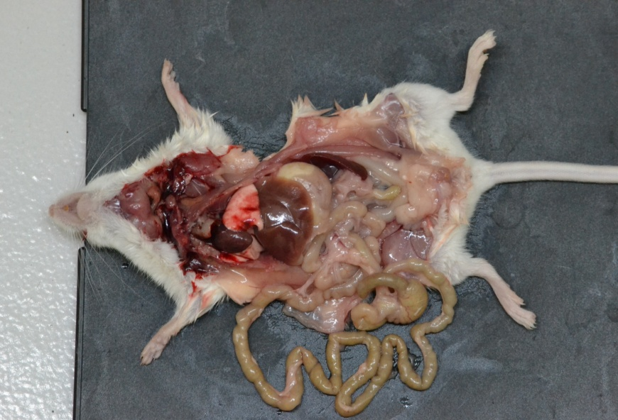
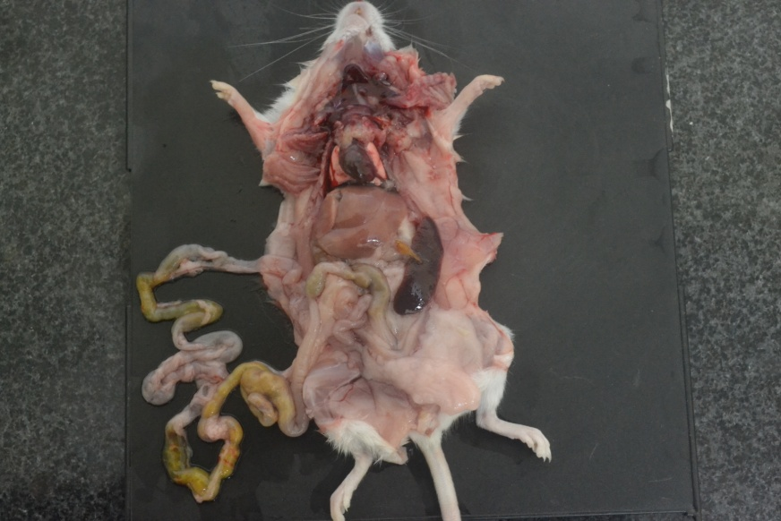
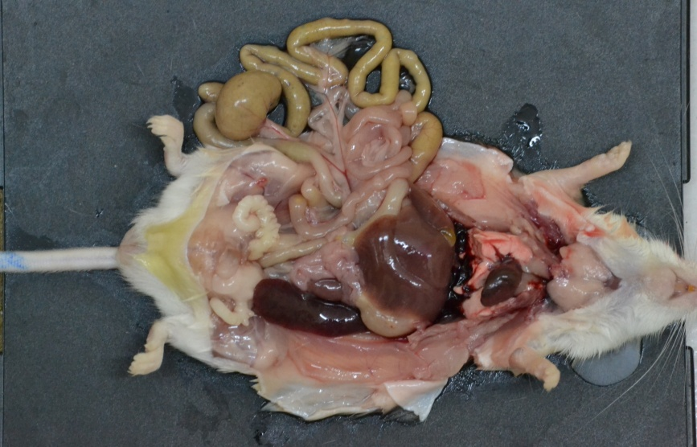
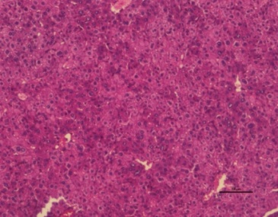
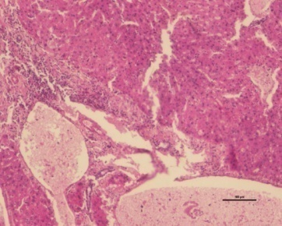
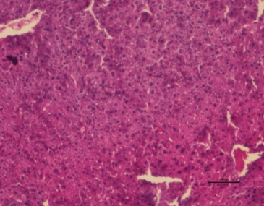
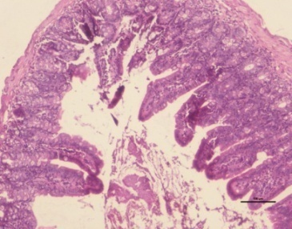
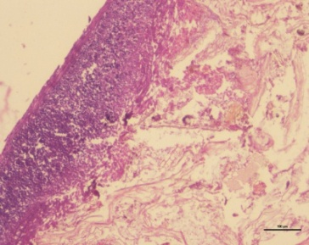
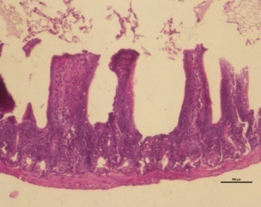
Results
Gross Pathology and Histopathology
Y. enterocolitica O:8
Uninfected
Control
rVE
(A)
(B)
(C)
(D)
(E)
(F)
Liver
(G)
(H)
(I)
Intestine

Slide 22
Results
Memory response
Kaplan Meier survival curve of sham immunized and immunized groups of mice I.P. challenged with Y. enterocolitica after 120days post immunization

Slide 23
Salient Findings
Developed a novel bivalent recombinant fusion protein (rVE) comprising of immunologically active regions of Y. pestis LcrV and YopE protein with an intervening 15 amino acids flexible glycine linker (G₄S)₃.
Immunization with purified rVE protein developed robust and strong humoral immune responses mounted with a prominent IgG1 and IgG2a/IgG2b response in BALB/c mice.
A significantly higher in-vitro lymphocyte proliferation at 15 µg/ml concentration of rVE protein.
Complete protection to rVE group of mice against lethal Y. enterocolitica challenge in both active and passive immunization modules.
CD4+ and CD8+ T-cell mediated long term protection maintained upto 4 months post immunization.
Petite or no conspicuous sign of infection in gross pathology and histopathological analysis of spleen, liver and intestine of anti-rVE immunized mice.

Slide 24
Acknowledgements
Parents
Dr. H. V. Batra, Director, DFRL, Mysore.
Dr. Joseph J. Kingston, HOD Microbiology Division, DFRL, Mysore.
Dr. J. S. Virdi, Delhi University, South Campus, New Delhi, India.
Council of Scientific and Industrial Research (CSIR), Delhi, India.
Dr. Venkatramana M.V., BU DRDO, Coimbatore.
Dr. Sanjay Kumar, University of Pennsylvania, USA.

Slide 25
THANK YOU

