Slide 1



Nitrones as potential therapeutic agents against Alzheimer’s Disease
Dra. Alicia Merlino, Computational Chemistry Lab, Facultad de Ciencias, Universidad de la República, Montevideo, Uruguay
MedChem & CADD 2015, 2-4 November, Atlanta, USA

Slide 2
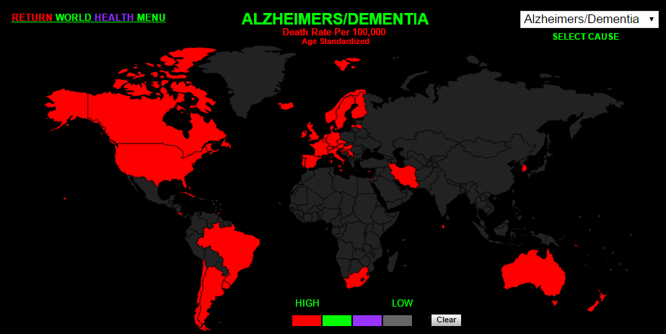
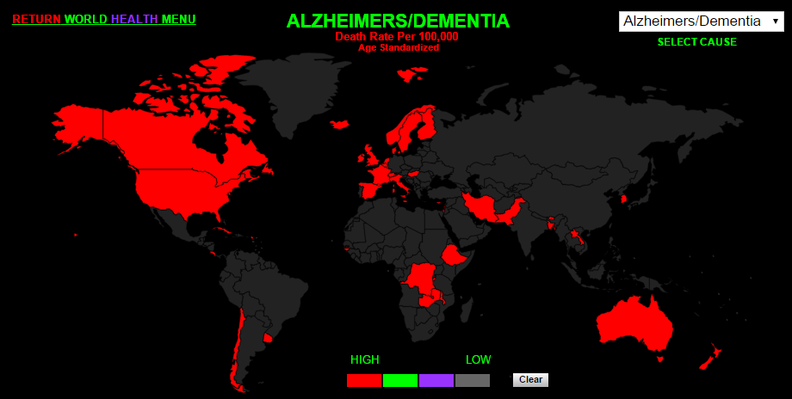
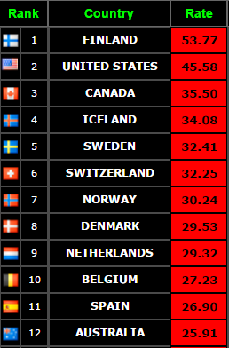
Alzheimer’s Disease
Alzheimer’s disease (AD) is the most common form of dementia with nearly 47 million people affected worldwide.
In USA it is estimated that Alzheimer's will cost $1.1 trillion in 2050.
http://www.worldlifeexpectancy.com/cause-of-death/alzheimers-dementia/by-country/
Notes:
To begin with AD is …
AD is a big economic burden in USA it is … 1.1 trillion dollars
This map depicts in red the countries with a great death rate per onehundredthousand population

Slide 3
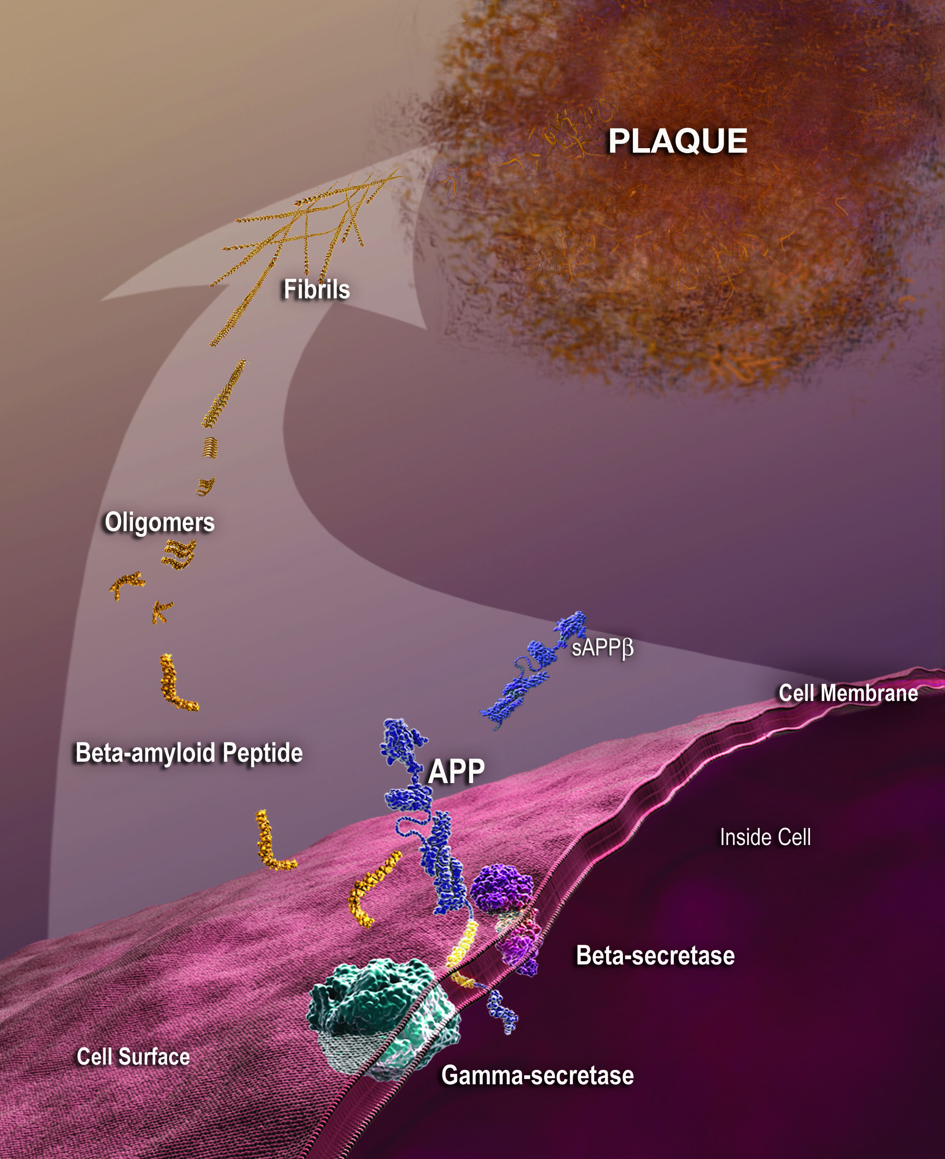
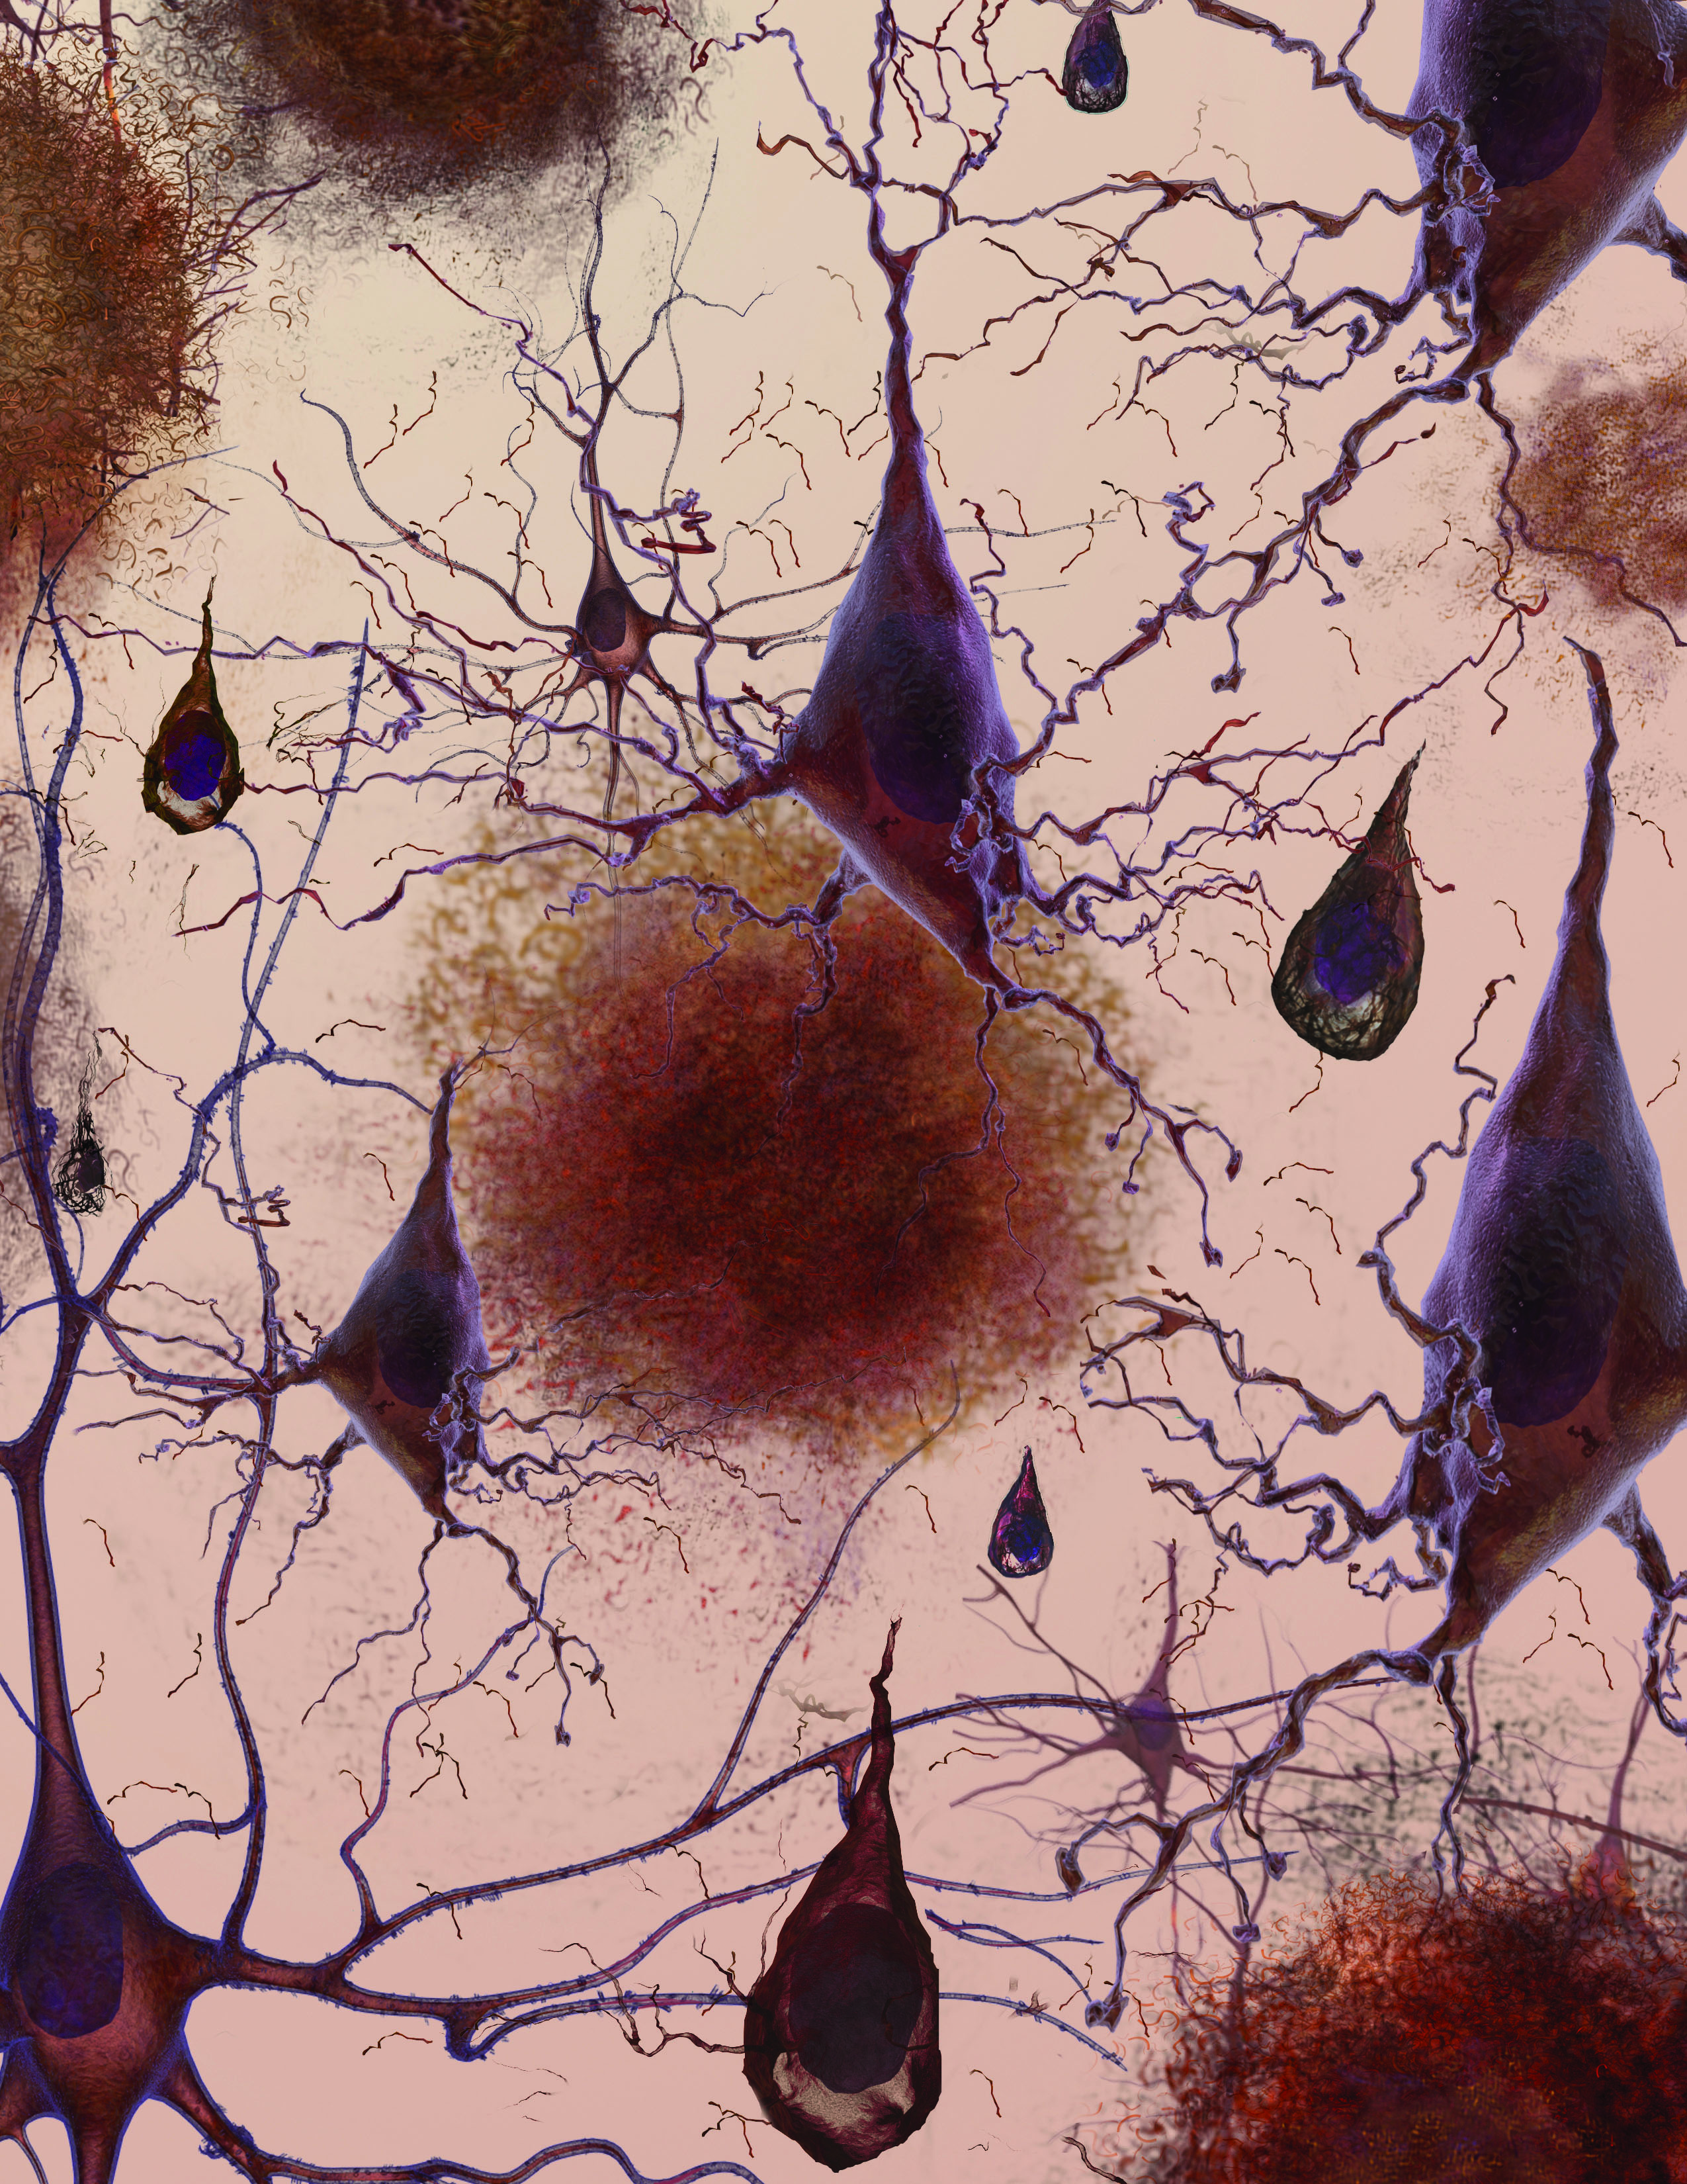
Alzheimer’s Disease
New therapeutic targets
Amyloid hypothesis
Cholinergic hypothesis
None of these hypothesis have been able to explain the molecular mechanisms involved in the onset of AD.
Neurochem. Int. 2008, 53, 103
Notes:
While treatments to manage symptoms are available, currently there is no effective treatment to prevent or cure this disease.
Amyloid and cholinergic hypothesis have not been able to explain the molecular mechanisms involved in the onset of AD.
Up to now 51 drugs have failed in Phase III trials.
New antibodies targeting abeta peptide were not so succesfull as expected
Urgent need to look into new therapeutic targets.

Slide 4
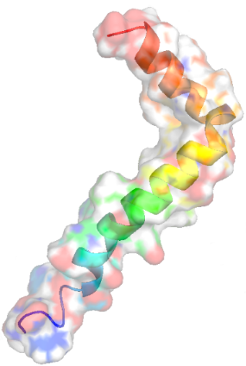
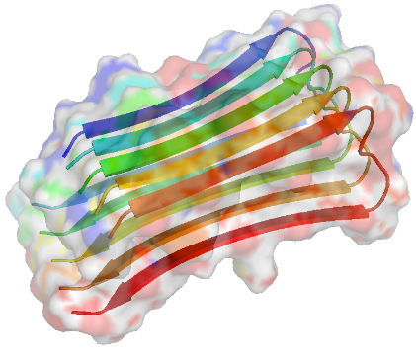
Caspase-3

Apoptosis
γ-secretase
APP
Aβ

GSAP
APP
Casp-3
Aβ peptide aggregation
Akt
APPΔC31
Calcineurin
GSK3
Apoptosis

AMPA dephosphorylation
TAU phosphorylation
AMPA
NFTs
Dendritic spines degeneration and memory loss
Neurotoxic effects
Biol. Psych. 2015, 77, 720
Nat. Neurosc. 2011, 14, 69
Notes:
Caspase-3 activity is enhanced in hippocampal cells at the onset of memory decline in a murine model of AD.
Caspase-3 is involved in the activation of γ-secretase activating protein that leads to Aβ accumulation and in the cleavage of tau, leading to NFT.
Casapse-3 inhibition restores synaptic transmission and memory performance in mice.
Interesting as a novel therapeutic target against AD

Slide 5
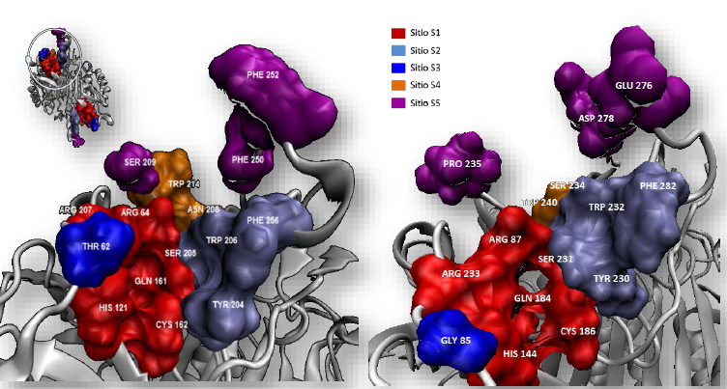
Caspase-3 as therapeutic target
Caspases inhibition is not an easy task due to their key roles in normal cellular processes.
Strategy for its use in AD: selective modulation of caspase-3 activity when it is overexpressed.
Caspase-3 Caspase-7
Notes:
Although caspases inhibition is not an easy …
We think that selective modulation of casp-3 activity in pathological conditions where it is overexpressed it would be an adequate strategy
HERE are DEPICTED THE RESIDUES OF THE SUBSTRATE BINDING CLEFT IN CASP3 ON THE LEFT AND CASP7 ON THE RIGHT. Although caspase-3 and caspase-7 shared 54 percent identity there are key differences in residues involved in substrate binding that can be exploited in the design of selective inhibitors

Slide 6
Nitrones as neuroprotective agents
PBN
4-POBN
S-PBN
NXY-059
MDL-101.002
TEMPO
DMPO
Hydroxyphenyl nitrones
Anti-apoptotic
Anti-inflammatory
Antioxidants
Biological targets that mediate their actions remain unclear
PBN and DMPO have shown to reduce caspase-3 activity in endothelial cells
Good blood brain barrier penetration
Pharm. Ther. 2003, 100, 195
Biochem. Pharmacol. 2012, 84, 486
Eur. J. Med. Chem. 2012, 58, 44

Slide 7
Anti-apoptotic effects of novel nitrones in HT22 murine hippocampal cells
PBN
5
1a
6
1b
4a
4b
4c
2a
2b
2c
Compounds were evaluated at 25 μM
Non-toxic against HT22 cells up to 200 μM

Slide 8
Active caspase-3 reduction

Slide 9
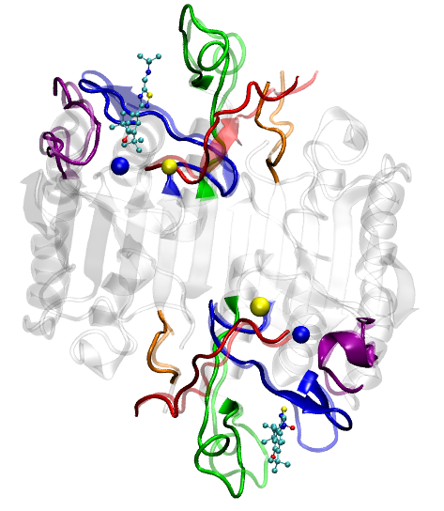
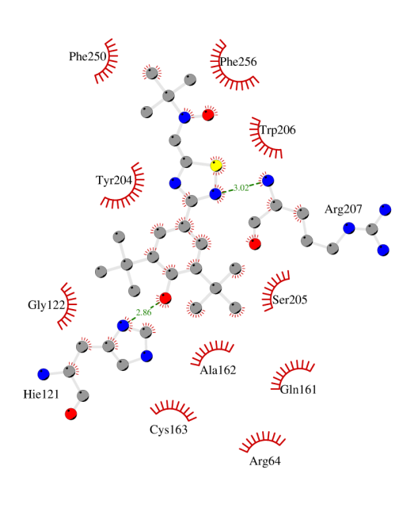
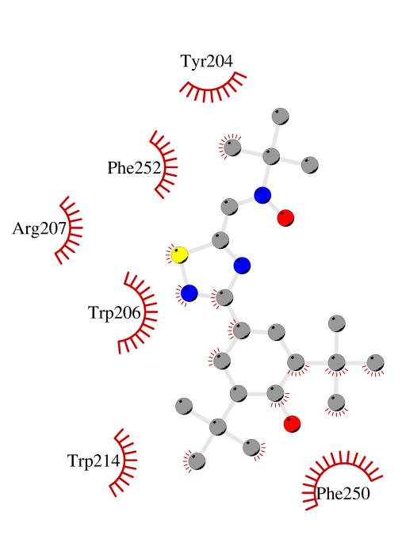
MD simulations of caspase-3 and 4c
MD 50 ns-PBC
AMBER 14
L4
L3
L2’
L2
Initial complexes obtained
by blind docking.
Autodock 4.2
L1
C130
H88

Slide 10
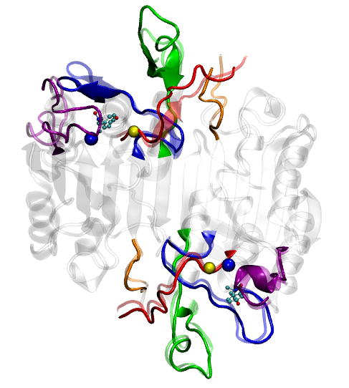
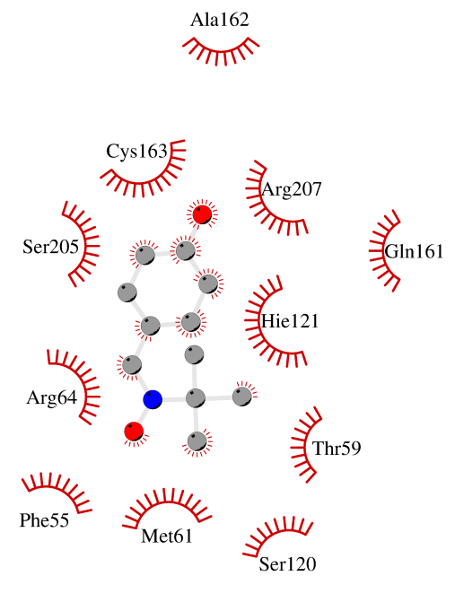
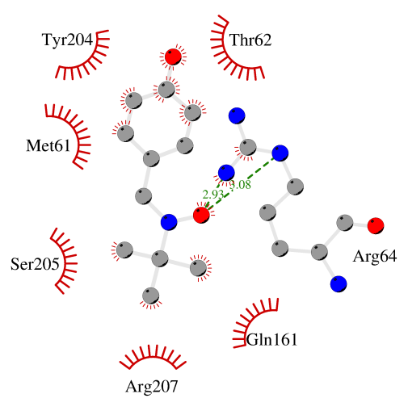
MD simulations of caspase-3 and 1a
L4
L3
L2’
L2
L1
C130
H88

Slide 11

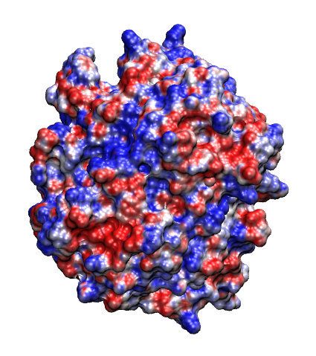
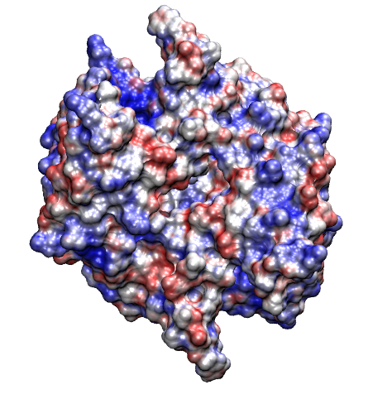
Conformational and electrostatic alterations triggered by 4c
caspase-3
caspase-3 + 4c
kT/e
Upon 4c binding molecular recognition events would be dramatically affected

Slide 12
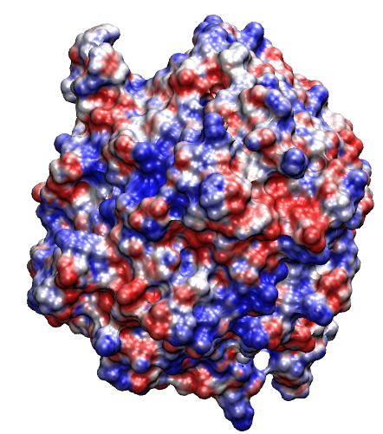
Conformational and electrostatic alterations triggered by 1a
caspase-3
caspase-3 + 1a
kT/e
1a causes a notorious disruption of the substrate- binding cleft

Slide 13
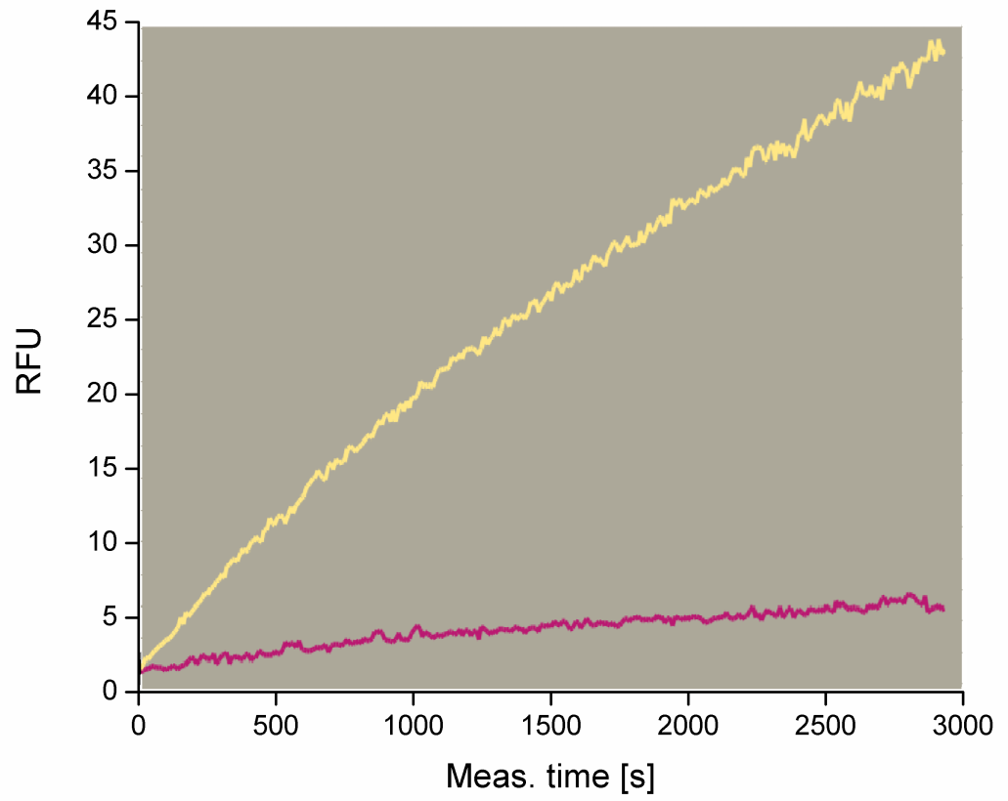
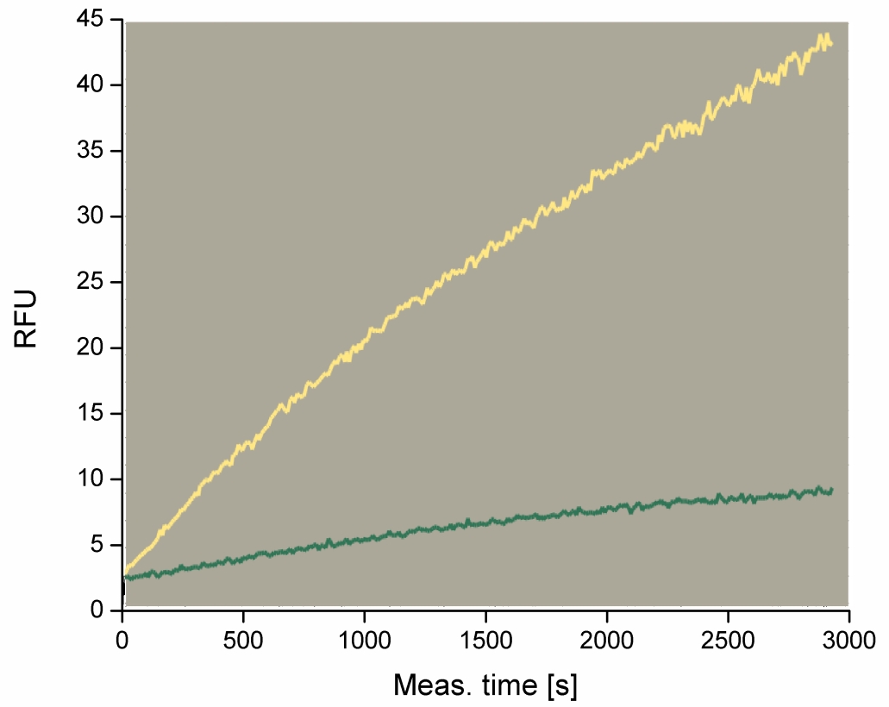
In vitro caspase-3 inhibition assays
4c
1a
At 100 μM nitrones 4c and 1a act as efficient non covalent inhibitors of caspase-3.

Slide 14
MD simulations of caspase-3 with PBN
After 1.5 ns PBN leaves the binding site predicted by molecular docking suggesting that this compound would not exerting its action by direct interaction with caspase-3.
● initial structure
● PBN location after 1.5 ns

Slide 15
Conclusions
Experiments using hippocampal murine HT22 cells demonstrated that our nitrones are non-toxic even at 200 μM concentration.
Nitrones were able to inhibit apoptosis by reducing the levels of active caspase-3 in HT22 cells.
In vitro enzymatic assays pointed out that these compounds, tested at 100 μM concentration, act as potent caspase-3 inhibitors.
MD simulations showed that hydroxyphenyl nitrones bind near the caspase-3 active site dramatically affecting its conformation.
Notes:
Based on previous reported mild inhibitors we have designed new compound which are not toxic on hippocampal HT22 cells
According to MD simulations this compound would be able to be active and selective against caspase-3
In vitro inhibition assays against caspase-3 and -7 are currently underway to validate our theoretical predictions

Slide 16





Acknowledgments
Williams Porcal
Gustavo Mourglia
Paola Hernández
PEDECIBA QUÍMICA
Notes:
Williams, Gustavo and Paola are our experimentalists colleagues members of the caspasa’s team and fellows
PEDECIBA and CSIC for economical support
ANII for the scholarships to Saira and Lucy (our student)

Slide 17

The team …
Notes:
This is the people in our lab. She is Laura the head of the lab. And here is Jenner who wasn’t there when the pic was taken because it was early in the morning …

Slide 19
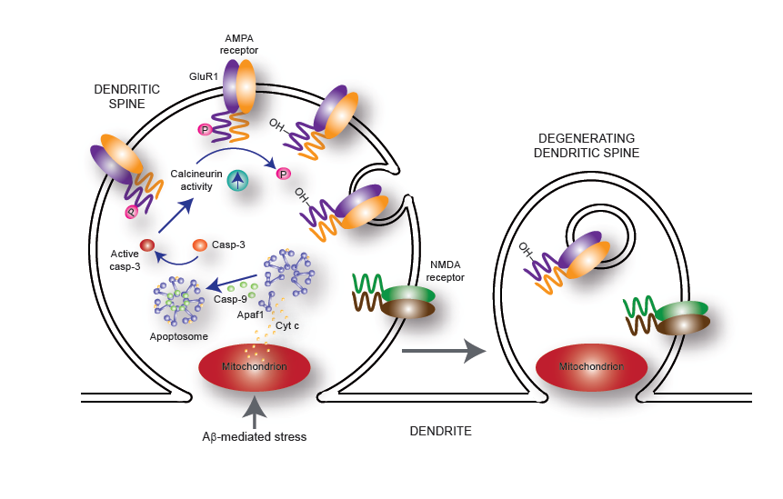
Dendritic spine degeneration triggered by caspase-3

