Slide 1

Dr. Alessandra Nurisso
School of Pharmaceutical Sciences
University of Geneva-University of Lausanne
Switzerland
MedChem & CADD 2015
Atlanta, USA
November 02-04, 2015
Identification of sirtuin inhibitors :
from screening to activity assays

Slide 2
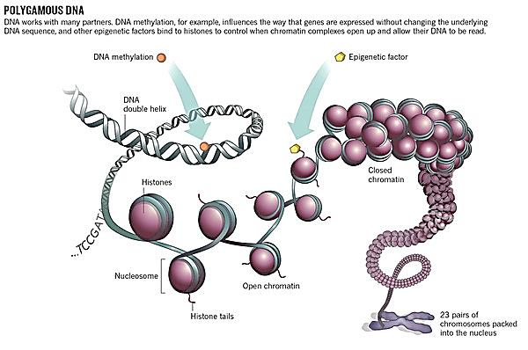


Sirtuins (SIRTs) are epigenetic targets
Introduction
Epigenetic targets control DNA condensation by writing, removing or reading chemical marks (epigenetic modifications) on histones and/or DNA
Epigenetic modification
Epigenetic modification
DNA wrapped around histones
Histones
Closed chromatin
→ Transcription downregulation
Nucleosome
Histone
talis
Open chromatin
23 pairs of chromosomes compacted into the nucleus
Transcription upregulation
Sirtuins are histone deacetylases
Egger et al., 2004, Nature, 429: 457
Image Source: http://www.cellsignal.com

Slide 3
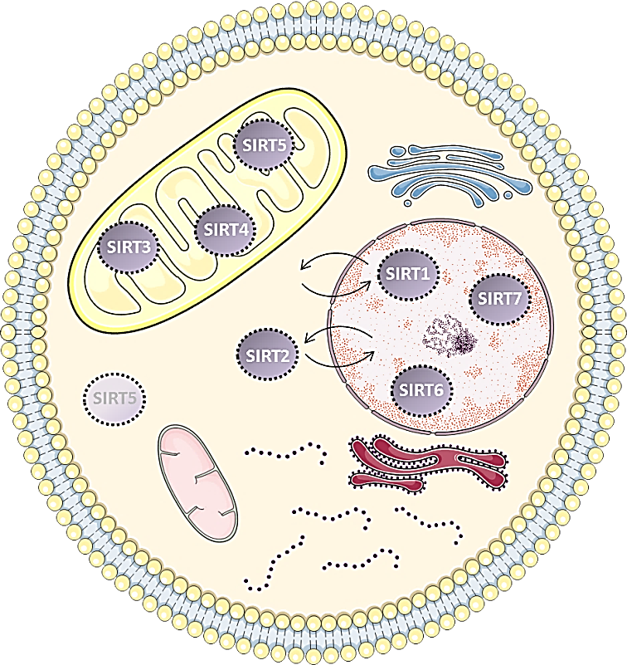
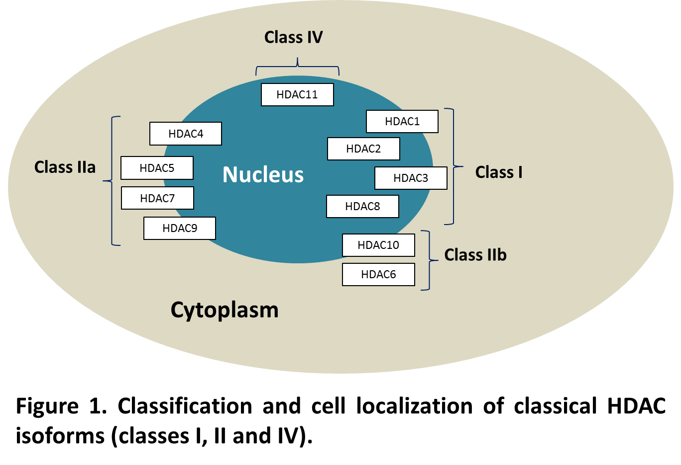
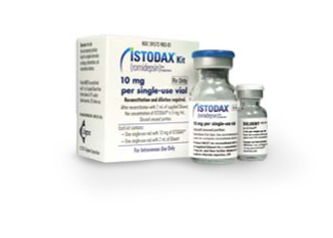
SIRTs are Histone DeACetylases (HDACs)
Introduction
Classical human HDAC isoforms
Zn²⁺-dependent catalytic activity
Class III HDACs: human sirtuins (SIRT)
NAD⁺-dependent catalytic activity
Vorinostat (FDA, 2006)
Romidepsin (FDA, 2009)
Panobinostat (FDA, 2015)
Cutaneous T-cell lymphoma
Cutaneous T-cell lymphoma
Multiple myeloma
Chen et al., 2015, Chem Soc Rev, 44: 5246

Slide 4
SIRTs (class III HDACs) & Diseases
Introduction
SIRTs deacetylate histones and other substrates for regulating physiological processes (chromatin structure, genomic stability, and cellular metabolism)
Huntington’s disease (HD)
A mutated gene codes for an abnormal protein, Huntingtin (HTT), which gradually damages neurons (neurotoxicity)
Acetylation of HTT promotes its clearance by autophagy
SIRT1 inhibition results in a clearance of HTT
EX-527 increases survival, improves psychomotor behavior
Clinical phase II
clinicaltrials.gov
Identifier: NCT01521585
EX-527 (Selisistat)
SIRT1 inhibitor
Gertz et al., 2013, PNAS, 110(30): E2772
Sussmuth et al., 2015, J Clin Pharmacol, 79: 465
Westerberg et al., 2015, J Clin Pharmacol , 79: 477

Slide 5
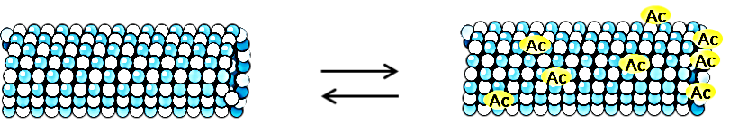

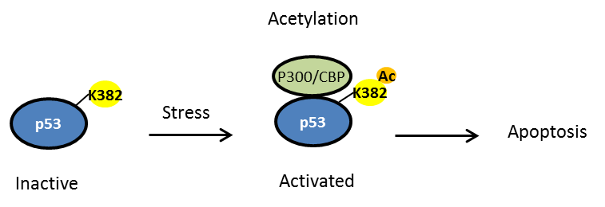
SIRTs (class III HDACs) & Diseases
Introduction
SIRTs deacetylate histones and other substrates for regulating physiological processes (chromatin structure, genomic stability, and cellular metabolism)
Parkinson’s disease
SIRT2 inhibition restores acetylation of α-tubulin: effects on microtubules, preventing neurotoxicity induced by α-Synuclein (neuroprotection)
Polymerization
α-tubulin
Stable microtubules
Complex with α-Syn
Larger
inclusions
Depolymerization
Cancer
SIRT1-2 inhibition activates the tumor suppressor p53 and its related mechanism of defense (apoptosis), blocking abnormal cell development
Acetylation
SIRTs can have tumor‑suppressor or
oncogenic roles
Stress
Apoptosis
Inactive
Activated
Outerio et al., 2007, Science, 3117: 516
Chalkiadaki & Guarente, 2015, Nat Rev, 15: 608

Slide 6
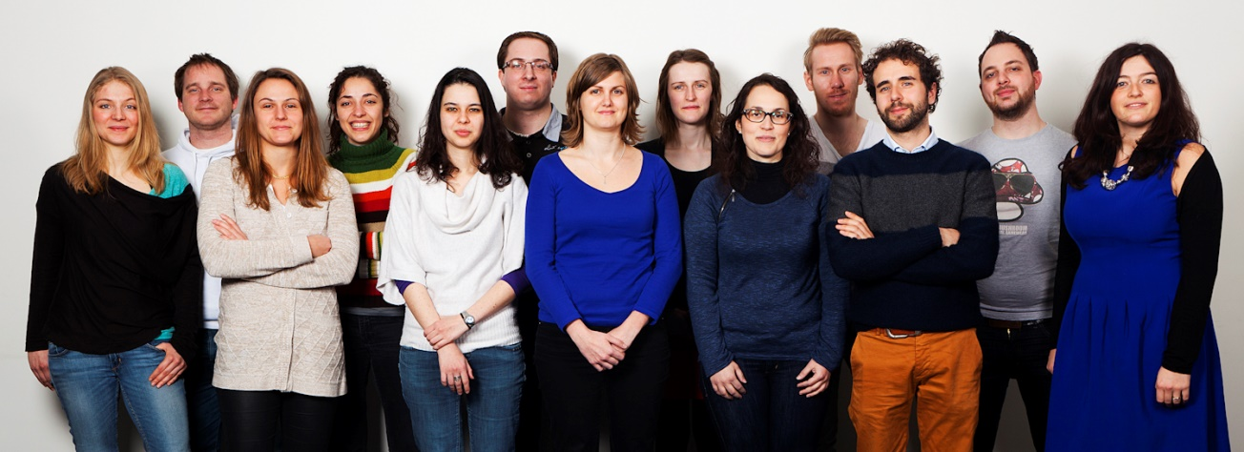

Research goals & Strategies
Aim
Pharmacochemistry lab
To find novel and diverse scaffolds inhibiting SIRTs (SIRT1-2)
-Chemical probes
-Potential therapeutics
In silico-driven approaches
-Structure-based methods
-Ligand-based methods
Enzymatic assays
Cell-based assays to unravel SIRT-related mechanisms
-Compounds of natural origin
-Compounds of synthetic origin

Slide 7
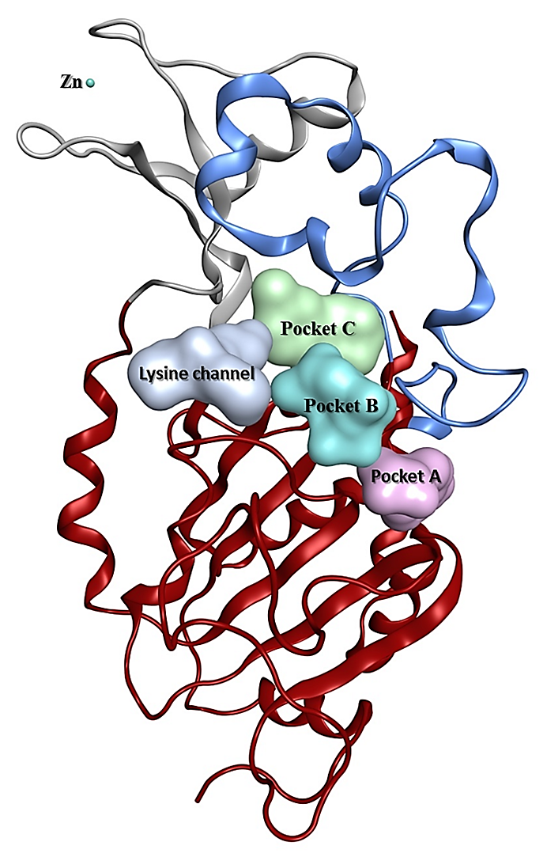

SIRTs: structural information
Results
Helical module
Zinc
binding module
Small domain
No structural
rationale for the design of SIRT selective inhibitors
Large domain
Rossman fold
apo-SIRT1:PDB-ID 41G9 4IF6; 4KXQ;
SIRT1-activator: PDB-ID 4ZZH; 4ZZI; 4ZZJ; 5BTR;
SIRT1–ex527: PDB-ID 4I5I;
apo-SIRT2:PDB-ID 1J8F, 3ZGO;
SIRT2-ADPR: PDB-ID 3ZGV; 4RMJ;
SIRT2–S2iL5 peptide: PDB-ID 4L3O;
SIRT2–BHJHTm1 peptide: PDB-ID 4R8M;
SIRT2-SirReal2: PDB-ID 4RMG; 4RMH; 4RMI;
Bordo, 2013, Curr Drug Targ, 14: 662

Slide 8

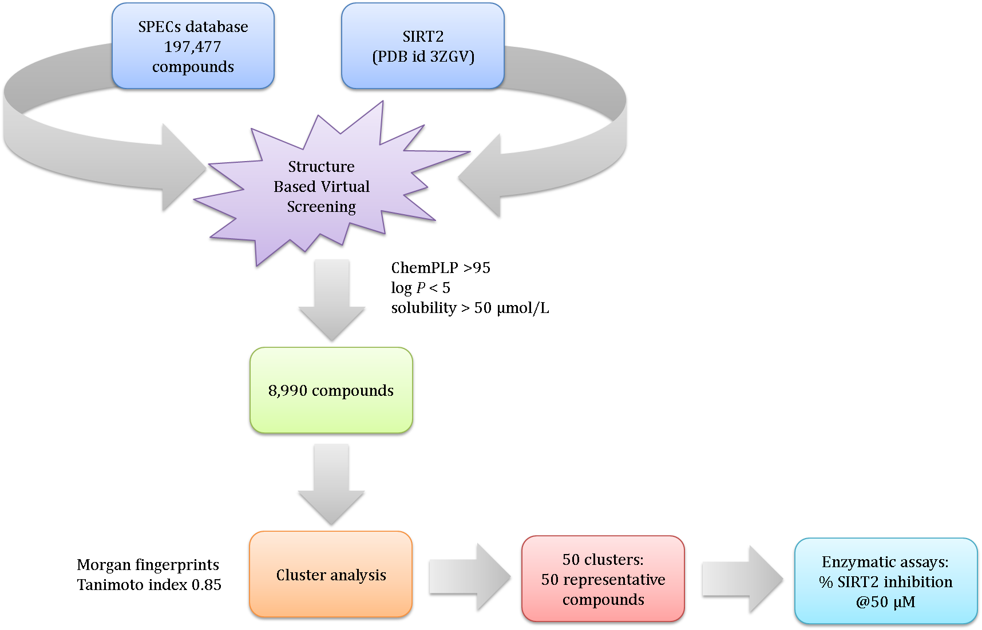
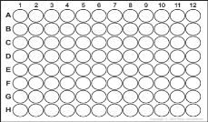
The hunt for new SIRT inhibitors
Results
www.specs.net
GOLD 5.2®
VolSurf®
MOE 2014®
RDKit ®
Ryckewaert et al., 2015, Europ. J. Pharm. Sci. (accepted)

Slide 9
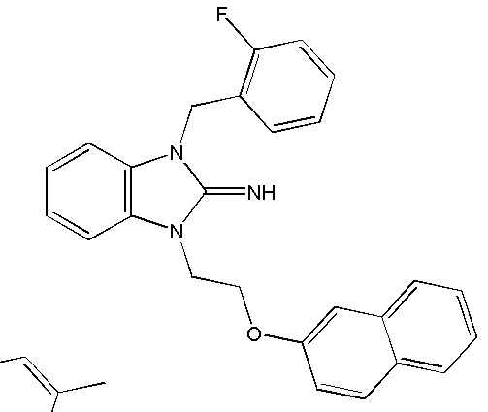
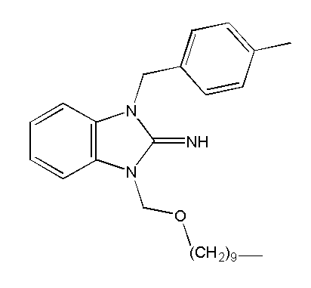

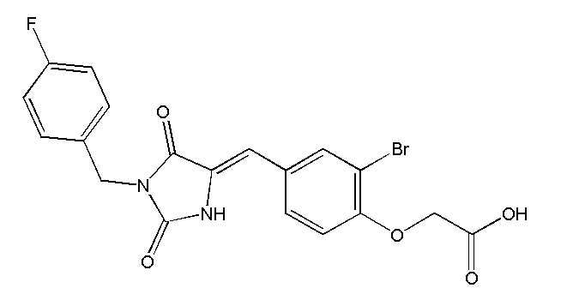
The hunt for new SIRT inhibitors
Results
Compound 5 *
AE-848/36959240
SIRT2 inhibition 53.1 ± 9.7%
@50µM
Compound 16
AN-465/42888135
SIRT2 inhibition 46.3 ± 1.4 %
@50µM
Compound 36 *
AE-848/41538790
SIRT2 inhibition 62.0±4.7
@50µM
Yoon et al. 2014
Yoon et al. 2014
Anticancer properties associated to 5-benzylidene-hydantoin scaffold are reported in the literature (lung cancer cell lines)
Compound 30
AO-081/41227595
SIRT2 inhibition 54.4 ± 1.9 % @50µM
IC₅₀48.5 ± 1.2 µM
Ryckewaert et al., 2015, Europ. J. Pharm. Sci. (accepted)
Cavazzoni et al., 2008, Mol Cancer Ther., 7:361
Notes:
EGFR

Slide 10
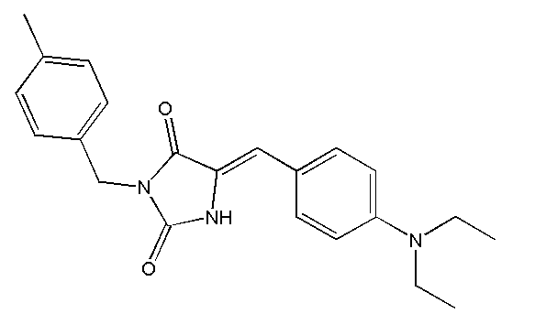
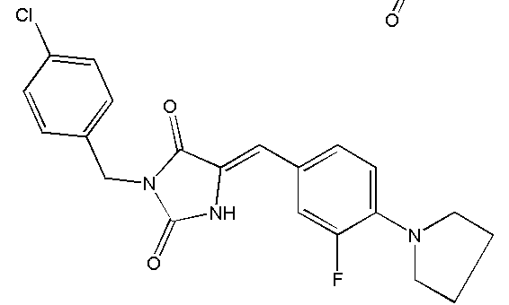
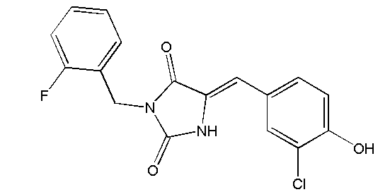
The hunt for new SIRT inhibitors
Results
SMART string substructure search in SPECs database identified 65 compounds
Compound 30
AO-081/41227595
SIRT2IC₅₀48.5 ± 1.2 µM
No cell permeability
Compound 106
AN-698/41890199
SIRT2 IC₅₀38.8 ± 2.9 µM
Compound 107
AN-698/41606803
SIRT2 IC₅₀68.7 ± 11.0 µM
Compound 97
AH-487/41657829
SIRT2 IC₅₀37.7 ± 1.1 µM
Ryckewaert et al., 2015, Europ. J. Pharm. Sci. (accepted)

Slide 11
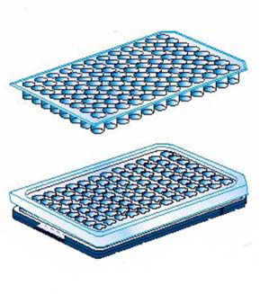
The hunt for new SIRT inhibitors
Results
Permeability & Metabolism prediction using VolSurf+ (Molecular Discovery®):
Compounds | MW (Da) | CACO2 | LogBB | MetStab CYP3A4
30 | 449.2 | -0.5 | -1.4 | 84.1
97 | 346.7 | 0.2 | -0.04 | 65.1
106 | 363.5 | 1.0 | 0.5 | 27.6
107 | 399.9 | 0.8 | 0.4 | 29.2
Parallel Artificial Membrane Permeability Assays (PAMPA): (passive permeation)
Compounds | HDM-PAMPA |  | PAMPA-BBB
 | P_{e} (10⁻⁶ cm/s) | Classification | P_{e} (10⁻⁶ cm/s) | Classification
30 | < 2 | GIT - | < 3 | CNS -
97 | 46.4 ± 3.1 | GIT + | 12.1 ± 2.8 | CNS +
106 | < 2 | GIT - | < 3 | CNS -
107 | < 2 | GIT - | < 3 | CNS -
Ryckewaert et al., 2015, Europ. J. Pharm. Sci. (accepted)

Slide 12
The hunt for new SIRT inhibitors
Results
Good PK features
Poor PK features
Poor PK features
97 has the lowest cytotoxicity in human cell lines (Hela, HEK293, 48h)
Crystal violet
staining method
Ryckewaert et al., 2015, Europ. J. Pharm. Sci. (accepted)

Slide 13
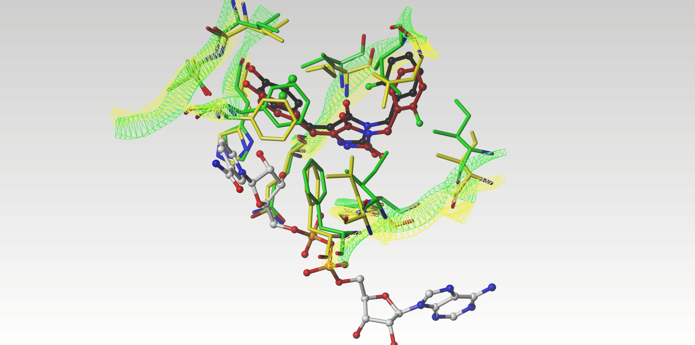
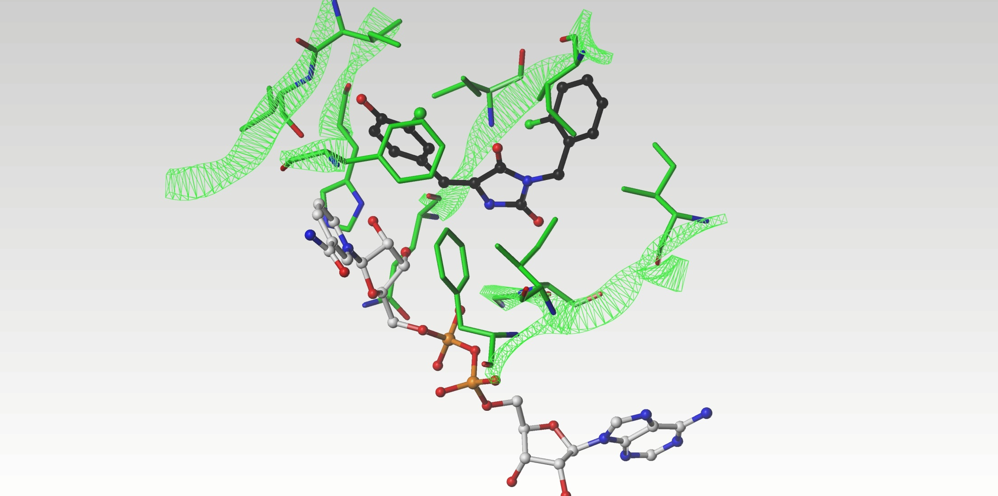
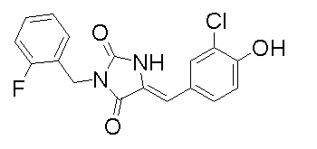
The hunt for new SIRT inhibitors
Results
I232/I411
L138/I316
SIRT1
SIRT2
I69/I347
V233/V412
Compound 97
Uncompetitive inhibitor
toward NAD⁺ (confirmed!)
F199/F297
H187/H363/
SIRT1 IC₅₀ 34.4 ± 1.8μM
SIRT2 IC₅₀ 37.6 ± 0.5 μM
C-subpocket
A85/A262
I93/I270
Q167/Q345
F96/F279
L103/I279
NAD⁺
10ns MD simulations
Ryckewaert et al., 2015, Europ. J. Pharm. Sci. (accepted)

Slide 14
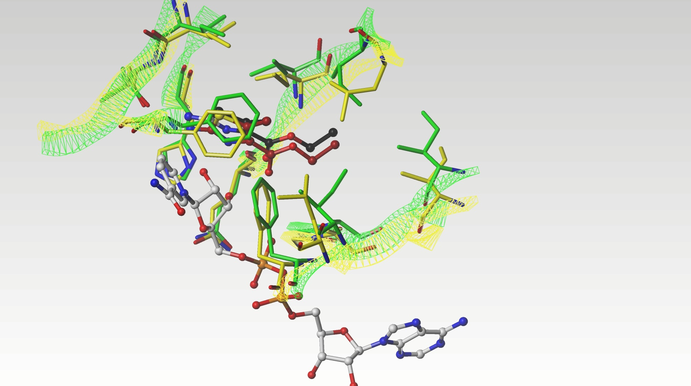
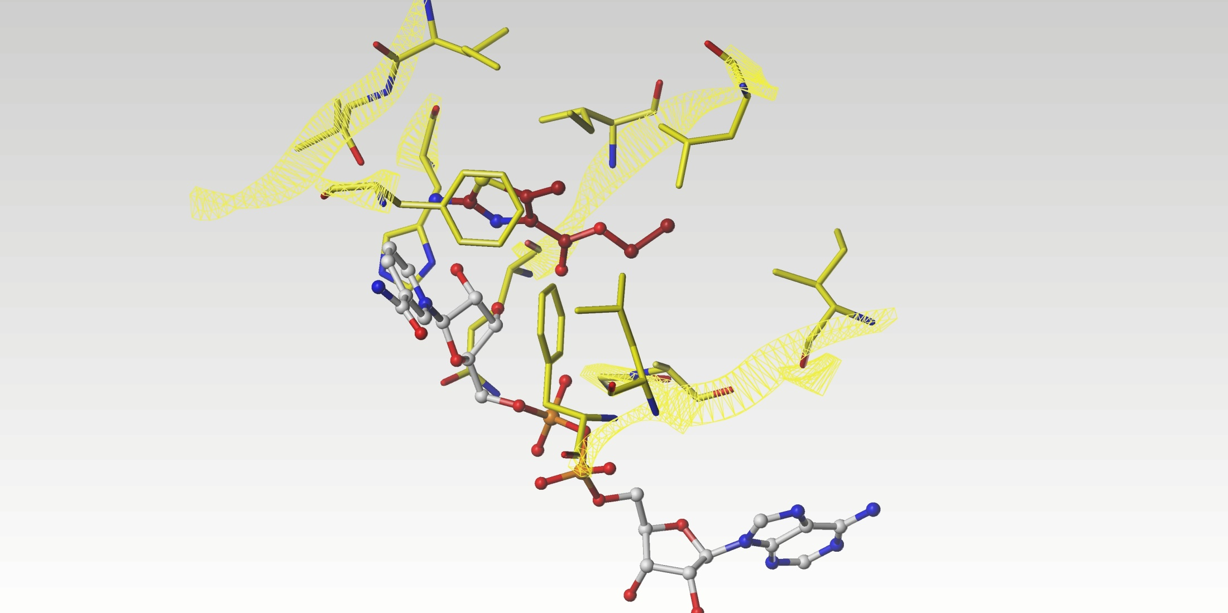
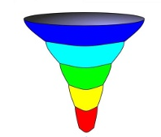
The hunt for new SIRT inhibitors
Results
I232/I411
L138/I316
SIRT1
SIRT2
I69/I347
V233/V412
Compound 205
Uncompetitive inhibitor
toward NAD⁺ (confirmed!)
F199/F297
Log P1000 database
(576 compounds from ZINC
selected by diversity)
SIRT1 IC₅₀ 19.7 ± 1.2μM
SIRT2 IC₅₀ 13.1 ± 1.6μM
A85/A262
I93/I270
Q167/Q345
F96/F279
L103/I279
C-subpocket
SIRT1
(PDB ID 4I5I)
NAD⁺
ZINC00243170
Compound 205
Ryckewaert et al., in preparation
Martel et al, 2013, Europ. J. Pharm. Sci., 48: 21

Slide 15
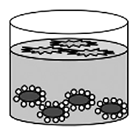
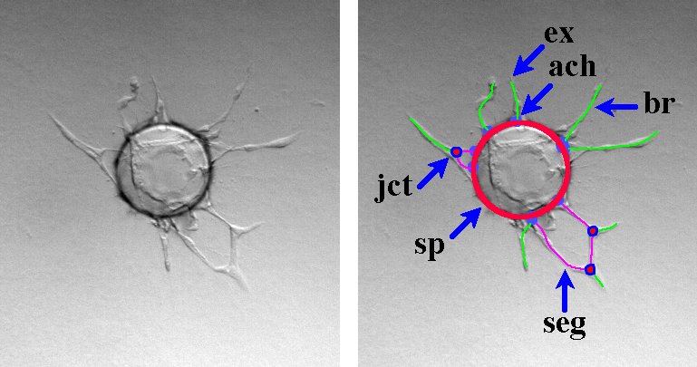
The hunt for new SIRT inhibitors
Results
Angiogenesis is a process stimulated in cancer development
SIRTs are able to control angiogenesis during vascular growth
Nicotinamide and Sirtinol inhibit HUVEC (Human Umbilical Vein Endothelial Cells) sprouting : anti-angiogenic effect
HUVEC 3D Fibrin Bead in vitro assay
Recapitulates the essential steps of angiogenesis including sprouting, migration, alignment, proliferation, tube formation
Fibroblasts
Fibrin gels
HUVEC cells coated onto cytodex beads
jct: junction
sp: sphere
seg: segment
ex: extremity
ach: anchorage junction
br: branch
HUVEC sprouting (day 3)
Potente et al., 2007, Genes Dev, 21: 2644
Nakatsu et al., J2007, Vis Exp, 3: 186
Ryckewaert et al., in preparation

Slide 16
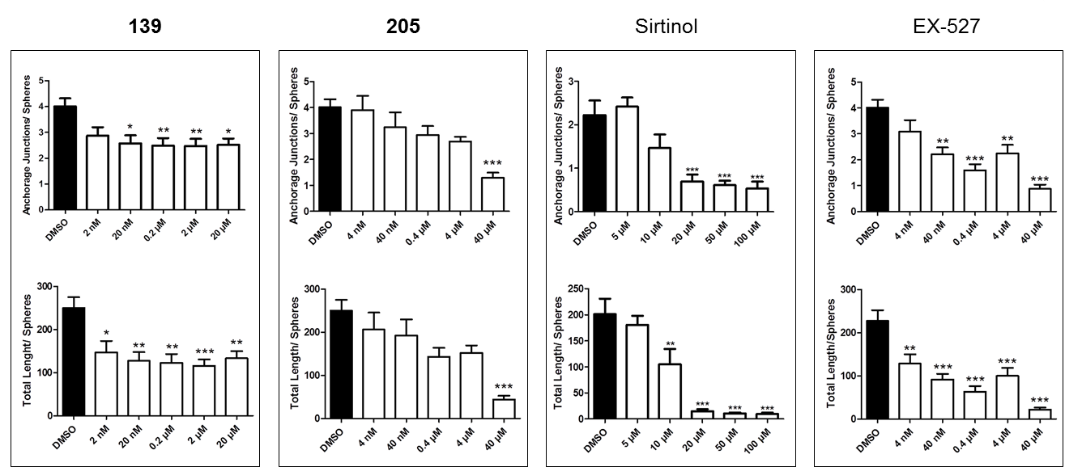
The hunt for new SIRT inhibitors
Results
HUVEC 3D Fibrin Bead in vitro assay: the number of anchorage junctions/sphere and the sprout length/sphere were quantified to evaluate effects on angiogenesis
Anti-angiogenic activity of SIRT inhibitors in a dose-dependent manner, independent to SIRT isoform selectivity
Ctrl
Ctrl
Ctrl
Ctrl
Ctrl
Ctrl
ImageJ software plugin (angiogenesis analyser), Prof. Carpentier
Ryckewaert et al., in preparation

Slide 17
The hunt for new SIRT inhibitors
Results
Foxo1 is a mammalian transcription factor, reported as a critical regulator for vessel formation, maturation, and remodelling
SIRTs deacetylate Foxo1 in HUVEC cell lines
Reduction of Foxo1-DNA binding has been proven when Foxo1 is acetylated
Is Foxo1-DNA binding reduced in presence of SIRT inhibitors (in HVECs) ?
Foxo1-DNA binding is reduced in presence of SIRT inhibitors in a dose-dependent manner, independent to SIRT isoform selectivity
Brent et al., Structure 2008, 16: 2407
Ryckewaert et al., in preparation

Slide 18
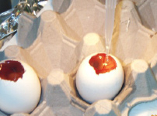
Conclusions & Perspectives
Conclusions
Cell-based assays for SIRT inhibitors are ongoing (check Foxo1, p53, α-tubulin acetylation)
Compounds require optimization for increasing potency and selectivity
New scaffolds for SIRT modulation have been found through the in silico driven strategy
Anti-angiogenic activity related to SIRT inhibition is now tested in vivo in chick embryo chorioallantoic membrane (CAM) models (Prof. Lange, University of Geneva)
Notes:
The chick embryo chorioallantoic membrane (CAM) is an extraembryonic membrane which serves as a gas exchange surface and its function is supported by a dense capillary network. Because of its extensive vascularization and easy accessibility, the CAM has been broadly used to study the morphofunctional aspects of the angiogenesis process in vivo and to investigate the efficacy and mechanisms of action of proangiogenic and antiangiogenic natural and synthetic molecules.
Methods Mol Biol. 2012;843:47-57. doi: 10.1007/978-1-61779-523-7_5.
Chicken chorioallantoic membrane angiogenesis model.
Ribatti D¹.

Slide 19









Aknowledgments
Acknowledgments
Pharmacochemistry
University of Geneva (Switzerland)
Dr. Claudia Avello Simoes-Pires (Researcher)
Dr. Carolina Passos (Post doc)
Charlotte Petit (PhD student)
Lucie Ryckewaert (PhD student)
Lionel Sacconnay (PhD student)
Prof. D. Osella
University of Eastern Piedmont (Italy)
Dr. Ilaria Zanellato (Post doc)
Dr. M. Daumantas
Biothermodynamics and Drug Design
Vilnius University (Lithuania)
Prof. M. Cuendet
Pharmacognosy
University of Geneva (Switzerland)
Dr. Sarah Berndt (Post doc)
Prof. G. Carpentier
CRRET laboratory
University of Paris Sud (France)
Prof. N. Lange
Pharmaceutical technology
University of Geneva (Switzerland)
Prof. G. Cruciani
Molecular Discovery®
University of Perugia (Italy)
Dr. Laura Goracci (Researcher)

Slide 20
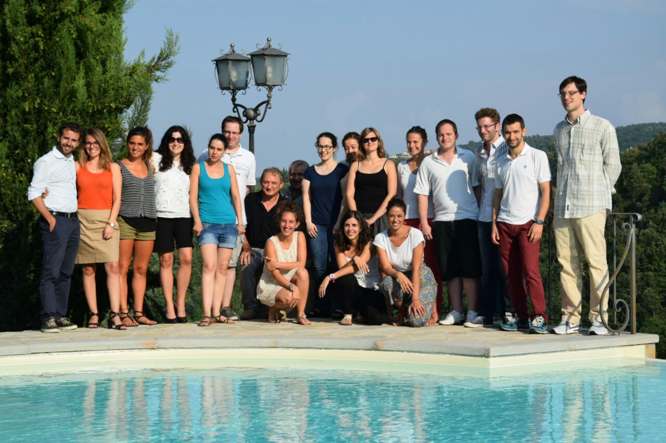
Aknowledgments
Acknowledgments
Summer University Network
July 2015
Montelino-Perugia
(Italy)

Slide 21
Thank you!

